Slide 1


Genişletilmiş Pan-Etnik Taşıyıcılık Paneli:
Tüm çiftlere önermenin zamanı geldi mi?
Doç. Dr. Murat ÖZEKİNCİ
Akdeniz Üniversitesi Tıp Fakültesi
Kadın Hastalıkları ve Doğum Anabilimdalı
Üreme Endokrinolojisi ve İnfertilite Bilimdalı

Slide 2
Taşıyıcılık Taraması
Taşıyıcılık taraması terimi herhangi bir genetik bozukluk için aşikar bir fenotipe sahip olmayan yani asemptomatik bir bireyde, özel bir bozukluk yada hastalıkla ilgili olarak kişinin gen yada genlerinde bulunma ihtimali olan mutasyon yada değişiklikleri saptamaya yönelik testler için kullanılmaktadır.
Prenatal yada daha ideal olarak prekonsepsiyonel olarak yapılması önerilir.
Prekonsepsiyonel olarak otozomal resesif (OR) yada X geçişli yüzlerce genetik hastalığın çiftlerde taşıyıcılık durumunun saptanması üreme ile ilgili risklerin aydınlatılmasında ve sağlıklı bir bebeğe ulaşma açısından oldukça önemlidir. Her iki ebebeyn aynı hastalık için OR genleri taşıyorsa fetusta %25 ciddi bir risk vardır. Çiftler PGD, CVS yada donor gamet kullanımı vs gibi seçenekler açısından bilgilendirilmiş olurlar.

Slide 3
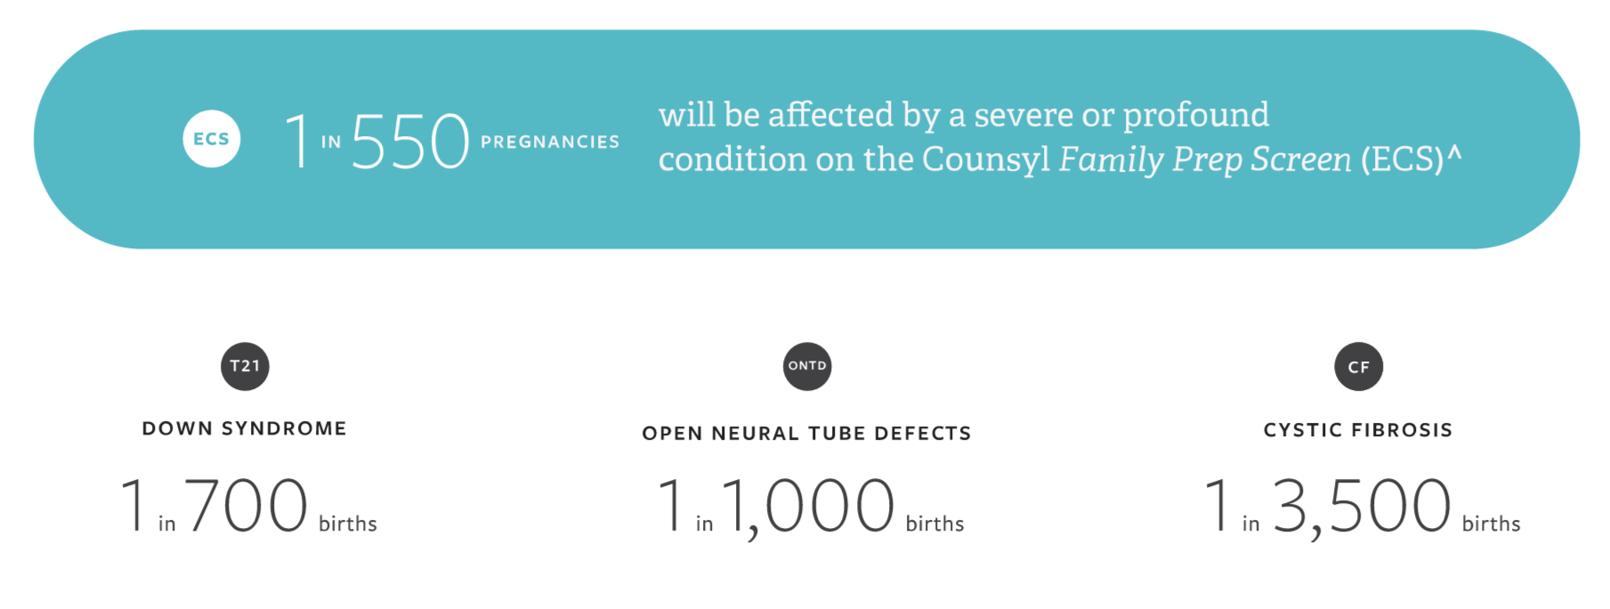
Karşılaştırma: ECS daha fazla etkilenmiş gebelik tespit ediyor
ECS (Expanded carrier screening)
ECS rutin olarak taranan durumlardan kümülatif olarak daha fazla insidansta bulunan ciddi hastalıkları tespit ediyor
Notes:
Talking points:
Comparatively, the total risk of serious disorders identified through ECS is higher than the incidence of routinely screened for conditions such as Down syndrome.^{4,5}
1 in 550 pregnancies are at risk to be affected by a severe/profound condition on the Counsyl Family Prep Screen.
This is a weighted average of total risk across ethnicities for all 94 severe and profound disorders based on US census population estimates. (Data on ethnicity-specific risk is on the next slide.)
The total risk of serious disorders detected by ECS (1 in 550) is higher than the incidence of routinely screened for conditions, such as Down syndrome (1 in 700 births), open neural tube defects (1 in 1000 births), and for CF alone (1 in 3,400 births). (Note: this includes guideline AND non-guideline conditions.)
References
[Down Syndrome and Neural Tube Defects incidence in AMA style]
Parker SE, Mai CT, Canfield MA, et al. Updated National Birth Prevalence estimates for selected birth defects in the United States, 2004-2006. Birth Defects Res A Clin Mol Teratol. 2010 Dec;88(12):1008-16.
[Cystic Fibrosis incidence in style recommended by CFF] - make sure to use population risk, find source
Cystic Fibrosis Foundation Patient registry 2012 annual data report. Bethesda, Maryland. ©2013 Cystic Fibrosis Foundation
Use this slide to drill down on data on total recessive condition risk for each ethnic group compared to routinely screen for conditions, as needed.
Talking points
And the data are consistent across ethnicities… this chart shows the total risk of serious disorders detected by ECS is higher than the incidence of routinely screened conditions, when looking across each ethnicity in our study.
<More detailed alternative: The total risk of serious disorders detected by ECS for each ethnicity is higher than the incidence of routinely screened for conditions, such as Down syndrome (1 in 700 births), open neural tube defects (1 in 1000 births), and for CF alone (1 in 3,400 births). (Note: this includes guideline AND non-guideline conditions.)>
References
[Down Syndrome and Neural Tube Defects incidence in AMA style]
Parker SE, Mai CT, Canfield MA, et al. Updated National Birth Prevalence estimates for selected birth defects in the United States, 2004-2006. Birth Defects Res A Clin Mol Teratol. 2010 Dec;88(12):1008-16.
[Cystic Fibrosis incidence in style recommended by CFF] - make sure to use population risk, find source
Cystic Fibrosis Foundation Patient registry 2012 annual data report. Bethesda, Maryland. ©2013 Cystic Fibrosis Foundation

Slide 4
Etnik Bazlı Tarama vs Universal Tarama
Hedeflenmiş vs Genişletilmiş Tarama
Etnik yada coğrafi bazlı taşıyıcılık taraması geleneksel yöntem olarak 1970 li yıllardan günümüze kadar yapılagelen yöntemdir.
Universal yada pan etnik tarama bireylerin kökenine soyuna bakmadan tüm bireylerin belirli bir bozukluk yada bozukluklar için taranmasıdır.
Hedeflenmiş (targeted) tarama insidans prevelansı bilinenen mutasyonlarının çoğu aydınlatılmış ve buna bağlı gelişecek risklerinde uzun dönemde ortaya net bir şekilde konmuş bir hastalık için bireylerin taranmasıdır.
Genişletilmiş (expanded) tarama teknoloji avantajını kullanarak tarama yapılan toplumda daha az görülen ciddi hastalıkların yada sık olup belirli riskleri taşıyan genlerin de tarama panellerine eklenmesidir.

Slide 7
Tarihçe
Genişletilmiş pan etnik taşıyıcılık tarama ya (ECS) seyir
2017 Commitee on Genetics - ACOG
2016 en büyük sayıdaki ECS çalışması (JAMA)
2015 ECS Joint Statement - Repro Med
2013 ACMG Position Statement
2011 CF taraması güncelleme - ACOG
2009 ilk ECS )
Development of carrier screening
1993 Kan hastalıkları mücadele kanunu
1988 Cystic fibrosis (CF) taraması - NIH
2008 SMA taraması - ACMG
2005 CF taraması - ACOG
1970 Tay Sachs taraması Ashkenazi Yahudileri (AJ)
70s
80s
90s
00s
10s
Notes:
If we fast forward from the 70s and look at what’s going on today, there’s been an explosion in the number of genes we can include on a carrier screening panel. In part, this is because of the introduction of technology that allows for “expanded carrier screening.” As is usually the case, the technology outpaced the medical guidelines (and continues to do so).
Talking points: genetic screening has come a long way, from Tay Sachs screening in people of Ashkenazi Jewish descent in 1970, to universal screening for cystic fibrosis, and now expanded carrier screening. As more focus was put towards genetics and the human genome in the past 2 decades, things have really picked up. The technology improved. Public interest grew. Companies, like Counsyl, were formed. And you can see that Counsyl has led the way in expanded carrier screening. We launched our Family Prep Screen in 2009--the first commercial expanded carrier screen. That spawned other followers, but Counsyl has led the way with research (like the recently published landmark study published in JAMA) and we’ve also led the way by taking the time to create a test that would identify more at-risk couples than any other.

Slide 9
ECS
Bu çalışmayla ciddi penetrasyonu olan ve ciddi bozukluklarla ilgili 437 adet patolojik gen mutasyonları NGS yöntemi ile etkili bir şekilde taranabildiği gösterilmiştir.

Slide 11
ECS
Farklı etnik kökenlerden infertilite, kadın doğum ve genetik bölümlerinden refere edilen 23,453 birey ECS ile taranıyor.
Bireylerin % 24 ü ciddi seyreden 96 resesif bozukluktan en az bir tanesi için taşıyıcı. Bireylerin % 5.2 si en az iki bozukluk için taşıyıcı.
Teknoloji (NGS) maliyetleri çok ucuzlattı ve bu süreç devam ediyor.
(500 milyon $ → 1000 $ → Günümüzde 300-350 $)
Bu testlerde her bir bozukluğun taranması bozukluk başına 1 dolardan daha az bir maaliyet getirmiştir.
Sadece 1-2 gen mutasyonunu araştıran eski moleküler tekniklerle (genotyping) kıyaslandığında ECS ile fiyatlar şuanda benzer

Slide 12
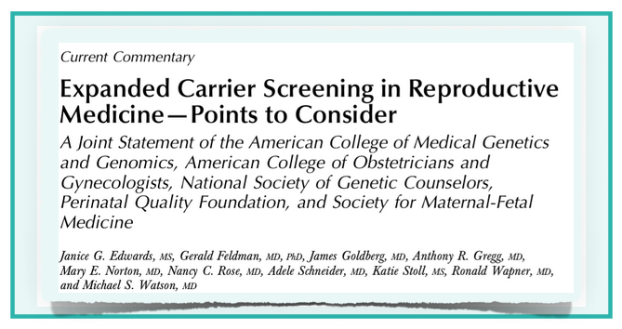
Tüm herkese genel pan-etnik taramayı önermek için daha çok veriye ihtiyaç var:
“... Varyantların sıklığının daha önce hiç test edilmemiş etnik yada ırksal gruplarda belirlenmesine ihtiyaç vardır...”
Notes:
Talking points: The joint statement was issued by 5 organizations and really added credibility and validity to the debate abou expanded carrier screening. This statement (2015) does not replace current screening guidelines, which are published by individual organizations to direct the practice of their constituents. But it opened a serious conversation about the merits of rethinking the way we offer carrier screening, with some discussion points about requiring need for further research was requested to better quantify and qualify the clinical impact of ECS across ethnic groups. Specifically, the 2015 joint statement on ECS suggested a need for more data on “the frequency of variants in previously untested racial and ethnic groups” to facilitate general pan-ethnic testing.
Talking points:
Though medical societies like ACOG and ACMG have commented on the value of ECS, they have remained cautious in recommending it as routine care.
The need for further research was requested to better quantify and qualify the clinical impact of ECS across ethnic groups. Specifically, the 2015 joint statement on ECS suggested a need for more data on “the frequency of variants in previously untested racial and ethnic groups” to facilitate general pan-ethnic testing.
Talking points: Here’s what ACOG says the point of carrier screening is…”the goal is to provide couples with information to optimize pregnancy outcomes based on their personal values and preferences.”
This statement was made in 2016 by ACOG, ACMG, NSGC, PQF and SMFM in a paper that validated the role of expanded carrier screening for patients. You will notice that it doesn’t say that the goal is to find carriers in certain ethnic groups, but to give couples information. One issue that was highlighted in this article is that the cost of screening has decreased, while ethnic admixture has increased.
NOTE: (can’t say experts “recommended” expanded carrier screening, but

Slide 13
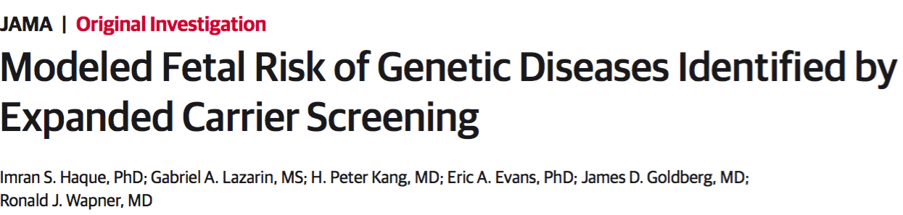
ECS study in JAMA
N=346,790
Published in the Journal of the American Medical Association (JAMA)
August 16, 2016
Notes:
Talking points:
To address the need for additional data, Counsyl has conducted the largest Expanded Carrier Screening (ECS) study ever published to date, with a diverse study population of nearly 350,000 individuals.
This study was published in the Journal of the American Medical Association (JAMA) in August, 2016.

Slide 14
Study design & methods
Çalışma Tasarımı ve Mataryel - Metot
Katılımcıların bildirimine göre etnisiteler: 15 ethnik kategori
1 Ocak 2012- 15 Ocak 2015
Dışlama kriteri: Bilinen taşıyıcılığı olanlar veya genetik bir hastalık için aile öyküsü olanlar, infertil olanlar, akraba evlilikleri
İlgili Klinik Durumlar: 94 ciddi/şiddetli önemli hastalık
  Hafif orta fenotipler taranmıyor
Teknoloji: Targeted genotipleme ve NGS
<Each ethnic population in the study was well-represented in number, with the smallest group in the ECS study outnumbering the total population of some of the largest genetic studies>
Notes:
Talking points:
Results: In major US racial and ethnic categories, ECS identifies more potential pregnancies at risk for severe/profound conditions than current screening guidelines.
Data is based on self-reported ethnicity and assumes that people reproduce within the same ethnic group
At least 5,000 people had to self-identify in each ethnic category to be included in the analysis (11 of 15 groups fit this criterion)
To minimize bias, individuals with self-reported personal or family history, infertility or other reason of testing were excluded.
The study was designed with a focus on 94 serious or “severe and profound” recessive conditions on the Counsyl Family Prep Screen.
Severe conditions were defined as those that if untreated cause intellectual disability or a substantially shortened lifespan (e.g., spinal muscular atrophy); profound conditions were those causing both (e.g., Canavan disease).^{2,6}
Gene variants with known mild, moderate or highly variable phenotypes or incomplete penetrance were excluded from this study.
Analysis was done on the Counsyl Family Prep Screen using targeted genotyping and next-generation sequencing.
Use as needed for technical audiences who may want more technical details about study design.
>430,000 patients screened; statistical analysis only performed on people who were referred for “routine screening”, amounting to >346,000 patients
>300,000 genotyped and >38,000 sequenced for up to 110 diseases; a total of 94 were included in the analysis
SMA and FrX performed separately
VUS and mild diseases/alleles excluded, as well as diseases with highly variable clinical presentation (i.e. familial Med fever and alpha-1)
Anything that was categorized as Moderate or Mild was removed: e.g., GJB2, MTHFR, hemochromatosis.
Within severe and Profound diseases, alleles that were found to consistently cause mild phenotypes or considered VUS were removed.
There is a supplementary table that shows all that was included/excluded.
Diseases were categorized as “profound” or “severe” based on the previously published PLOS paper that assessed 13 disease characteristics, such as shortened lifespan, intellectual disability, impaired movement, internal physical malformations, and sensory impairment, to assign severity.
Severe: those that if left untreated cause intellectual disability OR shortened lifespan to adolescence or earlier (Fr X, CF)
Profound: those that if untreated cause intellectual disability AND shortened lifespan to adolescence or earlier (Canavan, Pompe)

Slide 15
Current carrier screening guidelines
Current guidelines support limited screening in select ethnic groups
2016 yılına kadar önerilen tarama programı
 | Caucasian | AJ | African / AA | Asian | Hispanic | Meditter. | S.E. Asian
Cystic Fibrosis
Spinal Muscular Atrophy
Tay Sachs Disease
Canavan Disease
Familial Dysautonomia
Gaucher Disease
Fanconi Anemia Type C
Mucolipidosis IV
Neimann-Pick Disease Type A
Sickle Cell Anemia
Thalassemia
ACOG
ACMG
Notes:
Talking points:
Current ACOG guidelines only support pan-ethnic cystic fibrosis screening, and additional single-gene screening based on ethnicity and family history.
This is based on the belief that only certain individuals -- based on self-reported ethnicity or family history -- are at higher risk to pass down serious inherited conditions.
Note: Other factors to limited guidelines include practical considerations, such as, interpretation and discussion of results, access to genetic counselors, rapid advancements in technology (quicker than guidelines), and cost to patients. (All of which Counsyl addresses.)
Current medical guidelines support
limited
screening in select ethnic groups

Slide 17
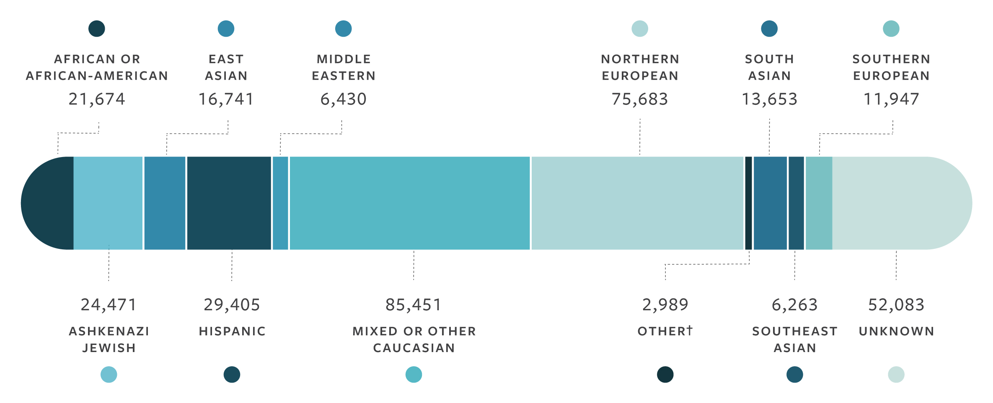
ECS çalışma populasyonu N=346,790
Günümüze kadar ki en büyük genişletilmiş taşıyıcılık tarama çalışması
Notes:
Talking points:
We are proud to release results from the largest expanded carrier screening study ever published from nearly 350,000 ECS patient results.
The study population—unmatched in magnitude to date—is more diverse than any previous genetic study published to date.
The sample size of each of these individual ethnic groups is substantial. Even the sizes of individual populations (e.g., Hispanic, East Asian) eclipse the total population of other similar genetic testing studies published to date.³
Examples of other studies that show our study’s magnitude and diversity in comparison. (Some have similar total N, but focus on single gene or one condition; some have a total N that is smaller than the n for just one of our ethnic groups.)

Slide 19
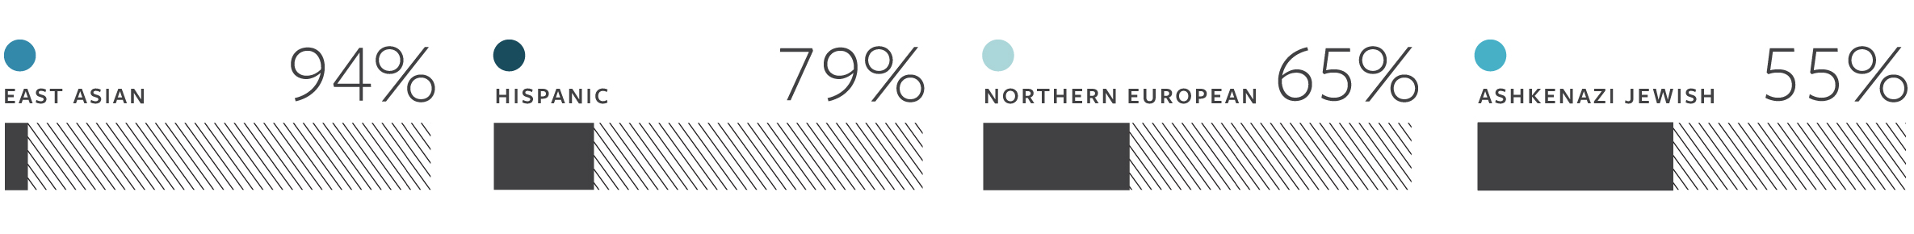
Mevcut tarama rehberleri etkilenmiş gebelikleri kaçırabilir.
Guideline-based carrier screenings miss a significant percentage of pregnancies affected by serious conditions:
Notes:
Talking points:
When analyzed and compared to the current ACOG and ACMG guidelines, the data showed that:
Guideline and single-gene carrier screening practices can miss a significant number of pregnancies affected by serious conditions.
In all populations, ECS uncovered affected pregnancies beyond what can be identified using current routine practices.
For Example:
>90% of hypothetically affected pregnancies would be missed in East Asian patients
Similarly, nearly 80% of potentially affected pregnancies would be missed in Hispanic patients
This was consistent even for ethnic groups where screening is more common:
>60% for Northern Europeans,
>50% for AJ

Slide 20
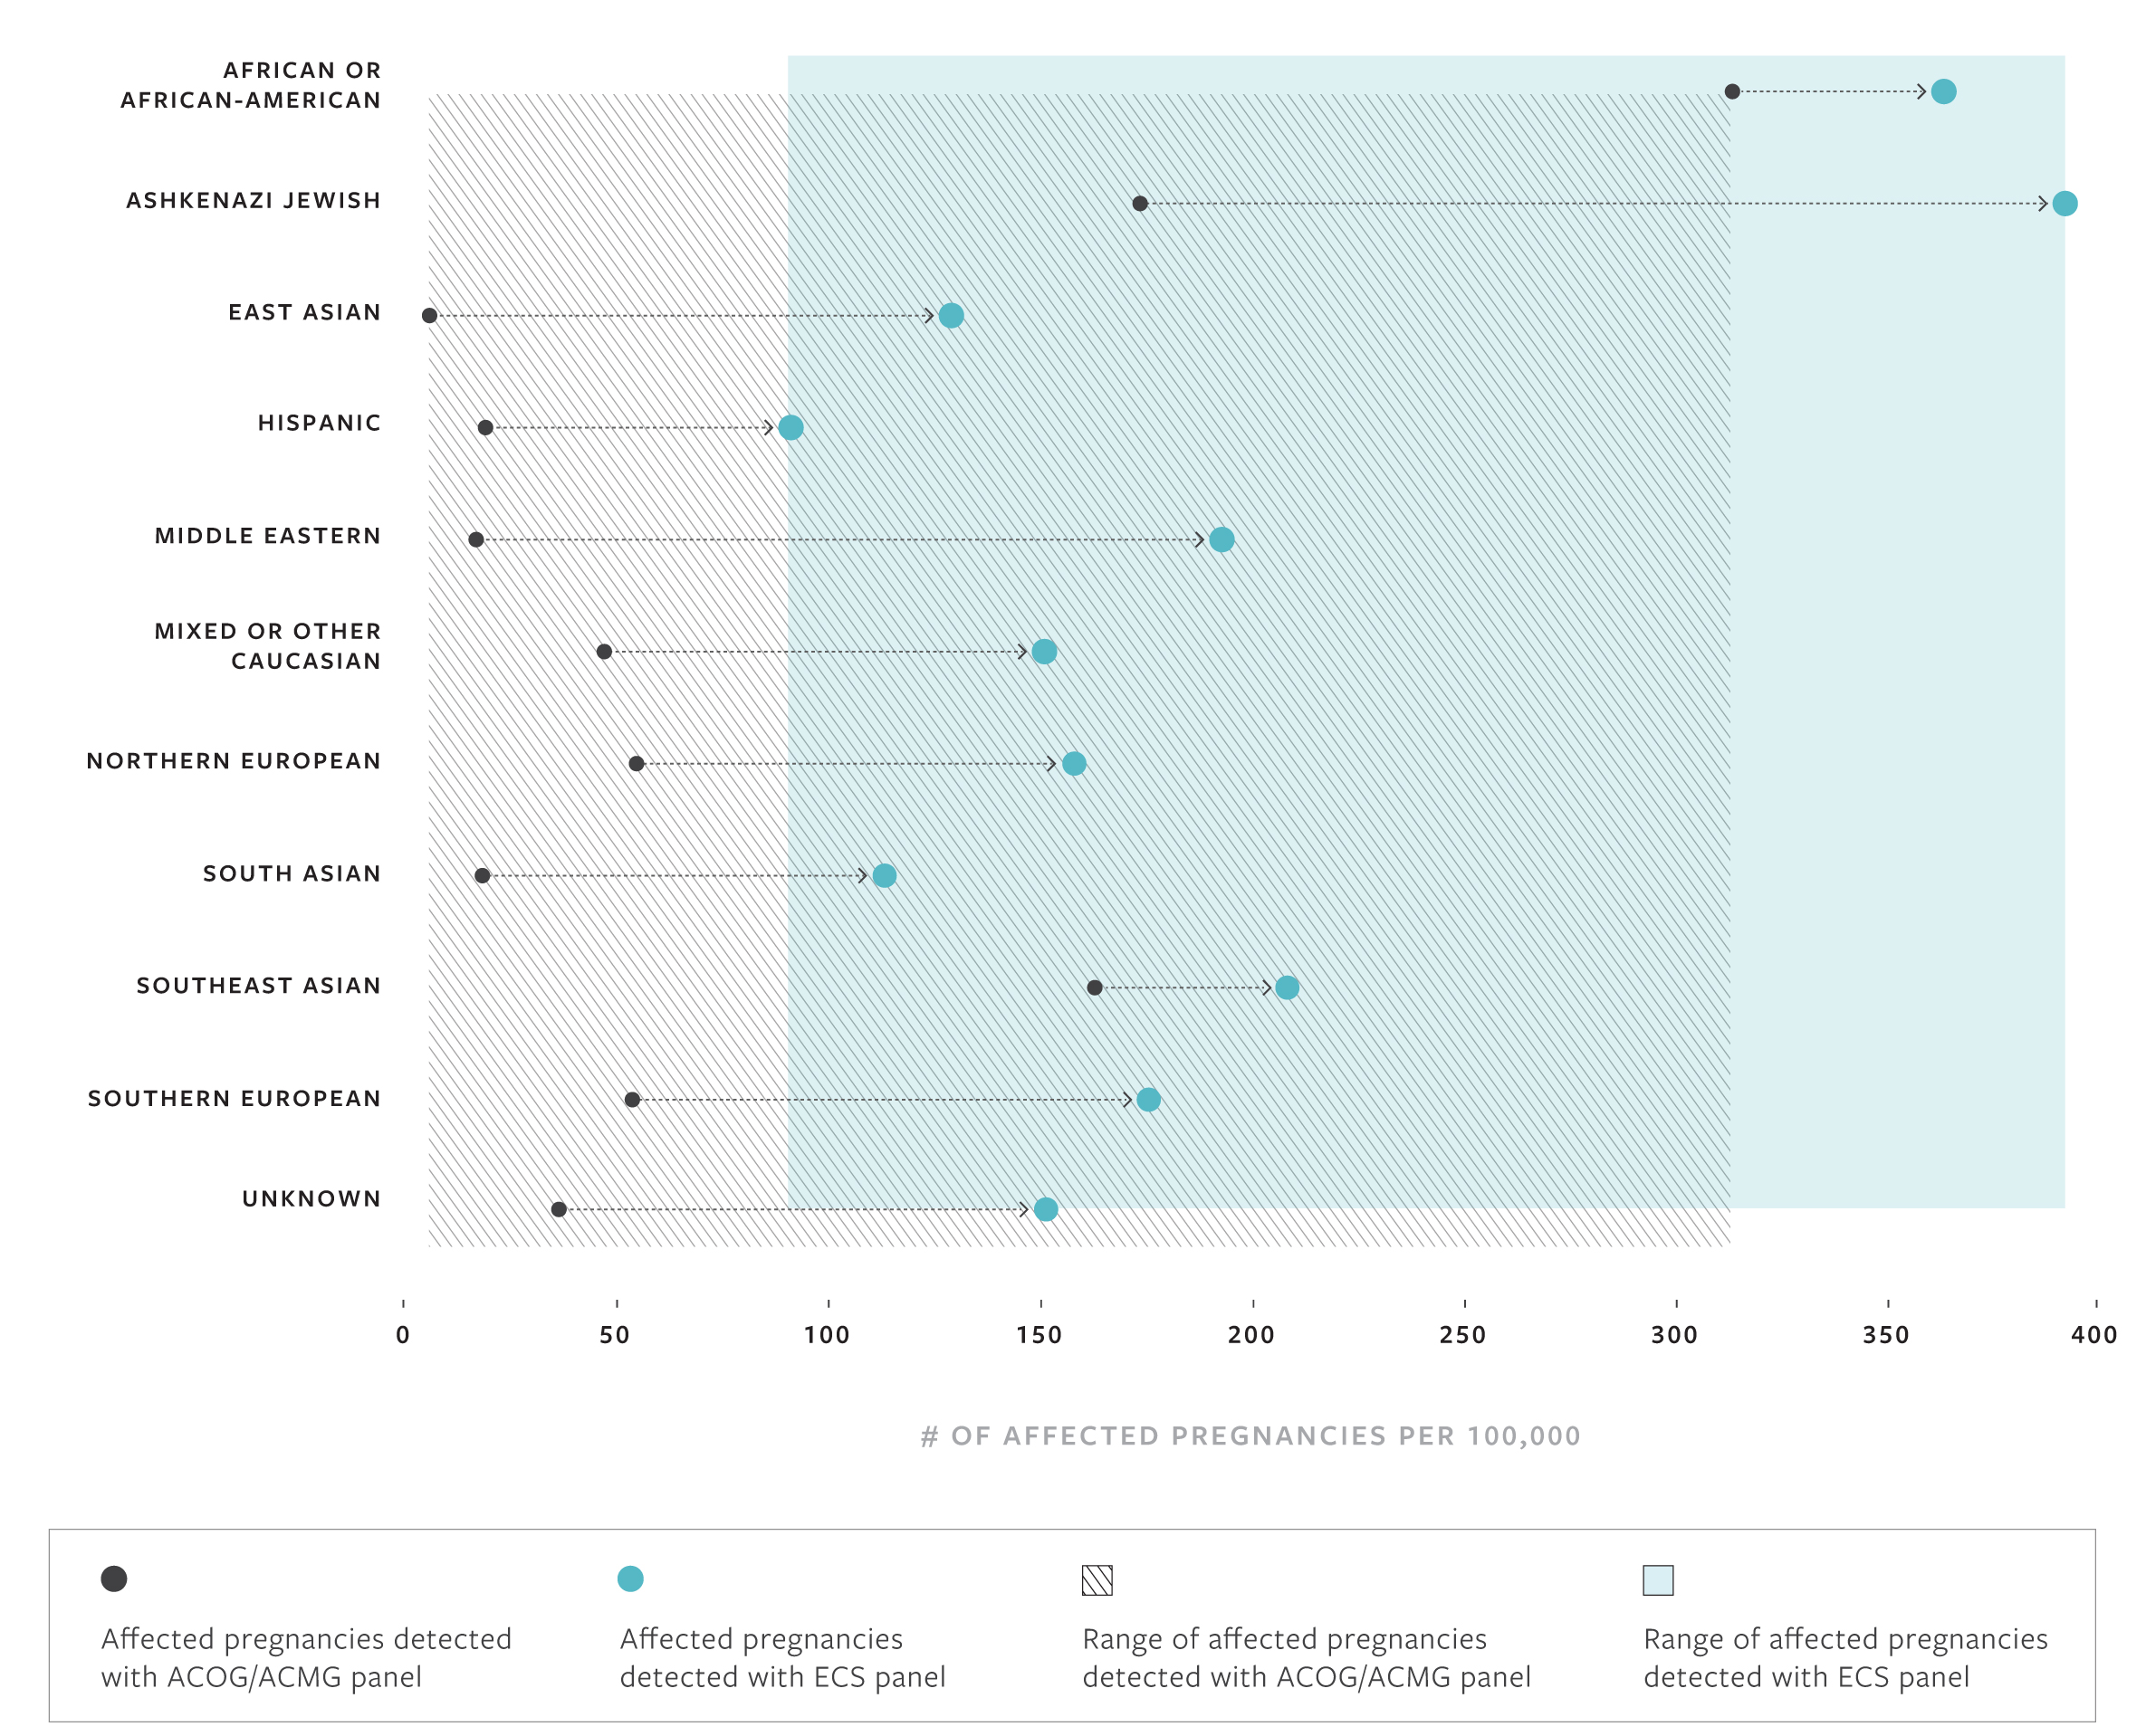
Increased detection of affected pregnancies with ECS by ethnicity
Notes:
Use this slide to drill down on the increased detection of affected pregnancies for each ethnic group compared to current guidelines-based screening, as needed.
Talking points:
This graph shows the number of affected pregnancies per 100,000 plotted across ethnicities.
Black points = affected pregnancies detected by status quo (current screening guide
Blue points = true risk your patients have of an affected pregnancy, which can be detected with ECS
(Drill down by ethnicity, as necessary.)
Conclusion: ECS detects more pregnancies affected by serious conditions across ethnicities that could otherwise be missed by guidelines…
Reference - Table 5: Cumulative Risk of Recessive Disease by Screening Panel
Key take-away: Guideline and single-gene carrier screening practices miss a significant number of pregnancies affected by serious conditions… whereas ECS enables the detection of more affected pregnancies in patients across ethnicities.

Slide 21
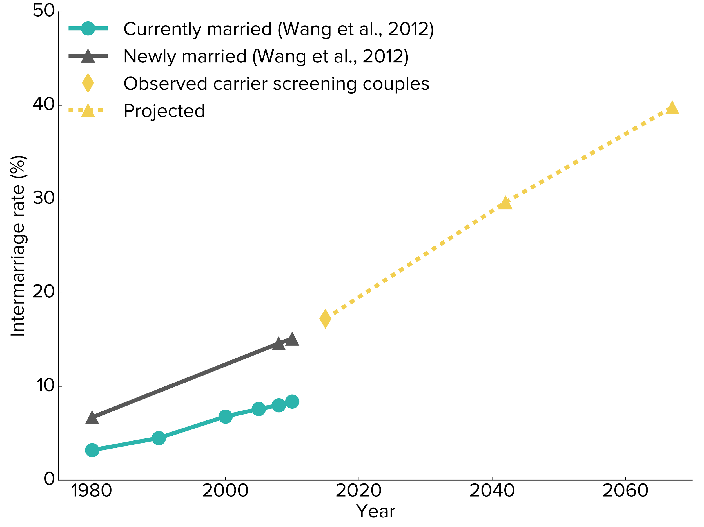
Intermarriage rates are expected to rise
17.2%
Notes:
This is from NSGC poster presented in 2016. Essentially we looked at 30,000 mixed couples and plotted it against the US Census data for intermarriage. If we predict out 2 generations ahead, then by 2060 nearly 40% of couples will be interracial. So, how do we ask people to define themselves ethnically?

Slide 23
ACOG 2017; Comitee opinion on Genetics
ECS; geleneksel ve etnik bazlı tarama ile karşılaştırıldığında kabul edilebilir bir seçenektir.

Slide 24
Sıklık ferkansı 100 de 1 yada daha fazla
Fenotip iyi tanımlanmış olmalı
Hayat kalitesi üzerine zararlı ve yıkıcı etkileri olması gerekli
Bilişsel ve fiziksel bozulmaya neden olmalı
Cerrahi yada tıbbi girişim gerektirmeli
Hayatın erken döneminde başlamalı
ACOG dışındaki organizasyonlar
Anne ve baba adayının bahsi geçen bozukluk için prenatal tanıyı düşünmeleri yada PGD seçeneğine değerlendirmeyi seçtiği olguların taranmasını önermektedirler

Slide 25
ACOG 2017
CF
SMA
Hemogram
Hb elektroforez → Afrika, Akdeniz, Orta doğu, Güneydoğu Asya, Batı Hindistan
Askenazi Yahudileri→ Tay Sachs, Canavan Hast., Familial Disotonomia
Frajil X premutasyon taşıyıcılık taraması aile öyküsünde Frajil X ilişkili bozukluğu ya da aile bireylerinde Frajil X i düşündürecek zeka geriliği olan tüm gebe kadınlara ya da gebelik planlayan tüm kadınlara önerilmelidir.
Eğer bir kadında açıklanamayan ovaryan yetersizlik ya da yetmezlik durumu varsa veya 40 yaşından önce FSH değerleri yükselmişse FMR1 premutasyonunu içeren Frajil X taşıyıcılık taraması önerilmelidir.

Slide 26
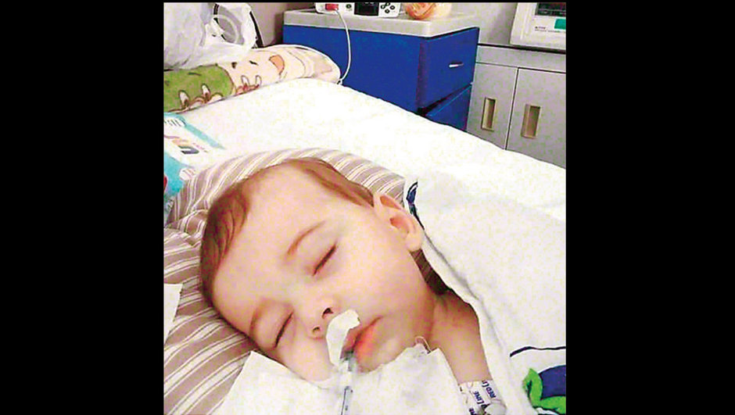
SMA Nusinersen Spinraza, 2017 YM:1050000 YTL

Slide 27
Hangi Genler Analiz Edilmeli
Otozomal resesif hastalıklar
ATM??? → meme ca
GBA; Gauscher Hastalığı??? Homozigot→metobolizma uzmanı→ PGD?
GJB2 ilişkili duyma kaybı!!!
X geçişli Hastalıklar
Frajil X ? (Hoque et al 2015, Rosenwaks et al 2017)
DMD yeni mutasyonlar, gonadal mosaizm ???? Reziduel risk fazla
OD hastalıklar ?????

Slide 28
Geleneksel Yöntem, Genotipleme vs NGS
Residual risk hesaplanması

Slide 29
ECS
Residual risk (RR): Tarama test sonuç negatif ancak hasta taşıyıcı
RR: Taranan popülasyonda taşıyıcılık sıklığı x (1 – Detection Rate)
Yakalama Oranı (Detection rate) DR:
Yeni variantlar tespit edilebilir yada bazı varyantlar artık patojenik kabul edilmeyebilir. Bunlar yakalama oranını değiştirir.

Slide 30
Ek olarak üreme açısından kapalı toplumlarda(Askenazi Yahudileri) Tay Sachs hastalığı ile ilgili HEXA genindeki iki patojenik varyasyon bu grupta ciddi fenotipsel bozukluğun % 90 nından sorumlu ancak diğer ırklarda yada genel popülasyonda bu varyant ciddi hastalığın % 35 inden sorumlu

Slide 32
AMP - ACMG

Slide 33
Test Öncesi Danışmanlık
ECS panellerinde taranan bozukluk sayısı giderek arttığı için her bir bozukluğu tek tek tartışmak çok mümkün ve uygun değildir. CF, SMA zaten universal taramanın bir parçası buna ek olarak Frajil X hakkında detaylı bilgi verilmeli

Slide 34
Test Öncesi Danışmanlık
NGS ile taramada detection rate %98-99 olup çokta az da olsa rezidüel bir risk vardır ancak bu çok küçük bir risktir.
Her laboratuar hangi teknolojinin kullanıldığını ve bu teknoloji ile taşıyıcıların hangi oranda tespit edildiğini açıkça belirtmelilerdir.

Slide 35
Test Sonrası Danışmanlık
Taşıyıcılık pozitif olan bozukluğun detaylı şekilde tartışılması. (Partnerin durumu, partnere hangi test yapılacak, diğer aile bireylerinin taşıyıcı olan kişi tarafından bilgilendirilmesi, üreme ile ilgili riskler ve seçenekler)

Slide 36
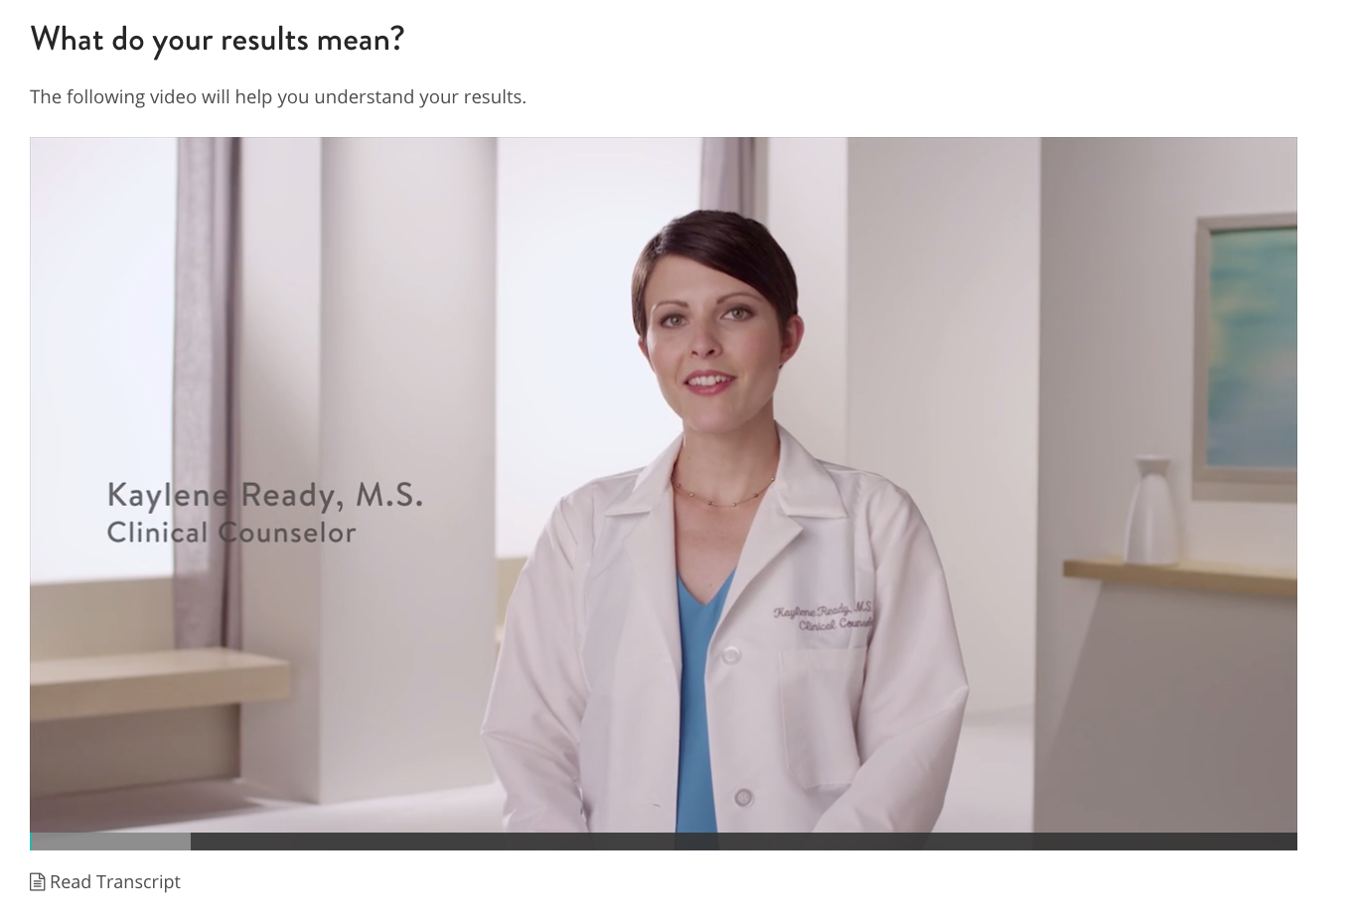
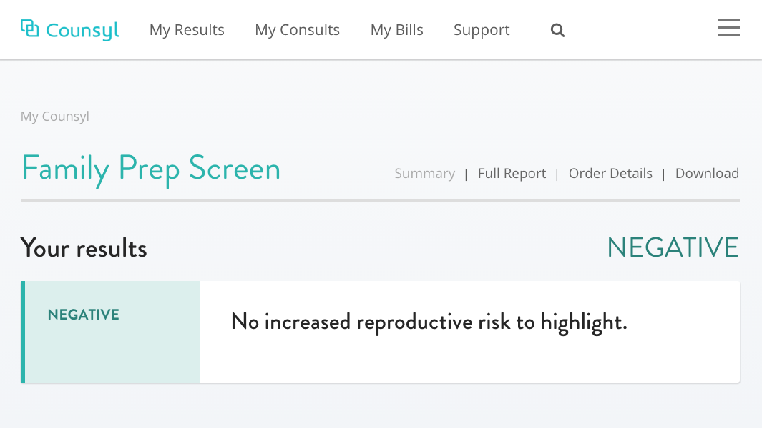
Checking for results

Slide 37
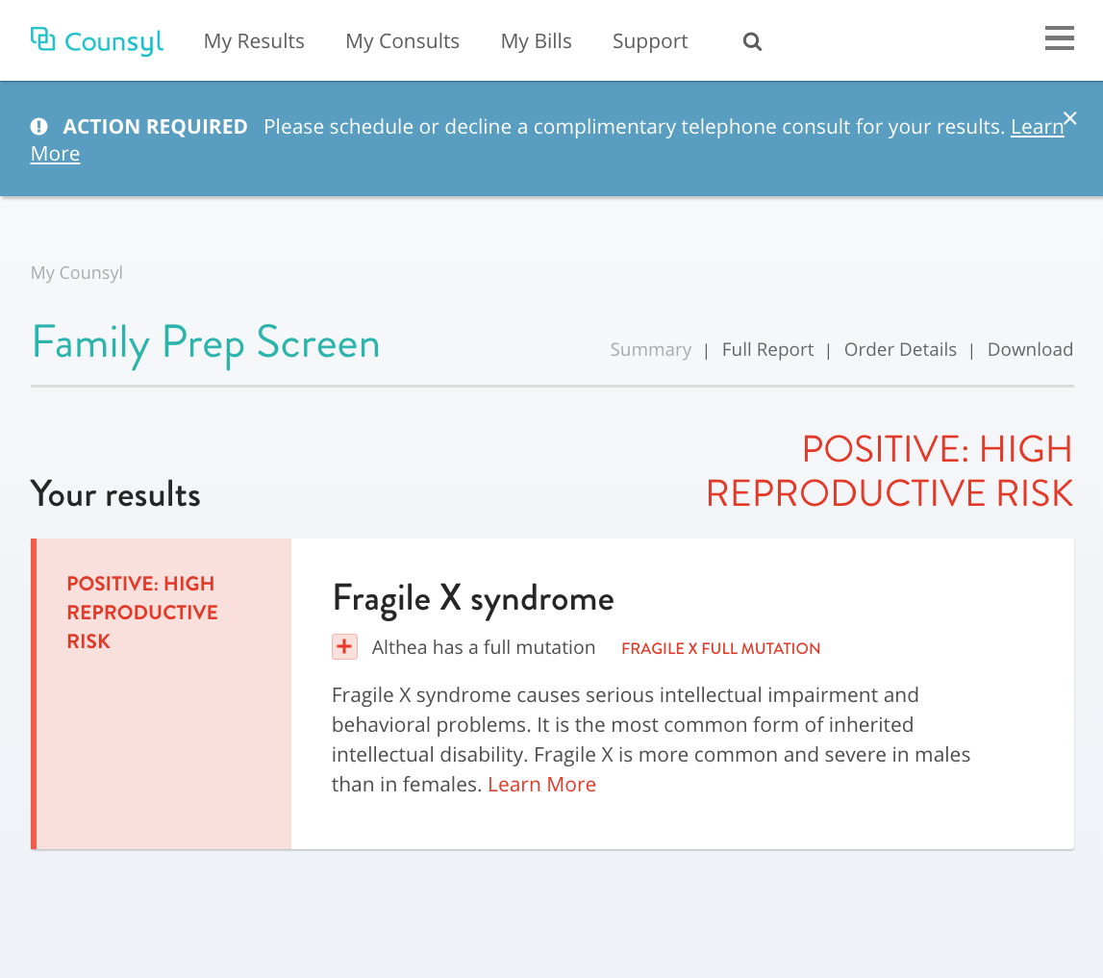
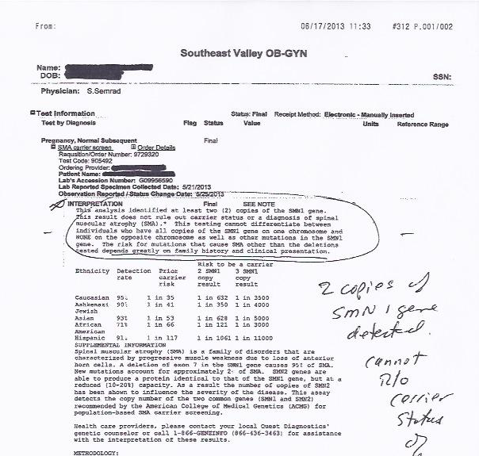
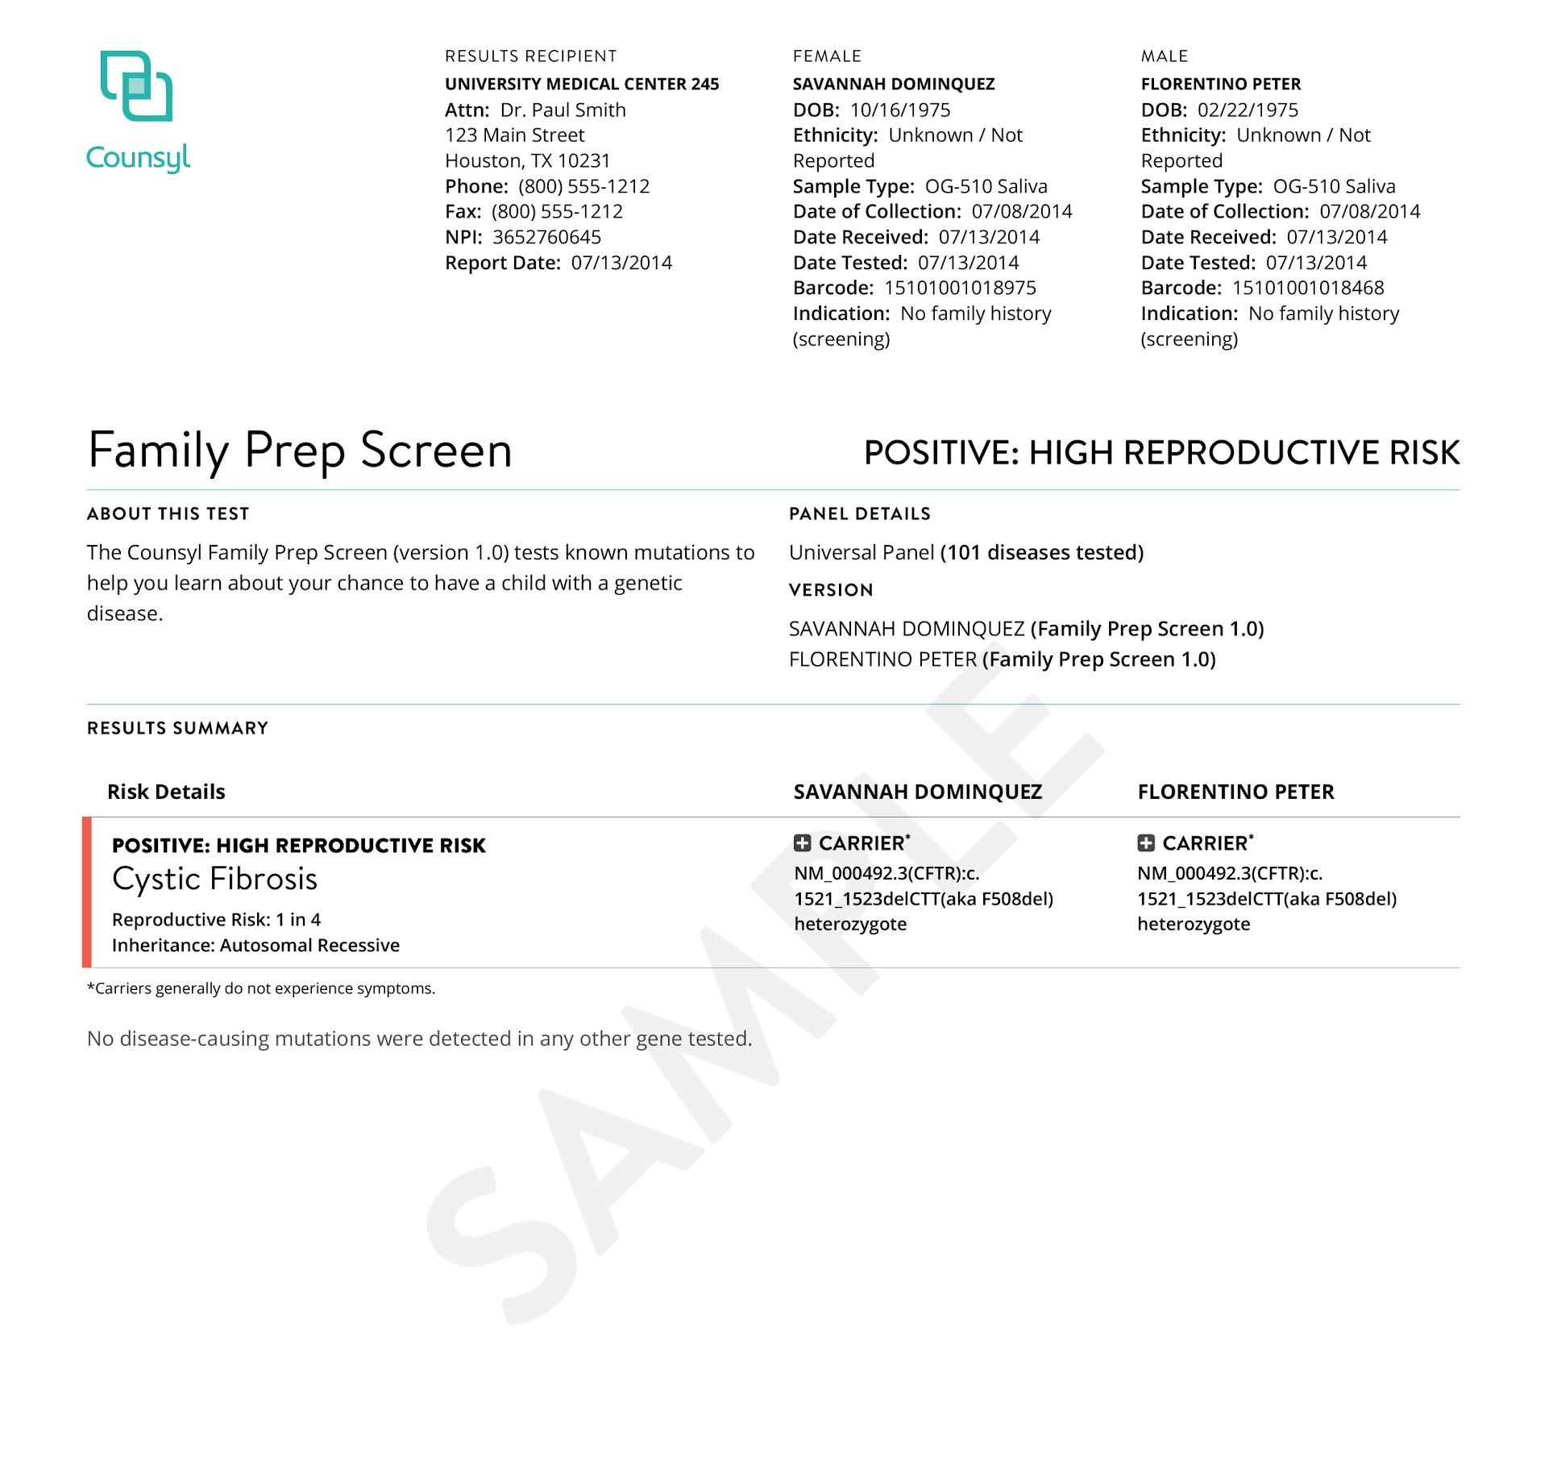
Patient-friendly Reports
Traditional results
Cluttered, unclear results
with no follow up
ESC results
Clear, patient friendly
explanation of results
Notes:
Sample notes: We’re also leveraging technology and design to reinvent what a medical report looks like. A user-friendly results means less time trying to figure out what the report is trying to say, and more time addressing the points of concern.We’ve gone to great lengths to make sure reports are clear. All the information you need is on the first page, with PPV or Residual Risk calculations included, where appropriate. The end result is TIME SAVED for your clinic. {What would you do if you received the report on the left? It would probably be multiple phone calls back and forth to ensure you understand the report…. that translated to time spent on something that should have been straightforward.)
Optional: We’re also working on a “sharing” tool that patients can easily use to share their results with family members, if they so choose.

Slide 39
Ocak 2011-Nisan 2014 arasında tek bir IVF merkezinde 3738 çift taranmış , 1666 bireyde en az bir taşıyıcılık pozitif (%25.1)
8 çiftte ortak taşıyıcılık mevcut (%0.21 oranında), bu çiftlere PGD yapılmış sonuç olarak sağlıklı embryoların transferi sağlanmış.

Slide 41
Frajil X bu popülasyonun % 50 sinden azında taranmış (inheritest panelinde yok counsyl panelinde mevcut). 4 tane hastada bu açıdan değerlendirilmesi gereken sonuç mevcut. PGD???

Slide 42
IVF pratiğinde
Normal sikluslarda ve donasyon sikluslarında gebe kalmadan önce ek bilgi arayışı içinde olan hastalarda ECS; etnik bazlı taramaya göre geçerli ve değerli bir seçenekdir.

Slide 43
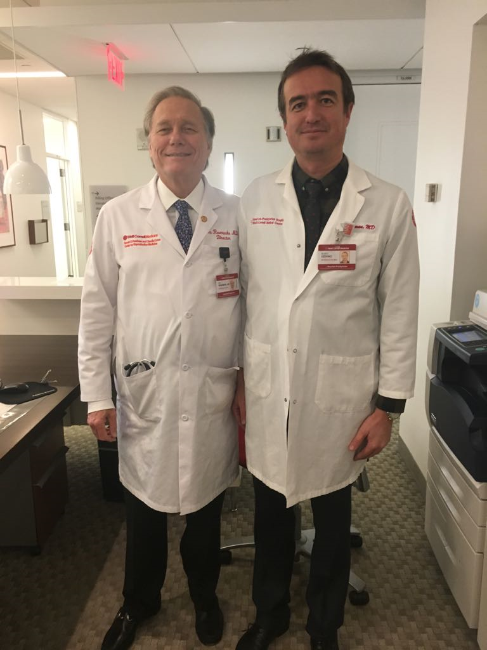
SABRINIZ İÇİN TEŞEKKÜRLER

