Slide 1
Onkofertilite: fertilite prezervasyonu güncel durum
Dr. Gülnaz Şahin
Ege Üniversitesi IVF Merkezi

Slide 2
Fertilite prezervasyonu
Fertilite prezervasyonu
Onkofertilite/fertilite prezervasyonu yeni bir disiplin
Geçtiğimiz iki dekatta onkofertilite özel ilgi alanı
Konuyla ilgili ulusal/uluslararası rehberler

Slide 3
Fertilite prezervasyonu
Artan sağ kalım oranları
Yaşam kalitesine ilgi artışı
Yardımcı üreme tekniklerinde gelişmeler
Hastalar
Onkologlar
Üreme sağlığı ile ilgili uzmanları
ÖNEMLİ BİR DİSİPLİN

Slide 4
Fertilite prezervasyonu
Kanser dünya genelinde büyük bir halk sağlığı problemi
Sadece ABD’de 2017 yılı içinde 1.688.780 yeni tanı kanser vakası (Dünya çapında 14 milyon WHO 2015)
Kadınlarda en sık meme, AC, kolorektal kanserler
Erkeklerde prostat, AC ve kolorektal ca ilk sıraları almakta
Notes:
>1 milyonu Adolesan ve genç erişkin

Slide 5
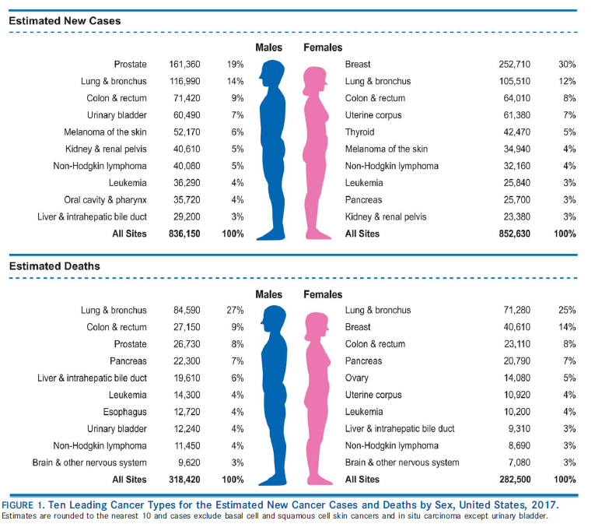
Ten Leading Cancer Types for Estimated New Cancer Cases and Deaths, by Sex, United States, 2017
Notes:
The three most commonly diagnosed types of cancer among women in 2017 will be cancers of the breast, lung and bronchus, and colon and rectum, accounting for 50% of estimated cancer cases in women. Breast cancer alone is expected to account for 30% of all new cancer cases among women.

Slide 6
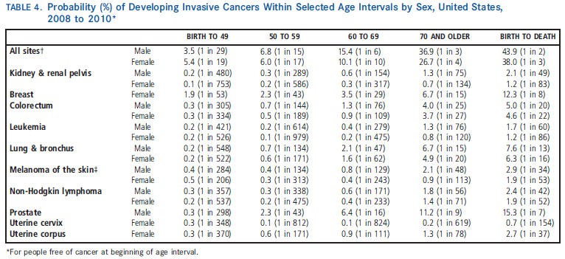
CA Cancer J Clin 2014;64:9-29

Slide 7
Fertilite prezervasyonu
Son otuz yılda tüm kanserler ele alındığında 5 yıllık sağ kalım oranlarında %20-24 artış
Kanser tanı ve hedefe yönelik tedavilerdeki gelişmeler bu artışla ilişkili görünmekte
Hayat kurtarıcı bu tedavilerin reprodüktif endokrin fonksiyonlar ve fertilite üzerine etkileri var

Slide 8
Fertilite prezervasyonu
Çocukluk çağı kanseri geçiren kadınlarda %20, genç erişkin yaşta kanser geçiren kadınlarda hastalık geçirmeyen kardeşlerine göre %50 daha düşük gebelik eldesi
Green DM et al. Fertility of female survivors of childhood cancer: a report from the Childhood Cancer Survivor Study. Journal of Clinical Oncology. 2009

Slide 9
Fertilite prezervasyonu
Son 3 dekadda kanser araştırmalarındaki ilerlemeler, tarama ve korunma programları ile kanser insidansı ve buna bağlı ölüm oranları azalma göstermiştir
Jemal A, Murray T, Samuels A, Ghafoor A, Ward E and Thun MJ (2003) Cancer statistics, 2003. Ca Cancer J Clin 53,5-26.
Notes:
5 year survival rates in all stages of breast ca has reached %89 in US.

Slide 10
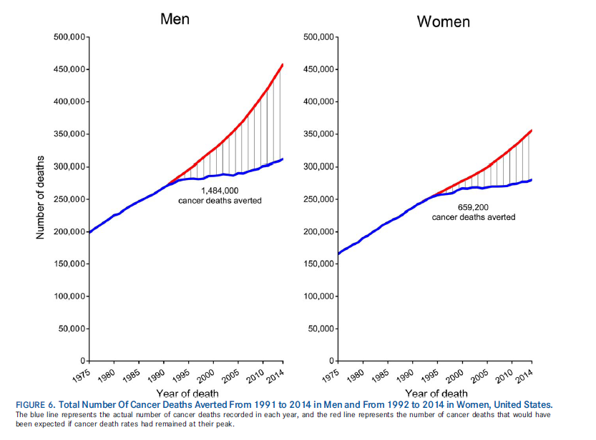
CA Cancer J Clin 2017

Slide 11
Genç yaş ve Kanser
40 yaşındaki 1/46 kadında invaziv kanser tanısı beklenmekte
Üreme çağında en sık gözlenen kanserler;
>Meme
>Kolorektal
>melanom
>servix ca
>NHL
>lösemi

Slide 12
Meme Kanseri
Kadınlarda üreme çağında en sık görülen kanser türü (1,2)
Olguların yaklaşık %15’i tanı konduğunda menapoz öncesi dönemde
Genç kadınlarda meme kanseri insidansında artış (3)
1. Weir HK, Thun MJ et al.(2003) J Natl Cancer Inst 95,1276±1299.
2. Goodwin PJ, Enis M et al(1999) Journal of Clinical Oncology, Vol 17, 1999: 2365-2370
3. Merlo DF et al. Breast cancer incidence trends in European women aged 20-39 years at diagnosis. Breast Cancer Res Treat 2012;134:363-70

Slide 13
Meme Kanseri
* Siegel R, et al .Cancer statistics 2012, . Ca Cancer J Clin . 2012,62,1,10-29
Notes:
Toplamda 1.665.540 yeni vaka 2014 yılı için bekleniyor ve 585.000 kansere bağlı ölüm bekleniyor

Slide 14
Meme Kanseri
%90’dan fazlası tanı anında lokal veya lokal ileri hastalık evresinde 5 yıllık sağ kalım oranları bu evreler için %97 ve %80
Hastaların çoğunda adjuvan tedavi olarak siklofosfamid gibi gonadotoksik ajanları içeren kombine KT rejimleri uygulanıyor
Ghafoor A, Jemal A, Ward E et al. Trends in breast cancer by race and ethnicity.CA Cancer J Clin 2003;53:342–355
Kaufmann M, von Minckwitz G et L(2003) Journal of Clinical Oncology, Vol 21,2600±2608.
Notes:
Dünya çapında 44 yaş öncesi 240.000 kadın meme ca tanısı alıyor GLOBOCAN database. Çoğunluğu CT alacak olan hastalar. Kamangar et al, JCO 24:2137-50, 2006. Merlo ve ark. 1995-2006 yılları arası 20-30 yaşta Anual Incidence change(AIC)de 1.032 30-40 yaşta AIC:1.014 özellikle 25-29 yaşta artış var.

Slide 15
Genç Yaş Meme kanseri
Aile öyküsü ve gen mutasyonları daha sık
Fertilite, psikososyal sorunlar, seksüel disfonksiyon, erken menapoz, tedavi sonrası gebelik
Cardoso F et al. The European Society of Breast Cancer Specialists recommendations
For the managenent of young women with breast cancer. European Journal of Cancer 2012;48:3355-77
Notes:
Juvenil adenokarsinom, invaziv lobuler karsinom daha fazla. Lokal relaps daha fazla. İmflamatory breast ca genç yaşta daha fazla.

Slide 16
Genç Yaş Meme kanseri
Meme kanseri tipleri dağılımı daha farklı; daha fazla üçlü negatif (ER-, PR-, HER2-)
Genellikle lokal ileri evrede yakalanıyor ve cerrahiye ek olarak sistemik tedavi gerekiyor
Alt tipe rağmen prognozları iyi
Adjuvan sistemik terapi seçimi diğer yaş gruplarında olduğu gibi tümörün evresi ve biyolojik karakteristiğine göre yapılıyor
Cardoso F et al. The European Society of Breast Cancer Specialists recommendations
For the managenent of young women with breast cancer. European Journal of Cancer 2012;48:3355-77
Notes:
HR+olanlarda endokrin terapi Tamoxifen (GnRH analoglu veya analogsuz) 5yıl veriliyor. HER2 pozitiflerde 1 yıl transtuzumab ekleniyor.

Slide 17
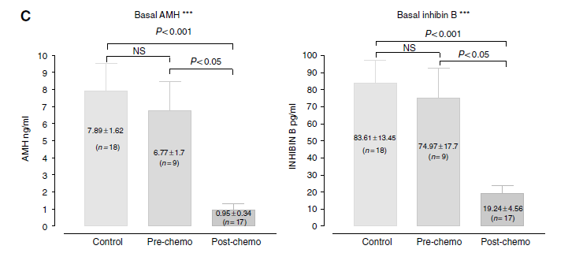
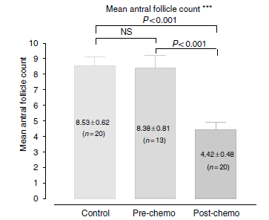
Predictors of ovarian reserve in young women with breast cancer
K Lutchman Singh et al,
British Journal of Cancer (2007) 96, 1808 – 1816
Notes:
AMH levels decrease after the first courses of chemother-apy and progressively thereafter during treatment [34,104].In a cohort of 50 premenopausal women with EBC, it wasdemonstrated that CT induced rapid decreases in AMH,inhibin-B, and AFC, without modifying estradiol levels [33= Anderson et al.2006].

Slide 18
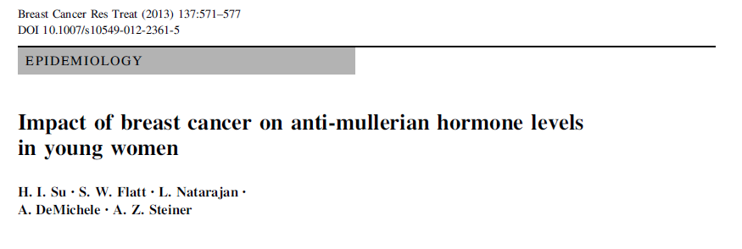
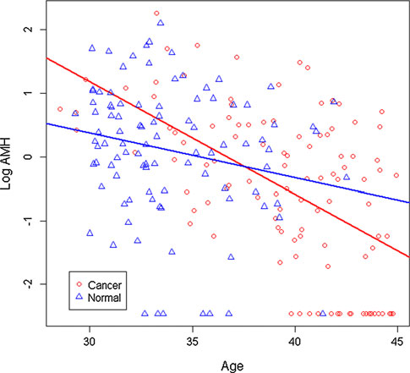
108 yeni tanı almış meme ca ile 99 sağlıklı kontrol
AMH, FSH, Inhibin B düzeyleri
Meme ca median yaş: 40.2(5.5) Kontrol grubu:33(4.6)
Yaş, BMI, sigara içimi gibi etkenler düzenlendikten sonra AMH düzeyleri benzer
(0.85 vs 0.76 ng/ml)
37 yaş altı AMH düzeyleri her iki grupta benzer (β= 0.24, 95 % CI -0.24,0.72, p = 0.32)
37 yaş üstü grupta AMH düzeyleri meme ca grubunda daha düşük
*(β= -0.85, 95 % CI -1.48, -0.22,p = 0.009)
Notes:
AMH was measured by theAMH enzyme-linked immunosorbent assay kits (Beckman Coulter,AMHGen II assay, Brea, CA, USA)
Birçok çalışma kanser hastalalrında KOH ile oosit sayıları arası fark bulmadı, iki çalışmada meme ca’da diğer kanserlere göre daha kötü sonuçlar verildi (Quintero ve Garcia-Valesco; 2010-2012 FS

Slide 19
Oncologist. 2014 Jun 20. the oncologist.2014-0016 Estimates of Young Breast Cancer Survivors at Risk for Infertility in the U.S. Trivers KF¹, Fink AK², Partridge AH², Oktay K², Ginsburg ES², Li C², Pollack LA²
Author information
¹Division of Cancer Prevention and Control, National Center for Chronic Disease Prevention and Health Promotion, Centers for Disease Control and Prevention, Atlanta, Georgia, USA; ICF International, Rockville, Maryland, USA; Dana-Farber Cancer Institute, Boston, Massachusetts, USA; Brigham and Women's Hospital, Boston, Massachusetts, USA; Division of Reproductive Medicine and Laboratory of Fertility Preservation and Molecular Reproduction, New York Medical College, Valhalla, New York, USA; Innovation Institute for Fertility Preservation, New York, New York, USA fph1@cdc.gov.
²Division of Cancer Prevention and Control, National Center for Chronic Disease Prevention and Health Promotion, Centers for Disease Control and Prevention, Atlanta, Georgia, USA; ICF International, Rockville, Maryland, USA; Dana-Farber Cancer Institute, Boston, Massachusetts, USA; Brigham and Women's Hospital, Boston, Massachusetts, USA; Division of Reproductive Medicine and Laboratory of Fertility Preservation and Molecular Reproduction, New York Medical College, Valhalla, New York, USA; Innovation Institute for Fertility Preservation, New York, New York, USA.
BACKGROUND:
Standard treatments for breast cancer can impair fertility. It is unknown how many U.S. survivors are at risk for infertility. We estimated the population at risk for infertility secondary to treatment among reproductive-aged breast cancer survivors. METHODS: We combined data from three sources: the National Program of Cancer Registries (NPCR) and Surveillance, Epidemiology, and End Results cancer registry data on incident breast cancers diagnosed in women aged 15-44 years between 2004 and 2006; treatment data from NPCR's 2004 Breast and Prostate Cancer Data Quality and Patterns of Care (PoC) study; and data on women's intentions to have children from the 2006-2010 National Survey of Family Growth (NSFG).RESULTS: In the cancer registry data, an average of 20,308 women with breast cancer aged <45 years were diagnosed annually. Based on estimates from PoC data, almost all of these survivors (97%, 19,416 women) were hormone receptor positive or received chemotherapy and would be at risk for infertility. These women need information about the impact of treatments on fertility. Estimates based on NSFG data suggest approximately half of these survivors (9,569 women) might want children and could benefit from fertility counseling and fertility preservation. CONCLUSION: Nearly all young breast cancer survivors in the U.S. are at risk for infertility. Physicians should discuss the potential impact of treatment on fertility. A smaller but sizeable number of at-risk survivors may be interested in having children. Given the magnitude of potential infertility and its quality-of-life implications, these survivors should have access to and potential coverage for fertility services.

Slide 20
BRCA-1 ve BRCA-2 mutasyonları
Yaşam boyu meme ve over ca gelişme riskinde artış
Insidans:1/400-1/800
Askenazi Musevi orjininde:1/40
BRCA1 mutasyonu ile düşük ovaryan cevap
BRCA mut+/ mut- (%33 vs %3)*
BRCA1/2 mutasyonu olanlarda doğal menapoz yaşı daha erken**
Woodson AH, et al. Breast cancer in the young: role of the geneticist. J Thorac Dis 2013;5(S1):S19-S26.
*Oktay K et al. Association of BRCA1 mutations with occult primary ovarian insufficiency: a possible explanation for the link between infertility and breast/ovarian cancer risks. J Clin Oncol. 2010;28:240-244.
**Lin T et al. Comparison of Age at Natural Menopause in BRCA1/2 Mutation Carriers With a Non–Clinic-Based Sample of Women
in Northern California. Cancer May 2013; 1652-59.
Notes:
BRCA mutation of known significance was associated with 28.7 times the normal OR of low response (95% CI, 1.8 to 447; P.016) n=14 mutasyon+, n=33 mutasyon-

Slide 21
BRCA 1/2 mutasyonları
BRCA genleri DNA çift sarmal onarım mekanizmasında rol oynuyorlar
1600 den fazla mutasyon+
BRCA1 mut.ile düşük over cevabı/DNA onarım mekanizmaları ile infertilite/meme/over ca arası ilişki olasılığı
DNA onarım mekanizmasındaki bozukluk oositlerin DNA hasarına daha dayanıksız olması ve apoptozisi ile ilişkili olabilir
Henüz BRCA gen dizilimindeki varyasyonlarla over rezervi arası ilişki tam bilinmiyor
Bu hastalarda FP+ ise PGD mümkün
Notes:
BRCA mutant male miceda spermatogenez bozuk, BRCA2 mutant female miceda testis ve overler hipoplastik . Although these findings require
further confirmation, these data indicate that some women with BRCA mutations may have a lower egg reserve and can experience earlier menopause. Whether or not this has an effect on the fertility potential of women with BRCA mutations is another question that needs to be answered. In a recent study
based on a survey of 2,254 women with BRCA mutations in comparison with 764 controls, a history of fertility problems and fertility medication use as well as the mean parity were similar. Those authors concluded that larger studies with agestratified analyses are needed to definitely answer this question,
and if there is a difference in fertility it would most likely be toward the limits of their reproductive life . Consistent with this observation and hypothesis, we found that all BRCA mutation–positive women who responded poorly to fertility medications were aged 33 years [16]. Taking these observations together with the data indicating earlier menopause in BRCA carriers [17, 48], some women with BRCA mutations may have a reproductive life span that is 2–4 years shorter than that of the general population.(Rodriguez) PGD tartışmalı: Quinn GP, Vadaparampil ST, Bower B et al. Decisions and ethical issues among BRCA carriers and the use of preimplantation genetic diagnosis. Minerva Med 2009;100:371–383.

Slide 22
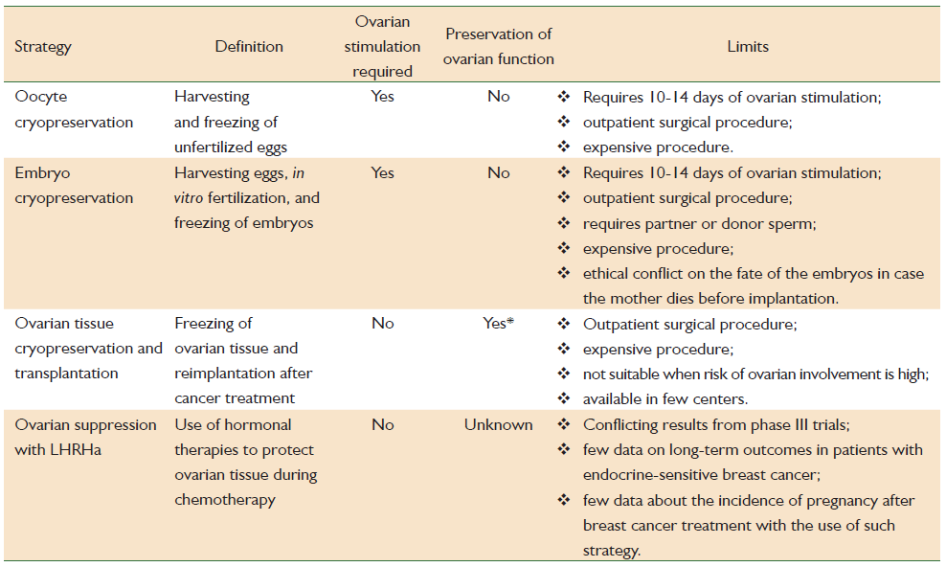
Available strategies for fertility preservation in breast cancer patients
Lambertini M et al. J Thorac Dis 2013;5(S1):S68-S80

Slide 23
Çocuk/adölesan hastalar ve onkofertilite
Lösemi, SSS maligniteleri, lenfoma, sarkom, renal kanser, kemik tm.leri
KT, RT, KIT, cerrahi kombinasyonları
Tedaviye bağlı geç etkiler (gonadotoksiste )
20-40 yaş aralığında tahmini 1/640 erişkinde, çocukluk çağı kanser öyküsü+
İleri yaştaki kadınlara göre KT bağımlı ovaryan kayıp ve infertilite riski daha düşük ancak risk+
Pediatrik KI transplantasyonu %65-84 ovaryan kayıpla ilişkili
Dillon K, Gracia G: Pediatric and young adult patients and oncofertility
Current Treatment Options in Oncology 2012

Slide 24
Çocuk/genç erişkin hastalar ve onkofertilite
Pediatrik ve adolesanlarda fertilite prezervasyonu seçenekleri erişkinlere göre kısıtlı
Postpubertal dönemde oosit/sperm kriyoprezervasyonu
Prepubertal dönemde ovaryan doku /testiküler doku cryoprezervasyonu deneysel***
Notes:
Matür sperm Tanner evre 3, testis volümü>5 ml olduğunda bulunabiliyor, 13-14 yaşta efektif. 48 saat ara ile üç semen örneğinin saklanması öneriliyor. Dsha erken yaşlarda deneysel testiküler doku

Slide 25
Hematolojik kanserler
Standart FP seçeneklerinin her zaman uygun olamadığı özel bir populasyon
Bireysel yaklaşım: standart teknikler, deneysel teknikler, hormonoterapi, kanser sonrası değerlendirme
Hematologla reprodüktif endokrinoloğun iletişimi hastaya yaklaşımın kalitesi için önemli

Slide 26
Hematolojik kanserler
ALL, AML, Hodgkin lenfoma, Non-Hodgkin lenfoma
2020 yılı için KIT tedavisi alması beklenen 242.000 (tüm kanser olgularının %2’si, çoğunluğu nakil sırasında 40 yaş altı)
Loren A. Fertility issues in patients with hematologic malignencies. Hematology 2015
Notes:
There are 1 million survivors of acute leukemia and Hodgkin (HL) and non-Hodgkin (NHL) lymphoma in the United States and an estimated additional 130 000 new cases of these blood cancers will be diagnosed each year.6 Although acute myeloid leukemia (AML) and NHL predominantly impact older adults, a substantial number of cases (20% of AML and 17% of NHL) occur in patients under the age of 50, with cure rates 50%-60% for AML and 60% for diffuse large B-cell lymphoma. There are 1 million survivors of acute leukemia and Hodgkin (HL) and non-Hodgkin (NHL) lymphoma in the United States and
an estimated additional 130 000 new cases of these blood cancers will be diagnosed each year.6 Although acute myeloid leukemia (AML) and NHL predominantly impact older adults, a substantial number of cases (20% of AML and 17% of NHL) occur in patients under the age of 50, with cure rates 50%-60% for AML and 60% for diffuse large B-cell lymphoma. On the other hand, patients under the age of 50 predominate in Hodgkin lymphoma
(64%) and acute lymphoblastic leukemia (ALL; 75%), with cure rates 80% for HL and between 40%-90% for ALL.6 In addition, there were an estimated 108 900 HCT survivors in the US in 2009 with 242 000 HCT survivors anticipated by 2020, representing 2% of all cancer survivors7; 45% of allogeneic HCT recipients and 25% of autologous HCT recipients are under the age of 40 at the time of transplant.

Slide 27
Hematolojik kanserler
Hodgkin Lenfoma: 20-29 yaşta pik insidens (4.4/100.000), 5 yıllık sağ kalım %87-96
ABVD (doxorubicin, bleomycin, vinblastine, dacarbazine):POF riski düşük
Alkilizan içeren rejimler (MOPP, CHOP, BEACOPP): Doz ilişkili %70’e varan POF riski, yaş PoF riskine etkin
Non-Hodgkin Lenfoma: 30 yaş altında daha az yaygın (0.6-3.3/100.000), 5 yıllık sağ kalım %69-84, tedavi rejimlerinin çoğunda alkilizan ajanlar+

Slide 28
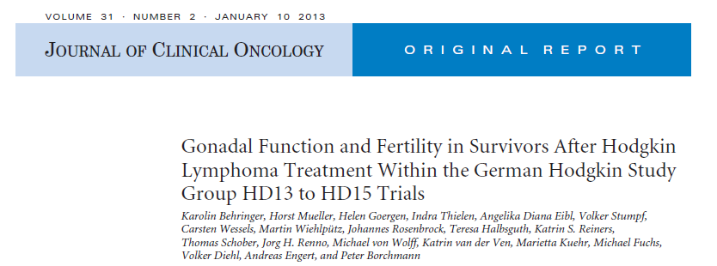
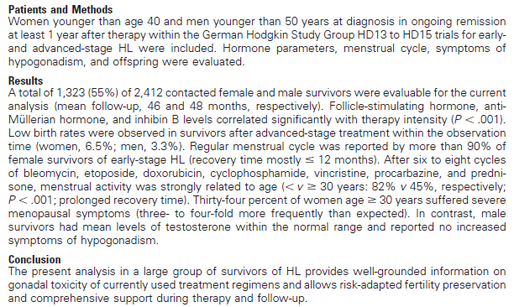

Slide 29
Hematolojik kanserler
ALL: En yaygın çocukluk çağı kanseri, 5 yıllık sağ kalım %67-90. Tüm ALL olgularının %75’i çocukluk çağında. Kök hücre transplantasyonu gerektiren grup dışında tedavinin gonadotoksik etkileri sınırlı
Ovaryan doku dondurma, OTC sırasında oosit aspirasyonu (IVM) seçenek olabilir?
Ancak lösemik hücrelerin transmisyon-reimplantasyonu riski yüksek !!!. İleride in-vitro folikül kültür sistemleri?
Kim S, Jadoul P. Fertility considerations in young women with hematological malignancies. JARG 2012
Notes:
Antrasiklin+citarabin

Slide 30
Hematolojik kanserler
AML: 5 yıllık sağkalım %24 ve çocuklarda %60
Çoğu rejimde alkilizan ajan yok. FP seçenekleri ALL gibi
KML: Tirozin kinaz inhibitörleri (İmatinib)
Fertilite üzerine etkisi sınırlı?yok?
2. jenerasyon TKI etkisi?
Akut lösemide olduğu gibi ovaryan infiltrasyon riski+. Uzun süreli terapi, terapiye gebelik için ara ancak onkolog onayı olursa, relaps riski+

Slide 31
Hemopoetik kök hücre nakli
Transplant öncesi myeloablatif rejimler (TBI/alkilizan ajanlar) erken gonad kaybına neden. Post BMT, gebelik şansı < %0.6-11
KIT yapılan hastalarda kardeşlerine göre 36 kat artmış gebe kalmama durumu*
Post BMT, gebeliklerinde anomali riskinde artış yok, TBI almış ise erken doğum, S/C, LBW riski artıyor
Carter A, Robison LL, Francisco L, et al. revalence of conception and pregnancy outcomes after hematopoietic cell transplantation: report from the Bone Marrow Transplant Survivor Study. Bone Marrow Transplant.2006

Slide 32
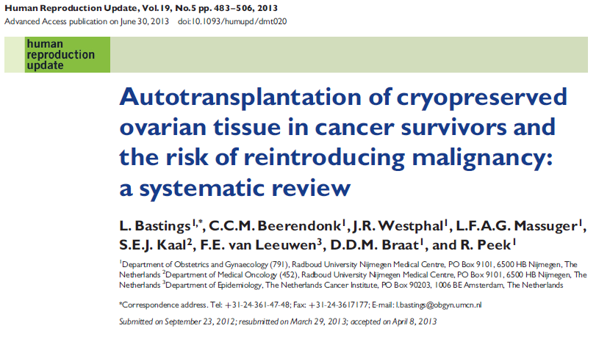

Slide 33
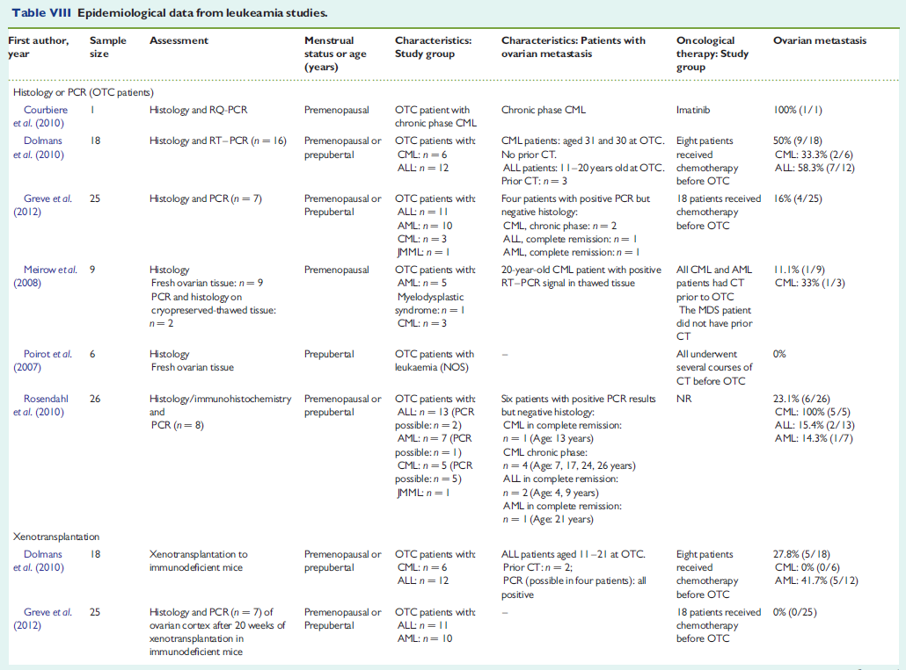

Slide 34
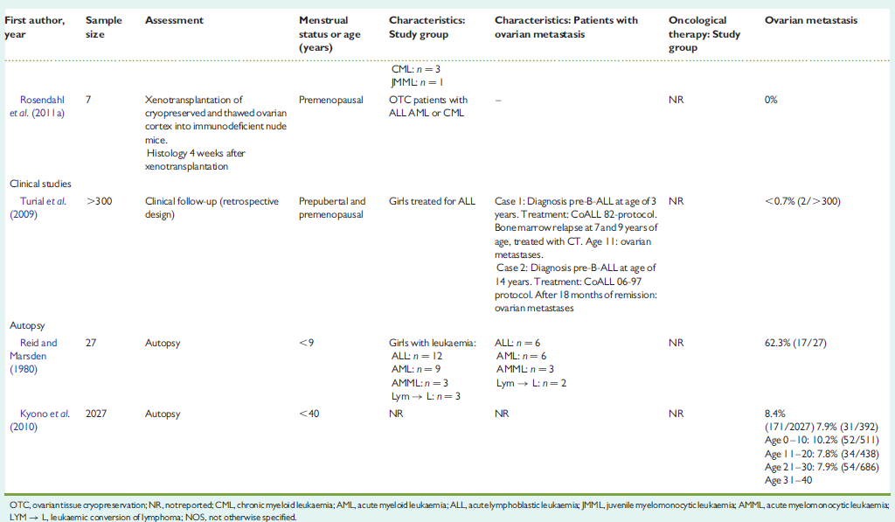
GREAT CONCERN: In leukaemia, a clear risk of ovarian involvement and disease recurrence after transplantation has been shown by different methods. Therefore, autotransplantation of ovarian tissue should be considered unsafe in survivors of this blood borne malignancy.
Least concern: Results from histological examination and xenotransplantation of ovarian
tissue from patients in a fertility preservation programme suggest a low risk of disease recurrence following autotransplantation in lymphoma survivors.

Slide 35
Çoğu lösemi ve Hodgkin L. tedavisinde küratif KT sonrası <%20 kalıcı amenore riski. Ancak subfertilite, ovaryan rezerv azalması ve fertil pencere daralmasıyla ilişkili. Analoglar? Tedavi sonrası oosit eldesi?
Sitotoksik tedaviye hemen başlama gereksinimi, sitopeniler, enfeksiyonlar, klinik instabilite varlığı vb. durumlar FP metodlarının güvenle yapılmasında sorun? Doğru hasta seçimi
Tedavi sonrası relaps olasılığı ve ek yoğun KT, KIT gereksinimi olasılığı nedeniyle tedavi sonrası FP açısından tekrar değerlendirme
Ne kadar süre sonra ?????. Sınırlı veri
Hematology 2015
Notes:
Patients with acute leukemia and some types of lymphoma often require urgent/emergent cytotoxic therapy. Furthermore, the typical
treatment regimens for acute leukemia and Hodgkin lymphoma, all delivered with curative intent , do not involve alkylating agents at
sufficient doses to induce immediate and irreversible ovarian failure, whereas patients with non-Hodgkin’s lymphoma, particularly
diffuse large B-cell NHL, do require cyclophosphamide at moderate doses as a component of curative therapy.

Slide 36
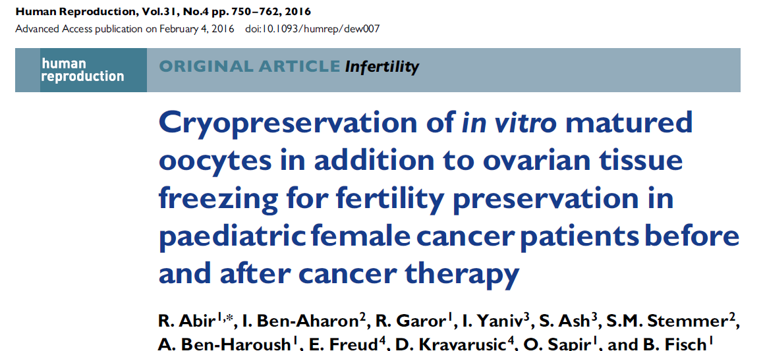
2007-2014 arası 42 pediatrik kanserli olgu(2-18 yaş)
OT dondurma sırasında immatür oositlerin exvivo aspirasyonu ve IVM ile matürasyonu
%80’inden oosit eldesi+
393 oositin %30’u atretik, %30’u IVM ile matür+
KT öncesi 16/20 olguda ve KT sonrası 12/13 olguda ortalama 4 (1-20) matür oosit vitrifikasyonu+
Notes:
22’si KT öncesi, 20’si KT başlandıktan sonra . 14 olgu prepubertal.

Slide 37
Jinekolojik kanserler
Wallberg KA, Keros V, Hovatta O. Clinical aspects of fertility preservation in female patients. Pediatr Blood Cancer. 2009;53(2):254–260.
Notes:
(SEER) statistics, 8% of endometrial cancers, 12% of ovarian cancers and 40% of cervical cancers are diagnosed during reproductive years. Fifteen to 21% of women diagnosed with genital tract tumors are younger than 40. Conservative surgery is defined as a complete staging procedure with the preservation of at least the uterine corpus and part of one ovary [3].

Slide 38
Fertilite Prezervasyonu
Hastalıksız sağ kalım
Fertilite ?
Fertilitenin korunması?
Tedavi sonrası gebelik?
Yaşam kalitesi

Slide 39
Bilgilendirilme
Hastaların büyük çoğunluğu ilerideki fertilite kaybı olasılıkları nedeniyle stres yaşamakta
Ayrıca hastalar gelecekteki fertilite durumları hakkında yeterince bilgilendirilmediğinde daha yüksek depresyon skorları göstermekte
%95 onkolog kanser tedavilerinin fertilite üzerine etkilerini tartışıyor ancak <% 40’ı üreme uzmanına hastasını yönlendiriyor
A. H. Partridge, S. Gelber, J. Peppercorn et alJournal of Clinical Oncology, vol. 22, no. 20, pp. 4174–4183, 2004.
J. Carter, L. Raviv, L. Applegarth et al Journal of CancerSurvivorship, vol. 4, no. 3, pp. 236–246, 2010. E. J. Forman, C. K. Anders, and M. A. Behera. Fertil Steril vol. 94, no. 5, pp. 1652–1656, 2010

Slide 40
Bilgilendirme
Onkologların genç kanser hastalarını tedavileriyle ilişkili infertilite olasılıkları ve ilgili grupta fertilite prezervasyonu yöntemlerini değerlendirmek üzere konuyla ilgili uzmanlara yönlendirmeleri önerilmektedir
Lee SJ, Schover LR, Partridge AH et al. American Society of Clinical Onkology
recommendations on fertility preservation in cancer patients. J Clin Oncol.2006;24:2917-31
Notes:
Son yıllarda infertilite riskindeki artış, elde olan korunma stratejileri, konuyla ilgili bilgilerin giderek artışı hasta ve doktorlar arasında hastaların başarılı tedavi şansını artırıyor.

Slide 41
J Oncol Pract. 2014 Dec 30. pii: JOP.2014.000786. [Epub ahead of print]
If You Did Not Document It, It Did Not Happen: Rates of Documentation of Discussion of Infertility Risk in Adolescent and Young Adult Oncology Patients' Medical Records.
Quinn GP¹, Block RG², Clayman ML², Kelvin J², Arvey SR², Lee JH², Reinecke J², Sehovic I², Jacobsen PB², Reed D², Gonzalez L², Vadaparampil ST², Laronga C², Lee MC², Pow-Sang J², Eggly S², Franklin A², Shah B², Fulp WJ², Hayes-Lattin B².
Author information
¹Moffitt Cancer Center; Morsani College of Medicine, University of South Florida, Tampa, FL; Oregon Health & Science University, Portland, OR; Northwestern University, Chicago, IL; Memorial Sloan Kettering Cancer Center, New York, NY; LIVESTRONG Foundation, Austin; The University of Texas MD Anderson Cancer Center, Houston, TX; and Karmanos Cancer Institute, Wayne State University, Detroit, MI gwen.quinn@moffitt.org.
²Moffitt Cancer Center; Morsani College of Medicine, University of South Florida, Tampa, FL; Oregon Health & Science University, Portland, OR; Northwestern University, Chicago, IL; Memorial Sloan Kettering Cancer Center, New York, NY; LIVESTRONG Foundation, Austin; The University of Texas MD Anderson Cancer Center, Houston, TX; and Karmanos Cancer Institute, Wayne State University, Detroit, MI.
Abstract
PURPOSE:
The adolescent and young adult (AYA) population is underserved because of unique late-effect issues, particularly future fertility. This study sought to establish rates of documentation of discussion of risk of infertility, fertility preservation (FP) options, and referrals to fertility specialists in AYA patients' medical records at four cancer centers.
METHODS:
All centers reviewed randomized records within the top four AYA disease sites (breast, leukemia/lymphoma, sarcoma, and testicular). Eligible records included those of patients: diagnosed in 2011, with no prior receipt of gonadotoxic therapy; age 18 to 45 years; with no multiple primary cancers; and for whom record was not second opinion. Quality Oncology Practice Initiative methods were used to evaluate documentation of discussion of risk of infertility, discussion of FP options, and referral to a fertility specialist.
RESULTS:
Of 231 records, 26% documented infertility risk discussion, 24% documented FP option discussion, and 13% documented referral to a fertility specialist. Records were less likely to contain evidence of infertility risk and FP option discussions for female patients (P = .030 and .004, respectively) and those with breast cancer (P = .021 and < .001, respectively). Records for Hispanic/Latino patients were less likely to contain evidence of infertility risk discussion (P = .037). Records were less likely to document infertility risk discussion, FP option discussion, and fertility specialist referral for patients age ≥ 40 years (P < .001, < .001, and .002, respectively) and those who already had children (all P < .001).
CONCLUSION:
The overall rate of documentation of discussion of FP is low, and results show disparities among specific groups. Although greater numbers of discussions may be occurring, there is a need to create interventions to improve documentation.
Copyright © 2014 by American Society of Clinical Oncology.

Slide 42
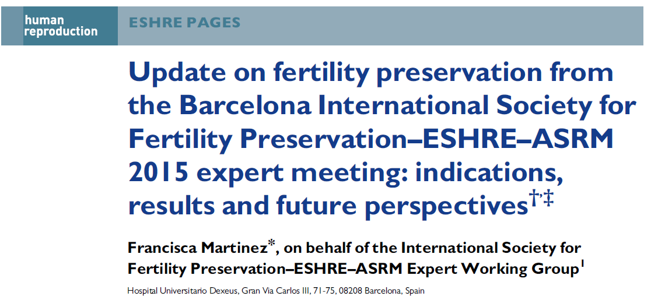
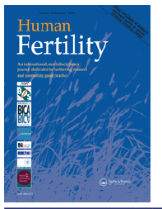
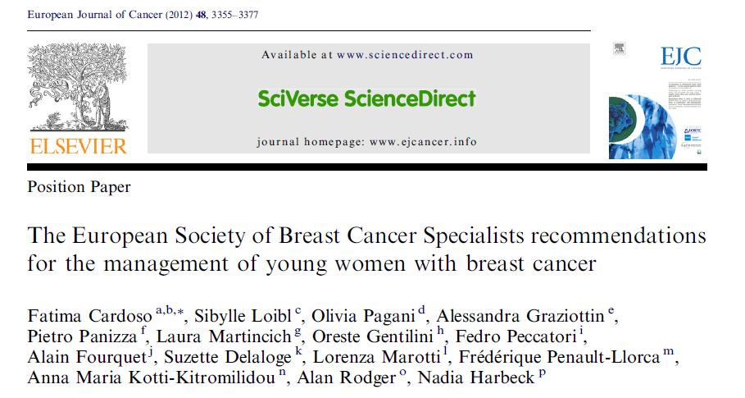
Pubmed Key words:
fertility preservation: 2810 publication/1508 in last 5 years

Slide 43
Kemoterapi ve gonadal toksisite
KT rejimleri uzun süreli sağ kalımı artırmakla birlikte, bu tedaviler ;
Over dokusunda follikülerin hızlı kaybına,
Fertilite şansında azalmaya,
Irreversible gonad hasarına neden olabilmektedirler
Meirow D. (2000) Molecular and Cellular Endocrinology
Oktay K, Kan MT and Rosenwaks Z (2001) Curr Opin Obstet Gynecol
Notes:
Birçok klinik çalışmada KT’nin ovaryan fonksiyonlar üzerine olumsuz etkileri gösterilmiştir

Slide 44
KT-gonadal toksisite
Hasta yaşı
KT protokolü
KT ajanlarının dozları
gonadal hasarı etkileyen başlıca faktörler**
Goodwin PJ, Enis M, Pritchard KI, Trudeau M, Hood N. (1999)Journal of Clinical Oncology
Meirow D and Nugent D (2001) Human Reproduction Update

Slide 45
KT-gonadal toksisite
İleri yaştaki kadınlarda KT’ye bağlı ovaryan yetmezlik daha sık*,**
KT sonrası amenore insidansını siklofosfamid tabanlı tedavilerde ≤ 40 yaşta %40 ve üzerindekilerde % 76 oranında bildirmişlerdir ***
Ek olarak E2-reseptör (+) olanlarda 5-10 yıl Tamoxifen kullanımı zaman bağımlı kayıpla ilişkili
*Brice P et al. (2002) Blood 100,736
**Bianco AR et al. (1991). Br J Cancer 63:799-803, 1991
***Bines J et al. (1996) J Clin Oncol 14:1718-1729

Slide 46
KT-gonadal toksisite
Alkilizan ajanlar hücre siklusuna spesifik olmamaları nedeniyle dinlenmedeki primordial follikülleri etkileyerek gonadotoksik özellik gösterirler
Chiarelli AM, Marrett LD and Darlington G.(1999) Early Menopause and Infertility in Females after Treatment
for Childhood Cancer Diagnosed in 1964-1988 in Ontario, Canada. Am.J. Epidemiol., 150,245-254

Slide 47
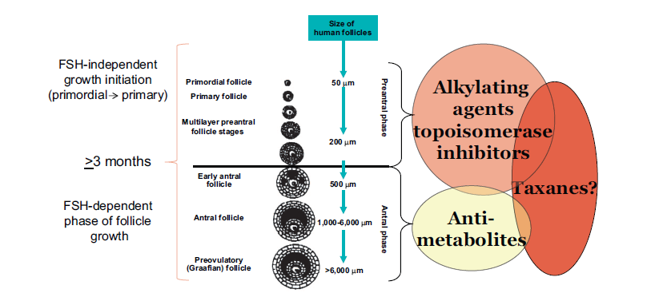
From; Rodriguez K, Oktay K. Fertility Preservation and Pregnancy in Women With and Without
BRCA Mutation–Positive Breast Cancer. The Oncologist 2012;17:1409–1417
Notes:
Impact of breast cancer chemotherapy on different stages of follicle growth. Based on molecular studies in our laboratory,
alkylating agents such as cyclophosphamide and topoisomerase inhibitors such as doxorubicin affect primordial follicle reserve, which
results in the shortening of the reproductive life span. These agents are toxic against the nonproliferating population of primordial follicles
because they induce apoptotic cell death via induction of breaks in double-strand DNA. The impact of taxanes on the primordial follicle
population is unclear from clinical observations and molecular studies are awaited. Regardless of the type of agent, all chemotherapeutics
are capable of damaging developing follicles because their granulosa cells are proliferating, and causing at least temporary amenorrhea.
Because new follicles will develop from an undamaged primordial follicle population within 3–6 months, this amenorrhea is temporary
for non-DNA-damaging agents and hence should not affect future fertility. Antimetabolites such as methotrexate appear to only affect the
developing population and hence cause transient amenorrhea without altering ovarian reserve.

Slide 48
KT-gonadal toksisite
Siklofosfamidle kombine KT rejimlerinde kontrollere göre 4-9 kat ovaryan yetmezlik riski (1, 2)
Cisplatin ve adriamycin orta düzeyde gonadotoksik,
Bleomycin, actinomycin D, vincristine, methotrexate ve 5-FU düşük etkili (3)
Taxanler, oxaliplatin, irinotecan, monoklonal antibodiler ve thyrosine kinase inhibitörleri ile ilgili data henüz yetersiz (4)
Ek olarak çoğu KT protokolünde sinerjistik etkileri olan çoklu ajan kullanılıyor
1. Byrne J et al.(1992) Early menopause in long-term survivors of cancer during adolescence. Am J Obstet.Gynecol 166,788-793
2. Meirow D and Nugent D (2001). The effects of radiotherapy and chemotherapy on female reproduction. Human Reprod. Update, 7, 535-543
3. Sonmezer M, Oktay K. Fertility preservation in female patients.2004, Human Reproduction Update, 10,251-266
4. Lee SJ, Schover LR, Partridge AH, Patrizio P, Wallace WH, Hagerty K, Beck LN, Brennan LV, Oktay K (2006).
American Society of Clinical Oncology recommendations on fertility preservation in cancer patients. J Clin. Oncology 24,2917-2931

Slide 49
Risks of Permanent Amenorrhea after Chemotherapy & Radiotherapy
Degree of Risk | Treatment
High risk (>80%) | Hematopoietic stem cell transplantation with cyclophosphamide/total body irradiation or cyclophosphmide/busulfan External beam radiation to a field that includes the ovaries CMF, CEF, CAF x 6 cycles in women age 40 and older
Intermediate risk | CMF, CEF, CAF x 6 cycles in women age 30-39 AC x 4 in women age 40 and older
Lower risk (<20%) | ABVD CHOP X 4-6 cycles CVP AML therapy (anthracycline/cytarabine) ALL therapy (multi-agent) CMF, CEF, CAF x 6 cycles in women age less than 30 AC X 4 in women less than 40
Very low or no risk | Vincristine Methotrexate 5-fluorouracil
? | Taxanes Oxaliplatin Irinotecan Monoclonal antibodies (cetuximab) Tyrosine kinase inhibitors (imatinib, erlotinib)
Lee et al. JCO, 2006
Notes:
As Estimating the risk of infertility after cancer treatment is difficult.: Type and doseof chemo, method of administration, the age of the patient, the pretreatment fertility of a patient,
Decrease in number of primordial follicles
Regular menstruation does not guarantee normal fertility
Duration of fertility may be limited even if their fertility is seemingly okay
Treatments with Associated risks of infertility difficult as data are poor and heterogeneous. Most data for amenorrhea…not a real surrogate for fertility.
In addition to address possibility of infertility with patients treated during their reproductive years, ASCO also recommended:
1. Being prepared to discuss possible fertility preservation options
3. Referring appropriate and interested patients to reproductive specialists
4. Sperm and embryo cryopreservation are considered standard practice and are widely available; other methods are considered investigational and should be performed in centers with the necessary expertise…this is us!
WHAT DOES THIS MEAN???

Slide 50
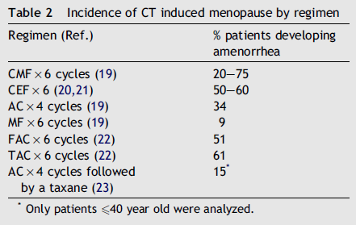
Risks of Permanent Amenorrhea after Chemotherapy
Del Mastro L, Catzeddu T, Venturini M. Cancer Treatment Reviews (2006) 32, 417– 422

Slide 51
Risks of Permanent Amenorrhea after Chemotherapy
Regimen | % patients developing amenorrhea
CMF x 6 cycle | 20-75
CEF x 6 | 50-60
AC x 4 | 34
MF x 6 | 9
FAC x 6 | 51
TAC x 6 | 61
AC x 4 cycle followed by Taxane* | 15*
*Only patients ≤40 year old were analysed
Del Mastro L, Catzeddu T, Venturini M. Cancer Treatment Reviews (2006) 32, 417– 422

Slide 52
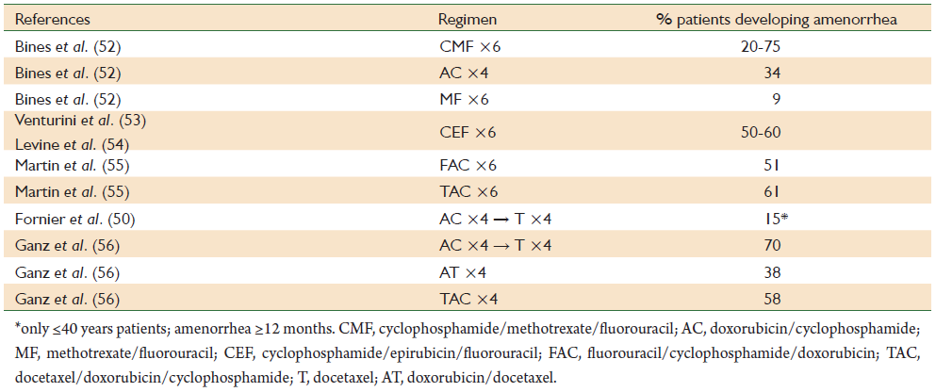
Risks of Permanent Amenorrhea after Chemotherapy
Lambertini et al. Fertility counseling of young breast cancer patients. J Thorac Dis 2013;5(S1):S68-S80

Slide 53
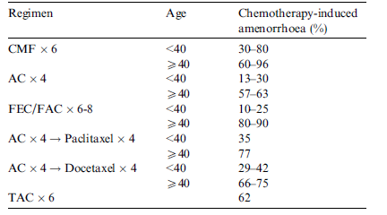
Risks of Permanent Amenorrhea after Chemotherapy
F. Cardoso et al. / European Journal of Cancer 48 (2012) 3355–3377

Slide 54
KT sonrası amenore
Regimen | Age | Chemotherapy induced amenorrhea
CMF x 6 | <40 | 30-80
 | ≥40 | 60-96
AC x 4 | <40 | 13-30
 | ≥40 | 57-63
FEC/FAC x 6-8 | <40 | 10-25
 | ≥40 | 80-90
AC x 4 ͢ Paclitaxel x 4 | <40 | 35
 | ≥40 | 77
AC x4 ͢ Docetaxel x 4 | <40 | 29-42
 | ≥40 | 66-75
TAC x 6 |  | 62
F. Cardoso et al. / European Journal of Cancer 48 (2012) 3355–3377

Slide 55
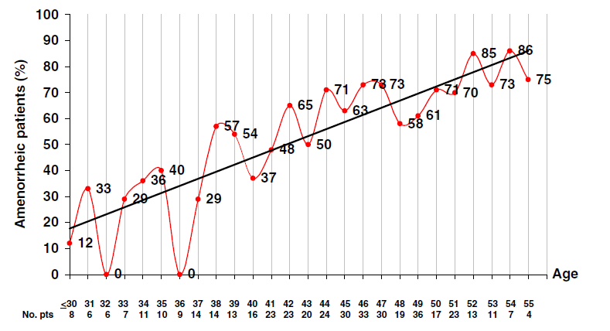
Risks of Permanent Amenorrhea after Chemotherapy
423 premenapozal kadın, CEF x 6 siklus sonrası yaşa göre amenore insidansı
Del Mastro L, Catzeddu T, Venturini M. Cancer Treatment Reviews (2006) 32, 417– 422

Slide 56
KT sonrası menstruasyon
Menstrüel düzensizlik veya amenore KT sırasında genellikle görülür ve hastaların bir bölümünde KT bitiminden sonraki 6 ay içinde menstrüasyon tekrar başlar
Ancak menstrüasyonun varlığı ovaryan fonksiyon ve fertilitenin değerlendirilmesi için yeterli bir kriter değil!!!
Notes:
In a study reported by Schmidt et al. [33], five of the eight women with breast cancer who were treated with cyclophosphamide,methotrexate, and 5-fluorouracil (CMF) or cyclophosphamide, epirubicin, and 5-fluorouracil (CEF) had undetectable inhibin B levels (as a moderately sensitive marker of ovarian reserve) despite having regular or irregular menstrual periods.

Slide 57
KT-gonadal toksisite
Ovaryan kesitlerin histolojik incelemeleri, hayvan çalışmaları ve ovaryan xenograft deneyleri;
Oositler ve granulosa hücrelerinde apoptozis ve
Ovaryan stromal fonksiyonlarda bozulmanın (stromal fibrozis, vasküler hasar)
sitotoksik ajan bağımlı ovaryan hasardan sorumlu mekanizmalar olabileceğini göstermiştir*,**
*Tilly JL, Kolesnick RN. Realizing the promise of apoptosis-based therapies: separating the living from the clinically undead. Cell Death Differ 2003;10:493–495.
**Oktem O, Oktay K (2007) A novel ovarian xenografting model to characterize the impact of chemotherapy agents on human primordial follicle reserve. Cancer Res. 2007 Nov 1;67(21):10159-62

Slide 58
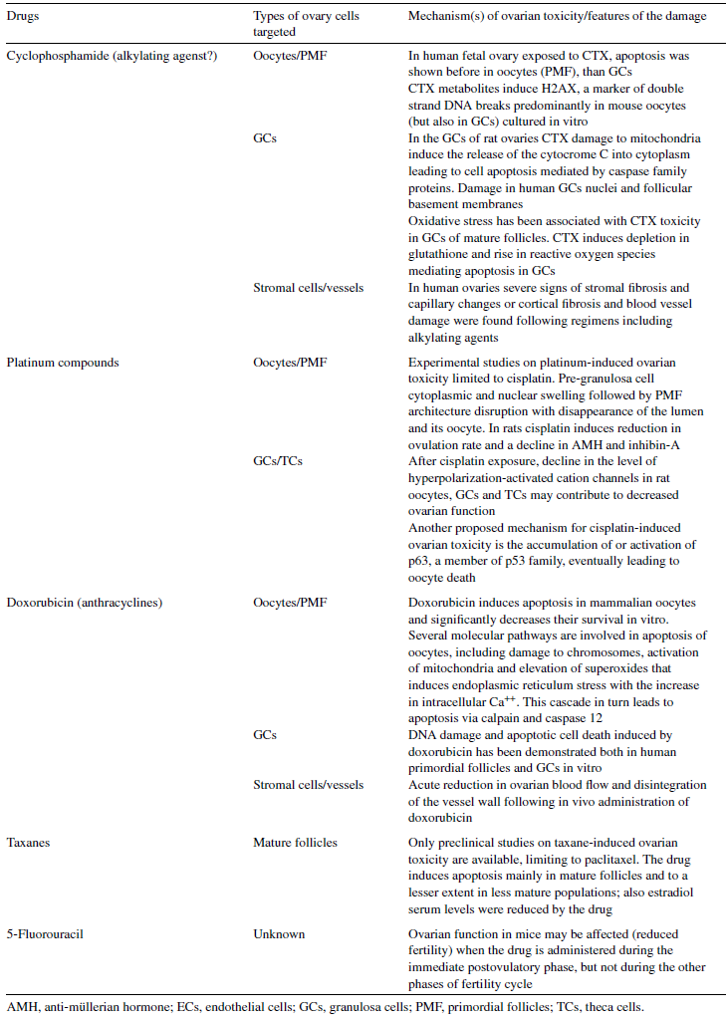
Torino et al. Article in press. Critical Reviews in Oncology/Hematology

Slide 59
KT-gonadal hasar
Kemoterapi sonrası AMH düzeyleri düşüyor
‘Kemoterapi sonrası over yaşı yaklaşık 10 yıl ileride’
Elgindy EA, El-Haieg DO, Khorshid OM et al. Gonadatrophin suppression to prevent chemotherapy-induced ovarian damage: a randomized controlled trial. Obstet Gynecol 2013; 121: 78–86
Leonard RC, Adamson D, Bertelli G et al. The relative value of anti-Mullerian hormone to predict menopause in patients receiving adjuvant chemotherapy for breast cancer: results from the OPTION trial. J Clin Oncol 2012; 30(15s); Abstr 1094
Giraudi S, Marroni P, Boni L et al. Anti-mullerian hormone (AMH) and ovarian function in young breast cancer (BC) women receiving adjuvant chemotherapy (CT). J Clin Oncol 2009; 27(suppl); Abstr e11544.
Gracia CR, Sammel MD, Freeman E et al. Impact of cancer therapies on ovarian reserve. Fertil Steril 2012;
97:134 –140.e1.

Slide 60
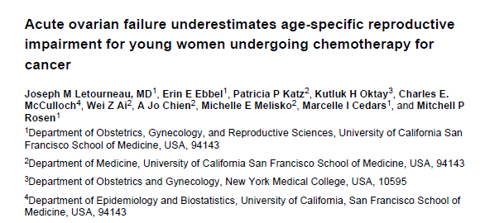
Cancer 2012
1993-2007 yılları arasında,18-40 yaş aralığında tanı konup, yalnız KT alan n=620 olgu
2010 yılında retrospektif değerlendirme
% Akut ovaryan kayıp
Lösemi | %3
GIS | %5
Hodgkin L. | %8
Meme | %9
Non-Hodgkin L. | %10
Notes:
Background—We sought to describe the age-specific impact of infertility and early menopause
after chemotherapy, among reproductive age women with cancer.
Methods—1041 women diagnosed with cancer between the ages of 18 and 40 responded to
retrospective survey on reproductive health history. Five cancer types were included: leukemia,
Hodgkin’s disease (HD), non-Hodgkin lymphoma (NHL), breast cancer, and gastrointestinal
cancer (GI). Survey questions addressed: AOF (cessation of menses after treatment), early
menopause (menopause prior to 45 years old) and infertility (failed conception). Logistic
regression was used to determine the proportions of AOF and infertility based on age at diagnosis.
Censored data methods were used to determine the probability of early menopause.
Results—620 women received chemotherapy alone. The percentage reporting AOF was 8%,
10%, 9%, and 5% for HD, NHL, breast cancer, and GI, respectively. AOF increased significantly
with age at diagnosis (p<0.05). If not in AOF, the incidence of infertility was at least 40% at age
35 and increased significantly with age at diagnosis in HD and breast cancer (p<0.05). The
estimated probability of early menopause was at least 25% at age 30 and increased significantly
with younger age at diagnosis in HD, NHL, and GI (p<0.05).
Conclusions—In order to give patients appropriate counseling, it is important that they
understand the potential increased risk of infertility and early menopause beyond that of acute
ovarian failure. These findings can provide improved, age-specific counseling regarding
reproductive impairment for young women diagnosed with cancer.
Correspondence

Slide 61
Ortalama infertilite %
Lösemi | 20
Hodgkin L. | 18
Non-Hodgkin L. | 15
Meme | 27
GIS | 23

Slide 62
RT-gonadal hasar
Her iki cinste gonadlar RT’ye hassas
RT dozu/şeması/uygulama alanı
KIT öncesi total vücud ışınlamasında gonad kayıp riski çok yüksek
Erişkinde testiküler RT dozu>2.5 Gy, prepubertal dönemde >6 Gy de uzamış azospermi
Dişide gonadal bölgeye uygulanan 2 Gy doz primordial folikül havuzunda %50 azalma (LSD50)

Slide 63
RT-gonadal hasar
Dişide POY’a neden olacak RT dozları;
yenidoğan 20 Gy
10 yaşında 18 Gy
20 yaşında 16.5 Gy
30 yaşında 14.3 Gy
Over transpozisyonu standart bir yaklaşım
Uterusun 20-30 Gy radyasyona maruziyeti gebelik komplikasyonlarıyla ilişkili

Slide 64
RT gonadal hasar
20 yaşında pelvise 3 Gy radyasyon maruziyeti, ortalama menapoz yaşı 35 yaş
Wallace WH, Thomson AB, Saran F, et al. Predicting age of ovarian failure after radiation to a field that includes the ovaries. Int J Radiat Oncol Biol Phys. 2005;62(3):738-744.

Slide 65
Male infertilite
Alkilizan ajanlar, platinium bazlı ajanlar, RT spermler üzerine toksik
Siklofosfamid <4 g/m2’de spermatogenezde etkilenme düşük ancak her 1g/m2 doz artışında azospermi ve oligospermi riskleri %22-%14 artıyor
Male kanser survivorları kardeşlerine göre %50 daha az ihtimalle baba oluyorlar, bu risk testis>7.5 Gy RT veya yüksek doz alkilizan ajan alanlarda en yüksek
Green DM, Liu W, Kutteh WH, et al. Cumulative alkylating agent exposure and semen parameters in adult survivors of childhood cancer: a report from the St Jude Lifetime Cohort Study. Lancet Oncol. 2014;15(11):1215-1223.
Green DM, Kawashima T, Stovall M, et al. Fertility of male survivors of childhood cancer: a report from the Childhood Cancer Survivor Study. J Clin Oncol. 2010;28(2):332-339.

Slide 66
FP-Başlangıç üreme potansiyelinin değerlendirilmesi
Yaş
FSH, E2
AMH
Inhibin B
AFC

Slide 67
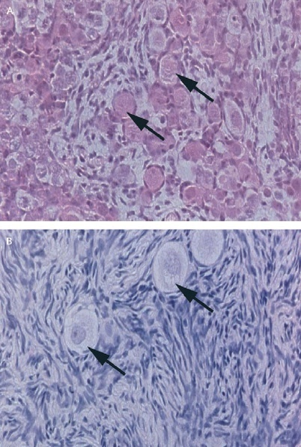
Over primordial folliküller
Fetal primordial folliküller
23 yaş primordial folliküller
W Hamish B Wallace, Richard A Anderson, D Stewart Irvine. Lancet Oncol 2005; 6: 209–18
Notes:
Lancet 2 breast. Primordial folliküller1. mayozun profazında arrest olmuş oositleri içeriyorlar.

Slide 68
Natural Decline of Oocytes with Age
(Lobo, NEJM 2005)

Slide 69
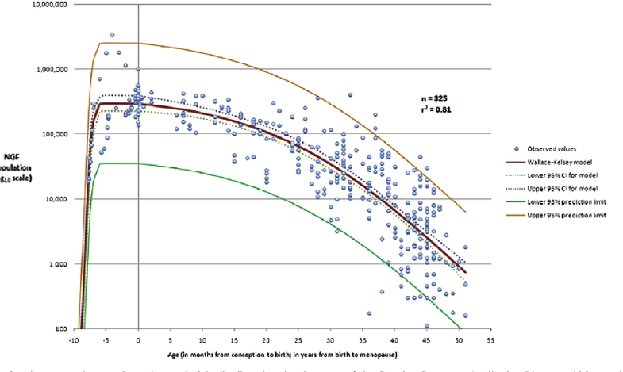
Wallace WHB, Kelsey TW (2010) Human Ovarian Reserve from Conception to the Menopause. PLoS ONE 5(1): e8772. doi:10.1371/journal.pone.0008772
http://www.plosone.org/article/info:doi/10.1371/journal.pone.0008772
Notes:
Wallace WHB, Kelsey TW. Human ovarian reserve from conception to the menopause. PLoS ONE 5(1):e8772.
Women are born with a set number of oocytes according to the current understanding, and this reserve of oocytes is continually depleted with age. The
rate of depletion appears to accelerate after the age of 37 years [18]; mirroring this change, pregnancy rates and assisted reproduction
success rates also decline more sharply past the age of 37 years. Fertility is significantly diminished in the early 40s and is practically abolished by the age of 46 years.

Slide 70
Fertilite Prezervasyonu
Fertilite prezervasyonu multidisipliner yaklaşım gerektirir
Yaklaşımlar bireye özgüdür

Slide 71
Fertilite Prezervasyonu
The American Society for Reproductive Medicine, 2004
Fertility Preservation Special Interest Group
NICHD, 2005
Fertility preservation research section
ASCO Recommendations on Fertility Preservation in Cancer Patients, 2006,2013
ESHRE Task Force Fertility Preservation in severe disease,2006
European Society of Breast Cancer Specialists recommentations, 2012

Slide 72
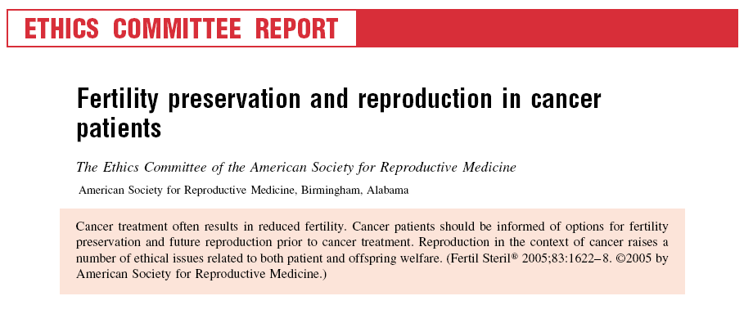
Fr
Fertility Preservation Special Interest Group (Established 2004)
The Fertility Preservation Special Interest Group promotes knowledge among health care workers and the public on infertility induced by cancer therapy and other medical treatments through national and international collaboration among Reproductive Specialists, Oncologists, and Allied Health Workers to promote research, education and to develop new strategies of fertility preservation.
Notes:
72

Slide 75
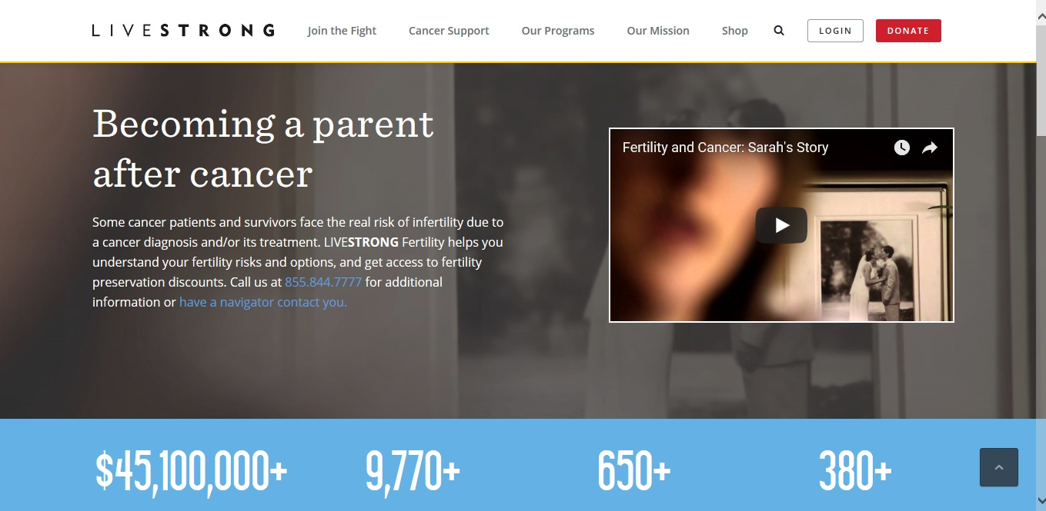

Slide 76
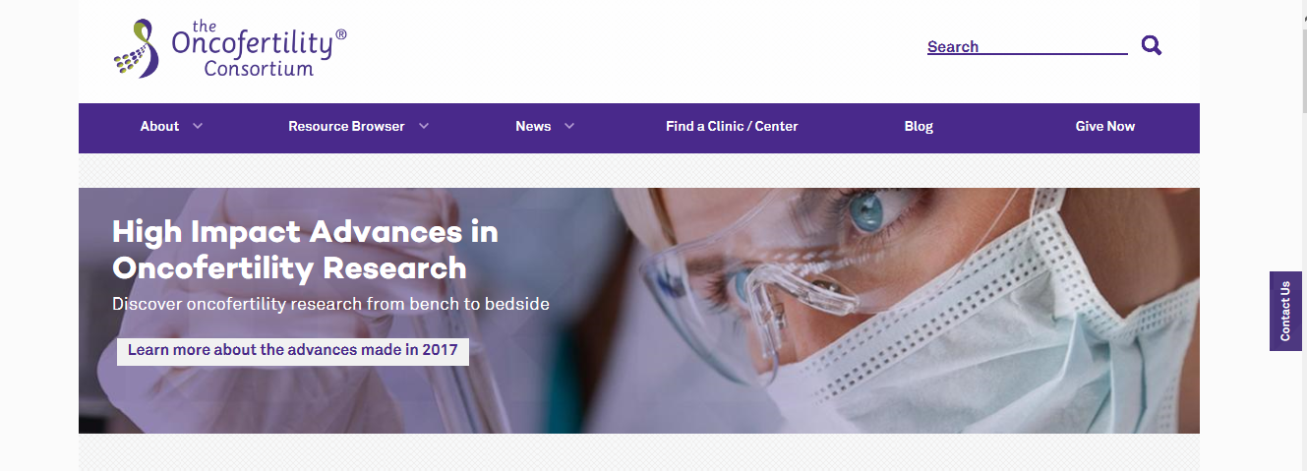
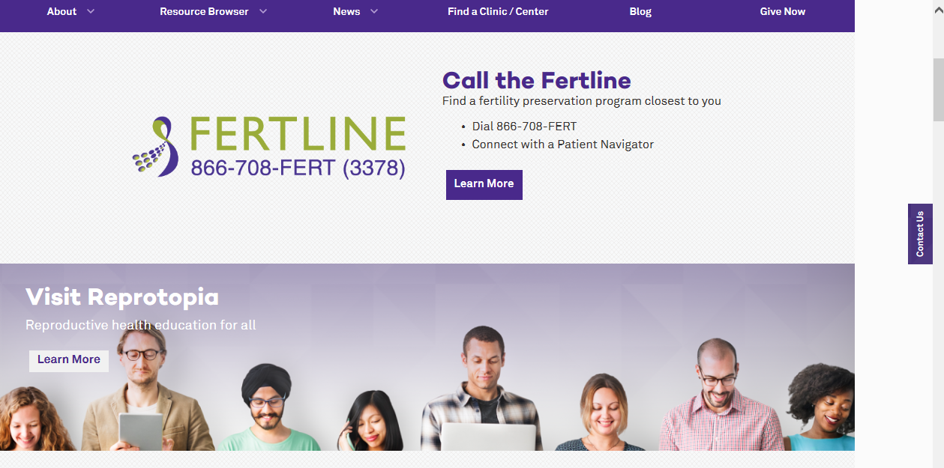

Slide 77
Notes:
ChairmanProf. Dr. med. Michael von Wolff. Vice-Chairman Prof. Dr. Ralf Dittrich. Centres from Germany, Austria and Switzerland have currently joined the network.

Slide 78
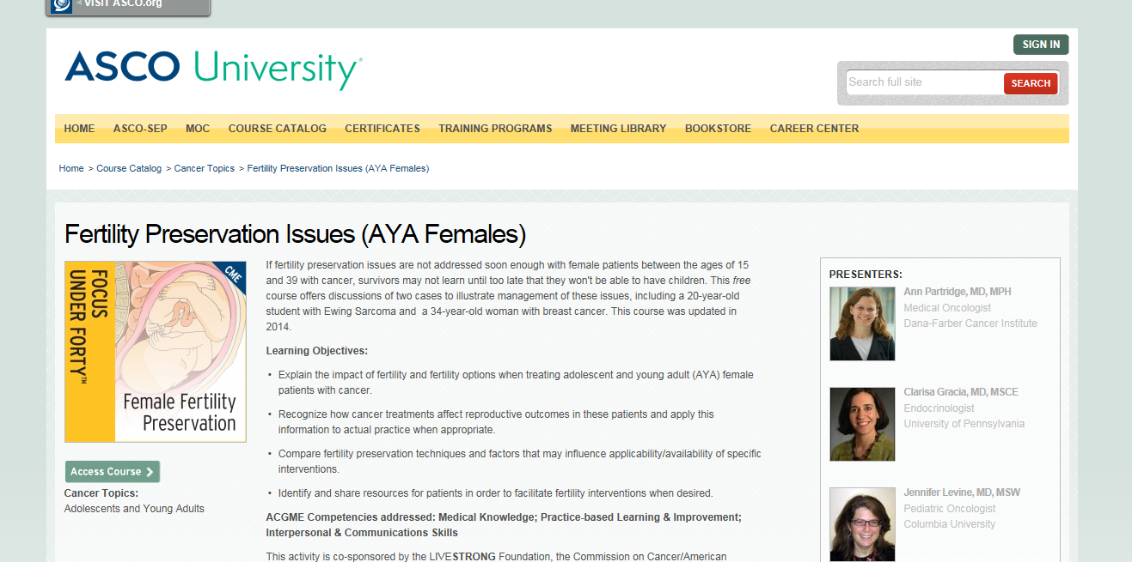

Slide 79
Fertilite prezervasyonu yöntemleri
Hastanın yaşı
Uygulanması planlanan tedaviler
Elde olunan zaman
Partner durumu ve
Overlere potansiyel kanser metastazı durumuna
göre seçilmektedir
Lee SJ, Schover LR, Partridge AH, Patrizio P, Wallace WH, Hagerty K, Beck LN, Brennan LV, Oktay K (2006).
American Society of Clinical Oncology recommendations on fertility preservation in cancer patients.J Clin. Oncology 24,2917-2931

Slide 80
Fertilite prezervasyonu
Embryo cryopreservation standard
Oocyte cryopreservation standard
Ovarian cryopreservation experimental
Ovarian transposition standard

Slide 81
American Society of Clinical Oncology Recommendations on Fertility Preservation in People Treated for Cancer
Assessment of risk for infertility
Communication with patient
Patient at risk for treatment-induced infertility
Patient interested in fertility preservation options
Refer to specialist with expertise in fertility preservation methods
Eligible for proven fertility preservation method
Eligible for proven fertility preservation method
Investigational fertility
Investigational fertility
preservation technique*
preservation technique
Male:
Female:
•
•
Cryopreservation
Cryopreservation
of
of
sperm
sperm
cryopreservation
embryo
embryo or oocyte cryopreservarion
testicular or ovarian tissue
testicular or ovarian tissue
conservative gynecologic surgery
•others
conservative gynecologic surgery
www.asco.org (Loren et al., J Clin Onc; 2013)

Slide 82
Ege Üniv- Onkolojik tedaviler öncesinde FP uygulanan female hastalar

Slide 83
Onkofertilite-FP uygulaması yapılan n=72 hasta
Endikasyon | Hasta sayısı (n) | Oosit cryo (n) | Embryo cryo (n) | Oosit+embryo cryo (n)
Meme ca | 40 | 24 | 12 | 4
Hodgkin Lenfoma | 14 | 8 | 4 | 2
Non Hodgkin L.(NHL) | 1 | 1 | - | -
Osteosarkom | 4 | - | 3 | 2
Kondrosarkom | 3 | 3 | - | -
Medulloblastoma | 2 | 1 | - | 1
Disgerminoma | 2 | 2 | - | -
İmmatür teratom | 1 | 1 | - | -
Endometrioid over ca | 1 | - | - | 1
Nazofarinks ca | 1 | 1 | - | -
Tiroid ca | 2 | 1 | 1
Progressiv MS (mitoxantrone ted) | 1 | - | 6 | -

Slide 85
Teşekkürler,,,

