Slide 1

The experience of Cervical Cancer
screening program
in Kazakhstan
Dilyara Kaidarova, MD, PhD, Professor
President of the Kazakh Cancer Society,
Director of KazIOR
Notes:
Good Morning Dear Chairman and Colleagues!
First of all, I want to thank the Turkish society of Obstetrics and of Gynecology for the invitation to be part of the congress and the opportunity to make a presentation
I am honored to present a report: The experience of Cervical Cancer screening program in Kazakhstan

Slide 2
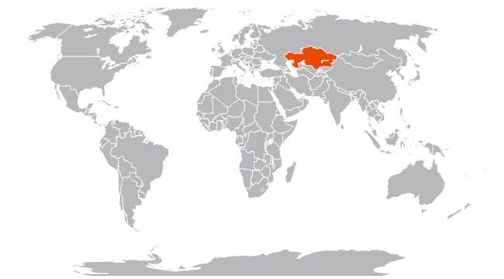


Quick facts about Kazakhstan
Territory 2 724,900 square kilometers
Population 18 146 156 people (2017)
Location: Eurasia
Average life expectancy 72 year (2017)
Borders: China, Kyrgyzstan, Russia, Turkmenistan, Uzbekistan
131 ethnic groups, 46 religions
Notes:
Kazakhstan is located in the centre of the Eurasia. In terms of territory Kazakhstan is on the ninth place in the world.
Kazakhstan has more than 18 million people and includes 131 ethnicities
Health policy focuses on primary care, prevention, quality of care, health promotion and access to care for everyone.

Slide 3

Kazakhstan Cancer Morbidity and Mortality Data
1999-2017
270,5
per 100 000
Mortality
211,0
per 100 000
1st place: Lung cancer
Notes:
Here are the main statistical data on cancer situation in our country. As you can see cancer morbidity is increasing every year and for 2017 there were about 35 thousand new cases.
However, the incidence rate in Kazakhstan is a little bit lower than that of OECD countries.
Breast cancer is on the first place in cancer morbidity, and the main cause of death is lung cancer.
As you can see, mortality is gradually decreasing. In 2017 we started to change the methodology of data gathering together with IARC
After changing the methodology we see decreasing in morbidity by 67%

Slide 4
Cancer Incidence and Mortality in Kazakhstan for 2017, %
Notes:
Here are the main statistical data on cancer situation in our country. More than 34 thousand cases were registered in Kazakhstan in 2017.
Cervical cancer is in the second place in women cancers after breast cancer with an incidence rate of 19.6 per 100,000 female population and mortality rate is 6.3 per 100,000 female population

Slide 5
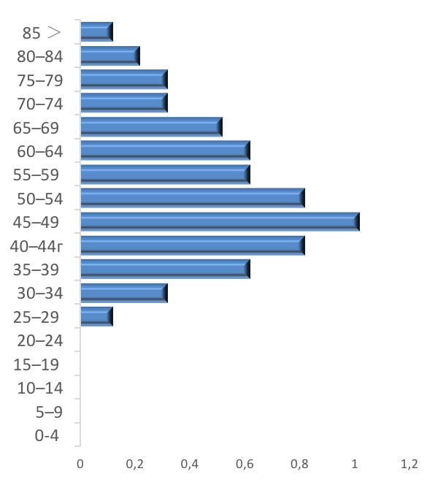
Mortality of Women in Fertile Age in
Kazakhstan, 2017
CERVICAL CANCER
ALL CANCERS
Half of women with cervical cancer are dying in fertile age
23% of women with all types of cancer are die in fertile age
Notes:
You can see that 23% of fertile age women with cancer die.
More than 600 women with cervical cancer die each year and 45% of them are women of fertile age

Slide 6






SCREENING PROGRAMMS IN KAZAKHSTAN
History
Current programs
2013-2017
Endoscopy
50-60 years every 2 years
Since 2008
PAP smear
30-70 years every 4 years
2013-2017
PCA
50-66 years every 4 years
Since 2011
Hemoccult-test
50-70 years every 2 years
2013-2017
AFP+UltraSound
Patients with Liver Cirrhosis every 2 years
Since 2008
Mammography
40-70 years every 2 years
Notes:
There were 6 screening programs in Kazakhstan until 2018
10-years experience of screenings shows that our results are not as good as the OECD results.
That is why a new optimized screening program, based on recommendations of WHO IMPACT MISSION experts is being currently introduced in Kazakhstan.
Today we have 3 screening programs of cervical, breast and colorectal cancer

Slide 7

Historical overview Cervical Cancer Screening in Kazakhstan
Started among women aged 35-60, every 5 years, PAP-test
Expansion of age groups to 30-60.
Interpretation by Bethesda system
Development of National cancer guidelines
2008
2011
2011
2012
Switching to liquid-based cytology (LBC)
Expanding age to 30-70 years and period of screening to 4 year
Introducing HPV screening for cervical cancer
2013-2014
2018
2019-2020
Notes:
As you can see on this slide, we start our Cervical cancer screening program in 2008 among women aged 35-60 with period of screening of 5 years.
In 2011 we expanded women age group to 30-60
in 2012 developed National cancer guidelines.
In 2013-2014 we switched from conventional PAP smear to liquid-based cytology (LBC) and for now we have expanded target age to 30-70 years with 4-years interval of screening.
Now we are on the way to implementing pilot program of HPV screening

Slide 8
Cervical Cancer in Kazakhstan before screening
Age-related incidence rate as per 100,000 women of corresponding age group, average from 2004-2008
Notes:
The incidence of cervical cancer before the introduction of the screening program was relatively stable and was 15.3 per 100,000 women in 2008.
As you can see there is an increase in the detection of cervical cancer at a young age and with highest rate in 55-59 and 65-69 years
Nevertheless, the pre-screening period was characterized by improvement in the registration of patients with the first stage from 67.2% in 2004 to 73.6% in 2007

Slide 9
Cytological screening coverage
Coverage, in absolute numbers
Coverage by the Population Registry, %
Coverage by regions in 2016, %
Notes:
Here are main cytological screening results for 9 years. As you can see coverage by screening is decreased every year from 72.9% in 2008 to 45.9% in 2016
Now we have regions in Kazakhstan with low coverage rate
The low coverage of screening is associated with a decrease in funding for screening programs

Slide 10
Screening results
Cancer and Pre-cancer Detection
Cervical Cancer Incidences in absolute numbers
Proportion of screen-detected cancers that are stage I, %
CC detection: % of examined women
Pre-cancer detection (ASC-H + HSIL): % of examined women
Notes:
Cervical cancer screening has been characterized by some success since the introduction
Here Is an increase in the detection of cervical cancer in the first stage and an increase in the detection of pre-invasive pathology
The purpose of screening is to detect preinvasive pathology, but 9 years of Cervical cancer screening experience have shown a low detection of preinvasive pathology.

Slide 11
Cervical Cancer in Kazakhstan
Early detection
(I and II stages) – 84,8% (2017)
2017:
Number of СС patients – 1827
through self initiated visits to cancer clinics – 1102 (60,3%)
through medical examination visits – 527 (28,8%)
through screening program – 198 (10,8%)
Notes:
As you can see on this slide Cervical cancer Incidence is increasing every year.
In 2017 is 17.9 per 100 thousand women in Kazakhstan. Growth rate is 11% over 10 years
Mortality rate from cervical cancer remain stably high
This slide shows that the total number of Cervical cancer patients according to Cancer Registry is more than one thousand eight hundred women.
As you can see from the diagram, more than 60% of patients are being detected during visits to doctors with visible signs of the disease, while 40% detected through screenings and medical examinations.
With this in mind, we increased the role of primary care institutions in early detection by we improved the equipment of examination rooms with colposcopes, ultrasound devices, training of nurses for smear taking. Bonus system of reward for early detection of cancer. Analysis of advanced cases of cervical cancer

Slide 12
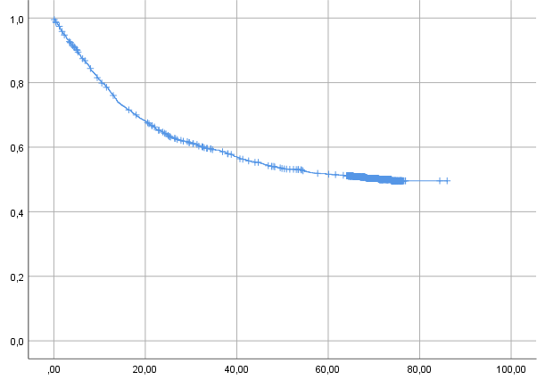

5-year survival among cancer patients
Cervical Cancer– 88,9%
2007
45,8%
2017
52.5%
Cervical Cancer – 52,5%
months
5-year survival | 95% CI
52.505 | 50.7-52.2
Notes:
The 5-year survival rate in Kazakhstan is 52.5%
This indicator is low in comparison with the developed countries despite the improvement in treatment approaches
our 10-years experience of screenings shows that results are not as good as the OECD results and require improvement in approaches to early detection

Slide 13

Cervical cancer screening problems
Poor-quality sampling and conservation of biomaterial
Violations in the screening algorithm
Delayed delivery of consumables for screening
Inadequate software
High level of cervical cancer detection
Notes:
We have several problems in screening program of CC:
poor-quality sampling and conservation of biomaterial - poor-quality stabilizing solution. We have a tender system for selecting a company that serves screening. The company that provided the services for a low price wins the state order for screening. In this case, we stalked with an unscrupulous company supplying invalid solutions for liquid based cytology
Violations in the screening algorithm – due to low qualification of gynecologists and cytologists
Delayed delivery of consumables for screening- due to the fact that unscrupulous companies are engaged in the delivery of consumables
Inadequate support for screening by software – here are the problems with creation of the target group, invitation of women, there is no integration with the Registry of the attached population, dispensary and National Cancer Registry
There is a high level of cervical cancer detection by screening and a high incidence of cervical cancer due to lack of non-treatment and a large screening interval.

Slide 14


ImPACT Mission (November, 2016)
The program was initiated by the Ministry of Health of the Republic of Kazakhstan
THE MINISTRY OF HEALTHCARE OF THE REPUBLIC OF KAZAKHSTAN
Strengthening of monitoring for patient with precancerous pathology.
Implementation of HPV screening
Increasing of coverage
Notes:
Ministry of Health of the Republic of Kazakhstan initiated ImPACT Mission in November, 2016
We started from Strengthening of monitoring for patient with precancerous pathology
And we are on the way of introduction HPV screening in KZ

Slide 15
THE MINISTRY OF HEALTHCARE OF THE REPUBLIC OF KAZAKHSTAN
RECOMMENDATIONS
Expanding of target age
PAP smear+ LBC
Software improvement
Notes:
During the conference, the experts of IGCS analyzed the existing screening and made recommendations for improvement.
It was recommended to expand the range of the target group and reduce the interval, conduction of conventional PAP smear and liquid based cytology

Slide 16
Results of ImPACT Mission in 2018
COVERAGE
Age expansion
30-70 years
Interval reduction to 4 years
Precancerous pathology
TRAINING of CYTOLOGISTS AND GYNECOLOGISTS
CONTROL BY KAZIOR
HPV screening
PILOT project
2019-2020
TURKISH MODEL OF HPV SCREENING
Notes:
Here are first results of new optimized screening program, based on recommendations of WHO IMPACT MISSION experts
In 2018 we expanded of target age to 30-70 years and reduced interval
We started training program of cytologists and gynecologists by Kazakh Institute of oncology
Now we are on the way of HPV Screening Implementations
During the last month the Minister of Health of Kazakhstan instructed to work on the implementation of HPV screening. at the moment we are working closely with Turkish specialists on the introduction of HPV screening based on the experience of HPV screening in Turkey

Slide 17


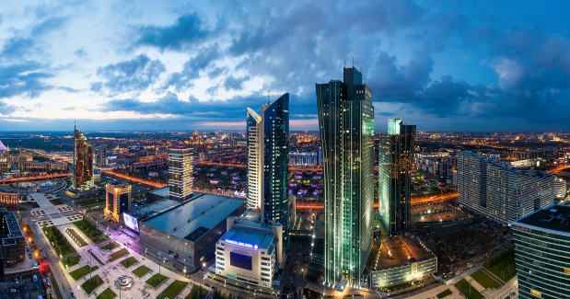


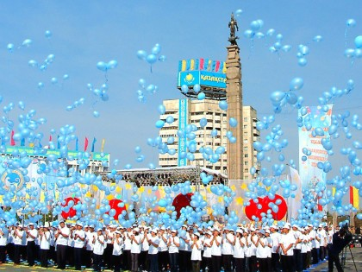





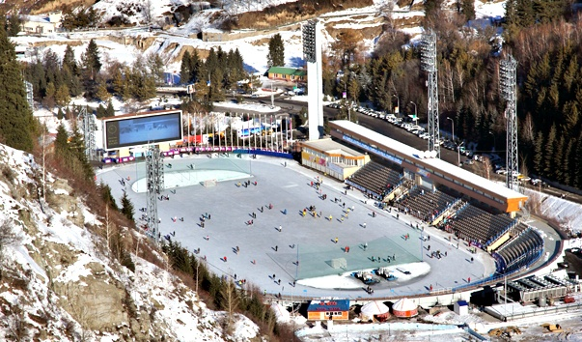

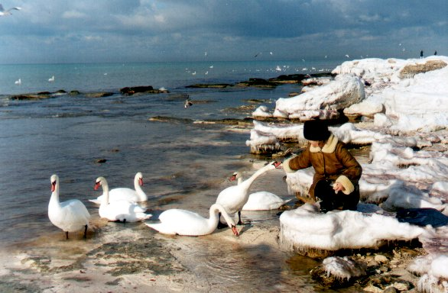
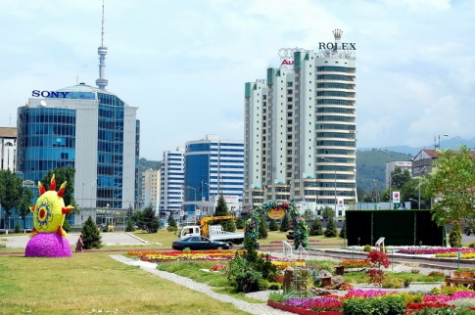
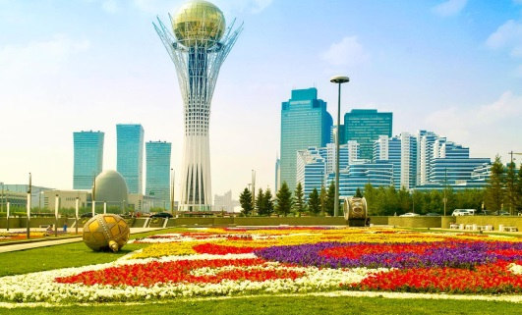



THANK YOU
Notes:
I would like to thanks you for the attention and welcome you in our beautiful country, Kazakhstan.

