Slide 1
FERTILITY SPARING IN OVARIAN CANCER
Çetin ÇELİK MD.
SELÇUK UNIVERSITY FACULTY OF MEDICINE
DEPARTMENT OF OBSTETRICS AND GYNECOLOGY
GYNECOLOGYC ONCOLOGY DIVISION
KONYA/TURKEY
25. Eurepean Congress of Obstetrics and Gyneacology
15. Congress of TJOD 17-21 May 2017 Belek Antalya

Slide 2
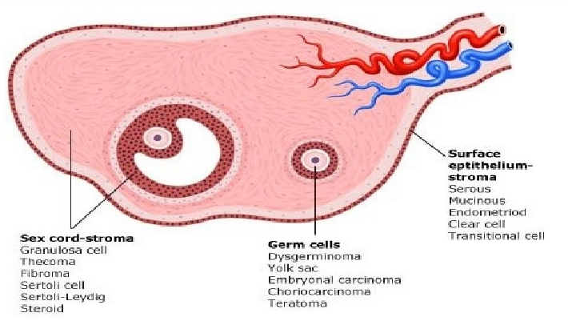
OVARIAN CANCER
Ovarian cancer is the most lethal gynecologic cancer
Most of ovarian cancer is epithelial ovarian cancer (EOC)
3–14% EOC is diagnosed less than 40 years old
These are mainly borderline ovarian tumors (BOT)
Frankly malignant epithelial ovarian tumors are rare
Less than 1% of ovarian cancer is pediatric or adolescent tumors
Their histologic profile differs from in the adult population
The vast majority of ovarian tumors are germ cell origin

Slide 3
OVARIAN CANCER TREATMENT
Treatment of gynecologic cancer involves
Surgery
Comprehensive staging
Hysterectomy and bilateral salpingooophorectomy
Peritoneal washings
Biopsy of all suspicious lesions
Omentectomy
Lymphadenectomy
Appendektomi (Müsinöz tm)
Chemotherapy
Pelvic radiation ?

Slide 4
PROBLEMS OF OVARIAN CANCER TREATMENT SURGERY
Detrimental of reproductive potential
Early menopause
Affect sexual function- psychological state
Increased risk of cardiovascular diseases
Osteoporosis
Neurological impairment

Slide 5
PROBLEMS OF OVARIAN CANCER THERAPY CHEMOTHERAPY
Chemotherapeutic agents are gonadotoxic
These gonadotoxity depends on
Age
Action mechanism
Treatment dose and length
Alkylating agents are highest risk for gonadotoxicity
Platinum agents, taxanes, and anthracyclines are an intermediate risk for gonadotoxicity
Ovarian suppression with a GnRH agonist is not well demostrated to reduce the risk of premature ovarian failure

Slide 6
PROBLEMS OF OVARIAN CANCER TREATMENT RADIATION
Abdominal and pelvic radiation may lead to oocyte atresia
Radiation effect on the ovary depend on:
Age
Dose
The size of the radiation field
The number and magnitude of fractions

Slide 7
FERTILITY SPARING SURGERY (FSS)
FSS is a conservative surgical treatment
The preservation of the uterus and the contra-lateral ovary
Endometrial sampling should be considered endometrioid tumors and granuloza cell tm
Appendectomy is recommended in mucinous tumour

Slide 8
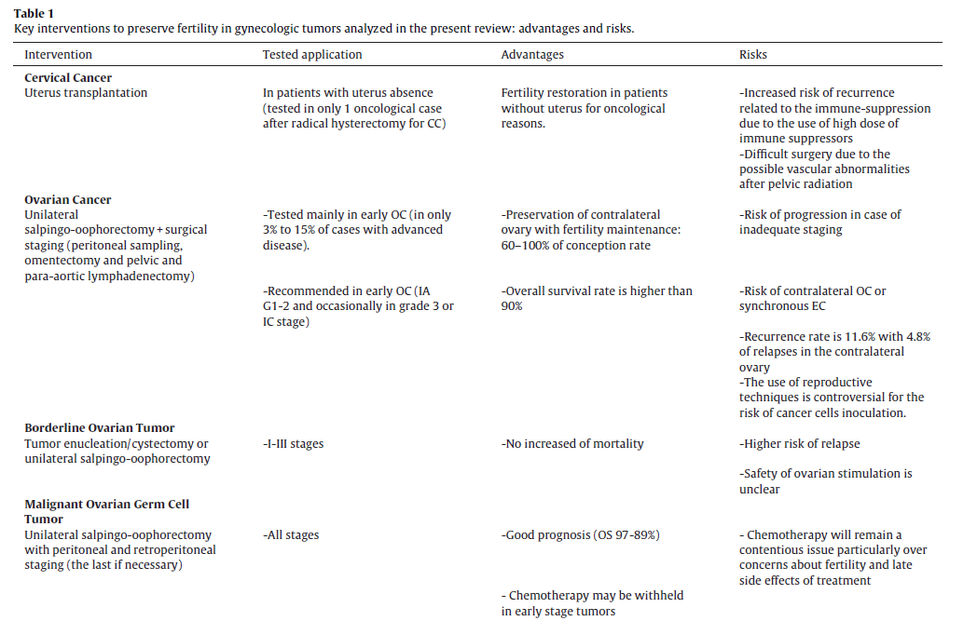

Slide 9
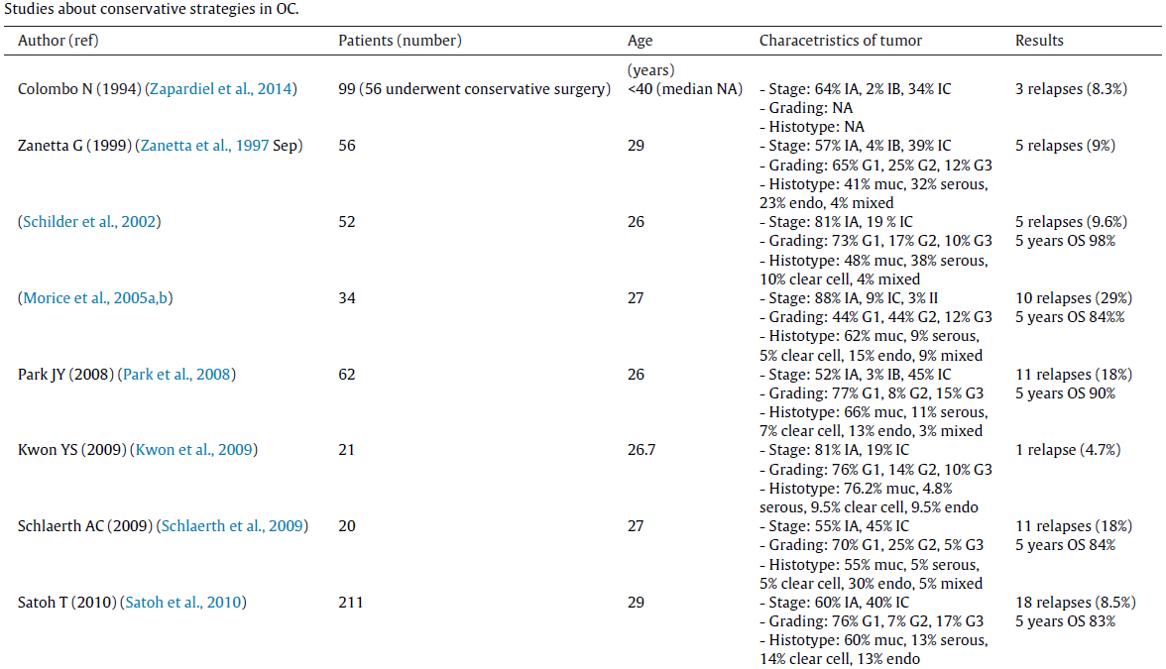

Slide 10
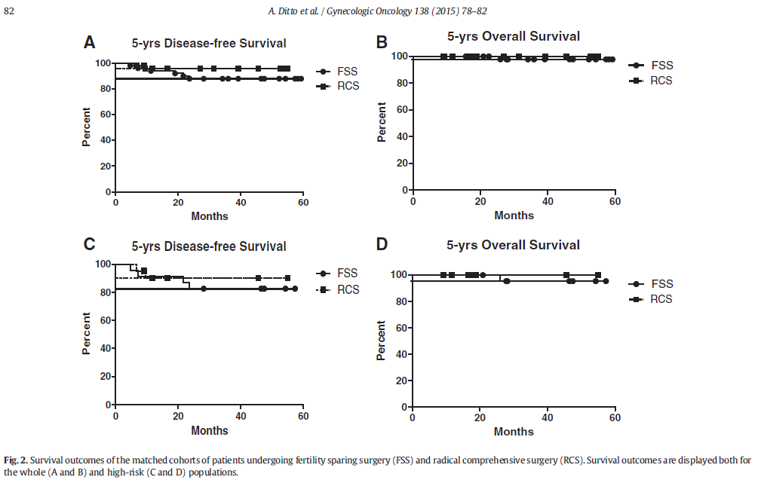
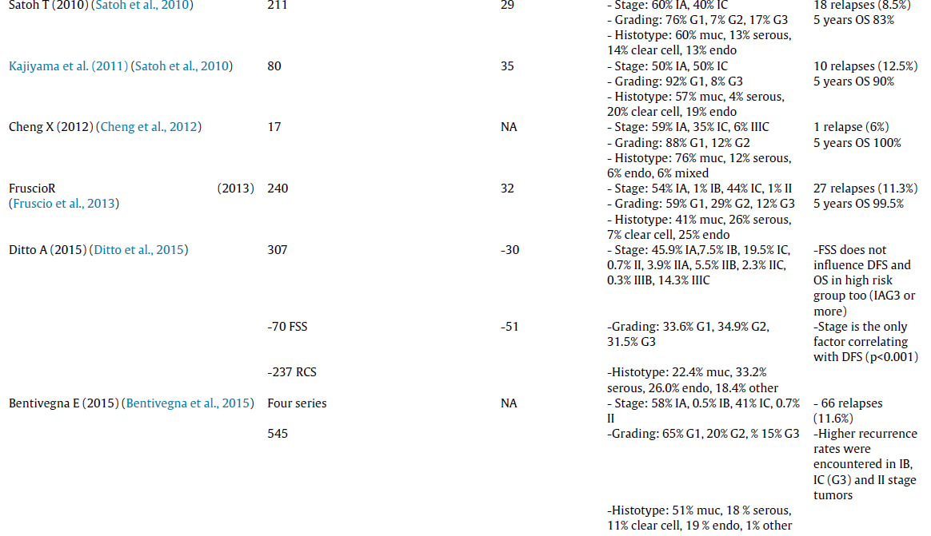

Slide 11
FERTILITY SPARING SURGERY
Crucial to patient selection for FSS
Disease stage
Stage IA
Stage IC ?
Histologic data
Tumour type
Clear Cell ?
Grade
Grade 1-2
Grade 3 ?
Age <39 year old

Slide 12
FERTILITY SPARING SURGERY
Grade 3 and stage IC were important prognostic factors
FSS did not effect the 5-year survival
84–99.5%
Recurrence rate
8.5–11.3%
4.8% recurrence occurred on the contralateral ovary
FSS does not worsen the prognosis of these patients
Tomao F. Critical Reviews in Oncology/Hematology. 2016

Slide 13
FERTILITY SPARING SURGERY
FSS for stage IC disease
Recurrence rate is acceptable for stage IC1
Half of these recurrences were isolated on the remaining ovary
Recurrence rates are higher (23%) in stages I C2+I C3 disease

Slide 14
FERTILITY SPARING SURGERY
FSS for stage I clear-cell histology
17% recurrence rate
Clear-cell tumours had developed a recurrence very early
Within the ﬁrst 2 years after the initial treatment
Recurrence is extra-ovarian and lethal
DFS and OS were not demonstrated any difference for clear-cell tumour with FSS
Park JY. Int J Gynaecol Obstet 2016

Slide 15
FERTILITY SPARING SURGERY
Stage II and III disease
38% recurrence
It is unsafe to use FSS in stage II and III EOC

Slide 16
FERTILITY SPARING SURGERY Bentivegna E. Annals of Oncology 2016
1150 patients who had undergone FSS
12% recurrence
10% recurrence for stage IA
7% stage IA grade 1
11% stage IA grade 2
29% stage IA grade 3
16% recurrence for stage IC
11% recurrens stage IC grade 1-2
23% stage IC grade 3 disease
37% isolated ovarian tumour
63% extraoverian
38% recurrence for stage II-III

Slide 17
FERTILITY SPARING SURGERY Bentivegna E. Annals of Oncology 2016
Recurrence rate according to tumour histology
10% mucinous tumours
15% Serous
13% endometrioid
22% clear-cell tumours
87% extra-ovarian recurrence
13% ovarian recurrence

Slide 18
BORDERLINE TUMORS FERTILITY PRESERVATION
The disease has a good prognosis
Stage I five-year survival is 99 %
USO to be an option for women with unilateral disease
Even when diagnosed at an advanced stage
With a high recurrence rate but limited mortality
Recurrence after conservative surgery 7 to 30 %
Recurrences typically show borderline histology, not invasive carcinoma

Slide 19
BORDERLINE TUMORS FERTILITY PRESERVATION
Stage I ovarian borderline tumors treated with either USO or ovarian cystectomy
Borderline recurrence rate was 13 %
For USO, 7% recurrence
For cystectomy, 23%
Death rate was 0.5 percent
If no malignant disease is present, borderline recurrences are not associated with mortality
After a recurrence, the uterus and one ovary or part of an ovary may be conserved to retain fertility
Patients with stage I to III disease tumor recurrence rates after
TAH-BSO 6%
Adnexectomy 15 %
Cystectomy %36
Women with stage II to IV serous borderline tumors, 6% reports of invasive recurrences.

Slide 20
FSS- LAPAROSCOPY
Laparoscopy has been demonstrated a feasible technique, but:
To avoid spillage
Rupture
Morcellation of the ovarian cyst,
Tumors greater than 10 cm are probably correlated with higher risk of rupture and spillage
That may occur in 88% vs 9% when comparing laparoscopy to laparotomy
Control-randomized trials are not feasible, evidence for FSS and minimally invasive options derives only from case-series
Tomao F. Critical Reviews in Oncology/Hematology. 2016
F. Ghezzi. Gynecol. Oncol. 2016

Slide 21
FERTILITY SPARING SURGERY FERTILITY OUTCOME
Conception rate higher than 60% (63–100% )
Chemotherapy did not affect
Fertility
Obstetrical outcome
Congenital abnormalities
BOT spontaneous pregnancy rate of 54%
With a low risk of lethal recurrence
In patients with advanced stage BOT
The spontaneous pregnancy rate is lower 34%
Risk of lethal recurrence increased 2%
Tomao F. Critical Reviews in Oncology/Hematology. 2016

Slide 22
FERTILITY SPARING MANAGEMENT FOLLOW-UP
Other associated risks for FSM
Development of a second primary malignancy
2.9% of those with EOC developed a second primary tumor because of
Adjuvant chemotherapy
Specific genetic predisposition in young patients
Adolescents with EOC should be offered genetic testing and counseling

Slide 23
FERTILITY SPARING MANAGEMENT FOLLOW-UP
Clinical examination, tumour markers and ultrasound is the most effective techniques for the follow-up
The optimal interval and length of follow-up is not clearly defined
Especially when FSS has been performed, but should be prolonged since
Recurrence has been observed even 10 years after primary treatment

Slide 24
OVARIAN GERM CELL TUMORS-TREATMENT
Comprehensive surgical staging (CSS) should be performed
Lymphadenectomy is crucial to follow up patients without adjuvant chemotherapy in stage I MOGCTs
Lymph node metastasis was present in 28 % of dysgerminoma and 24 % of non-dysgerminoma
These tumors are chemosensitive
Cure can be achieved also in advanced cases
Initial surgery followed by platinum-based combination chemotherapy
Except for stage IA dysgerminoma and stage I immature teratoma

Slide 25
FERTILITY PRESERVATION FOR PATIENTS WITH OVARIAN GERM CELL TUMORS
A 5-year overall survival rates
95.6% in stage I
73.2% advanced stages
Bilateral ovarian involvement
4.3 to 6.9 %
10 to 15 % in dysgerminoma
If the contralateral ovary appears grossly normal
Biopsy of the contralateral ovary could be avoided

Slide 26
FERTILITY PRESERVATION FOR PATIENTS WITH OVARIAN GERM CELL TUMORS
NACT followed by interval FSS may be a reasonable option in patients with extensive disease
When initial debulking is not an option
NACT with PEB regimen followed by FSS
These FSS are not the standard management

Slide 27
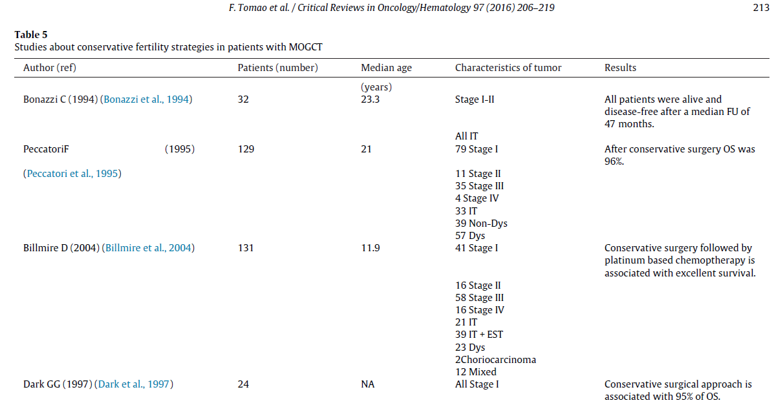

Slide 28
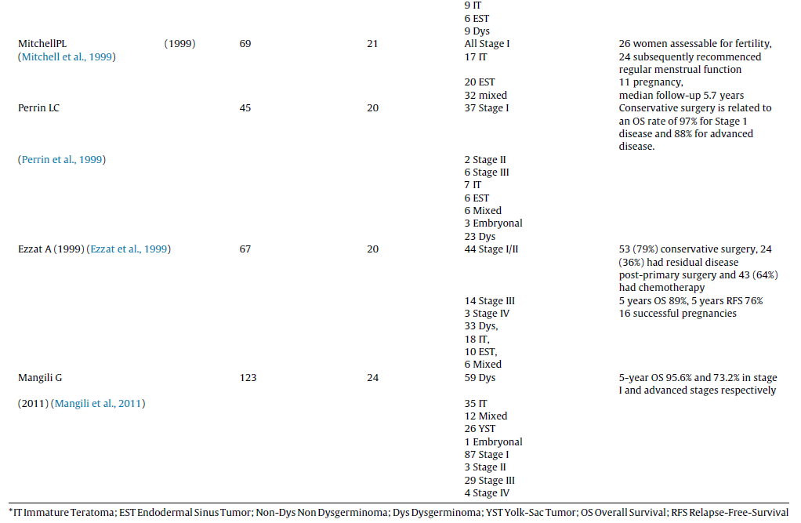

Slide 29
OVARIAN GERM CELL TUMORS FOLLOW-UP
Adolescent girls who performed FSS and received BEP
Ovarian failure were not determined
Return of menses in 97% of patients
Pregnancies in 75% of women who attempted conception

Slide 30
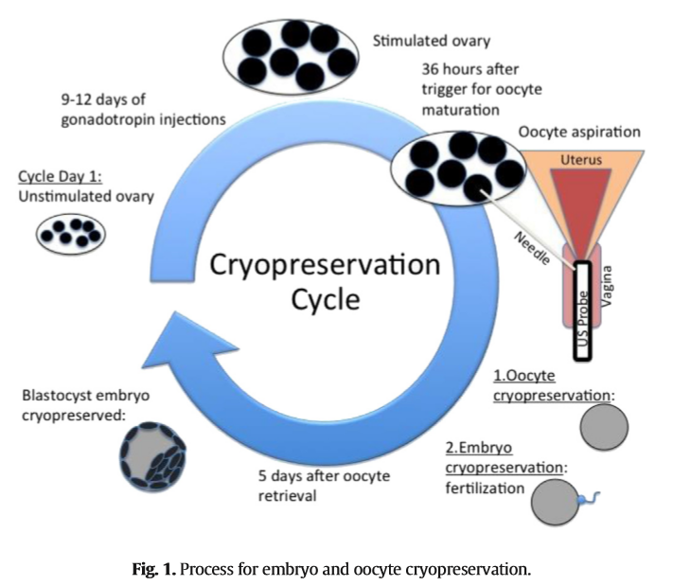
ASSISTED REPRODUCTIVE TECHNOLOGY
The rate of infertility after treatment for MOGCT 5-10%
Embryo cryopreservation
Oocyte cryopreservation
Embryo or oocyte cryopreservation is not an option for prepubertal girls
As the ovaries are not yet responsive to gonadotropin hormones
Ovarian tissue cryopreservation is an experimental procedure
Bilateral oophorectomy and retain uterus for use of donor oocytes
Dysgerminoma associated with gonadoblastoma
Prophylactic bilateral gonadectomy is recommended
Bilateral MOGCTs with aggressive subtype

Slide 31
CONCLUSION - EOC
FSS can be safely performed for
Stage IA and IC grade 1 and 2 disease
Stage IC1 according to the 2014 FIGO staging system
The safety of FSS for grade 3 or stage 1C 2-3 could not be conﬁrmed
BOT stage I-III
FSS could probably be considered for stage I clear cell tumours
FSS should remain contraindicated in stage II/III disease

Slide 32
CONCLUSION - MOGCT
Patients with MOGCT have an excellent prognosis if adequately treated
Fertility-sparing surgery is feasible in most cases
In advanced stages, fertility-preserving surgery may be a reasonable option
Oocyte cryopreservation can be proposed
Do not desire or can’t try to become pregnant in the short term

Slide 33
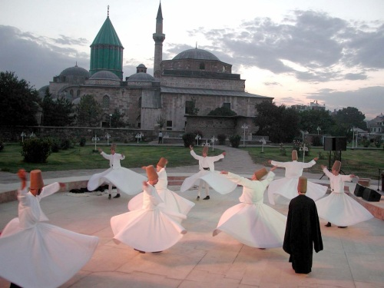
THANKS FOR ATTENTİON
ATATÜRK’ ü ANMA VE
19 MAYIS GENÇLİK - SPOR
BAYRAMINIZ KUTLU OLSUN

