Slide 1
Previous abdominal surgery and obesity does not affect unfavorably the outcome of total laparoscopic hysterectomy
Yavuz Emre ŞÜKÜR
Ankara University School of Medicine
Department of Obstetrics & Gynecology
Prof. Dr. Bülent BERKER
Dr. Batuhan TURGAY
Assoc. Prof. Dr. Salih TAŞKIN
Dr. Kaan BAYDEMİR
Prof. Dr. Ruşen AYTAÇ
Prof. Dr. Cem ATABEKOĞLU
Prof. Dr. Murat SÖNMEZER
Prof. Dr. Batuhan ÖZMEN

Slide 2
Total Laparoscopic Hysterectomy
1984: LAVH, Kurt Semm, Germany
1988: TLH, Harry Reich, Pennsylvania
Reich, J Gynecol Surg, 1989
1993: LSCH, Kurt Semm, Germany
1990s: Robotic hysterectomy
Advantages:
Fast recovery
Fast return to normal activities
Short hospital stay
Less postoperative pain
Cost-effective
Esthetic
Low complication rate

Slide 3
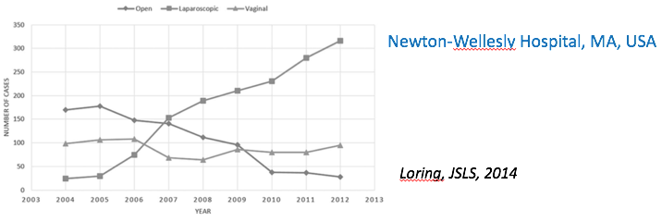
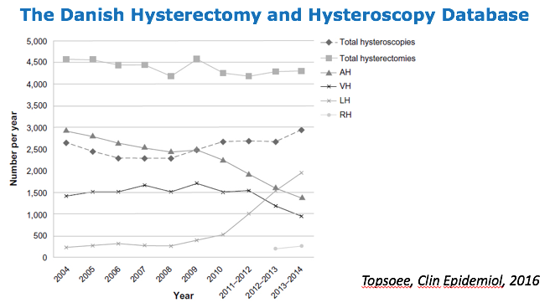
Laparoscopic Hysterectomy

Slide 4
Contraindications for TLH?
LH not appropriate
Medical conditions, such as cardiopulmonary disease, where the risks of either general anesthesia or the increased intraperitoneal pressure are deemed unacceptable
Where morcellation is known or likely to be required and uterine malignancy is either known or suspected
Circumstances where anatomy is so distorted by uterine disease or adhesions that laparoscopic approach is not deemed safe or reasonable by individuals with expertise
AAGL, J Minim Invasive Gynecol, 2011
- BMI
- Previous surgery
Contraindication?
Increase complication rate?

Slide 5
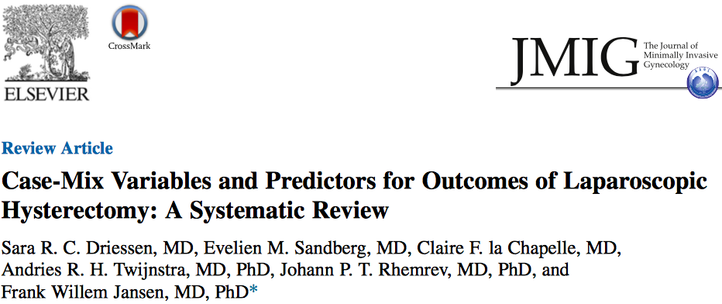
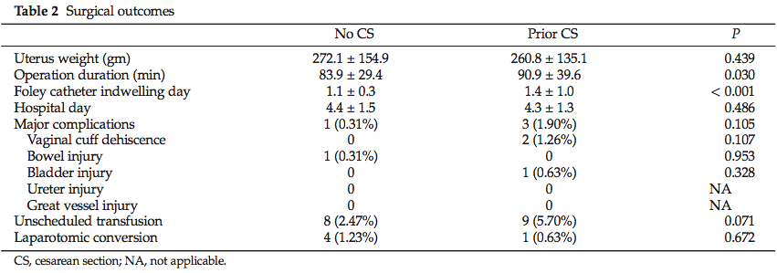
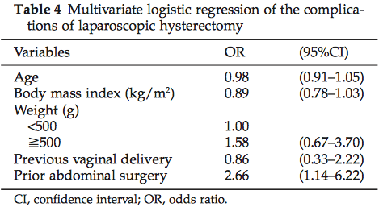
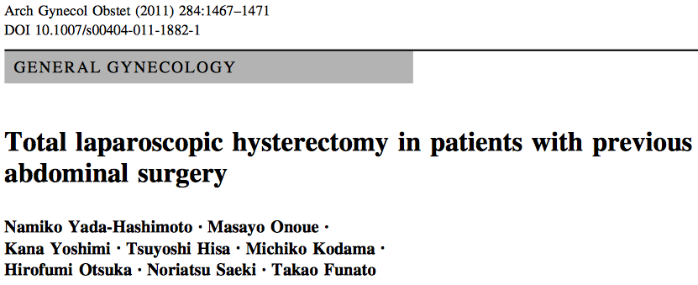
Previous surgery
Similar rates of minor and major complications

Slide 6
Obesity
TLH for patients with BMI > 30 kg/m²
Complication rate increases as BMI increase, regardless of surgical route
Bogani, Eur J Obstet Gynecol Reprod Biol, 2015
TLH vs. AH
Postoperative complication
Duration of hospitalization
Wound infection
Naveiro-Fuentes, Minerva Chir, 2017
Colling, Surg Infect, 2015
Bogani, Eur J Obstet Gynecol Reprod Biol, 2015
Longer operative time
Similar intraoperative complication rate
Shah, Obstet Gynecol, 2015
Blikkendaal, Arch Gynecol Obstet, 2015

Slide 7
Ankara University
AIM
To assess the effects of previous abdominal surgery and obesity on the intra-operative and post-operative outcomes of total laparoscopic hysterectomy (TLH).

Slide 8
Material & Methods
Ankara University School of Medicine
Department of Obstetrics & Gynecology
2011-2016
Hysterectomy for benign reasons
234 TLH
74 previous abdominal surgery
160 first abdominal surgery
38 C/S (16 recurrent)
17 appendectomy
7 cholecystectomy
4 myomectomy
4 endometrioma excision
2 BTL
1 appendectomy+cholecystectomy
1 C/S+cholecystectomy

Slide 9
Results
 | Previous surgery (n=74) | No surgery (n=160) | P
Age, years; mean±SD | 49.8±6.3 | 50.7±8.5 | 0.435
BMI, kg/m²; mean±SD | 28.1±4.3 | 28.6±3.7 | 0.342
Indications for surgery, n (%) Adenomyosis Adnexal mass Endometrial pathology Cervical pathology Uterine prolapse Fibroid | 3 (4.1) 9 (12.2) 22 (29.7) 2 (2.7) 10 (13.5) 28 (37.8) | 2 (1.3) 25 (15.6) 51 (31.9) 11 (6.9) 8 (5.0) 63 (39.4) | 0.120
Systemic disease, n (%) | 31 (41.9) | 83 (51.9) | 0.155
Additional surgical intervention, n (%) | 10 (13.5) | 16 (10.0) | 0.426
Bilateral salphingo-oophorectomy, n (%) | 64 (86.5) | 139 (86.9) | 0.935
Demographics

Slide 10
Results
 | Previous surgery (n=74) | No surgery (n=160) | P
Operative time, min; mean±SD | 91.8±31.6 | 92.7±29.9 | 0.841
Estimated blood loss, ml; mean±SD | 190.3±123.3 | 193.3±99.2 | 0.843
Hemoglobin drop, g/dL; mean±SD | 1.7±0.8 | 1.5±0.8 | 0.190
Blood transfusion, n (%) | 2 (2.7) | 11 (6.9) | 0.195
Hospital stay, days; mean±SD | 2.7±1.3 | 3.0±1.9 | 0.372
Major complication, n (%) | 2 (2.7%) | 0 (0) | 0.099
Outcome
Bladder injury (n=1)
Intestinal injury (n=1)
 | Previous surgery (n=77) | No surgery (n=164) | P
Conversion to laparotomy, n (%) | 3 (3.8%) | 4 (2.4%) | 0.683

Slide 11
Material & Methods
Ankara University School of Medicine
Department of Obstetrics & Gynecology
2011-2016
BMI >30 kg/m²
Hysterectomy for benign reasons
n=239
TLH
n=93
AH
n=146

Slide 12
Results
 | Laparoscopic (n=93) | Abdominal (n=146) | P
Age, years; mean±SD | 50.9±6.1 | 49.6±6.8 | 0.118
BMI, kg/m²; mean±SD | 32.8±2.3 | 33.0±2.7 | 0.511
Indications for surgery, n (%) Adenomyosis Adnexal mass Endometrial pathology Cervical pathology Uterine prolapse Fibroid | 0 (0) 11 (11.8) 32 (34.4) 2 (2.2) 6 (6.5) 42 (38.9) | 3 (2.1) 11 (7.5) 69 (47.3) 3 (2.1) 2 (1.4) 58 (39.7) | 0.074
Systemic disease, n (%) | 53 (57.0) | 82 (56.2) | 0.900
Previous abdominal surgery, n (%) | 28 (30.1) | 47 (32.2) | 0.735
Additional surgical intervention, n (%) | 14 (15.1) | 26 (17.8) | 0.578
Bilateral salphingo-oophorectomy, n (%) | 35 (37.6) | 60 (41.1) | 0.594
Demographics

Slide 13
Results
 | Laparoscopic (n=93) | Abdominal (n=146) | P
Operative time, min; mean±SD | 92.0±29.7 | 84.6±31.1 | 0.071
Estimated blood loss, ml; mean±SD | 191.9±88.8 | 193.3±88.2 | 0.906
Hemoglobin drop, g/dL; mean±SD | 1.5±0.8 | 1.4±1.0 | 0.392
Blood transfusion, n (%) | 5 (5.4) | 2 (1.4) | 0.073
Hospital stay, days; mean±SD | 3.1±2.0 | 4.2±3.5 | 0.006
Major complication, n (%) | 3 (3.2%) | 9 (6.1%) | 0.376
Outcome
TLH
Bladder injury (n=1)
Intestinal injury (n=1)
Dehiscence (n=1)
AH
Bladder injury (n=7)
Intestinal injury (n=1)
Iliac vessel injury (n=1)

Slide 14
Conclusion
Having a previous abdominal surgery does not seem to affect unfavorably the outcome of TLH.
Laparoscopic surgery, rather than open surgery, shortens hospital stay of obese hysterectomy patients without an unfavorable effect.
TLH is likely to be associated with less major complication rate.

Slide 15
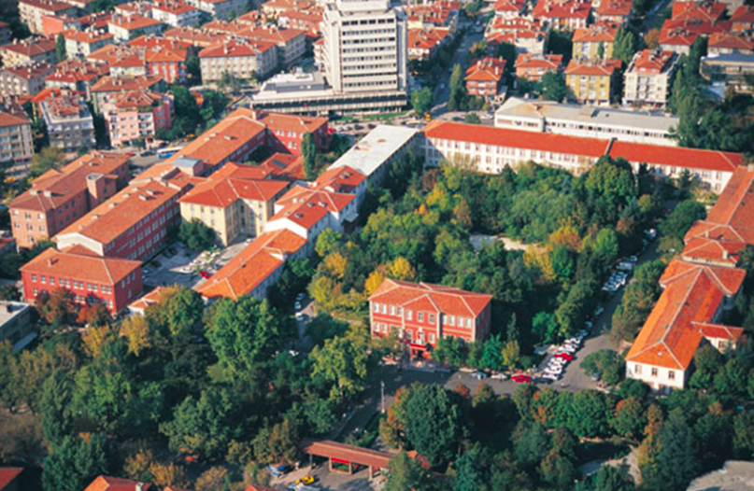
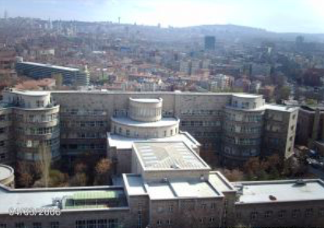
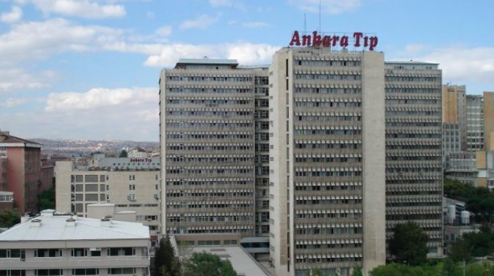
THANK YOU FOR YOUR ATTENTION

