Slide 1
Helle Karro Kai Part
Impact of sex education and services on teenage sexual and reproductive health
Antalya, 2017

Slide 2
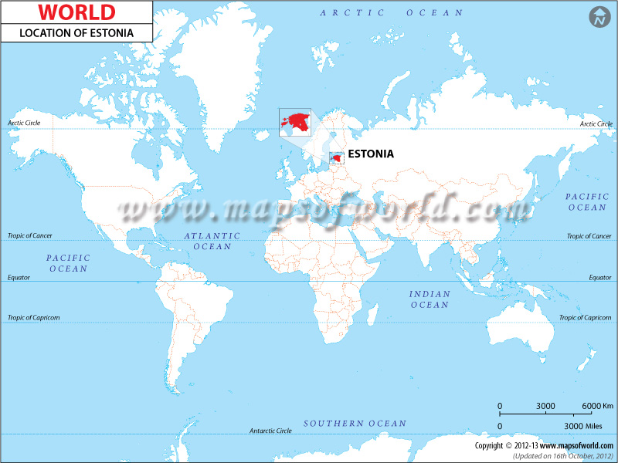

Slide 3
Teenage sexual and reproductive health (SRH) – why important?
Teenage pregnancy and childbearing are linked with adverse health and social outcomes
Great majority of teenage pregnancies in developed countries are unintended and unwanted
Teenage pregnancies must be viewed in the context of SRH and rights

Slide 4
Social context of teenage SRH
Social determinants:
- legal framework
- social and cultural norms
- access to confidential SRH services
- access to good quality sexuality education
- general degree of equity and social justice
Policy makers and legislators can direct their efforts in programs which are more likely to improve the teenage SRH

Slide 5
Youth friendly SRH services in Estonia
Intended for young people for both sexes
> 25-years of age
Common principles for promotion of sexual health of young people
Integrated approach to problems
Trustworthy information and counselling
Lecturers
http://whqlibdoc.who.int/publications/2009/9789241598354_eng.pdf

Slide 6
Teenage sexual and reproductive health (SRH) indicators
The number of live births, women 15-19 years (fertility rate)
The number of induced abortions (abortion rate)
The number of teenage pregnancies (pregnancy rate)
Teenage (15-19-year-olds) contraceptive prevalence
The incidence of STI

Slide 7
Teenage sexual and reproductive health (SRH) indicators
Experience of sexual intercourse
Contraceptive use during the first intercourse
Abortion legislation concerning teenagers
Teenage SRH services
Coverage of sexual education

Slide 8
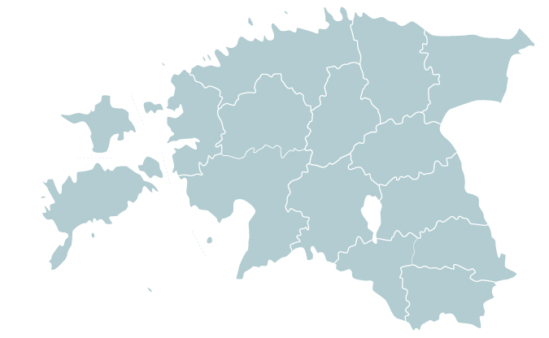
Network of youth-friendly sexual health clinics in Estonia
YFCs in 14 cities free for young women and men up to age 25
Main integrated elements of services:
Prevention, diagnosis and treatment of STIs/HIV
Contraceptive care
Abortion care
Identification/care for sexual violence
Psychological and sexual life problems
SE lectures
Phone counselling

Slide 9
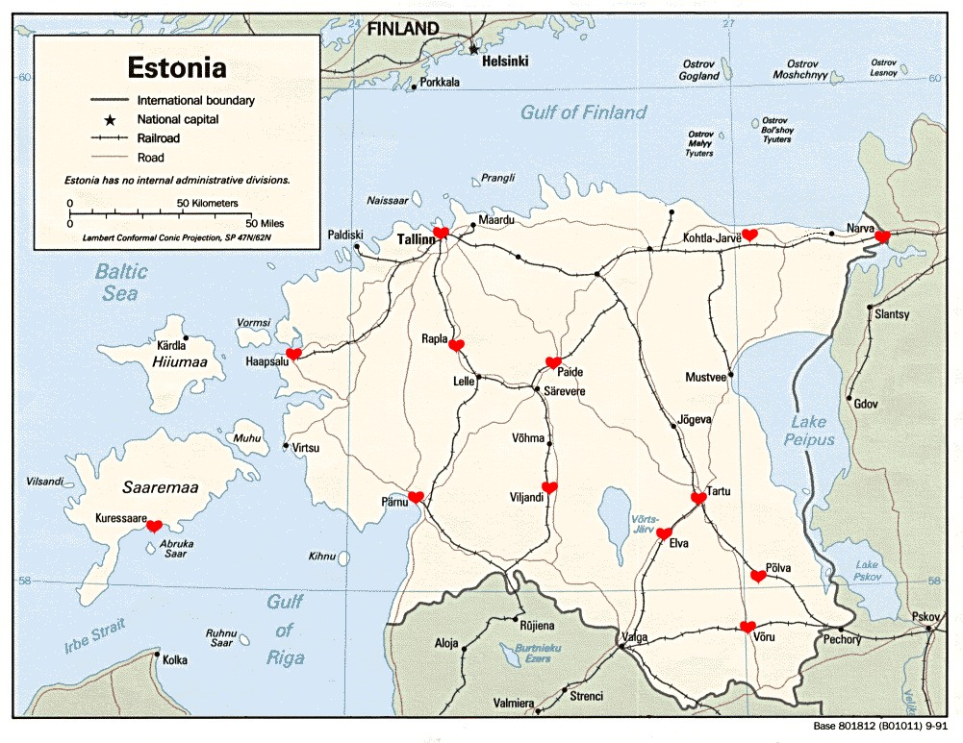
Amor youth clinic network in Estonia
Rakvere

Slide 10
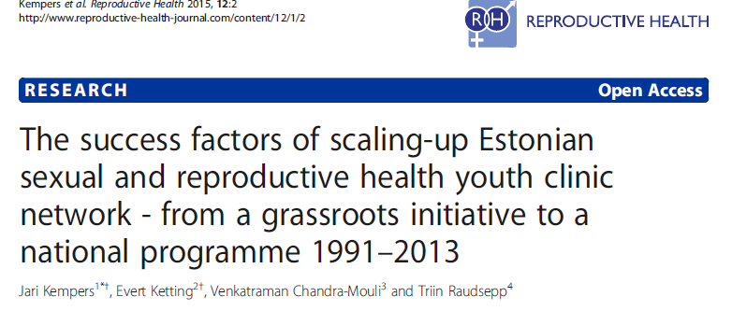
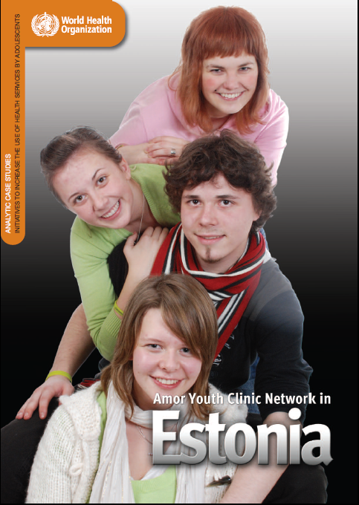
The main factors that contributed to the successful scale-up in Estonia were: 1) favourable social and political climate, 2) clear demonstrated need for the adolescent services, 3) a national professional organization that advocated, coordinated and represented the youth clinics, 4) enthusiasm and dedication of personnel, 5) acceptance by user organizations and 6) sustainable funding through the national health insurance system. Finally, the measurement and recognition of the remarkable improvement of adolescent SRH outcomes in Estonia would not have been possible without development of good reporting and monitoring systems, and many studies and international publications.
WHO 2009
http://whqlibdoc.who.int/publications/2009/9789241598354_eng.pdf
Kempers J, Ketting E, Chandra-Mouli V,
Raudsepp T, 2015
Notes:
A comprehensive overview of the development of YCCs in Estonia was published by the World
Health Organisation (WHO) in 2009

Slide 11
Youth clinics in Estonia 1991-2013 and visits to the youth clinics 2002-2013
Source: J. Kempers, E. Ketting, V. Chandra-Mouli, T. Raudsepp. The success factors of scaling-up Estonian sexual and reproductive health youth clinic network – from a grassroots initiative to a national programme 1991–2013. Reproductive Health 2015; 12: 2

Slide 12
Sexuality education (SE)
Different philosophies:
Abstinence only
How to say „no“
Comprehensive
Prevention of risks
Public health interventions
Holistic
More than prevention and ill-health
Sex is positive human potential
Rights to know
Notes:
Kas siia mingi viide?

Slide 13
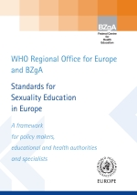
Standards for SE in Europe
Holistic SE
„Learning about the cognitive, emotional, social, interactive and physical aspects of sexuality“
From early childhood to adulthood
Gradually equips and empowers young people with information, positive values and skills →to enjoy their sexuality, safe and fullfilling relationships and responsibility
WHO Regional Office for Europe/BZgA, 2010:20

Slide 14
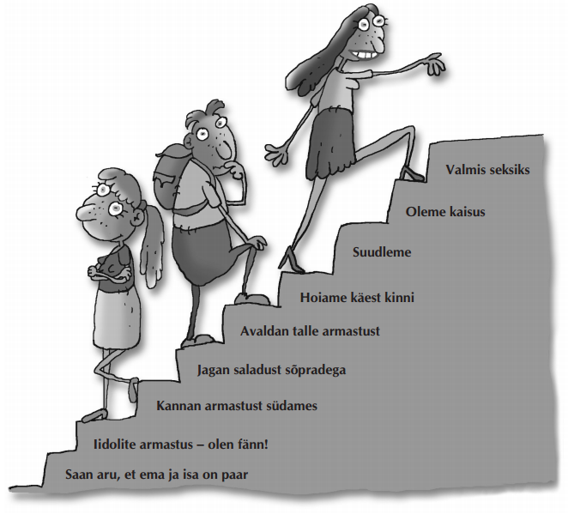
School based sexuality education in Estonia
SE is integrated into school curriculum since 1996 as a compulsory topic.
SE is part of subject called ‘Human studies’ and is taught by teachers.
The curriculum supports holistic approach for SE, which means that SE should teach comprehensive, honest and varied information mixing physiological and relational aspects of sexuality.
SE is integrated in all levels of school curriculum, with broad range of topics and positive approach.
http://lft.ee/admin/upload/files/Seksuaalkasvatus_II_ja_III_kooliaste_est.pdf
Notes:
- In 2002 a new curriculum was approved, and in 2010 the updated version of the curriculum was introduced, and implemented in 2011. The updated version of the curriculum focuses on prevention and defines more clearly the topics on health and SE.
- Teachers may include local NGOs to give SE classes, for example YFCs or Estonian Medical Students Association.

Slide 15
SE school program in Estonia
Started in 1996
Integrated intra-curricular program
Holistic
Part of Human studies program
Fully scaled-up, country wide
Age group (8) 12-16
Sexuality is not sensitive issue

Slide 16
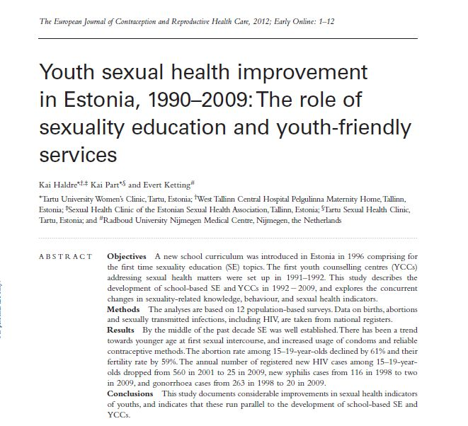
Results By the middle of the past decade SE was well established. There has been a trend towards younger age at first sexual intercourse, and increased usage of condoms and reliable contraceptive methods. The abortion rate among 15–19-year-olds declined by 61%, and their fertility rate by 59%. The annual number of registered new HIV cases among 15–19-year-olds dropped from 560 in 2001 to 25 in 2009, new syphilis cases from 116 in 1998 to two in 2009, and gonorrhoea cases from 263 in 1998 to 20 in 2009.
Conclusions This study documents considerable improvements in sexual health indicators of youths, and indicates that these run parallel to the development of school-based SE and YCCs
Notes:
The analyses are based on 12 population-based surveys. Data on births, abortions and sexually transmitted infections, including HIV, are taken from national registers.

Slide 17
Coverage of school-based sexuality education
N=2672
%
Estonian Women-s Health Survey 2004
Notes:
by 2004 SE was well established

Slide 18
Association between sexuality education and the use of contraception among 16- to 24-year-old women
Estonian Women's Health Survey 2004
Use of effective contraceptive methods (hormonal, condom, IUD)
 | AOR | 95% CI
School-based sexuality education | 2.69 | 1.32–5.50
Use of hormonal methods
School-based sexuality education | 3.79 | 1.51–9.49
Source: K. Part, I. Ringmets, M. Laanpere, M. Rahu, H. Karro. Contraceptive use among young women in Estonia. Eur J Contr RH Care, 2016
Notes:
- Using effective contraception at last sex intercourse was significantly associated with receiving SE at school. And this association was even stronger when more specifically hormonal contraception was used.

Slide 19
Association between sexuality education and sexuality-related knowledge among 9th grade pupils
Good sexuality-related knowledge
KISS study 1994 | AOR | 95% CI
School-based sexuality education | 0.94 | 0.63–1.40
Experience of sexual intercourse | 2.14 | 1.37–3.35
KISS study 1999
School-based sexuality education | 4.63 | 1.91–11.24
Experience of sexual intercourse | 1.69 | 1.15– 2.49
Source: K. Part, K. Rahu, M. Rahu, H. Karro. Factors associated with Estonian adolescents’ sexuality-related knowledge. E J Contr RH Care, 2008
Notes:
- Whereas in 1994, good sexual knowledge was positively associated only with experience of sexual intercourse and not with SE, then in 1999, good knowledge was also strongly associated with school SE.
- We may assume that acquiring information about sexuality, reproduction and contraception through school lessons is far less risky than searching the needed information independently after the event of a personal sexual experience.

Slide 20
Association between the use of contraception among 16- to 24-year-old women and type of a contraceptive service
Estonian Women’s Health Survey 2004
Use of effective contraception methods (hormonal, condom, IUD)
 | AOR | 95% CI
women’s outpatient clinic | 1
youth-friendly clinic | 1.82 | 1.03–3.23
private gynecology clinic | 2.08 | 1.11–3.92
family doctor | 1.82 | 0.95–3.49
Use of hormonal methods
women’s outpatient clinic | 1
youth-friendly clinic | 2.87 | 1.54–5.37
private gynecology clinic | 2.44 | 1.20–4.95
family doctor | 2.37 | 1.17–4.78
Source: K. Part, I. Ringmets, M. Laanpere, M. Rahu, H. Karro. Contraceptive use among young women in Estonia. Eur J Contr RH Care, 2016
Notes:
The results showed that the use of all effective contraceptive methods at last sexual intercourse was positively associated with the use of a YFC or private gynaecology clinic among young women in Estonia.
The use of hormonal methods was analysed in a separate model, because using hormonal methods definitely requires an initial visit to a health care provider.
The results showed that the use of hormonal methods was more than two times more likely when women visited YFCs, private and family doctors, compared to the traditional women's outpatient clinic.

Slide 21
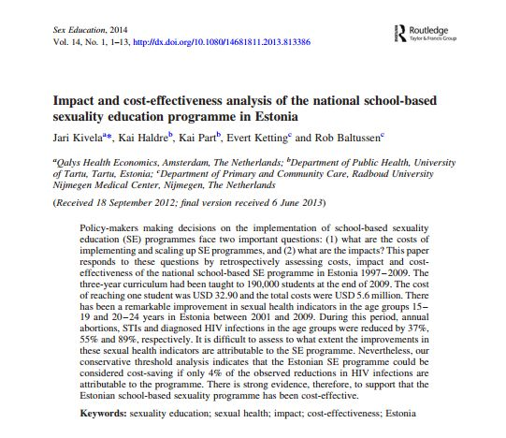

Slide 22
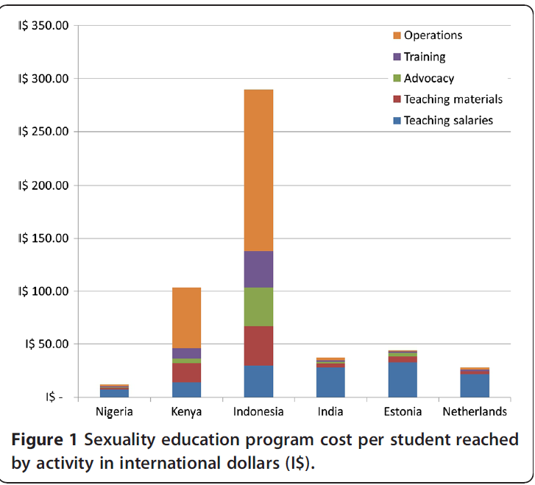
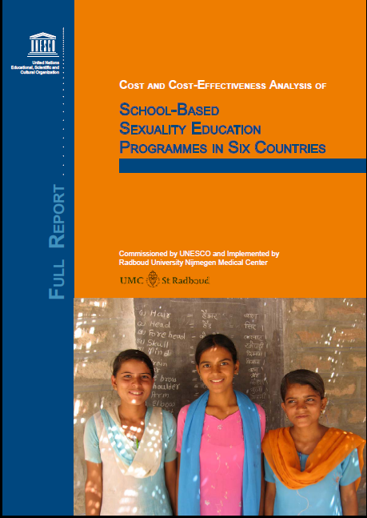

Slide 23
Use of contraception during first sexual intercourse, 2004 and 2014 (%)
%
2004 (n=2385)
2014 (n=1885)
Source: Estonian Women’s Health Survey 2004 and 2014

Slide 24
School-based SE increased the odds for good sexuality related knowledge of 9th grade pupils in 1999 five times
POR 4.63
POR 0.78
Part K, Rahu K, Rahu M, Karro H. Factors associated with Estonian adolescents’
sexuality-related knowledge: Findings frim the 1994 and 1999 KISS Studies. Eur J Contr RH Care 2008
Notes:
If in 1994, good sexual knowledge was positively associated only with experience of sexual intercourse and not with school-based SE, then in 1999, good sexual knowledge was strongly positively associated with school sex education, as well as with personal experience of sexual intercourse. We concluded that the route of acquiring sexuality-related information from school is far less risky for adolescents than through personal experience, and that the aforementioned trend may be the result of the introduction of compulsory SE in schools

Slide 25
Poor knowledge increased the risk of unplanned pregnancy among Estonian teenagers three times
(adjusted OR: 3.07; 95%CI: 1.73 – 5.46)
Haldre K, Rahu K, Rahu M, Karro H. Individual and familial factors associated with teenage pregnancy: An interview study. Eur J Public Health 2009;19:266 – 70
Notes:
At the same time there is evidence that good knowledge
reduces the risk of unplanned pregnancy.

Slide 26
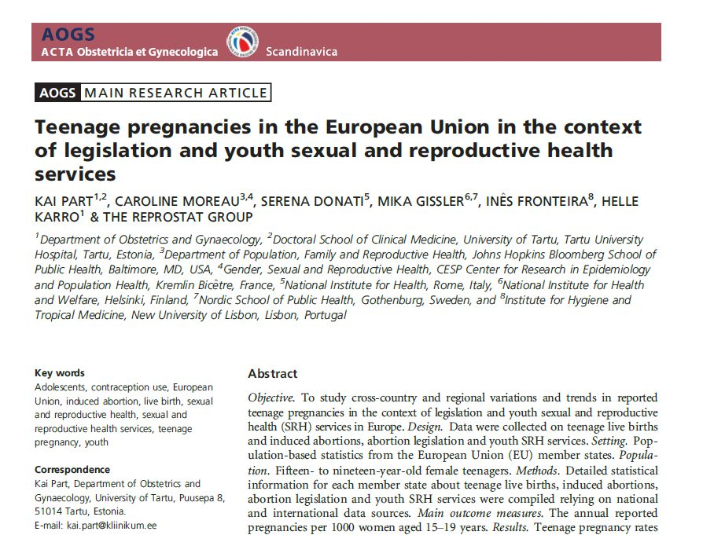

Slide 27
Teenage pregnancies in EU, Part et al. AOGS, 2013
Information about teenage SRH indicators for each EU member states was compiled relying on national and international data sources
Main conclusion:
Collection of standardized statistics about teenage pregnancies is critically needed
Teenage pregnancies are declining, but remarkable cross-country differences need to be explored further to reduce regional disparities in Europe
Equal access to abortion and youth friendly SRH services is important

Slide 28
Changes in adolescent pregnancy rates, 1995-2011
Notes:
One of the most rapid declines in teenage pregnancies seen in the EU between 1995 and 2011 took place in Estonia.

Slide 29
Teenage birth and abortion rate in Estonia, 1992-2015
Estonian Birth Registry1992-2015, Estonian Abortion Registry 1996-2015

Slide 30
Decline in diagnosed STIs in the period from 2001 to 2009 in Estonia
Cost and cost-effectiveness analysis of school-based sexuality education programmes in
six countries. UNESCO, 2011. http://unesdoc.unesco.org/images/0021/002116/211604e.pdf
Notes:
There was a dramatic increase in registered cases of Chlamydia infections, gonorrhoea and syphilis in the middle of the 1990s in all age groups, but thereafter the incidence sharply declined, desspite of somewhat increased sexual activity and greater numbers of people tested

Slide 31
Decline in diagnosed HIV infections in the period from 2001 to 2009 in Estonia
Cost and cost-effectiveness analysis of school-based sexuality education programmes in
six countries. UNESCO, 2011. http://unesdoc.unesco.org/images/0021/002116/211604e.pdf
Notes:
Although Estonia has one of the highest adult HIV infection prevalence rate (1.3%) in
the WHO European Region, the number of new cases among teenagers and young people has declined remarkably.
The transmission has been predominantly via IDUs, and the implementation of school-based SE is believed to be one of the factors that has prevented the generalisation of the epidemic via sexual route.

Slide 32
Conclusion
Availability of youth friendly SRH services and comprehensive sexuality education contributes significantly to improvements in the sexual health of teenagers
Notes:
Good knowledge reduces the risk of unintended pregnancy
Non-health outcomes: less gender-based violence, gender equality, decision making skills, better educatio

Slide 33
Thank you

