Slide 1
Uterocutaneous Fistula after Myomectomy: An Anusual Complication
Gülşah İlhan, Hamdullah Sözen, Fatma Ferda Verit,
Ali Galip Zebitay, Emre Sinan Güngör, Ahmet Hasan Ergin.

Slide 2
Introduction
Abdominal myomectomy is still considered as a good choice for women with a huge fibroid who need to maintain their reproductive function.

Slide 3
Introduction
Uterocutaneous fistula is a rarely seen complication of myomectomy procedure.
In the present case, we introduced a patient who presented with uterocutaneous fistula after myomectomy procedure.

Slide 4
Case Report
A 32-year-old women presented with the complaint of pelvic pain and bulk symptoms.
Her ultrasonography revealed a giant (12x13cm) subserosal- intramural leiomyoma
Abdominal myomectomy was performed.

Slide 5
On the 20th postoperative day, the patient presented again with hemorrhagic discharge through an opening on the abdominal incision.

Slide 6
Gram stains and cultures of the discharges by a sterile cotton swab was performed.
Her body temperature was 38.2˚C.
Her laboratory results were WBC:18,07 (10^3/uL) and CRP(c- reactive protein):65 mg/L.

Slide 7
Ceftriaxone 1 g intravenously twice a day was administered empirically for 7 days.
Staphylococcus lugdunensis was isolated and intravenous metronidazole (3g/day) was added to existing treatment.

Slide 8
CT clearly demonstrated a fistula tract with a thickness of 0.7 cm between the skin and the uterus.

Slide 9
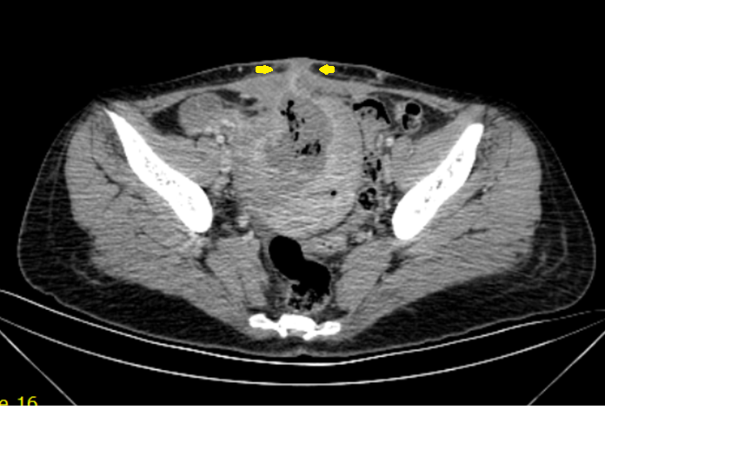
Figure 1. CT appearance of fistula tract

Slide 10
Despite of intravenous antibiotherapy, fever, leukocytosis and high CRP levels were persisted.
The patient had a wish to preserve fertility and explorative laparotomy, fistulectomy and primary repair of myometrium were performed.

Slide 11
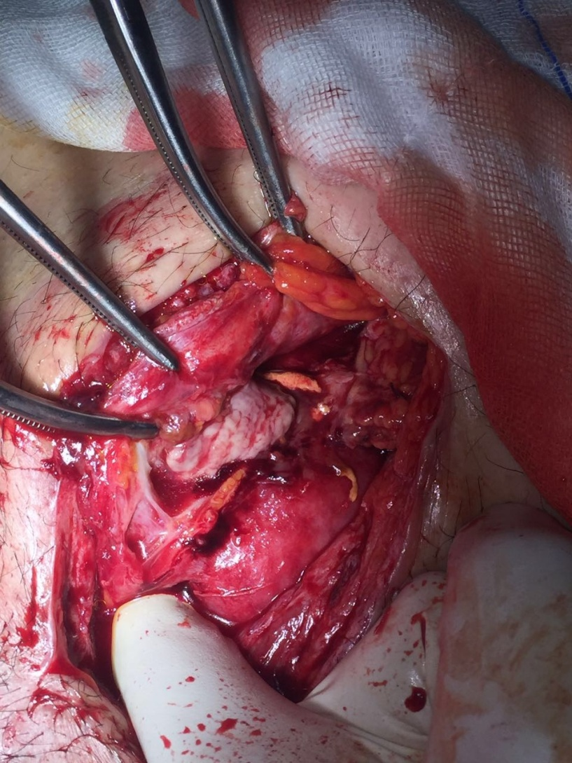
Figure2. Granulation tissue surrounding fistula tract

Slide 12
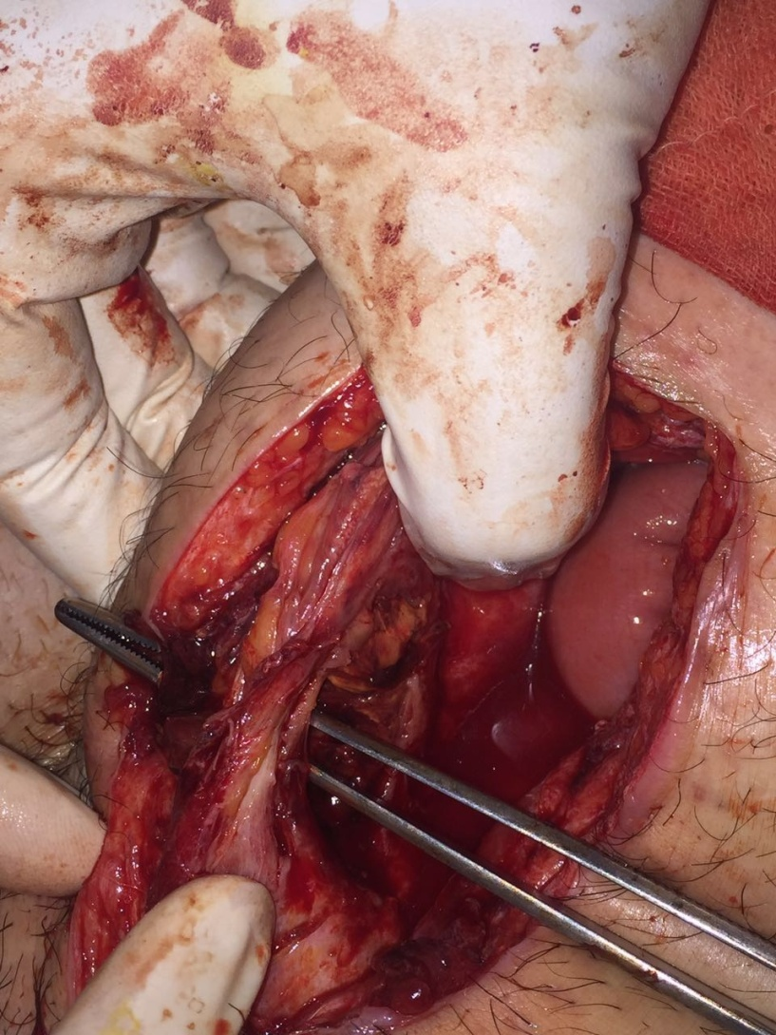
Figure 3. Fistula tract through the abdominal wall

Slide 13
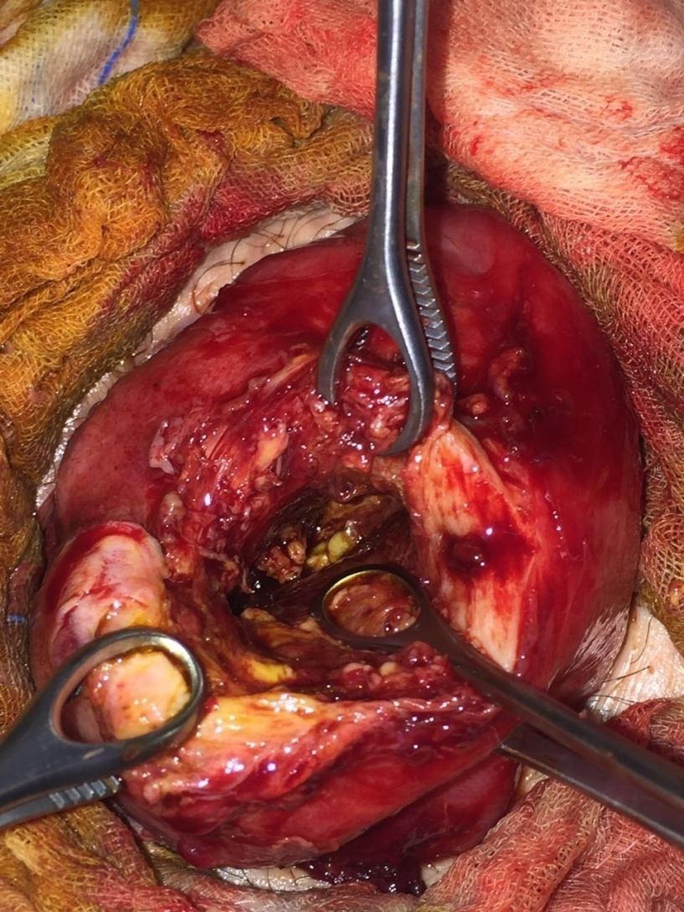
Figure 4. Fresh myometrium after fistulectomy

Slide 14
Pathologic examination showed granulation tissue and endometrial epithelization.

Slide 15
After operation, acute phase reactants were normalized dramatically and the patient was discharged on the 6th postoperative day.

Slide 16
The patient had no complaints on the third postoperative months and experiences regular menstrual cycles.

Slide 17
Uterocutaneus fistula
A fistula is defined as an abnormal connection between two epithelium lined organs.
Uterocutaneus fistula is an abnormal tract between the skin and the uterus.
The pathognomonic symptom of uterocutaneous fistula is bloody discharge from the skin that occurs simultaneously with menstruation.

Slide 18
Definitive may be possible with ultrasonography, contrast studies such as fistulogram, hysterosalpingography, CT and MRI.
In our case; the patient was presented with hemorrhagic discharge and the diagnosis was established by contrast enhanced computerized tomography.

Slide 19
Uterocutaneous fistula formation may be related to multiple previous cesarean deliveries, diabetes mellitus, intrauterine devices and endometriosis.
In our case; the woman had neither systemic disease nor previous surgery.

Slide 20
Total abdominal hysterectomy together with excision of the fistula tract has been reported to be definitive treatment.
Medical treatment with GnRH agonist administration was also reported in the literature.

Slide 21
In our case; the clinician gave information about the medical treatment options for uterocutenous fistula.
When considering patient wish to retain her fertility and age in our case, we performed fistulectomy and primary repair of the fresh myometrium.

Slide 22
The period for fistula formation after the procedure was given between 3 months to 3 years in the literature.
20 day postoperative period seems to be short for the fistula formation. Infectious process that disrupts the continuity of the tissues involved is speculated such an early fistula formation.

Slide 23
In conclusion uterocutenous fistula following myomectomy is a very rare condition in women.
Fistulectomy without hysterectomy and intravenous large spectrum antibiotics have a favorable prognosis.

