Slide 1
Perinatal outcome of fetuses with echogenic intracardiac focus
Mehmet Özsürmeli, Selim Büyükkurt, Mete Sucu, Erol Arslan, Selahattin Mısırlıoğlu, Süleyman Cansun Demir, İsmail Cüneyt Evrüke

Slide 2
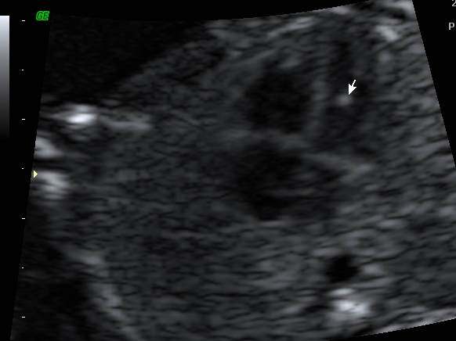
Echogenic Intracardiac Focus
EIF ;
is a microcalcification localized in the papillary muscle
is a soft marker
within either or both ventricules
is defined by comparing the echogenicity of adjacent bone

Slide 3
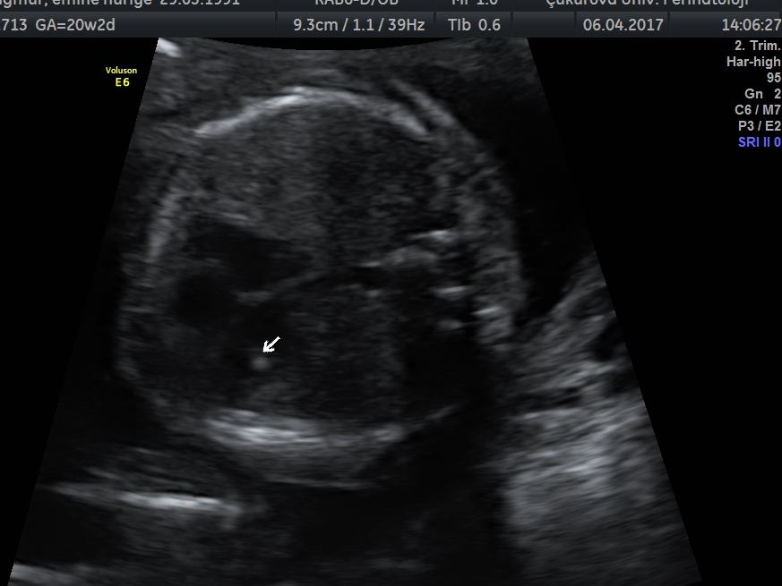
Objective
in the presence of an isolated eif, the increase in the risk for Down syndrome is minimal
The aim of the study is to determine the role of isolated echogenic intracardiac focus (EIF) and EIF accompanying to soft markers

Slide 4
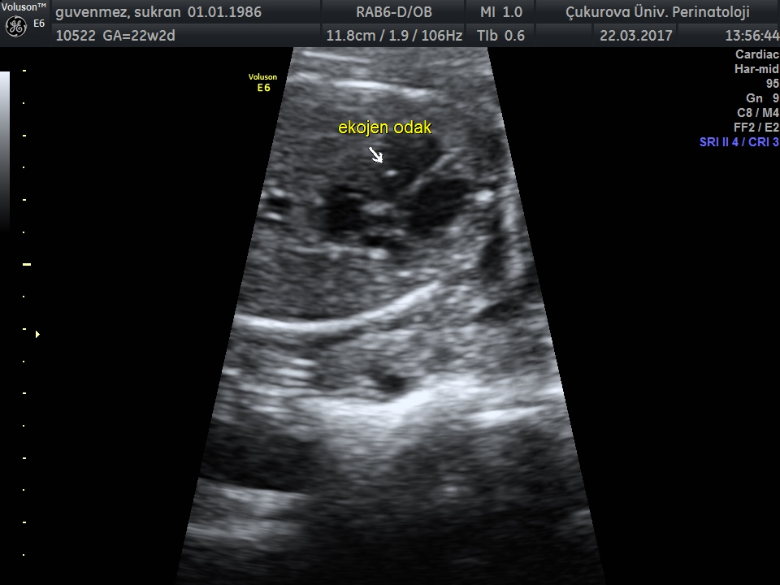
Material and Method
Data collected retrospectively from the 1-November-2014 to 31-October-2016.
9640 patients were examined for routine second trimester anatomical scan
EIF is diagnosed in 197 of patients (2%)

Slide 5
Material and Method
Group 1: isolated eif (n=168)
Group 2: EIF with at least one soft marker (n=29)
Fetal karyotyping is offered to all women in group 2 and women in group 1 with positive biochemical trisomy screening test.
Neonatal outcomes are obtained from electronic medical reports or the family is interrogated by phone call.

Slide 6
Result
 | Fetal karyotype - | Fetal karyotype + | Trisomy (n)
Group 1 (n=168) | 155 (%92) | 13 (%8) | 0
Group 2 (n=29) | 18 (%62) | 11 (%38) | 0

Slide 7
Conclusion
In old studies: positive likelihood ratio ranging between 1.8 and 5.4,
The type of studied population may influence these differences in likelihood ratios.
In contrast to old studies, current data indicates that there is no need for fetal karyotyping in cases of low-risk population with isolated EIF.

Slide 8
Conclusion
Rates of invasive testing were higher in group 2. (%8 vs %38, respectively)
No trisomy was detected in both groups.
When EIF is isolated or negative biochemical trisomy screening test, there is no association with trisomies.
Karyotyping can only be performed in the presence of strong desire of woman.

