Slide 1
The effects of Atorvastatin and Dienogest on inflammation markers and histopathological effects on lesions in rat endometriosis model
Ayşe Güler Okyay,
Orhan Nural, Neslihan Pınar, Oğuzhan Özcan, Oya Soylu Karapınar, Esin Atik

Slide 2
This study was conducted in Mustafa Kemal University Experimental Research and Animal Experiments Center between June 2015 and August 2015.

Slide 3
Prospective, randomized, controlled experimental study

Slide 4
Objectives
IL-6
Hs-CRP
TNF-α in peritoneal fluid
VEGF
Histopathological effects on endometriotic implants in rats with endometriosis model.
After treatment with Atorvastatin and Dienogest, alone and in combination.

Slide 5
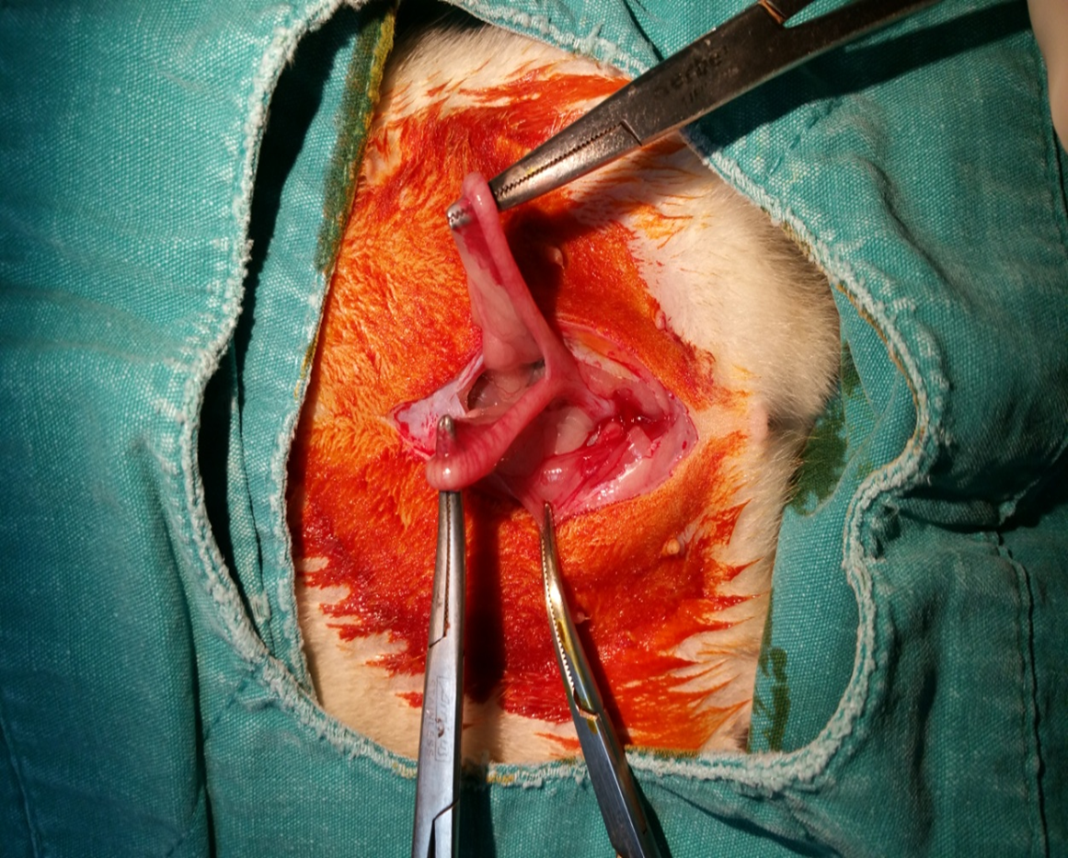
Method and Materials-1
44 Wistar female rats………12 rats died……32 rats completed the study
Endometriosis was surgically induced…

Slide 6
Method and Materials-2
4 weeks later 2nd laparotomy
Assessment of implants (volumes were measured) and collection of peritoneal fluid samples
Randomization of rats into 4 groups

Slide 7
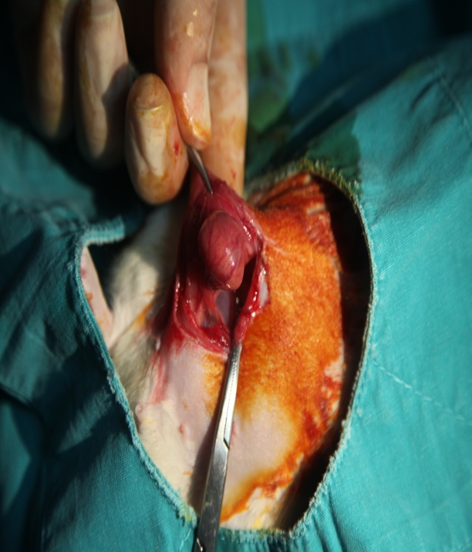
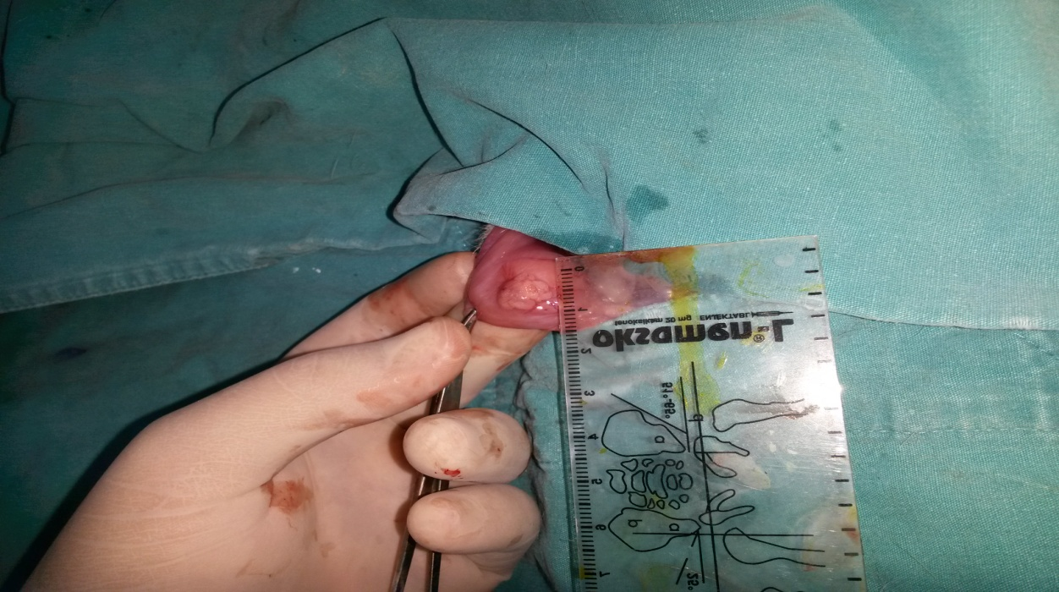

Slide 8
Method and Materials-3
Groups
Group I (n:7) ……………………….Atorvastatin (2,5 mg/kg/day, po)
Group II (n:9) ………………………Dienogest (0,3 mg/kg/day/ po )
Group III (n:6) ……………………..Atorvastatin and Dienogest in combination (2,5 mg/kg/day, po - 0,3 mg/kg/day, po, respectively)
Group IV (n:10)…………………….Control group (no treatment).

Slide 10
Method and Materials-4
4 weeks treatment, 3rd laparotomy
Peritoneal fluid samples were collected
IL-6, Hs-CRP, TNF-α and VEGF
Volumes of endometriotic implants were measured again
and the implants were excised for histopathological evaluation and
scoring

Slide 11
Method and Materials-5
Levels of İnflamation markers tested in peritoneal fluid and volumes of endometrial implants before the treatment were compared with the levels and volumes after the treatment.
Three groups were compared with each other and with the control group.

Slide 12
Method and Materials-6
Histopathological scores of the groups were compared with that of the control group. (Keenan et al, 1999)
Skor 0: Kötü korunmuş epitelyal tabaka Epitel hücresi yok
Skor 1: Kötü korunmuş epitelyal tabaka (seyrek epitel hücreleri)
Skor 2: Orta derecede korunmuş epitelyal tabaka (lökosit
infiltrasyonlu epitel)
Skor 3: İyi korunmuş epitelyal tabaka

Slide 13
Statistical Analysis
SPSS for windows release 21.0 program
Nonparametrik Mann-Whitney U
Kruskal-Wallis, tekyönlü varyans analizi ve
Wilcoxon sign test
p< 0.05 was accepted for significance.

Slide 14
Findings-1
Groups | n | Before treatment (cm³) | After treatment (cm³) | p value
Group I-Atorvastatin | 7 | 1,87 | 1,23 | 0.018
Group II-Dienogest | 9 | 1,39 | 0,95 | 0.008
GroupIII-Atorvastatin+Dienogest | 6 | 1,57 | 0,83 | 0.028
Group IV-Control | 10 | 1,21 | 1,88 | 0.005
a) significant difference with control group (p=0,007) b) significant difference with control group (p=0,001) c) significant difference with control group (p=0.001) Statistical significance: p<0.05

Slide 15
Findings-2

Slide 16
Findings-3 IL-6
IL-6 levels (pg/ml) were decreased in all treated groups. When compared with the control group, the decrease in the IL-6 levels was statistically significant in group I (p=0.05) and group III (p=0.001).

Slide 17
Findings-4 Hs-CRP
Hs-CRP levels were decreased significantly in all groups after treatment comparing to the pre-treatment levels (p<0.05) and
Decreases were significant in all three groups comparing to the control group.. However when three groups were compared with each other, there was no significant difference between them (p>0.05).

Slide 18
Findings-5 TNF-α
Decrease in the TNF-α levels after the treatment were statistically significant in group I (p=0.001) and group III (p=0.001).

Slide 19
Findings-6 VEGF
Peritoneal fluid VEGF levels before and after treatment

Slide 20
Findings-6 VEGF
GROUPS | Peritoneal fluid VEGF( pg/ml) |  | p value
 | Before treatment | After treatment
Group I (n=7) | 50,81 | 41,50 | 0,063
Group II (n=9) | 64,57 | 46,88* | 0.015
Group III (n=6) | 64,50 | 43,96* | 0.028
Group IV (n=10) | 50,06 | 55,05 | 0.445
*: Significant difference in comparison with control (p<0,05)

Slide 21
Conclusion
Atorvastatin and Dienogest causes a reduction in endometriotic implants in rats.
Atorvastatin decreases IL-6, Hs-CRP, TNF-α and Dienogest decreases Hs-CRP and VEGF levels, when combined all markers were decresed significantly
Because the IL-6, Hs-CRP, TNF-α and VEGF levels decrease more significantly after the combination treatment with Atorvastatin and Dienogest, in the treatment of endometriosis, using this combination may be more effective than their single application.
Further clinical studies are needed to determine the effect of this combination in treatment of patients with endometriosis.

Slide 22
Thank you...

