Slide 1
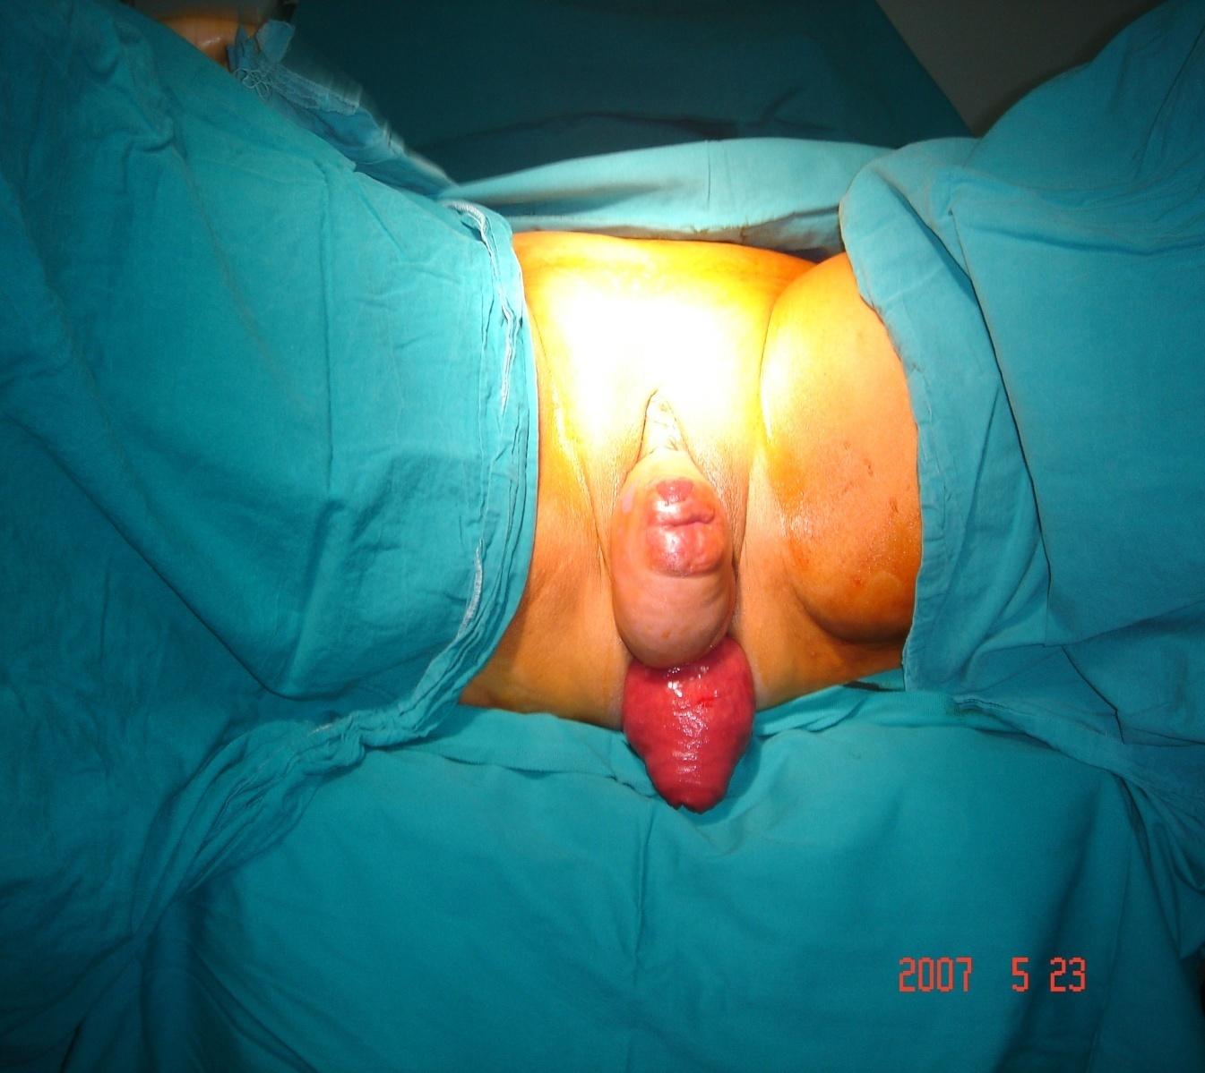
PELVIC ORGAN PROLAPSE TIPS and TRICKS
Ateş KARATEKE, MD, Prof.
Istanbul Medeniyet University
Faculty of Medicine
Dept. of Obstetrics and Gynecology, Chair

Slide 2
Pelvic Organ Prolapse
The lifetime risk that a woman in the United States will have surgery for prolapse or urinary incontinence is 11%, with up to one third of these requiring repeat procedures
Olsen AL, Smith VJ, Bergstrom JO, Colling JC, Clark AL. Epidemiology of surgically managed pelvic organ prolapse and urinary incontinence. Obstet Gynecol 1997;89:501-6.

Slide 3
Pelvic Organ Prolapse
Pelvic floor damage
Goodrich et al. Obstet Gynecol 1993:82:883-91
3

Slide 4
PELVİC FLOOR STRUCTURES
M. levator ani
Endopelvic fascia
4

Slide 5
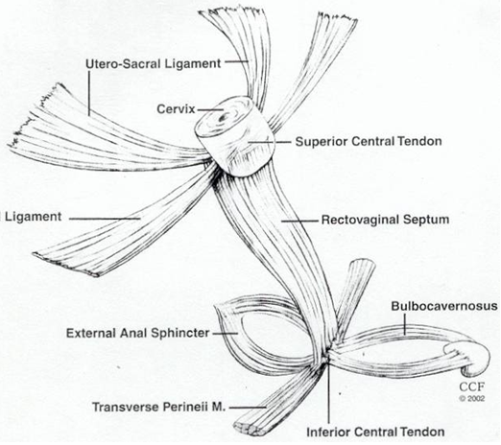
Current Concept of Pelvic Organ Prolapse
The endopelvic fascia is a surgical layer which can be easily identified surgically
For this, the current surgical practice aims to reconstruct and restore the integrity of the endopelvic fascia
All defects should be identified and repaired considering the patient‘s symptoms

Slide 6
Relevant anatomy
The vaginal support and anchoring system has 3 levels (De Lancey)
level I holds the vaginal apex attached to the uterosacral and cardinal ligaments
level II anchors the vaginal walls to the tendinous arch of the endopelvic fascia
level III is represented by the perineal body
Notes:
As we know
These are described by de lancey
İn this way:

Slide 7
Prolapse is a Hernia
Prolapse is a result of tearing and breakage of the endopelvic fascia therefore
prolapse is a hernia

Slide 8
Current Concept of Pelvic Organ Prolapse Surgery
Endopelvic fascial defects should be repaired in accordance with the principles of hernia repair
1.Use permanent suture
2.Take adequate bites of good fascial tissue
3.Bring near the fascia without undue
tension

Slide 9
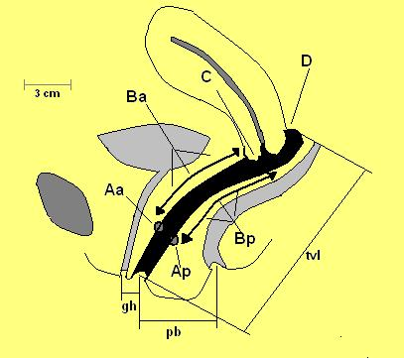
Clinical Assessment of Pelvic Organ Prolapse
1) The patient must be examined in an upright position with the patient straining forcefully
2) The clinician must examine each element of support independently and demonstrate or rule out stress urinary incontinence

Slide 10
Complex Function
The female pelvic floor has an extremely complex function
In addition to supporting the abdominal and pelvic organs and maintaining continence of urine and feces, the pelvic floor must also permit sexual intercourse, birth and storage and evacuation of excretory products

Slide 11
The goals of pelvic organ prolapse surgery
The goals of pelvic organ prolapse surgery are to correct all defects, therefore re-establishing vaginal support at all three levels, and to maintain and restore normal visceral and sexual function

Slide 12
Symptom Specific to Prolapse is Vaginal Bulge
There are a number of symptoms ; urinary, defecatory, sexual dysfunction, pelvic pressure, pain, vaginal bulge, protrusion and low backache
The only symptom specific to prolapse is the awareness of a vaginal bulge or protrusion
Pelvic symptoms, other than a vaginal bulge , may not be controlled with prolapse surgery
Notes:
12
Patient: avoid unreasonable expectation. Physician: Do not promise what we cannot deliver. Surgery is only trying to restore the anatomy, we can not guarantee the function. Some pts with mild to mod. Prolapse have severe symptoms and some pts with marked prolapse without much complaints.

Slide 13
Asymptomatic prolapse can be observed
Women with prolapse who are asymptomatic or mildly symptomatic can be observed at regular intervals, unless new symptoms develop
If an asymptomatic patient is operated on, new symptoms could develop and the patient’s condition might deteriorate and this could lead to more complaints

Slide 14
YOU CAN’T MAKE AN ASYMPTOMATIC PATIENT BETTER DOING SURGERY
YOU CAN ONLY MAKE HER WORSE

Slide 15
Listen to the patient carefully
Warn the patient against unreal expectation
Do not promise what you can’t deliver
The main aim of surgery must be to improve the quality of life, not to perform excellent anatomy

Slide 16
The choice of operation depends on a number of factors
Surgeons have to ask themselves whether the results are applicable to their patients and to their care, considering factors such as
occupational issues
sexual activity
age
religion
availability of adequate follow-up
whether the surgeon has adequate training
access to material
whether the health insurance covers the costs
whether complications are acceptable to the patients

Slide 17
Type of Procedures
In general, surgery for prolapse can be seperated into 3 main categories
1) Restorative surgery, which uses the patient’s endogenous support structures
2) Compensatory surgery, which uses some type of meshes to replace deficient support instead of the endopelvic fascia
3) Obliterative surgery, which closes the vagina

Slide 18
In the Restorative Procedures
The vaginal apex is the keystone for support of the pelvic organ
This surgery involves
Reconstructing the pericervical ring ;
this means the reattachment of uterosacro-cardinal ligament to pubocervical fascia and rectovaginal septum.
This structure must be resuspended to the level of the ischial spine.

Slide 19
‘The Apex Is The Keystone’
The best surgical correction of the pelvic organ prolapse will be a failure unless the apex is adequately supported
Adequate support for the vaginal apex is an essential component of the pelvic organ prolapse surgery
The Surgery for Prolapse Committee of the 4th International Consultation on Incontinence
The apex is the keystone of pelvic organ support
Notes:
Let me reiterate that
If we move the keystone from the bridge
The will colpase
The same is true of apex prolapse

Slide 20
Whether or not to perform a Hysterectomy
The uterus plays a passive role in the apical prolapse, hysterectomy alone does not address the underlying problem.
If the uterus is removed, restoration of apical support should be performed
Uterosacral ligament suspension and sacrospinous ligament suspension are considered equally effective procedures and can be combined with a vaginal hysterectomy.
Hysterectomy is not necessary for all apical prolapse cases, since the same apical suspension procedures could be performed without hysterectomy

Slide 21
Whether or not to perform a Hysterectomy
The preservation of the uterus offers, besides reduced surgical trauma, a better function of the pelvic floor and urinary bladder
Urgency and frequency are more common among women with prior hysterectomy

Slide 22
Whether or not to perform a Hysterectomy
The uterus has been shown to contribute positively to the patient’s self-esteem, body image, confidence, and sexuality

Slide 23
Synthetic Meshes
Another debated issue in POP surgery is the use of synthetic mesh through the vaginal route
There is a lack of strong evidence to support ROUTINE use in anterior and posterior repairs
There is insufficient good evidence on the long-term safety of synthetic mesh in pelvic reconstructive surgery

Slide 24
Transvaginal mesh
The use of transvaginal mesh has been shown in some studies to be superior to native tissue repairs with regard to anatomic outcomes, but severe complication rates are higher

Slide 25
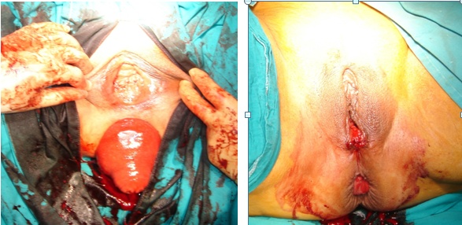
Obliterative Procedures Colpocleisis
For older women who are at a high risk of complications with reconstructive procedures and who no longer desire vaginal intercourse, colpocleisis can be offered

Slide 26
Cystoscopy
Cystoscopy should be performed intraoperatively to assess for bladder or ureteral damage after all prolapse or incontinence procedures during which the bladder or ureters may be at risk of injury

Slide 27
Pessary
Pessaries can be fitted in most women with prolapse, regardless of prolapse stage or site of predominant prolapse

Slide 28
Pessary
In general:
Ring type pessary is suitable for stage II and III prolapse
Gelhorn pessary is suitable for stage IV with wide genital hiatus
50 -70% of patients can be fitted with a pessary but only about half of them can maintain pessary use after fitting

Slide 29
Informed Consent
Women have to be very well informed about anatomical and functional aspects, risks, and complications of an operation in order to have a choice and give informed consent

Slide 30
Conclusion
Prolapse is a result of tearing and breakage of the endopelvic fascia
Surgery is performed to reconstruct or restore the integrity of the endopelvic fascia
The vaginal apex is the keystone for support of the pelvic organ

Slide 31
Conclusion
Bladder/bowel/sexual function are more important and the quality of life should be the priority of the surgeon
It is not possible to correct sexual dysfunction with surgery

Slide 32
Conclusion
Surgery should be easily performed with minimum early and long term morbidity and without serious complications

Slide 33
Conclusion
Optimize
Patient satisfaction
Patient outcomes
Patient quality of life
Minimize
Complication
Recovery time
Cost

Slide 34
Thank you for your attention

