Slide 1



19 May, NATIONAL INDEPENDENCE, YOUTH and SPORTS DAY
Peace in the country,
peace in the World.
Atatürk
Everything in the world is the works of the women.
Atatürk

Slide 2


DIABETES and
THE REGIONAL EPIDEMIC OF GDM:
WHY IS THIS
A PROBLEM ?
Başak Baksu, MD
Acıbadem Kozyatağı Hospital
Perinatology Clinic

Slide 3

OUTLINE
The region
Diabetes data
History
Types
Gestational Diabetes
Complications
Summary

Slide 4


Slide 5

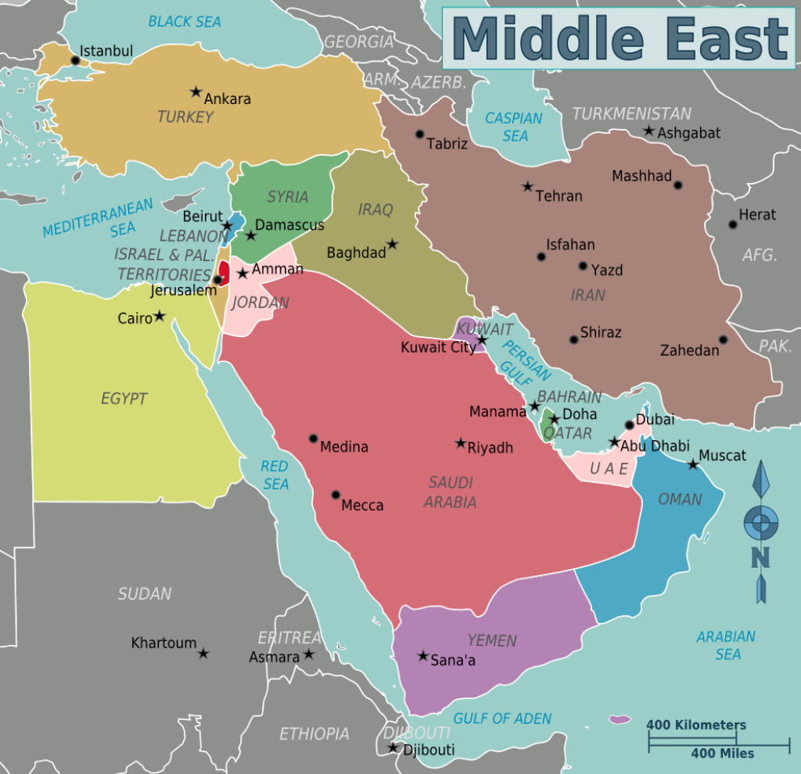
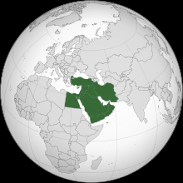
MIDDLE EAST: LOCATION, COUNTRIES
Turkey,
Island of Cyprus,
Syria,
Iraque,
Iran,
Lebanon,
Israel,
Palestine,
Jordan
Egypt,
Saudi Arabia
Kuwait,
Qatar,
United Arab Emirates,
Bahrain,
Yemen,
Oman

Slide 6


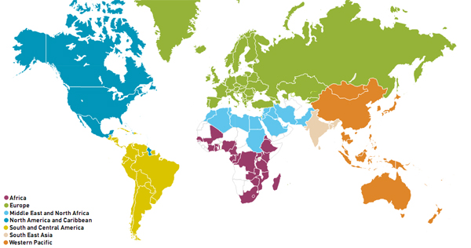
The InternatIonal DIabetes FederatIon (IDF) REGIONS
7 regions,
170 countries
230 members

Slide 7
ıDF MEMBERS
Number of associations
EUROPE
MIDDLE EAST AND NORTH AFRICA
Turkey 2
Island of Cyprus 1
Syria 1
Iraque 1
Iran 1
Lebanon 2
Israel 1
Palestine 1
Jordan 1
Egypt 3
Saudi Arabia 2
Kuwait 1
Qatar 1
United Arab Emirates 1
Bahrain 1
Yemen 1
Oman 1

Slide 8



3. DIABETES
If diabetes was a country,
it would be the world’s 3rd populous country.
2015

Slide 9
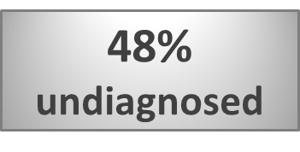

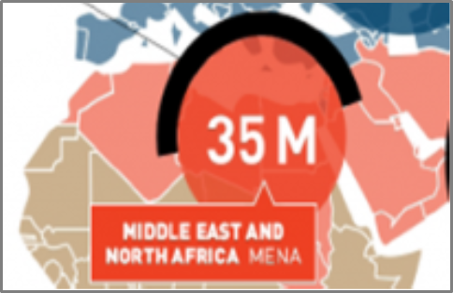
Diabetes is a global disease !
Estimated global prevalence of diabetes
151 million
2000
415 million
2015
552 million
2030
642 million
2040

Slide 10
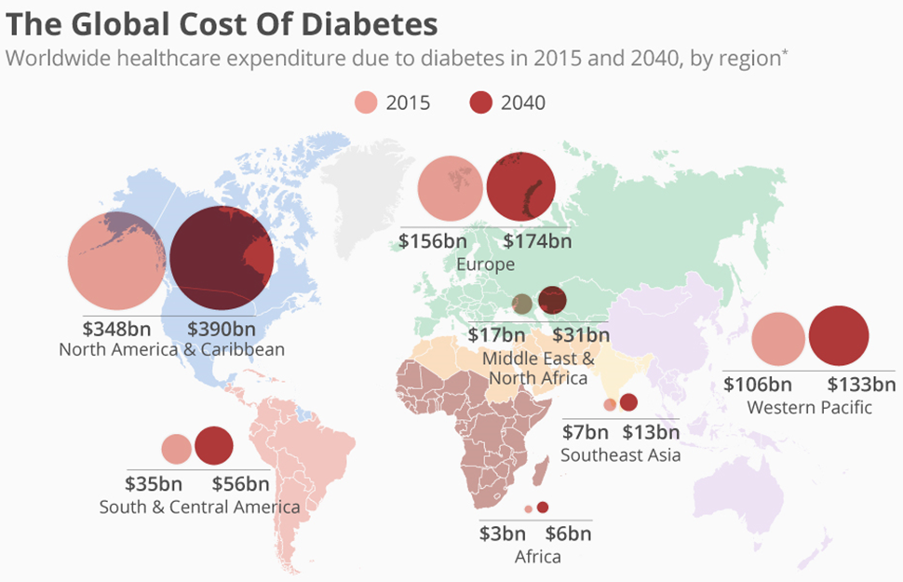


Slide 11
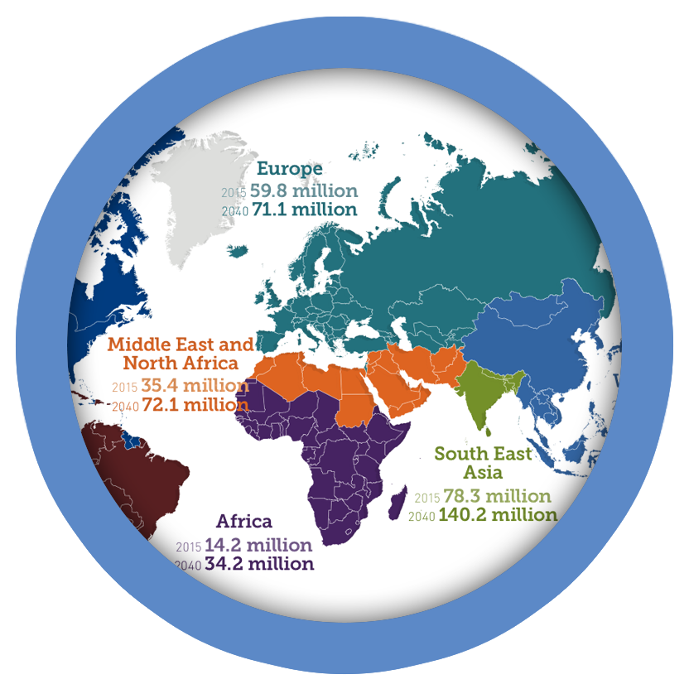
HOW DIABETES BECAME AN EPIDEMIC ?
1971 Bennett: ≥ 35 y American Pima Indians 50 % had diabetes.
1975 Zimmet: ≥ 15 y Micronesian community of the Central Pacific island
of Nauru 34 % had diabetes. Bennett PH, et al. Lancet 1971
Zimmet P, et al. Diabetologia 1977
Developed ≈ Developing
Increase in elderly population
Rapid economic development
Urbanization
Lifestyle changes:
Unhealthful diets
Little physical activity
80% in developing countries
Largest ↑ in prevalence
in developing countries
IDF 2015

Slide 12

PARALLEL EPIDEMICS of DIABETES & OBESITY
Obesity x2 ↑ since 1980
The leading risk factor (80-85%)
for type 2 DM.
13% of adult population
11% of men; 15% of women
1/5 of adults will be obese by 2025 !
Diabetes + Obesity = “DIABESITY"
Largest epidemic the world has ever faced !
366 million
by 2030
No of obesity-induced
diabetes will be
in life expectancy.
8-10 year decrease
Zimmet P. Med Gen Med 2007
Wild S, et al. Diabetes Care, 2004
Astrup A, et al. Obes Rev, 2000
diabetes.co.uk 2017
WHO 2016

Slide 13
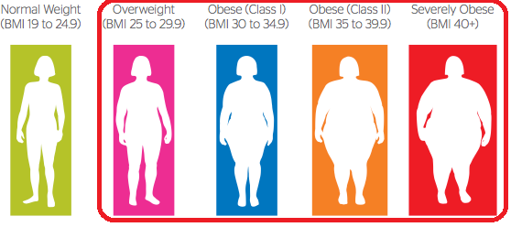
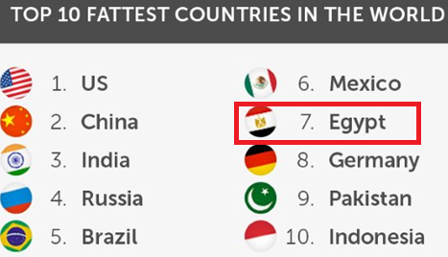


OBESITY IN THE REGION
Overweight and obesity are the strongest risk factors for type 2 diabetes.
WHO Global Report on Diabetes 2016
TURKEY
2 of 3
adults
MENA
7 in 10
adults
OVERWEIGHT
OBESE
WHO 2016

Slide 14
impaired
insulin & leptin response
↓
impaired metabolism
Leiter EH, et al. Obesity (Silver Spring). 2007
Lethal factor
linking
obesity & diabetes:
↓
INFLAMMATION
Weisberg SP, et al. Endocrinology. 2008

Slide 15


Progression of Type 2 Diabetes
ONSET OF DIABETES
COMPLICATIONS
DISABILITY
DEATH
IFG
Metabolic Syndrome
Development of Microvascular Complications
Development of Macrovascular Complications

Slide 16
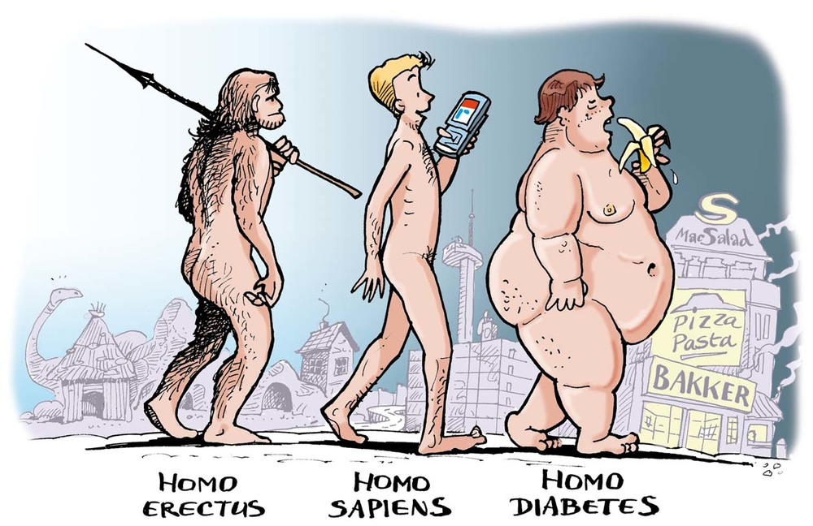
Million of years
50 years

Slide 17
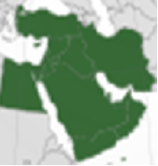
MIDDLE EAST: THE WORLD’S
DIABETES EPICENTRE
Past 3 decades, major social and economic changes: Greatest disparity in gross national income per capita
Some rapid economic growth, urbanisation, ↓ infant mortality, ↑ life expectancy.
Others ↓ in economic growth.
The vast majority (83.9%) with DM from low- or middle- income countries.
Many low- and middle-income countries are facing a "double burden" of obesity.
Rapid upsurge in risk factors like obesity and overweight.
Major challenge: a lot of migrants and refugees.
Diabetes rise across all age groups.
Continue rising over the next 20 years
IDF Diabetes Atlas · 2015

Slide 18
DIABETES IN TURKEY: FACTS and FIGURES
In 2013: 1 º in Europe: 1 in 7 adults = 7.2 million
14 million prediabetes
60,000 diabetes-related deaths
By 2035: 1 º with 12 million.
A VERY HIGH HbA1c LEVEL
Healthcare expenditures:
23% attributable to diabetes
3/4 of diabetes costs due complications.
IDF 2014
The rule of halves

Slide 19
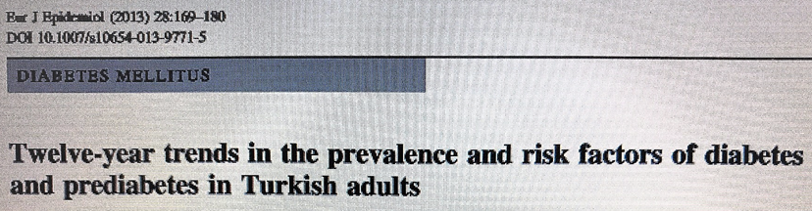
THE TURKISH EPIDEMIOLOGY SURVEY OF DIABETES, HYPERTENSION, OBESITY AND ENDOCRINE DISEASE
 | TURDEP 1 1997 | TURDEP 2 2010 | Increase
DM | 7.2 % | 13.7 % | 90 %
IGT | 6.7 % | 13.9 % | 106 %
Female DM | 32.9 % | 44.2 % | 32 %
Male DM | 13.2 % | 27.3 % | 107 %
Obesity | 22% | 31% | 40%
1997, 2010
Same centers
Cross-sectional, Population-based survey
Random sample
≥ 20 y population
Satman I, et al. Diabetes Care 2002
Satman I, et al. Eur J Epidemiol 2013

Slide 20
Prefix from Greek
meaning
: through, across
Root word from Greek
meaning to
: pass, go, walk
From Latin meaning: honey-sweet
Thomas Willis: urine of a diabetic sweet
In 1675, added "mellitus" to "diabetes"
passer through; a siphon
Aretaeus of Cappadocia
"excessive discharge of urine"

Slide 21
Diabetes is a group of metabolic diseases
characterized by hyperglycemia
resulting from defects in
- insulin secretion,
- insulin action, or
- both. ADA: Diabetes Care 2004

Slide 22
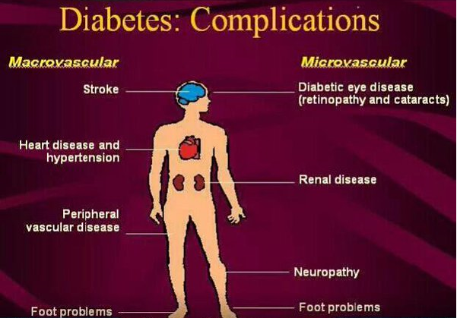
DIABETES
EPIDEMIC:
AN EPIDEMIC
OF
DIABETIC
COMPLICATIONS
2025= 380 M
70% (270 M)
will develop complications

Slide 23
CLASSIFICATION
90 %
of people with diabetes have type 2 diabetes.
IDF 2015
SPECIFIC TYPES
due to b-cell destruction, usually leading to absolute insulin deficiency
due to a progressive loss of insulin secretion on the background of insulin resistance
Diabetes diagnosed in the 2nd or 3rd trimester that is not clearly overt diabetes
monogenic diabetes syndromes,
drug- or chemical-induced diabetes

Slide 24
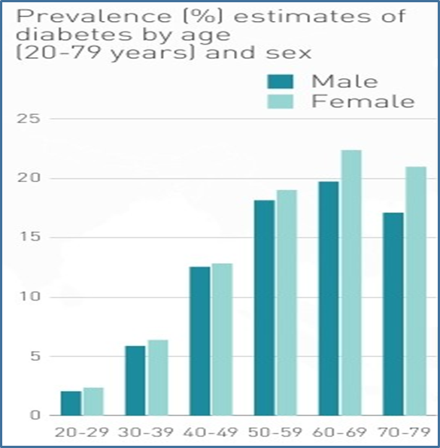
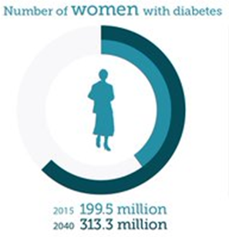
FACTS & FIGURES
WOMEN, IDF 2015
WORLD
MENA 2015
The greatest
increase in
female DM
in the next 20 years
(96%)
9. cause of death
(2.1 M/year)
40 % (>60 M) with DM
of reproductive age
highest obesity prevalance (≥ 25%)
in women ≥ 18 y

Slide 25
FACTS & FIGURES
ABOUT GDM
Hyperglycaemia is one of the most common
health problems of pregnancy (3-10%).
It’s prevalence increases rapidly with age.
20.9 million
(16.2%) of
live births
1 in 7 births affected by GDM.
GDM is a severe and neglected threat
to maternal and child health.
IDF 2015

Slide 26

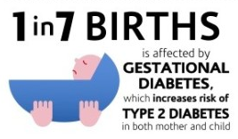
GDM
The ongoing epidemic of
obesity and diabetes
↑ T2DM in women of
childbearing age
↑ in no of pregnant women with undiagnosed T2DM
Lawrence JM, et al. Diabetes Care 2008

Slide 27

GESTATIONAL DIABETES
Major barrier to understanding the significance:
No consensus on the definition
No universal standard for diagnosis
No universal standard for screening
No universal validated guidelines for care
No reliable profile of the global burden
No reliable profile of the global distribution
Consequently, a lack of clear direction

Slide 28
ANTENATAL
Miscarriage Birth defects
DELIVERY
Birth asphyxia
POSTNATAL
RDS, Transient tachypnea
Cardiomyopathy, NICU
Brachial plexus injury
IUGR Macrosomia
Hypoglycaemia, Hypocalcemia
Polycythaemia, Jaundice
Sudden IUD
Clavicular fracture
Shoulder dystocia
FETAL COMPLICATIONS
ADOLESCENCE:
Obesity
Glucose intolerance
Diabetes
Metabolic Syndrome
Cardiovascular risks
Neurocognitive

Slide 29
ANTEPARTUM
Abortion
Recurrent infections
Polyhydroamnios
PPROM
PTL
Hypertension, Preeclampsia
Microvascular complications
Large vessel disease
DELIVERY
Prolonged labor
Failed induction
Operative delivery
Perineal injury
Cesarean section
PPH
PUERPERIUM& AFTER
Puerperal sepsis
Type 2 DM

Slide 30

FETAL ORIGINS OF ADULT DISEASES
It is now widely accepted that the risk of a number of chronic diseases in adulthood such as diabetes may have their origins before birth.

Slide 31
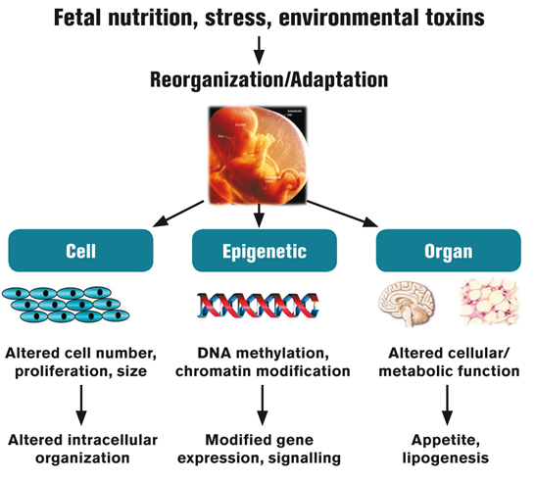
FETAL PROGRAMMING
Mechanism of Developmental Programming
Developmental Plasticity
Ability of an organism to develop in various ways , depending on the particular environment and setting
Developmental Programming
the response by the developing organism to a specific challenge during a critical time window resulting persistent effects in tissue structure or function.
Gluckman P. N Eng J Med 2008

Slide 32
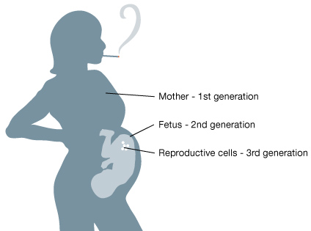

EPIGENETICS:
FETAL PROGRAMMING and INTERGENERATIONAL RISK
Epigenetic changes may
be passed down from one parent to child, directly affecting genes that control risk for conditions such as obesity, diabetes

Slide 33
SUMMARY
Diabetes is a global health and development crisis, giving an alarming picture in emerging countries.
Diabetes continues to rise exponentially globally.
The human and financial costs threaten to overwhelm health systems and undermine national economic progress.
Ageing, lifestyle change and urbanisation have been targetted as the main drivers, but in developing nations and indigenous communities, the story may be very different.
It is more than a ‘lifestyle disease’.
Evidence is growing on the genetic, epigenetic, environmental and biological factors contributing to diabetes, starting before conception.

Slide 34
SUMMARY
To date, prevention has been placed on lifestyle interventions.
However, a greater focus on epigenetics and early life risk factors may lead to more effective preventive strategies.
Therefore, prevention must start with a healthy pregnancy.
The health of mothers before and during pregnancy, and nutrition and growth in fetal and early postnatal life, have profound effects on vulnerability to diabetes later in life.

Slide 35
SUMMARY
GDM is also increasing rapidly with a multidimensional and trans-generational impact, long-term public health significance and contribution to the escalating type 2 diabetes epidemic.
The threat GDM imposes on public health can be mitigated if appropriate proactive and preventive strategies are put in place.
These include early screening and identification of women with GDM, provision of appropriate non-pharmacological and pharmacological therapy, and regular follow up after delivery to detect and treat diabetes in a timely manner.

Slide 36
SUMMARY
GDM is invisible to policy makers, largely because there is no reliable profile of the global burden and distribution.
Establish global standards for diagnosis and screening for GDM, in order to calculate GDM prevalence and plan policy and interventions accordingly.
Global efforts to improve maternal and child health are threatened by the neglect of diabetes, particularly as the epidemic grows in LMCs where maternal and child mortality are highest
Preventing and treating diabetes and GDM is essential for women’s rights and health equity.
A life course approach is imperative to reduce the intergenerational transmission of diabetes

Slide 37
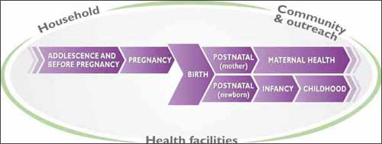
THE CONTINUUM OF CARE FOR REPRODUCTIVE, MATERNAL, NEWBORN AND CHILD HEALTH

Slide 38
WINDOWS OF OPPORTUNITY ACROSS THE LIFE COURSE
TO REDUCE INTERGENERATIONAL TRANSMISSION OF DIABETES
PHASE | INTERVENTION
Infancy and Childhood | • Promote exclusive breastfeeding for the first six months • Educate and support the mother on appropriate nutrition for the infant child • Promote exercise and healthy eating in pre-school- and school-aged children (including the provision of nutritional education)
Preconception | • Educate women that pregnancy can be a risk factor for the development of diabetes • Advocate balanced nutrition with respect to macro and micronutrients • Measures to help pregnant women and their partners stop smoking and refrain from alcohol • Provide education and awareness to support and reinforce these initiatives in adolescent girls
Pregnancy | • Improve maternal nutrition through appropriate supplementation to avoid under- and over-nutrition and ‘fetal programming’ of adult disease • Improve management of gestational diabetes to reduce transmission of type 2 diabetes to the off spring • Postnatal follow up for low birthweight off spring and mothers with gestational diabetes and their off spring

Slide 39
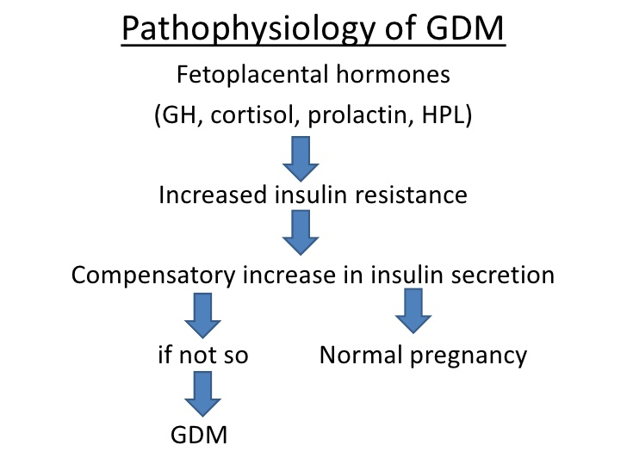
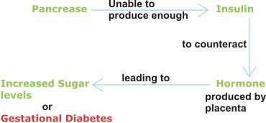
PREGNANCY
mild fasting hypoglycemia
postprandial hyperglycemia
peripheral insulin resistance

Slide 40
GDM RISK FACTORS
RISK FACTORS OF GDM (ADA)
Marked obesity, overweight (BMI≥25 or 23 if Asian) and have additional risk factors:
physical inactivity
ﬁrst-degree relative with diabetes
high-risk race/ethnicity (e.g., African, Latino, Native American, Asian, Paciﬁc Islander)
Infant > 4.5 kg
Previous GDM
HT (≥140/90 mmHg or on therapy for HT)
HDL-C <35 mg/dL ± triglyceride >250 mg/dL
PCOS
A1C ≥5.7% , IGT, or IFG on previous testing
Clinical conditions ass. with IR (severe obesity, acanthosis)
History of CVD
Age (> 25y; risk even greater if > 35y)
Race (African, Hispanics, American Indians, Asian)
Current glycosuria
T2DM in a first-degree relative (sibling, parent),
History of glucose intolerance (including previous GDM
Marked obesity, overweight
Previous infant with macrosomia (>4500 gr)
- Diagnosis of PCOS
- Previous unexplained stillbirth
- Smoking
- Interpregnancy gain > 3 BMI points
- Multiple pregnancy

Slide 41
DIABETES
Complex, chronic illness
Long-term damage, dysfunction, failure of various organs (esp. eyes, kidneys, nerves, heart, blood vessels)
Continuous medical care
Multifactorial risk-reduction strategies beyond glycemic control
To prevent acute complications and to reduce the risk of long-term complications therefore improving outcomes
ADA: Diabetes Care 2016

Slide 42
Egyptian papyrus:
‘too great
emptying
of urine’
Aretaus:
symptom,
course,
name
TIMELINE OF DIABETES
Galen: rarely seen
30-40 AC
131-201 AC
1550 BC
Ancient Age
(3000 BC – 476 AC)
Modern Age
(1492–1789)
Medieval Age
(476–1492)
Colombus discovered America
Fall of West
Roman Empire
Colombus discovered America
Invention of writing
980 - 1037
Late 1600s
India:
‘honey
urine’
400 – 500 AC
Avicenna:
first clear reference
Thomas Willis: added ‘mellitus’
Sushruta + Charaka:
identified type 1, 2 as seperate

Slide 43
LANDMARKS
OF
DISCOVERY
1921: Frederick Banting and Charles Best purified insulin; proved diabetes as a disease of insulin deficiency
1922: Development of metformin
1936: Distinction between type 1 and type 2 first clearly by Sir Harold Percival (Harry) Himsworth
1942: Identification of first of the sulfonylureas
1940s: Development of the long acting insulin NPH
1955: Insulin as the first protein to be fully sequenced by Nobel Prizewinner Frederick Sanger
Late 1950s: Reintroduction of the use of biguanides for Type 2 diabetes
1977: Radioimmunoassay for insulin discovered by Rosalyn Yalow and Solomon Berson
1979: Metformin first marketed in France
1988: Dr Gerald Reaven identified the constellation of symptoms now called metabolic syndrome
1990s: Identification of the first thiazolidinedione as an effective insulin sensitizer
1994: Marketing of metformin in USA
Stem cell therapy

