Slide 1
Comparative analysis of Hysteroscopic resection of type 0 vs type 1 submucous myoma
Erbil Karaman, Ali Kolusarı, İsmet Alkış, Orkun Çetin, Numan Çim, Recep Yıldızhan, Hanım Güler Şahin Yuzuncu Yil University, Medical Faculty, Department of Obstetric and Gynecology

Slide 2
INTRODUCTION
Fibroids are benign tumors of myometrium.
Incidence at least 25% in many studies.
Fibroids are classified according to location.

Slide 4
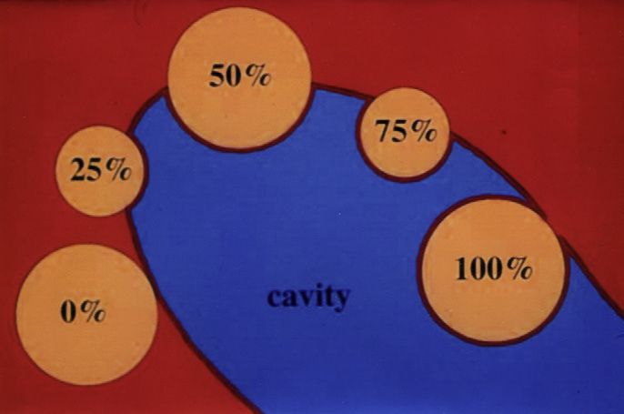

Slide 5
INTRODUCTION
Hysteroscopic resection is the gold standart.
Surgical feasibility and outcomes differs between type 0 and 1 fibroids.
Many techniques and instruments are suggested.

Slide 6
AIM
To compare the operative outcomes of hysteroscopic resection of type 0 and 1 submucous fibroids.

Slide 7
METHODS
Retrospective study design was used.
Cases underwent hysteroscopic myomectomy between 2010 and 2017 were selected.
Classification was done according to ESGE.
Only the data of type 0 and 1 submucos fibroids were collected.

Slide 8
METHODS
Preoperative and intraoperative assessment with ultrasound, magnetic resonance imaging and hysteroscopic view were used for diagnosis and classification.
Exclusion criteria :
- patients with multiple fibroids
- absence of histologic confirmation
- uterine anomaly
- patients recevied preoperative GnRH-a

Slide 9
METHODS
The included data were as:
- Demographic characteristics
- symptom on admission
- size of type 0 and 1 fibroids
- location of fibroids: fundus, corpus, lower segment
- preoperative assesment tool
- number of repeated resections
- duration of surgery
- method of anesthesia: general or spinal
- length of hospital stay
- completeness of surgery
- pre-postoperative Hb difference
- any complication

Slide 10
METHODS
The patients were divided into two groups as
Group 1(type 0) Group 2(type 1)

Slide 11
RESULTS
68 patients with hysteroscopic myomectomy records were reviewed during study period.
56 patients after exclusion were included.
30 patient had type 0 (group 1 ) and 26 patients had type 1 (group 2) submucous fibroids.

Slide 12
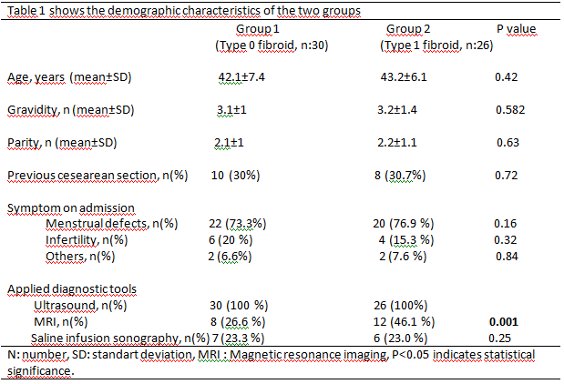

Slide 13
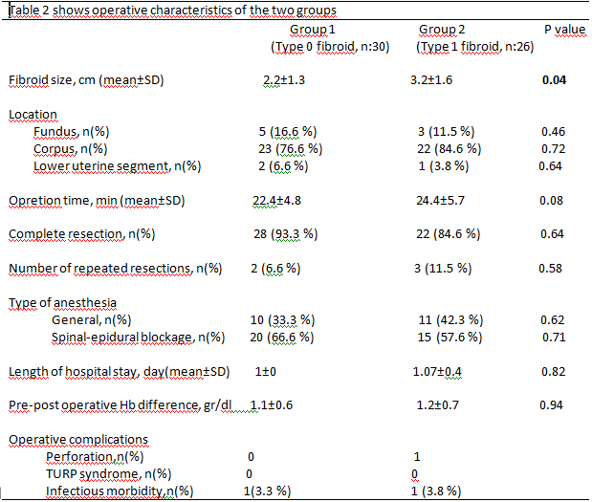

Slide 14
DISCUSSION
The fibroid classification system based mainly on the degree of protrusion into the uterine cavity and extension to the myometrium.
The operative outcomes of type 2-3 fibroids are significantly different from type 0-1.
As the degree of myometrial extension increases, the operation becomes more complex and prone to occurrence of complications.

Slide 15
DISCUSSION
The size and intramyometriyal extension are the main factors associated with complications of hysteroscopic resections.
The literature and clinical experiences show that the type 0 and 1 fibroids have comparable operative feasibility and outcomes.

Slide 16
CONCLUSION
Our findings show that hysteroscopic myomectomy of type 0 and 1 submucous fibroids has comparable operative outcomes.
Hysteroscopy resection seems to represent a safe and effective procedure for removal of submucous myoma with less 50% extension into myometrium.

Slide 17
THANK YOU…

