Slide 1
EBCOG Antalya 2017
INFECTIOUS DISEASES
INFECTIOUS DISEASES
IN OBSTETRICS & GYNAECOLOGY
P.I.D. &
Mycoplasma
Genitalium:
State of the Art
ISIDOG
Mr Peter Greenhouse FRCOG FFSRH
Consultant in Sexual Health Bristol UK peter.gh@icloud.com
PG – EBCOG Antalya 2017

Slide 2
EBCOG Torino 2016
Management
of PID
- New Ideas
- New Data
INFECTIOUS DISEASES
INFECTIOUS DISEASES
IN OBSTETRICS & GYNAECOLOGY
ISIDOG
Modern View of Infections in O&G

Slide 3
Declaration
INFECTIOUS DISEASES
INFECTIOUS DISEASES
Societies:
ISIDOG – Vice-President
BASHH – Honorary Life Fellow
ESC – Expert Advisory Group on STI
Consultancies:
Swiss Precision Diagnostics GmBH 2010 -
[Cepheid UK plc 2013-15]
[Sanofi Pasteur MSD plc 2007-16]
Great Wall of Vagina 2008 -
IN OBSTETRICS & GYNAECOLOGY
ISIDOG
Mr Peter Greenhouse FRCOG FFSRH
Consultant in Sexual Health Bristol UK peter.gh@icloud.com
Cambridge MedSoc Revue ‘Punk Doc’ 1977

Slide 4
Bristol Sexual Health Centre

Slide 7
Mycoplasma genitalium & PID
What is it?
Is it important?
Does it cause PID?
How is it treated?
What further research is needed?

Slide 8
Mycoplasma genitalium & PID
What is it?
Is it important?
Does it cause PID?
How is it treated?
What further research is needed?
EVIDENCE ?
Cervicitis
Endometritis = AUB
Severe Salpingitis
Ectopic Pregnancy
Tubal Infertility
Miscarriage
Premature Birth

Slide 9
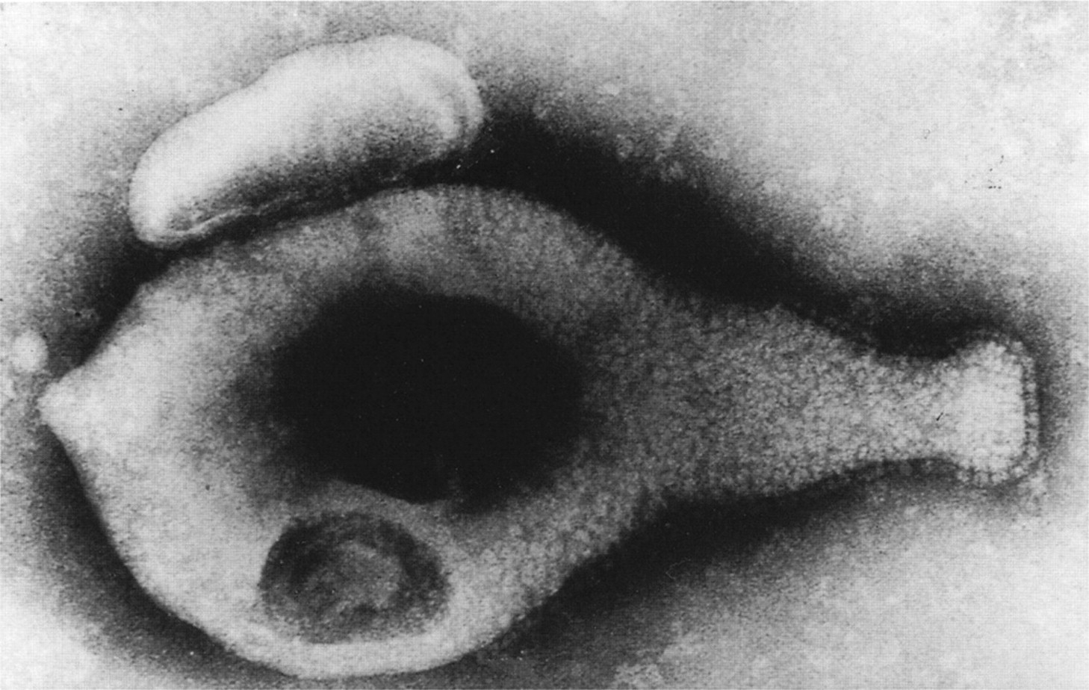
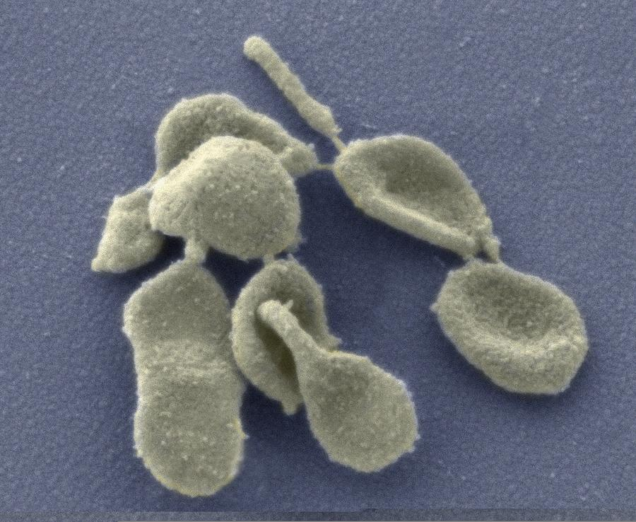
Mycoplasma genitalium - biology
Member of ‘Mollicutes’ class – No cell wall
Smallest known genome – 580 kb
Flask-shaped organism – DNA + RNA + proteins
Discovered in 1981 in male urethritis
Very slow growing in culture – PCR/TMA now available
A newly discovered mycoplasma in the human urogenital tract
Tully JG, Taylor-Robinson D et al. Lancet 1981;1:1288–91

Slide 10
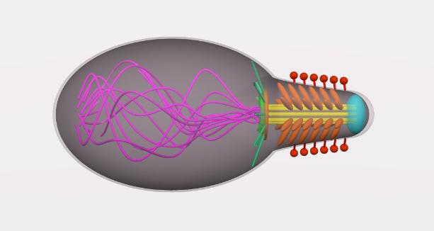
Mycoplasma genitalium - biology
Motile structures attach to human cells
Surface parasite of mucous membranes
Adherent to spermatozoa
Cytoskeletal ‘‘jellyfish’’ structure of Mycoplasma mobile
Nakane D, Makoto Miyata MPNAS 2007; 104: 19518–19523.

Slide 11
Mycoplasma Genitalium & Urethritis
Frequently found in Non-Specific Urethritis
[Non-Chlamydial Non-Gonococcal]
Editorial review of 11 studies – pooled results
NSU vs No Urethritis
M.Genitalium 23.5% 5.6%
p<0.00001 OR 5.14 (3.38–7.87)
CLINICALLY RELEVANT

Slide 12
Mycoplasmata - vaginal commensals?
Found in vagina/cervix
Mycoplasma hominis
Ureaplasma urealyticum
Ureaplasma parvum
Mycoplasma genitalium
20-50%
40-80%
0 - 5%
COMMENSAL?
}

Slide 13
Mycoplasma genitalium & PID
What is it?
Is it important?
Does it cause PID?
How is it treated?
What further research is needed?

Slide 14
M. genitalium & PID - EVIDENCE
Cervicitis
Endometritis = AUB
Severe Salpingitis
Ectopic Pregnancy
Tubal Infertility
Miscarriage
Premature Birth
PID Meta-Analysis

Slide 15
Upper Genital Tract Infection (UGTI)
Perihepatitis
(Perisplenitis)
Periappendicitis Peritonitis
Parametritis
Oophoritis Salpingitis
Endometritis
Cervicitis
Simple
Diagnostic
Tests?

Slide 16
M. genitalium & PID - EVIDENCE
Cervicitis
Endometritis = AUB
Severe Salpingitis
Ectopic Pregnancy
Tubal Infertility
Miscarriage
Premature Birth
PID Meta-Analysis

Slide 17
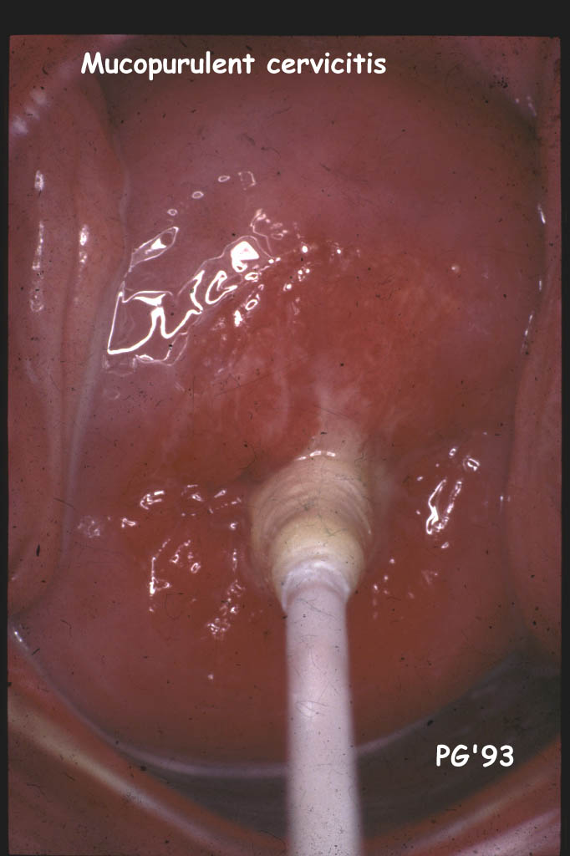
Cervicitis in PID diagnosis?
Clinical Photography ©1993
Peter Greenhouse FRCOG

Slide 18
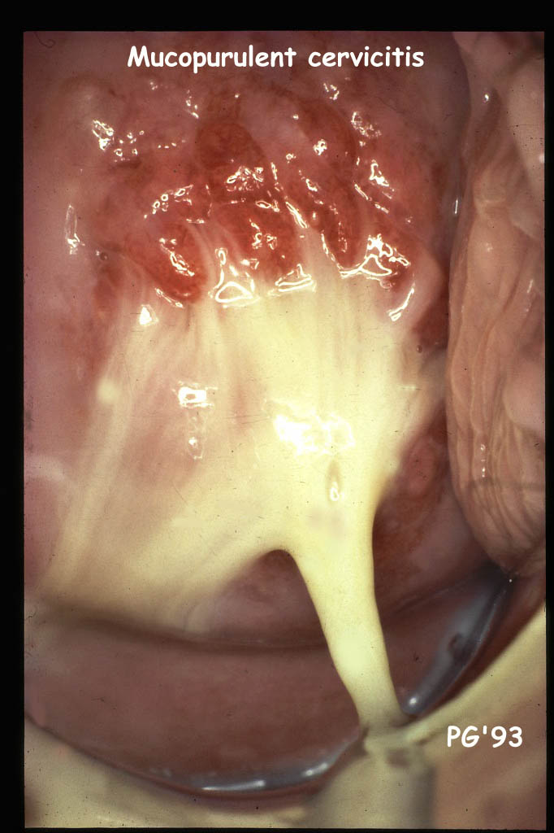
Cervicitis in PID diagnosis?
Clinical Photography ©1993
Peter Greenhouse FRCOG

Slide 19
Cervicitis in PID diagnosis?
Pus Cells + Bacterial Vaginosis as
markers of endometritis in PID
“Non-Specific” finding
Variable definitions
Poor Positive PV – 17%
Good Negative PV – 95%
Yudin MH et al Am J Obstet Gynecol 2003; 188: 318-23

Slide 20
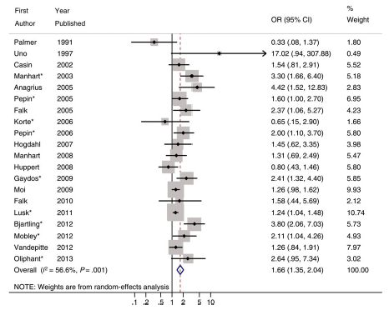
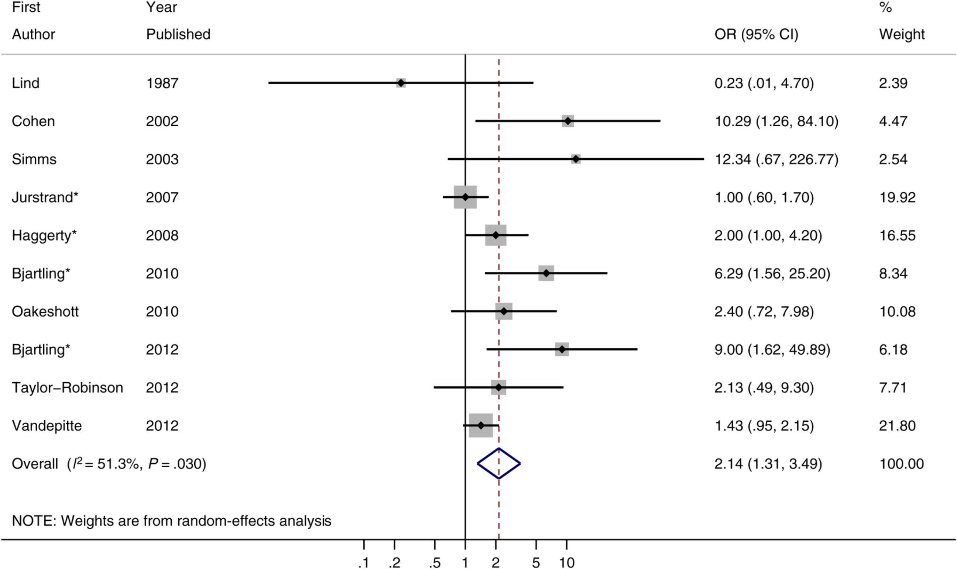
Mycoplasma genitalium & Cervicitis
? !
AUTHOR YEAR ODDS RATIO
“M.genitalium was associated with a
significantly increased risk of cervicitis”
POR = 1.66 [1.35-2.04]
Lis R et al. Mycoplasma genitalium Infection and Female Reproductive Tract Disease: A Meta-analysis
Clin Infect Dis. 2015;61:418-426
Notes:
Figure 2. Forest plot of the association between Mycoplasma genitalium and pelvic inflammatory disease. *Adjusted effect estimate (crude effect estimate in all other cases). Abbreviations: CI, confidence interval; OR, odds ratio.
20

Slide 21
M. genitalium & PID - EVIDENCE
Cervicitis
Endometritis = AUB
Severe Salpingitis
Ectopic Pregnancy
Tubal Infertility
Miscarriage
Premature Birth
PID Meta-Analysis

Slide 22
M. genitalium & PID - EVIDENCE
Cervicitis
Endometritis = AUB
Severe Salpingitis
Ectopic Pregnancy
Tubal Infertility
Miscarriage
Premature Birth
PID Meta-Analysis

Slide 23
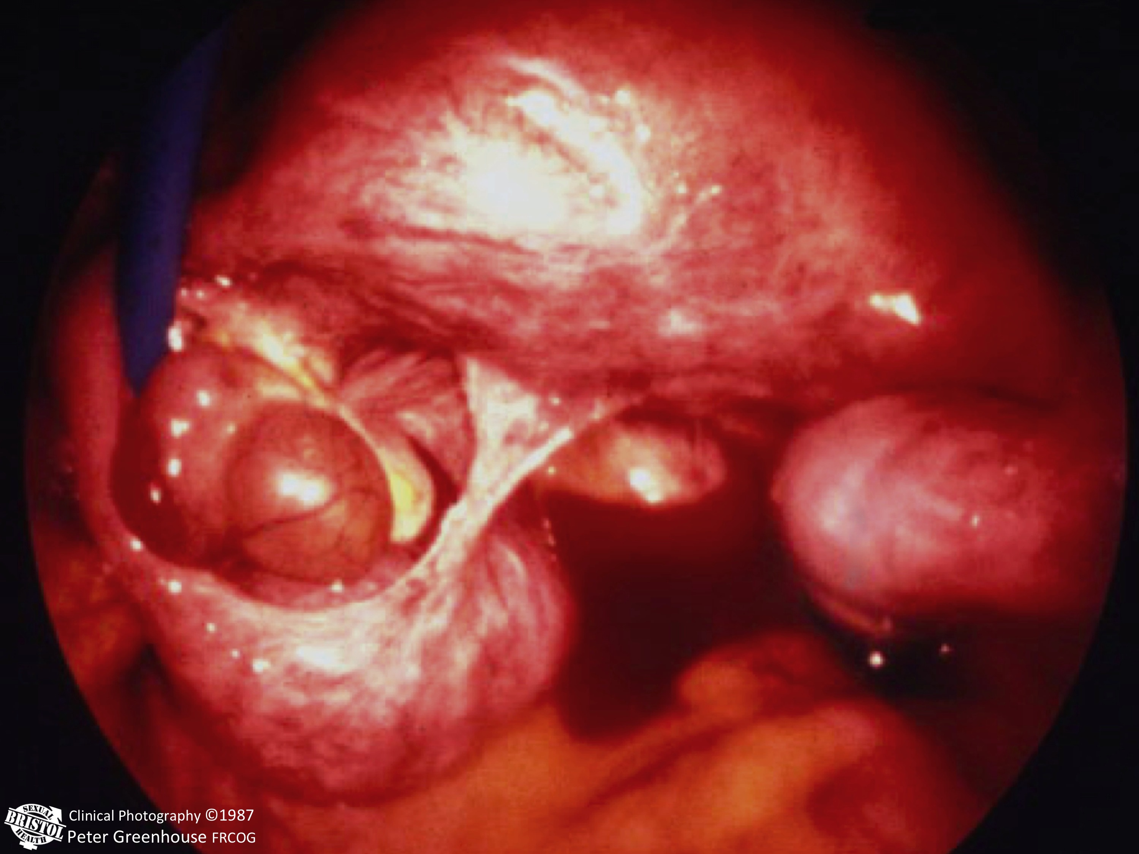
M.Genitalium in Severe PID?
Severe PID is very rare in Europe
More common in Africa

Slide 24
M.Genitalium in Severe PID?
Nairobi Laparoscopy cohort
Acute PID n=123 MG found
Cervix & Endometrium 9 (7%)
Fallopian Tube 1 (0.8%)
WHY? ? More in seen mild salpingitis
? Poorly detected by assay
? Not important as pathogen

Slide 25
M.Genitalium in Severe PID?
Nairobi Laparoscopy cohort
Acute PID n=123 HIV Positive
M.Genitalium Positive 79% (7/9)
M.Genitalium Negative 37% (42/114)
p<0.03
WHY? ? Role of immune response

Slide 26
M.Genitalium in Severe PID?
Tubo-Ovarian Abscess – most severe PID
More common in Africa
Clinical Photography ©1986
Peter Greenhouse FRCOG

Slide 27
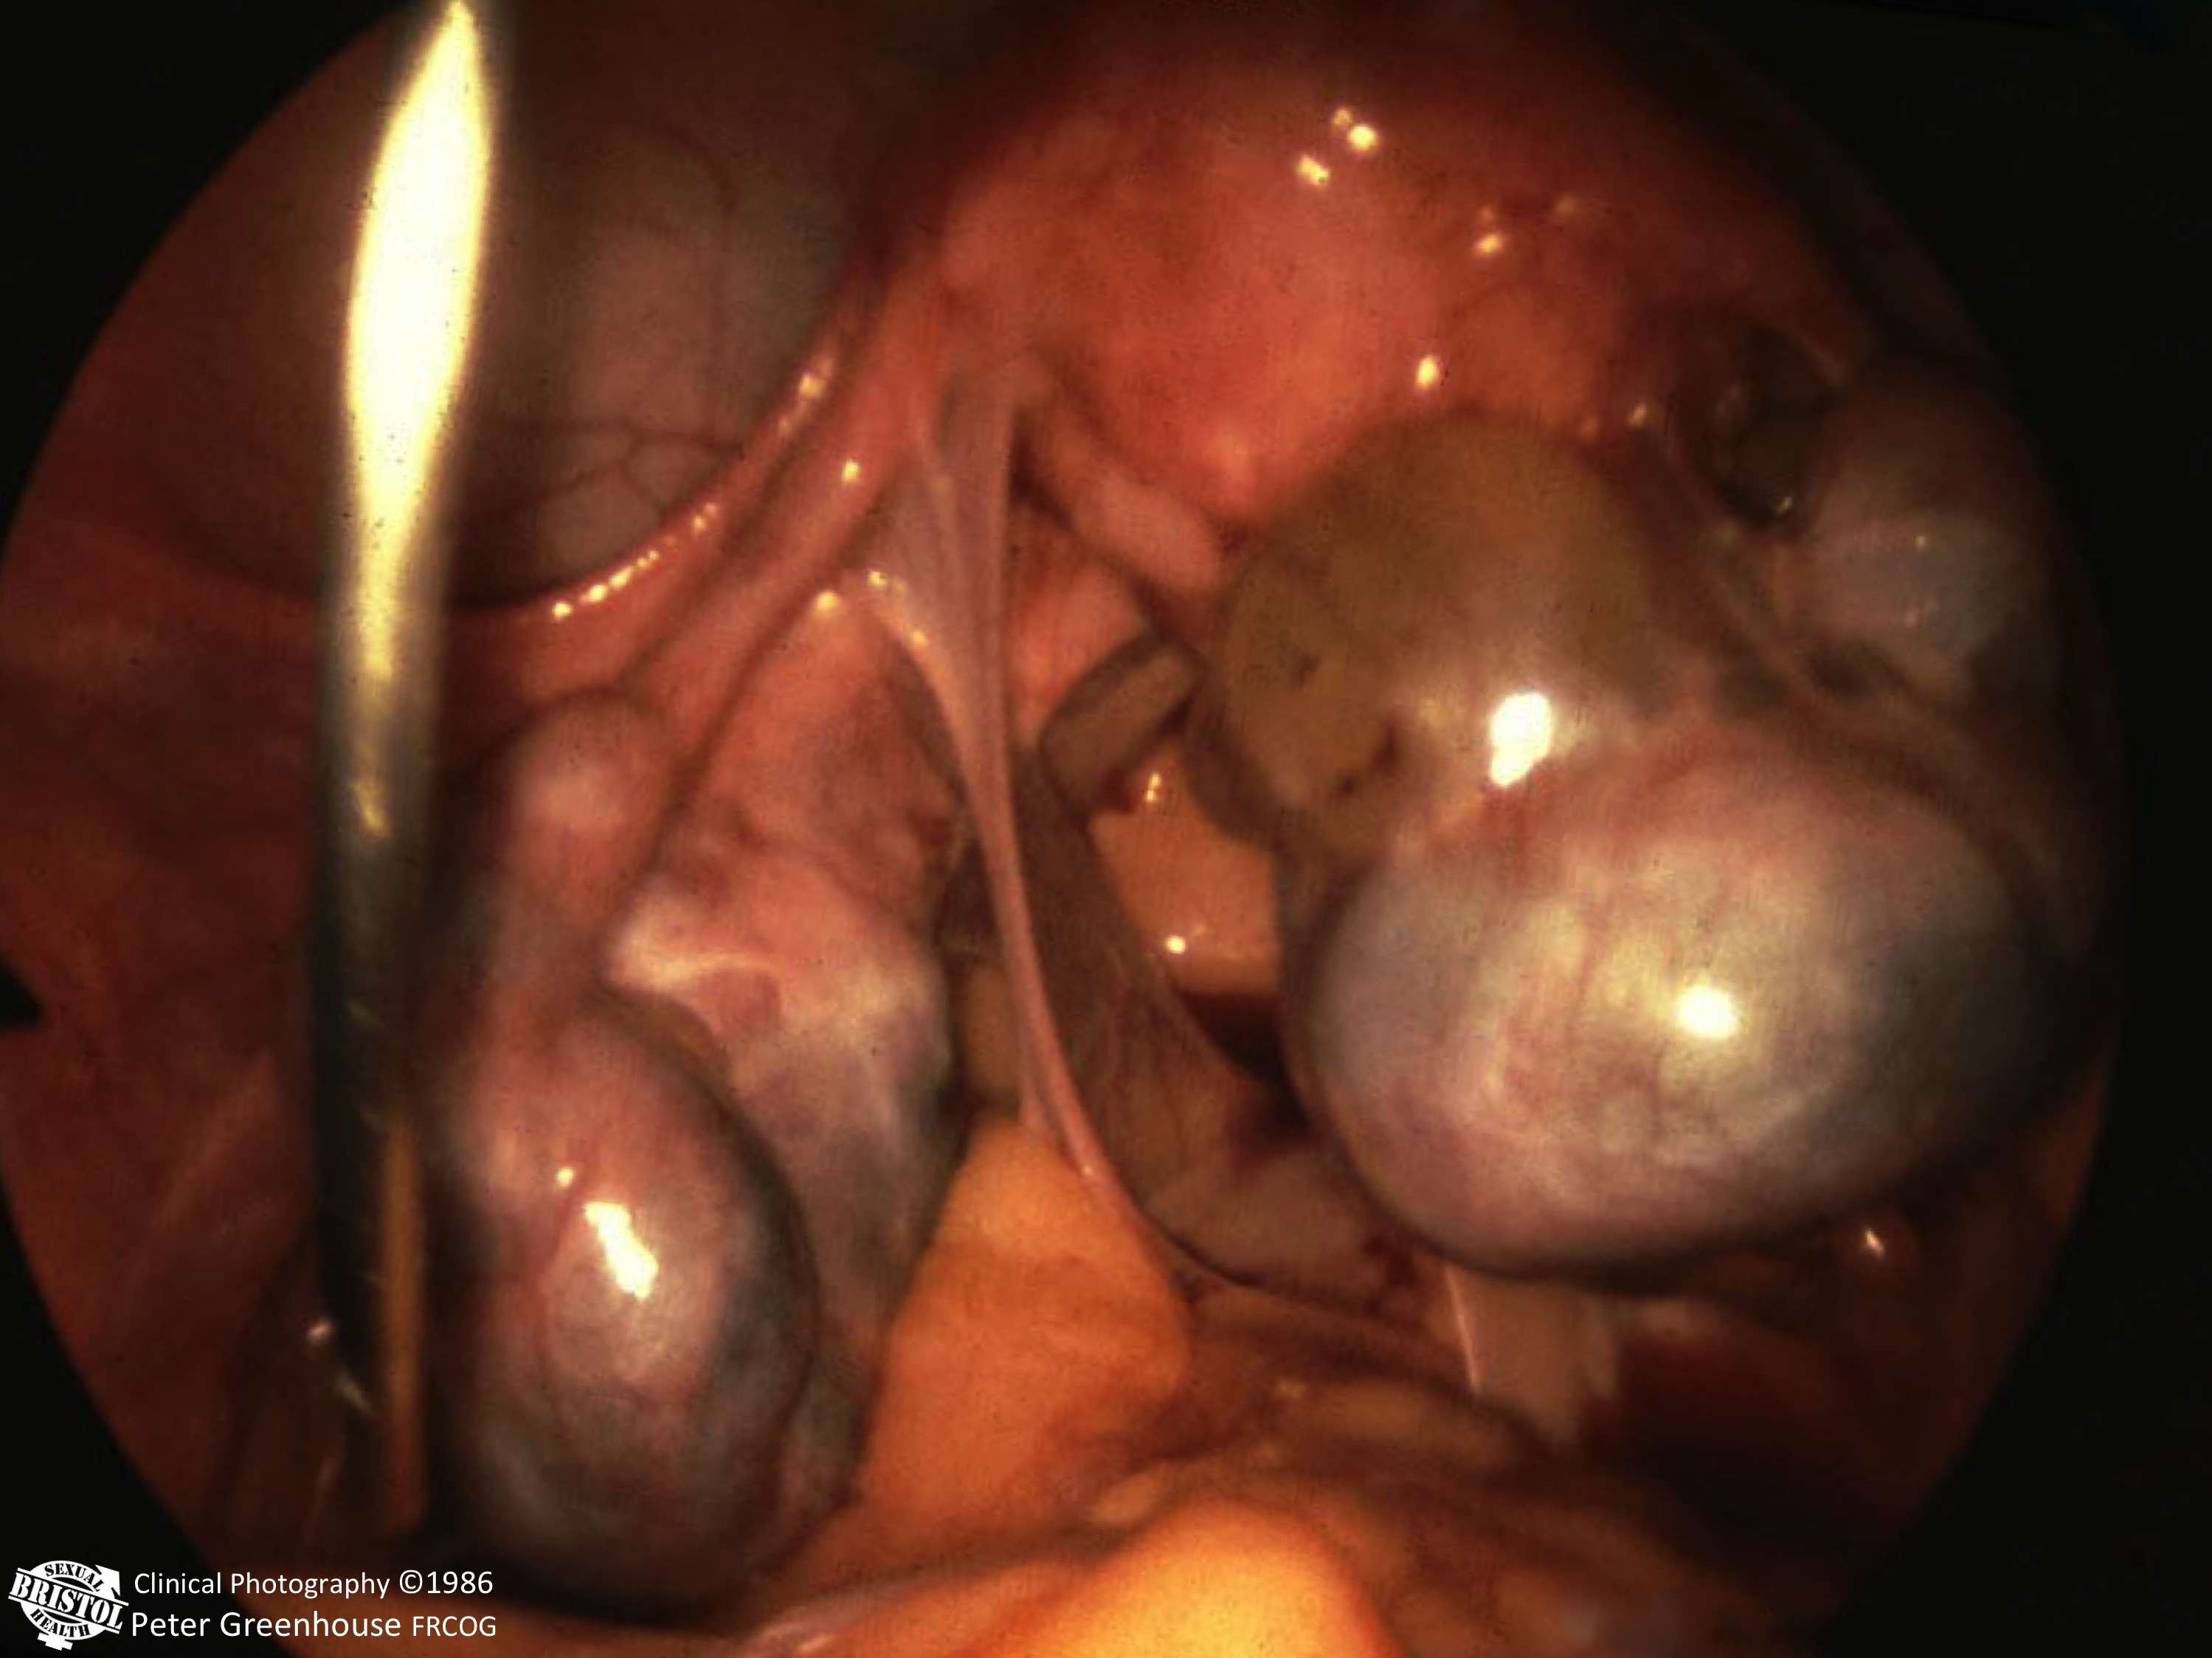
M.Genitalium in Severe PID?
Tubo-Ovarian Abscess – most severe PID
More common in Africa
Less often caused by STI

Slide 28
Etiology of persistent TOA (Nairobi)
Gut Aerobes 100%
Anaerobes 82%
STI 10%
Cohen C et al Inf Dis Obst Gyn 2003; 11: 45-51

Slide 29
M. genitalium & PID - EVIDENCE
Cervicitis
Endometritis = AUB
Severe Salpingitis
Ectopic Pregnancy
Tubal Infertility
Miscarriage
Premature Birth
PID Meta-Analysis

Slide 30
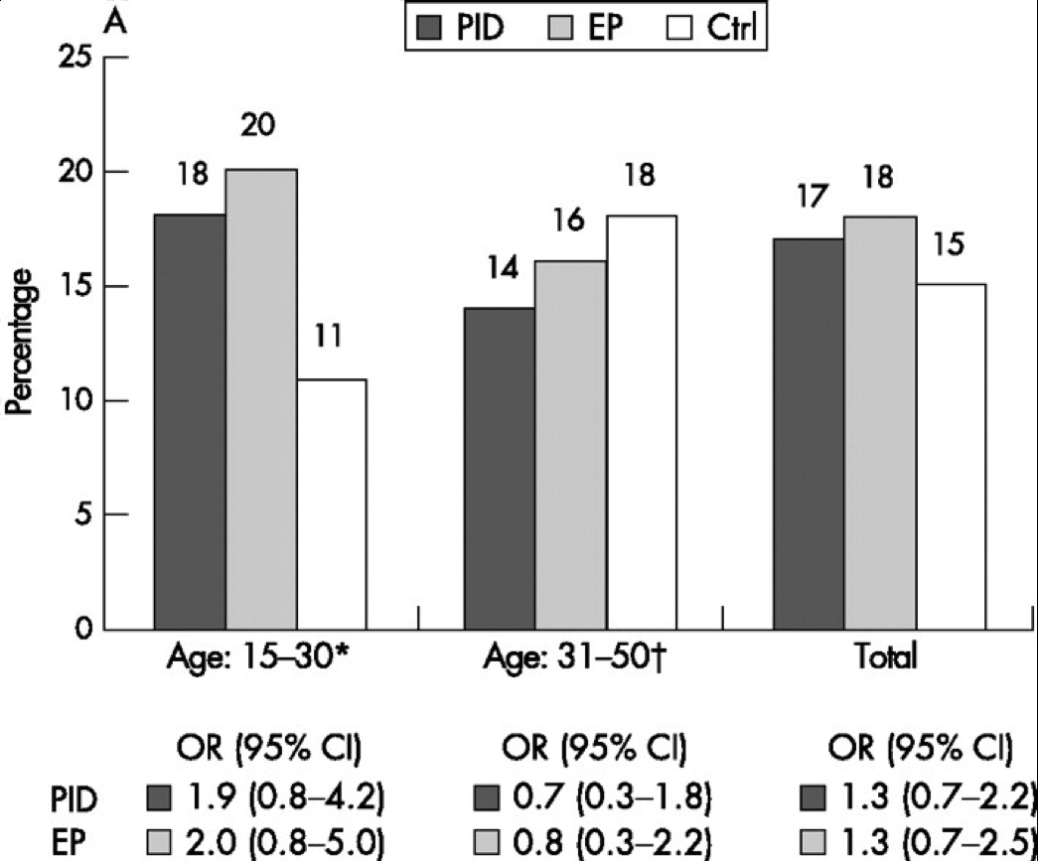
Figure 1 (A) M genitalium LAMP-EIA results in percentages (%). Seropositive pelvic inflammatory disease (PID) patients (n = 194) and ectopic pregnancy (EP) patients (n = 83) are compared to the control group (Ctrl) of healthy pregnant women (n = 246). Statistical analyses were carried out by logistic regression and crude results are shown as the odds ratios (OR) and their 95% confidence intervals (CI). (B) Chlamydia trachomatis IgG EIA results in percentages (%). Seropositive pelvic inflammatory disease (PID) patients (n = 194) and ectopic pregnancy (EP) patients (n = 83) are compared to the control group (Ctrl) of healthy pregnant women (n = 246). Statistical analyses were carried out by logistic regression and crude results are shown as the odds ratios (OR) and their 95% confidence intervals (CI).*The age is 18-30 years for the EP patients and Ctrl.{dagger}The age is 31-42 for the EP patients and Ctrl.
Lipid Associated Mem. Prot. - EIA
M. genitalium - PID + Ectopic Pregnancy
PID
Ectopic
Jurstrand, M. et al. Sex Transm Infect 2007;83:319-323 .
Copyright ©2007 BMJ Publishing Group Ltd.

Slide 31
Chlamydial antibody titres
(median, range & quartiles)
according to outcome of pregnancy
≥4096
2048
2048
1024
512
p<0.0001
256
Chlamydial titre
128
64
<64
Live births
Miscarriages
Ectopics
AKANDE VA Univ. Bristol PhD Thesis 2001
Notes:
If we turn to this slide we see the distribution of antibody titre according to the outcome of pregnancy.
Women who had ectopic pregnancies the median titre was 1024 and the majority of women had high titres
Titres were significantly lower in women who had a live birth or miscarriage

Slide 32
Chlamydial antibody titres
(median, range & quartiles)
according to outcome of pregnancy
≥4096
2048
2048
1024
512
p<0.0001
256
Chlamydial titre
128
64
<64
Live births
Miscarriages
Ectopics
AKANDE VA Univ. Bristol PhD Thesis 2001
Notes:
If we turn to this slide we see the distribution of antibody titre according to the outcome of pregnancy.
Women who had ectopic pregnancies the median titre was 1024 and the majority of women had high titres
Titres were significantly lower in women who had a live birth or miscarriage

Slide 33
E.P. vs Chlamydia
1985
1995
No Chlamydia
= No Ectopics!
Egger M et al BMJ 1998: 316; 1776-9

Slide 34
M. genitalium & PID - EVIDENCE
Cervicitis
Endometritis = AUB
Severe Salpingitis
Ectopic Pregnancy
Tubal Infertility
Miscarriage
Premature Birth
PID Meta-Analysis

Slide 35
M.Genitalium in TFI?
METHODS:
Sera from 308 infertile women were investigated for antibodies to M. genitalium by immunoblotting. Women with tubal factor infertility (TFI) made up 132 of the patients, 67 of the women had an infertile male partner and 109 were infertile for unknown reasons.
RESULTS:
TFI patients 29 (22.0%) positive M. genitalium versus 11 (6.3%) pos in normal tubes
TFI 75 (56.8%) of the TFI seropositive to C. trachomatis.
Eight (27.6%) TFI patients seropositive to MgPa were negative to C. trachomatis.

Slide 37
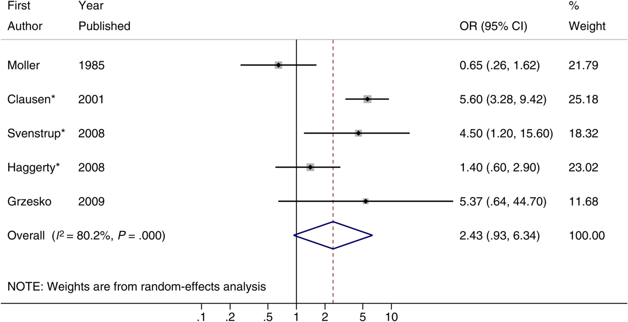
Mycoplasma genitalium & Infertility
AUTHOR YEAR ODDS RATIO
“More studies will be required”
POR = 2.43 [0.93-6.34]
Lis R et al. Mycoplasma genitalium Infection and Female Reproductive Tract Disease: A Meta-analysis
Clin Infect Dis. 2015;61:418-426
Notes:
Figure 2. Forest plot of the association between Mycoplasma genitalium and pelvic inflammatory disease. *Adjusted effect estimate (crude effect estimate in all other cases). Abbreviations: CI, confidence interval; OR, odds ratio.
37

Slide 38
M. genitalium & PID - EVIDENCE
Cervicitis
Endometritis = AUB
Severe Salpingitis
Ectopic Pregnancy
Tubal Infertility
Miscarriage
Premature Birth
PID Meta-Analysis

Slide 39
Debate
“Multiplex testing should
be universally used
for STI diagnosis”
FOR the motion:
Mr. Peter Greenhouse FRCOG
Bristol, UK

Slide 40
Mycoplasmas: No Correlation with SFGA
Ivanova T.A.¹, Guschin A.E.¹, Belova A.V.², Astsaturova O.R.², Nikonov A.P²
¹⁻Central Research Institute for Epidemiology;
²⁻I.M. Sechenov Moscow Medical Academy, Russia
Genital mycoplasmas: impact on neonatal pathology

Slide 41
Genital mycoplasmas: impact on neonatal pathology
No correlation with SFGA
No correlation with PPROM
Weak association of U.parvum high concentration & low apgar score
No association of M.hominis
U.Urealyticum
with any poor outcome
Ivanova T.A., Guschin A.E., Belova A.V., Astsaturova O.R., Nikonov A.P
IUSTI Tbilisi 2010 – Prizewinning presentation

Slide 42
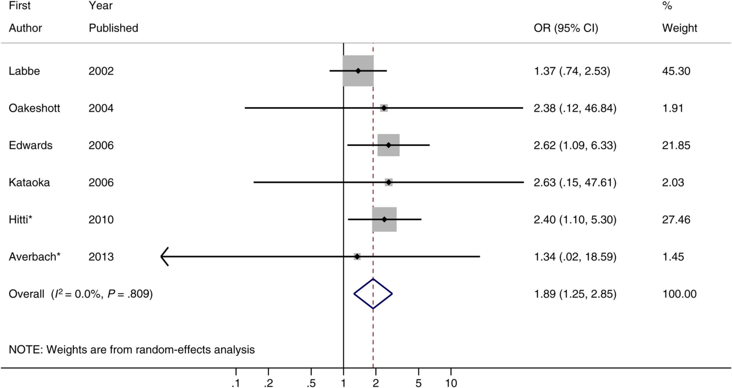
M.genitalium & Pre-Term Birth
AUTHOR YEAR ODDS RATIO
“M.genitalium was significantly associated with increased risk of pre-term birth”
POR = 1.89 [1.25-2.85]
Lis R et al. Mycoplasma genitalium Infection and Female Reproductive Tract Disease: A Meta-analysis
Clin Infect Dis. 2015;61:418-426
Notes:
42

Slide 43
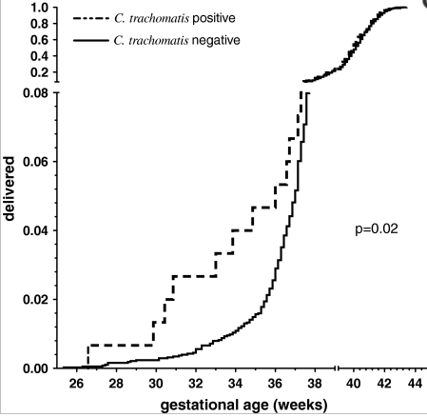
Chlamydia & Premature Labour
RR = 4.1
27-34 w
14% of PTB
Rours GI et al Eur J Epidemiol. 2011;26:493-502
Chlamydia trachomatis infection during pregnancy associated with preterm delivery:
a population-based prospective cohort study.

Slide 44
M.genitalium, C.trachomatis & PID (NZ)
MG CT
Controls n = 250 8.7% 9.9%
PID Cases n = 91 9.9% 27.5%
PID ASSOCIATION OR [95% CI]
C. Trachomatis 2.44 [1.24-4.81]
M. Genitalium 0.91 [0.38-2.20]
“M. genitalium was almost as commonly diagnosed as C. trachomatis”
“C. trachomatis was the only organism significantly associated with PID”

Slide 45
M. genitalium & PID - EVIDENCE
Cervicitis
Endometritis = AUB
Severe Salpingitis
Ectopic Pregnancy
Tubal Infertility
Miscarriage
Premature Birth
PID Meta-Analysis

Slide 46
Mycoplasma genitalium & PID
AUTHOR YEAR ODDS RATIO
?
“M.genitalium was associated with a
significantly increased risk of PID”
POR = 2.14 [1.31-3.49]
Lis R et al. Mycoplasma genitalium Infection and Female Reproductive Tract Disease: A Meta-analysis
Clin Infect Dis. 2015;61:418-426
Notes:
Figure 2. Forest plot of the association between Mycoplasma genitalium and pelvic inflammatory disease. *Adjusted effect estimate (crude effect estimate in all other cases). Abbreviations: CI, confidence interval; OR, odds ratio.
46

Slide 47
Statistical significance ≠ Clinical relevance
ODDS RATIO
?
.1 .2 .5 1 2 5 10 20 50 100
Lis R et al. Mycoplasma genitalium Infection and Female Reproductive Tract Disease: A Meta-analysis
Clin Infect Dis. 2015;61:418-426
Notes:
Figure 2. Forest plot of the association between Mycoplasma genitalium and pelvic inflammatory disease. *Adjusted effect estimate (crude effect estimate in all other cases). Abbreviations: CI, confidence interval; OR, odds ratio.
47

Slide 48
Statistical significance ≠ Clinical relevance
ODDS RATIO
!
Smoking & Lung Cancer 40 (22-80)
.1 .2 .5 1 2 5 10 20 50 100
Stellman SD et al. Cancer Epidemiol Biomarkers Prev. 2001;10:1193-9
Notes:
Figure 2. Forest plot of the association between Mycoplasma genitalium and pelvic inflammatory disease. *Adjusted effect estimate (crude effect estimate in all other cases). Abbreviations: CI, confidence interval; OR, odds ratio.
48

Slide 49
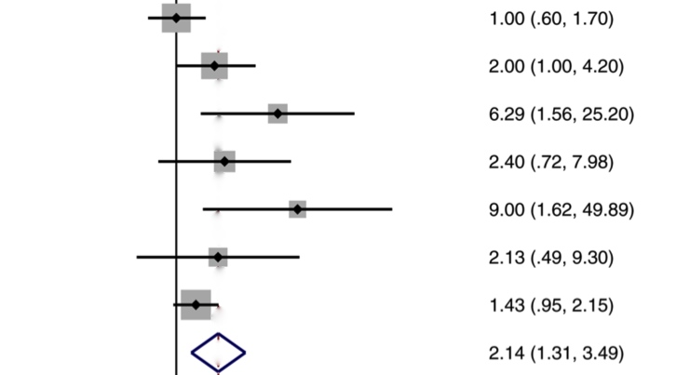
Chlamydia trachomatis & PID
AUTHOR ODDS RATIO
Paavonen 6.90 (0.8–61.4)
Mascellino 7.00 (3.1–15.8)
Simms 18.7 (2.5–142.1)
Pooled estimate 9.20 (4.4–18.1)
Pooled adjusted 17.1 (7.9–34.0)
M.genitalium data
C.Trachomatis data
POR = 2.14 [1.31-3.49]
POR = 17.1 [7.9-34.0]
.1 .2 .5 1 2 5 10 20 50 100
Notes:
Figure 2. Forest plot of the association between Mycoplasma genitalium and pelvic inflammatory disease. *Adjusted effect estimate (crude effect estimate in all other cases). Abbreviations: CI, confidence interval; OR, odds ratio.
49

Slide 50
Mycoplasma genitalium & PID
What is it?
Is it important?
Does it cause PID?
How is it treated?
What further research is needed?

Slide 51
Mycoplasma genitalium - TREATMENT
1= Josamycin 500mg tds x10d
1= Extended Azithromycin 500mg stat THEN 250mg od x4d
2. - if Azithromycin resistant
Moxifloxacin 400mg od x7-10d
3. - after Azithromycin & Moxifloxacin failure
Pristinamycin 1g qds x10d
4. - for complicated MG (PID)
Moxifloxacin 400mg od x14d
?

Slide 52
M.genitalium - Rx PROBLEMS +++
No routine testing – specialist centres only
Moxifloxacin expensive & side effects
Other antibiotics not widely available
15% Rx failure with Azithromycin 1g
40-50% Azithro resistance at 23S RNA gene
Pattern of resistance varies by country
10% in Sweden 100% in Greenland!

Slide 53
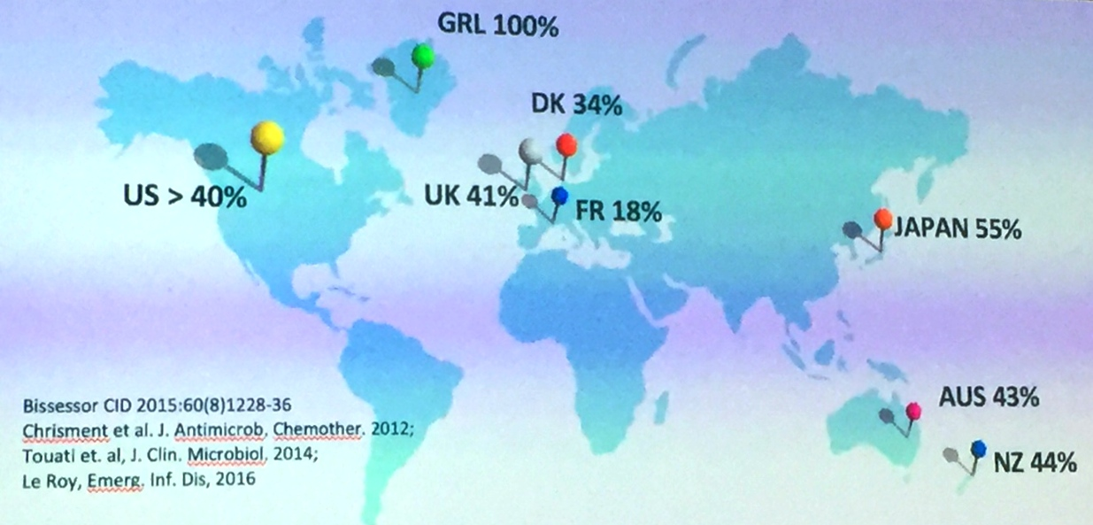
M.genitalium - Azithromycin resistance
!

Slide 54
Mycoplasma Genitalium & PID
?
What is it?
Is it important?
Does it cause PID?
How is it treated?
What further research is needed?

Slide 55
Mycoplasma Genitalium & PID
Certainly NOT the principal cause of PID
Rarely found in severe PID, but…
Sometimes the ONLY infection found
Conflicting evidence on significance
Marginal statistical sig. ≠ Clinical relevance
MAYBE - relevant in few individual women
??? Genetic predisposition
Teşekür ederim

Slide 57
Blah de blah
]]
Clinical assessment of women with pelvic pain was a poor indicator of disease seen at laparoscopy. Thus, of 109 women, 22 at laparoscopy had salpingitis, 19 had adhesions without salpingitis, 20 had endometriosis or ovarian pathology and 48 no observable abnormality. In all laparoscopic categories, Ureaplasma spp. and Mycoplasma hominis, but not Mycoplasma genitalium, were at least as common in the cervix/vagina as Chlamydia trachomatis and equally frequent in the endometrium. However, C. trachomatis had the greatest propensity for spread to the Fallopian tubes. Thus, of 28 women who had C. trachomatis organisms in the vagina/cervix, 13 had them in a Fallopian tube (ratio 2.2:1); the ratio was 6:1 for Neisseria gonorrhoeae, 8:1 for M. genitalium, 21:1 for M. hominis and 31:1 for Ureaplasma spp. M. hominis organisms in a large number were detected most often in women with salpingitis. The likelihood of spread of Ureaplasma urealyticum and U. parvum from the lower to the upper genital tract was about the same and they were detected only once each in a tube, which was not inflamed in either case. Multiple bacteria were often detected at a single site, making it difficult to establish the exact cause of disease. However N. gonorrhoeae was considered to be the sole cause of salpingitis in one woman and the primary or equal primary contributor in four others; C. trachomatis was involved in at least 11 women, mostly as the sole cause or as the primary contributor; M. genitalium was considered the cause in one woman and had possible involvement in three others; and M. hominis was a questionable sole cause in one woman and the primary or equal primary contributor in three. Serologically, C. trachomatis was related to adhesions, without salpingitis, more often (63%) than any other micro-organism. M. genitalium may have been implicated in one case.

Slide 58
Chlamydia trachomatis & PID
Paavonen 6.9 (0.8–61.4)
Mascellino 7.0 (3.1–15.8)
Simms 18.7 (2.5–142.1)
Pooled estimate 9.2 (4.4–18.1)
Pooled adjusted 17.1 (7.9–34.0)

