Slide 1
The Fetal Heart : what you should know
Juriy Wladimiroff, MD, PhD, FRCOG,FCNGOF,FEBCOG,FISUOG, FAIUM,FUAOG,Dr h.c.

Slide 2
FETAL CARDIOVASCULAR SYSTEM CONGENITAL HEART DISEASE (CHD)
8/1000 live births
20% of prenatal deaths from congenital malformations
>50% of deaths from lethal malformations during childhood
At least about 25% of prenatally diagnosed cardiac anomalies are associated with a chromosomal defect.

Slide 3
FRONTAL VIEW OF THE FETAL HEART C Tennstedt. In: Fetal Cardiology. (Yagel et al,eds).Dunitz, 2004, pp 23-31.

Slide 4
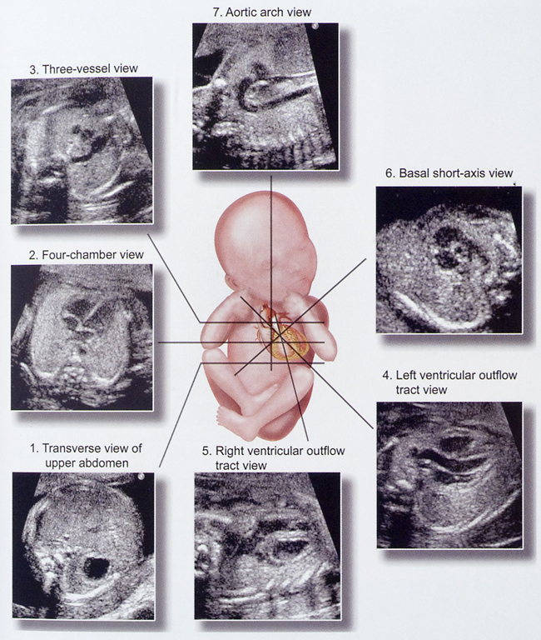
CROSS SECTIONS THROUGH THE FETAL HEART

Slide 5
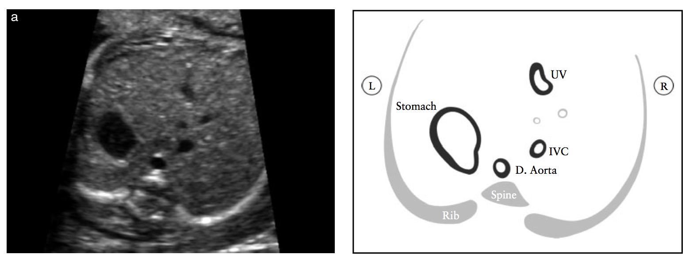
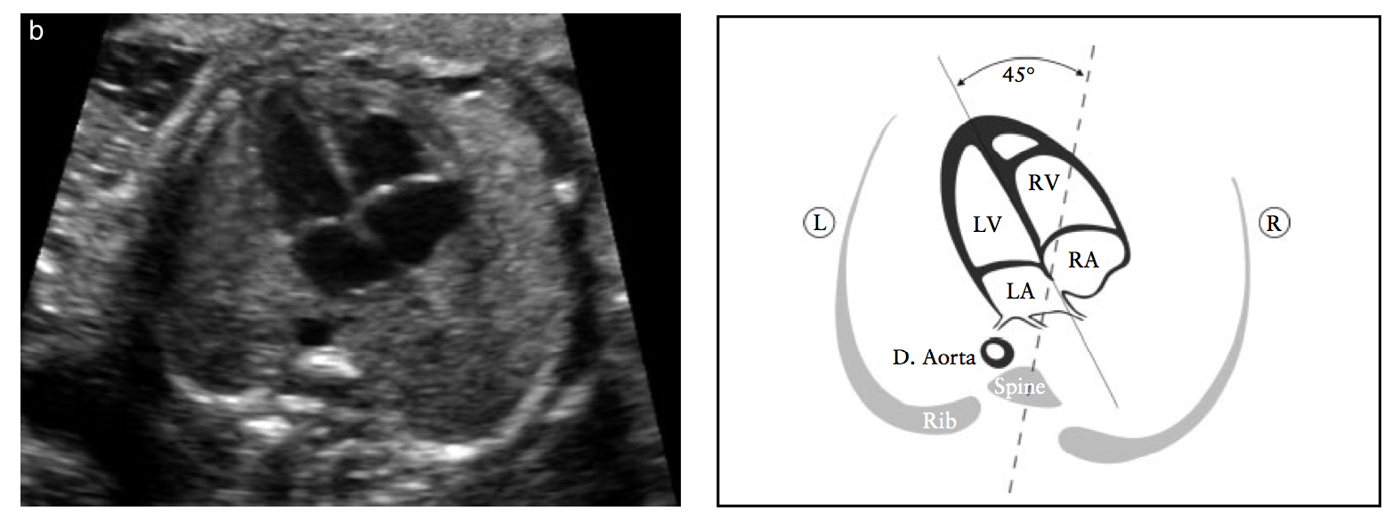

Slide 6
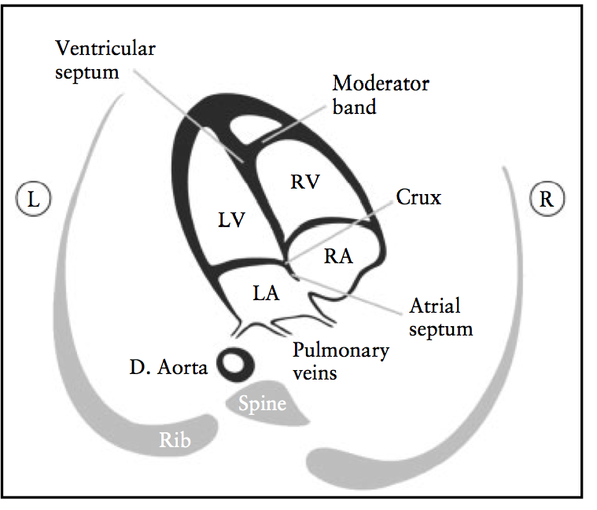

Slide 7
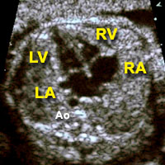
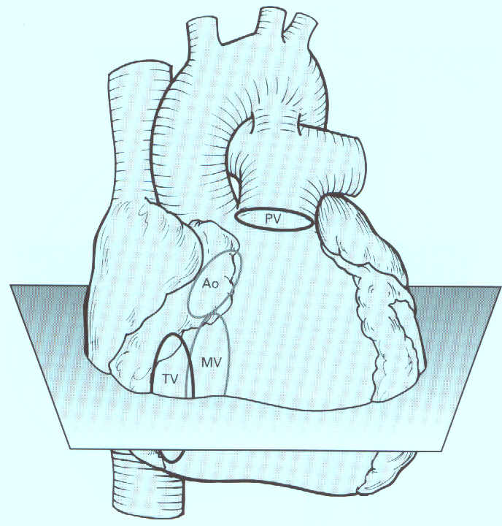
4 Chamber View & Great Vessels
What to look for:
Size
Position
Morphology
Rhythm
Function

Slide 8
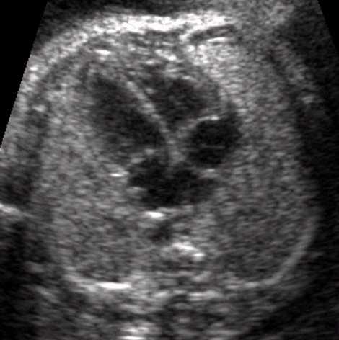
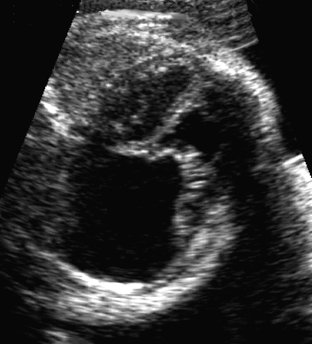
4 Chamber View
* Cardiac size approx 1/3 thoracic area
* cardio-thoracic ratio 0.4 - 0.5

Slide 9
HEART: 4 CHAMBER VIEW; HEART AXIS
Heart axis: angle of 45 degrees to the spine – sternum axis which travels through: a) the LEFT atrium and b) the RIGHT ventricle !
45 º

Slide 10
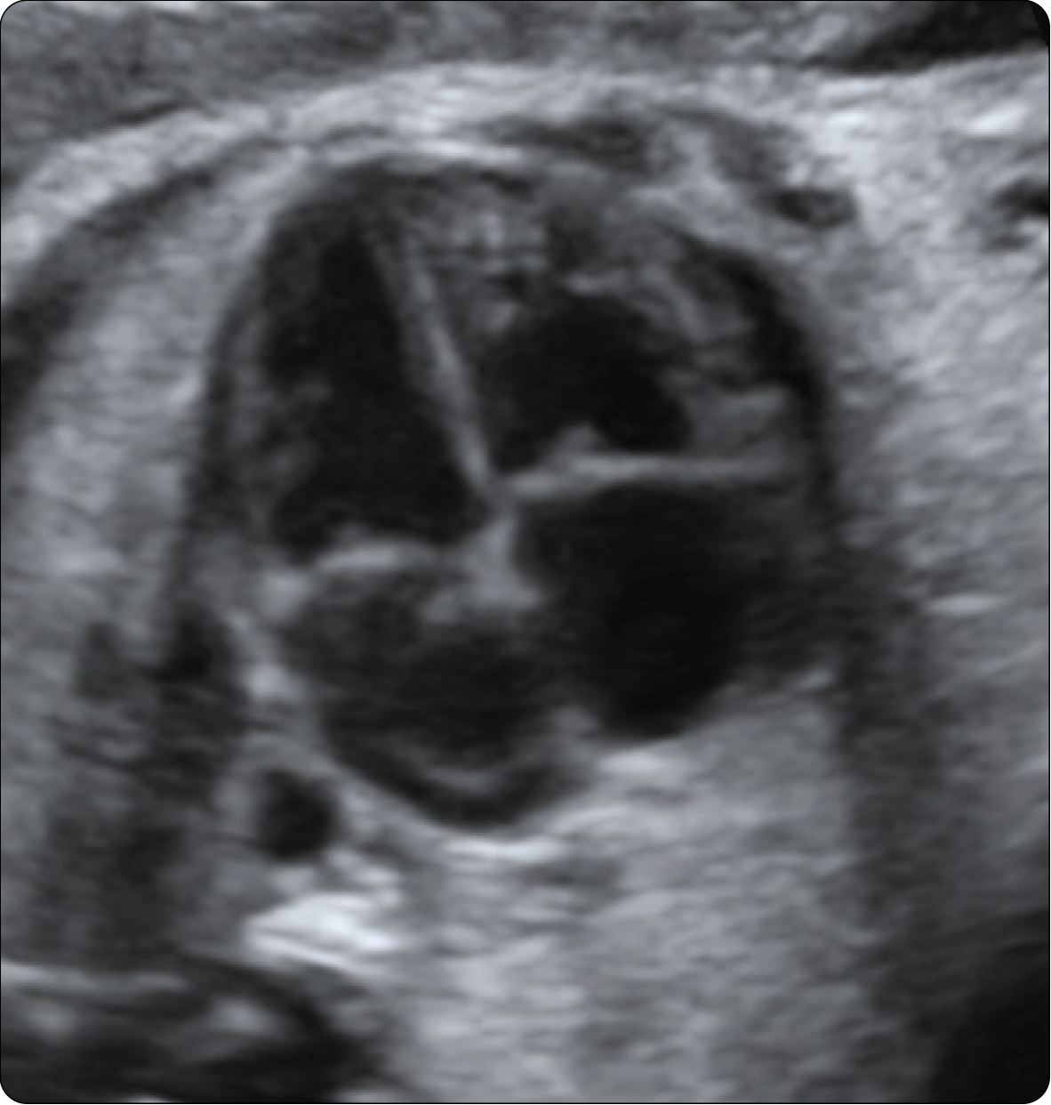
Left ventricle
RV
R
LV
L
MV
RA
LA

Slide 11
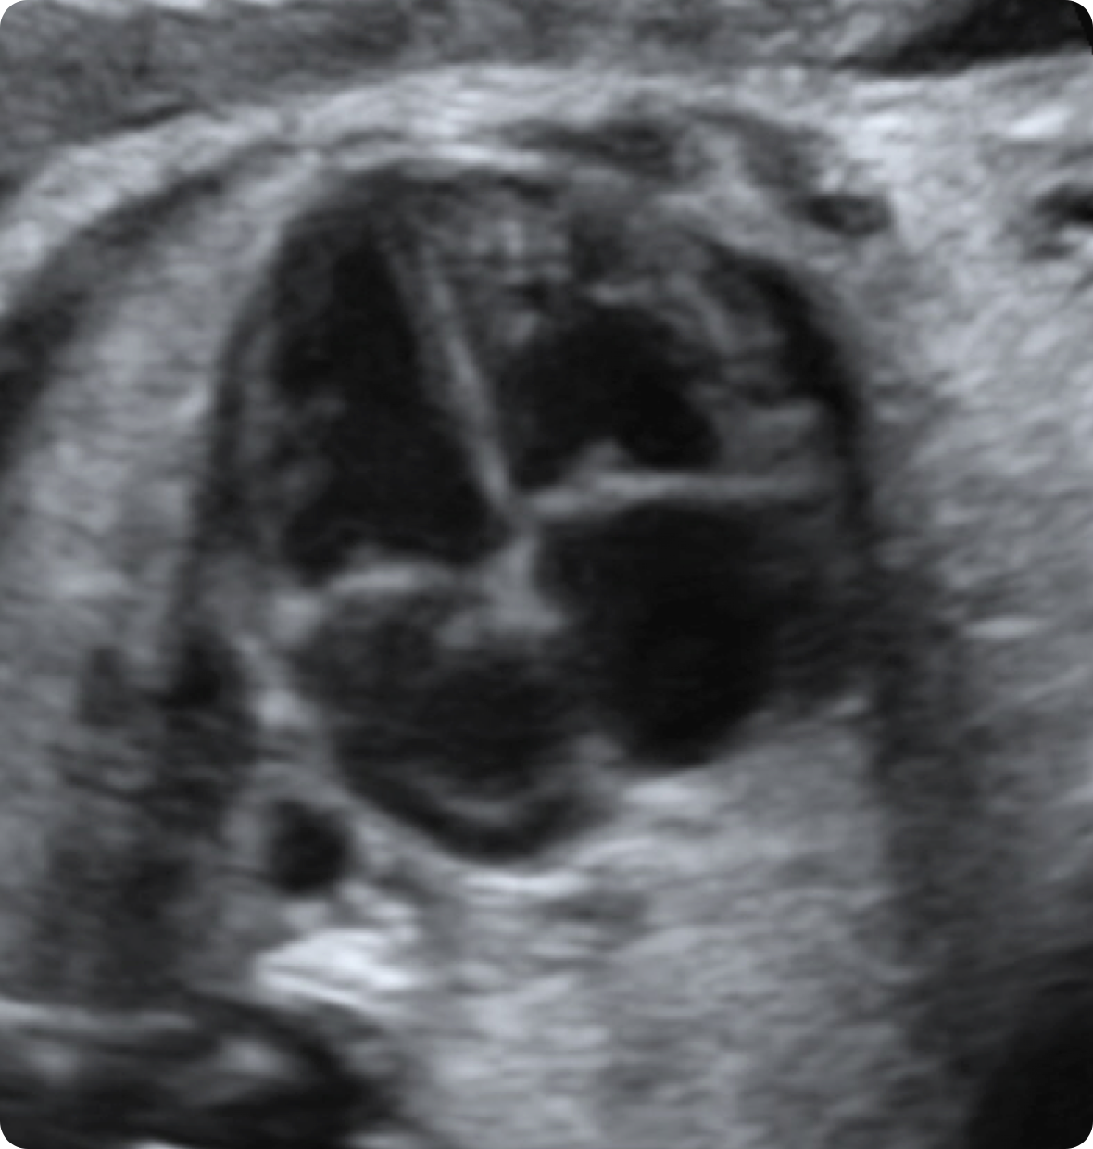
Right ventricle
R
RV
L
LV
TV
RA
LA

Slide 12
MB
RV
L
LV
Septum
secundum
RA
Septum
primum
LA
FO

Slide 13
Systole
Diastole
RV
LV
TK
RA
MK
LA
Ao

Slide 14
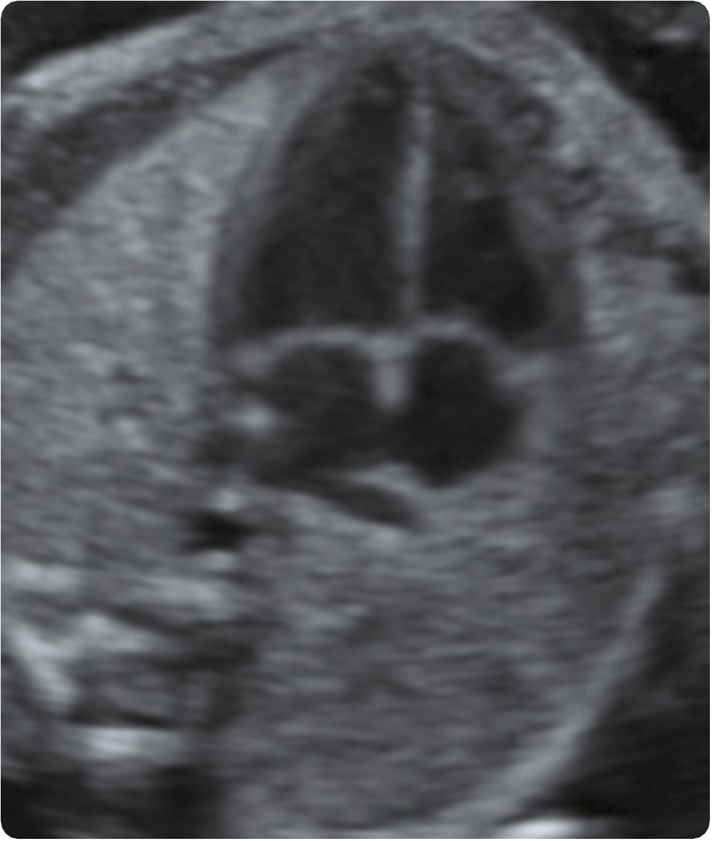
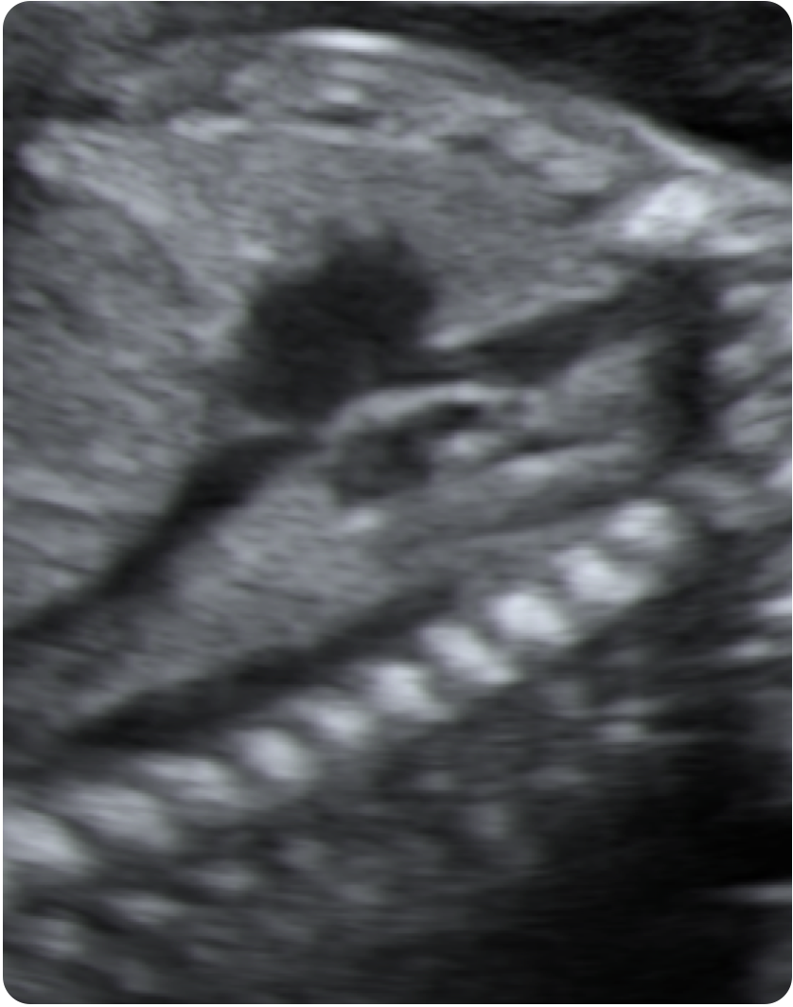
Atria
L
Left inf. PV
RA
LA
RA
VCI
VCS
Right inf. PV

Slide 15
Color Doppler: its use is helpful
RV
LV
RV
LV
RA
LA
AoA
AoD

Slide 16
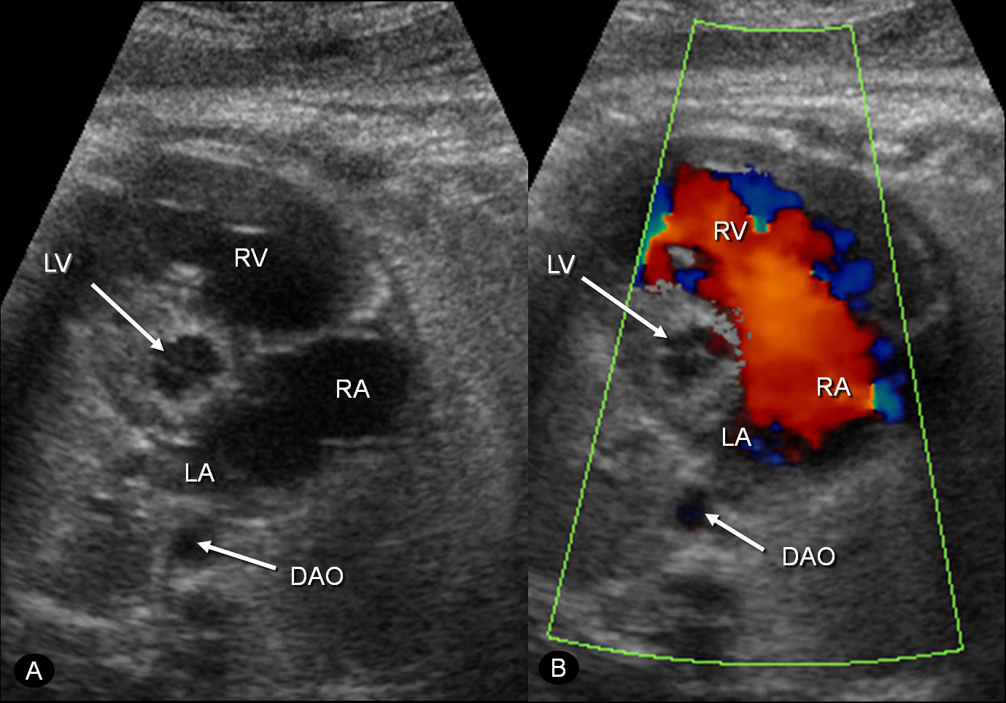
Hypoplastic left heart syndrome
Color Doppler

Slide 17
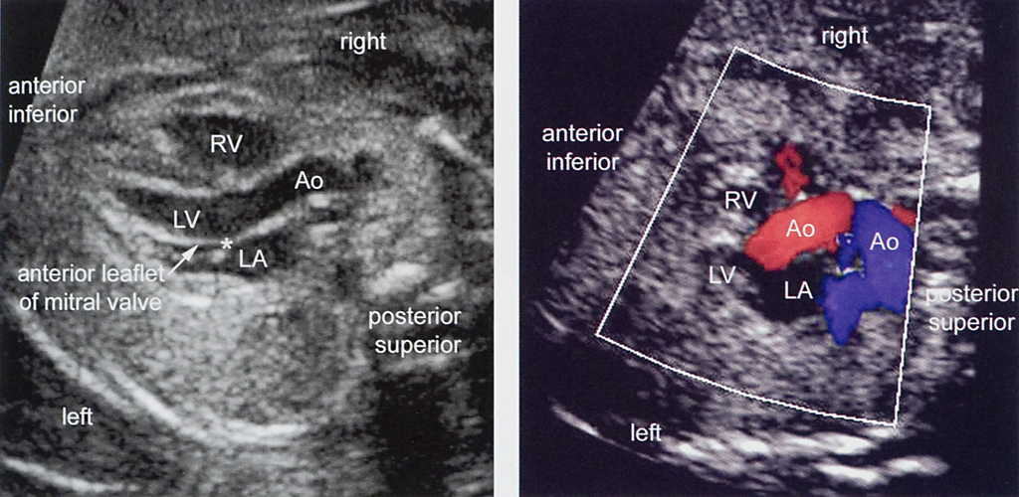
LEFT VENTRICULAR OUTFLOW TRACT (CALLEN)

Slide 18
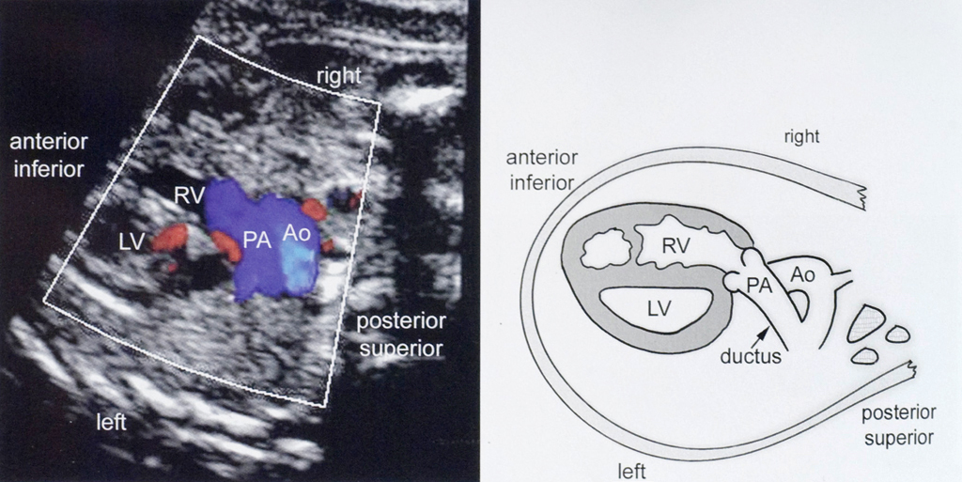
RIGHT VENTRICULAR OUTFLOW TRACT (CALLEN)

Slide 20
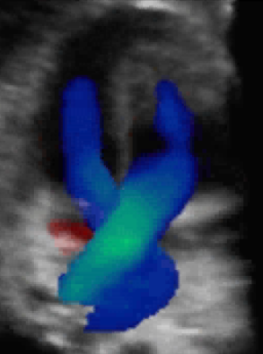
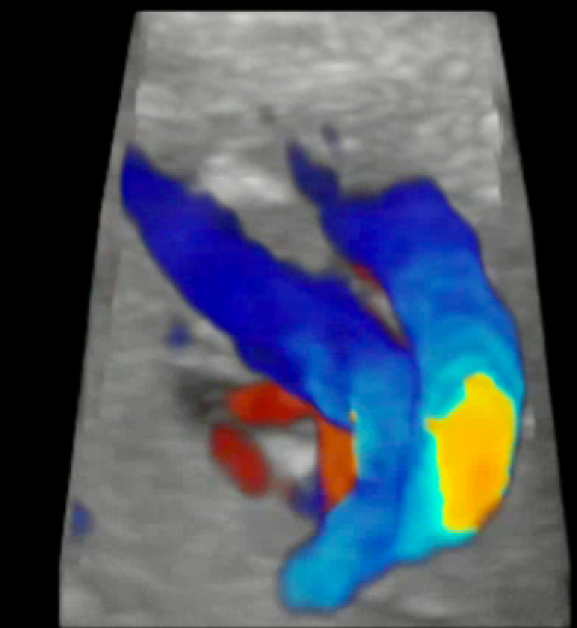
Normal Crossing of
the Great Arteries
Transposition of
the Great Arteries
Practical Guide to fetal Echocardiography: Abuhamad & Chaoui, 2009

Slide 21
Normal Sized
Great Arteries
Tetralogy of Fallot
(Narrow PA)
RV
LV
RV
PA
PA
AO
AO
A
B
Practical Guide to fetal Echocardiography: Abuhamad & Chaoui, 2009
Notes:
Color STIC with Glass Body mode display with a view from the top on the three-vessel-trachea view A) in a normal fetus with normal sized great arteries and in B) with TOF with the tiny pulmonary artery and the dilated ascending and transverse aortic arch.

Slide 22
Screening and fetal echo studies
Detection rate (sensitivity)
Not targeted exam, different centers, not specialized teams
5-15%
4 Chamber view, trained persons, targeted fetal heart
15-40%
Extended exam, special centers, 4CV + great vessels
40-80%

Slide 23
THREE-VESSEL VIEW Shi-Joon Yoo & Jaeggi, 2008

Slide 24
AORTIC ARCH Shi-Joon Yoo & Jaeggi (2008)

Slide 25
DUCTUS ARTERIOSUS shi-joon-yoo & Jaeggi, 2008

Slide 26
TAKE HOME MESSAGE (I)
The four-chamber view:
- The heart area represents one-third of the chest area ;
- The heart axis runs at an angle of 45 degrees to the
spine-sternum axis;
- The right ventricle lies directly under the sternum, the
left atrium closest to the spine;
- Left & right ventricle are of equal size; the right
ventricle is more trabeculated (moderator band);
- The tricuspid valve displays a more apical insertion
than the mitral valve.

Slide 27
TAKE HOME MESSAGE (II)
Left ventricular ( ascending aorta) and right ventricular (main pulmonary artery) outflow tract cross each other at virtually right angles;
The three-vessel view depicts the intricate spatial relationship between aortic arch, main pulmonary artery and ductus arteriosus;
A complete image of aortic arch and ductus arteriosus can only be obtained on a sagittal cross-section;
The aortic arch gives rise to three head and neck vessels.

Slide 28
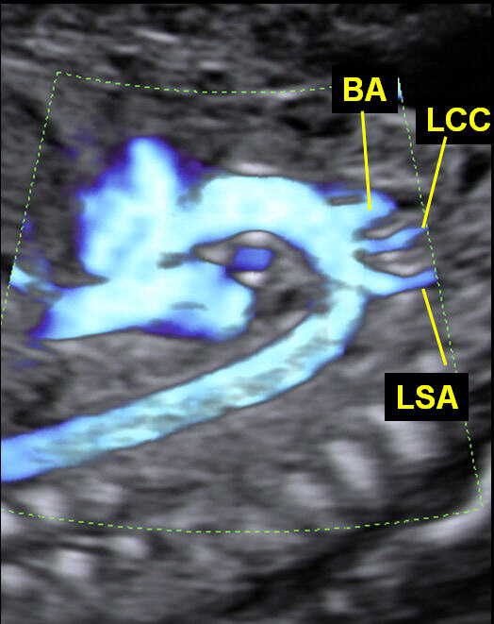
Notes:
Abb.: Links Längsschnitt des Aortenbogens im Power Doppler mit dem Isthmus (Pfeil) und Abgang der Stammgefässe
Rechts: die gleiche Einstellung bei einer Aortenisthmusstenose mit tubulärer Hypoplasie des Aortenbogens

Slide 29
Color Doppler not mandatory but its use is helpful
RV
LV
RV
LV
RA
LA
AoA
AoD

