Slide 1
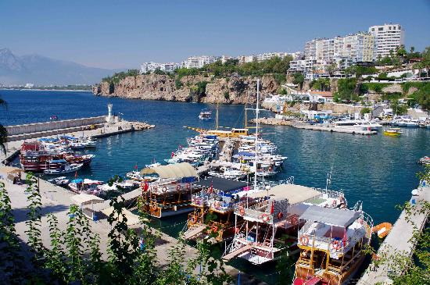
AV and BV: time to differentiate Ebcog, Antalya, 21 May 2017
Prof Dr Gilbert GG DONDERS,
Dept Obstetrics and Gynecology
Infectious diseases in OB/GYN
1) Femicare VZW Tienen
2) H Hart Kliniek Tienen
2) Antwerp University,
Belgium

Slide 2
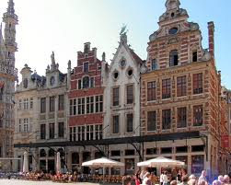
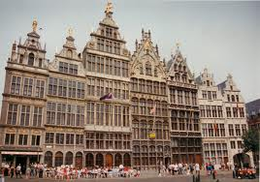
Tienen

Slide 5
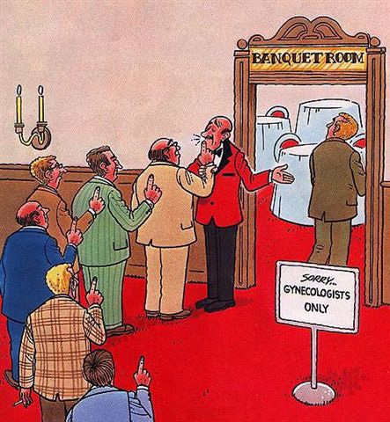
Is BV a problem?
You don’t die of it
You don’t get cancer of it.
You can’t operate it.
It will relapse anyway.
You dampen the symptoms but no cure
(Then you will make more money)
Do we treat the asymptomatic?
Adapted from P-G Larson

Slide 6
Bacterial vaginosis
Diagnosis
i) Clinical criteria according to Amsel:
3 out of 4
1 | Homogenous gray watery discharge
2 | Fishy smell (10%KOH)
3 | pH > 4.5
4 | Clue cells
Notes:
De klassieke criteria van Amsel om bacteriële vaginose vast te stellen, gelden nog steeds. Verse microscopie door een ervaren technieker of clinicus, vervangen echter meestal de klinische criteria.

Slide 7
Diagnosis of BV (ii)
Unstained
Fresh wet mount
Rehydrated delayed wet mount
Stained
Papanicolau
Gram stain
Spiegel
Nugent
Ison-Hay

Slide 8
Diagnosis of BV (ii)
Cultures
G vaginalis
Anaerobic cultures
Mycoplasmata
Molecular techniques
Atopobium vaginae
Multiple others/new bugs
Multiplex/combination molecular tests

Slide 10
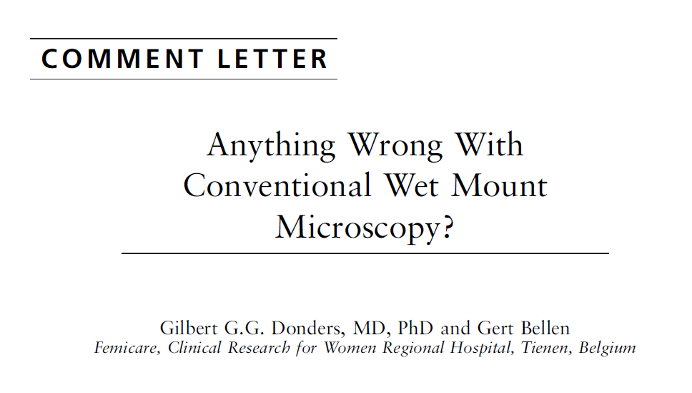
,

Slide 11
Utility of microscopic techniques and quantitative real-time PCR for the diagnosis of vaginal microflora alterations. Rumyantseva T.A…. Guschin A. Central Research Institute for Epidemiology, Moscow, Russia

Slide 12
Utility of microscopic techniques and quantitative real-time PCR for the diagnosis of vaginal microflora alterations. Rumyantseva T.A…. Guschin A. Central Research Institute for Epidemiology, Moscow, Russia
Agreement
between Nugent score and PCR 78.6%
between WM microscopy and PCR 82.7%
between WM microscopy and Nugent score 85.7%
Sensitivity and specificity
75.0% and 97.1% for Nugent score
96.4% and 94.3% for WM microscopy
92.8% and 85.7% for PCR
Conclusion: 1) POC test based on PCR is possible 2) wet mount microscopy superior to Nugent and PCR: gold standard?
(paper submitted)

Slide 13
Diagnosis of BV (iii)
Advantages of fresh wet mount microscopy
The cheapest (that s why doctors don’t love it)
Very accessible (provided there is electricity)
Instant diagnosis (while your patient gets dressed)
Complete diagnosis (you pick up and treat mixed infections)
Immediate and correct treatment (no need to call patient back in or leyt her suffer untill next visit)
You ll feel better (because you are a better doctor)

Slide 14
J low Gen Tract Dis, 2014

Slide 15
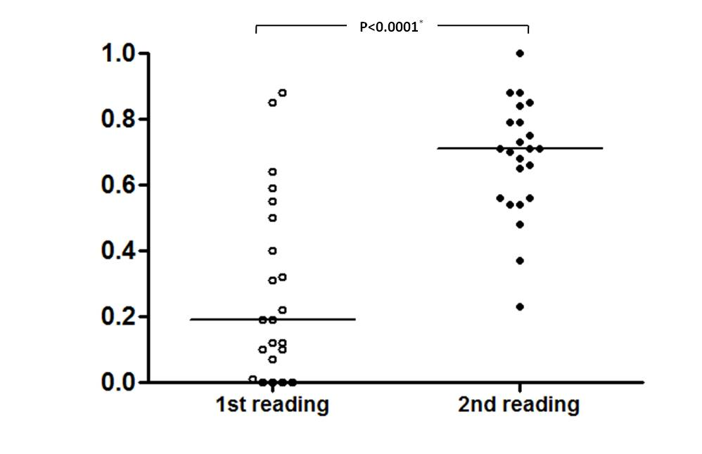
J low Gen Tract Dis, 2014

Slide 16
J low Gen Tract Dis, 2015

Slide 17
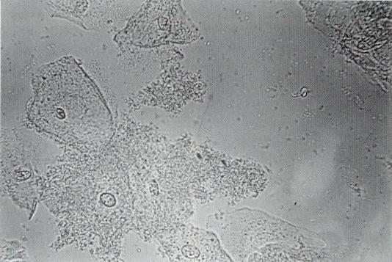
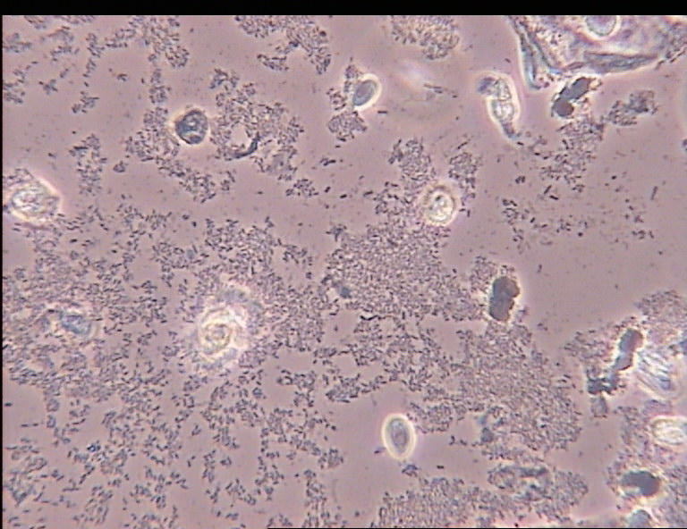
2. Pathology: Vaginal microflora
Abnormal flora: BV
© Donders G, Femicare
© Donders G, Femicare
Notes:
Het beeld van BV bij rechtstreeks microscopisch onderzoek is typisch, ook al zijn er geen ‘clue cells’. Het beeld wordt veroorzaakt door een enorme hoeveelheid anaerobe bacteriën die virtueel alle lactobacillen verdrijven.

Slide 18
Microbial Shifts Occurring in BV
10¹¹
• G. Vaginalis
• Anaerobes
• Mycoplasmas
Lactobacillus
No Leukocytes
No pain, no itch, no dyspareunia
No redness nor edema of the vagina
___________________________
NO INFLAMMATION in BV!!
10⁴
BV is characterized by 100- to 1,000-fold increase in pathogenic bacteria. Lactobacilli concentrations decrease substantially.= Ecological disorder

Slide 19
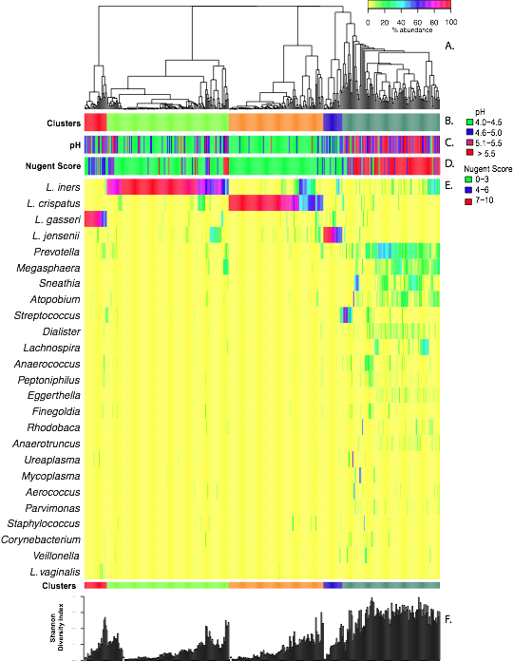
Vaginal community state types (CST)
II
III
I
V
IV
Community state type IV lacks significant number of Lactobacillus
Five community state types that differ in their microbial composition and abundance
Ravel et al. The vaginal microbiome of reproductive age women. PNAS. 2011. 108 Suppl 1, 4680–4687.

Slide 20
Bacterial vaginosis
Diagnosis
Nugent criteria: score 7 to 10
What do we do with Nugent 4-6?
What does ‘intermediate flora’ mean??
 | Lactobacilli | Gardnerella | Mobiluncus
0 | 4+ | 0 | 0
1 | 3+ | 1+ | 1-2+
2 | 2+ | 2+ | 3-4+
3 | 1+ | 3+
4 | 0 | 4+

Slide 21
While enjoying
The view of
The historical beauty
Of the bridge
Over the Garonne river
In Toulouse....
.... But at times with huge consequences! ......
...your eye may catch
Seemingly
Worthless
Details....

Slide 22
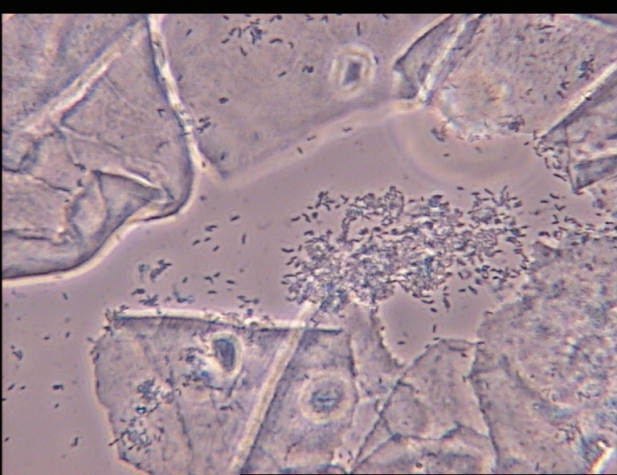
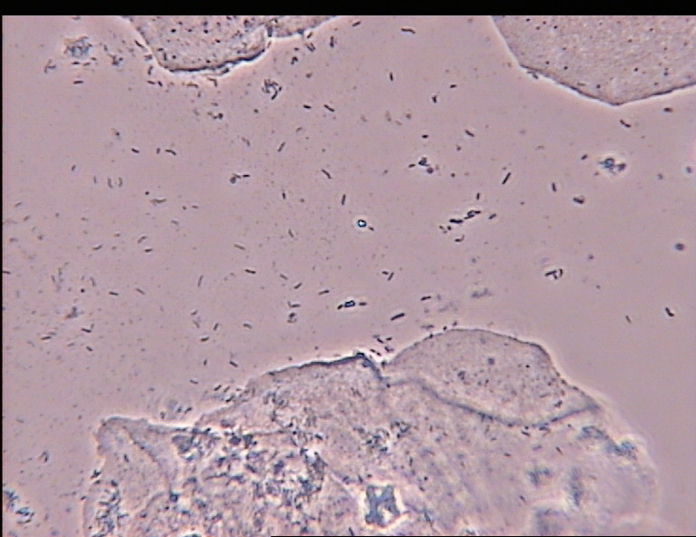
Partial BV

Slide 23
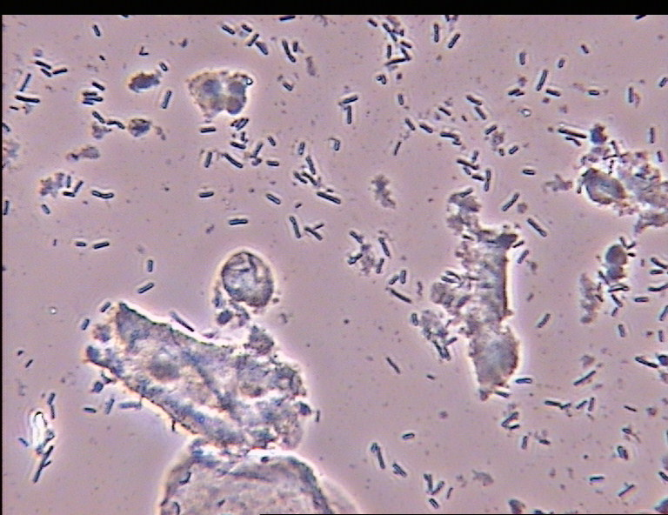
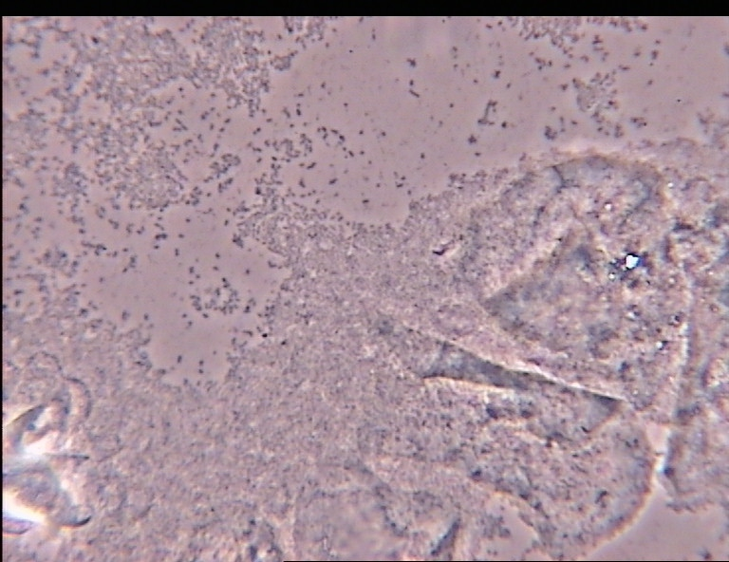
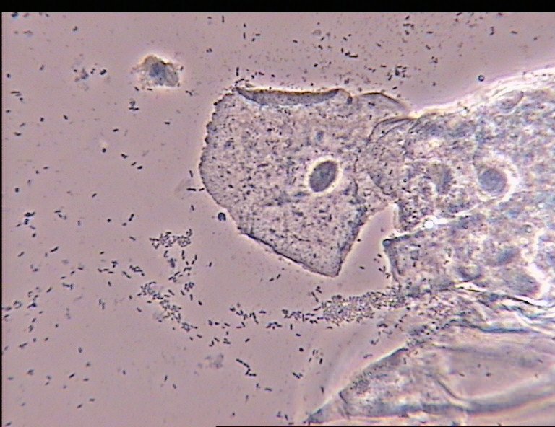
Bacterial vaginosis
Diagnosis
P-BV
Full-BV
Nl

Slide 24
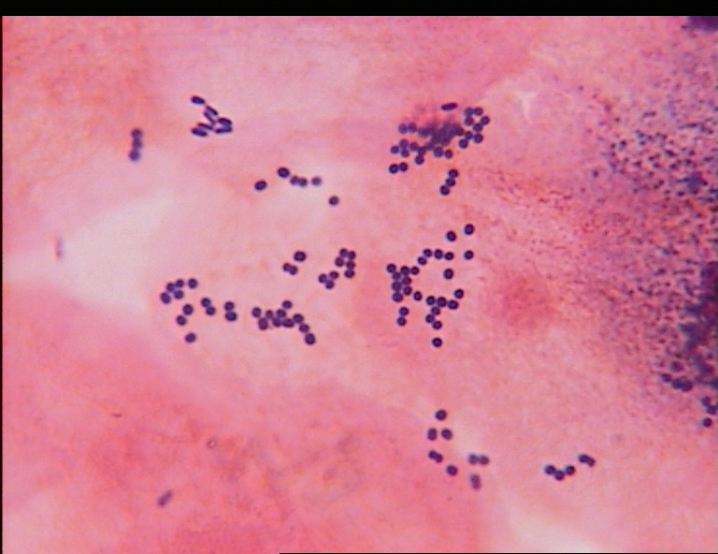
Difficulties in reading vaginal bacterial flora

Slide 25
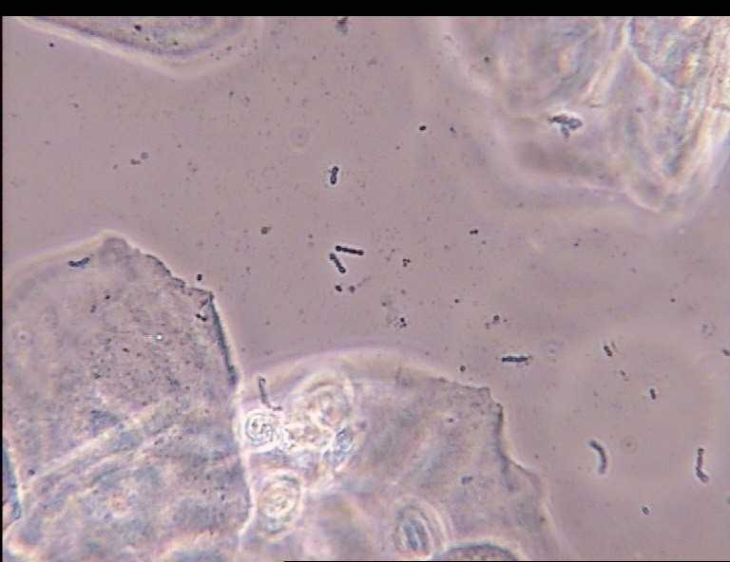

Slide 26
Scoring of aerobic vaginitis
Background flora
Donders GGG et al, Br J Obstet Gynecol, 2002; 109: 34-43

Slide 27
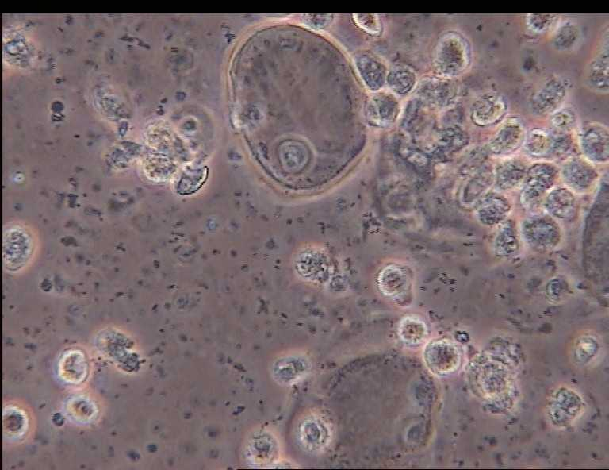

Slide 28
Scoring of aerobic vaginitis
Relative number of leukocytes
Donders GGG et al, Br J Obstet Gynecol, 2002; 109: 34-43

Slide 29
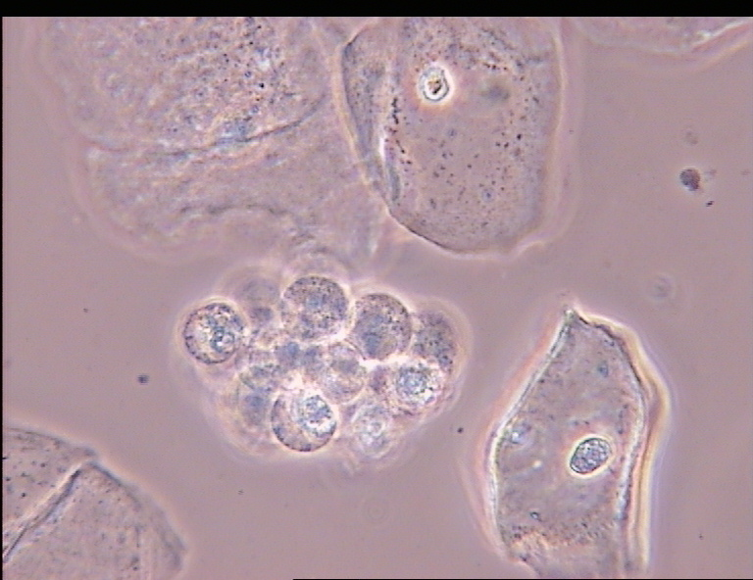

Slide 30
Scoring of aerobic vaginitis
Proportion of toxic leukocytes
Br J Obstet Gynecol. 2002; 109.

Slide 31
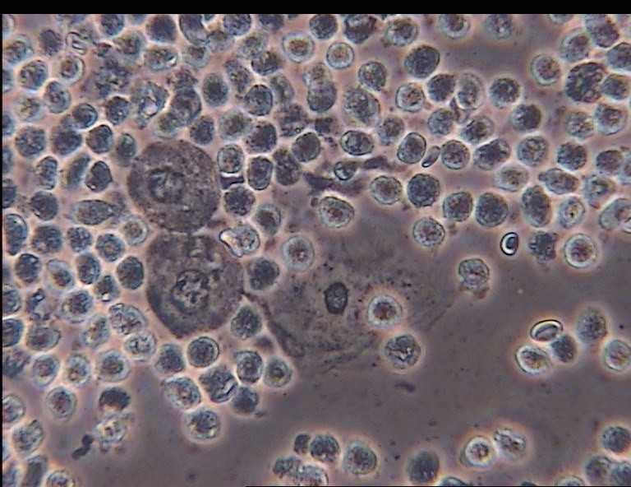

Slide 32
Scoring of aerobic vaginitis
Proportion of parabasal cells
Donders GGG et al, Br J Obstet Gynecol, 2002; 109: 34-43

Slide 33
Composite score of AV
 | AV Score
Lactobacillary grades | 0-1-2
Relative number of leukocytes | 0-1-2
Proportion of toxic leukocytes | 0-1-2
Parabasal cells | 0-1-2
Cocci/small bacilli | 0-1-2
Donders GGG et al, Br J Obstet Gynecol, 2002; 109: 34-43

Slide 34
Composite score of AV
 | AV Score
Light | 3-4
Moderate | 5-6
Severe | >6
Donders GGG et al, Br J Obstet Gynecol, 2002; 109: 34-43

Slide 35
Pathogenesis of aerobic vaginitis
Vaginal signs in AV
%
P<0.0001
P<0.0001

Slide 36
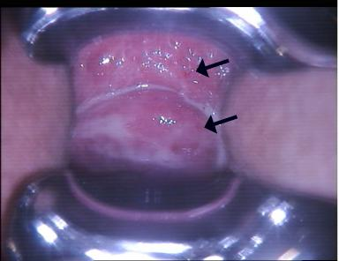
Clinical findings in aerobic vaginitis

Slide 37
AV related to severe forms of infammatory vaginitis
Inflammatory desquamative vaginitis (DIV)
Severe AV= Papular colpitis
Severe GBS vaginitis
Atrophic vaginitis (menopauze)
Moderate AV
Light AV
Normal flora
Notes:
De top van de ijsberg van normale tot aerobe vaginitis flora, kan ‘severe’ of ‘ernstige’ aerobe vaginitis genoemd worden. Het is een aandoening met tevens sterk uitgesproken klachten van roodheid in de schede, uitgesproken dyspareunie, en een profuse, gele rottend-riekende afscheiding. Deze aandoening kan moeilijk of niet onderzscheiden worden van wat in dermatologisce middens beschreven wordt als ‘desquamative inflammatory vaginitis (DIV)’

Slide 38
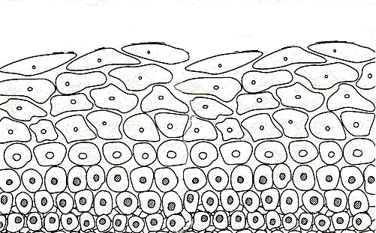
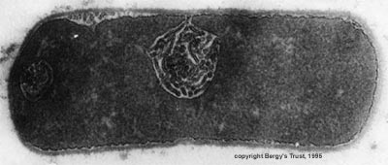
Abnormal vaginal ecosystem
pH > 4,5
pH > 5,0
Pathogens
Intermediate cells
Parabasal cells
Basal cells
Bacterial vaginosis
Aerobic vaginitis (<50 y)
Atrophic vaginitis (> 50 y)
Notes:
In contrast, the situation of a verstoord vaginaal ecosysteem is shown here.
The vaginal epitheel is more or less damaged. Highly differentiated epithelial cells are not present.
Pathogenic micro-organisms dominate the vaginal flora en only single lactobacillen may be present,
The vaginal pH might be increased

Slide 39
Pathogenesis of vaginitis
Lactate (mg/dl)
Succinate (mg/dl)
P<0.0001
P<0.04
Donders G et al, Br J Obstet Gynecol. 2002; 109.

Slide 40
Vaginal cytokine production
IL-1b
Mg/dl
IL6
Mg/dl
P<0.0001
P<0.0001
P<0.04
P=0.03
Donders G et al, Br J Obstet Gynecol. 2002; 109.

Slide 41
Cytokine and sialidase levels in abnormal vaginal flora
Marconi C et al, J low Gen Tract Dis, 2012

Slide 42
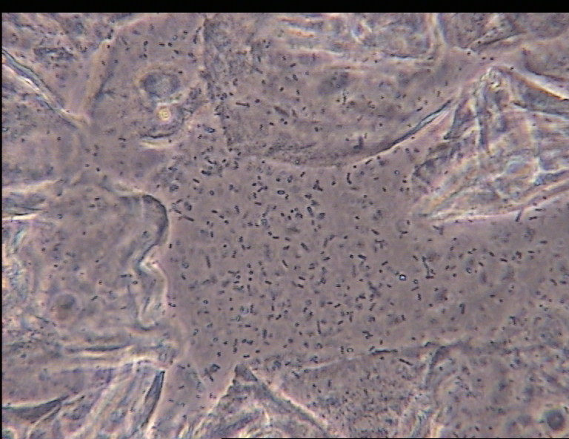
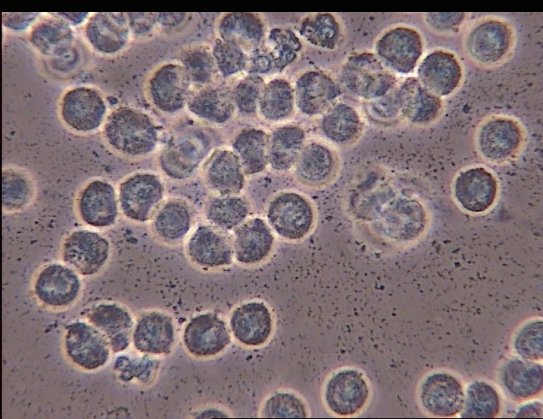
Bacterial vaginosis
P-BV
Full-BV
Nl
Aerobic abnormal flora

Slide 43
Pathogenesis of abnormal vaginal flora
Immune overreaction
Very high IL-1 ↑↑
Very high Il-6, Il-8 ↑↑
Inflammation (PBC) +
(Toxic) leukocytes ++
Immune impaired
Discrete IL-1 ↑
No Il-6, Il-8
No inflammation
No leukocytes
Aerobic vaginitis / DIV
Bacterial vaginosis

Slide 44
Normalization of
host response
Interfering with
adequate host response
Heavy inflammation/leukocytosis
Pain/dyspareunia
AV
NL
BV
No signs of inflammation /No leukocytosis / No pain/dyspareunia
Exuberant host response
Excellent host response

Slide 45
Prevalence
8-9%
12,0%
Non pregnant
Pregnant
7,4%
9,4%
13,1%
4,3%
?
10,3%
8,3%
15,4%
7,4%
2,9%
11,0%
2,0%
24,7%
Donders G et al. BJOG 2009
Grincevičienė Š et al. Poster. EBCOG 2016
Tibaldi C et al. Int J Gynaecol Obstet 2016
Wang ZL et al. Taiwan J Obstet Gynecol 2016
Donders G. APMIS. 2011
Tomusiak A et al. Ginekol Pol. 2013
Zodzika J et al. Acta Obstet Gynecol Scand. 2011
Gondo F et al. Gynecol Obstet Invest. 2011
Villaseca R et al. Rev Chilena Infectol 2015
Dermendjiev T et al. Akush Ginekol. 2015
Rumyantseva TA et al. Arch Gynecol Obstet 2016
Vieira-Baptista et al. Eur J Clin Micr Infect Dis. 2016

Slide 46
P Baptista et al, 2016
AV and BV prevalence
15.5%
BV
7.4%
AV

Slide 48
Results
Pap test abnormalities and HPV infection
Moderate/severe aerobic vaginitis
p=0.083
p=0.053
p=1.000
msAV
p=0.029
p=0.461
p=1.000

Slide 49
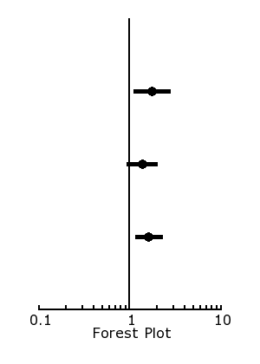
Results
Major Pap test abnormalities and vaginal flora
Moderate/severe aerobic vaginitis
RR 1.76 (IC 95% 1.10-2.79)
Bacterial vaginosis
RR 1.36 (IC 95% 0.92-2.01)
msAV or BV
RR 1.62 (IC 95% 1.16-2.27)

Slide 50
Association between abnormal vaginal flora and cervical length as risk factors for preterm birth.
G Donders, et al. Ultrasound Obstet Gynecol 2010 Jan 26.
P<0.01

Slide 51
Predictive Value for Preterm Birth of Abnormal Vaginal Flora, Bacterial Vaginosis and Aerobic Vaginitis during the First Trimester of pregnancy.
Donders GGG, et al. Br J Obstet Gynecol. 2009; 116:1315-24.
**
**
% women with preterm delivery
**
**
**
**
**
*
*

Slide 52
Complications
Premature rupture of membranes
Indirect evidence: increase in the levels of IL-6 and -8 (Massaro G et al. J Matern Fetal Neonatal Med 2009; Hitti J et al. Obstet Gynecol 2001; Rizzo G et al. Am J Obstet Gynecol 1996 )
Chorioamnionitis and funisitis
Indirect evidence: increase in the levels of IL-6 and -8 (Romero R et al. Am J Obstet Gynecol 2004)
Evidence of placental infection in the presence of:
S. aureus (15,2% vs. 3,8%, p=0,04)
Aerobic vaginitis (20,0% vs. 5,7%. p=0,023)
G. vaginalis (28,3% vs. 9,5%, p=0,013)
(No differences in the case of SGB or enterococcus) (Rezeberga D et al. Acta Obstet Gynecol Scand 2008 )
Neonatal sepsis
S.aureus associated with neonatal sepsis in premature babies. (Vedmedovska N et al. Int J Gynaecol Obstet 2010)
SGB and E. coli are common agents of neonatal sepsis.
Notes:
Romero R, Chaiworapongsa T, Kuivaniemi H, Tromp G. Bacterial vaginosis, the inflammatory response and the risk of preterm birth: a role for genetic epidemiology in the prevention of preterm birth. Am J Obstet Gynecol 2004

Slide 53
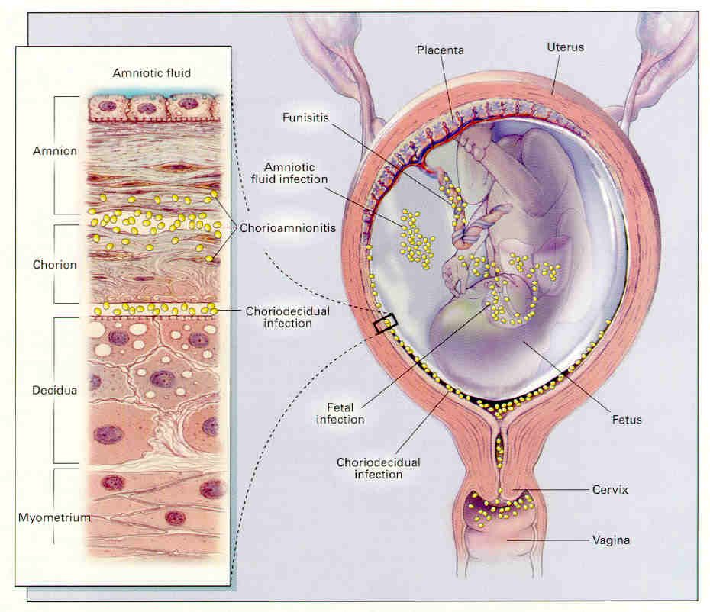
Parietal chorioamnionitis:
BV (p=0.008)
G.vaginalis (p=0.002)
S.aureus (p=0.014)
Placental chorioamnionitis:
G.vaginalis (p=0.004)
S.aureus (p=0.019)
Funisitis:
GDS (p=0.02)
‘Aerobic vaginitis’ (p=0.049)
Subchorial intervillitis:
No correlations with RTI

Slide 55
Complications
Abnormal Pap test
Prevalence of AV in women with LSIL (28%) higher than in those with a normal flora (12%) or with BV (4%), p<0,05. (Jahic M et al. Med Arch. 2013)
No relation with HPV infection!
Vieira-Baptista P et al. Eur J Clin Microbiol Infect Dis. 2016

Slide 56
Diagnosis
“AV score”:
Desquamative inflammatory vaginitis
Streptococcal vaginitis
Purulent vaginitis
Severe AV (>6)
Moderate AV (5-6)
Light AV (3-4)
Normal (<3)

Slide 58
Abnormal vaginal bacterial flora
BV
Bad smell and discharge
Sexually ‘associated’
Resolves with metronidazole or clindamycin
But is recurrent
AV
Confused with BV, but different entity
Most likely nothing to do with sex
Metronidazole will not help
Linked with more disease than previously recognized
Use your microscope!

Slide 59
www.ISIDOG.com

Slide 61
So if you are confused
and don’t know anymore
what type of treatment
you should choose…

Slide 62
Thank you, Co-workers!
H Hart Kliniek Tienen (B)
I Riphagen, T VdBosch, M Verjans, V Vd Broek
Femicare vzw, Tienen Belgium
Gert Bellen, Katherina Ruban, Svitrigaile Ginç
Maternity Hospital Riga University,
Dace Rezeberga, Natalija Vedmedovska, Jana Zodzika
Bocutu Hospital, Brazil
Camila Marconi, Marcia da Silva
University Hospital Antwerp
Pierre Van Damme, Yves Jacquemyn
Covilha Beires University, Portugal
José Martinez, Ana Palmeira, Carlos Santoz
Mulago Hospital Kampala Uganda
Gonzaga Andabati, Josaphat Byamugisha, John Lule, Francesca Donders, Thirsa Michiels, Jolien Pinget, Inge Vandevelde, Birgit Krause
Laboratory
Leuven: Jan Desmyter
Antwerpen: Christoph Depuydt, Fons dekeerschmaeker, Annie Vereecken
Porto: Acacio Rodriguez
New York: Steve Witkin
Bologna: Patricia Brigidi, Beatrice Vitali
Baltimore: Jack Ravel
Mentors
Jan Desmyter, Steve Witkin, William Ledger, Jean-Michel Foidart, Rainer Weissenbacher,Udo Hoyme, Jorma Paavonen, André Van Assche, Ivo Brosens, Werner Mendling, Babill Stray Pedersen, Austin Ugwumadu, Jack Sobel, James Mc Gregor, Roberto Romero, Michael Gravett, Jack Sobel
Pharmaceutical companies /Disclosures
Alfa Wasserman Biotec
Glaxo Smith Klein Bayer-Shering
Barrier Roche
Janssens (J&J) Novartis
Medinova Pfizer
Novosanis SP-MSD
Genticel Phacobel

Slide 63
Any questions?

