Slide 1
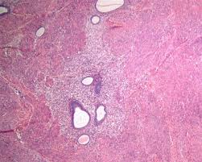
Does Adenomyosis Impede Spread of Endometrial Cancer
Dr. Selçuk Erkılınç
Tepecik Education and Research Hospital

Slide 2
Background
Adenomyosis is the presence of the endometrial tissue among myometrial tissue.
The observation that the patient had adenomyosis had favorable oncologic outcomes made us investigate the effect of adenomyosis in endometrial cancer.

Slide 3
Method
This study was conducted at a tertiarry referral centre. The hospital data was reviewed from 2007 to 2016. A total of 1217 diagnosis of endometrial cancer encountered and 80 patients with concurrent adenomyosis constituted study group.
Control group was selected according to the grade of tumour. Four times as many as patients were included to the control group for each grade. A total of 320 patients constituted the control group. All pathologic slides in study group were reviewed by pathologists those were experienced in gynecological oncology.

Slide 4
Table I. Demographic and pathologic data of study and control groups
 | Study | Control | P
Age | 56±8,9 | 59±24,8) | 0,266
BMI | 32,4±7,0 | 33,4±5,2 | 0,171
HT | 6 (7,5) | 110 (35,6) | <0,001
DM | 5 (6,3) | 66 (21,4) | 0,001
Surgery |  |  | 0,779
TAH | 9 (11,3) | 30 (9,7)
TAH+PLND | 11 (13,8) | 55 (17,8)
TAH+PPLND | 60 (75) | 223 (72,2)
Grade 1 | 44 (55) | 163 (52,8) | 0,885
Grade 2 | 30 (37,5) | 125 (40,5)
Grade 3 | 6 (7,5) | 21 (6,8)
MI |  |  | <0,001
< ½ | 67 (83,8) | 173 (56)
≥ ½ | 13 (16,3) | 136 (44)
LVSI | 8 (10) | 82 (26,6) | 0,002
TD | 24,6±15,9 | 37,4±22,3 | <0,001
Stage |  |  | <0,001
I | 76 (95) | 225 (72,8)
II | 2 (2,5) | 33 (10,7)
III-IV | 2 (2,5) | 51 (16,5)
CT | 4 (5) | 61 (20,1) | 0,001
RT | 17 (21,3) | 159 (51,5) | <0,001

Slide 5
The Comparison of study and control groups in patients with high grade and low grade tumors
.
 | High Grade |  |  | Low Grade
 | Study | Control | p | Study | Control | p
İnner ½ | 28 (77,8) | 44 (30,1) | <0,001 | 39 (88,6) | 129 (79,1) | 0,153
Outer ½ | 8 (22,2) | 102 (69,9) |  | 5 (11,4) | 34 (20,9)
LVSI | 6 (16,7) | 54 (37) | 0,02 | 42 (95,5) | 134 (82,7) | 0,03
Tumor Diameter | 28,6±14,5 | 44,1±22,9 |  | 2 (4,5) | 28 (17,3)
Stage
I | 33 (91,7) | 86 (58,9) | 0,003 | 43 (97,7) | 139 (85,3) | 0,047
II | 2 (5,6) | 24 (16,4) |  | 0 (0) | 9 (5,5)
III-IV | 1 (2,8) | 36 (24,7 |  | 1 (2,3) | 15 (9,2)

Slide 6
Pathologic Findings of the patients with adenomyosis and endometrial cancer
 | N, %
Proksimal Adenomyosis | 21 (26,5)
Distal Adenomyosis | 68 (85)
Proksimal and Distal | 9 (11)
Tumor in Adenomyosis | 6 (7,6)
Distance to Adenomyotic focus
<1 mm | 32 (40)
1-10 mm | 16 (20)
>10 mm | 32 (40)

Slide 7
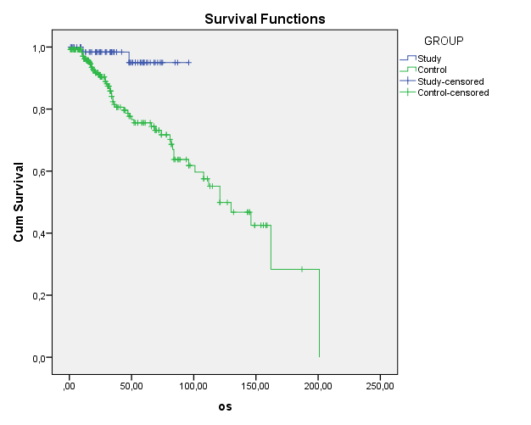
Overall Survival

Slide 8
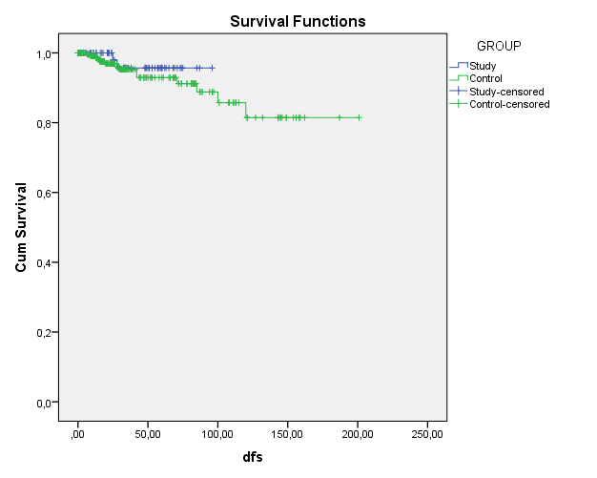
Disease Free Survival

Slide 9
Univariate and Multivariate analysis for endometrial cancer death
 | Univariate Analysis |  |  | Multivariate Analysis
 | HR | 95% CI | P Value | HR | 95% CI | P value
Age | 1,04 | 1,01-1,07 | 0,006 | 1,03 | 0,99-1,07 | 0,06
MI
<1/2 | Reference
≥1/2 | 1,94 | 1,13-3,32 | 0,01
G I Tumor | Reference |  |  | Reference
G II Tumor | 1,72 | 0,97-3,08 | 0,06
G IIITumor | 5,01 | 2,08-12,03 | <0,001 | 3,6 | 1,3-10,12 | 0,01
LVSI
No | Reference
Yes | 3,02 | 1,67-5,48 | <0,001
TD
<2 cm | Reference |  |  | Reference
≥2 cm | 4,20 | 1,64-10,7 | 0,003 | 3,1 | 1,14-8,53 | 0,02
RT
No | Reference
Yes | 1,75 | 1,01-3,01 | 0,04
CT
No | Reference
Yes | 2,58 | 1,32-5,05 | 0,005
Adenomyosis
No | Reference |  |  | Reference
Yes | 0,15 | 0,03-0,65 | 0,01 | 0,15 | 0,35-0,68 | 0,01

Slide 10
Conclussion
Our study suggested that patients with endometrial cancer and adenomyosis had favorable pathologic and survival outcomes
Presence of adenomyosis may treat like a barrier for spread of endometrial cancer

Slide 11
Thank You

