Slide 1
VULVAR İNTRAEPİTELYAL NEOPLAZİLERDE YAKLAŞIM
Yrd. Doç. Dr Erbil KARAMAN
YYÜ Tıp Fakültesi
Kadın Hast. ve Doğum AD
Jinekolojik Onkoloji Cerrahisi BD

Slide 2
VIN
VIN is a high-grade intraepithelial squamous lesion.
Precursor of invasive squamous cell carcinoma.
VIN incidence → 5.0/100,000 (SEER databases)
Median age at diagnosis → 46 (40-49 yaş)
Preti M, et al. Best Prac & Res Clin Obs Gynecol 2014

Slide 3
TERMINOLOGY
-1982, the term VIN was first introduced by ISSVD
-1986, VIN 1 ( mild atypia)
VIN 2 ( moderate atypia)
VIN 3 ( severe atypia, CIS)
Historical perspective
Dyskeratose erythroplasiforme de la muqueuse vulvaire
1922
J.T. Bowen
(Bowen dermatosis)
1929
Carcinoma in situ of vulva
1958
Vulvar Atipi
Karsinoma in situ
ISSVD
1976

Slide 4
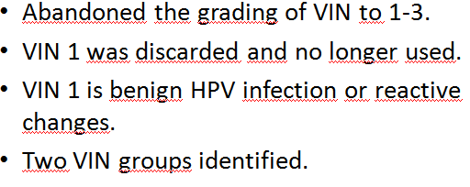
ISSVD, 2004

Slide 5
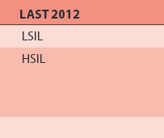
LAST, 2012

Slide 6
ISSVD, 2015

Slide 7
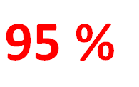
Usual VIN vs Differentiated VIN

Slide 8
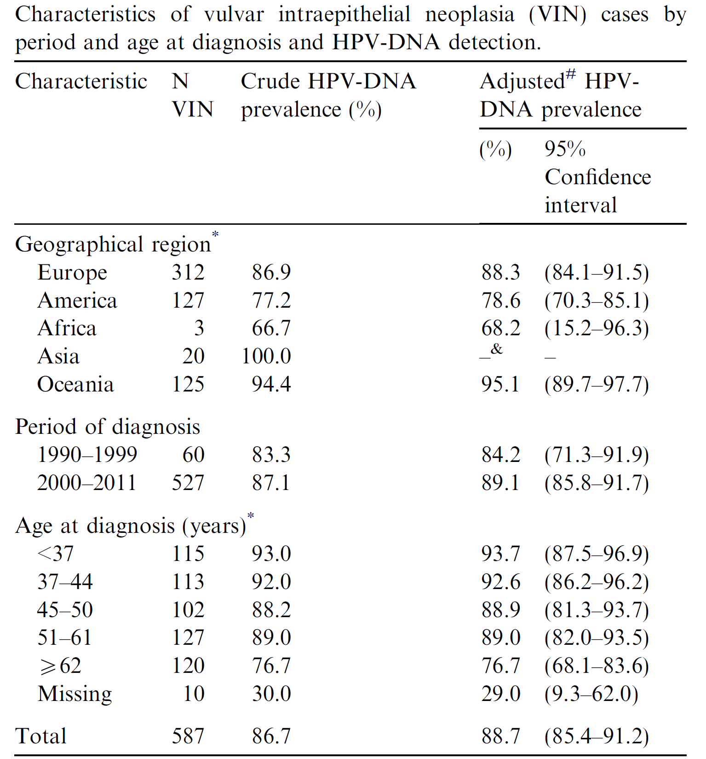
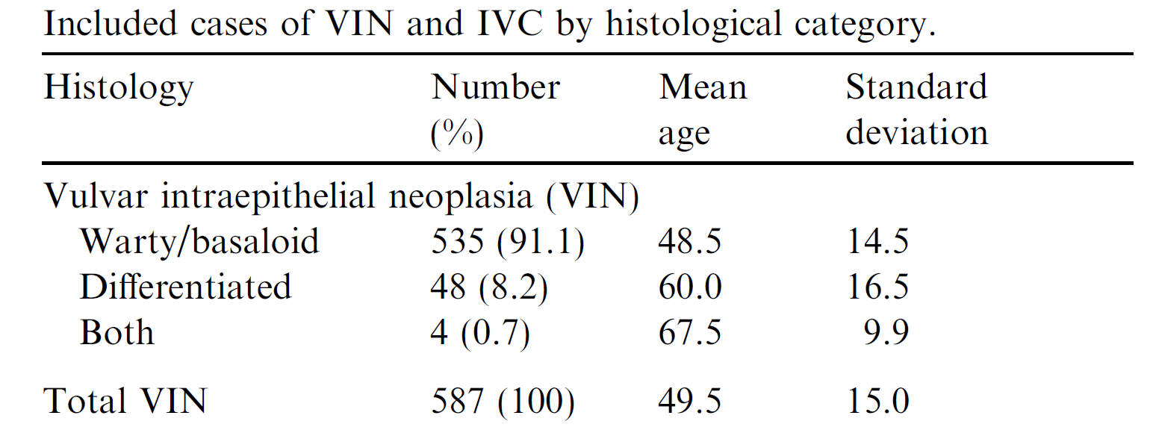
HPV VVAP study group. Eur J Cancer 2013

Slide 9
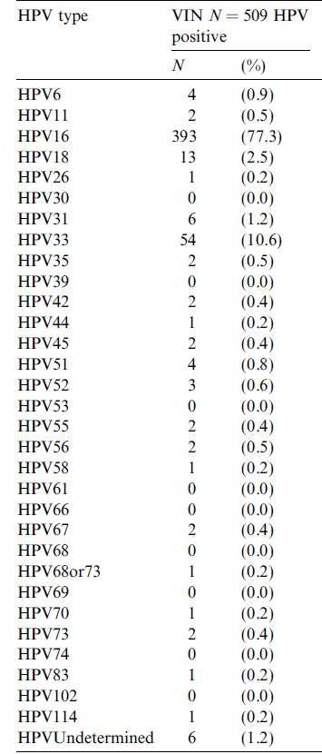

Slide 10
VIN Localization

Slide 11
uVIN (vulvar HSIL)
uVIN; presented with multiple, verrucoid, white plaques
Lai WK, et al. Dermatologic Therapy 2010

Slide 12
dVIN
Differentiated type (dVIN) arising in a background of lichen sclerosus is seen as white patches

Slide 13
Symptoms and Findings
Symptoms
Asymptomatic (> 50%)
Itching, pain
Findings
Lesions seen by naked eyes
Local or generalized color changes
White lesions on cutaneous surface
Dark-brown lesions on mucousal surfaces

Slide 14
Examination

Slide 15
Diagnosis

Slide 18
TREATMENT
1. Characteristics of the lesion
( size, configuration, location, multifocality and multicentricity)
2. Characteristics of the patient
(age, general condition, symptomatology, associated disease, psychologic issues, reliability to follow up)
3. Available resources and medical skills
Preti M, et al. Clin Obstet Gynecol 2005

Slide 19
TREATMENT
Ideal treatment
should completely destroy the lesion
improve symptoms
exclude invasion
preserving vulvar function
avoid recurrences

Slide 20
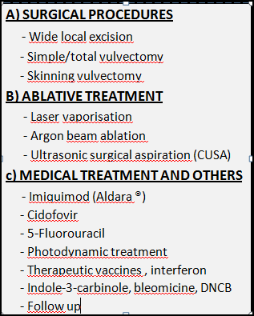
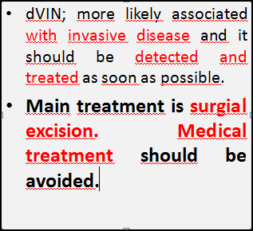
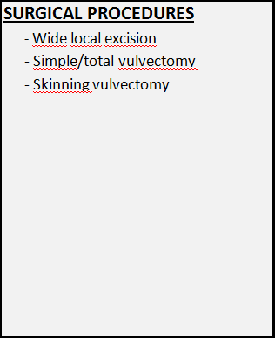
TREATMENT

Slide 21
SURGICAL PROCEDURES
WİDE LOCAL EXCİSİON
A 5-mm peripheral margin is appropriate for the management of localized and single VIN lesion.
No definitive study for safety of margins.
Resection depth: 1 mm Hairless area
4 mm Hairy area
Recurrence rate after 20-40 %

Slide 22
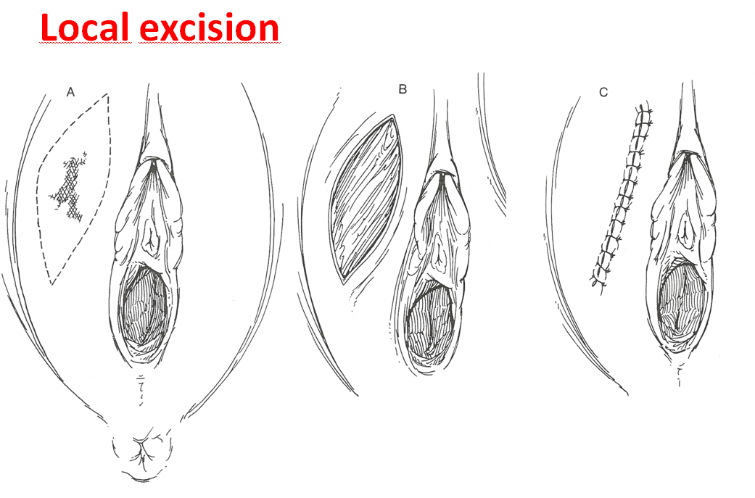

Slide 23
SURGICAL PROCEDURES
Skinning Vulvectomy
Multifocal or large lesion
Uncontrolled disease after topical treatment, laser ablation or local excision
It is excision of vulvar skin with preservation of subcutaneous tissue.

Slide 24
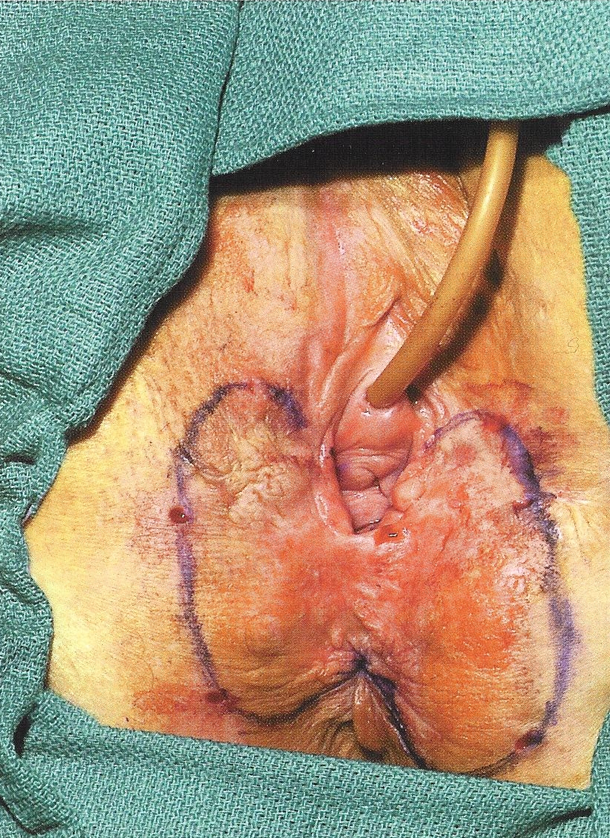
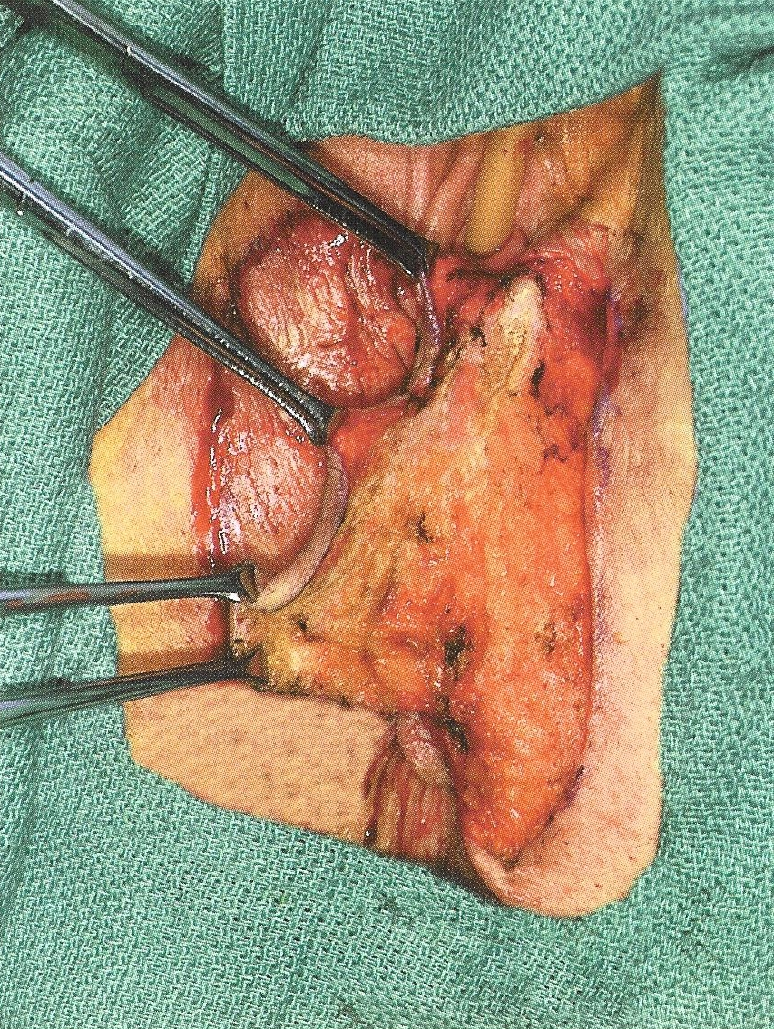
Partial Skinning Vulvectomy

Slide 25
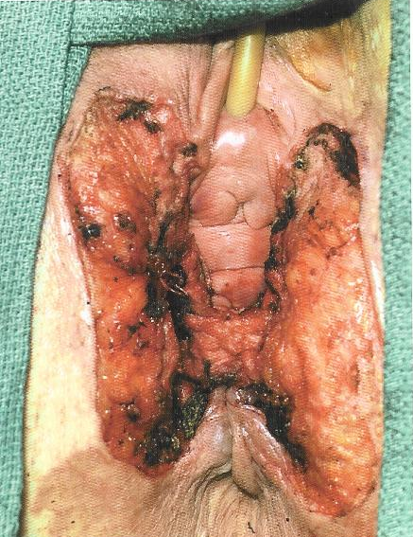
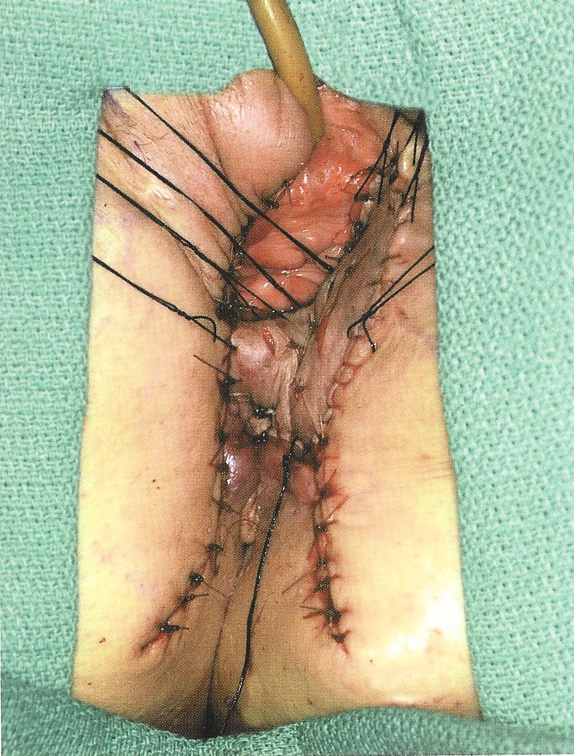
Partial Skinning Vulvectomy

Slide 26
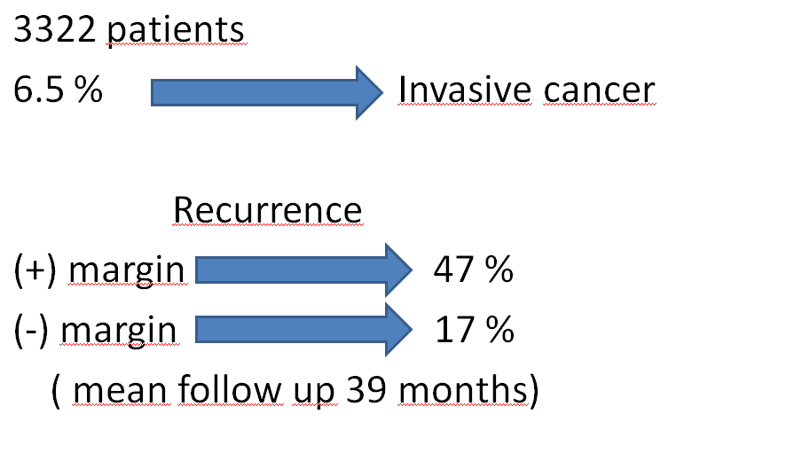
Surgical margins

Slide 28
Medical and Ablative treatment
Suspect of invasion
irregular border
ulceration
Patients with important clinical risk factors
VIN or vulvar ca history
immunsupression
smoking
age > 45
lichen sclerosis
SURGICAL
EXCISION
Ablative or medical treatments can be applied in patients without these risk factors in order to preserve vulvar anatomy and QOL.
Preti M, et al. Best Prac & Res Clin Obs Gynecol 2014
Goff B, Garcia RL. UpToDate Nov 07, 2014

Slide 29
CO2 LASER VAPORIZATION
Very good cosmetic and functional results.
No histological specimen.
Rule out invasion
The complete response 75 %
Notes:
In largest series

Slide 30
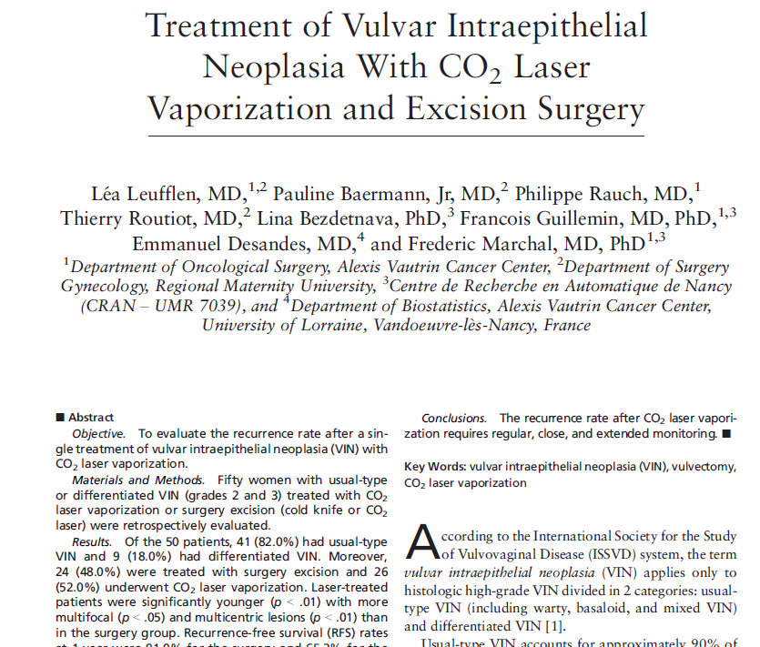
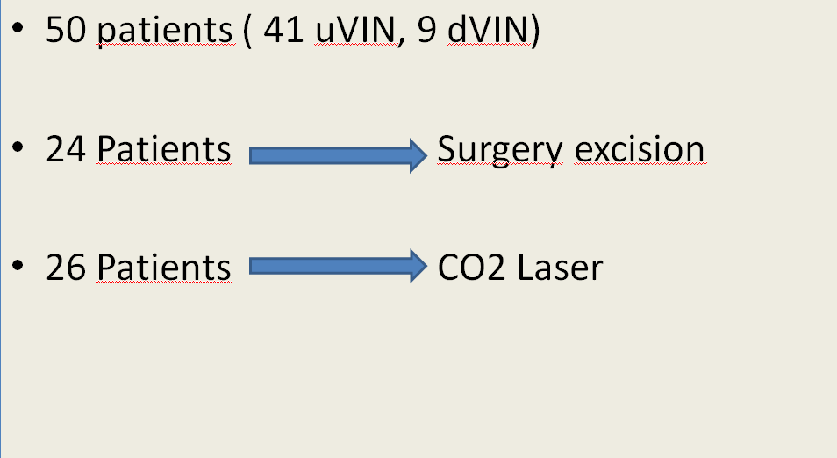
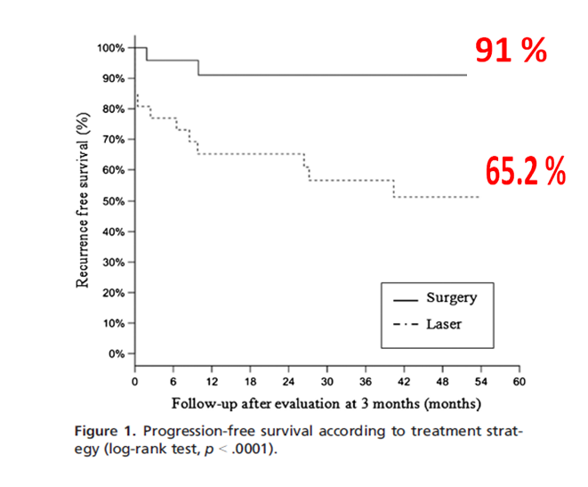

Slide 31
Imiquimod (Aldara®)
Immunmodulator, antiviral and anti-tumoral activity.
5% cream is applied on the lesion and remains overnight without a cover.
2-3 times/week (12-16 weeks).

Slide 32
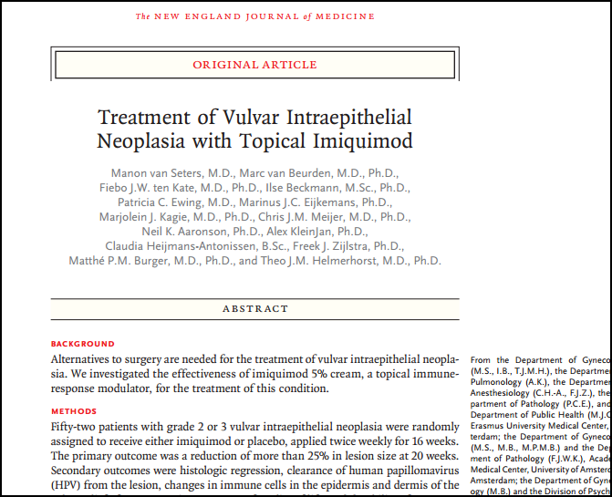

Slide 33
n=24
Response→ 19/24 (%79.2)
Follow-up → 7.2 years (5.6-8.3)
Recurrence → 1/9 (Complete response)

Slide 34
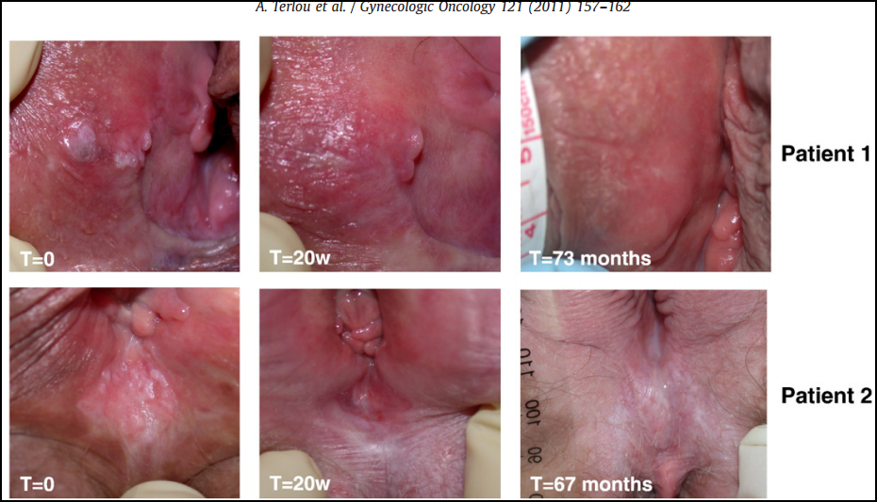

Slide 35
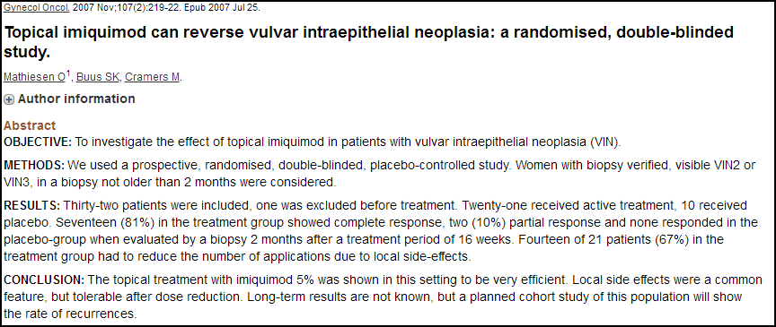
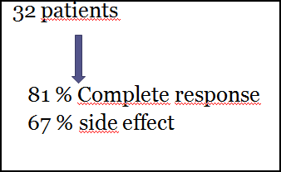

Slide 36
Cidofovir
Acyclic nucleoside analog with antiviral activity.
It may induce the apoptosis of HPV-infected cells.
Side effect Ulceration
Pilous area Refractory
Topical 1% cidofovir 1x1/16 weeks (n:12)
- complete response 4
- >50% regression 3
- Failure 3
RESPONSE→
%58.3
Tristam A, et al. Gynecol Oncol 2005

Slide 37
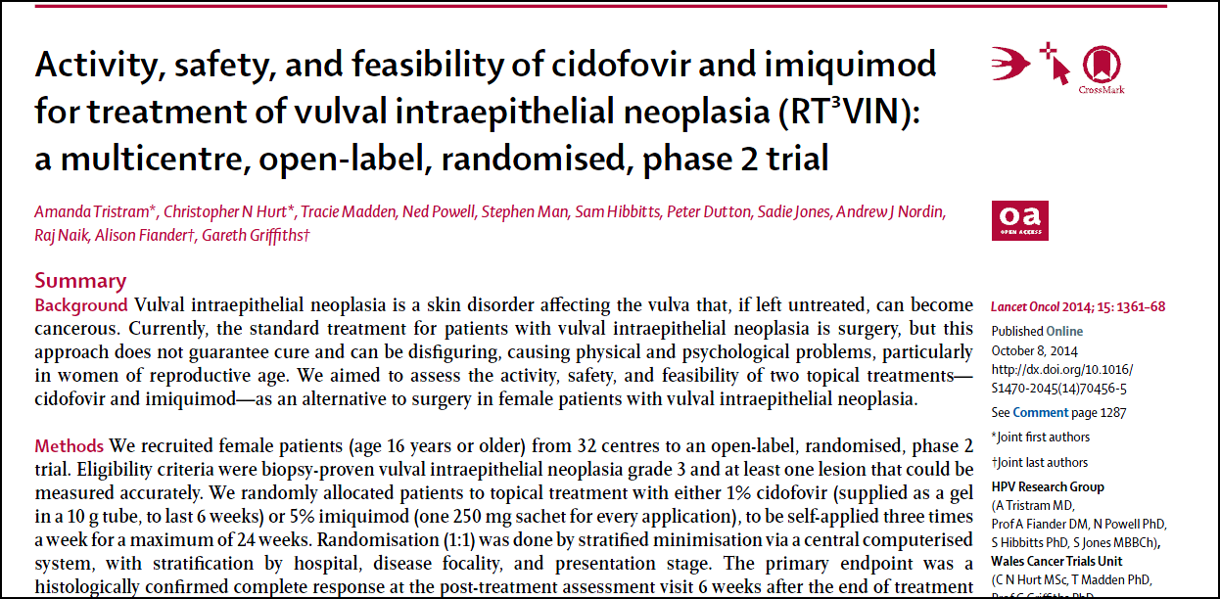

Slide 38
5-Fluorouracil (5-FU)
Chemotherapeutic agent that inhibits DNA synthesis.
Chemical desquamation in VIN lesion.
Failure of other treatments
Rarely used as last option.
Overall remission 34 %
Low tolerability ( pain, ithching, inflammation and ulcers)

Slide 39
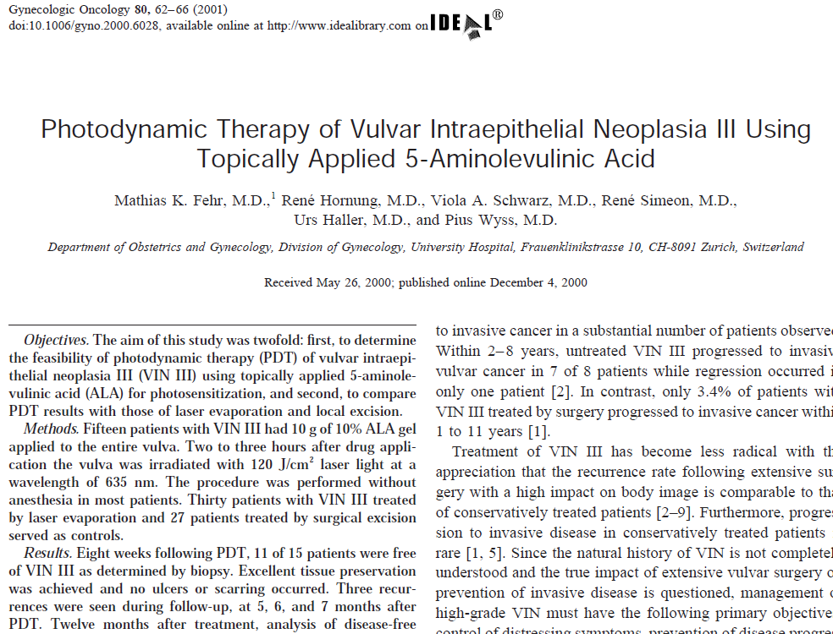
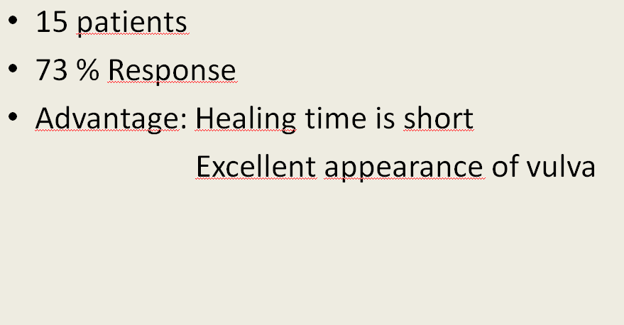
Photodynamic therapy
Tumor-localizing photosensitizer as 5- aminolevulinic acid (ALA) and nonthermal light generates oxygen-induced CELL DEATH.
After application of 10-20% ALA on the lesion, the light (625 nm) is used.
Requires specialized equipment and training.
CLEARANCE RATE 40-60%.
Notes:
Ülser veya skar formasyonu oluşmaz

Slide 40
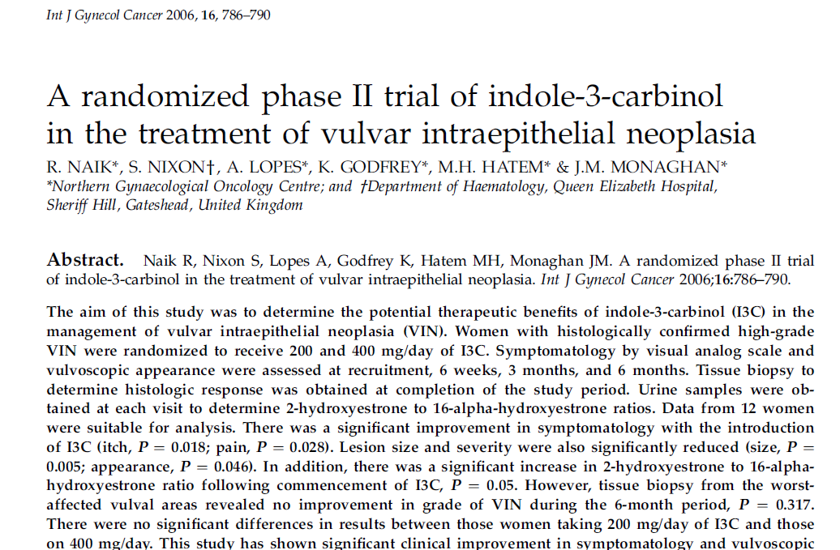
Indole-3-carbinol
A phytochemical that is inducer of 2-hydroxylation of estradiol.
Antiproliferative metabolite
Carcinogenic metabolite
n=13 (200mg/day [n=6] vs 400 mg/day [n=7])
Significant improvement in symtomatology
(itch, p=0.018; pain, p=0.028)
Lesion size and severity were significantly reduced
(size, p= 0.005; appearance, p=0.018)
No improvement in grade of VIN (p=0.317)
Follow-up → 6-month period

Slide 41
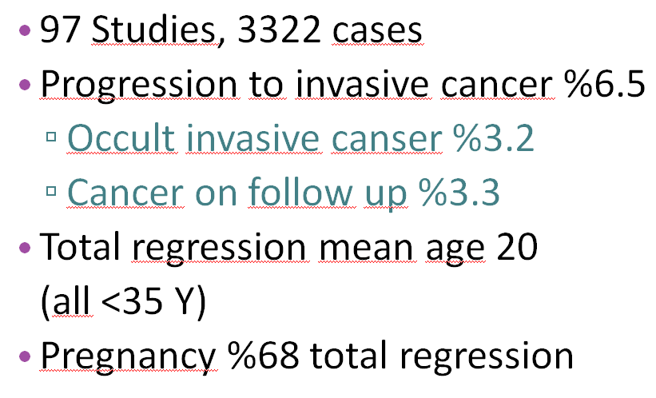
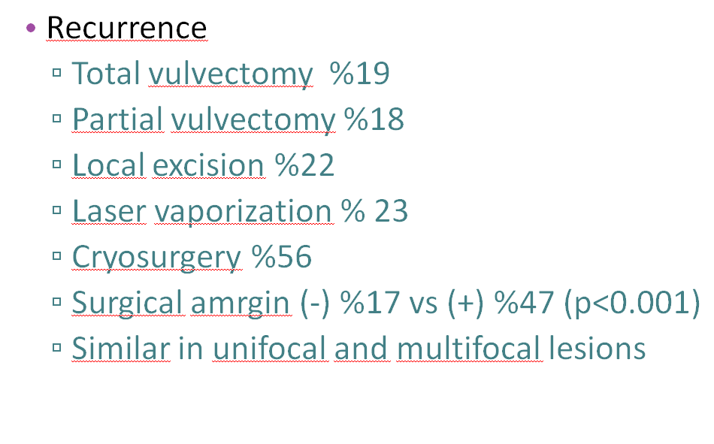
VIN METAANALYSIS

Slide 42
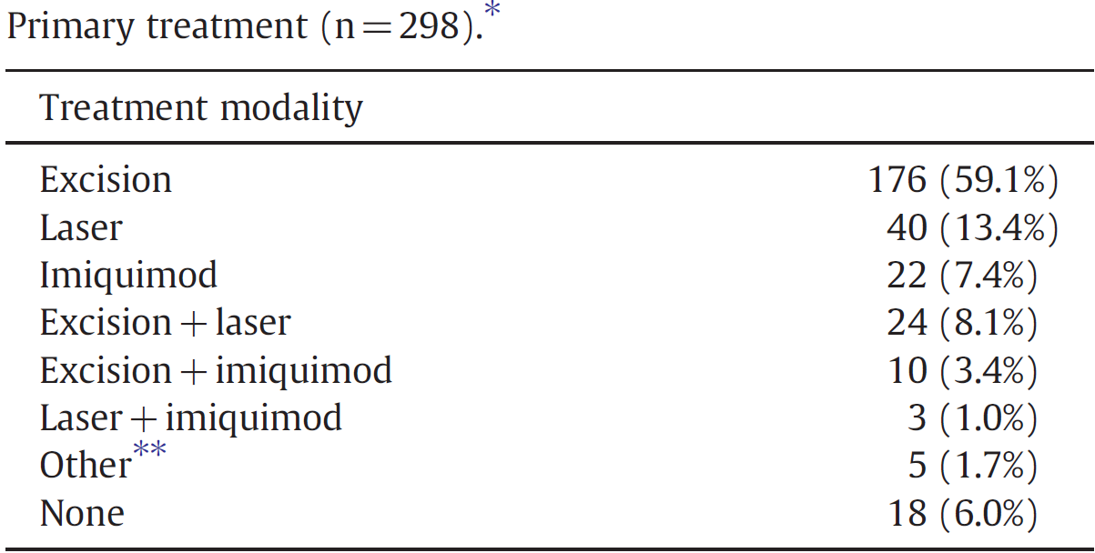
Follow-up→ 1.8 yıl (0-28.4)

Slide 43
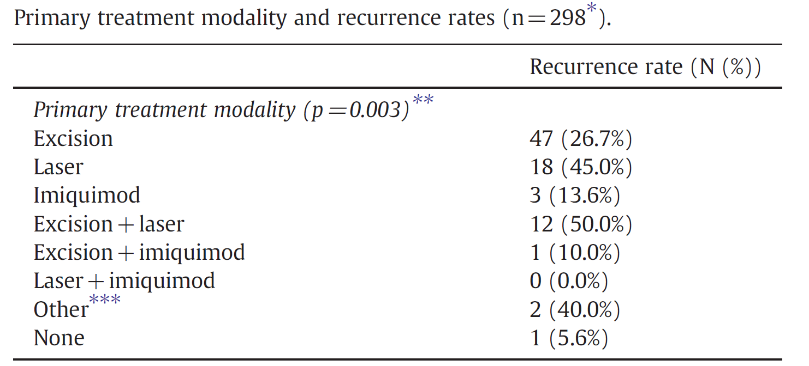

Slide 44
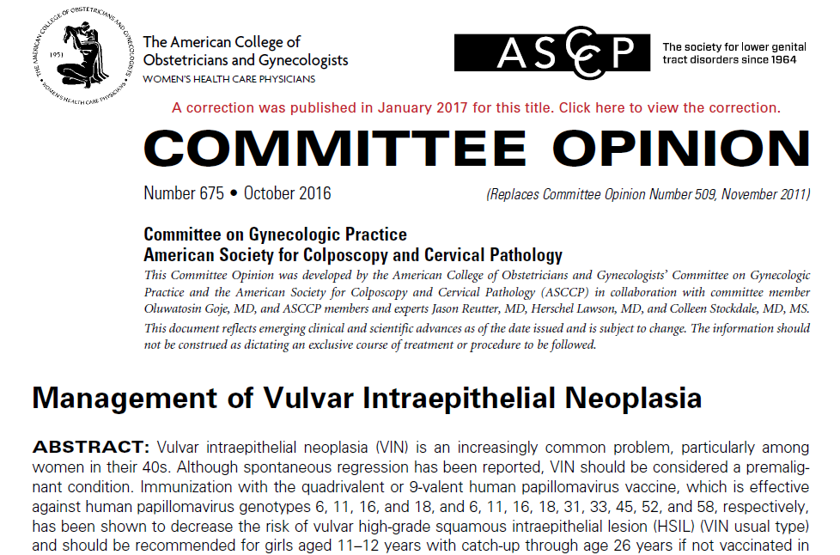
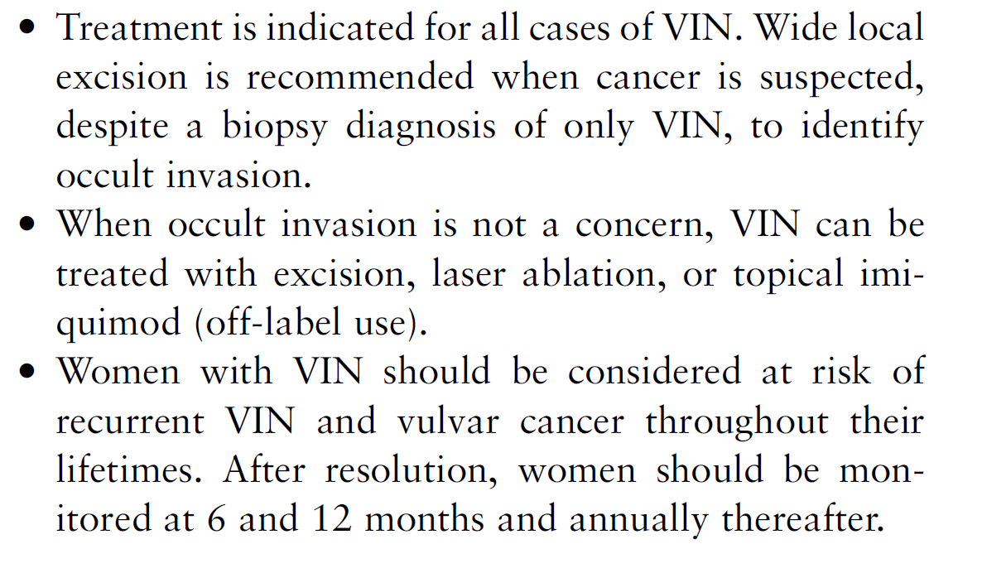

Slide 45
CONCLUSION-1
Treatment of VIN should be individualized.
Aim should be prevention of invasive cancer and preservation of vulvar anatomy and function.
uVIN (vulvar HSIL) with suspect of invasion or high risk factors
Surgical excision
In otherwise, ablative or medical treatment can be used.

Slide 46
CONCLUSION-2
dVIN should be treated with surgical excision.
Recurrence 30 % of treated VIN patients.
Long-term follow up is crucial (6-12. months after initial treatment and then annually).
Prophylactic HPV vaccine will dramatically decrease uVIN incidence.
Notes:
4-8 % progession to invasive cancer should not be forgotten.

Slide 47
TEŞEKKÜRLER…

