Slide 1
European Board and College of Obstetrics and Gynaecology
Capacity Building:
To Develop networks For Universal access to SRH in Eastern Europe And Central Asia- A Collaborative project of UNFPA and EBCOG
Dr Tahir Mahmood CBE
MD, FRCPI, MBA, FACOG,FRCPE, FDGGG,FRCOG
President EBCOG
17th May , 2017 Antalya

Slide 2
Greetings from the Council of European Board and College of Obstetrics And Gynaecology (37 countries)

Slide 3
Mission Statement
To improve the health of women and their babies
by seeking to achieve
the highest possible standards of care and training
in the field of Obstetrics and Gynaecology
in its 37 member countries

Slide 4
Current Challenges for SRH Services Provision - the Gaps!
What works best for Women?
Capacity Building- A multi faceted Approach

Slide 5
Unmet needs for Contraception

Slide 6
Teenage Pregnancy Rates

Slide 7
Taking stock - End of 2015
Rolled into SDG 3

Slide 8
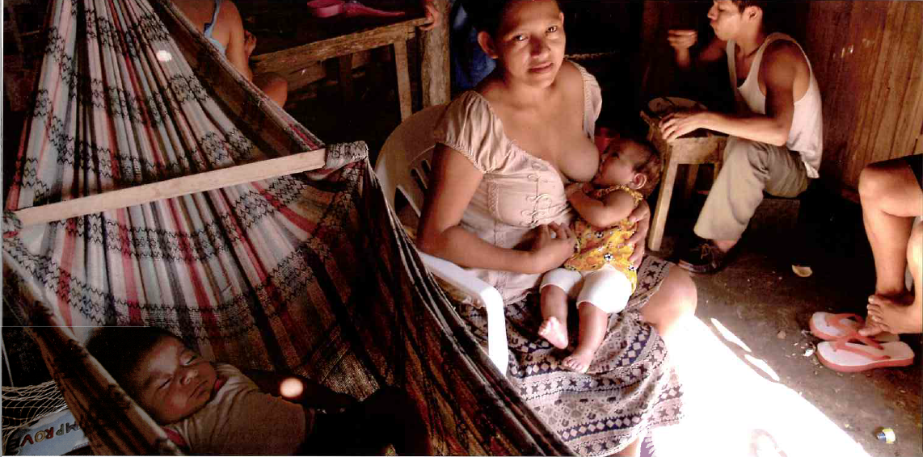
Teenage Pregnancies: Short Inter – Pregnancy Interval
Breast Feeding is not always an effective method of Contraception

Slide 9
Figure 8.2.9 Trends in Contraceptive Prevalence, by Specific Methods among Married Women Aged 15–44 Years; 1999 ,2005 and 2010 (Georgia)
Notes:
Source: GERHS 2010

Slide 10
Evidence of what works to reduce unwanted and untimed Pregnancies

Slide 11
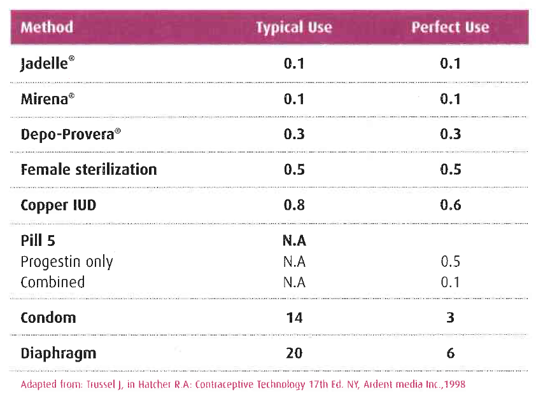
Percentage of women experiencing an unintended pregnancy within the first year of use (Pearl index)

Slide 12
Effective access to contraception reduces abortion rate

Slide 13
Multi-faceted Approach
g with Organisations which can make a difference
Developing an Effective Strategy to deliver an integrated SRH Strategy at Primary/Community Care level
Capacity Building for Workforce fit for purpose
Promoting availability of all effective methods of contraception including access to abortion
Services
Working with EBCOG and the National Societies in developing and delivering Regional/National Action Plan

Slide 14
Delivering care in the community
It is possible to adopt successful models of Care from the United Kingdom, the Netherlands and the Nordic Countries to deliver contraception services in the community
EBCOG will work very closely with UNFPA to develop a work force suitable to deliver high quality Standards of Care.

Slide 15
Multi-faceted Approach
Working with Organisations which can make a difference
Promoting availability of all effective methods of contraception including access to abortion
Focusing on developing integrated Services at Primary/Community Care level
Work Force Capacity Building to Deliver High Quality SRH Services
Working with EBCOG and the National Societies in developing and delivering Regional/National Action Plan

Slide 16
EBCOG and UNFPA-Capacity Building initiatives
EBCOG Standards of Care- Russian Translation for use in Eastern Europe and Central Asia, including Russia.
EBCOG UNFPA Scholarships- Young Specialists to visit a specialised centre to acquire knowledge and skills to advance quality improvement in SRH in the Eastern Europe and Central Asia Region.
Building SRH Experts Capacity- Delivering a Bachelor and Master Class Programme

Slide 17
Russian translation of Maternity standards of Care supported by UNFPA and RSOG 2016

Slide 18
Russian translation of Gynaecological standards of Care supported by UNFPA and RSOG 2016

Slide 19
EBCOG Standards of Care -Gynaecology

Slide 20
EBCOG- UNFPA EECA Region- Capacity Building
First Scholar- Dr Lela Shengelia-Georgia-Edinburgh- (SRH Unit)
Second Scholar- Prof Andrii Tkachenko -St Georges, London ( Clinical Governance and policy unit)
Third Scholar- Dr Natalia Silina from Ukraine (2016-17)

Slide 21
Capacity Building in Work Force At Country/Regional Level
Cluster development plan at each country level/Regional level to deliver the followings:
EBCOG/UNFPA Bachelor Class Programme for Health care providers in the community
EBCOG/UNFPA Master Class Programme for Senior Doctors and Policy Advisors

Slide 24
Cluster Development-1 (stakeholder engagement)
National Societies Role-Identify key leaders who can facilitate change and work with MOH and the educational institutions
EBCOG will encourage the societies to join EBCOG to access best models of care and expertise
Local educational institutions role- Will act as hubs for delivering UNFPA/EBCOG Training Programmes both Nationally and Regionally. They will develop working relationships with local national societies.

Slide 25
Cluster Development-2 (stakeholder engagement)
Role of UNFPA- facilitate engagement between all key players
Provide key pointers for action plan
Role of EBCOG:
Advisory at all levels and work very closely with UNFPA to deliver a focused service for family Planning in EECA Region
Advocacy Role with in EU

Slide 26
We can do it- Sexual and Reproductive Health 2017
A comprehensive strategy of Capacity Building,
Integrated Service delivery model for family Planning at the Primary care Level to meet the local needs (Long Acting contraceptives, Post coital contraception and Sex Education in Schools)
Full provision of family Planning Services will add value to overall wellbeing of Women and the Society. It is money worth investing!
Let us do it together

