Slide 1
THE EFFECTS OF ADIPOGENIC AND BONE MARROW DERIVED MESENCHYMAL STEM CELLS ON VAGINAL ATROPHY IN RAT MENOPAUSE MODEL Project Grant No : 15/208
Dr.Burcu Kasap, Dr. Şükrü Kasap, Dr.Seda Vatansever, Remziye Kendirci, Dr.Osman Yılmaz, Meryem Çalişir, Dr.Tuba Edgünlü, Dr.Melike Nur Akın

Slide 2
Objective:
Vaginal dryness due to vaginal atrophy is the most common symptom in postmeopausal women desrupting the life quality and sexual function (1).
Although hormone replacement therapy is the only proven treatment modality in this symptom, there are so many problems in patient compliance due to side effects of hormone replacement therapy (2).
Hence, alternative treatment approaches are seeking (3).
In this context, Adipogenic derived mesenchymal stem cells (ADMSC) and Bone Marrow Derived Mesenchymal Stem Cells (BMDSC) are currently being used in animal studies and menopause models other than vaginal atrophy due to their antioxidant, antiinflammatory and regenerative effects (4,5).
Bygdeman M, Maturitas 1996
The Society of Obstetricians and Gynaecologists of Canada. Int JGynaecol Obstet 2005
Ibe C J Sex Med 2010.
Saidi RF. Arch Iran Med 2012.
Ishikawa T. Curr Stem Cell Res Ther 2010.

Slide 3
Objective:
Our aim was to evaluate the regenerative and possible improvement effects of (ADSC) and Bone marrow derived mesenchymal stem cells (BMDSC) on vaginal atrophy.

Slide 4
Materials:
10-12 weeks, 170-210 gr weighting, 28 virgin Wistar albino rats were allocated in the study.
Vaginal smears were performed daily and rats having 4-5 days cycle were included.
Rats were randomly divided into 4 (four) groups.

Slide 5
Materials:
Group 1. Sham
Laparatomy
20 µl Saline injection into the microfolds below the vaginal mucous membrane 2 weeks later
Vaginectomy 4 weeks later

Slide 6
Materials:
Group 2. Menopause
Laparatomy+ oopherectomy
20 µl Saline injection into the microfolds below the vaginal mucous membrane 2 weeks later
Vaginectomy 4 weeks later

Slide 7
Materials:
Group 3. Menopause + ADSC,
Laparatomy+ oopherectomy
20 µl ADSC injection into the microfolds below the vaginal mucous membrane 2 weeks later
Vaginectomy 4 weeks later

Slide 8
Materials:
Group 4. Menopause + BMDSC.
Laparatomy+ oopherectomy
20 µl BMDSC injection into the microfolds below the vaginal mucous membrane 2 weeks later
Vaginectomy 4 weeks later

Slide 9
ADSC and BMDSCs Isolation
ADSC and BMDSCs were derived from 5 rats in Dokuz Eylül Animal resesarch Center other than the study groups.
Subcutaneous fat tissue of 5 rats were excised after general anesthesia induction.
Femur and tibia of the same rats were excised and transported into sterile PBS.
Allocated adipose tissue and bone marrow tissue were transferred into culture media and transported to Manisa Celal Bayar University School of Medicine Stem cell Laboratory .
ADSC and BMDSC isolations were performed.
Stem cells were not differentiated into other cell groups.
Stem cells were labeled via ‘Brd-U labeling’ metod.

Slide 10
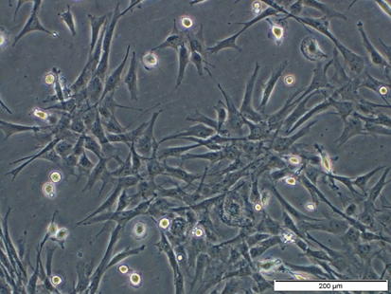
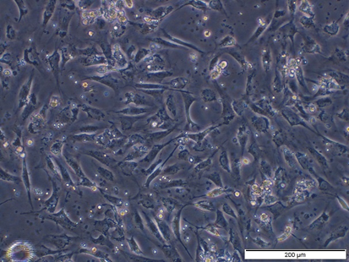
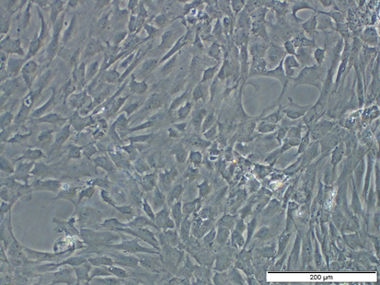
A
C
B
D
Figure 1: A.,B.,Adipogenic stem Cell, C.,D., Bone Marrow Stem Cell Culture Photograps. Scale: 200 µM.

Slide 11
Method:
Evaluated vaginal tissue were longitudinally divided into 2(two) equal parts.
Longitudinal and equal parts were seperately analyzed histologically/immunohistochemically and genetically.

Slide 12
Method:
Blood vessel number in vaginal folds and lamina propria was evaluated histopathologically.
Immunohistochemical analysis was performed by using Anti‑ER‑α, VEGF, VEGFR‑1, Bax and bcl-2 antibodies.

Slide 13
Method:
qPCR Analysis: Vaginal specimen for detection of mRNA and protein expression was transported within RNA LATER.
Gene expression levels were detected by analysis of Bax, Bcl-2 genes and beta actin gene as endogenous control
Genetical differences among the groups were compared by using Kruskal Wallis and Mann Whitney U test. P<0.05 was regarded as statistically significant.

Slide 14
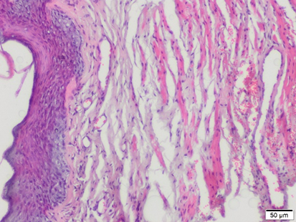
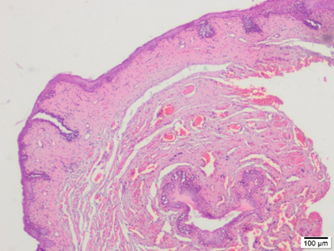
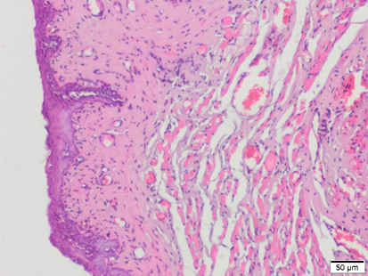
Results: Histological
Group 1
Vaginal epithelial thickness was lower, the number of cells in lamina propria was lower and collagen deposition was higher in the menopause group.
A
B
Vagen Hematoylen & Eosin staining. Scale: 50 µM (A, C), 100 µM (B, D).
Group 2
C
D

Slide 15
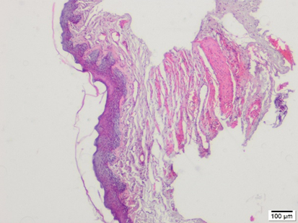
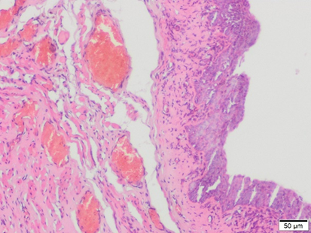
Results: Histological
Group 1
Epithelial thickness was higher than menopause group and lower than control group in ADSC applied group. However lamina propria and muscle tisuue were similar to control group.
A
B
Vagen Hematoylen & Eosin staining. Scale: 50 µM (A, F), 100 µM (B, G).
Group 3
F
G

Slide 16
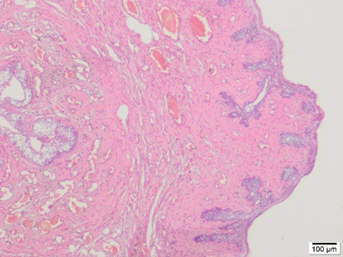
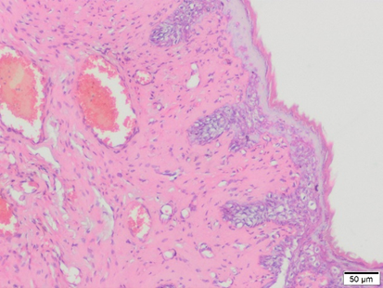
Results: Histological
Vaginal epithelial thickness was lower than control group whereas lamina propria and muscle tissue preserve their original histological appearance in BMDSC applied group.
Group 1
A
B
Vagen Hematoylen & Eosin staining. Scale: 50 µM (A, G), 100 µM (B, H).
Group 3
G
H

Slide 17
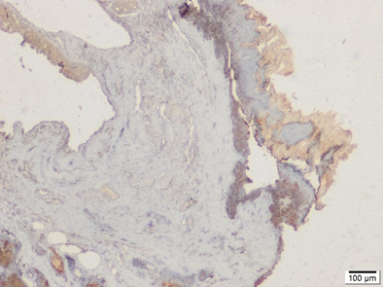
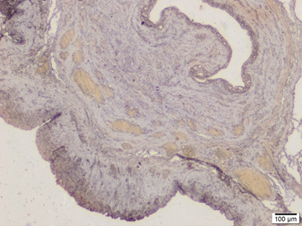
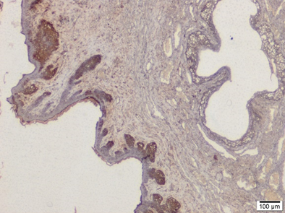
Results: Immunohistochemical
VEGFR-1 staining level was lower in menopause group whereas it was similar to control group and higher than menopause group in ADSC and BMDSC applied groups.
Group 1
Group 2
Group 3
Group 4

Slide 18
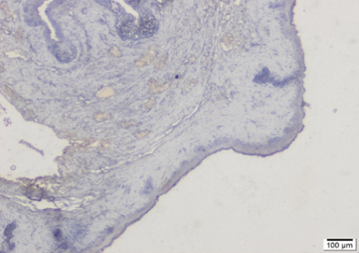
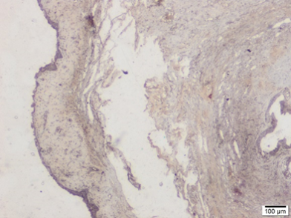
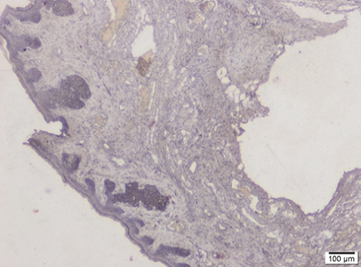
Results: Immunohistochemical
VEGF staining level was lower in menopause group however it became increased in ADSC group and more increased in BMDSC applied group.
Group 1
Group 2
Group 3
Group 4

Slide 19
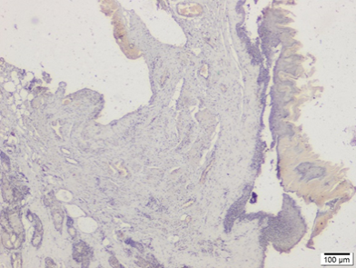
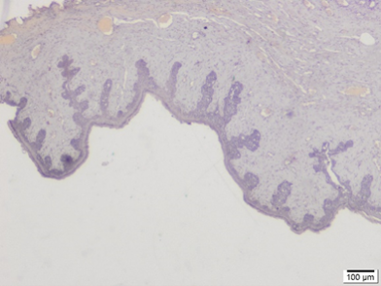
Results: Immunohistochemical
Bcl-2 staining level was increased in ADSC applied group and Bax staining was not detected in menopause group.
Group 1
Group 2
Group 3
Group 4

Slide 20
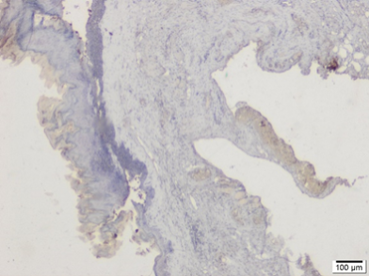
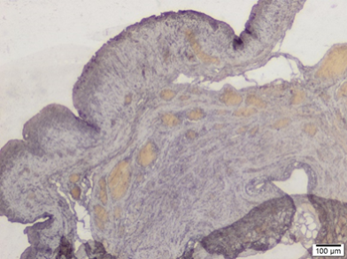
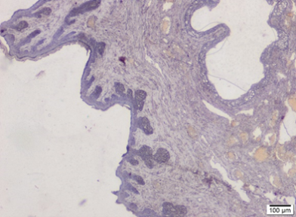
Results: Immunohistochemical
ER- α staining level was lower was similar to control group and higher than menopause group in ADSC and BMDSC applied groups
Group 1
Group 2
Group 3
Group 4

Slide 21
Results:
BAX, BCL2 and BAX/BCL2 levels were compared for each groups by Mann-Whitney U Test and no statistically significant difference was detected between groups in BAX and BCL2 genes and BAX/BCL2 ratio
 | comparison | p-values
BAX | I. group vs II. group | 0.95
 | I. group vs III. group | 0.13
 | I. group vs IV. group | 0.11
 | II. group vs III. group | 0.37
 | II. group vs IV. group | 0.23
 | III. group vs IV. group | 0.61
BCL2 | I. group vs II. group | 0.07
 | I. group vs III. group | 0.18
 | I. group vs IV. group | 0.48
 | II. group vs III. group | 0.73
 | II. group vs IV. group | 0.16
 | III. group vs IV. group | 0.35
BAX/BCL2 | I. group vs II. group | 0.10
 | I. group vs III. group | 0.59
 | I. group vs IV. group | 0.91
 | II. group vs III. group | 0.29
 | II. group vs IV. group | 0.23
 | III. group vs IV. group | 0.48

Slide 22
Conclusion:
It was concluded that ADSC and BMDSC applications improved vaginal atrophy histologically and imunohistochemically but this conclusion could not be supported via genetical analysis.

Slide 23
Conclusion:
Since increase in VEGF and bcl-2 immunoreactivities were higher in ADSC applied groups than BMDSC applied groups and Bax and ER-α immunoreactivities were similar to control group, it was also concluded that ADSC application improved the vaginal atrophy findings more than BMDSC application.

Slide 24
Conclusion:
Since VEGF secretion was shown to be directly related to VEGFR-1 secretion and expression of these antibodies increased in stem cell applied groups, angiogenesis might be improved via stem cell application.

