Slide 1
The effect of the duration of stimulation on ART outcomes
Kahyaoglu I, Dogru HY, Kaplanoglu I, Mollamahmutoglu L.
Etlik Zubeyde Hanım Women’s Health Research and Education Hospital

Slide 2
Introduction
Since the first successful use of assisted reproductive technology in 1978, much effort has been made to understand the factors that affect IVF outcomes (Steptoe and Edwards, 1978; Cramer et al., 2000). The most important factor is ovarian ageing & the incidence of infertility is proportional to maternal age (Menken et al., 1986)

Slide 3
Other factors known to affect assisted reproductive treatment outcomes include laboratory quality, the duration of infertility, and previous successful pregnancies (Templeton et al.,1996). However, none of these factors are readily modifiable.
In contrast, factors that may be modified include the length of gonadotrophin stimulation (the time it takes for the leading follicles to reach a predetermined size, e.g. 17–18 mm), and the dosage of gonadotrophins utilized.

Slide 4
Clinicians tend to assume that there is an ideal length of stimulation, and longer or shorter duration is cause for concern which may influence success of ART.
The objective of the current study was to determine if the length of ovarian stimulation affect ART outcomes.

Slide 5
Materials & Methods
Medical records of 3194 treatment cycles from March 2007 through August 2016 at the Etlik Zubeyde Hanım Women’s Health Research and Education Hospital, Center of Assisted Reproduction were reviewed using a computer based database. All IVF and ICSI cycles were identified.
Cycles were divided into 3 groups according to the length of stimulation; cycles with a duration of stimulation ≤8 days as Group 1, between 9 and 12 days as Group 2 and duration of stimulation longer than 13 days as Group 3.

Slide 6
Only fresh cycles were considered eligible for inclusion. Frozen embryo transfer cycles, natural cycles, cycles cancelled due to no response to gonadotrophins, cycles with no sperm and oocyte retrieval were excluded from the study.
The approval of the local ethics committee was obtained at the beginning of the study .

Slide 7
Results
A total of 3194 cycles were included
Long agonist protocol was used in 1356 (42.6%) cycles, microdose flare in 486 (15.3%) cycles and GnRH antagonist in 1342 (42.1%) cycles.
%42.2 of cases were male factor, %29.7 were unexplained infertility , %6 tubal factor, %16.1 DOR and %6 as hormonoovulatory dysfunction.

Slide 8
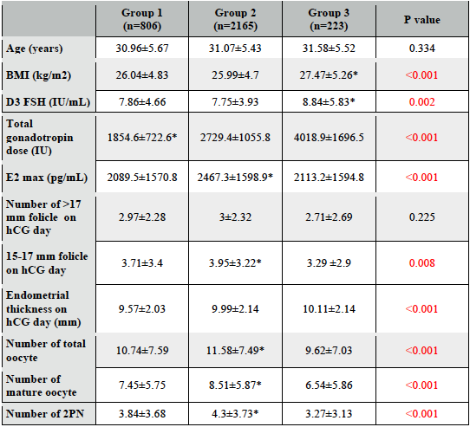

Slide 9
There is no statisticaly significant difference between 3 groups regarding clinical pregnancy rates and ongoing pregnancy rates (p>0.05)

Slide 10
Poor responder
Mature oocyte count, number of fertilized oocytes was significantly higher in Group 2 when compared to other two groups (p<0,05).
D3 FSH was significantly higher in Group 3 when compared to other groups (p<0,05).
No difference in clinical pregnancy rates.
Ongoing pregnancy rates were significantly lower in Group 3.
Notes:
When subgroup analysis was performed

Slide 11
Normoresponder
Number of follicles >17 mm ve 15-17 mm were higher in Group 1 when compared to other groups.
No difference in clinical and ongoing pregnancy rates.

Slide 12
Hyperresponder
Number of follicles 15-17 mm, number of total oocytes, mature oocytes were significantly lower in Group 3 when compared to other groups
No difference in clinical pregnancy rates and ongoing pregnancy rates.

Slide 13
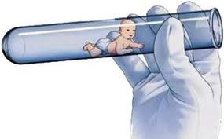
Conclusion
Controlled ovarian stimulation longer than 13 days is associated with lower ongoing pregnancy rates in poor responder patients, but in normo and hyperresponder patients no negative effect was observed regarding pregnancy rates.

