Slide 1
Servikal Preinvaziv Lezyonlar ve Serviks Kanserinin Primer Taramasında HPV’nin Rolü
Dr Polat Dursun

Slide 2
Sunum planı
Serviks kanseri sitolojik taramasındaki sorunlar
HPV serviks kanseri ilişkisi
Primer Taramada HPV çalışmaları
ATHENA çalışması
Sitolojik anormalliklerin yönetiminde HPV testi

Slide 3
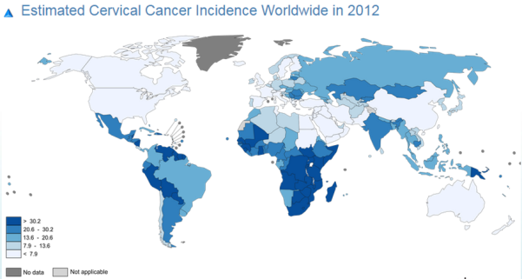
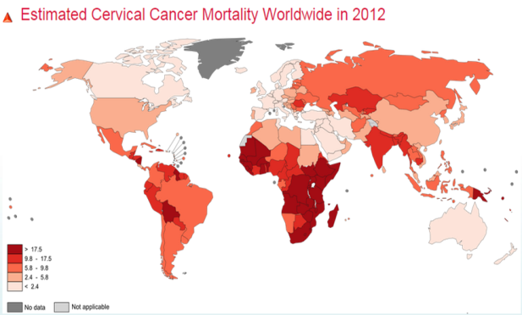
Servikal Kanser
> 500 bin yeni vaka /yıl
50% Mortality
>99% HPV İlişkili
Tamamen önlenebilir bir Kanser
  HPV Vaccination, Smoking Cessation
Erken Tanı Mümkün
  VIA-VILI / Smear / HPV / Combination / Others
  WHO
Eradike Edilebilir bir kanser !

Slide 4
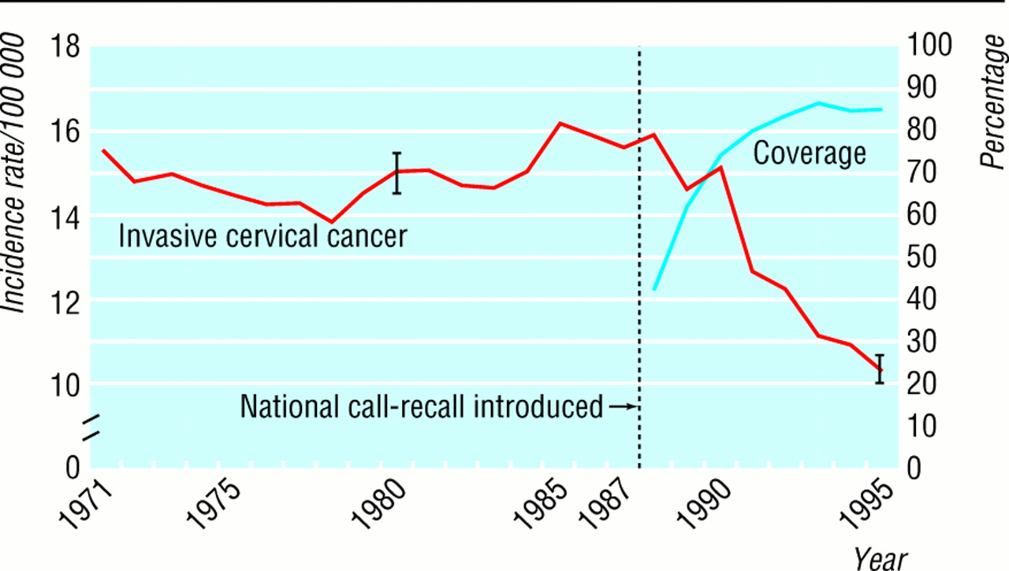
Sitolojik Taramanın Serviks Kanseri Sıklığına Etkisi
50 yıldır kullanımda
Mortalite ve insidansda %50 düşme
Özellikle gelişmiş ülkelerde başarılı programlar
Sadece 8 Avrupa ülkesinde yerleşik sistem
Ve…serviks kanserlerinden ölüm en iyi ülkelerde bile devam ediyor
England- 1971-1995

Slide 5
Sitoloji Tabanlı Taramanın Sorunları
Çok zor ve kompleks bir halk sağlığı hizmetidir.
Bilimsel Yetersizlikler
  CIN2+ lezyonlar için tek bir pap-testin sensitivitesi çok düşüktür.
  Pap-testin yanlış negatiflik oranı çok yüksektir.
  Pap-testin tekrarlanabilirliği düşüktür.
  Pap-test servikal adenokarsinom tanısı koymada yetersizdir.

Slide 6
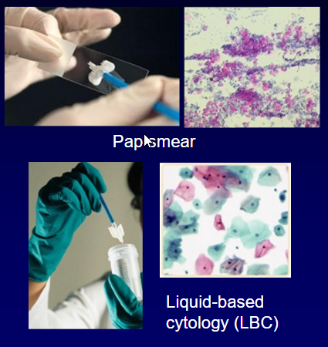
Pap Smear Taramasındaki Hatalar
Örnekleme hataları
Hücreler örneklenemez
Transfer edilemez
Korunamaz
Tarama / Yorumlama Hataları
  Sitolog tarafından yanlış yorumlama
  Yanlış yönetme

Slide 7
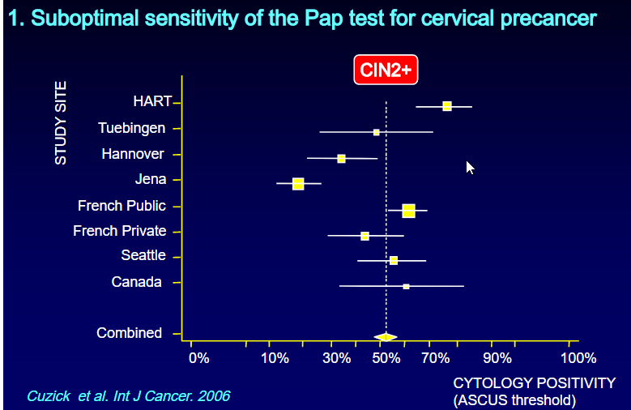
CIN2+ lezyonlar için tek bir pap-testin sensitivitesi çok düşüktür.
Sitoloji Tabanlı Taramanın Sorunları
Tek bir pap-testin sensitivitesi %50-60’tır.
Nanda K, et al, systematic review, Ann Intern Med. 2000;132(10):810-819
Sık tekrar edilmesi gerekir.
3 kez negatif sonuç alınmaksızın tarama aralığı 3 yıla çıkarılırsa servikal kanser risk, 3 kat artar.
Kitchener HC, Castle PE, Cox JT. Chapter 7: Achievements and limitations of
cervical cytology screening. Vaccine 2006;24:S63-70

Slide 8
Pap-testin yanlış negatiflik oranı çok yüksektir.
Sitoloji Tabanlı Taramanın Sorunları
2275 servikal kanser vakasının tarama öyküsü:
Tarama Öyküsü (%) | İtalyan Verisi₁ | Kaiser Verisi₂ | İsviçre Verisi₃
Taranmadı | %62 | %56 | %64
Normal Sitoloji | %14 | %32 | %24
Anormal sitoloji & Yetersiz takip | %24 | %13 | %7
 | n=262 | n=833 | n=1180
1 Amadori A, et al. Int J Gyn Can 1998, 8; 251-256
2 Leyden WA, et al. J Nat Can Ins 2005, 97; 675-683
3 Andrae B, et al. JNCI 2008, 100; 622-629

Slide 9
Pap-testin tekrarlanabilirliği düşüktür.
Sitoloji Tabanlı Taramanın Sorunları
İnter-observer ve inter-laboratuar variabilitesi yüksektir.
Bu variabilite klinik tutarlılığı azaltır.
Eğitim farkı arttıkça variabilite daha da belirginleşir.
Bu durum özellikle taramanın yeni başlatılacağı yerler için önemli.
Castle PE et al. ATHENA study. 2011 Lancet Oncol 12:880-90

Slide 10
Sitoloji Tabanlı Taramanın Sorunları
Pap-testin tekrarlanabilirliği düşüktür.
Oran (%) | Lab A | Lab B | Lab C | Lab D
Normal | 96,2 | 94,6 | 91,8 | 90,1
Anormal | 3,8 | 5,2 | 8,1 | 9,9
ASC-US/LSIL | 2,1 | 1,1 | 1,2 | 2,3
CIN2+ lezyonlar için Sitolojinin Sensitivitesi | 42,0 | 51,0 | 60,5 | 73,0
Wright TC et al. Insights from ATHENA. 2013

Slide 11
Pap-test servikal adenokarsinom tanısı koymada yetersizdir.
Sitoloji Tabanlı Taramanın Sorunları
Sitoloji tabanlı etkin taramalara rağmen servikal adenokarsinom insidansı artmaktadır.
Ault KA et al. 2011 Int J Can. 128, 1344-1353
AIS özellikle <40 yaş grubunda artmaktadır.
Saslow D et al. 2012 CA Can J Clin. 62(3):147-172
SCC’lerin %70’i HPV16/18’e bağlıyken adenokarsinomların %85-90’ı bu tiplerle ilişkilidir.
Katki HA et al. Lancet Oncol 2011;12:663-672

Slide 12
Pap-test servikal adenokarsinom tanısı koymada yetersizdir.
Sitoloji Tabanlı Taramanın Sorunları
Histoloji (n) | Sensitivite
 | Sitoloji | HPV
CIN3 (254) | %52 | %92
AIS (16) | %63* | %88
Adenoca ve Adenosq ca (1) | %100 | %100
SCC (3) | %100 | %100
%%25
*%25 fark
Castle PE et al. ATHENA study. 2011 Lancet Oncol 12:880-90

Slide 13
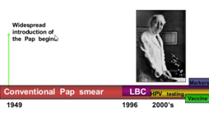
Serviks Kanseri Taramasının Dönüşümü

Slide 14
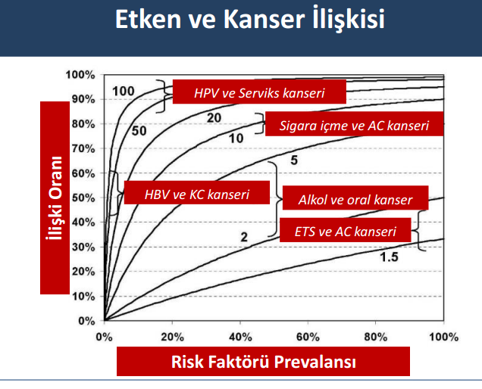
HPV Serviks Kanseri İlişkisi

Slide 15
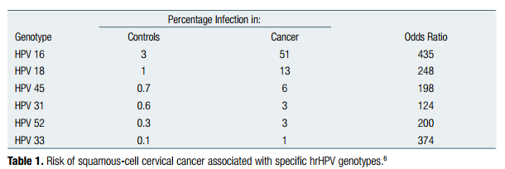
HPV Serviks Kanseri Riski
Munoz N, et al. Epidemiologic classification of human papillomavirus types associated with cervical cancer. N Engl J Med. 2003;348(6):518-27.

Slide 16
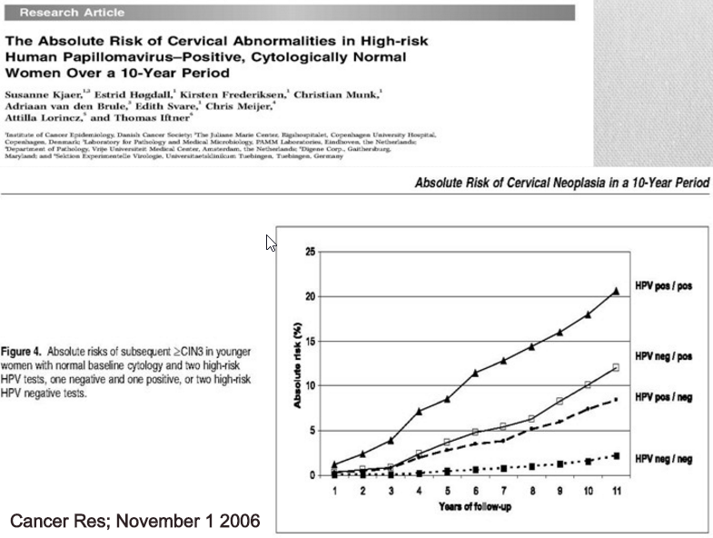

Slide 17
HPV Testi
HPV servikal kanserlerin %100’ü için etken ajan
Munoz N. Int J Cancer 2004 Aug 20;111(2)278-85
HPV testleri daha çok klinik kullanıma girdi
İlk metaanalizler HPV testlerinin yüksek sensitivitesini gösterdi
Primer tarama için randomize kontrollü çalışmalar planlandı
İlk tur sonuçlar
Avrupa ve Dünya’da primer taramalar
İkinci tur sonuçlar
Primer taramada önerildi
1990lar
2000
2007
2012
2015

Slide 18
RCTs of HPV testing in screening
POBASCAM study: The Netherlands (Meijer et al., Int J Cancer 2004; Bulkmans et al, Lancet 2007)
Indian Trial (Osmanabad) (Sankaranarayanan et al. NEJM 2009)
ARTISTIC trial: UK (Kitchener et al. Lancet Oncol 2009)
NTCC Italian Study (Ronco et al., Lancet Oncol, 2006; JNCI 2006)
SWEDESCREEN: Swedish trial (Elfgren et al. AJOG 2005; Naucler et al., NEJM 2007; JNCI 2009)
Finnish RCT (Kotaniemi et al., BJC 2005; Eur J Cancer 2008; IJC 2008; Leinonen et al., JNCI 2009)
CCCaST study: Canada (Mayrand et al., IJC 2006; NEJM 2007)
BC RCT (HPV FOCAL): Canada (Ogilvie et al, BJC 2012)

Slide 19
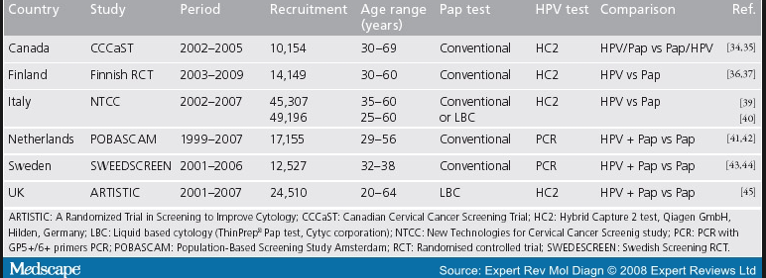

Slide 20
HPV Testlerinin Sensitivitesi
Metaanalizler HPV testlerinin daha sensitif olduğunu gösterdi
 | Sensitivite | Spesivite
Sitoloji | 53% | 97%
HPV testi | 96% | 92%
Mayrand MH et al. Int J Cancer 2006 119;615-623

Slide 21
Primer HPV Taraması İlk Tur Sonuçları
    Birleşik Avrupa verisi
CIN3+ lezyonların kümülatif insidansı
(10,000’de)
Başlangıç testinden itibaren zaman (ay)
Dillner, J. et al. BMJ 2008;337:a1754

Slide 22
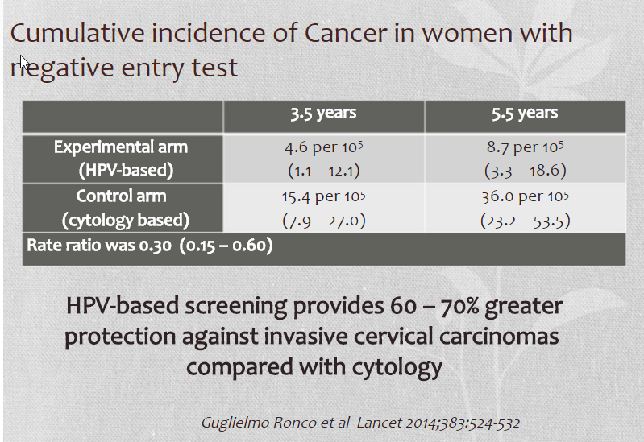

Slide 23
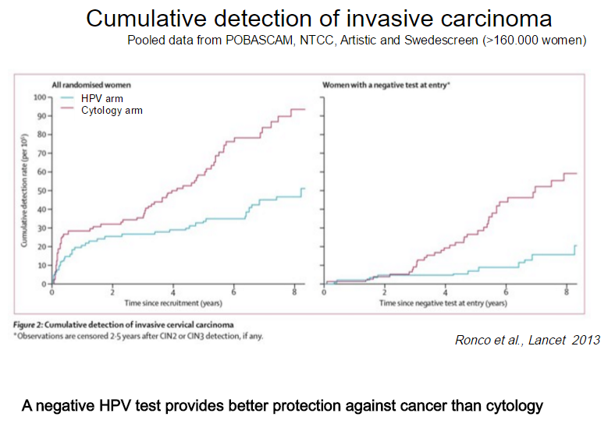

Slide 24
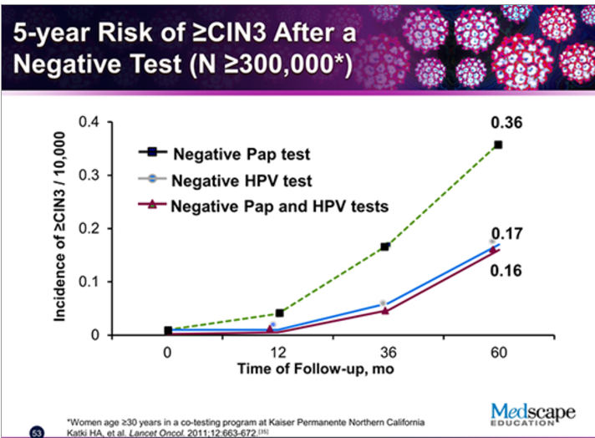

Slide 25
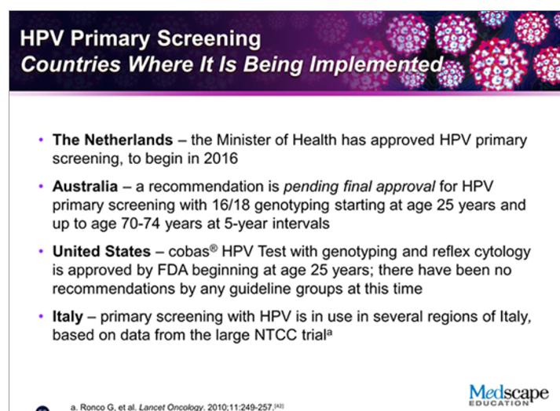

Slide 26
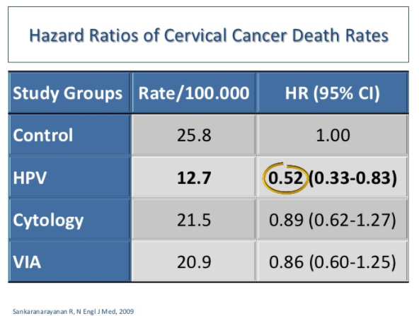
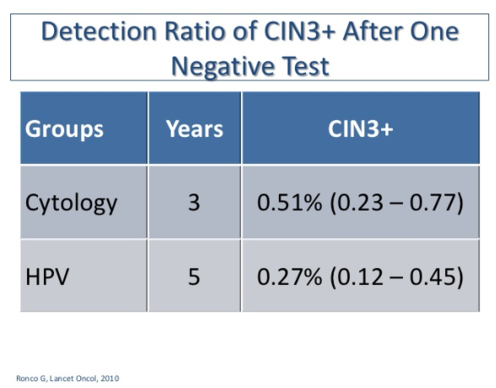
Negatif HPV Testi Sonrası CIN3 ve Servikal Kanserden Ölüm Oranları

Slide 27
The ATHENA Study

Slide 28
The ATHENA Study
ATHENA is the largest prospective cervical cancer screening study in the U.S.
Enrolled 47,208 women ≥21 years undergoing routine cervical cancer screening in the U.S.
  61 clinical sites in 23 states and 4 clinical laboratories
Served as the FDA registrational study for the cobas® HPV Test for:
  ASC-US management (approved in 2011)
  Cotesting with cytology for screening (approved in 2011)
  Primary screening (approved in 2014)
Wright et al. Am J Clin Pathol 2011;136:578-586
Notes:
The ATHENA trial is the largest prospective cervical cancer screening study conducted in the U.S to date.
During the course of the study more than 47,000 women 21 years and older were enrolled at 61 sites across 23 states and 4 clinical laboratories were enlisted for testing.
The ATHENA study served as the registrational trial for the cobas HPV Test with 16/18 GTing and (based on the cross-sectional data), FDA approval was granted in 2011.
Today, the approved intended uses are for the management of borderline or ASC-US cytology results and also as an adjunctive test to cytology.
Although the trial enrolled women 21 years & older, the data that will be showing on the next several slides is from an HPV primary screening population - women 25 years & older.

Slide 29
ATHENA Trial Design
Specifically designed to demonstrate the performance of
HPV testing in cervical screening in the U.S.
  The ATHENA population was representative of a U.S. screening population in demographics, cytology distribution, and HPV prevalence
  Both cytology and HPV testing (with genotyping) performed on all women
  Rigorous disease ascertainment was achieved
    All women who screened positive for either test
    (both Pap+ and HPV+) were taken to colposcopy
    Histology determined by consensus of expert pathologists
Wright et al. Am J Clin Pathol 2011;136:578-586
Notes:
The ATHENA trial was specifically designed so that it could demonstrate the performance of HPV testing in cervical cancer screening in the US.
To achieve this objective, first, the ATHENA population had to be representative of a US screening population.
Secondly, the study design had to allow for all women to have both cytology and HPV testing at enrollment.
And most importantly, to be able to compare the performance of HPV testing to cytology, all women with either abnormal cytology or positive HPV results had to be referred for colposcopy.
Colposcopy was performed by protocol and the histologic diagnosis of all biopsies was determined by the consensus review of expert pathologists.

Slide 30
Cytology Results and Prevalence of hrHPV in ATHENA
Pap Test Result | Eligible Subjects ≥25 Years N=40,944 % (n)
NILM | 93.5 (38,397)
ASC-US | 4.0 (1632)
>ASC-US | 2.4 (986)
LSIL | 1.9
ASC-H | 0.1
HSIL | 0.3
Squamous Cell Carcinoma
AGC^{a, b} | <0.1
ªAGC (Atypical Glandular Cells) includes: AGC - Endocervical, AGC - Endometrial, and AGC - Not Otherwise Specified ^{b}AGC, Favor Neoplastic includes: AGC - Endocervical - Favor Neoplastic and AGC - Favor Neoplastic
Notes:
Cytology for the Athena study was performed at four high volume accredited labs located in the US.
The distribution of cytology results in ATHENA was what would be expected in a US screening population when compared to the 50th percentile results of the CAP survey – and of note, the CAP numbers are not age-adjusted for women 25 years and older.

Slide 31
HPV Prevalence in ATHENA
Age Groups (Years) | HPV+ |  | HPV16+ |  | HPV18+
 | ATHENA % | NMHPVPR* % | ATHENA % | NMHPVPR* % | ATHENA % | NMHPVPR* %
Overall Evaluable Primary Screening Subjects | 10.5 | 14.2 | 2.1 | 3.1 | 0.8 | 0.9
25-29 | 21.1 | 21.8 | 5.3 | 5.2 | 1.6 | 1.4
30-49 | 9.4 | 11.5 | 1.7 | 2.2 | 0.7 | 0.7
≥50 | 6.0 | 6.9 | 0.8 | 1.3 | 0.4 | 0.5
*New Mexico HPV Pap Registry; assumed that carcinogenic HPV+ (HPV 16, 18, 31, 33, 39, 45, 52, 56, 58, 59, and 68) in NMHPVPR was equivalent to HPV+ (HPV 16, 18, 31, 33, 35, 39, 45, 51, 52, 56, 58, 66, and 68) in ATHENA
Wheeler C et al. Int. J. Cancer: 2013;132:198–207
Notes:
In terms of HPV prevalence, <CLICK> 10.5% of the women 25 years and older in ATHENA were found to HPV+. On this slide, the prevalences in Athena are compared to the cohort from the New Mexico HPV Pap Registry, the only recognized CCA registry in the US. <Click>There are slightly higher values in the New Mexico HPV Pap Registry, but there is relatively close agreement. <Click> When stratified by genotype, 2.1% were HPV 16+ and 0.8% were HPV 18+.
<Click> There were also some minor differences in the genotypes considered oncogenic in these two studies & that might account for some of the small discrepancies.

Slide 32
ATHENA Patient Flow
Cross-sectional Phase for Primary HPV Effectiveness
Women ≥25 years visiting for routine exam
n=42,209 40,944 evaluable women
Normal Pap and hrHPV (-)
≥ASC-US or hrHPV (+)
Randomized & proceeded to colposcopy
n=892 (86%)
Colposcopy
n=8073 (86%)
Not
Randomized
≥CIN2
No ≥CIN2
≥CIN2=431
Exit study
Wright et al. Am J Clin Pathol 2011;136:578-586
Notes:
32
The next 2 slides will show the design of the ATHENA trial in more detail.
This 1st slide shows the patient flow for the cross-sectional phase of the study that was designed to demonstrate the effectiveness of HPV testing for cervical cancer screening.
This phase of the study took place from 2008-9, during which time over 42,000 women 25 years and older were enrolled.
At enrollment, women had both liquid-based cytology (ThinPrep) & HPV testing performed and the results were used to determine referral to colposcopy.
All women with abnormal cytology (ASC-US or greater) and all women with positive HPV results proceeded to colposcopy.
Women with negative cytology and negative HPV results exited the study after the enrollment visit, except for subset of ~1000 women with negative/negative results who were randomized to colposcopy so that investigators would know how much disease was is in the entire population. An adjustment is needed and assumes the same rate of disease occurs in those who didn’t go to colpo as those neg/negs that did. Data presented therefore are adjusted for this. Results lead to the same conclusions even without this adjustment.
In total ~8000 women were taken to colposcopy & biopsy - and those who reached the study endpoint of CIN2 or greater were eligible for treatment & then exited the study.

Slide 33
ATHENA Patient Flow
3 Year Follow-up Phase for Safety Evaluation
Exited after Baseline
n=1359
Colposcopy
n=8073
N=6210
≥CIN2
No ≥CIN2
≥CIN2=79
Year 1 visit
≥CIN2=35
Year 2 visit
Exit study
≥CIN2=42
Year 3
exit colposcopy
n=4063
Wright et al. Am J Clin Pathol 2011;136:578-586
Notes:
33
Those who did not reach the study endpoint of CIN2 or greater were invited to participate in the follow-up phase of the study which concluded in 2012 and which provided sufficient FU to determine the safety of screening.
Of the ~8000 eligible for FU, 1359 exited & did not proceed to FU.
During follow-up, women were seen annually & had both cytology and HPV testing performed.
Only women with abnormal cytology, ASC-US or greater, were referred to colposcopy & biopsy.
As in the baseline phase, those who met the endpoint of CIN2 or greater exited the study and those with <CIN2 proceeded to the following year.
At year 3, all women were offered exit colposcopy.

Slide 34
Performance Comparison of Three Screening Strategies
Notes:
All evaluable women in the ATHENA study had both cytology and HPV tests at baseline and prior to knowledge of whether or not they actually had a precancerous lesion. And disease ascertainment is known for all with abnormal tests and can be estimated in the group that tests negative. This makes it possible to evaluate strategies using tests various combinations to see determine the effectiveness and efficiency of each and then compare strategies.
Unlike studying comparing drugs where control and treatment groups must be randomized, studies on screening strategies can use the one group of subjects since the test results don’t interfere with each other. In fact, this is has the advantage that there is no need to consider differences between the groups as a possible reason for different outcomes.
In this presentation, three different strategies will be compared.

Slide 35
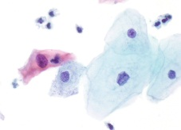
ASC-US Triage Strategy
Routine screening
Negative
Pap
Routine screening
Cytology
Negative
HPV test
ASC-US
Positive
LSIL/HSIL
COLPOSCOPY
COLPOSCOPY
This strategy is a recommended in US Guidelines for women 21+ every three years
Notes:
The first strategy is called “ASC-US Triage Strategy”. This is one of the strategies that is commonly employed in many countries. This strategy, is one of the strategies supported by current US Guidelines. A cervical sample is collected and if normal, the woman is dismissed until the next round of screening. If the cytology is read as LSIL or HSIL, she is sent for colposcopy. If the cytology is read as ASC-US she is triaged with an HPV test. If the HPV test is normal she is clear to return to routine screening, but if positive she is sent for colposcopy.

Slide 36

Cotesting Strategy
Routine screening
Cytology
NILM / HPV-
ASC-US / HPV-
Cotesting
12 months
NILM / HPV+
OR
31
33
35
HPV 16/18
genotyping
39
45
51
HPV
Test
52
56
58
ASC-US / HPV+
>ASC-US
59
66
68
16
18
COLPOSCOPY
This strategy is recommended in US Guidelines for women 30+ every five years as the preferred option
Notes:
The next strategy to be considered is called “Cotesting Strategy”. It is also one of the strategies supported by current US Guidelines. But unlike the previous strategy, which according to US Guidelines can be used for women starting at age 21, this strategy starts at age 30.
A cervical sample is collected and both cytologic assessment and HPV testing is performed. If both tests are normal, the woman is dismissed until the next round of screening. If the cytology is read as LSIL or HSIL, she is sent for colposcopy, regardless of the HPV result. If the cytology is read as ASC-US the HPV test determines whether or not she will be invited to colposcopy. If the cytology is read as normal, but the HPV test is positive she can be managed in one of two possible ways. One alternative is to repeat the test in 12 months. An alternative is to perform HPV16/18 genotyping and if positive she is sent for colposcopy.
It is helpful to note that the same group of women are initially selected for colposcopy for costesting when HPV16/18 genotyping is not used as in the ASC-US triage strategy. As a result, baseline performance for cotesting without genotyping and the “ASC-US Triage” triage strategy identical. Therefore baseline results will focus on cotesting with HPV16/18 genotyping and this strategy will be referred to as the “Cotesting with 16/18 Genotyping Strategy”.

Slide 37


HPV with Genotyping and Reflex Cytology Strategy
Routine screening
HPV−
Follow-up in
12 months
31
33
35
39
NILM
45
51
52
56
58
Cytology
12 other hrHPV+
59
66
68
16
18
≥ASC-US
hrHPV
COLPOSCOPY
HPV16/18+
COLPOSCOPY
hrHPV=high risk HPV
Notes:
The third strategy that will be considered is called “HPV with Genotyping and Reflex Cytology Strategy”.
HPV with genotyping is the first-line test and women who test positive for HPV 16 or HPV 18 are referred to immediate colposcopy.
Those who test positive for the pool of 12 other (or the non-16/18) genotypes, have cytology performed and those with an ASC-US or greater result, are referred to colposcopy. Those with a negative HPV test are dismissed from this round of screening.

Slide 38
Comparisons for Women 25+
ASC-US Triage Strategy (ages 25+)
Cotesting Strategy (ages 25+)
  Cytology with Reflex HPV Strategy (ages 25-29)
  Cotesting Strategy (ages 30+)
HPV with Genotyping and Reflex Cytology Strategy (ages 25+)
Notes:
The slides that follow will present data comparing two cervical cancer screening strategies are currently supported by US Guidelines. Since the data from the ATHENA trial for the “HPV with Genotyping and Reflex Cytology” strategy if for women ages 25+, to be meaningful the comparisons should also start at age 25. For the “ASC-US Triage” strategy, it is easy. This strategy is approved for women ages 21+, so using this strategy for women 25+ is supported by US guidelines. However, the “Cotesting” strategy starting at age 25 is not. So a hybrid strategy will be considered wherein women from 25-29 are managed with the “ASC-US Triage” strategy and women 30+ are managed with the “Cotesting” strategy.

Slide 39
Comparison to ASC-US Triage
Strategy | ≥CIN3
 | Relative Sensitivity¹ % | Relative Specificity¹ %
ASC-US Triage | 1.00 | 1.00
Cotesting† with 16/18 Genotyping | 1.28* | 0.99*
HPV with Genotyping and Reflex Cytology | 1.40* | 0.99*
Data from Medical Devices Advisory Committee Microbiology Panel Meeting: Sponsor Executive Summary
Adjusted results
¹Relative to Cytology with Reflex HPV Strategy
*Statistically significant differences compared to Cytology with Reflex HPV Strategy
†Cotesting: Cytology with ASC-US triage in women 25-29, Cotesting with cytology and HPV in women 30+
Notes:
The sensitivities and specificities of the “Cotesting with 16/18 Genotyping” and “HPV with Genotyping and Reflex Cytology” strategies relative to “Cytology with Reflex HPV” strategy for detection of CIN3 or greater in women 25 years and or older for each of the algorithms is shown on this slide.
The sensitivity of the “Cotesting with 16/18 Genotyping” strategy is 28 percent more than the “Cytology with Reflex HPV” strategy. And the sensitivity of the “HPV with Genotyping and Reflex Cytology” strategy is 40 percent more. Both of these are statistically significant differences.
The specifities of the “Cotesting with 16/18 Genotyping” and “HPV with Genotyping and Reflex Cytology” strategies are slightly lower than the “Cytology with Reflex HPV” strategy.
The sensitivity and specificity of cotesting when the option to repeat cotesting in 1 year is chosen is exactly the same as ASC-US Triage since the only difference between these two strategies occur at follow-up and these data are baseline results.

Slide 40
Comparison to ASC-US Triage
Strategy | ≥CIN3
 | PPV % | NPV %
ASC-US Triage | 11.58 | 99.41
Cotesting† with 16/18 Genotyping | 11.04 | 99.52*
HPV with Genotyping and Reflex Cytology | 12.25 | 99.58*
Data from Medical Devices Advisory Committee Microbiology Panel Meeting: Sponsor Executive Summary
Adjusted results
*Statistically significant difference verses Cytology with Reflex HPV Strategy
†Cotesting: Cytology with ASC-US triage in women 25-29, Cotesting with cytology and HPV in women 30+
Notes:
The positive predictive value (PPV) for the detection of CIN3 or greater similar and for all three strategies and the differences are not statistically significant.
The NPV is slightly but significantly increased with the both the “Cotesting with 16/18 Genotyping” and “HPV with Genotyping and Reflex Cytology” strategies and this means that women who test negative with this strategy can be given more reassurance that they don’t have high grade disease than women who screen negative with cytology.

Slide 41
ATHENA- Find disease missed by cytology
cobas®
HPV Test
In the ATHENA study more ≥CIN3 cases were detected by cobas® HPV Test in overall population than liquid-based cytology
252
LBC
146
False Negative Cytology
0
50
100
150
200
250
274
Superior sensitivity for ≥CIN3 allows for the identification of more
women with high-grade cervical dysplasia than cytology.
Castle, PE, Lancet Oncol. Doi: 10.1016/S1470-2045(11)70188-7

Slide 42
3-Year Cumulative Risks for ≥CIN3
Primary Screening Population (≥25 Years)
HPV 16+
CIR ≥CIN3 (%)
HPV 18+
HPV+
Other 12 hrHPV+
HPV-
The risk of ≥CIN3 for women who tested HPV16+ at baseline was approximately 25%
Gynecologic Oncology 2015
Notes:
Shown here are the 3 year cumulative risks from enrollment through the end of the longitudinal phase of ATHENA for CIN3 or greater, a stage of the disease unlikely to regress. And these risks are stratified further by genotype, as would be reported out by the cobas HPV Test.
The higher risks associated with HPV 16 and 18 were confirmed in the ATHENA study at baseline and over the 3 year follow-up.
In the overall population of women 25 years or older, those who are HPV16 positive at baseline have a risk of being diagnosed with CIN3 or greater of approximately 25 percent at 3 years. HPV18 positivity at baseline imparts approximately half the risk as HPV16 positivity at baseline and approximately twice the risk of being positive for the pool of 12 other high risk genotypes.
Of note, most of the HPV-associated disease was detected at baseline, with little additional disease seen over the 3 years.
It is also worth noting the very low risk of CIN3 or greater over the 3 years in those women who tested negative for HPV at baseline.

Slide 43
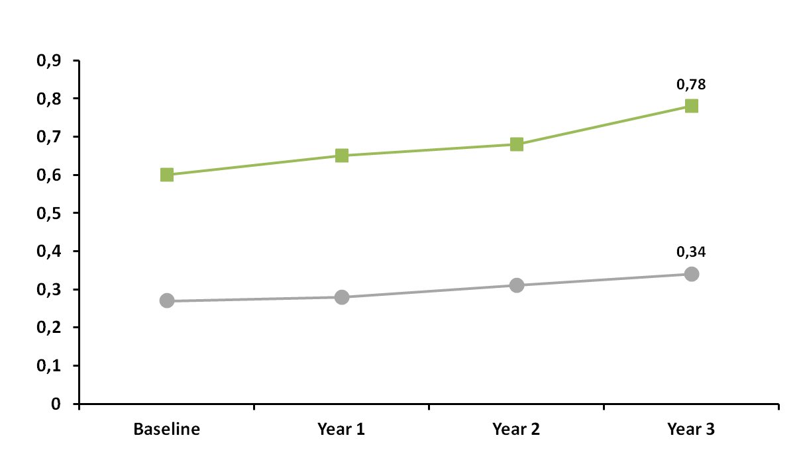
Reliability of a Negative Test
Primary Screening Population (≥25 Years)
Pap Negative
CIR ≥CIN3 (%)
HPV DNA Negative
The lower risk of disease of an hrHPV DNA negative result at Baseline confirms
the safety of a negative hrHPV DNA result over 3 years
Gynecologic Oncology 2015
Notes:
Up until this point, the focus has been on how to triage women with a positive screening test when in fact 90% will test negative in a screening population.
On this slide we can compare performance of cytology vs. HPV in these 90%.
The cumulative risk of CIN3 or greater over 3 years of a negative HPV test at baseline (the lower curve in gray) versus a negative Pap at baseline (the upper curve in orange).
The 3 year risk for a negative baseline HPV result is 0.34% compared to 0.78% for a negative Pap at baseline. The risk of being diagnosed with CIN3 or greater over the 3 year period for a woman with a negative HPV result is one-half the risk predicted by a negative Pap.
And so for a clinician, if only 1 screening test could be performed over a 3 year period, the choice should be straightforward. The lower risk associated with a negative HPV result provides more reassurance to both patient and clinician that disease will not be diagnosed over the next 3 years.
The lower risk for developing CIN3 or greater over 3 years for HPV also confirms the safety of a negative HPV test for a 3 year interval.

Slide 44
ASC-US Triage (detection of ≥CIN2)
 | cobas® HPV Test (hrHPV)
 | Point estimate | 95% CI
Sensitivity | 90.0% (72/80) | 81.5−94.8
Specificity | 70.5% (1,056/1,498) | 68.1−72.7
PPV | 14.0% (72/514) | 12.8−15.3
NPV | 99.2% (1,056/1,064) | 98.6−99.6
Optimal balance of sensitivity and specificity for ASC-US triage.
Stoler et al. Am J Clin Pathol 2011;135:468-475

Slide 45
US Guideline: ASC-US Triage
Repeat Cytology
@ 1 Year Acceptable
HPV DNA Testing
Preferred
In women with
ASC-US cytology, triage with HPV testing is preferred.
Negative
≥ ASC
HPV Positive
HPV Negative
Routine Screening
(Cytology in 3 years)
Colposcopy
Repeat Co-testing
@ 1 year
Manage per ASCCP Guideline
The cobas® HPV Test provides 93.5% sensitivity for the detection of ≥CIN3
lesions in women with ASC-US cytology
Massad LS et al. J Low Genit Tract Dis 2013;17:S1

Slide 46
US Guideline: Co-Testing
Repeat Cotesting
@ 1 Year Acceptable
HPV DNA Typing
Acceptable
In women ages 30+ with normal cytology, HPV DNA testing with 16/18 genotyping allows for closer follow-up of women at highest risk, while allowing women at lower risk to avoid immediate follow-up.
Cytology Negative
and HPV Negative
≥ ASC or HPV Positive
HPV 16 or
18 Positive
HPV 16 and
18 Negative
Repeat Co-testing
@ 3 years
Colposcopy
Repeat Co-testing
@ 1 year
Manage per ASCCP Guideline
Manage per ASCCP Guideline
The cobas® HPV Test allows for simultaneous genotyping of HPV 16 and 18
for more efficient management of HPV positive women with normal cytology.
Massad LS et al. J Low Genit Tract Dis 2013;17:S1

Slide 47

Sitolojik Anormalliklerin Yönetiminde HPV

Slide 48
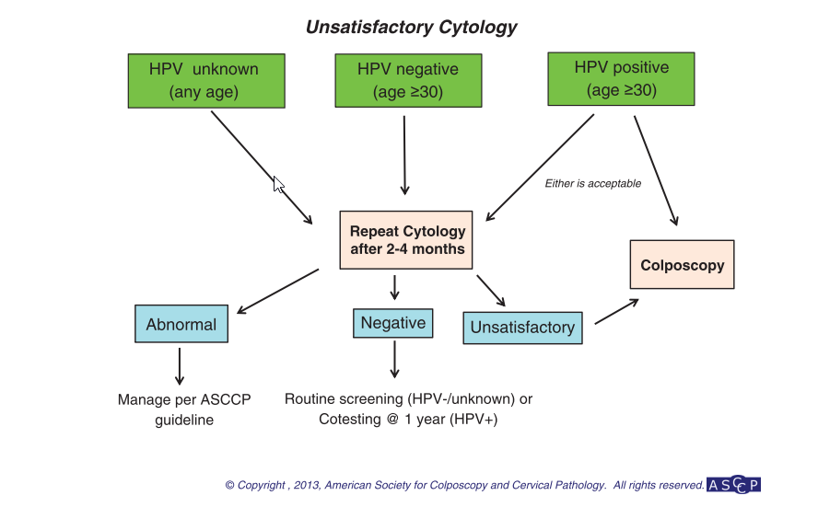
Yetersiz Sitoloji

Slide 49
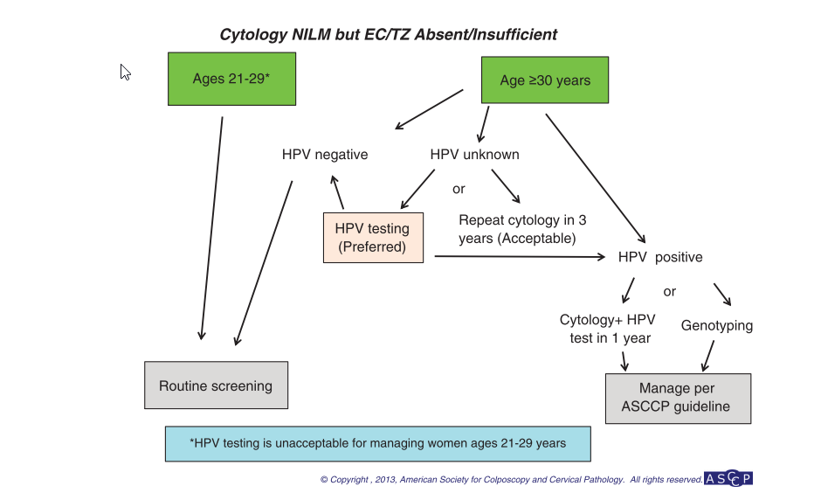
Sitoloji Negatif fakat EC/TZ Komponenti Yetersiz

Slide 50
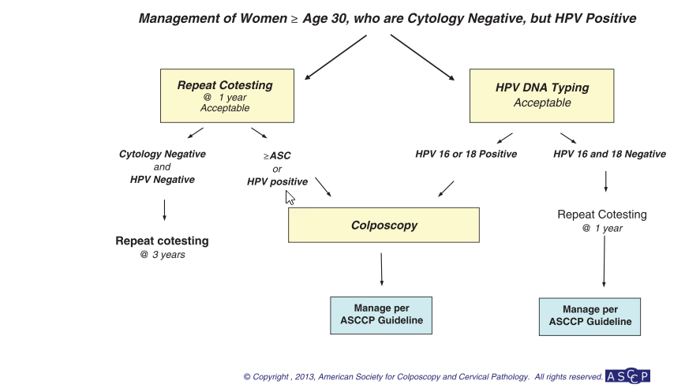
>30 y , Sitoloji Normal Fakat HPV +

Slide 51
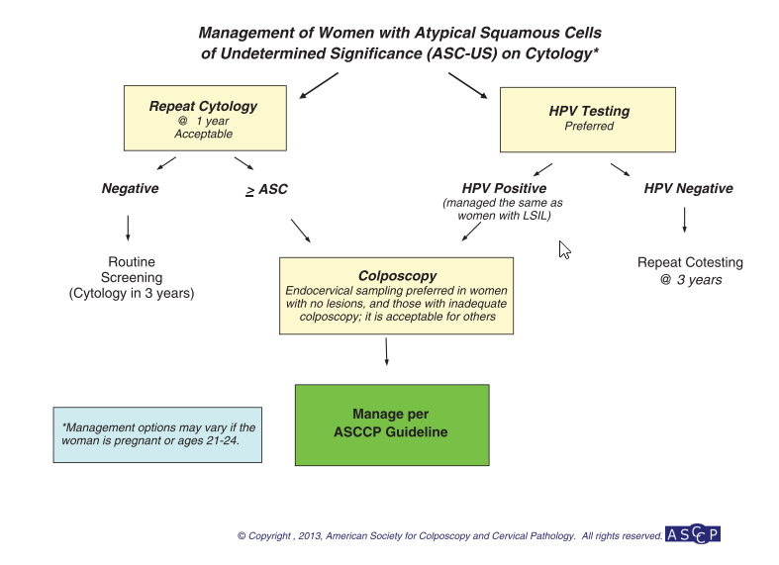
ASCUS Yönetimi

Slide 52
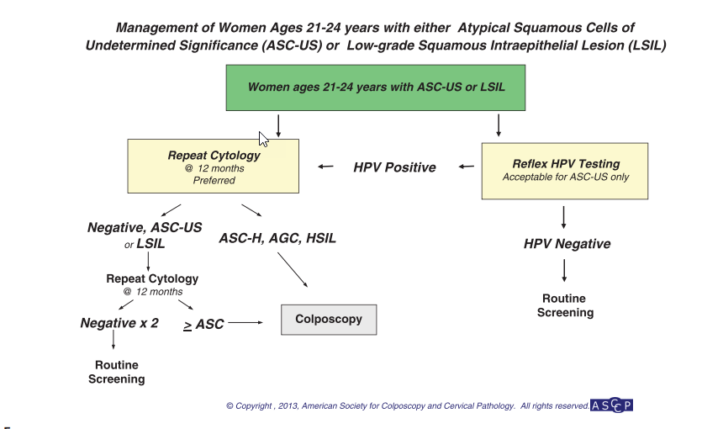
21-24 y LSIL Yönetimi

Slide 53
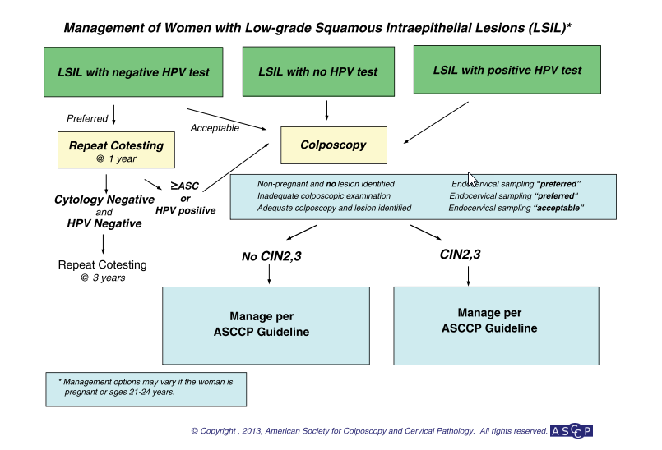
LSIL Yönetimi

Slide 54
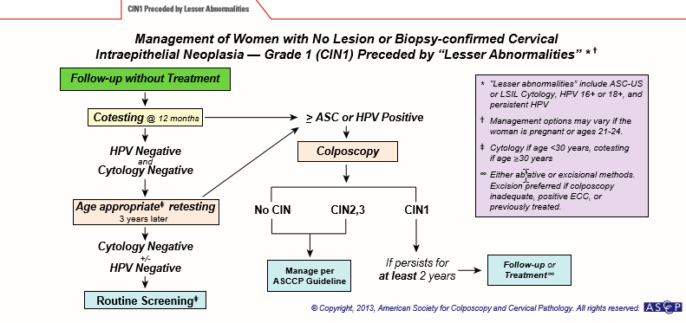
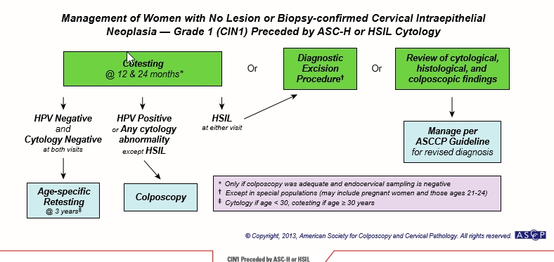
CIN1 Takip

Slide 55
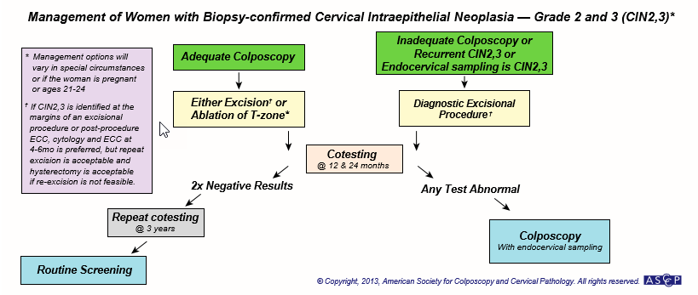
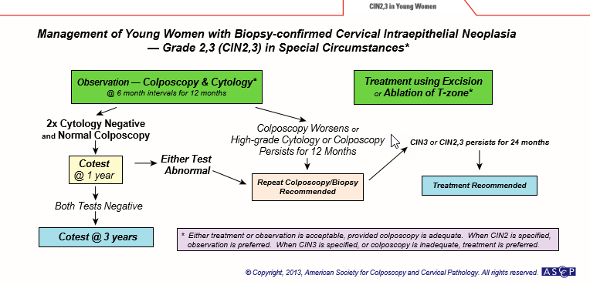
CIN 2/3 Takip

Slide 56
HPV Taramalarında Tartışmalar
Aşırı HPV pozitif, sitoloji normal olguların tesbiti
Spontan gerileyecek lezyonların aşırı tesbiti
    Tarama yaşı
    İkinci tur verileri
      POBASCAM, Swedescreen, ARTISTIC,NTCC
    Gereksiz kolposkopilerin önüne geçmek için risk değerlendirmesi
    Refleks sitoloji/ HPV genotiplendirme / Moleküler testler

Slide 57
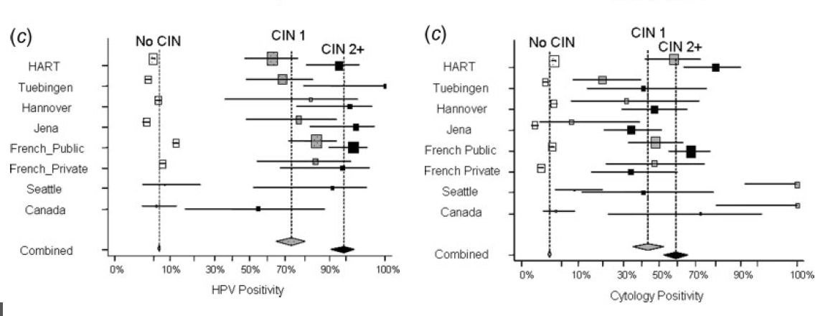
Yaş
Taramaya Başlama yaşı >30 olmalı
Cuzick J et al. 2006 Int J Cancer

Slide 58
At What Age Should We Initiate
Primary HPV Screening
Current U.S. screening guidelines do not recommend cotesting for women 25-29 years of age¹
However, there is a high burden of CIN3 in women 25-29 years and cytology performs poorly in this age group²
In 2013 Kaiser Permanente, N. California reviewed
their registry data and decided to begin cotesting
at age 25 years³
Screening for Cervical Cancer, Topic Page. March 2012. U.S. Preventive Services Task Force downloaded from: http://www.uspreventiveservicestaskforce.org/uspstf/uspscerv.htm ; Schiffman and Solomon, NEJM, 2013; 369: 2324-2331
Martin-Hirsch et al. BJOG. 2007 Apr;114(4):408-15
Katki et al. Lancet Oncol. 2011 Jul;12(7):663-72.
Notes:
Until recently, it has been widely thought that HPV testing as a primary screen for cervical cancer would not work for younger women. The transient nature of these infections and the high prevalence in young women was considered problematic. For this reason, recent guidelines have limited HPV testing for women under 30 to a triage test for ASC-US cytology.
However, there is increasing awareness that there is a high burden if CIN3 in women 25-29 years. It is also becoming clear that cytology performs poorly in this age group.
Recently, Kaiser Permanente, Northern California began using HPV and cytology (cotesting) for women starting at age 25 base on review of their data.
In the next few slides, a rationale for starting HPV based screening in women at age 25 will be presented.

Slide 59

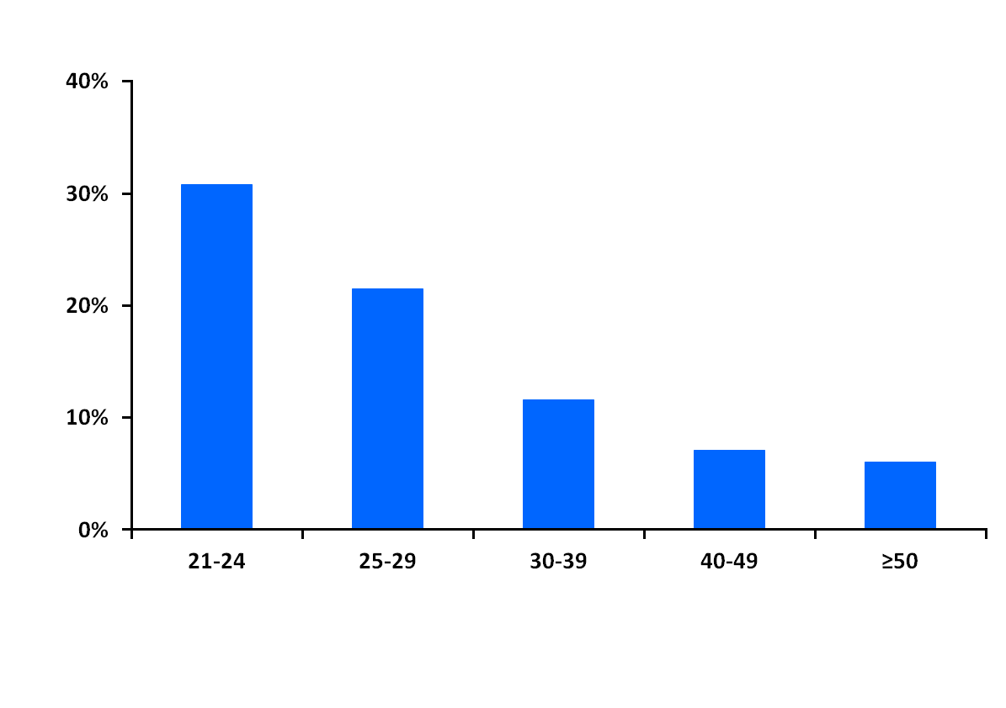
HPV by Age Group
ATHENA
21.1%
% Having HPV by cobas® HPV Test
Age Group
.
Wright et al. Am J Obstet Gynecol. 2012 Jan;206(1):46.e1-46.e11
Notes:
Another factor we need to consider is the prevalence of high-risk HPV.
In ATHENA, 21.5% of women 25-29 years of age were high-risk HPV positive.

Slide 60
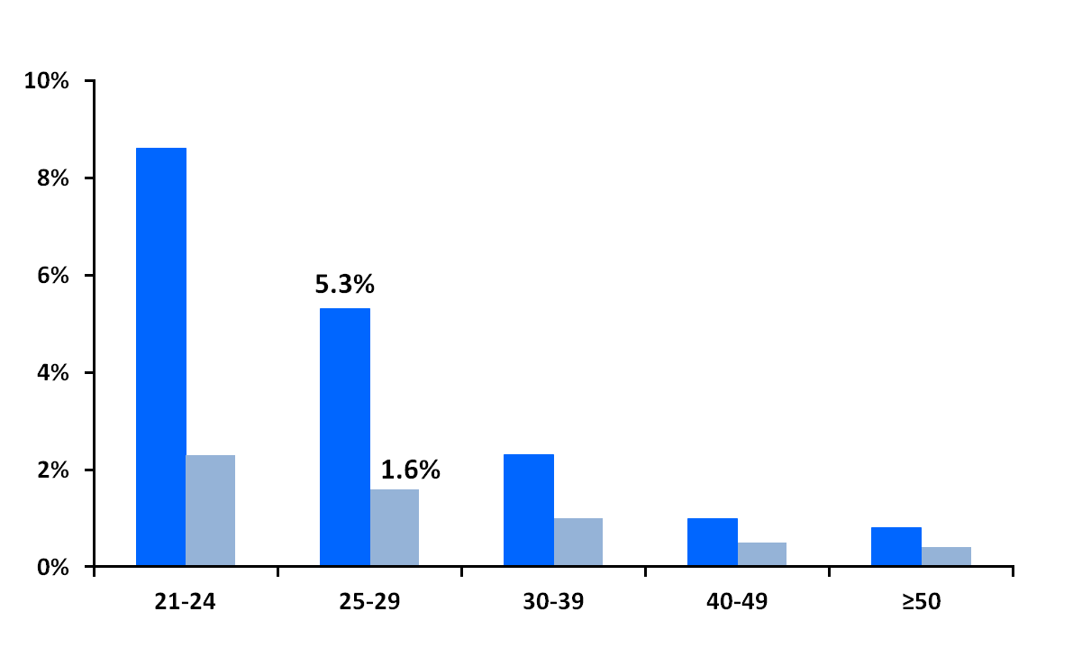
HPV 16/18 by Age Group
ATHENA
HPV 16
HPV 18
% Having HPV by cobas® HPV Test
Age Group
Wright et al. Am J Obstet Gynecol. 2012 Jan;206(1):46.e1-46.e11
Notes:
However, the prevalence of HPV 16 and HPV 18 in this age group is much lower.
Only 5.3% of women 25-29 years of age are HPV 16 positive and 1.6% HPV 18 positive.

Slide 61
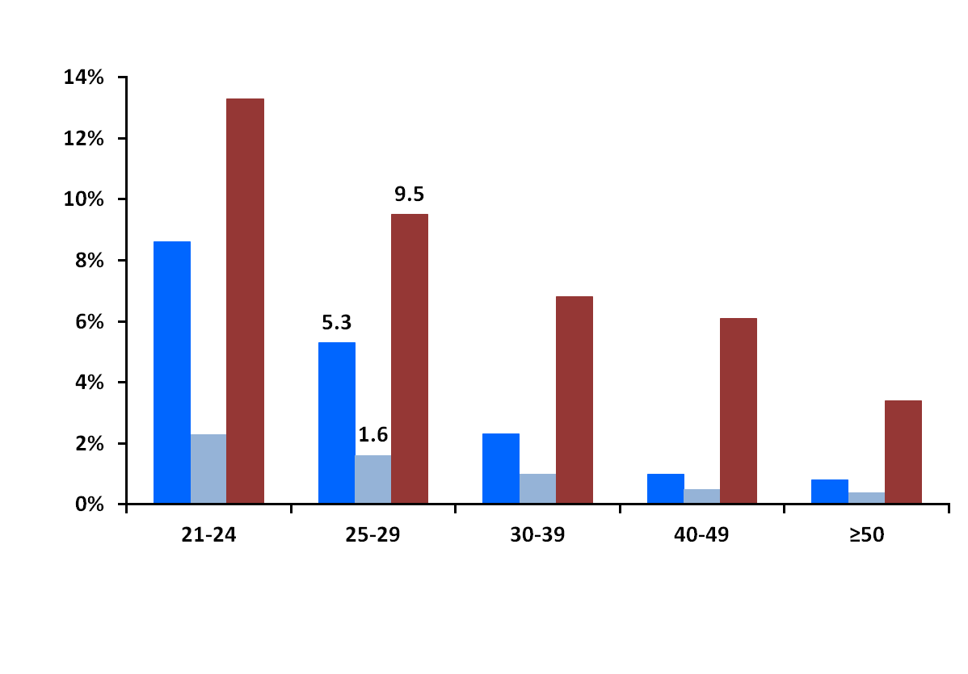
HPV 16/18 vs ≥ASC-US
ATHENA
HPV 16
HPV 18
Abnormal Pap
% Positive
Age Group
Wright et al. Am J Obstet Gynecol. 2012 Jan;206(1):46.e1-46.e11
Notes:
In fact, the prevalence of HPV 16 and 18 in women in this age group is lower than the rate of cytological abnormalities which was 9.5% in ATHENA

Slide 62
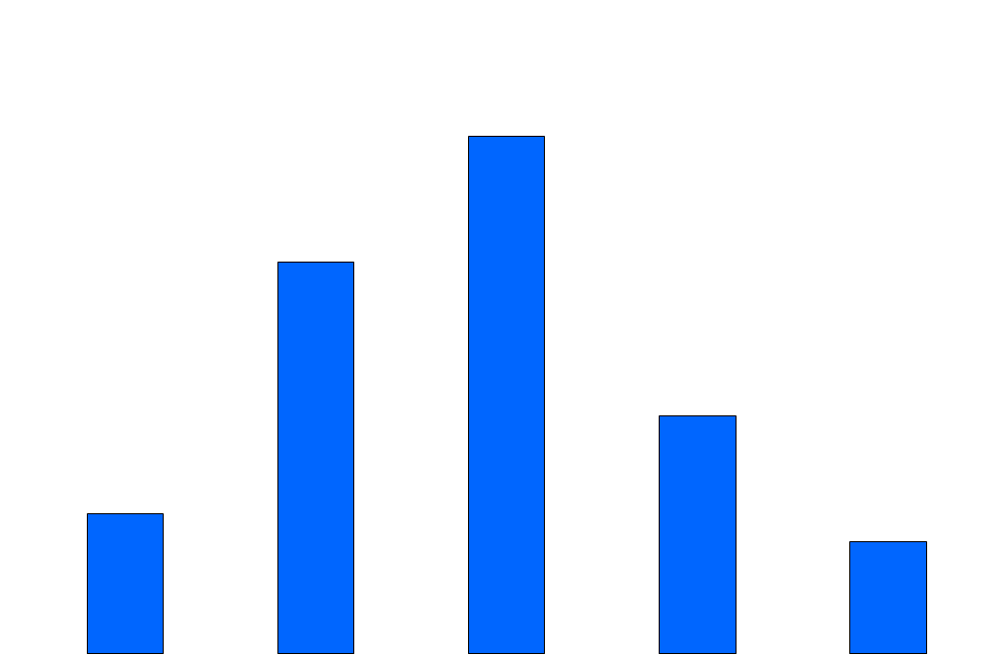
≥CIN3 by Age Group
ATHENA
37%
40%
28%
30%
Percentage of ≥CIN3 cases
17%
20%
10%
10%
8%
0%
21-24
25-29
30-39
40-49
>50
Age Group
Wright et al. Am J Clin Pathol 2011;136:578-586
Notes:
We also need to consider the prevalence of high-grade disease.
28% of all the CIN3 or greater found in ATHENA was found in women 25-29 years of age.

Slide 63
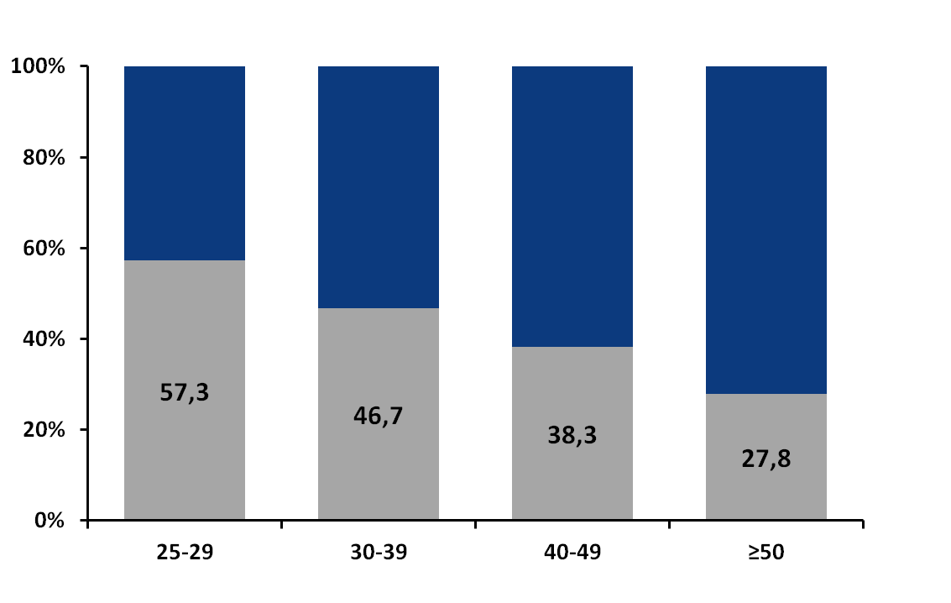
Proportion of Women with ≥CIN3
Who Have Negative Cytology (NILM)
ATHENA
In ATHENA, 57.3% of women 25-29 years of age with CIN3 or greater had a negative cytology.
≥ASC-US
NILM
42.7
53.3
61.7
72.2
Proportion of ≥CIN3 (%)
Age
Percentages shown are for hrHPV+ women with ≥CIN3, N=252
Wright et al. Am J Obstet Gynecol. 2012 Jan;206(1):46.e1-46.e11
Notes:
The final consideration is the performance of cytology for detecting high-grade disease.
In ATHENA, 57.3% of women 25-29 years of age with CIN3 or greater had a negative cytology.
This is much higher than seen in women 40 years and older.
Because of the high prevalence of disease, and the poor sensitivity of cytology in women 25-29 years of age, it is considered to evaluate the performance of primary HPV screening beginning at age 25 years.

Slide 64
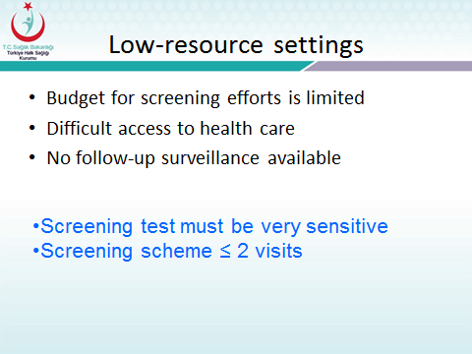
POBASCAM, Swedescreen, ARTISTIC,NTCC
RCT 94.370 Women HPV or Cytology
    İkinci Tur Tarama Verileri
Screening | HPV ile tarananlar |  |  | Smear ileTarananlar
 | CIN2 | CIN3/AIS | Kanser | CIN2 | CIN3/AIS | Kanser
1. Tur | 108 | 98 | 6 | 54 | 47 | 8
2. Tur | 8 | 8 | 0 | 15 | 17 | 9
Toplam | 116 | 106 | 6 | 69 | 64 | 15
Ronco et al, Lancet Oncol, 2010

Slide 65
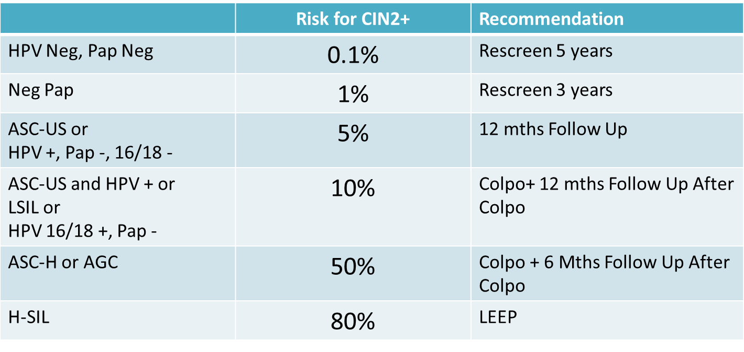
3-Risk Değerlendirmesi
        Refleks sitoloji
          Düşük risk
          Orta risk (6% CIN3+ over 5 years)
          Yüksek risk (17% CIN3+ over 5 years)
        HPV genotipi
          HPV 16/18 ve diğer
        Moleküler testler (p16, Ki67, mRNA )
Rijkaart DC/ Int J Cancer (2012)
Katki HA, Lancet Oncology 2011
M. Arbyn et al. / Vaccine 30S (2012) F88–F99
Notes:
1 Bulkmans, Lancet 2007; 370: 796-802 PCR-GP5+/6+
1 Rijkaart, Lancet Oncol 2012; 13: 78-88 PCR-GP5+/6+
2 Naucler, N Engl J Med 2007; 357: 1589-1597 PCR-GP5+/6+
3 Ronco, Lancet Oncol 2010; 11: 249-257 HC2
4 Kitchener, Lancet Oncol 2009; 10: 672-682 HC2
4 Kitchener, Eur J Cancer 2011; HC2

Slide 66
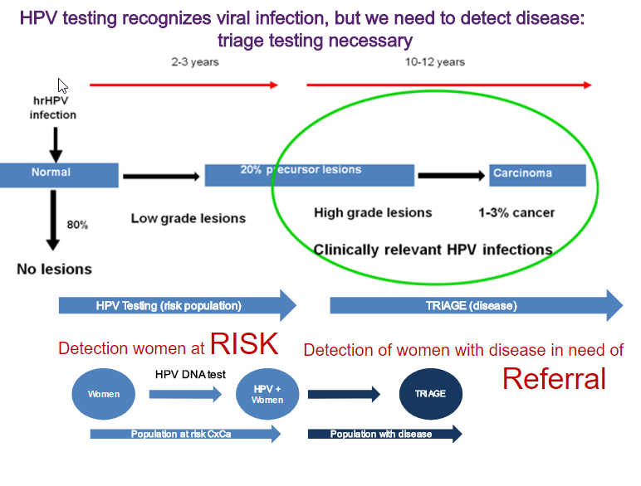

Slide 67
Co-Test / Sadece HPV ?
2012 Rehberleri Co-Test
  Bu rehberler 2011 ve öncesi yayımlardan üretilmişti
Ama….
Karşılaştırma | Hedef | Göreceli Sensitivite | Göreceli Spesifite | Çalışma Sayısı
Sito ve HPV vs. Sadece HPV | CIN2+ | 1,05 | 0,95 | 10
Sito ve HPV vs. Sadece HPV | CIN3+ | 1,02 | 0,93 | 6
M. Arbyn et al. / Vaccine 30S (2012) F88–F99

Slide 68
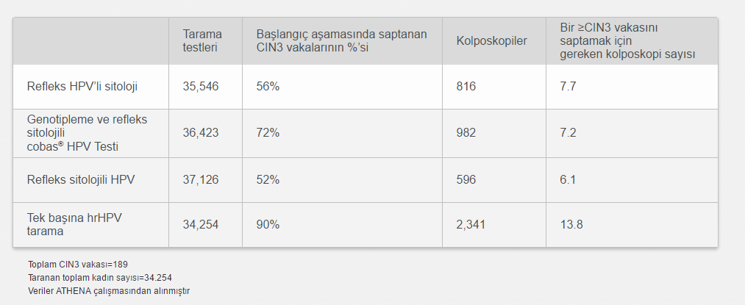
Primer HPV Taraması Kolposkopiyi Arttırır

Slide 69
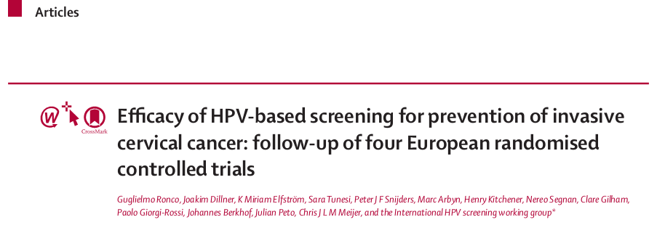
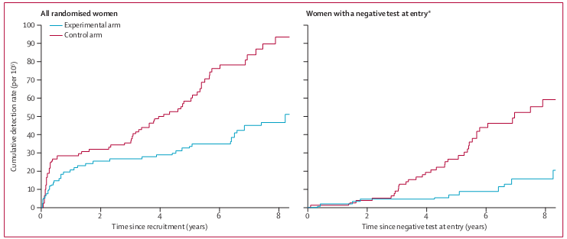
Lancet
2014
Cumulative Cervical Cancer Incidences for negative initial tests:
3,5 years 5,5 years
  Negative cytology; 15.4 / 10⁵ 36.0 / 10⁵
  Negative HPV test; 4.6 / 10⁵ 8.7 / 10⁵

Slide 70
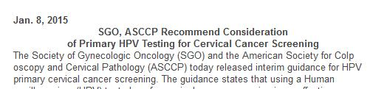
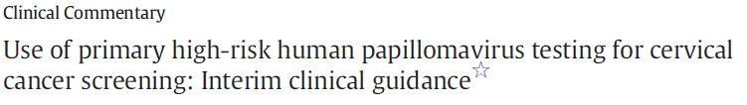
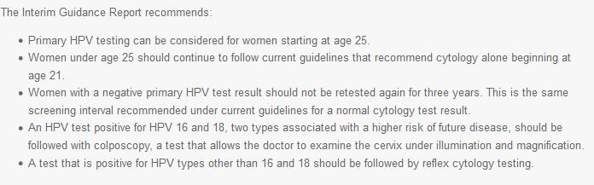
NCI, ASCCP, ACS, SGO,EU, ACOG
https://www.sgo.org/newsroom/news-releases/medical-societies-recommend-consideration-of-primary-hpv-testing-for-cervical-cancer-screening/

Slide 71
Yeni Algoritma

Slide 72
HPV Taramalarının Ek Faydaları
Objektif, merkezi, otomatize, laboratuarlar arası tutarlı, kalite kontrolü kolay
Daha uzun tarama aralığı
  Taramaya katılımda bireylerin uyum artışı
  HPV aşılarının etkisi
  Gelecek tarama stratejileri
Kendi kendine HPV-Self HPV
Diğer kanserlere HPV’nin etkisi
  Baş-boyun yüzde 30

Slide 73
Hangi HPV Testi ??
125 HPV Testi Mevcut
HC2, GP5+/6+ PCR-EIA, Abbott RT hrHPV test, cobas 4800 HPV test, PapilloCheck HPV-Screening test, BD Onclarity HPV assay and the HPV-Risk assay
M. Arbyn, P. J. F. Snijders, C. J. L. M. Meijer, J. Berkhof, K. Cuschieri, B. J. Kocjan and M. Poljak
Clin Microbiol Infect 2015

Slide 74
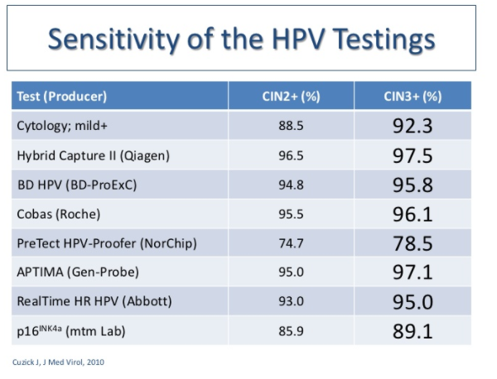

Slide 75
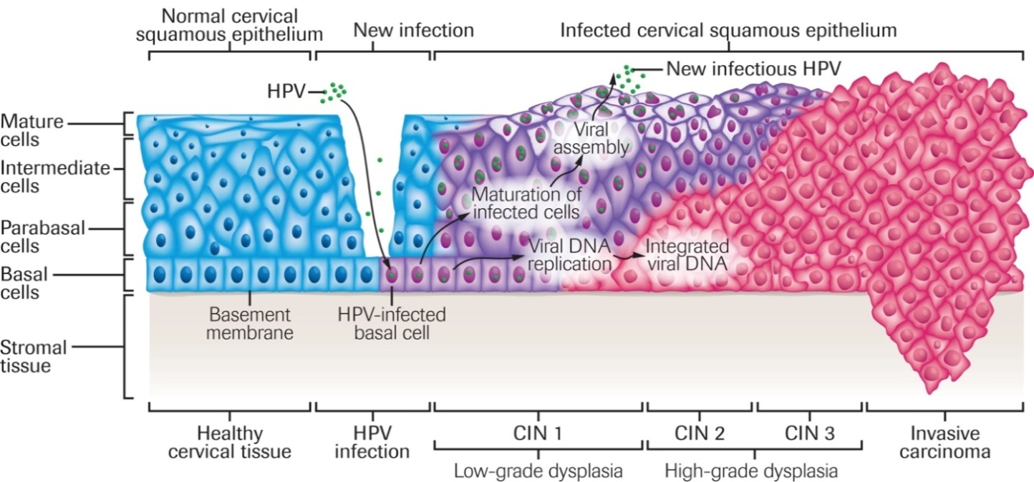
Disease Progression
Viral DNA consistently present throughout disease progression
cobas HPV Test clinical cut-off
mRNA expression elevates only after disease has progressed
Identification of high-risk HPV DNA allows for the earliest possible identification
of women who are at increased risk of cervical cancer and its precursors.
Nat Rev Cancer© Nature Publishing Group

Slide 76
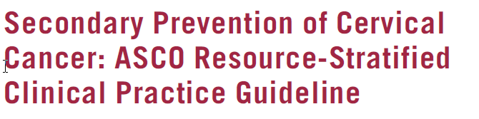
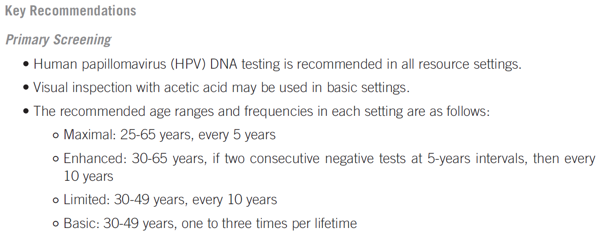
jgo.ascopubs.org JGO – Journal of Global Oncology. 2017

Slide 77
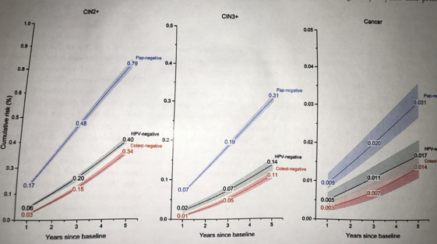
Kaiser Permanente California
5 Yılda CIN2/CIN3 ve Kanser Gelişme Riski
JNCI, 2014

Slide 78
Conclusions
Sitolojik tarama başarılı fakat limitasyonları var
HPV temelli primer serviks kanseri taraması ASCUS-triage yaklaşımına göre
Daha sensitif
Benzer PPV
Daha iyi NPV
Pozitif Cobas test riskli hastaların belirlenmesinde daha etkili
Negatif Cobs testi 3 yıl içinde CIN3 üzeri lezyonların gelişmeyeceğini daha iyi garanti eder
Primer HPV taraması yakın gelecekte rutine girebilir.
Notes:
Cytology based cervical cancer screening has been extremely successful in reducing the incidence of cervical cancer in countries where it has been employed. However, as with almost any aspect of practicing medicine, there is an opportunity to improve when we analyze limitations and address them with new information and/or technologies.
Using a more sensitive screening test as the first line screen is consistent with best practices for screening programs in general. HPV DNA testing is far more sensitive for detecting cervical cancer precursers and is also able to better identify those who are at risk to have a cervical cancer precurser in the next several years.
HPV16/18 genotyping can be used to identify those at greatest risk and by coupling this with a combination of cytology and repeat testing for those who are HPV positive with a genotype other than HPV16/18 we can achieve specificity that is nearly the same as cytology based screening and a positive predictive value that is the same thus allowing for efficient identification of those who need additional evaluation.
A positive cobas® HPV Test identifies those women who are at greatest risk of cervical cancer and allows clinicians to intervene.
A negative cobas® HPV Test provides approximately twice the reassurance that the patient will not develop a ≥CIN3 lesion in the next three years.

