Slide 1
Nutrisyon Microbiome ve uremetoksikolojisi
Prof Dr Onur KARABACAK
Gazi Universitesi Kadin Dogum ABD

Slide 2
Super gida lar
Su
Kefir ve diger lactoferment
crucifereous
berries
Chia keten tohum
Brokli
Samon
Yumurta
Alg ler
Avacado
nane
hindistan cevizi
Sarmisak
turmeric
fermente peynir suyu
Cocoa
Badem
Yesillikle beslenmis et
Bakteri zengin peynir

Slide 3
Probiotik yararlar
Digestion artar
Inflamasyon azalir
Kilo verilir
Immunoloji iyilesi BMJ 2001

Slide 4
peynir alti suyu
peristalsis arttirir
intestinal florayi destekler
Su tutmayi dusurur
Bobreklerden suzulmesi arttirir
Yuksek oranda elektrolit icerir

Slide 5
nutrisyon beslenme
anti inflamasyon
Su
Enerji nin kazanilmasi
Eser aa, vitamin, elementlerin temini
Yeni iyilik ve doygunluk halinin devami -Microbiome

Slide 12
vegetarian-style eating patterns have been associated with improved health outcomes—lower levels of obesity, a reduced risk of cardiovascular disease, and lower total mortality Lower blood pressure levels

Slide 14
Siez bulgur triticum monococcum 2n-14
Low glycemic index
resistant to infection and bugs
hard shell wheat
Seydiler Kastamonu

Slide 19
Birlestirici Materyeller
Agir Metal kursun ve kadmium reproToxic
Plastics 7 reproToxic
Agac - Tespih agaci Neem oil reproToxic Animal
Toprak Asbest fibers spermiotoxic
Andrologia. 2012 Apr;44(2):92-101. doi: 10.1111/j.1439-0272.2010.01109.x. Epub 2011 Sep 20.
Biochemical and reproductive effects of gestational/lactational exposure to lead and cadmium with respect to testicular steroidogenesis, antioxidant system, endogenous sex steroid and cauda-epididymal functions.
Pillai P1, Pandya C, Bhatt N, Gupta SS.

Slide 20
Glyphosate DDT
Herbicides Pesticides - Montesanto Round UP
Hardal Gazi ve Oncology

Slide 21
Su
Bilinir en kaliteli su yagmur suyu
Tasinir su cam ve celik icinde ehemniyetli
PET poly etyhlene tetrahidroklor Emin kisa sure
Chlorine and water No repo failure but increased bladder and rectal cancer
Water purification by filtration at reverse osmosis
R.D. Morris, A. Audet, I.F. Angelillo, T. C. Chalmers, and F. Mosteller. Chlorination, Chlorination byproducts,
and cancer: A meta-analysis. American Journal of Public Health, 82(7):955-977. 1992.

Slide 22
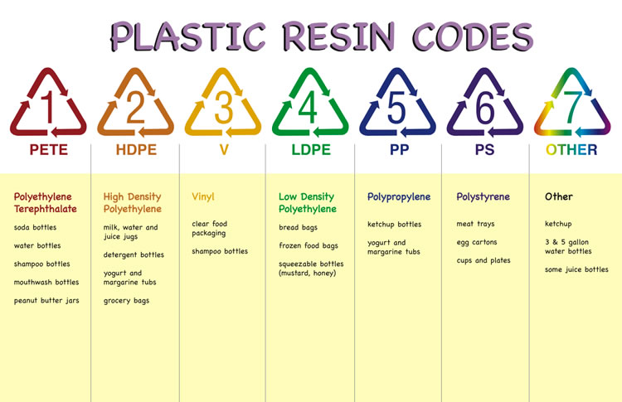
Plastics and ReproToxics
Polyurethanes (PUR), polyacrylonitriles (PAN) and polyvinyl chlorides (PVC) were considered as the most hazardous polymer types according to their monomer composition, whereas polypropylene (PP), ethylene-vinyl acetate (EVA), polyvinyl acetate (PVAc) and polyethylenes (PE) were evaluated to be the least hazardous

Slide 23
Energy
Refined Sugar is most addictive pure material of Energy needs to be controlled.
Fructose is much betterObesity and Type 2 diabetes in epidemics
Nutritional Neuroscience
An International Journal on Nutrition, Diet and Nervous System
Volume 8, 2005 - Issue 5-6
Implications of an animal model of sugar addiction, withdrawal and relapse for human health
C. H. Wideman, G. R. Nadzam & H. M. Murphy
Pages 269-276 | Published online: 05 Sep 2013
experimental group was presented with a 25% glucose solution. Experimental animals displayed a precipitous drop in body temperature and behavioral changes associated with withdrawal during week 3, when sugar was removed.

Slide 24
Obesity and Antibiotics
obesity. Administration of three or more courses of antibiotics before children reach an age of 2 years is associated with an increased risk of early childhood obesity.
“The more antibiotics you get, the stronger the effect,” says Schwartz. “And this effect seems to get larger as you get older.”
Some evidence suggests that babies born via Cesarean section, and therefore not exposed to the mother’s vaginal microbes, tend to be heavier and more susceptible to certain immune conditions such as allergies and asthma.

Slide 25
Obesity antibiotics and microbiome
High sugar intake and antibiotics contribute to obesity through effecting your micro biome
Antibiotics, obesity and the link to microbes - what are we doing to our children?
Olli Turta and Samuli Rautava
BMC Medicine 2016 14:57

Slide 26
How we can contribute to micro biome
Rather than sugar your micro biome needs acids
Lactobasilus. Bifidobacter bifidus
Kefir Kombucha kwass kimchii and beyond
Sauerkraut / tursu

Slide 27
Obesity infertility
Obesity decreases libido / Brain
lower sperm quality and oocyte quality in IVF
Obese low in androgenes that effect also in women
Curr Opin Endocrinol Diabetes Obes. 2007 Dec;14(6):482-7.
Obesity and infertility.
Pasquali R1, Patton L, Gambineri A.

Slide 28
Agregated Nutrient Density Index
Tell me what you eat
I tell you who you are

Slide 29
Non celIAC Gluten SENSETIVITY
"Fermentable, Oligo-, Di-, Mono-saccharides And Polyols“FODMAP short chain carbohydrates that are poorly absorbed in the small intestine. They include short chain oligo-saccharide polymers of fructose (fructans) and galactooligosaccharides (GOS, stachyose, raffinose), disaccharides (lactose), monosaccharides (fructose), and sugar alcohols (polyols), such as sorbitol, mannitol, xylitol and maltitol.
Low-FODMAP diet
Vegetables: alfalfa, bean sprouts, green beans, bok choy, capsicum (bell pepper), carrot, chives, fresh herbs, choy sum, cucumber, lettuce, tomato, zucchini
Fruits: banana, orange, grapes, melon
Protein: meats, fish, chicken, tofu, tempeh
Dairy: lactose-free milk, lactose-free yoghurts, hard cheese
Breads and cereals: gluten-free bread and sourdough spelt bread, crisped rice, oats, gluten-free pasta, rice, quinoa
Biscuits (cookies) and snacks: gluten-free biscuits, rice cakes, corn thins
Nuts and seeds: almonds (no more than 10 nuts per serving), pumpkin seeds
Beverage options: water, coffee, tea

Slide 30
Non celIAC Gluten SENSETIVITY –ncgs 1970
There is evidence that not only gliadin (main cytotoxic antigen of gluten), but also other proteins present in gluten and gluten-containing cereals (wheat, rye, barley, and their derivatives) may have a role in the development of symptoms
abdominal pain, bloating, bowel habit abnormalities (either diarrhea or constipation),^{[4][20]} nausea, aerophagia, gastroesophageal reflux disease, and aphthous stomatitis.^{[3][4]0}
Wheat allergy has a fast onset (from minutes to hours) after the consumption of food containing wheat and can be anaphylaxic
prevalence rates between 0.5–13% in the general population

Slide 31
Ne ogrendik
Kaliteli su ic
Enerji / ANDI oranli beslen
Az antibiotik kullanki sonra obes olma
Obes olmaki sperm yumurtan iyi olsun Sex yap
Micro biom a iyi bak / Bakterilerinde sana baksin
Cevresel toksinlere dikkat etki kaliteli yasayasin

