Slide 1
Recurrent Pregnancy Loss The case for a Dedicated Specialist Clinic.
MARK Formosa
Recurrent PREGNANCY LOSS Clinic
Mater Dei Hospital
MALTA

Slide 2
THE CHALLENGES
The definition of the condition; 500gms or 20 weeks WHO 1977
A group of women who ONLY share a similar miscarriage history. NO incidence studies; only prevalence studies 0.6% to 2.3%.
The natural background risk of miscarriage will influence the expected results and patients perception of the condition.
Shares similar risk factors with infertility and often overlaps.
Associated with significant emotional and psychological problems in the couple.

Slide 3
DEFINITION OF RECURRENT MISCARRIAGE
There is widespread disagreement on what constitutes Recurrent Pregnancy Loss.
The classical definition of three consecutive miscarriages reflects the statistics.
Live birth rates fall with increasing order of miscarriage:
Live birth rates after 3 losses is 42-86%
After 4 - 41-72% and after 5 it is 23-51%.
The risk of a further miscarriage increases with increasing order of miscarriage. This IS the most important prognostic factor.

Slide 4
MISCARRIAGE STATS
The risk of miscarriage is generally 12-15% in clinical pregnancies but 17-22% if early losses are included
Bio-chemical Pregnancies may account for 50-75% of all losses
The risk of a further miscarriage after two miscarriages is quoted to be around 20%
After three miscarriages it is approx 40%
There are only very small differences between patients with 2 and those with 3 pregnancy losses

Slide 5
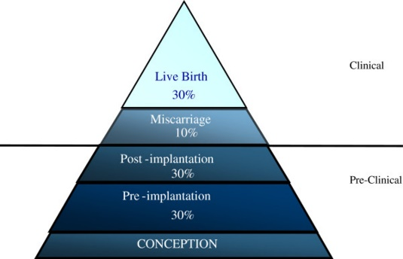
The background risk of miscarriage is 20%. Warburton D & Fraser FC (1964) Spontaneous abortion risks in man: data form reproductive histories collected in a medical genetics unit. Human Genet 16, 1-25
The
Pregnancy
Iceberg:

Slide 6
MORE ON STATS
CLINICAL PREGNANCY RATES ARE NOT EFFICIENT
IN ANY ONE CYCLE THE MAX PROBABILITY OF CONCEPTION IS ONLY 30%
ONLY 50% OF PREGNANCIES MAKE IT BEYOND 20 WEEKS
Recurrent Pregnancy Loss can be considered as part of a spectrum of abnormalities resulting from a deficient implantation and early trophoblastic development
The Great Obstetrical Syndromes

Slide 7
WHEN TO INVESTIGATE?
Applying a criteria of 3 consecutive early pregnancy losses will mean that 1-2% of couples trying to conceive will experience this condition
If 2 consecutive losses is used then 5% of couples will be affected.
These are both higher than that expected by chance alone.

Slide 8
BACK TO THE DEFINITION
RCOG & ESHRE both insist on a definition of THREE consecutive pregnancy losses
Patient groups and associations have argued that patients should be seen after two pregnancy losses.
The ARSM in 2012 defined recurrent miscarriage as a condition after two consecutive pregnancy losses. Our own experience has shown that investigating patients with two miscarriages can lead to important interventions

Slide 9
RISK FACTORS
Previous aneuploid miscarriage has a better prognosis than previous recurrent euploid miscarriage
One or more second trimester loss is a strong risk factor for a poor prognosis.
However the prognosis of primary and secondary RPL re live birth rates are similar. Higher late obstetric complication rates have been noted in the primary RPL’s.

Slide 10
GENETIC CONSIDERATIONS
In secondary RPL the birth of male child is a negative prognostic indicator.
Family studies have shown that RPL fits into a multifactorial pattern of inheritance.
Many risk factors combine to give rise to a recurrent high risk of pregnancy loss.

Slide 11
GENETICS OF RPL
2-4% of RPL is due to a balanced structural chromosomal re-arragement.
Translocations; reciprocal or Robertsonian
Inversions, insertions and mosaicism
Rarely single-gene defects.
CMA on POC is the only test which can give a definite cause behind a miscarriage.

Slide 12
THE PLAYERS
Idiopathic
Autoimmune
Endocrine disorders
RECURRENT
MISCARRIAGE
Thrombophilia
(PCOs, LPD,
Thyroid disorders, Diabetes)
(Acquired and Inherited)
Anatomical
Abnormalities
Genetic Defects

Slide 13
THE CLINIC
A TEAM OF DEDICATED STAFF
Consultant/Specialist/Trainee
Midwife/nurse practitioner
Psychologist

Slide 14
A RETROSPECTIVE OBSERVATIONAL STUDY
A retrospective observational analysis of 232 patients who attended the Recurrent Miscarriage Clinic over the past 5 years.
The causes of recurrent miscarriage and the effect of treatment were studied to determine the prevalence of the conditions associated with recurrent miscarriage in the Maltese population and to analyse the results of the treatment protocols applied.

Slide 15
METHODOLOGY
A detailed obstetric-gynaecological and medical history was recorded in each case.
A standard investigation protocol was applied in each case that was referred. There was no selection re the appropriate investigations for that particular case.
Treatment protocols were designed according to the aetiology. These were standardised for all patients.
Subsequent pregnancy outcome was recorded.

Slide 16
THE INVESTIGATION PROTOCOL
IMMUNOLOGICAL PROFILE:
Anticardiolipin antbody
Beta-2-glycoprotein 1 antibody
Anti-TPO antibodies
Anti-nuclear factor
Ds-DNA

Slide 17
THE INVESTIGATION PROTOCOL
GENETIC THROMBOPHILIA PROTOCOL
PROTEIN S & PROTEIN C DEFICIENCY
ANTITHROMBIN DEFICIENCY
FACTOR II (PROTHROMBIN) MUTATION
FACTOR V (LEIDEN) MUTATION
FASTING HOMOCYSTEINE

Slide 18
THE INVESTIGATION PROTOCOL
ENDOCRINE PROFILE :
DAY 2 HORMONE ASSAY : FSH, LH, PRL, E2, TESTOSTERONE AND free androgen index
Mid-luteal serum progesterone levels
Thyroid Function Test
OGTT

Slide 19
INVESTIGATION PROTOCOL
Parental Karyotyping
Chromosomal MicroAssay on POC
Genetic Counselling
Possible Options PGS/PGD or Oocyte donation

Slide 20
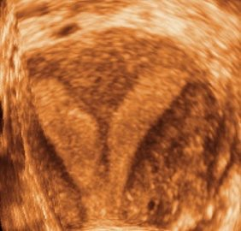
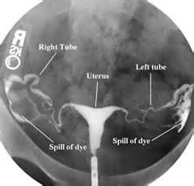
THE INVESTIGATION PROTOCOL
Hysterosalpingogram
Pelvic Ultrasound (3D)

Slide 21
THE TREATMENT PROTOCOLS
All patients were offered supportive care.

Slide 22
SUPPORTIVE CARE
ESTABLISHED AS THE MOST IMPORTANT THERAPY IN IDIOPATHIC RECURRENT EARLY PREGNANCY LOSS
PSYCHOLOGICAL SUPPORT : OFFERED CONSULTATION AT FIRST VISIT
EARLY ULTRASOUND EXAMINATION
ADMISSION TO HOSPITAL AT THE TIME OF THE PREVIOUS LOSS
RELAXATION TAPES
Avert 1954; Stray-Pedersen & Stray-Pedersen 1984; Liddell 1991; Clifford 1997 and Brigham 1999.

Slide 23
Conditions | Folic Acid | Dydro -gesterone | Low Dose Aspirin | Enoxaparin | Other Treatment
Idiopathic | ✓ | ✓ | ✓
PCOS | ✓ | ✓ | ✓ |  | Metformin (obese patients), Clomiphene (infertility cases)
Luteal Phase Deficiency | ✓ | ✓ | ✓ |  | Clomiphene (infertility cases)
Other Endocrine Disorders | ✓ | ✓ | ✓ |  | Thyroxine (hypothyroidism), Bromocriptine (hyperprolactinaemia)
Anatomical Abnormalities | ✓ | ✓ | ✓ |  | Cerclage (bicornuate uterus, cervical incompetence), Myomectomy (fibroids)
Genetic Abnormalities | ✓ | ✓ | ✓ |  | Genetic counselling
Acquired Thrombophilia | ✓ | ✓ | ✓ | ✓
Inherited Thrombophilia | ✓ | ✓ | ✓ | ✓
Autoimmune Conditions | ✓ | ✓ | ✓ | ✓ | Prednisolone (during first trimester)
Multiple Pathology | ✓ | ✓ | ✓ |  | Treatment of each associated condition

Slide 24
RESULTS

Slide 28
CONCLUSIONS
In all categories, the number of live births exceeded the number of miscarriages.
Recurrent pregnancy loss is a heterogenous condition, with numerous causes, therefore a multidiscilpinary approach is recommended.
Managing patients with recurrent pregnancy loss in a specialised clinic leads to best results.

