Slide 1
European Board and College of Obstetrics and Gynaecology
Management Options for Heavy Menstrual Bleeding: Alternatives to Hysterectomy
Tahir Mahmood CBE,
MD, MBA,FRCPI,FACOG, FRCPE, FRCOG
President EBCOG
21st May 2017

Slide 2
FIGO Abnormal Uterine Bleeding classification with Heavy Menstrual Bleeding as a sub group
-Affects 14-25% women of reproductive age
- “Excessive menstrual blood loss interfering with the woman's physical, emotional, social and material quality of life, and which occurs alone or in combination with other symptoms” (NICE, 2016)
-Significant economic cost to both family and the health service
-Financial cost of >$2K per patient per annum due to work absence (Frick et al, 2009-USA)

Slide 3
FIGO Classification of AUB(PALM-COEIN) Structural Vs. Non-Structural causes

Slide 4
FIGO-AUB Classification (PALM-COEIN)
Polyps:
Epithelial proliferations arising from the endometrial stroma and glands
The incidence of polypi increases with age
Fibroids and Polypi may co exist
Mostly present with prolonged heavy bleeding or break through spotting/bleeding

Slide 5
FIGO-AUB Classification (PALM-COEIN)
Adenomyosis
Relationship with AUB is uncertain
Increasing incidence with increasing age
May co exist with fibroids

Slide 6
FIGO Classification of AUB-Leiomyoma ( Fibroids)

Slide 7
FIGO-AUB Classification (PALM-COEIN)-Uterine Leiomyoma (Fibroids)-1
Relationship between fibroids and AUB is poorly understood
Possibly related to an increased endometrial surface area, presence of fragile and engorged vasculature in the peri-myoma environments and altered angiogenesis.

Slide 8
FIGO-AUB Classification (PALM-COEIN)
Malignancy:
Rising incidence of endometrial pre-cancerous changes and cancer
This is all secondary to rising obesity and increasing incidence of metabolic syndrome
Other malignancies to consider are Cervical Cancer and Uterine sarcoma (not part of this lecture)
Main area of interest is Endometrial Hyperplasia

Slide 9
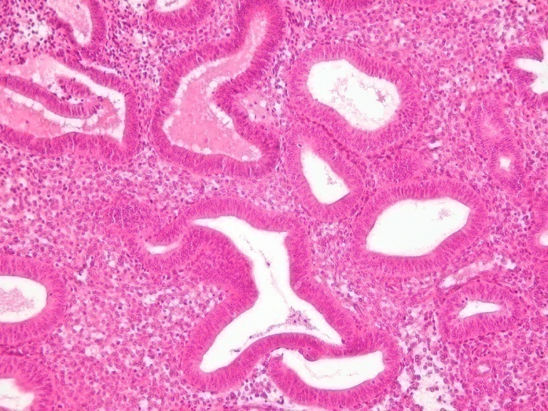
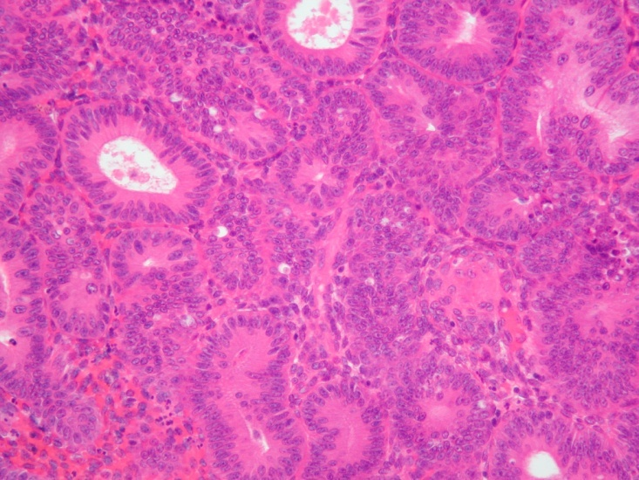
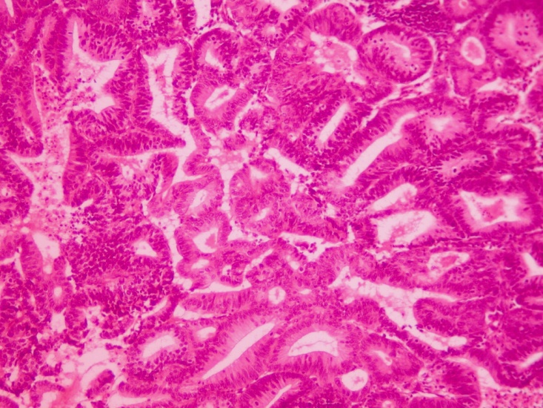
SIMPLE HYPERPLASIA
ATYPICAL HYPERPLASIA
ENDOMETRIOID ADENOCARCINOMA G1

Slide 10
FIGO-AUB Classification (PALM-COEIN)
Coagulopathy:
Effects up to 13% of women presenting with HMB
Commonly- Von Willebrand Disease
Other systemic disorders of haemostasis

Slide 11
Structured History for Coagulopathy

Slide 12
FIGO-AUB Classification (PALM-COEIN)
Ovulatory Dysfunction:
Due to unopposed oestrogen effects- thus causing increased proliferation and thickening of endometrium
Causes include: obesity, stress, anorexia OR/AND- PCO, Hyperprolactinaemia, Hypothyroidism, dopaminergic drugs etc.

Slide 13
FIGO-AUB Classification (PALM-COEIN)
Endometrial Dysfunction:
Localised causes- mainly as IMB
Mainly due to loss of local control of haemostasis-blood clots break easily
Impaired vasoconstriction-increased levels of PGI2 and PGI2 receptors
And enhanced fibrinolysis-by increased endometrial levels of Tissue Plasminogen Activator
Genetics: EBAF/LEFTY-A gene is located at chromosome -1 and is expressed transiently during menstruation.

Slide 14
FIGO-AUB Classification (PALM-COEIN)
Iatrogenic-unscheduled endometrial shedding:
Continuous oestrogen-progesterone therapy
GnRH agonists
Aromatase inhibitors,
Tamoxifen
Intra uterine device especially copper
Selective oestrogen receptor modulators (SERMs), and Selective Progesterone receptor modulators (SPRMs) like Esmya

Slide 15
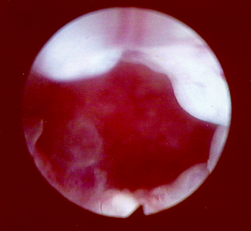
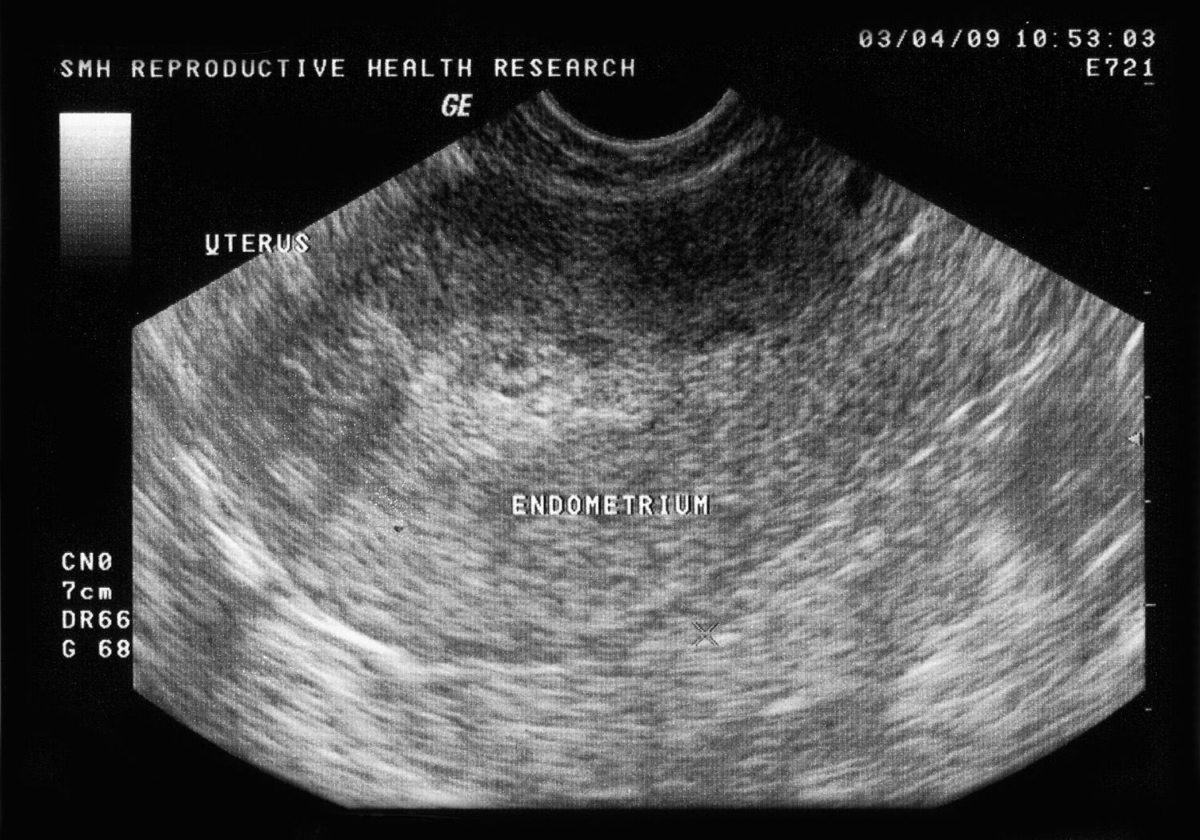
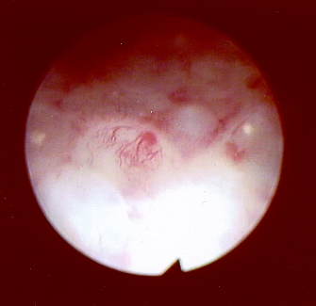
Endometrium and Tamoxifen

Slide 16
FIGO-AUB Classification (PALM-COEIN)
Not otherwise Classified
Arterio-venous malformations
Endometrial pseudo-aneurysm
Myometrial hypertrophy
Chronic endometritis ( sometimes seen with Intra- uterine devices)

Slide 17
Clinical Management

Slide 18
How do I group problems?
N.I.C.E.
NON
STRUCTURAL
STRUCTURAL

Slide 19
Non Structural
Physiological
Medication
Psychological?
Pharmacological Approach

Slide 20
What do they mean?
1st line
Levonogestrel releasing-IUS
3rd line
Oral progesterone
(Northisterone)
Injected progesterone
2nd line
Tranexamic acid
NSIAD
COC
Others – GnRH Analogues

Slide 21
Plasminogen Activator (PA) and Tranexamic Acid Local Hemostasis
Concentrations of tissue PA activity and antigen are significantly higher in women with HMB compared to normal women. Gleeson et al. Br J Obstet Gynecol 1993;100:768-71
Tranexamic acid significantly reduces PA activity menstrual blood simultaneously reducing menstrual loss by 58%. Gleeson et al. Acta Obstet Gynecol 1994;73:274-7

Slide 22
Medical Management: Non hormonal Therapies (Non-structural causes)
NSAID’s
Reduce menstrual bleeding by decreasing prostaglandins in endomyometrial area (20% Reduction in blood flow)
No evidence that one NSAID is more effective than another
Tranexamic acid
Antifibrinolytic
Two 500 mg tabs TID for the first 5 days of the cycle decreased bleeding significantly more than NSAID’s (58%)

Slide 23
Effectiveness of LNG- IUS
7 Studies: compared LNG with COC, POP, NDAIDs, Other Progestogens (Superior)
10 Studies: LNG Vs. Endometrial Ablations (equally effective at 2 years)
3 studies: LNG Vs Hysterectomy ( less effective but comparable QOL)

Slide 24
Abnormal Findings
STRUCTURAL
Fibriods<3cm/
Pharmacology failure
Enlarged uterus
>45,
Persistent IMB,
or treatment failure
Endometrial bx
Hysteroscopy/USS/ MRI (As Indicated)

Slide 25
Assume nothing sinister…
Very Severe Symptoms
+
No plans to conceive/
small fibroids <3cm
ESMYA/ ENDOMETRIAL ABLATION/Resection
HYSTERECTOMY

Slide 26
What if…
Very Severe
+
Fibroids>3cm
MYOMECTOMY, U.A. EMBOLISATION,
Radiological interventions/HYSTERECTOMY

Slide 27
Endometrial Ablation
Myomectomy
Hysterectomy
ESMYA

Slide 28
Endometrial Ablation
Patient Selection
Patients age,
Family is complete
Uterus less than 10 weeks size
Sub mucus Uterine fibroids < 3cm

Slide 29
Nd-YAG Laser
Novasure Ablation

Slide 30
Roller ball Ablation
Thermal ball Ablation

Slide 31
BJOG 2013

Slide 32
A study cohort of 55,000 women who had an EA-5 Year Follow up

Slide 33
Long term effectiveness of Ablation
Meta –analysis suggest that cumulative success rate as described by amenorrhea (up to 30%), reduced menstrual blood loss( another 45-55%)are the same for different techniques.
Risk of hysterectomy at the end of 10 year follow up is 15%
Key ref:Bansi-Matharu, L,Gurol I, Mahmood T, Vander-Meulen J, Cromwell D: BJOG 2013;120(12): 1500-1507

Slide 34
Uterine Fibroids

Slide 35
Epidemiology of Uterine Fibroids
20-25% % are Symptomatic during reproductive age
Develop due to Estrogens-Progesterone interaction and is growth factor dependent
Incidence increases with age
More common among Black as compared with White Caucasians (4:1)
Genetic, epigenetic, environmental, life style, Socio-economic factors

Slide 37
Uterine Fibroids Management
Issues:
Fertility Preservation
OR
Menstrual symptom Control-
Fertility Preservation: Options:
1- Surgical-Myomectomy ( Laparoscopic or Open or Robotic Assisted) and Hysteroscopic approach
2- New Radiological Interventions
3- Medical treatment

Slide 38
Menstrual symptoms Control
Family is complete
Uterine preservation no longer required
Co morbidity such as Endometriosis
Poor QOL
Then Hysterectomy is the answer- Routes dependent on Surgical expertise and patient needs ( Robotic, Laparoscopic, Open Abdominal and Vaginal)- no more to add!

Slide 39
Sub Mucus Fibroids
Do they cause infertility? Possibly
Do they cause heavy menstrual bleeding? YES
Treatment options: individualised
Hysteroscopic Resection- under direct vision- and Myosure can be used for small fibroids< 3cm
Risk of intra uterine adhesions/fibrosis/Bleeding/Perforation
Medical Treatment: Esmya for multiple fibroids of < 3 cms

Slide 40
Sub- mucus fibroid and Hysteroscopic Myomectomy

Slide 41
Intramural Fibroids

Slide 42
Intra- Mural fibroids
High quality meta-analysis reported no improvement in Pregnancy rates following Myomectomy-
Clinical Pregnancy rate: OR 1.88 ( 95% CI of 0.62 to 6.14)
Miscarriage rates: OR 0.89 (95% CI of 0.14 to 5.48)

Slide 43
Fertility Preserving Surgery-Myomectomy
Three Routes
Laparoscopic
Laparotomy
Robotic Assisted
Cochrane Review of Two studies with 158 patients: there was no evidence of benefit of safety and effectiveness of Robotic Surgery compared with Laparoscopic Surgery
There is increased risk of Uterine Rupture during labour

Slide 44
Radiological Techniques

Slide 45
Uterine Artery Embolisation

Slide 46
Efficacy of Uterine Artery Embolisation(UAE)
A register of 1387 patients reported that 83% of patients had an improvement in their symptoms after UAE at 6 and 24 months respectively.
Women reported an improvement in mean health-related quality of life scores at maximum 3-year follow-up
A re-intervention rate of 15% during a 3-year follow-up (10% hysterectomy, 3% myomectomy and 2% repeat UAE).

Slide 47
Safety of UAE
Uterine infection -2% of patients
Septic shock and multiple organ failure leading to death 25 days after UAE occurred in 1 patient.
Septicaemia and emergency myomectomy or hysterectomy were reported in 3% (17/649).

Slide 48
UAE Vs. Myomectomy
An RCT of 121 women treated by UAE Vs. myomectomy reported that 50% of women who tried to conceive after UAE became pregnant compared with 78% of women after myomectomy at a mean follow-up of 25 months (p < 0.05).
The rate of spontaneous abortion or missed miscarriage was 64% in the UAE group and 23% in the myomectomy group (p < 0.05).

Slide 49
MRI Focused ultra sound Treatment for Uterine Fibroids

Slide 50
MRI Focused Ultra Sound
54 Pregnancies reported in 51 Women
The mean time to conception post procedure was 8 months:
Spontaneous Miscarriage- 28%
Live Birth Rate- 41%
Vaginal deliveries- 64%

Slide 51
Magnetic Resonance Imaging Guided Cryomyolysis
Liquid Nitrogen is passed through a Cryoprobe directly into the uterine Fibroid to create a temperature of -90c within Fibroid thus causing necrosis.
There was a mean fibroid volume reduction of 50-62% with significant improvement in symptomatology.

Slide 52
Medical Treatment
Focusing on ESMYA
(Selective Progesterone Receptor Modulator)

Slide 53
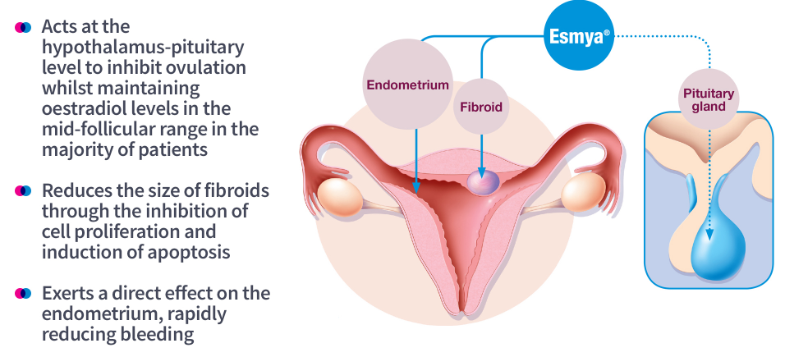
A novel, targeted mode of action
Ulipristal acetate 5mg works both locally and centrally¹⁻⁴
UPA

Slide 54
Effect on post treatment bleeding – blood loss in first menses post treatment
PEARL IV
Intensity of menstrual bleedingª (PBAC score) (FAS1)
p<0.0001
Median days to first menstruation after end of each UPA course was
≤ 28 days
(safety population)
Median PBAC score
P=0.001
P=0.0004
N=218
N=172
N=159
ªOnly the first 8 days of menses are included in the total PBAC score
PBAC, Pictorial Bleeding Assessment Chart; UPA, ulipristal acetate
Notes:
Source: CSR Table 34 – 14.2.33
The strength of the first menstrual bleed after treatment courses 1, 2 and 4 was markedly and progressively reduced as compared to study start and comparable between the two PGL4001 groups
Results comparable to PEARL III extension

Slide 55
PEARL IV
Efficacy: Fibroid volume reduction
Patients with clinically significant reduction in fibroid volumeª (≥25%) [FAS1]
80%
Percentage of patients
N=207
N=189
N=173
N=160
N=158
ªVolume of 3 largest fibroids combined
* After treatment course + 1 bleed N, number of patients with non-missing assessments; UPA, ulipristal acetate

Slide 56
EFFICACY: RELationship between reduction in myoma volume and amenorrhoea
PEARL IV
After 4 courses of 5mg
Myoma volume reduction ≥ 25% | Amenorrhoea
 | Yes | No
Yes | 73.5% | 7.8%
No | 13.9% | 4.8%
After 4 courses:
73.5% of patients had no bleeding and reduced fibroid volume ≥25%
4.8% still had some bleeding and did not have reduced fibroid volume ≥25%

Slide 57
Summary

Slide 58
Treatment options based on Symptoms

Slide 59
Take Home Messages
Management of every women with menstrual disorders should be individualised
Each patient should be offered all available treatment options
Importantly, all management plans should ensure improved QOL
Women should be provided with full information as regards success of individual treatment/and adverse outcomes
Overall surgical interventions had better improvements in QOL
Esmya offers a novel approach for treatment of small sized sub-mucus fibroids.

