Slide 1
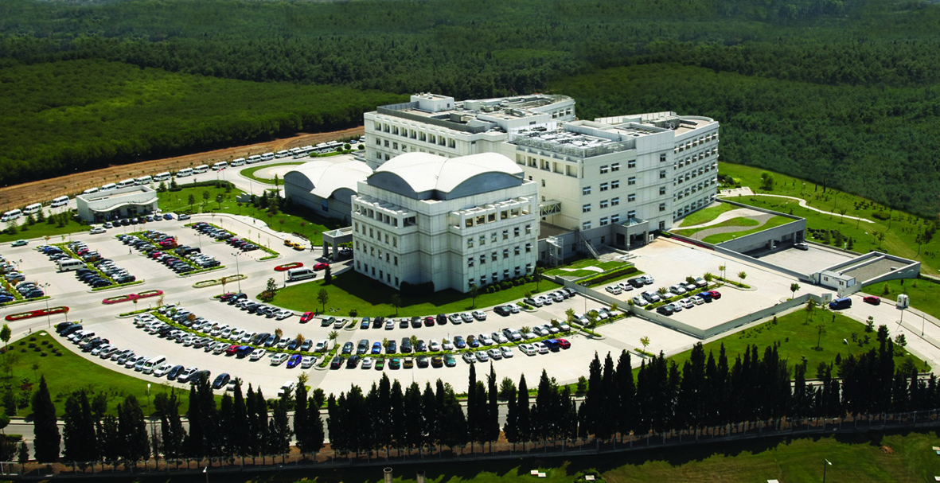
Laparoscopic Hysterectomy in Obese Women
25th European Congress of Obstetrics and Gynecology
in conjunction with
15th Congress of Turkish Society of Obstetrics and Gynecology
May 17-21, 2017, Antalya, Turkey
Fatih Güçer, MD
Anadolu Medical Center
Kocaeli - Turkey

Slide 2
Obesity= BMI>30
Class I
30-34,99
Class II
35-39,99
Class III
>40
moderately
morbidly

Slide 3
Obesity= BMI>30
prospective cohort, 118,707 pts, general surgery
Overall mortality and composite morbidity
Pts without metabolic compl.
Pts with metabolic compl.
Lower than normal weight women
higher than normal weight women
Obesity paradox
Low risk patients:
overweight
moderatly obese
High risk patients:
underweight women
morbidly obese
Mullen Jt et al Ann Surg 2009

Slide 4
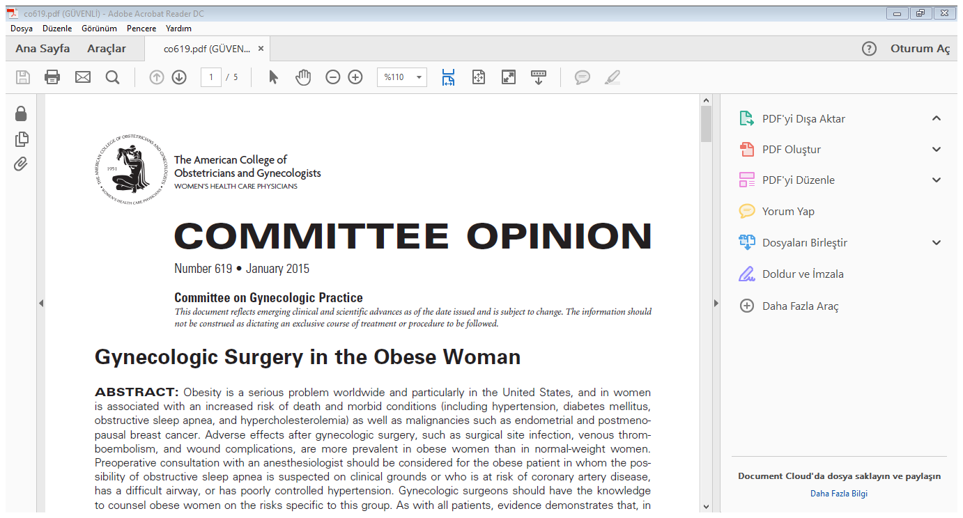
Obese pts with metabolic syndrome higher perioperative morbidity and mortality than normal-weight women !
Surgical site infection BMI>35
Venous thromboembolism BMI>35
Wound complications
(10 times more likely with a BMI 40-49)

Slide 5
Hysterectomy
Hysterectomy;
second most common procedure in USA !
433.000 annually !
Vaginal
Abdominal
Endoscopic
Laparoscopic
LAVH
L Subtotal H
LTH 1989
Single Port
Robotic 2002
ACOG, March 2015

Slide 6
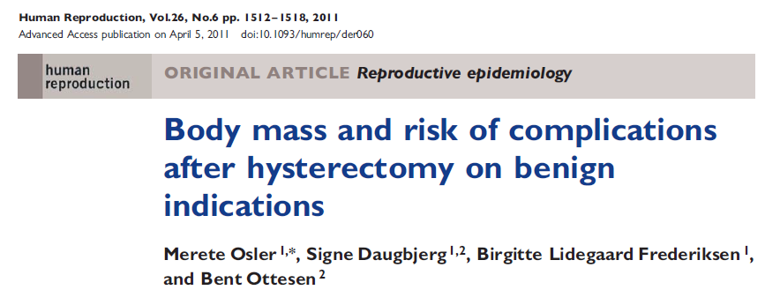
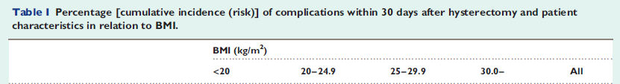

20353 pts, nationwide, Denmark, 2004-2009

Slide 7
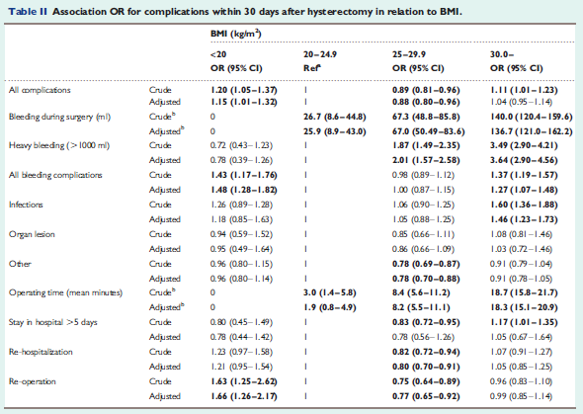

Slide 8
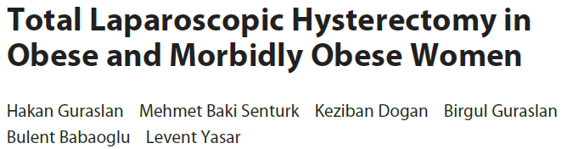
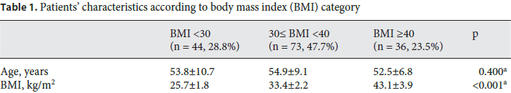
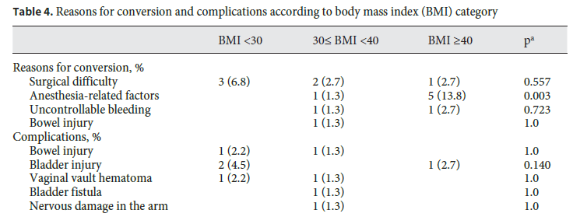


Slide 9
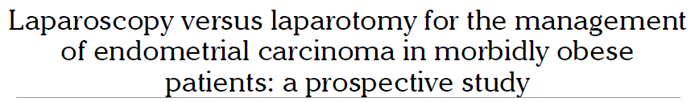
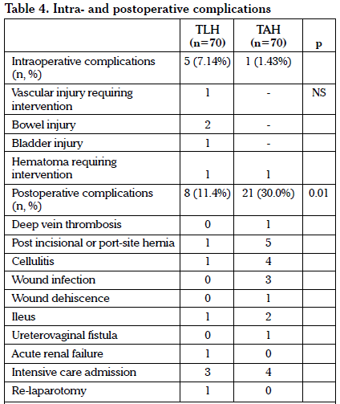
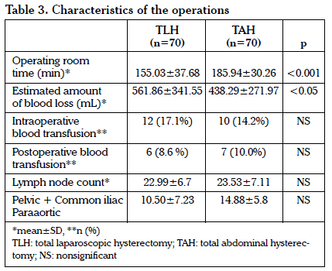

Slide 10




2 RCT, 7 prospective, 14 retrospective studies
Including 1058 AH, 959 LH, 215 VH
AH compred with LH, more wound dehiscence
more wound infection
longer hospital stay
Conversion rate 10,6%

Slide 11
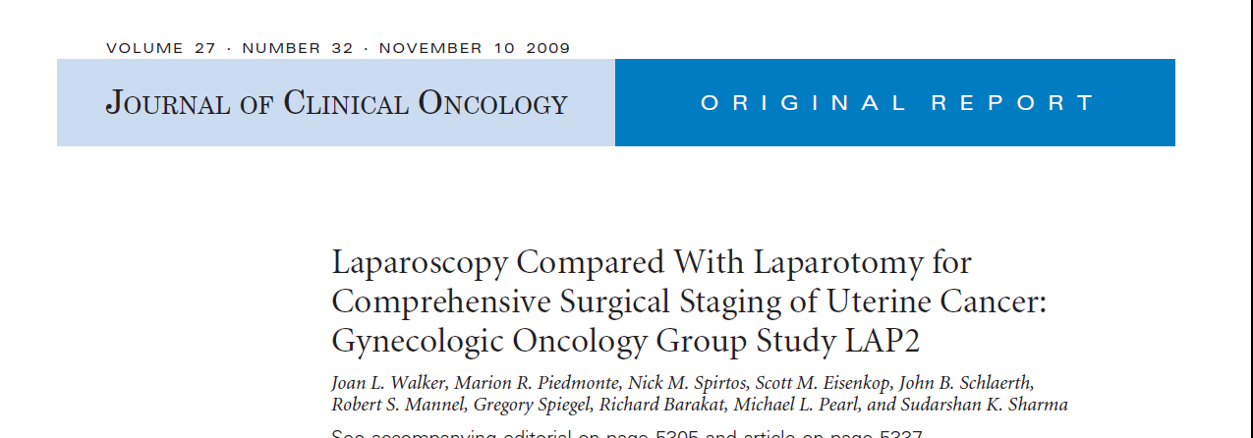
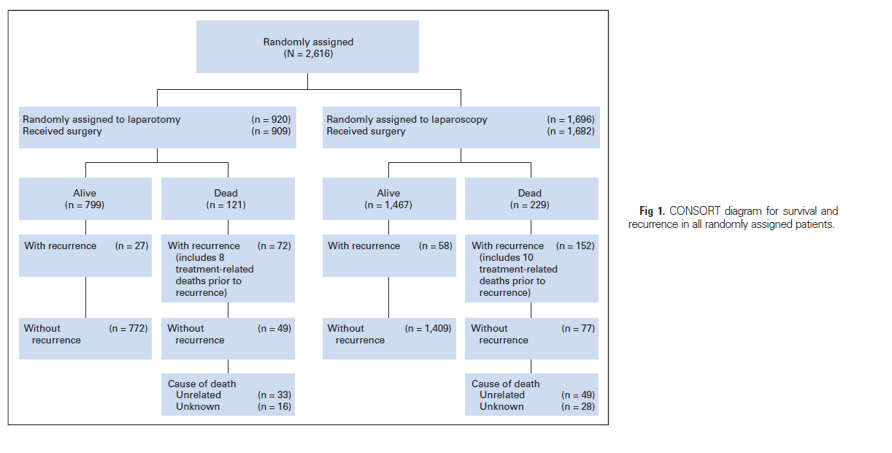
Notes:
GOG lap2 is prospective randomized multicenter study conducted by SGO.
11

Slide 12

Randomized phase III trial of laparoscopy vs laparotomy
Longer OR-time in laparoscopy group (203 vs. 130 min)
Similar intraoperative complications
Postoperative periode; LS is superior than LT
A superior QOL through the first 6 postoperative weeks.
Fewer complications
Less pain
Faster recovery
Reduced length of hospital stay
Notes:
Initially, perioperative data have presented. OR time was longer in lapscpy group but intraopperative complications were similar in two study groups. For the postoperative periode, LS was superior than LT.

Slide 13
Randomized phase III trial of laparoscopy vs laparotomy
Similar pelvic lymph node count
L/S: 17 vs. L/T: 18
Similar paraaortic lymph node count
L/S: 7 vs. L/T: 7

Slide 14
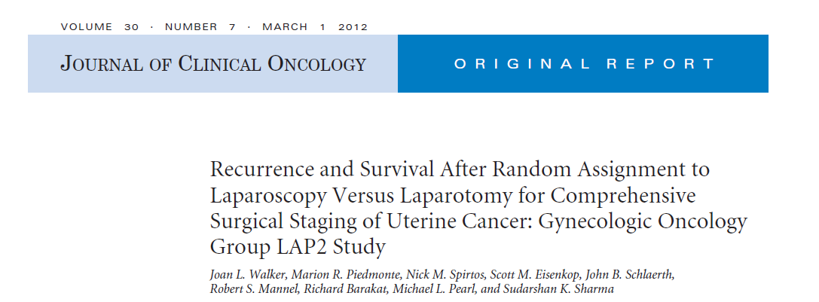
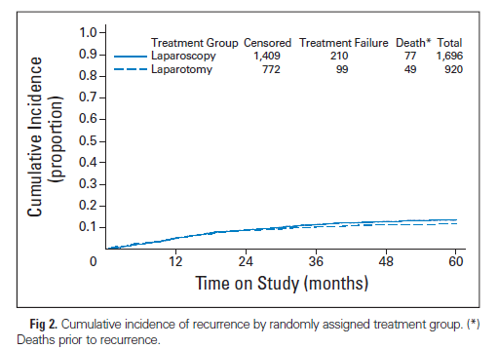
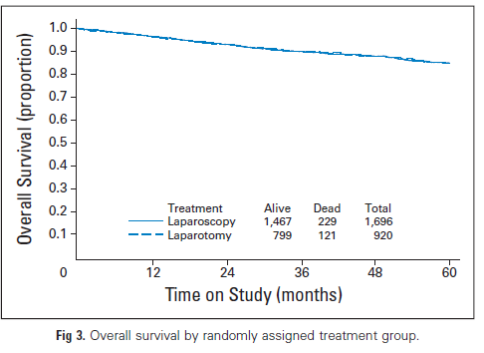
Notes:
Follow up data of this study have presented in 2012. Progression free survival and OS rates were similar in the LS and LT groups.

Slide 15
Randomized phase III trial of laparoscopy vs laparotomy
Conversion rate 26%
BMI<25
17%
BMI up to 35
26%
BMI>40
57%
Notes:
However, conversion rate was very high in this sudy and it was closely related with BMI.

Slide 16
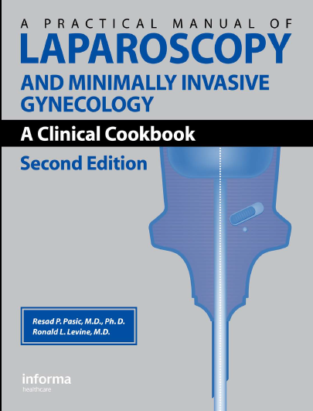
Relative Contraindications of Laparoscopy
Multiple previous major surgeries,
Morbid obesity,
>5 months pregnancy,
Severe chronically ill patients presenting anesthesia problems,
Malign ovarian or pelvic mass…

Slide 17
Complications are related to…
Laparoscopic entry (veress, trocar)
The operative procedure
Pneumoperitoneum
Patient position
Anaesthesia

Slide 18
Summary data for major laparoscopic complications
Overall complication rate Intestinal Vascular Urinary tract | 7-12.6 per 1000 1.6 to 2.4 per 1000 0.3 per 1000 2 to 8.5 per 1000
Complication during setup phase | 1:3
Conversion to laparotomy | 2%
Complication not recognised | 1:4
Mortality rate | 4.4 per 100,000
Mortality after hysterectomy for benign indications | 150 per 100,000

Slide 19
Entry Techniques
Classic or closed entry
Veress-pneumoperitoneum-trocar
Direct trocar entry
Open technique
New techniques
shielded disposable trocars
optical Veress needle
radially expanding trocars
optical trocars

Slide 20
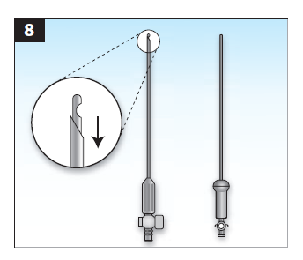

Slide 21
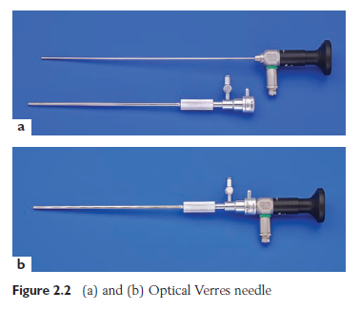

Slide 22
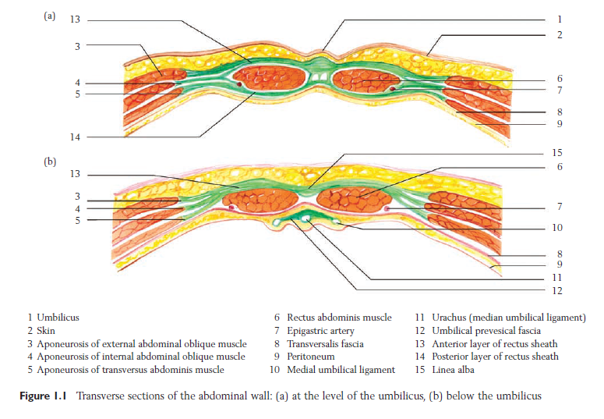

Slide 23
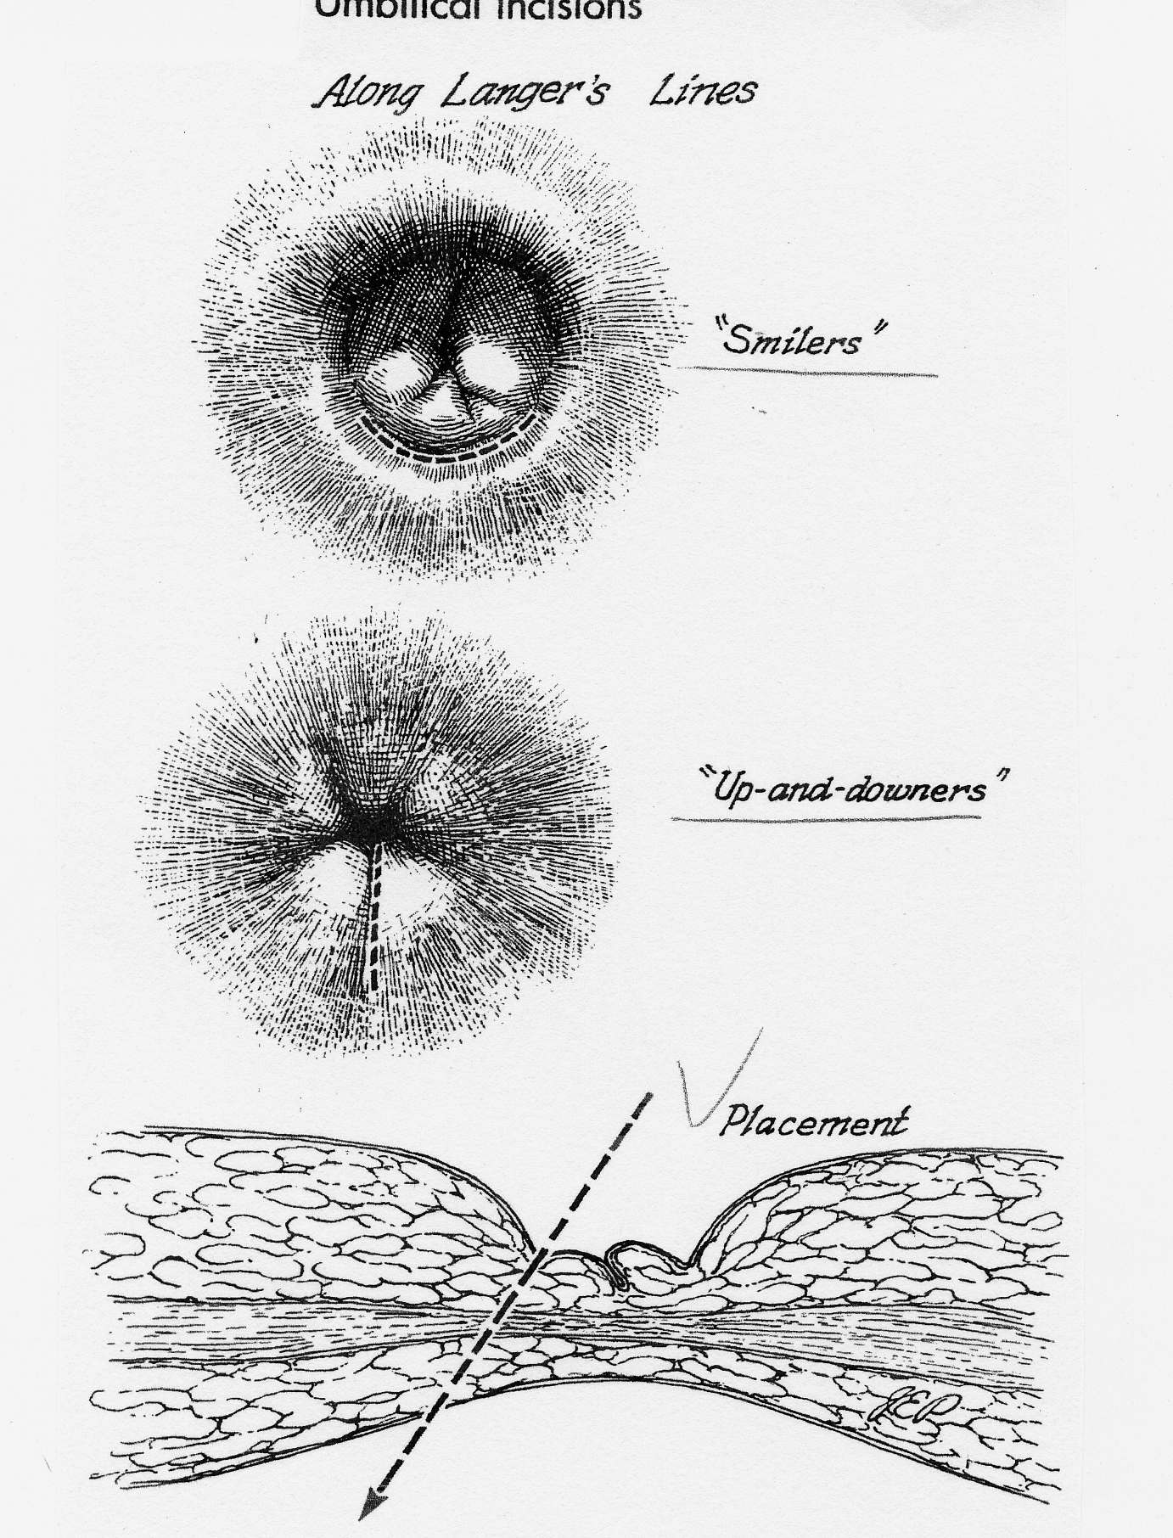

Slide 24

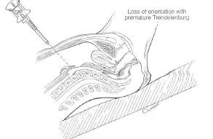

Slide 25
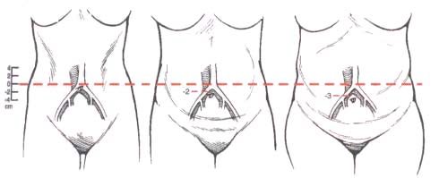


Slide 26
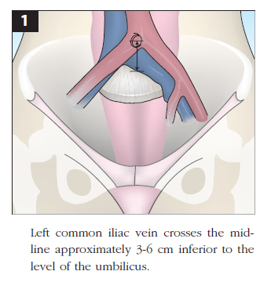

Slide 27
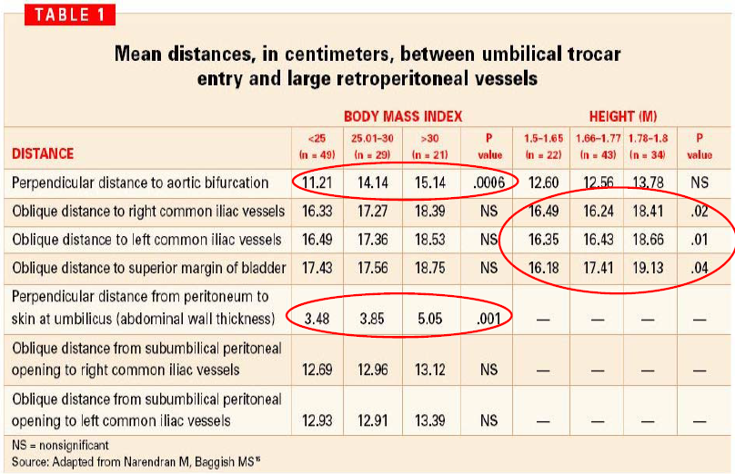

Slide 28
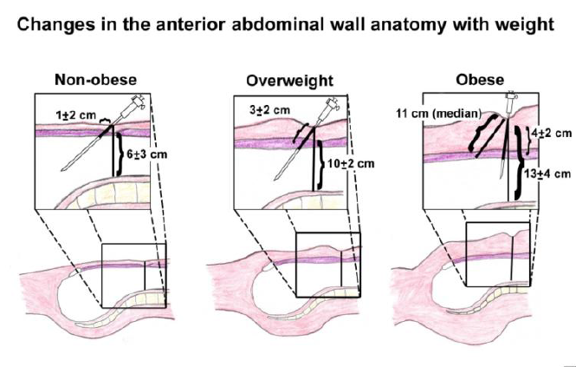

Slide 29

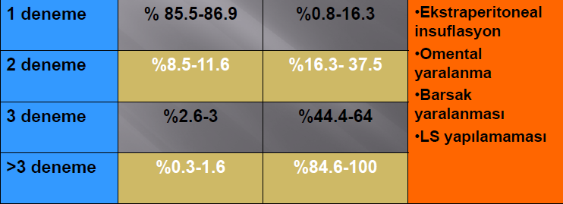
Veress iğnesini kaç kere denemeli?

Slide 30
Pneumoperitoneum
4 high-risk groups !
Obesity,
Thin patients,
Patients with previous abdominal surgery
Failed insufliation attempt…

Slide 31
Open Technique (Hasson)
2-3 cm incision
Opening the fascia and peritoneum under visiual control
Vascular injury is less common but intestinal injury rate similar !

Slide 32
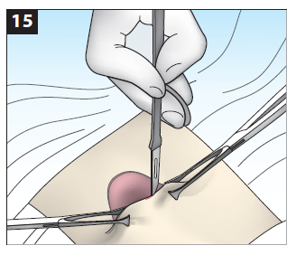
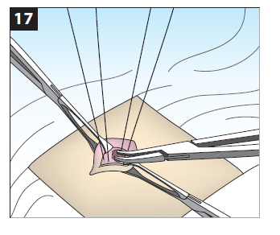
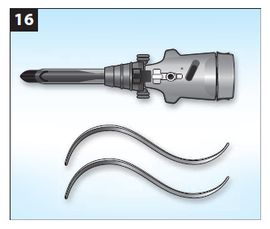
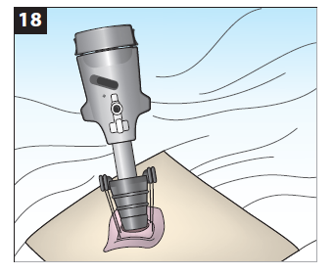

Slide 33
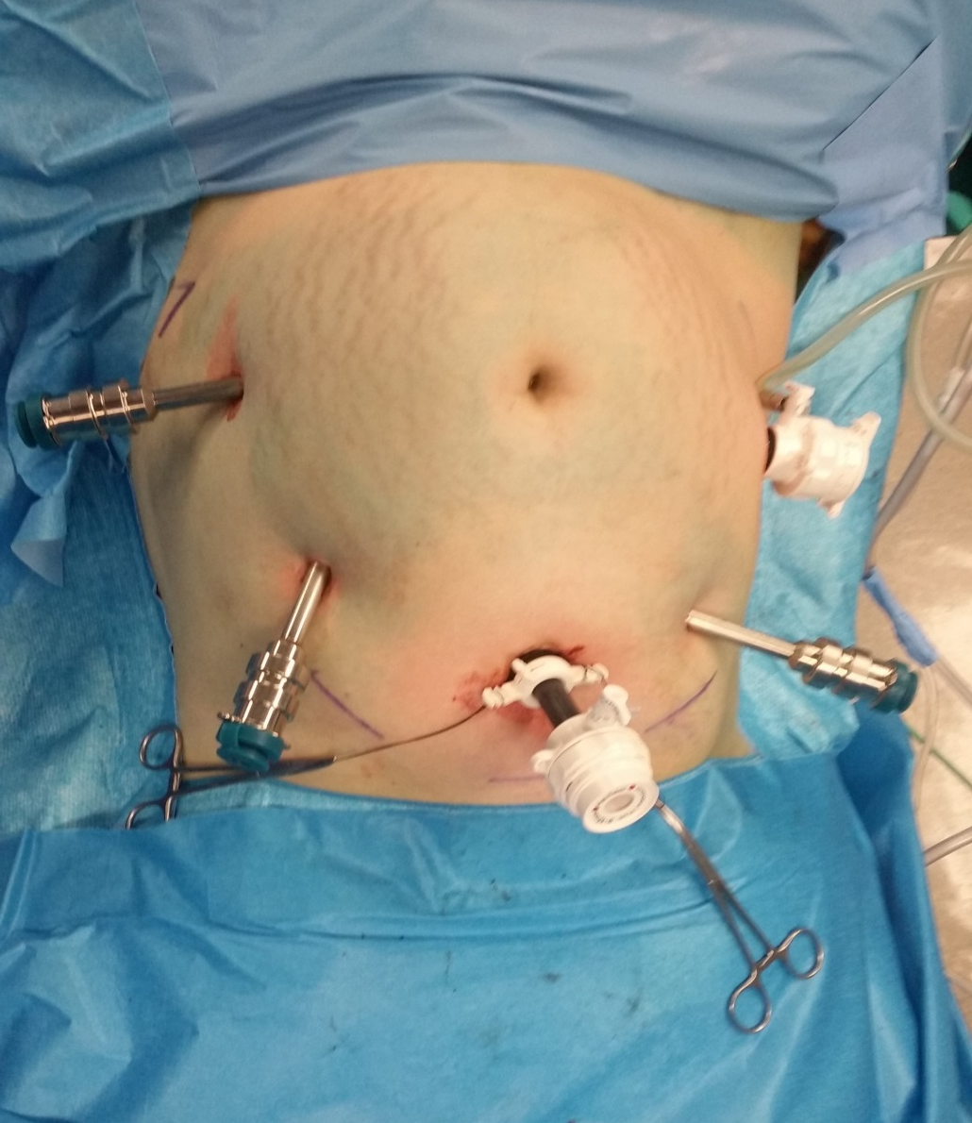
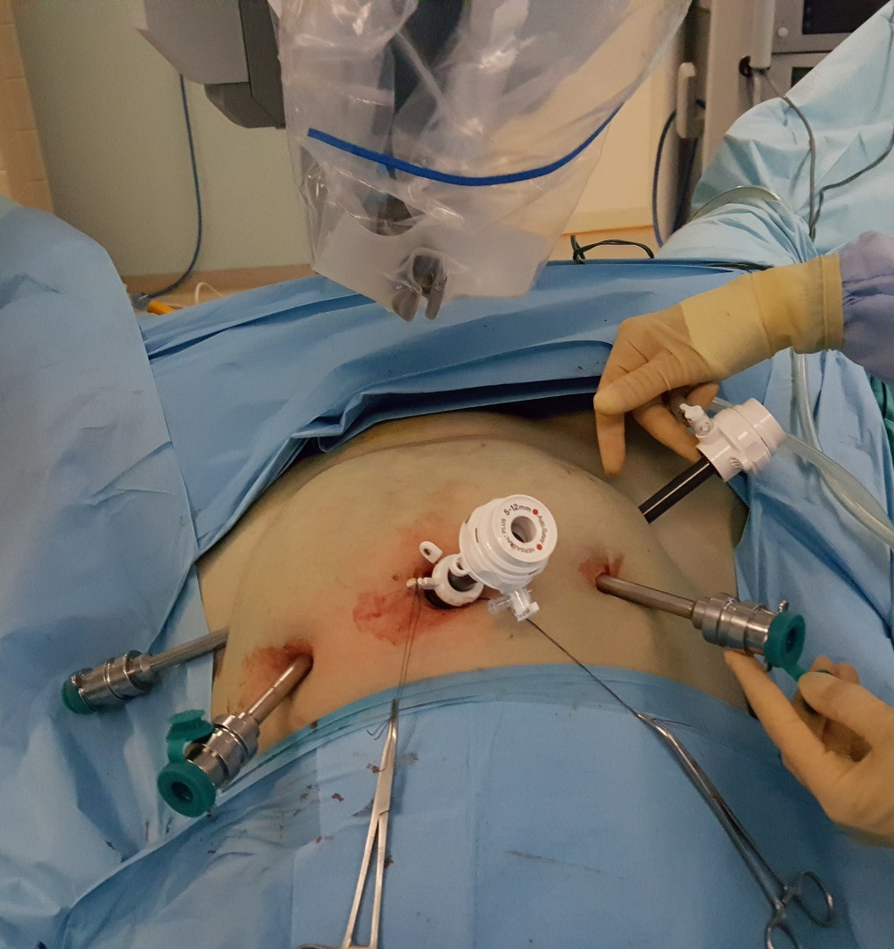

Slide 34
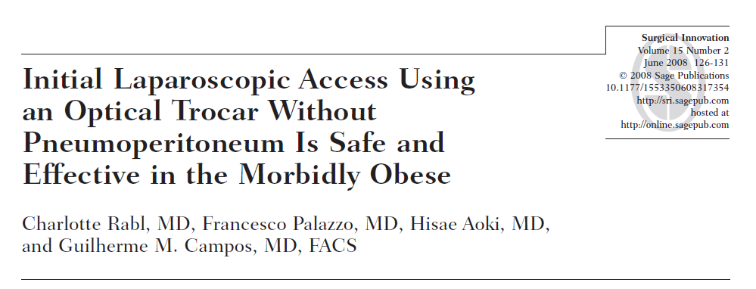

Slide 35
Summary
Complication rate increases related with increasing obesity rate even for LTH.
Complication rate is highest in obese patients with metabolic complications.
Access into the abdominal cavity may be difficult in obese patients.
Amount of bleeding may be higher in obese and morbidly obese patients.
The rate of thromboembolic events is higher in morbidly obese patients.

Slide 36

Summary

