Slide 1
Laparoscopic repair of cesarean scar defect: a case report
Meltem Tekelioglu, Ceren Saglam, Emel Canaz, Suat Karatas, Ayse Ender Yumru
Health Sciences University, Sisli Hamidiye Etfal Training and Research Hospital, Department of Gynecology & Obstetrics, Istanbul, Turkey

Slide 2
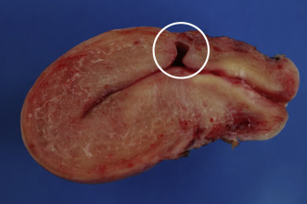
CSD
Defective healing of sutured myometrium
Cesarean scar syndrome (CSS)

Slide 3
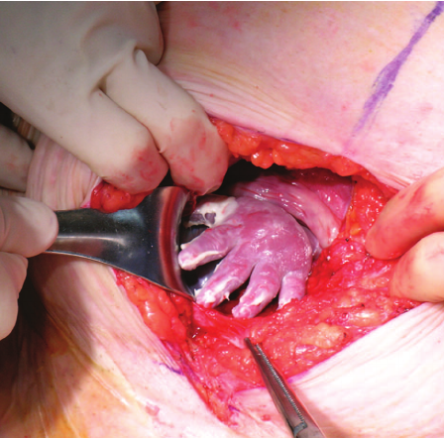
CSS
Gynecologic
Obstetric
Abnormal uterine bleeding (postmenstrual spotting)
Pelvic pain (dysmenorrhea)
Scar endometriosis
Secondary infertility
Scar ectopic pregnancy
Uterine rupture

Slide 4
Objective
Laparoscopic repair of cesarean scar defect (CSD) as a treatment option was presented in this study.

Slide 5
Case
27-year-old woman, gravida 2, para 2 (elective cesarean deliveries)
2 previous cesarean deliveries (the last one; 5 years ago)
Persistent postmenstrual spotting (for the past 3 years)
Oral contraceptive therapy had been administered (during last 2 years), however, abnormal uterine bleeding was not improved
Moreover, pregnancy desire was appeared
Transvaginal sonography: 9.9 x 6.7 mm wedge shaped niche and thickness of residual myometrium covering the defect was 1.9 mm

Slide 6
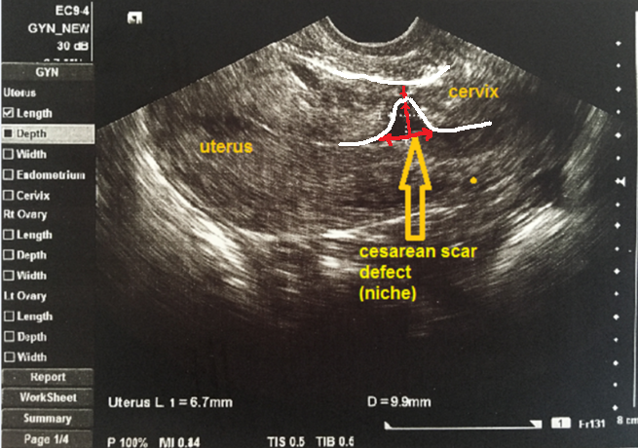

Slide 7
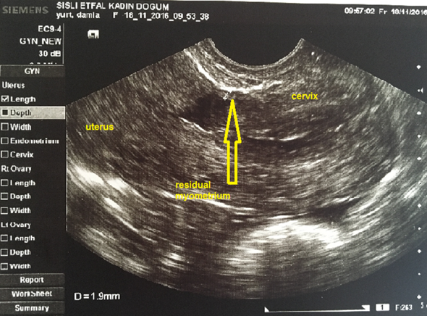

Slide 8
Treatment
Laparoscopic repair of the defect was decided for the treatment of persistent abnormal uterine bleeding and the concern of future pregnancy.

Slide 9
Laparoscopic repair
Insertion of trocars (1 main & 3 accessory trocars),
Dissection of bladder for freeing the lower uterine segment
Introducing a sharp curette through the cervix (into the uterine cavity) to uncover the defect
Puncturing the apex of defect with curette
Enlargement of puncture to reopen the incision line
Resection of the upper and lower margins of defect using harmonic scissors
Double-layer, unlocking, V-lock suture for uterine closure

Slide 10
After laparoscopic repair
Post-operative period; uneventful
Discharge home; post-operative day 1.
TVS: 8.4 mm residual myometrial thickness (7 weeks after operation)
Now: she is 5 months from her surgery and free of symptoms

Slide 11
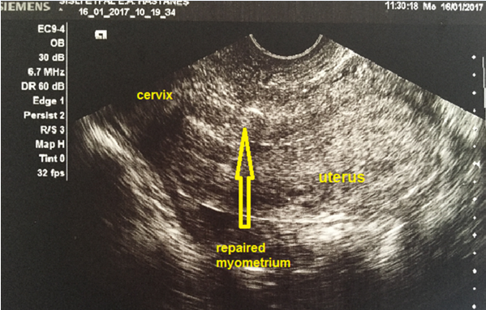

Slide 12
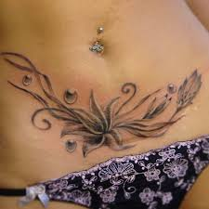
CSD & CSS
currently,
more prominent
due to
increasing cesarean frequency
worldwide !

Slide 13
Conclusion
Neither the association CSD with CSS, nor the standarts for the treatment of CSD has not yet been established (3).
Laparoscopic and hysteroscopic treatments are minimally invasive management options.
Laparoscopic repair of CSD appears to be an effective minimally invasive treatment according to short term clinical consequenses for persistent postmenstrual spotting.

Slide 14
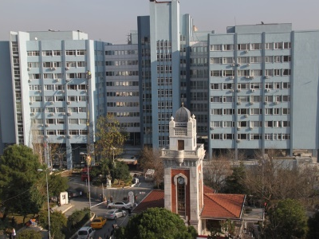
Teşekkürler..
Sisli Hamidiye Etfal Training and Research Hospital, Istanbul, Turkey
THANKS..

