Slide 1
Quality in gynaecological oncology
Andrina Kölle
Department of Obstetrics and Gynaecology University hospital Tübingen, Germany

Slide 2
3 dimensions of quality
1
Structural quality
Infrastructure
Financing
Human Resources
2
Process quality
Oncological Standards
Evidence based Medicine
Cooperations
3
Outcome quality
Progression-free survival
Total survival
Complications

Slide 3
The benefit of certification: Onko Zert breast cancer centres
Principle of voluntary, external benchmarking programme
Third party certification and recertification
Mandatory quality management systems to
German Cancer Society (DKG)
And German Society of Senology (DGS)
High quality of complete process chain:
Early detection and
correct diagnosis
Treatment based
on guidelines
Follow up care

Slide 4
How to measure quality?
Example of breast cancer centres in germany- criteria of certification
Stipulated cooperation partners (oncology, radiology et al.)
Commitment to act on general medical guidelines
Standardised documentation
Specified number of cases
Tumor conferences

Slide 5
Competition unlocks potential for innovation: Quality Indicators
Continuous benchmarking process, quantification by introducing quality indicators (QIs)
Preoperative histological
confirmation of diagnosis
QI
Guideline-concordant adjuvant
or neoadjuvant chemotherapy
QI
3
QMS- quality
management
system
QI
Appropriate axillary dissection

Slide 6
Benchmarking improves the quality of care
Large breast Centres
Relative performance of quality indicators (QIs) during the 2003–2010 period, expressed as a percentage of the respective DKG/ DGS Requirements of Breast Centres (FAB)

Slide 7
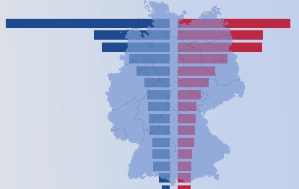
German national cancer registry: Real life data
Central documentation of incidences, procedures and results
Epidemiological data provides information about temporal and regional occurence
Quality management in prevention, diagnostic and therapy
Data set for cause studies
Basis for the setup of rational screening programmes

Slide 8
Centralisation
Improvement in patient survival
Shorter hospitalisation
Lower local-recurrence rates
Higher likelihood of receiving breast-conserving-therapy (BCT)
Increase in overall-survival
Specialisation
Multidisciplinarity

Slide 9
Learning translational networks: precision medicine
The PRAEGNANT study network (Prospective Academic Translational Research Network for the Optimization of Oncological Health Care Quality in the Advanced Therapeutic Setting)
Pharmacogenomics and biomarker
To carry out molecular tests under study conditions
To identify suitable breast cancer patients for clinical drug trials based on molecular testing
Health Services Research
To record treatment-induced toxicities and patientʼs quality of life in routine clinical practice
To record, show and benchmark the reality of medical care provided to patients with advanced metastatic breast cancer

Slide 10
Patient reported outcome
PRO: an instrument to detect patients at-risk
PRO | Symptom: depression
PRO-CTCAE | Patient-Reported Outcomes version of the Common Terminology Criteria for Adverse Events
High long-term acceptance and compliance
Early detection, early intervention

Slide 11
ePROs Patient-reported-outcomes as a quality parameter: discovering needs and improving life quality
Health status
Symptoms Psychological and social function Limitations
Patient satisfaction
Treatment Consulting quality
Subjective well-being
Fear Depression
ePRO- Quality of life and patient satisfaction
Function
Physiological and vegetative functions
Health related quality of life HRQOL
Individual evaluation of life quality
Compliance
Adherence to prescribed medication or other treatment

Slide 12
eHealth study-finder: new ways in oncological study recruitment
Central study data base for cancer centres, physicians, patients
Continuous update, individual selection
Direct contact to study coordination
Online education and training
Promotion of transparency

Slide 13
Quality in surgical gynaecological oncology: The sentinel lymphonodectomy concept in early and locally advanced cervical and endometrial cancer
adequate staging by omission of radical lymphonodectomy
Leads to a significant reduction of associated complications
Should be carried out only in specialised centers, which are equipped with a complete, interdisciplinary infrastructure
This setting provides the necessary surgical expertise over time leading to a high qualtity in oncological routine surgery

Slide 14
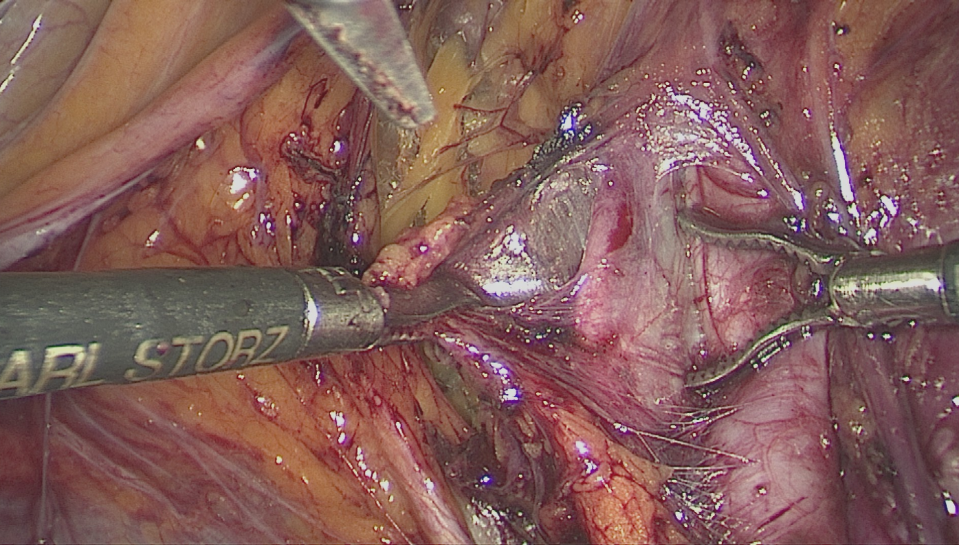
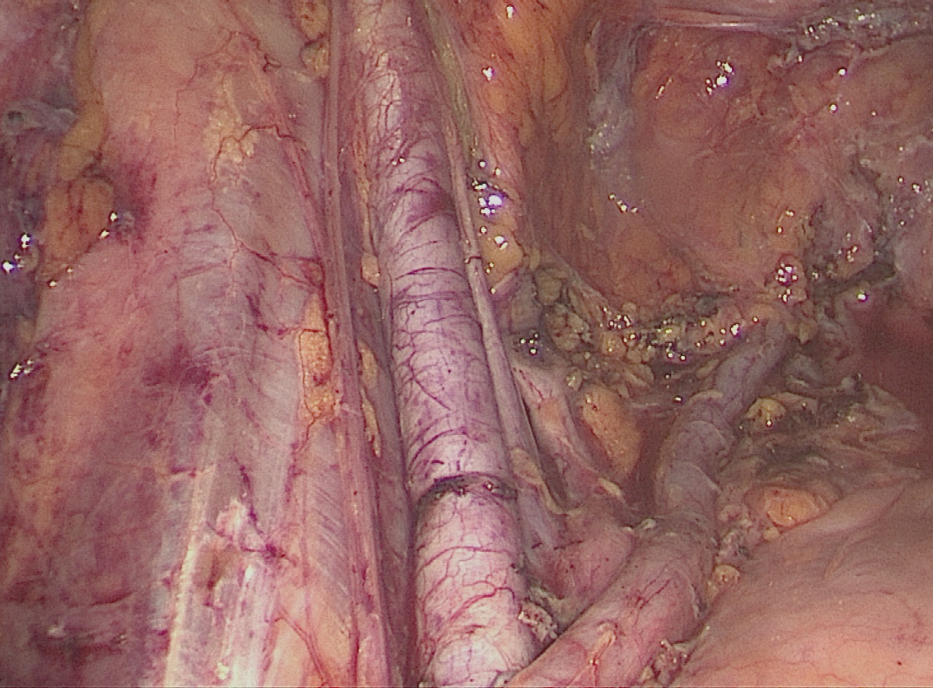
The surgeon´s learning curve: a quality parameter
Optimisation of staging
Reducing radicality
Reducing morbidity

Slide 15
Quality assurance and quality intensification: a multidisciplinary concept
Cooperations
Objective guidelines
Oncology
eHealth
Patient
Documentation

