Slide 1
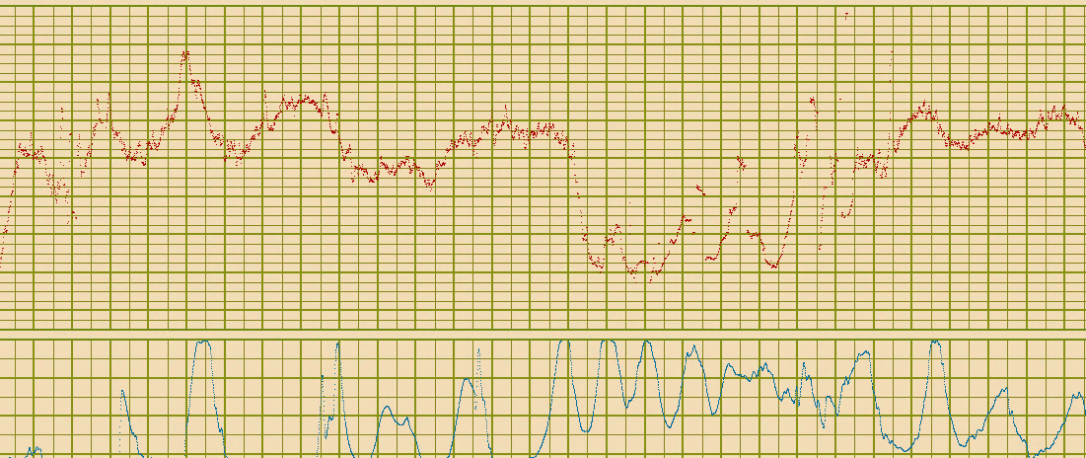
INTRAPARTUM FETAL MONITORING
Diogo Ayres-de-Campos, MD, PhD
Medical School – University of Lisbon
Safe Motherhood and Newborn Health Committee – FIGO

Slide 2
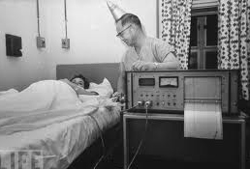
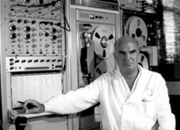
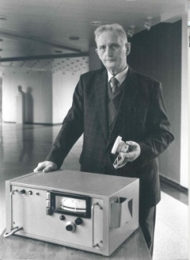
1960’s
Hon, Caldeyro-Barcia, Hammacher
1970’s - 1980’s
Myer-Menk/Fischer, Cardiff, Birmingham, Krebs
21 different CTG classifications 1974-1984
Devoe LD et al. AJOG 1985;152:1047-53

Slide 3
FIGO
1985
FIGO. IJOG 1987;25:159-67

Slide 4
2015 FIGO guidelines
Worldwide consensus
Include all currently available methods
Language accessible to all professionals
Simple and objective
Direct association between classification and management

Slide 5
34 experts appointed by national societies
16 experts invited based on publications
Lawrence Devoe (USA), Gerard Visser (Netherlands), Richard Paul (USA), Barry Schifrin (USA), Julian Parer (USA), Philip Steer (UK), Vincenzo Berghella (USA), Isis Amer-Wahlin (Sweden), Susanna Timonen (Finland), Austin Ugwumadu (UK), João Bernardes (Portugal), Justo Alonso (Uruguay), Ingemar Ingemarson (Sweden).

Slide 6
2015 FIGO guidelines

Slide 7
Open access IJGO
http://www.ijgo.org/issue/S0020-7292(15)X0017-8
Course slides - FIGO website
English, Spanish, Portuguese, Chinese, French
http://figo.org/figo-committee-and-working-group-publications

Slide 8
Endorsed/supported by:

Slide 9
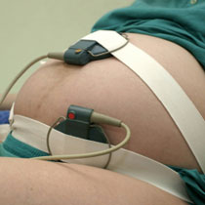
Cardiotocography
(kardia=heart, tokos=labour)
…is the term that best describes the continuous monitoring of FHR and uterine contractions

Slide 10
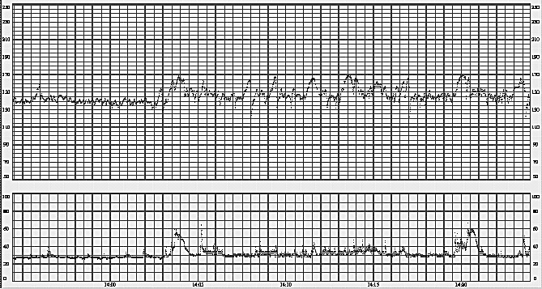
Baseline
Mean level of the most horizontal and less oscillatory FHR segments. Estimated in 10-min periods, expressed in bpm

Slide 11
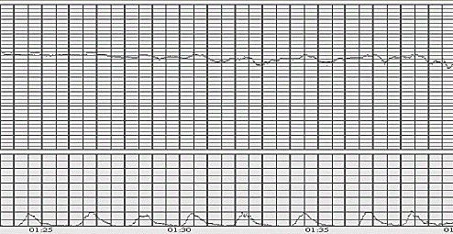
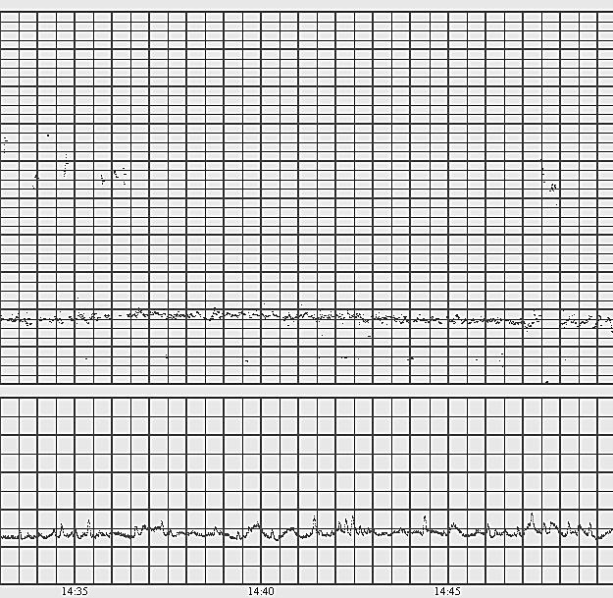
Normal | 110-160 bpm
Tachycardia | > 160 bpm for more than 10 min (pyrexia, epidural, hypoxemia, ANS drugs, arrhythmia)
Bradycardia | < 110 bpm for more than 10 min (hypothermia, ANS drugs and fetal arrhythmias)

Slide 12
Decelerations
Abrupt decreases in FHR below baseline, > 15 bpm amplitude, > 15 secs
150
>15 s
140
>15 bpm
130
120

Slide 13
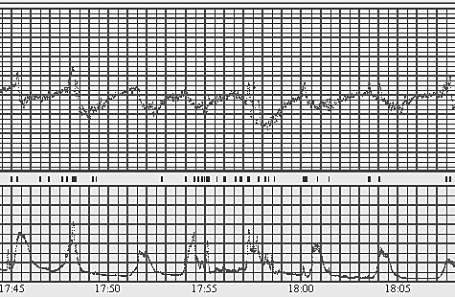
Early decelerations | Shallow, short-lasting, with normal variability and coincident with contractions
Believed to be caused by fetal head compression
Do not indicate fetal hypoxia/acidosis

Slide 14
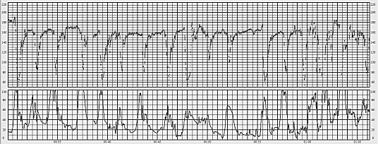
Variable decelerations | Rapid drop (onset-nadir in < 30 sec), rapid recovery, good variability. Varying size, shape and relation to uterine contractions
Baroreceptor-mediated response to ↑ BP (umbilical compression)
Seldomly associated with important hypoxia/acidosis

Slide 15
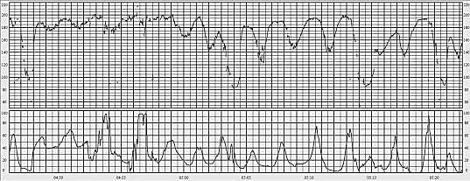
Late decelerations | Gradual onset and/or gradual return to baseline, and/or reduced variability. Onset > 20 sec after start of contraction, nadir after acme and return to baseline after end
Chemoreceptor-mediated response to hypoxemia
With ↓ variability and no accelerations, amplitude only > 10 bpm

Slide 16
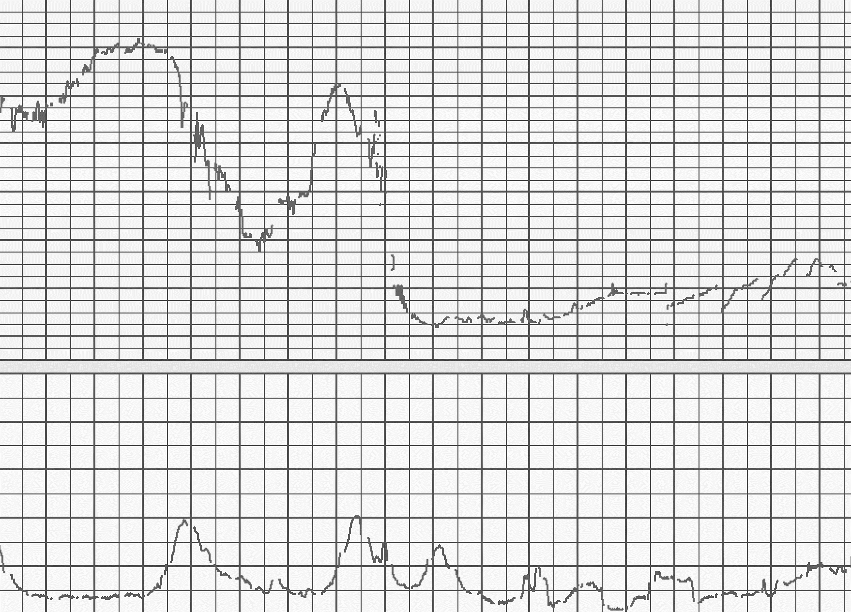
Prolonged deceleration | > 3 min
Likely to include a chemoreceptor-mediated component
If > 5 min, ↓ variability, and FHR < 80 bpm → emergency intervention

Slide 17
Variability
Average bandwidth amplitude in 1-min segments
1 min
125
120
115

Slide 18
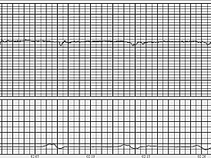
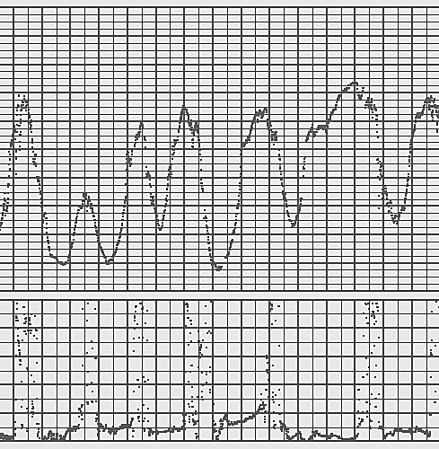
Reduced variability | < 5 bpm for more than 50 min in baseline or more than 3 min in decelerations
Hypoxia, previous cerebral injury, infection, CNS depressants or parasympathetic blockers

Slide 19
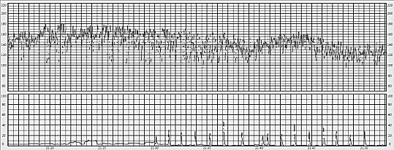
Increased variability (saltatory) | Bandwidth > 25 bpm for more than 30 min
Hypoxia/acidosis of rapid evolution

Slide 20
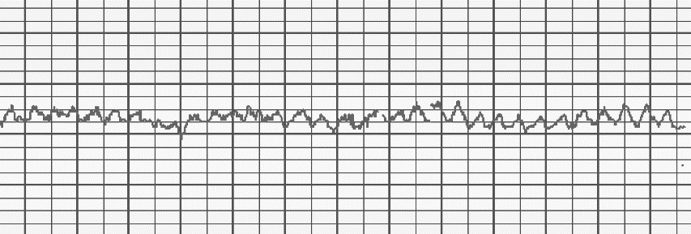
Sinusoidal pattern | Regular, smooth, undulating, resembling sine wave. Amplitude 5-15 bpm, frequency 3-5 cycles/min, > 30 min, no accelerations
Severe anemia, acute hypoxia/acidosis, infection, cardiac malformations, hydrocephalus, gastroschisis

Slide 21
Tracing classification
Baseline
Variability
Decelerations
Interpretation
Clinical Management
Normal
110-160 bpm
5-25 bpm
No repetitive* decelerations
Suspicious
Lacking at least one characteristic of normality, but with no pathological features
Pathological
< 100 bpm
Reduced variability. Increased variability. Sinusoidal pattern.
Repetitive* late or prolonged decelerations for > 30 min (or > 20 min if reduced variability). Deceleration > 5 min
No hypoxia/acidosis
No intervention necessary to improve fetal oxygenation state
Low probability of hypoxia/acidosis
Action to correct reversible causes if identified, close monitoring, or adjunctive methods
High probability of hypoxia/acidosis
Immediate action to correct reversible causes, adjunctive methods or if this is not possible expedite delivery. In acute situations, immediate delivery should be accomplished.
*Decelerations are repetitive when associated with > 50% contractions.
Absence of accelerations in labour is of uncertain significance.

Slide 22
Reversible causes

Slide 23
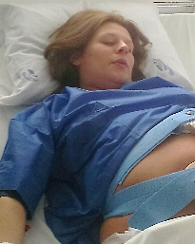
Excessive uterine activity
Maternal pushing aggravates the effect
↓ oxytocin
Acute tocolysis (salbutamol, atosiban, terbutaline, ritrodine, nitroglycerine)
Stop maternal pushing or push on alternate contractions

Slide 24
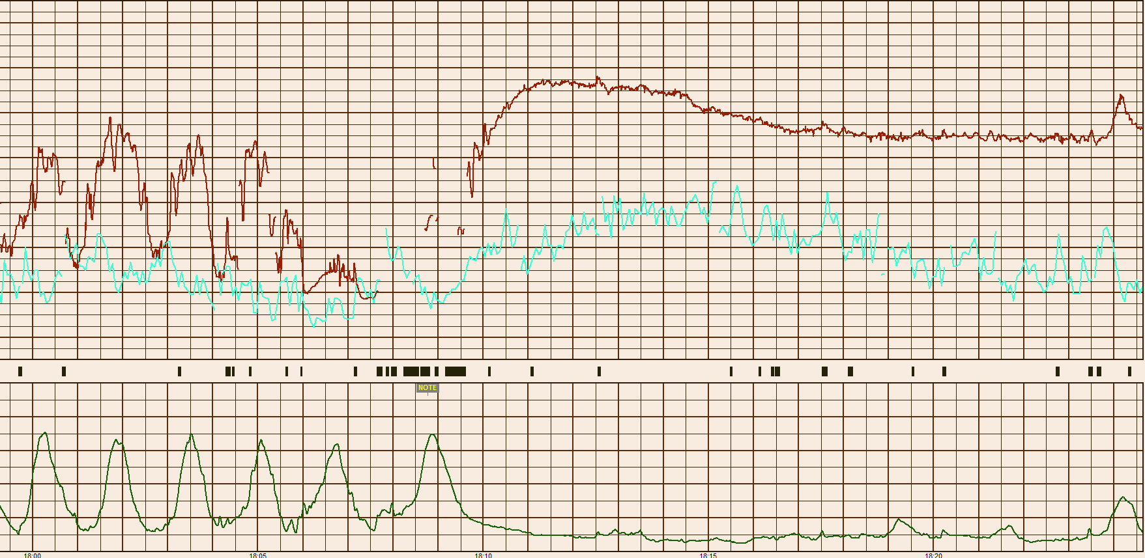
Start of salbutamol EV perfusion

Slide 25
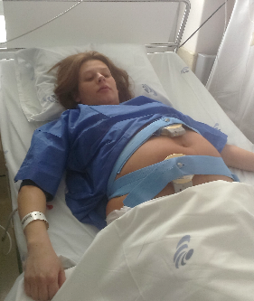
Maternal supine position
Aorto-caval compression by uterus
Turn patient on her side

Slide 26
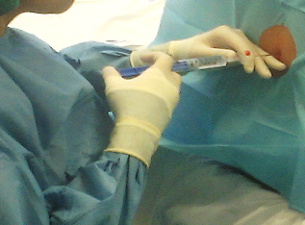
Sudden maternal hypotension
After epidural or spinal anaesthesia
Administer fluids rapidly
Ephedrine IV bolus

Slide 27
Irreversible causes

Slide 28
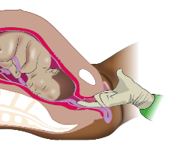
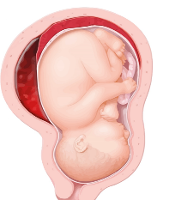
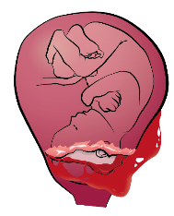
Umbilical cord prolapse
Major placental abruption
Uterine rupture

Slide 29
Some examples…

Slide 30
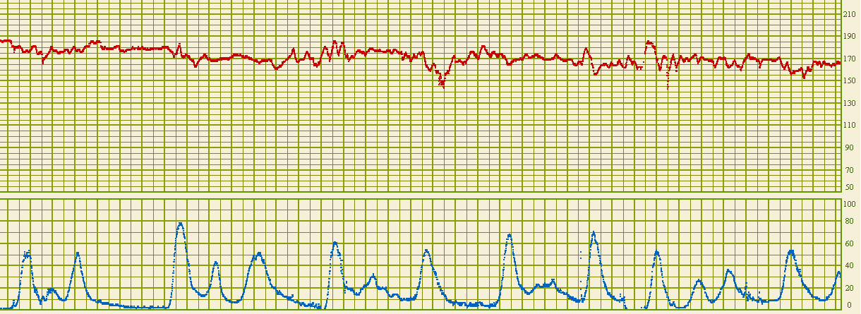
CASE 1
1 cm/min
Baseline 168 bpm
Accelerations
Deceleration (non-repetitive, early)
Normal variability
Suspicious

Slide 31
CASE 1
1 cm/min
Isolated tachycardia (epidural, maternal fever, infection)
Evaluate maternal temperature
Cool the room, paracetamol IV
Antibiotics if suspected bacterial infection

Slide 32
CASE 2
1 cm/min
Baseline 128 bpm
No accelerations
No decelerations
Borderline variability for 30 minutes
Normal

Slide 33
CASE 2
1 cm/min
Borderline variability (deep sleep, drugs)
Review administered drugs
Maintain monitoring
Fetal scalp stimulation

Slide 34
CASE 2
Deep sleep may last 50 min
Transitions between behavioural states represent adequate neurological responsiveness

Slide 35
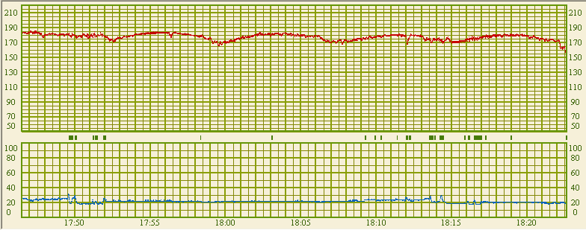
CASE 3
1 cm/min
Baseline 180 bpm
No accelerations
Repetitive late decelerations (> 30 min)
Reduced variability (requires 50 min)
Pathological

Slide 36
CASE 3
1 cm/min
↓ variability, shallow late decelerations (chronic hypoxemia)
Review administered drugs, fetal scalp stimulation
US – fetal biometry, AFI, umbilical Doppler
C-section

Slide 37
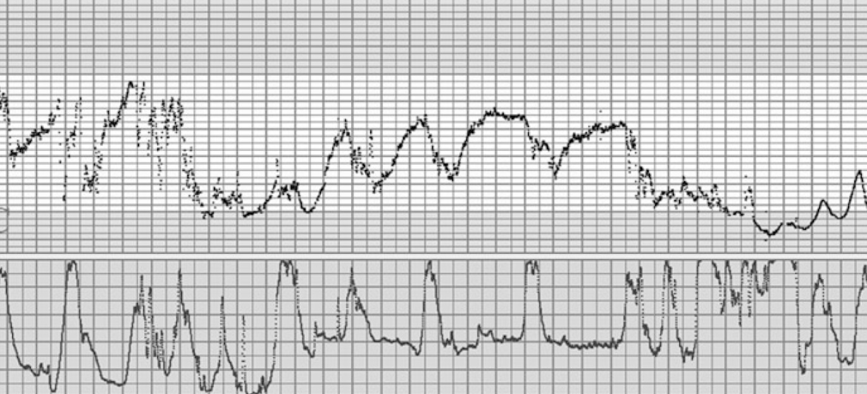
CASE 4
1 cm/min
Baseline 140 bpm
Accelerations
Repetitive late-prolonged decelerations (> 30 min)
Reduced variability (> 3 min in last deceleration)
Pathological

Slide 38
CASE 4
1 cm/min
Repetitive late-prolonged decelerations, ↓ variability
(recurring hypoxia – tachyssystole)
Stop oxytocin, tocolysis, turn on side, stop pushing
Await recovery of FHR before re-starting pushing
VE: if very favourable conditions – IVD

Slide 39
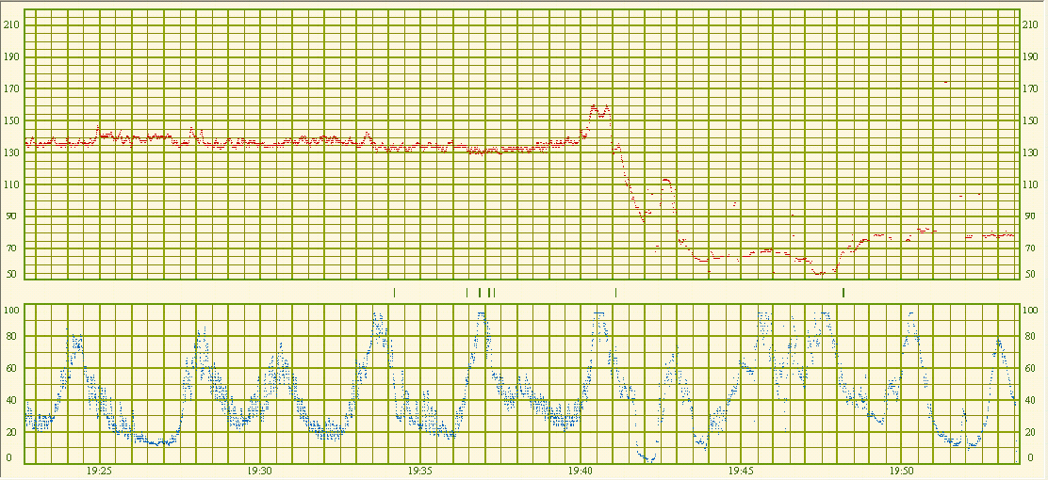
CASE 5
1 cm/min
Baseline 134 bpm
Acceleration
Prolonged deceleration (> 5 min, FHR< 80 bpm)
Reduced variability (> 3 min in deceleration)
Pathological

Slide 40
CASE 5
1 cm/min
Prolonged deceleration ↓ variability (acute hypoxia)
BP, VE, stop oxytocin and pushing, turn on side, tocolysis
If very favourable conditions – IVD
Otherwise crash c-section at 5-7 min
Earlier if VBAC, FGR, hemorrhage, no facilities for crash CS

Slide 41
The 2015 FIGO guidelines represent the largest consensus reached in the field
They are simpler, more objective, easier to remember, and incorporate management with a focus on reversible causes of hypoxia

