Slide 1
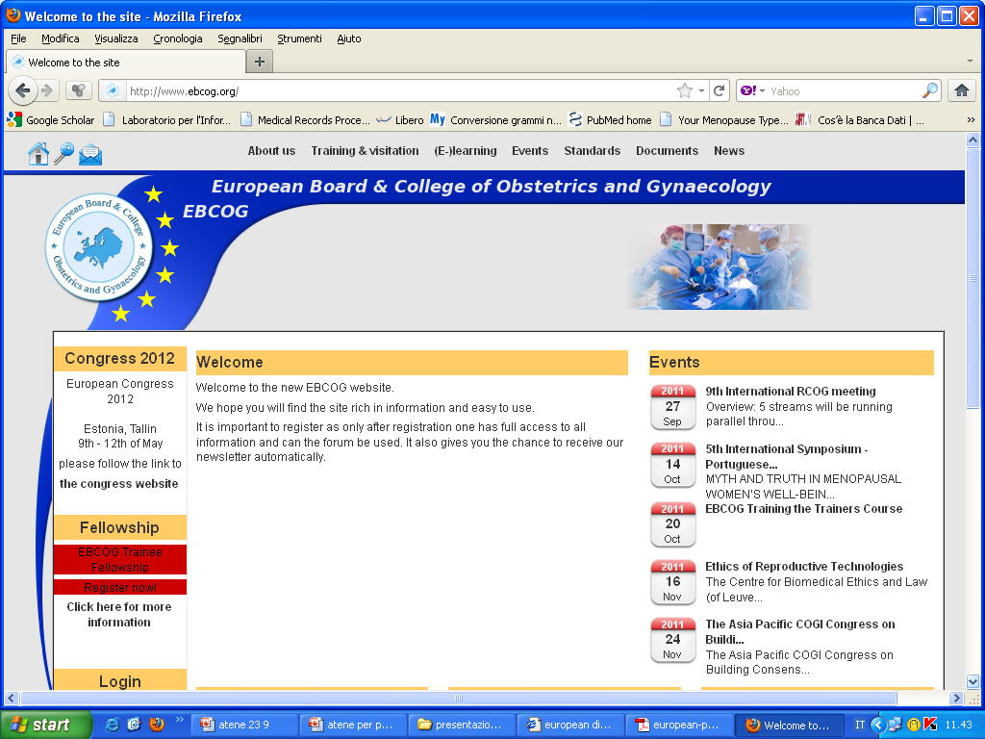
(
EBCOG Proposal to improve Standards of Care for Women
Dr Tahir Mahmood, CBE,
MD, FRCPI, FRCPE,MBA, FACOG, FRCOG
President European Board and College of Obstetrics &Gynaecology
International Session 20th May, 2017

Slide 2
Lay out of my Presentation
(
What are the challenges of Quality care in Europe?
EBCOG’s key initiatives for the Future

Slide 3
Discrepancies Across Europe
Obstetric Indicators
Maternal Mortality Rates: 2-200/100,000
Maternal Morbidity Rates:5.5-30/1000
IOL: 15-40%
CS rates: 15-42%
Perinatal Mortality rates: 6-22/1000
Gynecological Indicators
Hugely variable 5 yearly survival rates for Gynae Cancers
Variable QA of ART leading to high multiple pregnancy rates
Access to contraception choices
Cancer Screening Policies

Slide 4

CAUSES of Maternal Deaths in different settings
Higher MMR
group (n=160)
Lower MMR
group (n=130)
χ²
Cause of direct maternal death
%
%
Hypertensive disorders
21.4
35.6
14.16, p=0.015
Haemorrhage
30.2
16.1
Thromboembolism
23.0
27.6
Infection
13.5
9.2
Other direct cause
11.9
11.5
Wildman; BJOG; 2004

Slide 5
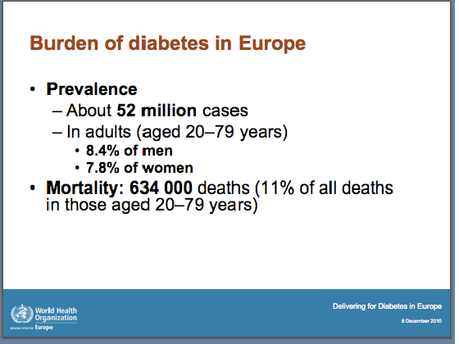

Slide 6
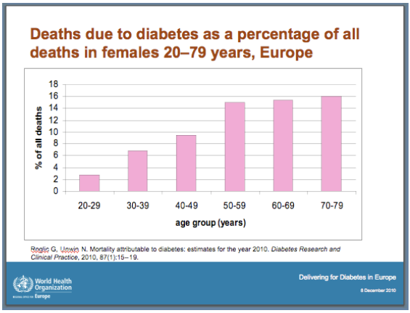

Slide 7
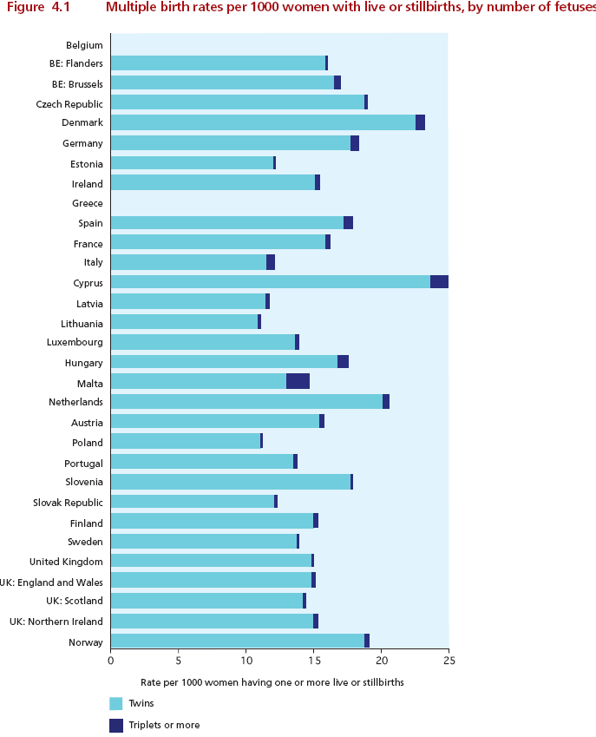
Multiple Birth Rates per 1000 Women

Slide 8
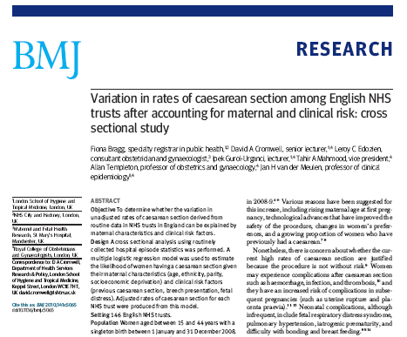
Caesarean section article

Slide 9
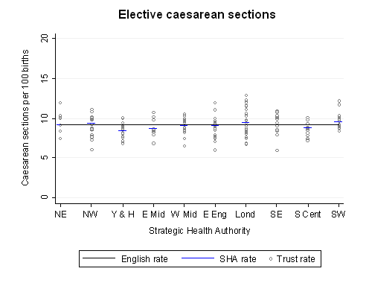

Slide 10
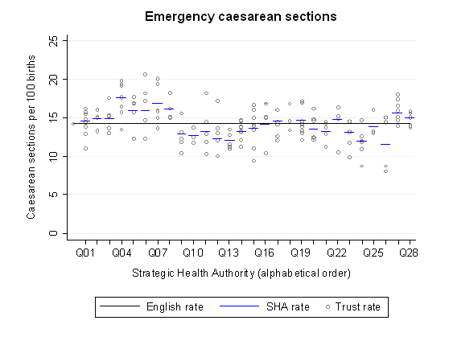

Slide 11
Figure 3: Proportion of rate of elective caesarean sections performed after 39 weeks in
NHS trusts between April 2000 and February 2009, by financial year. Overall proportion for all women is shown as bars (and values) for comparison.

Slide 12
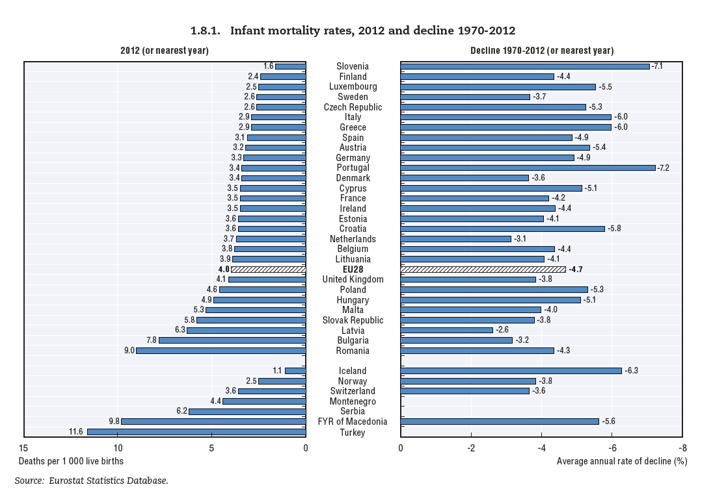

Slide 13
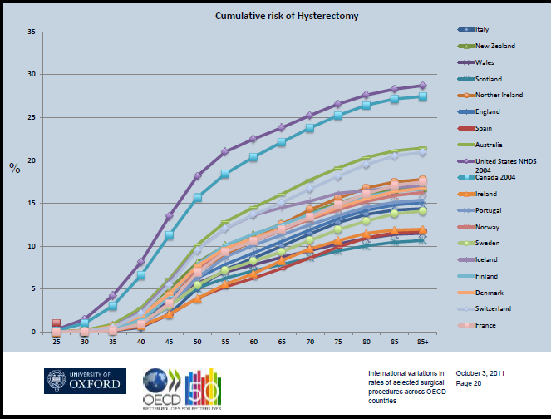

Slide 14

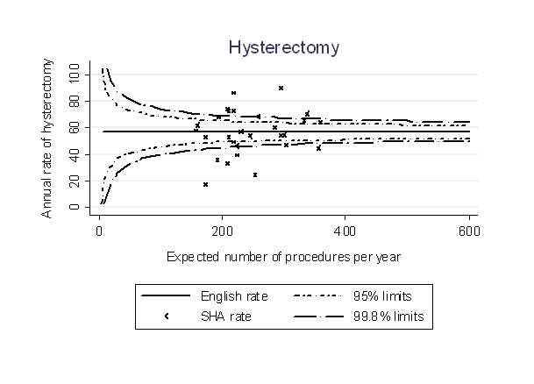
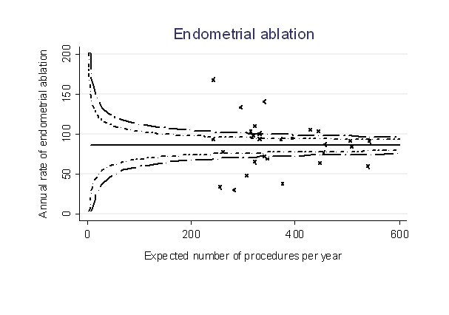

Slide 15


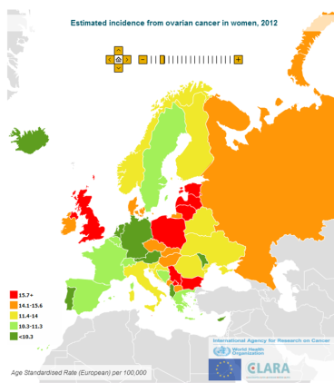
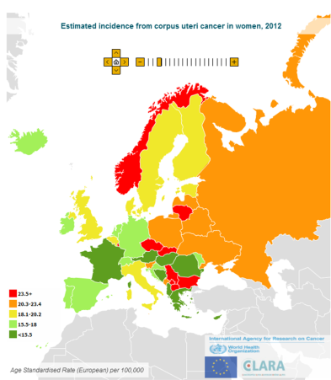
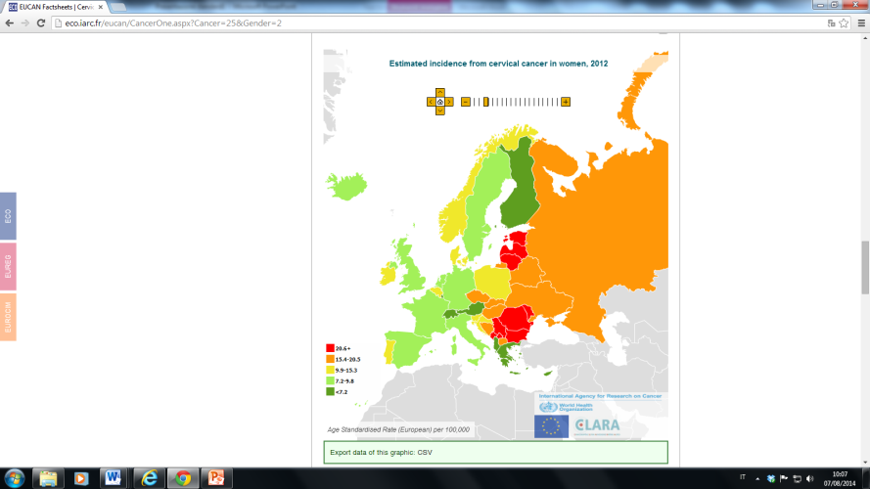
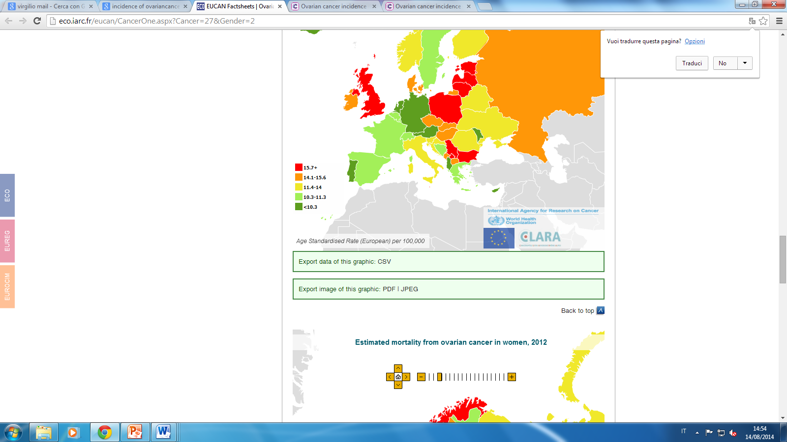
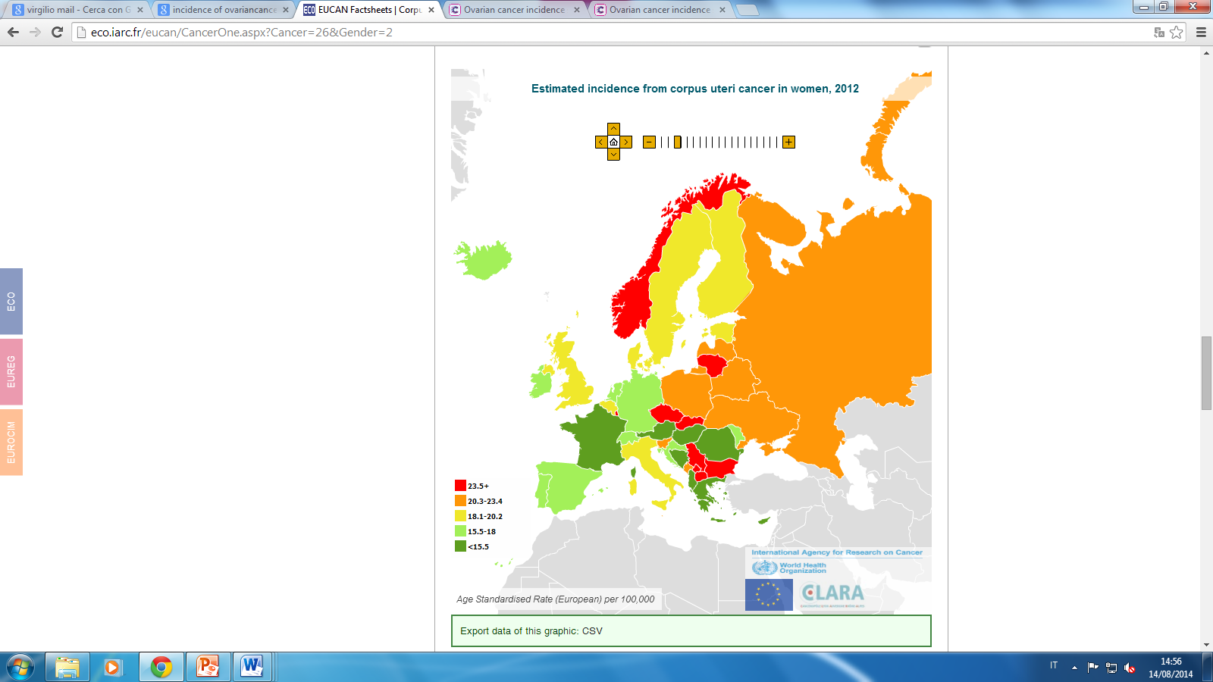
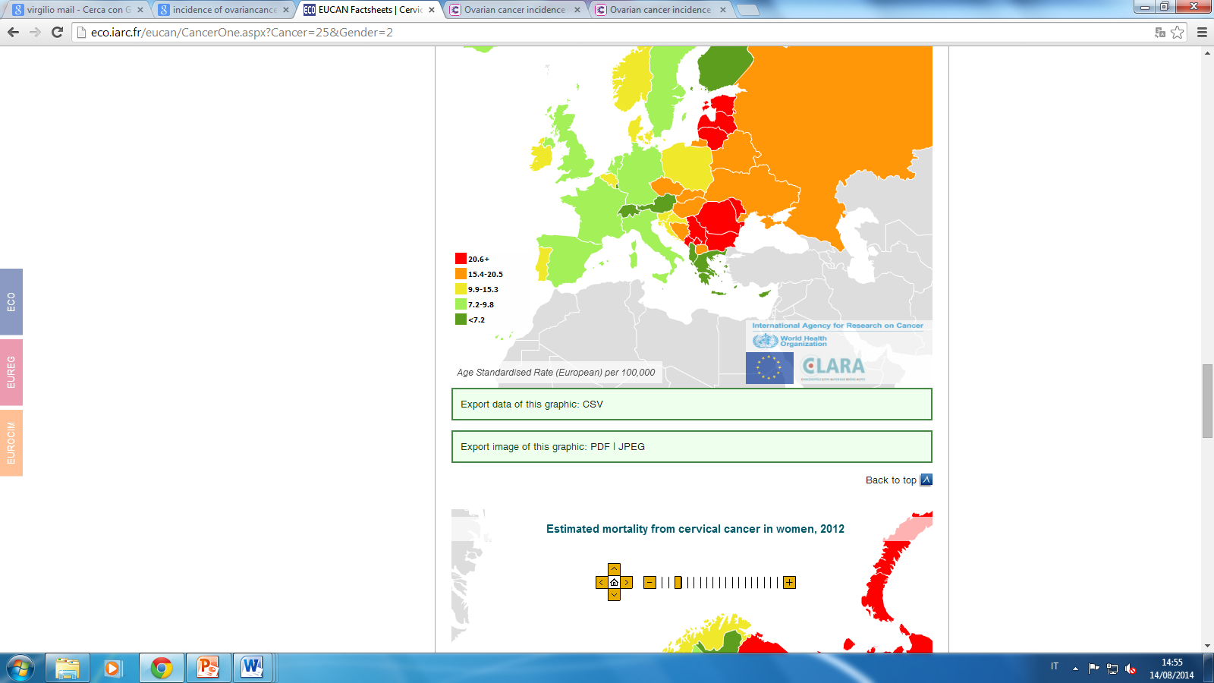
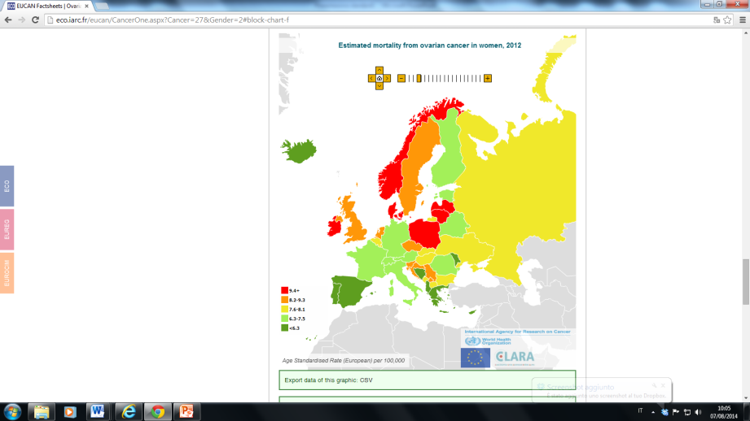
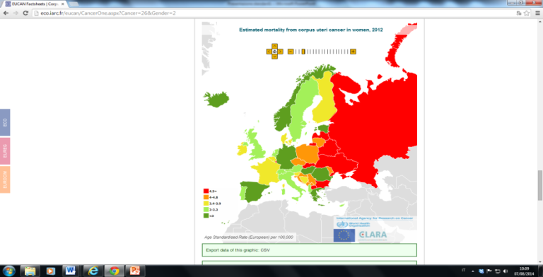
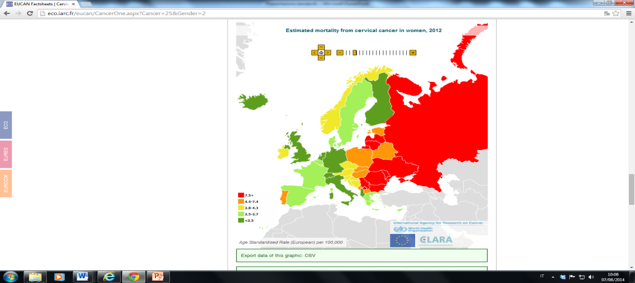
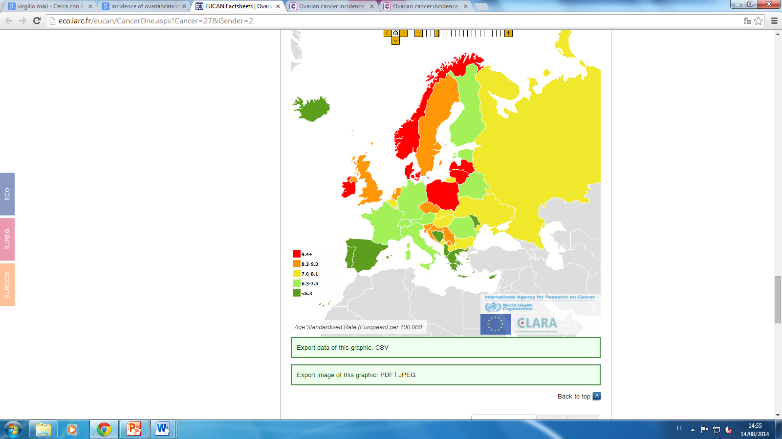
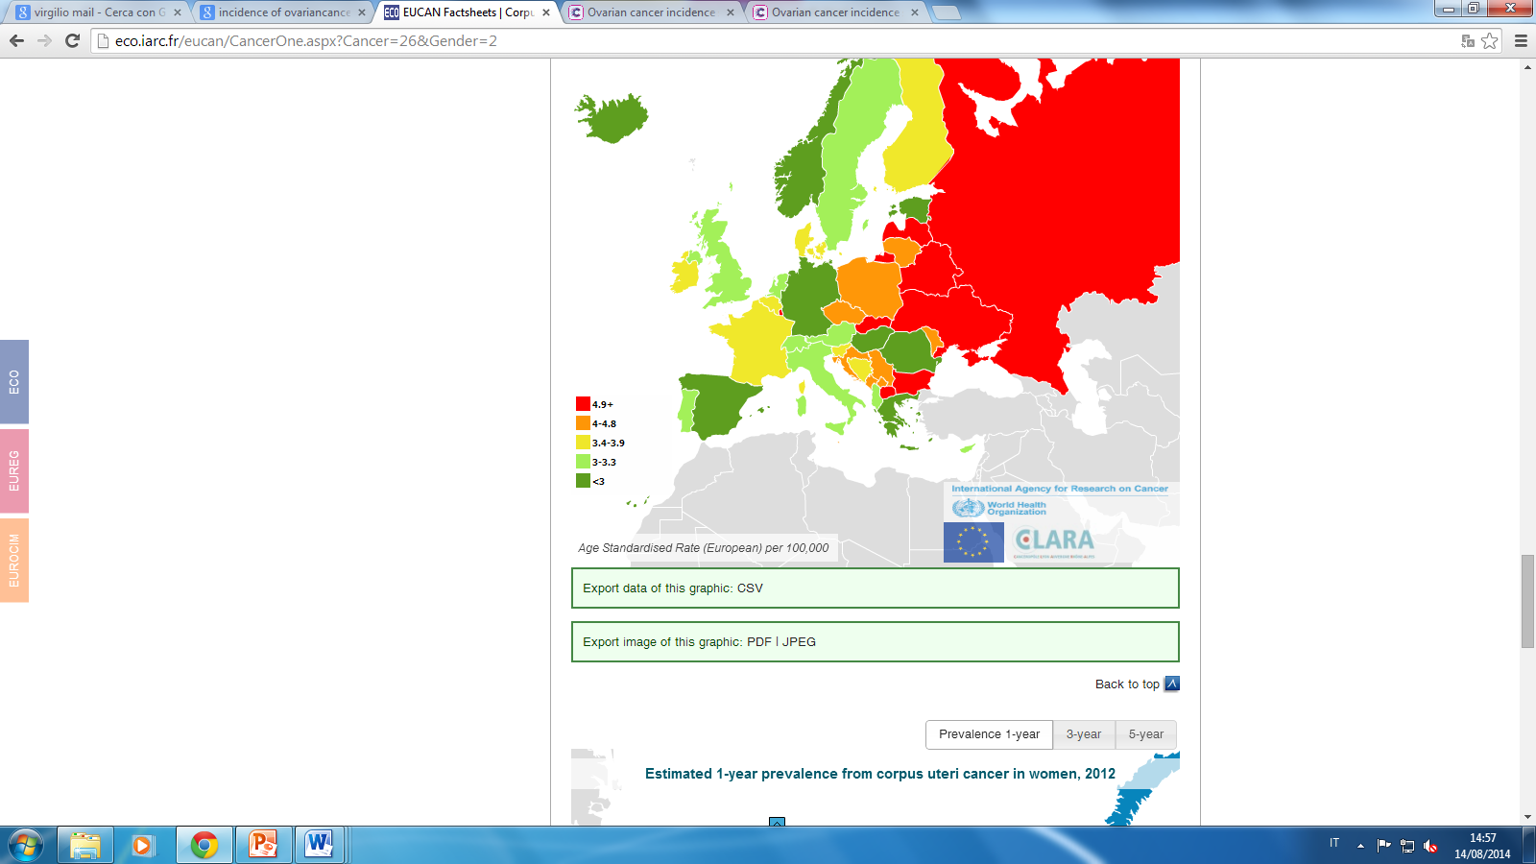
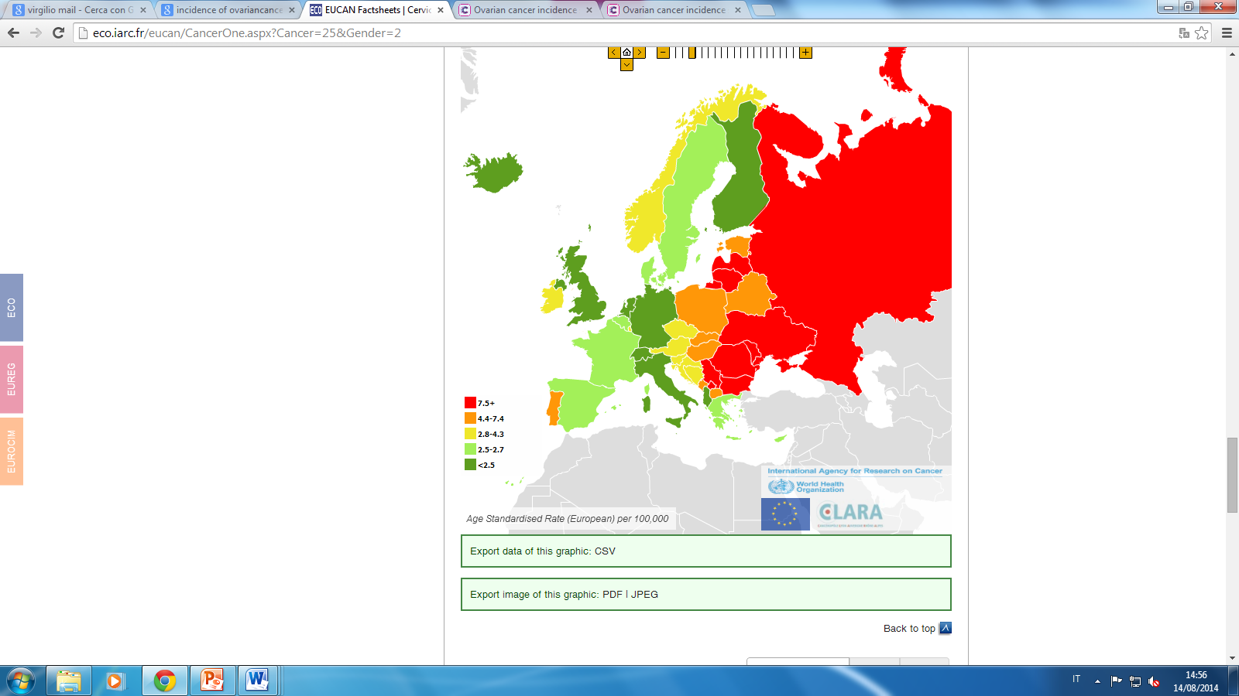
Standards of Care for Women’s Health in Europe
ESTIMATED INCIDENCE and MORTALITY RATES for OVARIAN, ENDOMETRIAL and CERVICAL CANCER in WOMEN
OVARIAN CANCER
ENDOMETRIAL CANCER
CERVICAL CANCER
Incidence
Incidence
Incidence
Age Standardised Rate/100,000
Age Standardised Rate/100,000
Age Standardised Rate/100,000
Mortality
Mortality rate
Mortality rate
Age Standardised Rate/100,000
Age Standardised Rate/100,000
Age Standardised Rate/100,000
WHO, 2012

Slide 16
EBCOG’ Strategy to improve Outcome measures for Women’s Health

Slide 17
Making quality the organising principle of the Health Service
Bring clarity
to quality
Measure quality
Publish quality
performance
Recognise & reward
quality
Clinical Quality Indicators
Raise standards
Safeguard quality
Stay ahead

Slide 18


Slide 19
Rationale For Developing Quality Indicators
A set of Quality indicators could be used for:
  PERFORMANCE ASSESSMENT (to monitor that minimum levels of standards are met)- Quality Improvement Tool
  QUALITY IMPROVEMENT (to highlight where improvements in obstetric or Gynaecological care might be made)- Individual and Provider units Comparison
  PATIENT Experience (As a service improvement tool )
  RESEARCH AND CLINICAL AUDIT

Slide 20
EBCOG’ Strategy to improve Outcome measures
Standards of Care Documents
Position statements on Public Health Issues
Advocacy Campaign
Working with other stakeholders- FIGO, UNFPA, WHO, EU Commission

Slide 21

Standards of Care for Women’s Health in Europe (www.ebcog.eu)
EBCOG has developed Standards of Care for
Obstetrics and Neonatal Services
Gynaecology Services

Slide 22


Russian Translation done with the help of UNFPA and RSOG

Slide 23



Slide 24
What is a Standard Of Care?
(
The Standards have been derived from the evidence based guidelines as a tool for measurement.
The Standards of Care focus on the safety, care, dignity and treatment of patients.
They reflect the Care that a Health Service and prudent Healthcare Professional should provide in order to be effective and safe for the patient.

Slide 25


Standards of Care for Women’s Health in Europe
The following is the complete list of the STANDARDS for OBSTETRIC and NEONATAL SERVICES:
STANDARD 1 Generic Standards of Care for Maternity Services
STANDARD 2 Pre-Conception Services
STANDARD 3 Early Pregnancy Emergency Services
STANDARD 4 Antenatal Care
STANDARD 5 Antenatal Screening
STANDARD 6 Care of Pregnant Women with Pre-existing Medical Conditions and/or
Special Needs
STANDARD 7 Care of Pregnant Women with Mental Health Conditions
STANDARD 8 Care of Women Developing Medical Conditions during Pregnancy
STANDARD 9 Care of Obese Pregnant Women
STANDARD 10 Prevention of Preterm Birth
STANDARD 11 Intrapartum Care
STANDARD 12 Infection Prevention and Control
STANDARD 13 Maternal Mortality and Morbidity associated with Childbearing
STANDARD 14 Post-natal Care of the Mother
STANDARD 15 Neonatal Care
STANDARD 16 Rationalising Care of Babies Born Prematurely
STANDARD 17 Supporting Families who Experience Pregnancy Loss
STANDARD 18 Routine Data Collection for Pregnancy and Childbirth

Slide 26


Standards of Care for Women’s Health in Europe
The following is the complete list of the STANDARDS for GYNAECOLOGY SERVICES:
STANDARD 1 Generic Standards for the Provision of Gynaecology Services
STANDARD 2 Emergency Gynaecology, Acute Abdominal Pain in Women
STANDARD 3 Early Pregnancy Loss
STANDARD 4 Recurrent Miscarriage
STANDARD 5 Pelvic Inflammatory Disease (PID)
STANDARD 6 Vulvovaginitis
STANDARD 7 Contraception and Sexual Health
STANDARD 8 Male Contraception
STANDARD 9 Safe Termination of Pregnancy
STANDARD 10 Paediatric and Adolescent Gynaecology (PAG)
STANDARD 11 Heavy Menstrual Bleeding
STANDARD 12 Chronic Pelvic Pain
STANDARD 13 Benign Vulval Diseases
STANDARD 14 Menopause and Hormonal Therapy
STANDARD 15 Benign Breast Pathology
STANDARD 16 Breast Cancer Screening
STANDARD 17 Cervical Cancer Screening
STANDARD 18 Gynae-Oncology Services, including Breast Cancer
STANDARD 19 Infertility and Assisted Conception
STANDARD 20 Urogynaecology
STANDARD 21 Ultrasound Scanning in Gynaecological Practice
STANDARD 22 Colposcopy
STANDARD 23 Diagnostic and Operative Hysteroscopy
STANDARD 24 Laparoscopic Surgery
STANDARD 25 Robotic Surgery

Slide 27
Lay Out Of a Standard
Standards of Care for Women’s Health in Europe
Rationale
Patient Focus
Accessibility
Environment
Process
Staffing and Competence
Training Standards
Auditable Standards

Slide 28

Standards of Care for Women’s Health in Europe
Standards of Care for Women’s Health in Europe
Standards of Care for Women’s Health in Europe
Standards of Care for Women’s Health in Europe
EXAMPLE
STANDARD 11
Heavy Menstrual Bleeding
Rationale
Menstrual disorders are the commonest presentation to gynecological clinics which interfere with a woman’s physical, social, emotional wellbeing and negatively impacts on quality of life.
Women’s health services should clearly set out management strategies for excessive menstrual bleeding.

Slide 29
Standards of Care for Women’s Health in Europe
Standards of Care for Women’s Health in Europe
Standards of Care for Women’s Health in Europe
Standards of Care for Women’s Health in Europe
EXAMPLE
STANDARD 11
Heavy Menstrual Bleeding
Patient Focus
1.2 Women should have access to clear and unbiased information which includes all diagnostic and treatment options, their outcomes and complications.
1.3 Women with heavy menstrual loss should have the opportunity to make an informed decision about their management with a primary aim of improving quality of life.
1.4 Services should be customised to meet the needs for special groups such as adolescents and peri-menopausal women and those from different ethnic background.
1.5 Treatment should be based on a woman’s own subjective evaluation and the impact on her quality of life.

Slide 30
Standards of Care for Women’s Health in Europe
Standards of Care for Women’s Health in Europe
Standards of Care for Women’s Health in Europe
Standards of Care for Women’s Health in Europe
EXAMPLE
STANDARD 11
Heavy Menstrual Bleeding
Accessibility
2.1
2.2 Local protocols, derived from the best available evidence, should be agreed and incorporated into the referral care pathways. A time-frame should be set to manage the
problem effectively.
2.3 Women should have access to all modalities of managing excessive menstrual loss and appropriate referral to a specialist centre may be required.
2.4.

Slide 31
Standards of Care for Women’s Health in Europe
Standards of Care for Women’s Health in Europe
Standards of Care for Women’s Health in Europe
Standards of Care for Women’s Health in Europe
EXAMPLE
STANDARD 11
Heavy Menstrual Bleeding
Environment
3.1 Development of “one stop” services, with facilities for ultrasound scanning and outpatient hysteroscopy should be encouraged.
3.2 Facilities for insertion of Levonorgestrel-releasing Intrauterine System (LNG-IUS), should be available in both primary and hospital care settings.

Slide 32
Standards of Care for Women’s Health in Europe
Standards of Care for Women’s Health in Europe
Standards of Care for Women’s Health in Europe
Standards of Care for Women’s Health in Europe
EXAMPLE
STANDARD 11
Heavy Menstrual Bleeding
Process
4.3 A multidisciplinary approach including haematological advice should be sought for the management of adolescents without obvious pathology suffering from heavy menstrual bleeding, particularly if presenting since menarche
4.4. Services should be able to provide a range of therapeutic modalities including least invasive ones such as LNG-IUS, second generation endometrial ablation hysteroscopic surgery, and Uterine Artery Emobilisation (UAE) is an option when available.
4.7..
4.8 Hysterectomy should be considered only if the woman has not responded to other treatments or declines other options after appropriate counseling.

Slide 33
Standards of Care for Women’s Health in Europe
Standards of Care for Women’s Health in Europe
Standards of Care for Women’s Health in Europe
Standards of Care for Women’s Health in Europe
EXAMPLE
Staffing and Competence
5.1 Gynaecology units should ensure competency/accreditation of staff involved in the management and those providing treatment modalities for heavy
menstrual bleeding including insertion of LNG-IUS, laparoscopic surgery and imaging and radiological procedures.
5.2
5.3 Maintenance of surgical and imaging skills requires regular assessment and evaluation including audit of the number of procedures performed by operators.
5.4

Slide 34
Standards of Care for Women’s Health in Europe
Standards of Care for Women’s Health in Europe
Standards of Care for Women’s Health in Europe
Standards of Care for Women’s Health in Europe
EXAMPLE
Training Standards
6.1
6.2 The trainee should attend hands on training courses in diagnostic and operative hysteroscopy, insertion of LNG-IUS, ultrasound scanning and second
generation endometrial ablation techniques.
6.3 The trainees should demonstrate their competence in diagnostic and operative procedures by maintaining a log book of all the procedures performed
and peri- operative outcomes.
6.4 Trainees wishing to learn advanced laparoscopic surgical techniques should be rotated to units with adequate work load.
.

Slide 35
Standards of Care for Women’s Health in Europe
Standards of Care for Women’s Health in Europe
Standards of Care for Women’s Health in Europe
Standards of Care for Women’s Health in Europe
EXAMPLE
Auditable Standards
7.2
7.3 Audit of the gynaecology unit’s surgical activity and complications.
7.4 Audit of randomly selected case notes to ascertain that women were counselled as regards possible intra-operative and post-operative complications.
7.5 Audit of patient satisfaction for each modality and for the service provided.
7.6

Slide 36




EBCOG VISION FOR Women’s Services IN EUROPE:
ADOPTION of the STANDARD of CARE/TRAINING
PATIENT’S SAFETY
minimum
dataset
European
Curriculum
European Wide Quality Assurance System
European
monitoring
centre
European-wide
CPD Programme
EU Professional Card/EFOG Examination

