Slide 1
International Educational Opportunities for Ob&Gyn Trainees in Europe
Agnieszka Horała, Laura Spinnewijn
ENTOG Executive Members
Antalya, 19th May 2017
Notes:
European Network of Trainees in Obstetrics and Gynecology
3 speerpunten

Slide 2
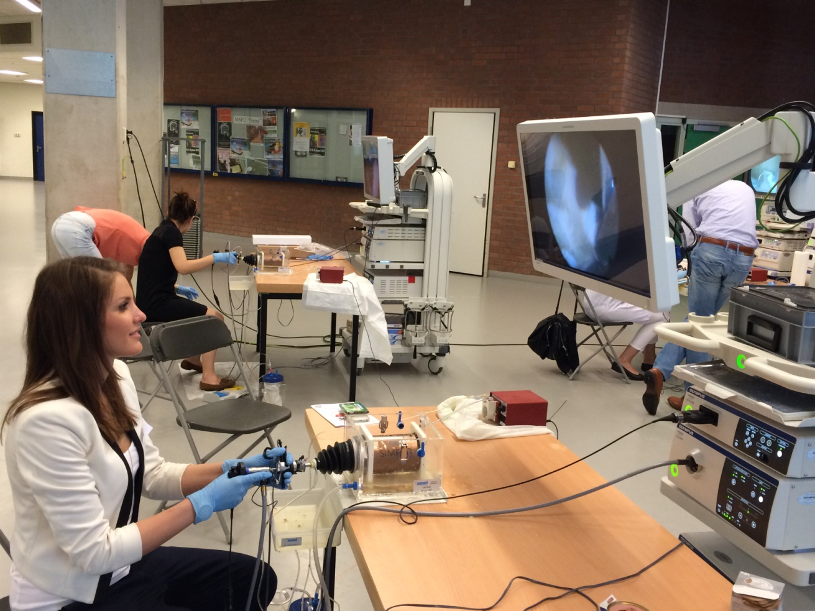
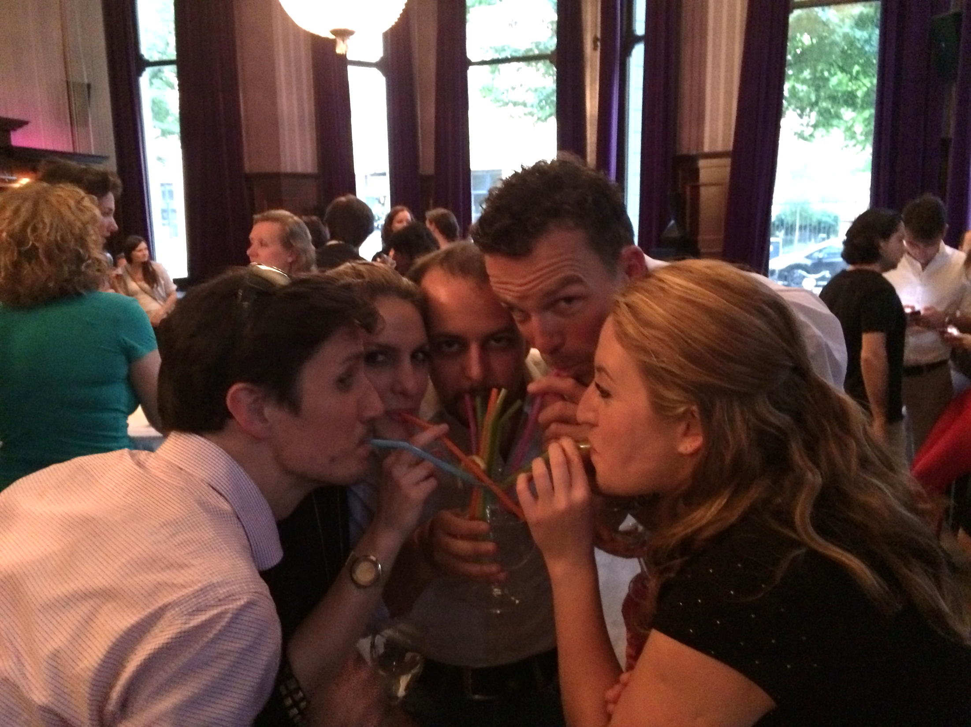
ENTOG Exchange
www.entog.eu -> ENTOG Exchange
Every year,
3 days hospital exchange, 1 day congress, 1 day council
Every 2 years EBCOG congress

Slide 3
ENTOG Exchange 2017

Slide 4
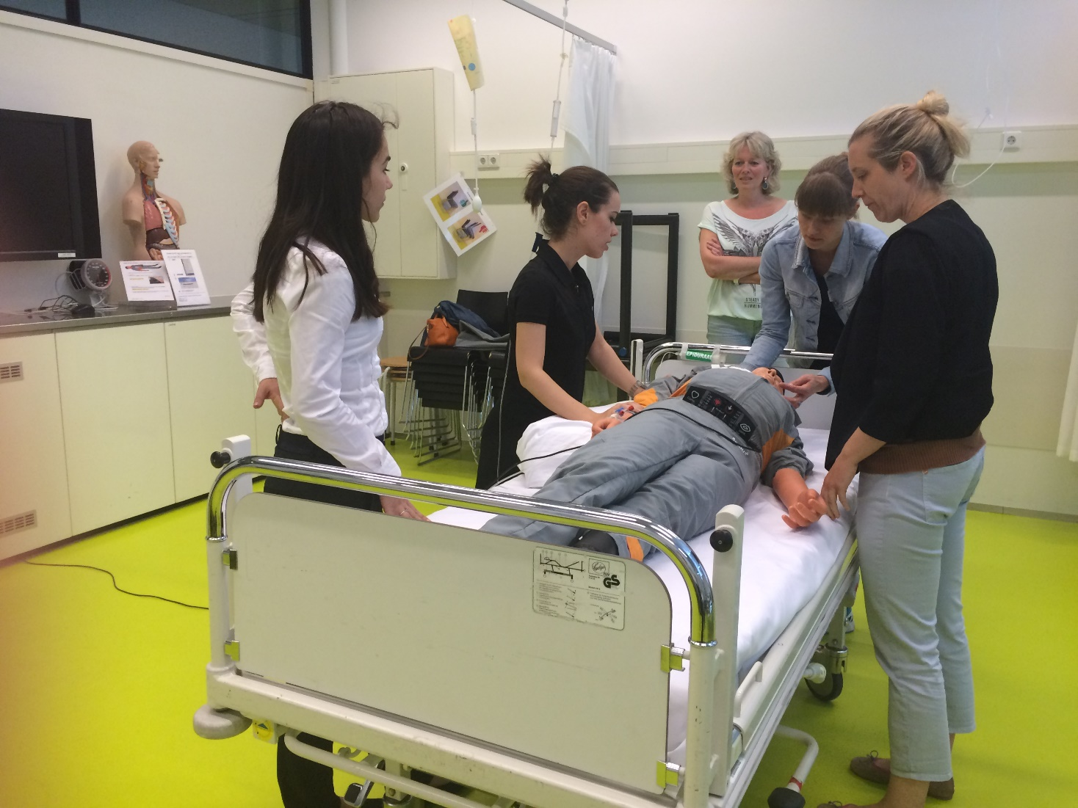
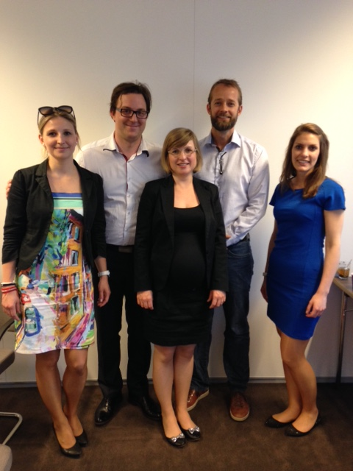
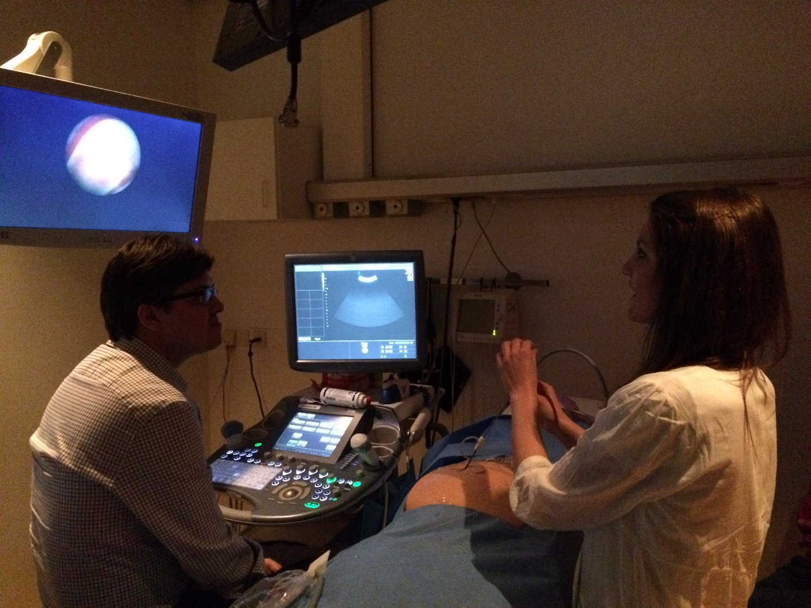
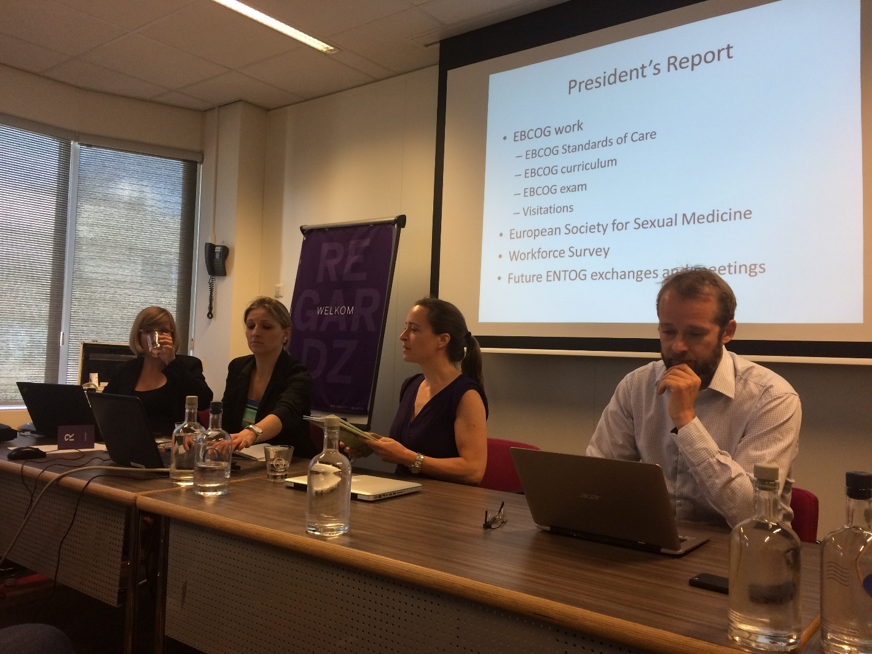
ENTOG Exchange 2015

Slide 5
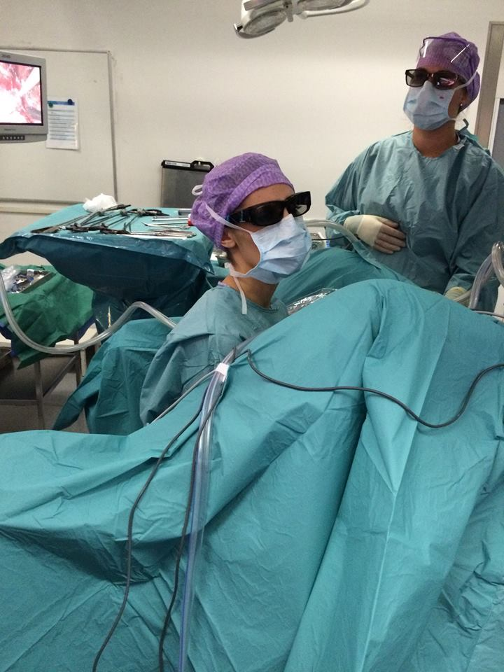
EBCOG Fellowship
www.entog.eu
-> Projects
Scholarship 3000EUR:
→3 months in a foreign country
Deadline for applications
1st of March (every year)

Slide 6
Fellowship in Russia
Independent visits
up to 4 weeks within the year 2017
contact Dr. Ekaterina Yarotskaya, inter_otdel@mail.ru
More info www.entog.eu
Notes:
unique offer from the Russian Society of Obstetricians and Gynecologists and the Research Center for Obstetrics, Gynecology and Perinatology, Moscow, Russia.

Slide 7
ESGE
Full-length Endoscopic training program: hands-off/hands-on
(GESEA)
www.europeanacademy.org
Free e-learning modules
Notes:
European Society of Gynaecological SurgeryThe full programme is called Gynaecological Endoscopic Surgical Education and Assessment (GESEA).
Free e-learning training and self-evaluation for the Bachelor Level at EAGS
well-balanced diploma curriculum, based on the current best scientific knowledge.

Slide 8
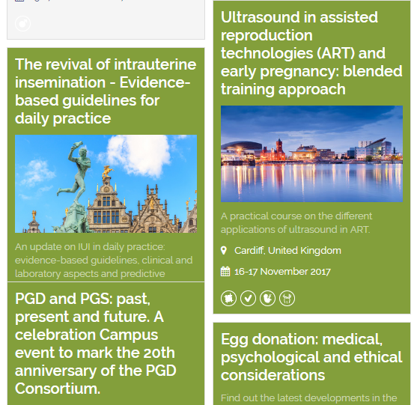
ESHRE
Membership 30EUR/year
ESHRE research grant up to €150,000
e-learning modules
International congresses
Notes:
European Society of Human Reproduction and Embryology

Slide 9
ENYGO/ESGO
Membership: 40-150EUR/year
Travelling Fellowship
6-month fellowship in gynaecological oncology
(october 2017: The Cancer Centre Barts and The Royal London Hospital) .
ESGO-ENYGO eMasterclass in Gynaecological Oncology

Slide 10
EUGA (and IUGA)
International fellowship in urogynecology: 12 months, unpaid; at least in advanced training stages (Both EUGA/IUGA)
E-learning (IUGA)
Notes:
International / European urogynecology association

Slide 11
EAPM
(Mostly postgraduate) courses
Connected to PREIS school
Notes:
European Association of perinatal medicine

Slide 12
ISUOG
2 year free trainee membership.
Notes:
International Society of Ultrasound in Ob&Gyn
When interested keep connected

Slide 13
Open Call for Fistula Surgery Fellowship Applications

Slide 14
WHO
WHO internships at Headquarters - Geneva
six to twenty four weeks
unpaid

Slide 15
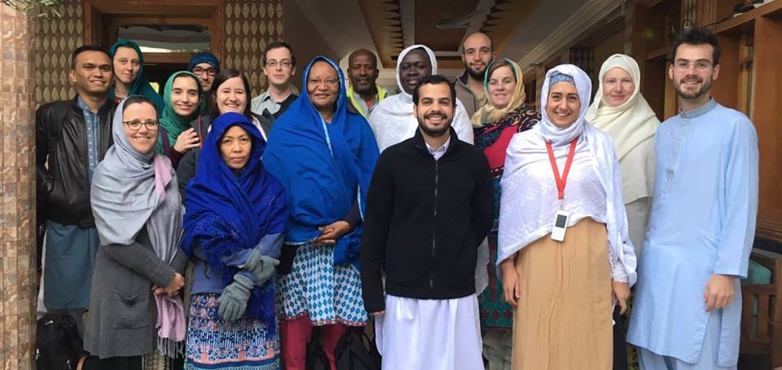
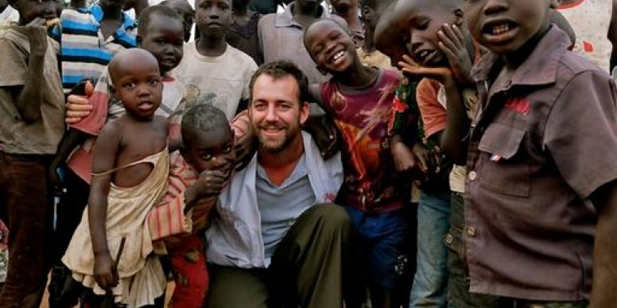
Experience required (ob/gyn; tropical)
9 to 12 months (Ob/gyn shorter; 2-3 months)
Language skills (French!)

Slide 16
Just Be Creative!
Networking and informing….
Through existing training programs
Through congresses
Through local contacts
Through research
Looking for opportunities within your training program:
Actual training abroad: the Belgian example

Slide 17
Suggestions?

Slide 18
www.entog.eu
executive@entog.eu
www.facebook.com/ENTOG

