Slide 1
SURGERY VERSUS IVF FOR ENDOMETRİOSİS
Assoc.Prof.Semra KAYATAŞ ESER, M.D.
Zeynep Kamil Women and Children’ Health Training and Research Hospital

Slide 2
Endometriosis and Infertility
Fertil population:2-10% of women have endometriosis
Subfertile population:30-50% of women have endometriosis
17-44% of women with endometriosis have endometrioma
Fecundity rate:
Normal Couples: %15-20
Endometriosis:% 2-10
(ASRM,2004)

Slide 3
Endometriosis and Infertility,Pathophysiology
Pelvic anatomy distorsion
Inflammatory and oxidative damage
Impaired endometrial receptivity, implantation
Ovulatory dysfunction
Endocrine disorders
Decreased oocyte and embryo quality
Tubal motility dysfunction
H
Hamdan et al, 2015

Slide 4
Treatment Modalities
Medical treatment
Surgical treatment
Expectant management(natural conception)
Ovulation induction with IUI
Assisted Reproductive Technology

Slide 5
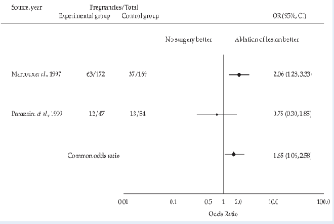
Stage 1 - 2 Endometriosis Surgical Treatment
Laparoscopic treatment of stage 1-2 endometriosis
increases live birth and ongoing pregnancies
Study from Canadian (ENDOCAN)
Canadian(ENDOCAN)Multicenter
N=172 laparoscopic surgery
N=169 diagnostic laparoscopic
PR: %29 in LS GR & %17 CONTROL
Significant
(Marcoux et al., 1997)
Study from Italy
Multicenter
N=54 laparoscopic surgery
N=47 diagnostic laparoscopic
LBR: %20 & %22
Not significant
(Parazzini et al., 1999)
Duffy JM,et al. Cochrane Database Syst Rev 2014

Slide 6
LBR is higher in complete diathermy group

Slide 7
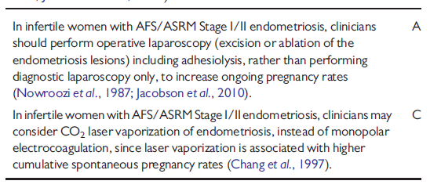
ESHRE guideline: management of women with endometriosis
Human Reproduction,Vol.29, No.3 pp.400-412,2014

Slide 8
Stage 1 - 2 Endometriosis ART Treatment
Wait 3-6-12 months for natural conception, then 3-4 cycles OI-IUI, then ART
Wait 3-6-12 months for natural conception, then ART
3-4 cycles OI-IUI, then ART
Direct ART
Decide according to age and other prognostic factor
Notes:
In younger women (under age 35 years) with stage I/II endometriosis-associated infertility, expectant management or SO/IUI can be considered as first-line therapy.
For women 35 years of age or older, more aggressive treatment, such as SO/IUI or IVF may be considered.

Slide 9
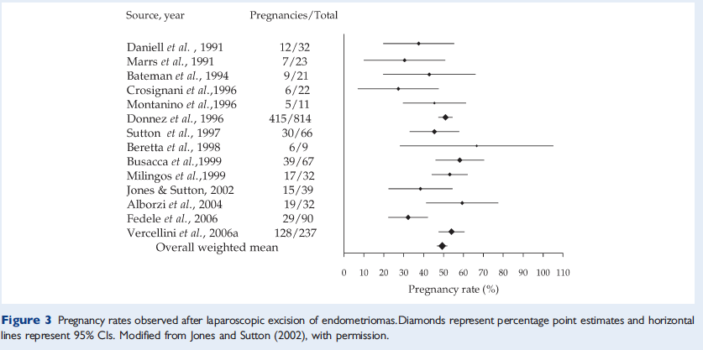
Stage 3-4 Endometriosis
No RCT, meta-analysis
Following Laparoscopic surgery PR :%50 (%30-67)
Vercellini et al., 2009

Slide 10
Stage does not have any impact

Slide 11
Endometrioma decreases ART success
Pregnancy and ongoing pregnancy rates are higher in group without endometrioma whereas total gonadotropin dose was higher in group with endometrioma

Slide 12
2005
4cm endometrioma ➔ SURGERY
Increased spontaneous pregnancy
Increased response to COH
Easier OPU
Decreased pelvic infection risk

Slide 13
2013
> 3 cm endometrioma
With concomittant pelvic pain ➔ surgery
Increased spontaneous pregnancy
Increased response to COH
Easier OPU
Decreased pelvic infection risk

Slide 14
Disadvantages to perform surgery
Decreased ovarain reserve
Serum AMH descreases
Decreased AFC
Raffi et al., 2012; Somigliana et al., 2012 Goodman 2016
Decreased spontanous ovulation following surgery
Loh et al., 1999; Candiani et al., 2005; Horikawa et al., 2008
Decreased response to COH
Gupta et al.,2006; Somigliana et al., 2011

Slide 15
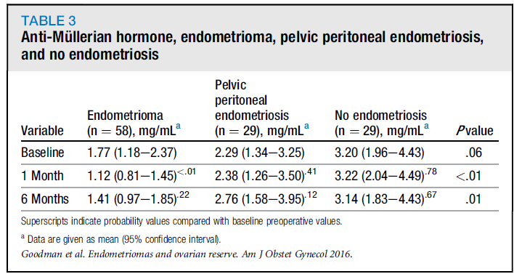
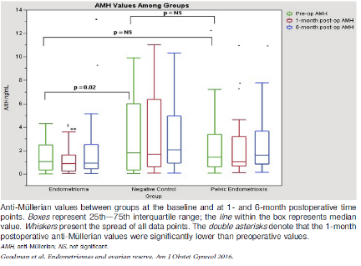
Effect of surgery on ovarian reserve in women with endometriomas, endometriosis and controls
At baseline, patients with endometriomas had significantly lower anti-Mu¨ llerian hormone values compared with women without endometriosis. Surgical excision of endometriomas appears to have temporary detrimental effects on ovarian reserve
Goodman L, AJOG2016

Slide 16
The post-operative decline in serum anti-Müllerian hormone correlates with the bilaterality and severity of endometriosis
The decrease in ovarian reserve should be taken into account in patients indicated for cystectomy for bilateral endometriomas or unilateral endometrioma with high rASRM scores
Hirokawa, Hum Reprod, 2011

Slide 17
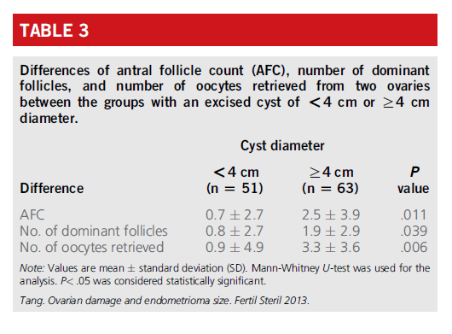
Yan Tang Fertil Steril 2013

Slide 18
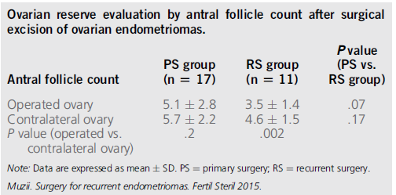
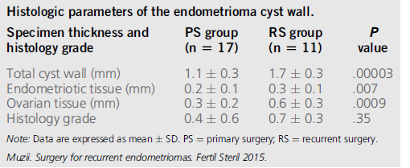
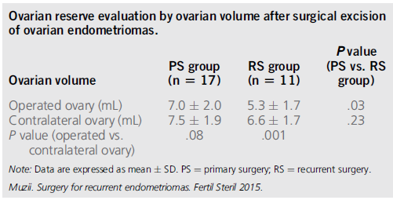
Surgery for recurrent endometriomas is associated with evidence of a higher loss of ovarian tissue and is more harmful to the ovarian reserve evaluated by AFC and ovarian volume, if compared with endometriomas operated for the first time. Indications to surgery for recurrent endometriomas should be reconsidered with caution.
Muzzii L, Fertil steril 2015

Slide 19
Demirol et.al.RBM Online 2006
Effect of endometrioma cystectomy on IVF outcome: a prospective randomized study
Ovarian surgery resulted in longer stimulation, higher FSH requirement
and lower oocyte number, but fertilization,
pregnancy and implantation rates did not differ between the groups.

Slide 20
Surgical risks
Major ( 1,4%)
Vascular
Intestinal
Anesthesia-related
Minor (7,5%)
Surgical site infection
Ekstraperitoneal insuflation
Chapron et.al,2002

Slide 21
Detrimental effect of surgery on the ovarian reserve !!!
No evidence for the beneficial effect of surgery on the fertility outcome !!!

Slide 22
Risks of conservative management
Oocyte quality may be affected
Opu procedure may become complicated
- İnfection
- Follicular fluid contamination
- Visceral injury
Endometriomas may affect response to COH
Risk of pregnancy complication
Malignancy
Progression of endometriosis
Somigliana et al,2015

Slide 23
Is there any decrease in oocyte quality?
Free iron decreases oocyte quality
(sanchez et al,2014)
Retrospective studies ( 2 major studies)
(Ashrafi et al., 2014; Filippiet al., 2014)
Fertilisation , high quality embryo rates are similar
(Ashrafi et al., 2014; Filippiet al., 2014
Decreased number of mature oocytes
(Ashrafi et al., 2014)

Slide 24
How does it affect OPU technique?
Distorsion of pelvic anatomy
Difficulty may be experinced while avoiding entry to endometrioma itself
risk of visceral injury

Slide 25
Malignancy potential?
The risk of missing an occult malignancy at the time of IVF
The risk of long-term ovarian cancer development from unoperated endometriomas.
2 big studies
8/950 %0.8
Mostoufizadeh and Scully (1980)
9/1000 %0.9
Stern et al. (2001)
Risk is very low (NNT > 300)
Endometrioid
Clear cell histotypes
Age
Family history
USG feature
Size(8-10?)
Recurrent endometrioma
Van Leeuwen et al., 2011; Rizzuto et al., 2013; Stewart et al.,2013, Kobayashi et al., 2007

Slide 26
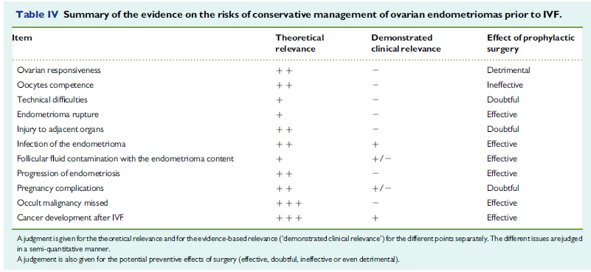
Infection of the endometriomas, follicular fluid contamination with the endometrioma content, higher risk of pregnancy complications risks do not justify surgery because these events are uncommon .
Somigliana E, Human Reprod Update, 2015

Slide 27
No significant difference in terms of ovarian responsiveness to hyperstimulation
Somigliana et al., 2015

Slide 28
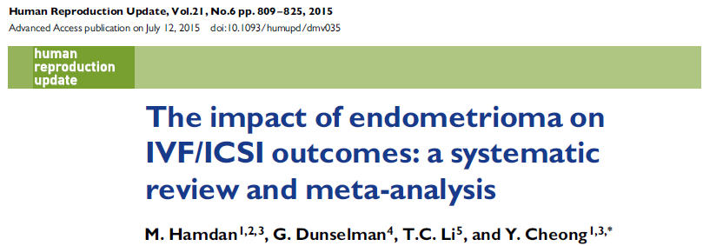

Slide 29
Women with intact endometrioma when compared with women without endometrioma;
- Similar LBR, CPR and MR
- Lower mean number of oocytes retrieved in women with intact endometrioma
- Higher cycle cancellation rate
Women with intact endometrioma when compared with women with surgical treatment prior to IVF/ICSI
- Similar LBR, CPR and MR
- Lower AFC, MNOR in women with surgical treatment
- Higher total gonadotrophin stimulation dose

Slide 30
Surgery vs ART

Slide 31
Should we perform surgery ?
No evidence for favorable IVF outcome when surgery is performed before ART
Risks of conservative management do not overweight surgical risks

Slide 32
Score <2: Follow up Score >3: Surgery İf score of 3 is obtained with 2a :medical treatment 2b:IVF
Multiparametric score for the indication to surgery in case of endometrioma (MISE score)
Score | 0 | 1 | 2
Size (cm) | <3 | 3-5 | >5(if>10, score is 3)
Growth rate | ≤1.0 cm/6 mo | >1.0 cm/6 mo | /
Pain | Absent/mild | / | Moderate/severe*
İnfertility** | Absent | / | Present*
Ultrasound features | Typical | / | Atypical(if blood flow, score is 3)
History positive for cancer *** | Absent | Familiar | Personal
Recurrent endometrioma | No | Yes | /
Age | ≤40 | >40 | /
Muzii L. et al., 2017

Slide 33
In summary,
İndications for surgery in patients with endometriosis-related subfertility
without significant pain:
Stage 1-2 endometriosis (If surgery is performed for other indications)
Improving access for oocyte retrieval
Doubts exist about their exact nature of endometrioma
Treating hydrosalpinges to improve IVF outcomes
Patient declines ART due to personal, cultural, or religious reasons
Patient choice for surgery or unable to access interventions such as ART
Sukhbir S et al.,2017

Slide 34
In summary,
The management of ovarian endometriomas for women with pain
Ovarian reserve may be lower in women with ovarian endometrioma compared with those women without
Surgical excision of an endometrioma is ideal for pain but may lead to reduced ovarian reserve
Bilateral, compared to unilateral, ovarian cystectomy for endometriomas may result in a greater negative effect on ovarian reserve
Recurrent endometrioma excision may further reduce ovarian reserve compared with primary surgery does not improve fertility
consider individualizing the care of women with endometrioma
Sukhbir S et al.,2017

Slide 35
Thank you

Slide 36
ZK

Slide 38
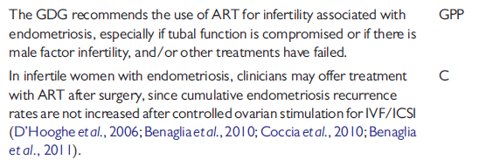
ESHRE guideline: management of women with endometriosis
Human Reproduction,Vol.29,No.3 pp.400-412,2014

Slide 39
Human Reproduction,Vol.29,No.3 pp.400-412,2014
Notes:
30 yaş altında ıvf gerektirecek durum yoksa over rezervi iyi ise cerrahi önerip spontan gebelik için şans verilebilinir.ıvf gerekli ise cerrahi önermiyoruz bcs ıvf başarısını arttırmıyor
Over rezervi iyi ise down regulation , iyi değilse antagonist uyguluyoruz

Slide 40
g
Notes:
Due to the heterogeneity of data,we are unable to evaluate the reproductive outcomes pertaining to the size of the endometrioma. The endometrioma
size and the patients’ symptoms in addition to the accessibility of the ovaries for oocyte retrieval are also logical reasons to justify the consideration for their removal prior to IVF/ICSI.
<4 cm endometriomalar IVF sikluslarında hiperstimulasyona cevabı etkilemiyor beneglia 2011

Slide 41
İntakt endometrioma versus non-endometrioma
Elde edilen oosit sayısı düşük
Bazal FSH yüksek
Total FSH dozu benzer
AFC benzer
Hamdan et al, Hum Reprod, 2015
Notes:
bütElde edilen oosit sayısı endometrioma grubunda anlamlı az olarak gösterilmiş,
bazal FSH değerleri endometrioma grubunda yüksek izlenmiş, total gonadotropin dozu ve bazal AFC ler gruplar arasında benzermiş.

Slide 42
İntakt endometrioma versus non-endometrioma
Canlı doğum oranları benzer
Klinik gebelik oranları benzer
Abort oranları benzer
Siklus iptal oranları 2.8 kat fazla
Hamdan et al, Hum Reprod, 2015
Notes:
SLAYT KAYMIŞ
Endometrioması olan ve olmayan hsta gruplarında IVF sonuçlarına baktığımızda canlı doğum, klinik gebelik, abort oranları bakımından fark yokken,
siklus iptal oranları endometrioma grubunda 2.8 oranında yüksek izlenmiştir.

Slide 43
Tedavi edilmiş endometrioma versus intakt
Elde edilen oosit sayısı düşük
Bazal FSH benzer
Total FSH dozu yüksek
AFC dahha düşük
Hamdan et al, Hum Reprod, 2015

Slide 44
Tedavi edilmiş endometrioma versus intakt endometrioma
Canlı doğum oranları benzer
Klinik gebelik oranları benzer
Abort oranları benzer
Siklus iptal oranları benzer
Hamdan et al, Hum Reprod, 2015

Slide 45
Endometrioma (intact) vs peritoneal endometriosis
Elde edilen oosit sayısı benzer
Bazal FSH benzer
AFC anlamlı düşük
Hamdan et al, Hum Reprod, 2015

Slide 46
Endometrioma(intact) vs peritoneal endometriosis
Canlı doğum oranları benzer
Klinik gebelik oranalrı benzer
Abort oranları benzer
Siklus iptal oranları benzer
Hamdan et al, Hum Reprod, 2015
Notes:
Endometrioma ve peritoneal endometriosis gruplarında ise canlı doğum, klinik gebelik, abort ve siklus iptal oranları benzer olarak izlenmiş

Slide 47
Conclusion

