Slide 1
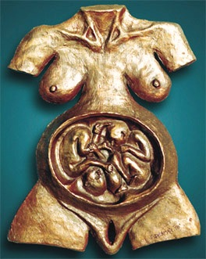
INTRAPARTUM MANAGEMENT OF TWIN PREGNANCY
Ass.Prof. Andrii Tkachenko
Kyiv, Ukraine

Slide 2
HISTORICAL VIEW
25:24 And when her days to be delivered were fulfilled, behold, (there were) twins in her womb.
25:25 And the first was born red, all over like a hairy garment: and they called his name Esau.
25:26 And after that his brother was born, and his hand took hold on Esau’s heel; and his name was called Jacob.
38:28 And it came to pass in the time of her travail, that (the one) put out (his) hand; and the midwife took and bound upon this hand a scarlet thread, saying, This came out first.
38:29 And it came to pass as he drew back his hand, that behold, his brother came out; and she said, How hast thou broken forth? (this) breach (be) upon thee: therefore his name was called Pharez.
25:26 And afterwards came out his brother that had the scarlet thread upon his hand; and his name was called Zarah.
Notes:
Since biblical times the miracle of twin birth has been such fascinating phenomenon that narrations of this have found their way into Old Testament.
In the Old Testament, the Genesis, there are descriptions of biblical twins, the first of Jacob and Esau, sons of Isaac and Rebekah [Genesis, 25:24-26], the second of Pharez and Zarah, sons of Judah and Tamar [Genesis, 38:27-30].
The labors are described in great detail, thus allowing contemporary obstetricians to clearly identify monoamnionic twin pregnancies and its delivery with accompanying complications.
Of the twins, Esau was the first to be born with Jacob following, holding his heel (the Hebrew name Yaacov meaning "Heel-holder"). Esau had "rough"^{[2]} qualities that distinguished him from his twin brother. Among these were his red hair and noticeable hairiness. ^{[9]} Jacob was a shy or simple man, depending on the translation of the Hebrew word "Tam" (which also means "relatively perfect man").^{[8]}

Slide 3
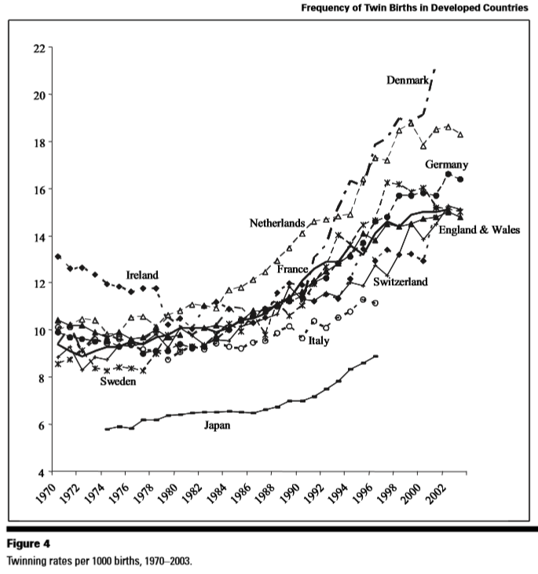
CURRENT TRENDS of twins birth
Since the mid-1970s, rising twinning rates have been reported in most developed countries and, especially during the last two decades, a sudden increase in multiple births has been observed.
After the introduction of assisted reproductive techniques such as IVF, natural twinning rates have been changing depending on how popular these techniques have been in each country.
The recent rise in twinning incidence reflects a change in the age distribution of women at childbirth, with more women giving birth at older ages, and an increased use of fertility drugs which greatly increase the risk of multiple ovulation and subsequent delivery of multiple births.
Other possible contributing factors can be the use of pesticides and food additives, and the increased pollution in general.
The increase in multiple births represents an important public health issue because of its large socioeconomic, physical and psychological impact.
Gilles Pison, Agata V. D’Addato
Frequency of Twin Births in Developed Countries
Twin Research and Human Genetics, 2006, Volume 9 Number 2 pp. 250–259
Notes:
This Figure presents trends in the overall twinning rate on a worldwide scale during the period 1970 to 2003. Since the mid-1970s, rising twinning rates have been reported in most developed countries and, especially during the last two decades, a sudden increase in multiple births has been observed.
The rising multiple birth rates have been attributed to the higher proportion of mothers treated with ovulation-inducing hormones, and partially attributed to in vitro fertilization (IVF) practice, such as in Japan, England and Wales, Italy, the Netherlands, Denmark and Sweden, and France. In the last 30 years of the 20th century, twinning rates were higher in European countries, Canada and Australia than in east Asian countries.
After the introduction of assisted reproductive techniques such as IVF, natural twinning rates have been changing depending on how popular these techniques have been in each country. Namely, the variations of these rates among countries were not only due to biological factors, but also to assisted reproductive techniques.
The recent rise in twinning incidence reflects a change in the age distribution of women at childbirth, with more women giving birth at older ages, and an increased use of fertility drugs which greatly increase the risk of multiple ovulation and subsequent delivery of multiple births. Other possible contributing factors can be the use of pesticides and food additives, and the increased pollution in general. The increase in multiple births represents an important public health issue because of its large socioeconomic, physical and psychological impact.

Slide 4
QUESTIONS AROSE
The best (optimal) time for twin birth
Rationale of the mode of delivery
Evaluation of fetal wellbeing before and during the labor
Substantiated obstetrical practice
Complications might happen
Neonatal outcomes
Maternal satisfaction
Organizational issues
Notes:
There is much discrepancy in the intrapartum management of twin pregnancies worldwide.

Slide 5
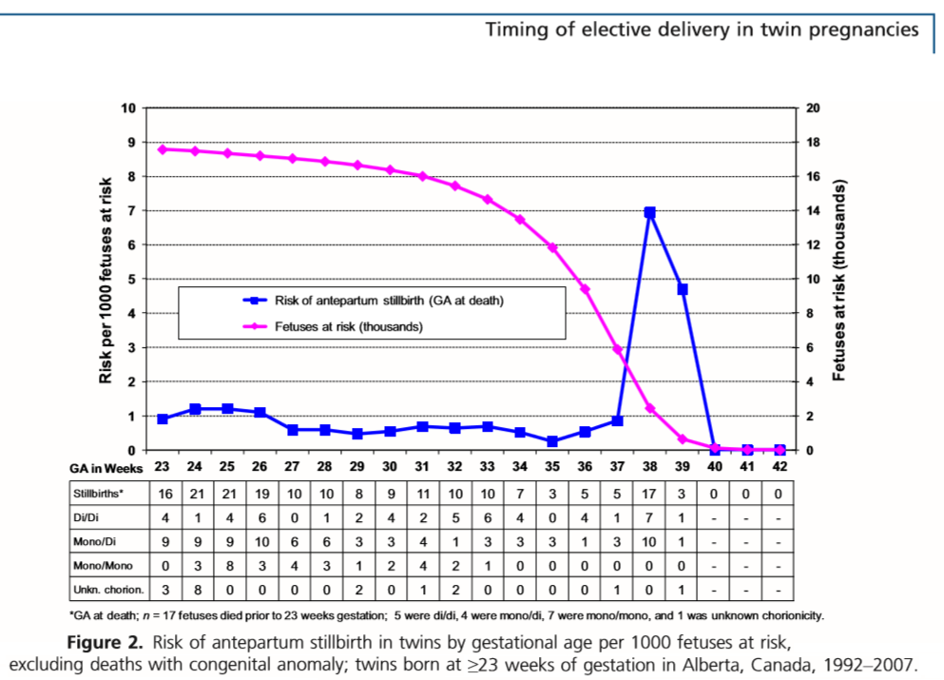
TIME OF DELIVERY
Retrospective cohort study to evaluate the optimal gestational age at delivery for twins.
Of a total of 17724 twin births.
Risk of stillbirth in MCDA was 2.3/1000 fetuses at risk at 37, and 17.4/1000 fetuses at risk at 38 weeks of gestation.
Balancing the risks of stillbirth with neonatal death suggests that delivery could be justiﬁed in the 36th week for MCDA, and in the 37th week for DCDA twins.
236 antepartum, 26 intrapartum, 244 neonatal deaths
Wood S, Tang S, Ross S, Sauve R.
Stillbirth in twins, exploring the optimal gestational age for delivery: a retrospective cohort study.
BJOG 2014; 121:1284–1293.
Notes:
To evaluate the optimal gestational age at delivery for twins, retrospective cohort study was conducted.
Database containing demographic, delivery, and pregnancy outcome data for over 600 000 births from 81 hospitals in Alberta, Canada, of a total of 17 724 twin births (as recorded in the databases of the Alberta Perinatal Health Project).
The case ﬁles were reviewed for cause of death and any information regarding the gestational age at diagnosis of stillbirth. Of a total of 17 724 twin births there were 236 antepartum stillbirths, 26 intrapartum stillbirths, and 244 neonatal deaths. The rate of stillbirth peaked at 7.0/1000 fetuses at risk at 38 weeks of gestation.
The majority of stillbirths at term occurred in monochorionic diamniotic twins. The estimated risk of stillbirth in this group was 2.3/1000 fetuses at risk at 37 weeks of gestation, and 17.4/1000 fetuses at risk at 38 weeks of gestation.
Conclusion:
Based on the competing risks of stillbirth and neonatal death, delivery of diamniotic monochorionic twins should be considered at 36 weeks of gestation, and delivery at 38 weeks of gestation should be considered for dichorionic twins.
Balancing the risks of stillbirth with neonatal death suggests that delivery could be justiﬁed in the 36th week of gestation for monochorionic diamniotic twins, and in the 37th week of gestation for dichorionic twins.

Slide 6
TIME OF DELIVERY
The optimal timing of birth for women with an otherwise uncomplicated twin pregnancy at term is uncertain for both – elective delivery at 37 weeks, as well as expectant management.
The gestation-speciﬁc rise in stillbirth rate seen in singletons at 40 weeks and beyond occurs in twins from 36 weeks’ gestation and onwards (Cincotta 2001).
The risk of both mortality and morbidity for MCDA twin infants is greater than for dichorionic twins, at all gestational ages (Hack 2008; Smith 2010).
The current NICE recommendations advocate birth for women with a MC twin pregnancy at 36+0 weeks’ gestation, and for women with a DC twin pregnancy at 37+0 weeks’ gestation (NICE 2011).
Elective birth at 37 weeks’ gestation compared with ongoing expectant management for women with uncomplicated twin pregnancies does not appear be associated with an increased risk of harms.
Dodd JM, Deussen AR, Grivell RM, Crowther CA.
Elective birth at 37 weeks’ gestation for women with an uncomplicated twin pregnancy.
Cochrane Database of Systematic Reviews 2014, Issue 2
Notes:
The optimal timing of birth for women with an otherwise uncomplicated twin pregnancy at term is uncertain, with clinical support for both elective delivery at 37 weeks, as well as expectant management (awaiting the spontaneous onset of labour).
Two randomised controlled trials comparing elective birth at 37 weeks for women with an uncomplicated twin pregnancy, with expectant management were included, involving 271 women and 542 infants.
Cincotta and colleagues retrospectively reviewed data from Queensland (Australia), over a 10-year period in 6328 women with a twin pregnancy, to establish the gestational age-speciﬁc stillbirth risk for both twins and singleton gestations (Cincotta 2001). On the basis of this information, the authors concluded that the gestation-speciﬁc rise in stillbirth rate seen in singletons at 40 weeks and beyond occurs in twins from 36 weeks’ gestation and onwards.
Minakami and Sato have suggested based on retrospective information obtained from almost 89,000 infants born to women with a multiple pregnancy in Japan the lowest risk of perinatal death in multiple pregnancies at 38 weeks’ gestation corresponded to that observed in singleton pregnancies at 43 weeks’ gestation.
Early birth at 37 weeks’ gestation compared with ongoing expectant management for women with an uncomplicated twin pregnancy does not appear to be associated with an increased risk of harms. Furthermore, there may be possible beneﬁts in earlier birth (including a reduction in infants being born small-for-gestational age). The ﬁndings of no increased risk of harms with birth at 37 weeks’ gestation is consistent with the NICE recommendations advocating birth for women with a dichorionic twin pregnancy at 37 + 0 weeks’ gestation.

Slide 7
TIME OF DELIVERY
Monoamniotic twin pregnancies have higher risks than other types of twin pregnancy and these increased risks include the death of both or one of the twins.
The optimal timing for the delivery of monoamniotic twins is not known.
The largest published series of MA twins recommends delivery at 33 weeks’ gestation (Van Mieghem 2014).
Published case series, and a survey of maternal fetal medicine specialists in the USA, suggest delivery should take place between 32 and 34 weeks’ gestation (De Falco 2006; Desai 2012; Dickinson 2005; Ezra 2005; Roque 2003).
There is insufﬁcient good quality randomized controlled trial evidence to guide decision making as to whether routine early delivery in monoamniotic twin pregnancies improves fetal, neonatal or maternal outcomes compared with ’expectant management’.
Shub A, Walker SP.
Planned early delivery versus expectant management for monoamniotic twins.
Cochrane Database of Systematic Reviews 2015, Issue 4
Notes:
Monoamniotic twin pregnancies in the current era are associated with a perinatal mortality of approximately 15% in pregnancies after 20 weeks’, although previously this has been reported to be as high as 70%.
Many authors have commented that early delivery will reduce the perinatal risks of monoamniotic twins, by delivering the babies before a catastrophic event such as cord occlusion associated with entanglement, with consequent death of one or both babies, occurs. Others have stated that this risk is minimal after 32 weeks’ gestation because less fetal movement occurs with increasing fetal size and relatively decreased amniotic ﬂuid.
These potential beneﬁts of reducing fetal death by early delivery must be balanced against the neonatal risks of prematurity; the medical, psychological, social and ﬁnancial implications for the mother of intensive inpatient or outpatient surveillance regimens; and cost implications for the health service. Consideration of the neonatal risks must include not only mortality, but short- and long-term morbidity. While there is insufﬁcient good quality randomized controlled trial evidence to guide the timing of birth for monoamniotic twins, there is a body of expert opinion to draw on.
The largest published series of monoamniotic twins speciﬁcally addresses the issue of timing of delivery and signiﬁcant neonatal complication, and recommends delivery at 33 weeks’ gestation. Other experts, based on published case series, and a survey of maternal fetal medicine specialists in the USA, suggest delivery should take place between 32 and 34 weeks’ gestation.
There are no randomised controlled trial data available to guide decision making as to whether routine early delivery in monoamniotic twin pregnancies improves fetal, neonatal or maternal outcomes compared with ’expectant management’. In their absence, we can refer to historical case series and expert consensus. Management plans should take into consideration the availability of high-quality neonatal care if early delivery is chosen. Women and their families should be involved in the decision making about these high-risk pregnancies.

Slide 8
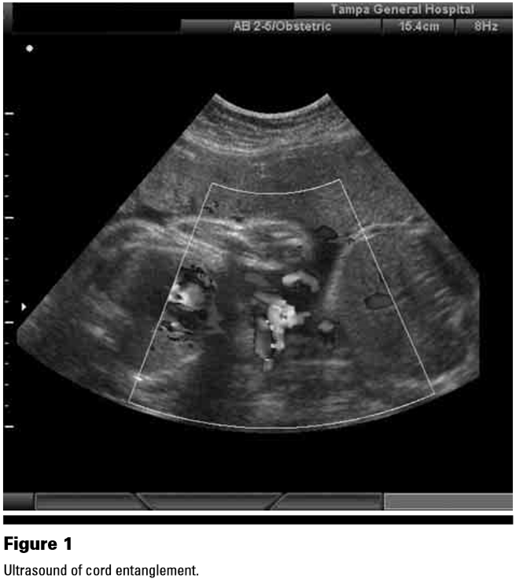
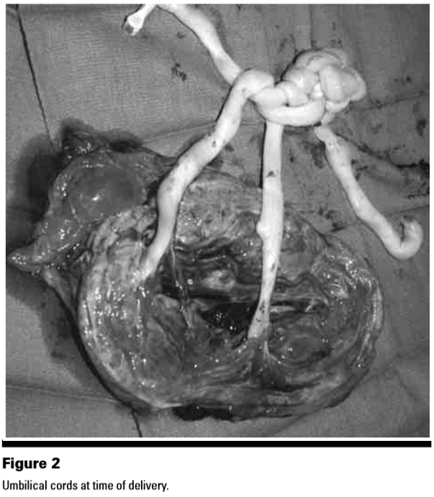
Cord Knotting in Monoamniotic Twins
Aaron B. Deutsch, Evan Miller, William N. Spellacy, Rhonda Mabry
Ultrasound to Identify Cord Knotting in Monoamniotic Monochorionic Twins
Twin Research and Human Genetics, February 2007, Volume 10, Number 1, pp. 216–218
Notes:
All twin pregnancies are associated with a higher maternal and fetal complication rate than singleton pregnancies, but none more so than monoamniotic twins.
Recent improvements in perinatal monitoring can be very beneficial in deciding when to perform delivery.
While intertwined umbilical cords do not mean that there will necessarily be a cord accident, a hypoxic event is possible.
Two studies have suggested that cord accident mortality occurs before 30 to 32 weeks of gestation, and thus early monitoring beginning at 25 weeks is very important. When coupled with variable decelerations on NST delivery should be expedited. The liberal use of NST and ultrasound with doppler in monitoring M/M twins should improve perinatal outcomes.

Slide 9
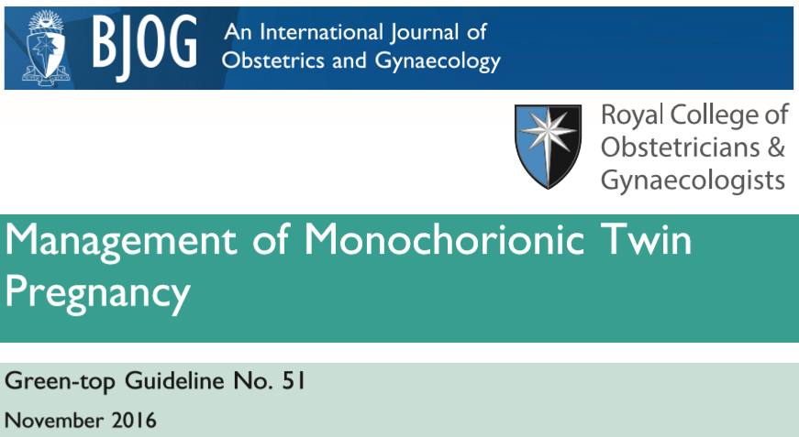
TIME OF DELIVERY
MCMA twins have a high risk of fetal death and should be delivered by caesarean section between 32+0 and 34+0 weeks. [New 2016] D
Prophylactic maternal steroids should be given if possible prior to delivery.
MCMA twins almost always have umbilical cord entanglement when visualised using colour ﬂow Doppler. Such a ﬁnding has not consistently been demonstrated to contribute to overall morbidity and mortality. [New 2016] D
Women with otherwise uncomplicated MCDA pregnancies (without TTTS, sGR or TAPS) should have timing of birth discussed and be offered elective delivery from 36+0 weeks with the administration of antenatal steroids, unless there is an indication to deliver earlier. [New 2016] C
Kilby MD, Bricker L on behalf of the Royal College of Obstetricians and Gynaecologists.
Management of monochorionic twin pregnancy.
BJOG 2016; 124:e1–e45
Notes:
What is the optimal timing and method of delivery for otherwise uncomplicated monochorionic pregnancies (without TTTS, sGR or TAPS)?
Women with monochorionic twins should have timing of birth discussed and be offered elective delivery from 36+0 weeks with the administration of antenatal steroids, unless there is an indication to deliver earlier. [New 2016] C
It is appropriate to aim for vaginal birth of monochorionic diamniotic twins unless there are other speciﬁc clinical indications for caesarean section. A
MCMA twins have a high risk of fetal death and should be delivered by caesarean section between 32+0 and 34+0 weeks. [New 2016] D
MCMA twins almost always have umbilical cord entanglement when visualised using colour ﬂow Doppler. Such a ﬁnding has not consistently been demonstrated to contribute to overall morbidity and mortality. [New 2016] D

Slide 10
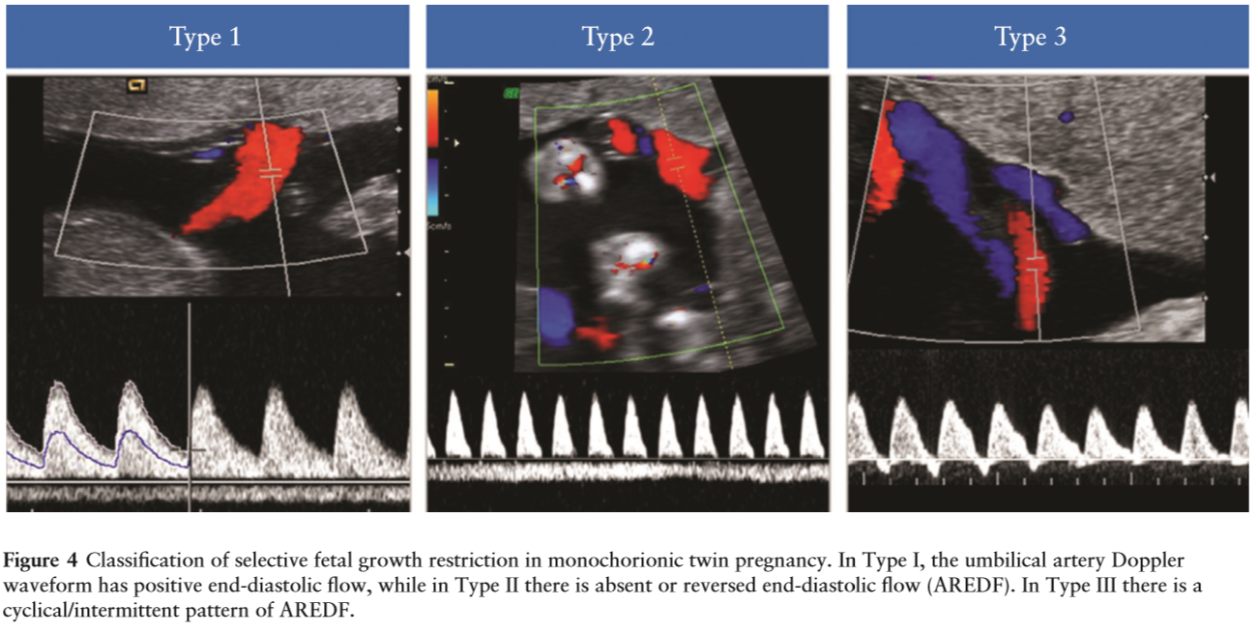
TIME OF DELIVERY
IUD up to 4%
IUD up to 29%
10–20% risk of sudden death
Khalil A, Rodgers M, Baschat A, Bhide A, Gratacos E, Hecher K, Kilby MD,Lewi L, Nicolaides KH,
Oepkes D, Raine-Fenning N, Reed K, Salomon LJ, Sotiriadis A, Thilaganathan B, Ville Y.
ISUOG Practice Guidelines: role of ultrasound in twin pregnancy.
Ultrasound Obstet Gynecol 2016; 47: 247–263.
Notes:
Diagnostic criteria and investigations for selective FGR (sFGR):
• sFGR, conventionally, is deﬁned as a condition in which one fetus has EFW<10th centile and the intertwine EFW discordance is>25% (GOOD PRACTICE POINT).
• A discordance cut-off of 20% seems acceptable to distinguish pregnancies at increased risk of adverse outcome (GRADE OF RECOMMENDATION: B).
• Classiﬁcation of sFGR in monochorionic twins depends on the pattern of end-diastolic velocity at umbilical artery Doppler (GOOD PRACTICE POINT).
In Type I, the umbilical artery Doppler waveform has positive end-diastolic ﬂow.
In Type II, there is absent or reversed end-diastolic ﬂow (AREDF).
In Type III, there is a cyclical/intermittent pattern of AREDF.
The survival rate in Type-I sFGR is greater than 90% (in-utero mortality rates of up to 4%).
Type-II sFGR is associated with a high risk of IUD of the growth-restricted twin and/or very preterm delivery with associated risk of neurodevelopmental delay if the other twin survives (IUD of either twin in up to 29% and risk of neurological sequelae in up to 15% of cases born prior to 30 weeks).
Type-III sFGR is associated with a 10–20% risk of sudden death of the growth-restricted fetus, which is unpredictable (even in cases in which ultrasound features have been stable). There is also a high (up to 20%) associated rate of neurological morbidity in the surviving larger twin (EVIDENCE LEVEL: 2++).
If both twins have an EFW<10th centile, the fetuses should be termed small-for-gestational age.
A discordance cut-off of 20% seems a pragmatic choice for distinguishing pregnancies at increased risk of adverse outcome (consensus of Guideline authors).
Assessing EFW using ultrasound is less accurate in twin than in singleton pregnancy.
Currently, the charts used to monitor fetal growth in twin pregnancy are the same as those used for singletons. However, there is a reduction in fetal growth in twin compared with singleton pregnancy, particularly in the third trimester. This is particularly marked in MCDA pregnancies.
This suggests that speciﬁc twin growth charts should be used for documenting and monitoring growth in twin pregnancies. However, the use of speciﬁc twin growth charts is controversial due to the concern that the reduced growth in the third trimester observed in most twin pregnancies might be caused by some degree of placental insufﬁciency, warranting close observation (EVIDENCE LEVEL: 2++).

Slide 11
TIME OF DELIVERY
Delivery of MCDA twin pregnancies previously complicated by TTTS and treated should be between 34+0 and 36+6 weeks of gestation. [New 2016] D
In case of sGR in MC twins abnormal ductus venosus Doppler waveforms or computerised CTG short-term variation should trigger consideration of delivery. [New 2016] B
In type I sGR, planned delivery should be considered by 34–36 weeks of gestation if there is satisfactory fetal growth velocity and normal umbilical artery Doppler waveforms. [New 2016]
In type II and III sGR, delivery should be planned by 32 weeks of gestation, unless fetal growth velocity is signiﬁcantly abnormal or there is worsening of the fetal Doppler assessment. [New 2016]
In sGR and TTTS (even after successful treatment) there can be acute transfusional events (which are neither predictable nor preventable) and therefore, despite regular monitoring, there may still be adverse perinatal outcomes. [New 2016].
Kilby MD, Bricker L on behalf of the Royal College of Obstetricians and Gynaecologists.
Management of monochorionic twin pregnancy.
BJOG 2016; 124:e1–e45
Notes:
There is limited evidence to guide clinical care in these complex cases. However, there is international consensus that such monochorionic twin pregnancies require regular review with interval ultrasound biometry to monitor fetal growth velocity, and placental and fetal circulation assessment by umbilical artery, middle cerebral artery and ductus venosus Doppler waveform measurements. The aim is to prolong pregnancy to at least viability and to achieve appropriate gestation for delivery (32–34 weeks), but to avoid the complication of single fetal death and the consequences for the surviving fetus. (Evidence level 2)
Timing of delivery (less than 32 weeks of gestation) is dependent upon assessment by computerised CTG and/ or ductus venosus waveform velocimetry. For monochorionic twin sGR where there is umbilical Doppler abnormality, delivery should be undertaken at 32 weeks (in line with singleton FGR with AREDV). (Evidence level 2++)
The placental anastomoses in monochorionic twins paradoxically may be beneﬁcial for the smaller twin as transfusion from the larger twin may compensate for the placental insufﬁciency. This is also associated with the presence of artery–artery anastomoses.
In monochorionic twins, where the placental vascular anastomoses remain intact, there is a risk of acute ‘intertwin’ transfusional events causing fetal death and neurological morbidity. This is true of apparently uncomplicated monochorionic twins, but more prevalent in monochorionic twins complicated by sGR and even treated TTTS. (Evidence level 3)

Slide 12
TIME OF DELIVERY
Gestational Age | 32 | 33 | 34 | 35 | 36 | 37 | 38
Type of Twins
DCDA (uncomplicated)
DCDA (sFGR)
MCDA (uncomplicated)
MCDA (treated TTTS)
MCDA (sFGR I)
MCMA
MCDA (sFGR II)
MCDA (sFGR III)
Notes:
Timing of birth:
Offer women with uncomplicated:
monochorionic twin pregnancies elective birth from 36 weeks 0 days, after a course of antenatal corticosteroids;
dichorionic twin pregnancies elective birth from 37 weeks 0 days;
triplet pregnancies elective birth from 35 weeks 0 days, after a course of antenatal corticosteroids.
Potential beneﬁts of reducing fetal death by early delivery must be balanced against the neonatal risks of prematurity; the medical, psychological, social and ﬁnancial implications for the mother of intensive inpatient or outpatient surveillance regimens; and cost implications for the health service.
Clinical care for women with twin and triplet pregnancies should be provided by a nominated multidisciplinary team consisting of:
a core team of named specialist obstetricians, specialist midwives and ultrasonographers, all of whom have experience and knowledge of managing twin and triplet pregnancies;
an enhanced team for referrals, which should include a perinatal mental health professional, a women's health physiotherapist, an infant feeding specialist, a dietitian.
Members of the enhanced team should have experience and knowledge relevant to twin and triplet pregnancies.

Slide 13
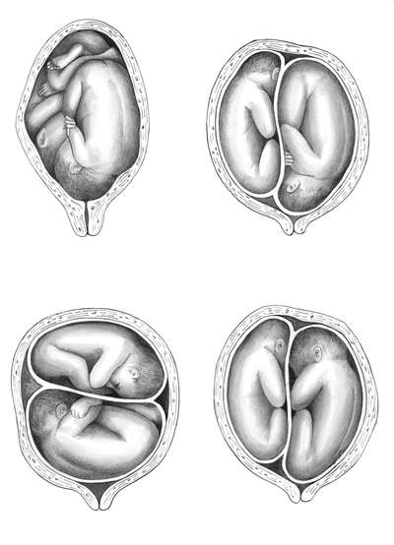
MODE OF DELIVERY
Three potential modes of delivery for twin pregnancies are possible:
VB of both twins (VB–VB),
Cesarean section (CS) for both twins (CS–CS),
VB of the first and CS of the second twin (VB–CS).
Three potential modes of twins presentation are possible:
vertex–vertex (V/V) twin gestations,
vertex/nonvertex (V/NV) twins,
first twin in non vertex (NV) presentation.
Decisions regarding the mode of delivery are based mainly on gestational age and presentation of the first twin and largely on historical practice rather than a body of reliable evidence
Vesna Bjelic-Radisic, Gunda Pristauz, Josef Haas, Albrecht Giuliani, Karl Tamussino, Arnim Bader, Uwe Lang, and Dietmar Schlembach
Neonatal Outcome of Second Twins Depending on Presentation and Mode of Delivery
Twin Research and Human Genetics, June 2007, p.521-527
Notes:
There is much discrepancy in the intrapartum management of twin pregnancies worldwide.
Three potential modes of delivery for twin pregnancies are possible: VB of both twins (VB–VB), cesarean section (CS) for both twins (CS–CS), and VB of the first and CS of the second twin (VB–CS). Decisions regarding the mode of delivery are based mainly on gestational age and presentation of the first twin. The American College of Obstetricians and Gynecologists (ACOG) recommends VB for vertex–vertex (V/V) twin gestations, unless specific contraindications exist (ACOG Practice Bulletin, 2004; ACOG Educational Bulletin, 1999). For pregnancies with the first twin in non vertex (NV) presentation, CS is now widely performed (ACOG Practice Bulletin, 2004; Hogle et al., 2003).
The mode of delivery for vertex/nonvertex (V/NV) twins remains controversial. CS has been advocated based on reports of increased perinatal mortality and lower Apgar scores for second twins in breech presentation delivered vaginally (Keith et al., 1995). However, many of these reports date from the 1970s, when fetal heart rate monitoring and ultrasound were not routine. ACOG noted the lack of evidence for advocating a specific route of delivery for NV second twins weighing less than 1500 g, but stated that VB is reasonable for infants weighing more than 1500 g when criteria for VB are met (ACOG Educational Bulletin, 1999). In contrast, recent evidence suggests a protective effect of elective CS for delivery of V/NV twins, regardless of birthweight (Yang et al., 2005).

Slide 14
MODE OF DELIVERY
Approximately 40% of twins present as vertex/vertex, 35% as vertex/non-vertex and the remaining 25% of twins present with the leading baby in a non-vertex presentation at birth (Blickstein 1987; Grisaru 2000).
The second born twin has an increased risk of a poor perinatal outcome compared with the ﬁrst-born twin. Some retrospective studies suggest there may be increased perinatal mortality due to intrapartum anoxia in the second twin at term.
A policy of planned vaginal birth for women with a twin pregnancy in a hospital setting is associated with a 30% to 40% rate of emergency caesarean section.
When the ﬁrst twin is born vaginally, there is still a risk of emergency CS for the birth of the second twin.
There is insufﬁcient evidence to support the routine use of planned caesarean section for term twin pregnancy with leading cephalic presentation.
Hofmeyr GJ, Barrett JF, Crowther CA.
Planned caesarean section for women with a twin pregnancy.
Cochrane Database of Systematic Reviews 2015, Issue 12
Notes:
Data mainly from one large, multicentre study found no clear evidence of beneﬁt from planned caesarean section for term twin pregnancies with leading cephalic presentation. Data on long-term infant outcomes are awaited. Women should be informed of possible risks and beneﬁts of labour and vaginal birth pertinent to their speciﬁc clinical presentation and the current and long-term effects of caesarean section for both mother and babies. There is insufﬁcient evidence to support the routine use of planned caesarean section for term twin pregnancy with leading cephalic presentation, except in the context of further randomised trials.
Infants from a twin pregnancy are at a higher risk of death around the time of birth than are infants from a singleton pregnancy. Some of this is due to a higher risk of preterm birth. The second born twin has an increased risk of a poor perinatal outcome compared with the ﬁrst-born twin.
A policy of planned vaginal birth for women with a twin pregnancy in a hospital setting is associated with a 30% to 40% rate of emergency caesarean section. When the ﬁrst twin is born vaginally, there is still a risk of emergency section for the birth of the second twin. It is possible that some of the adverse outcomes may be avoided by appropriately timed delivery by caesarean section but the risks of caesarean section for the mother in the current and subsequent pregnancies must be taken into account.
In this review we included two randomised trials comparing planned caesarean versus planned vaginal birth for twin pregnancies which together included 2864 women. For important outcomes the evidence was assessed as being of moderate quality. The number of women undergoing caesarean section was reported in both trials. Most women in the planned caesarean group had treatment as planned (90.9%), whereas in the planned vaginal birth group 42.9% had caesarean section for at least one twin. There were no signiﬁcant differences between groups for failure to breastfeed or for postnatal depression.
Approximately 40% of twins present as vertex/vertex, 35% as vertex/non-vertex and the remaining 25% of twins present with the leading baby in a non-vertex presentation at birth (Blickstein 1987; Grisaru 2000).
Mortality and morbidity for twins versus singletons:
The higher risk may be due to trauma and asphyxia associated with the birth of the second twin. It is possible that some of these adverse outcomes may be avoided by an appropriately timed delivery by caesarean section.
Outcome for second twin compared with ﬁrst twin:
In a study of 1305 twin pairs at 1500 g or more birth weight delivered between 1988 and 1999 in Nova Scotia, the risk of adverse perinatal outcome (intrapartum fetal death, neonatal death, moderate-severe respiratory distress syndrome (RDS), asphyxia, trauma and complications of prematurity) was signiﬁcantly increased for second-born compared with ﬁrst-born twins (RR 2.1, 95% CI 1.4 to 3.1) (Persad 2001b).
Outcomes for twins born vaginally versus by caesarean section:
Higher rates of adverse perinatal outcome have been reported for the twin pregnancy at or near term if birth is vaginal versus by caesarean section (Barrett 2004). In the Kiely 1990 review, for twins in vertex presentation weighing more than 3000g at birth, the perinatal mortality rate was 12.3/1000 versus 2.9/1000 (RR 4.22) if birth was vaginal versus caesarean. However, comparisons of actual as opposed to planned method of delivery are subject to considerable bias. In a retrospective study of women with previous caesarean section and a current twin pregnancy, perinatal mortality was more common following trial of labour than repeat caesarean section, but there was no difference in outcome after adjusting for confounding variables (Aaronson 2010). There is increasing evidence for perinatal beneﬁts related to vaginal birth. In a cross-sectional study of 6929 inborn infants without congenital anomalies, with gestational ages from 37 to 41 (6/ 7) weeks with vertex presentation, non-urgent caesarean delivery under regional anaesthesia compared to vaginal birth under local or no anaesthesia increased the risk of bag and mask ventilation (OR 1.42, 95% CI 1.07 to 1.89) when adjusted for number of gestations, maternal hypertension and birthweight (De Almeida 2010). However, another retrospective study found no signiﬁcant increase in transient tachypnoea of the newborn associated with increasing rates of elective caesarean section for twin pregnancies over time (Suzuki 2010). In a retrospective study of twin births at 37 or more weeks’ gestation, elective but not emergency caesarean section was associated with an increased risk of transfusion in the neonate (Suzuki 2008).
Outcomes for twins delivered by planned vaginal birth (actual vaginal birth plus emergency caesarean section) versus planned caesarean section:
A systematic review of non-randomised studies that compared the policies of planned vaginal birth and planned caesarean section for the delivery of twins weighing at least 1500 g or reaching at least 32 weeks’ gestation (Hogle 2002) found four small studies that were eligible for inclusion in the review (Blickstein 2000; Grisaru 2000; Rabinovici 1987; Wells 1991). A meta-analysis of the data from the four studies did not ﬁnd signiﬁcant differences between the two approaches to delivery in terms of mortality or neonatal morbidity, although low Apgar score at ﬁve minutes was reduced with a policy of caesarean section. This ﬁnding, however, was conﬁned to twins in which the ﬁrst twin presented as a breech. As a sequent retrospective comparison of planned vaginal birth versus planned caesarean section for twin pregnancies with a leading breech found no signiﬁcant differences in perinatal or maternal morbidity, other than an increase in thromboembolic disease in the planned caesarean section group (Sentilhes 2007). Two large retrospective studies of women with previous caesarean section and a current twin pregnancy comparing planned vaginal birth with elective caesarean section (Ford 2006; Varner 2005), found no difference in maternal or perinatal outcome, other than an incidence of uterine rupture of 0.9% in the planned vaginal birth group in one study (Ford 2006). A comparison of outcomes in two Danish counties with high (57%) and low (28%) caesarean rates for twin pregnancy found no difference in perinatal outcomes (Henriksen 1994). The previously published versions of this review (Crowther 1996; Hofmeyr 2011) found only one randomised controlled trial of planned caesarean section versus planned vaginal birth for twins, in which 60 pairs of twins were enrolled (Rabinovici 1987). There were no perinatal deaths or cases of serious neonatal morbidity in either group. The sample size was too small to provide evidence of the better approach to delivery. In low-resourced settings with limited facilities and personnel, high post-caesarean section complication rates and uncertain access for the mother to caesarean section facilities in future pregnancies, the beneﬁt to the mother of avoiding caesarean section is greater than in well-resourced settings.
Outcomes for second twin born by caesarean section following vaginal birth of twin one, compared with caesarean section for both twins:
A prospective multicenter cohort study compared the outcome for second twins born by caesarean section following vaginal birth of twin one, compared with caesarean section for both twins. There was no difference in low Apgar scores, low cord blood pH, or neonatal encephalopathy. Neonatal infection was increased in the group with caesarean section following vaginal birth of twin one, but this difference was not statistically signiﬁcant after logistic regression analysis (Alexander 2008). In a large retrospective study of planned vaginal birth for twin pregnancies, caesarean section for the second twin occurred in 9% of cases and was more common when the presentation of the second twin was non-vertex, and in pregnancies with other complications, and less common when the vaginal birth of the ﬁrst twin was operative (Wen 2004a).

Slide 15
MODE OF DELIVERY
Intrapartum problems following the birth of the ﬁrst twin:
conversion to transverse lie (20% of vertex presenting second twins),
placental separation,
cord prolapse,
uterine atony,
cervical spasm,
prolonged interval to delivery of the second twin.
These may lead to emergency caesarean section, perinatal death, and neonatal morbidity
Importance of fetal presentation:
If the ﬁrst twin presents as breech, the current trend in well-resourced health systems, as for singleton breech presentation, is to recommend caesarean section as being safer for the babies.
The approach to the delivery of vertex/non-vertex twins is controversial.
For twins presenting vertex/vertex, most clinicians recommend a planned vaginal birth.
Hofmeyr GJ, Barrett JF, Crowther CA.
Planned caesarean section for women with a twin pregnancy.
Cochrane Database of Systematic Reviews 2015, Issue 12
Notes:
Importance of fetal presentation:
1) If the ﬁrst twin presents as breech, the current trend in well-resourced health systems, as for singleton breech presentation, is to recommend caesarean section as being safer for the babies. This approach may be inﬂuenced by extrapolation of evidence from randomized trials of planned caesarean section for singleton breech presentation (Hofmeyr 2015), though the interpretation of this evidence is the subject of considerable debate.
2) The approach to the delivery of vertex/non-vertex twins is controversial (ACOG 2002; Barrett 2000; Crowther 1996). For twins presenting vertex/vertex, most clinicians recommend a planned vaginal birth (ACOG 2002; Crowther 1996). However, planned caesarean section may beneﬁt twins in which the ﬁrst twin is presenting vertex for a number of reasons. As many as 20% of vertex presenting second twins will change presentation spontaneously after the ﬁrst twin is born (Houlihan 1996).
3) A substantial number of those presenting vertex/vertex will present with serious acute intrapartum problems following the birth of the ﬁrst twin (for example, conversion to transverse lie, cord prolapse, prolonged interval to delivery of the second twin), which may lead to emergency caesarean section, perinatal death, and neonatal morbidity. Lastly, if there are beneﬁts to avoiding labour, both twins regardless of presentation should beneﬁt.

Slide 16
MODE OF DELIVERY
The question is: Who will be born first?...
Notes:
Knowledge of the anticipated birth order of twins is routinely used by obstetricians when deciding the timing and mode of delivery.
This is even more important in case of twins discordant for some fetal anomalies where immediate postnatal intervention is required at birth.
Even in uncomplicated twin pregnancies, the neonatal morbidity of the second-born twin is higher.
Obstetricians and Neonatologists need to be aware of the poor association between antenatal ultrasound labeling and twin birth-order when planning delivery of twins discordant for fetal growth or for non-cephalic presentation of the leading twin.
Prospective parents should also be informed of the potential discordance between prenatal and postnatal twin order so that this event is not perceived as an error on the part of their carers.

Slide 17
MODE OF DELIVERY
Obstetricians and Neonatologists need to be aware of the poor association between antenatal ultrasound labeling and twin birth-order when planning delivery.
It is especially important in twin pregnancies discordant for fetal abnormalities that are not immediately evident on external examination at birth.
The lack of a standardized way to label twins correctly and consistently on antenatal ultrasound has also led to uncertainty regarding the accuracy of predicting the birth order on scans.
The discrepancy between antenatal labeling and twin birth-order estimated from fetal sex and fetal-weight discordance was 37.6% (56/149) and 36.0% (757/2103), respectively, and there was no signiﬁcant difference between the two methods (P=0.72).
F. D’Antonio, T. Dias, B. Thilaganathan
Does antenatal ultrasound labeling predict birth order in twin pregnancies?
Ultrasound Obstet Gynecol 2013; 41: 274–277 on behalf of the Southwest Thames Obstetric Research Collaborative (STORK)
Notes:
The lack of a standardized way to label twins correctly and consistently on antenatal ultrasound has also led to uncertainty regarding the accuracy of predicting the birth order on scans. Twin order and presentation are relevant information for obstetricians planning timing and mode of delivery. Birth order is also especially important in twin pregnancies discordant for fetal abnormalities that are not immediately evident on external examination at birth, for example, if one twin is affected by a duct-dependent cardiac lesion.
The discrepancy between antenatal labeling and twin birth-order estimated from fetal sex and fetal-weight discordance was 37.6% (56/149) and 36.0% (757/2103), respectively, and there was no signiﬁcant difference between the two methods (P=0.72; Table 1). Multiple logistic regression analysis demonstrated that birthweight discordance, but not chorionicity, scan-to-delivery interval or gestational age at scan or at delivery, was signiﬁcantly associated with the occurrence of a discrepancy between ultrasound prediction of twin order and that observed at birth (as deﬁned by comparison of EFW and birth weight) (P<0.001, Table S1). Larger birth-weight discordance was associated with a lower probability of a discrepancy.
Antenatal ultrasound labeling does not predict twin birth order in a signiﬁcant proportion of twin deliveries.
The poor association between prenatal and postnatal order of twins may occur for a number of different reasons.
It may be the result of a true switch in twin order occurring before or during labor. It could be speculated that the relationship between the amniotic sac and the cervix, which presumably remains relatively constant throughout gestation, may change near term or during labor, leading to a change in the anticipated twin order. Alternatively, the relationship of the twins to the birth canal may also change following rupture of the membranes surrounding one or both twins. The birth order may also be inﬂuenced by folding of the inter-twin membrane, possibly because of discordance in fetal size or amniotic ﬂuid volumes. Cesarean section affords access to the lower uterine segment and ignores the relationship between the amniotic sac and the maternal cervix, giving preferential access to Twin 2. The physiological changes in the lower segment with active labor may alter the rate at which the twin labeled as ﬁrst is delivered second, and vice versa. Other factors not assessed in this study, such as fetal presentation, uterine morphology and active management of labor, may also play a role or inﬂuence the likelihood of a discordance between antenatal labeling and twin birth-order. Lastly, the discrepancy observed between the antenatal prediction and the actual twin order at birth may be also linked to the variable methods being used for the antenatal labeling of twins on ultrasound.

Slide 18
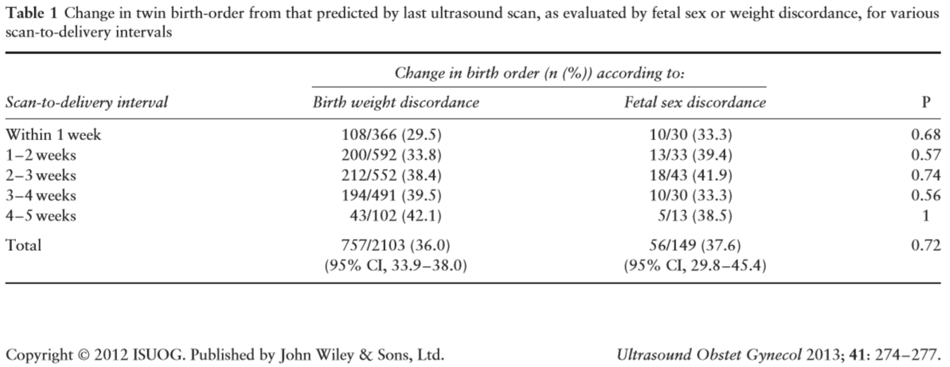
MODE OF DELIVERY
Antenatal ultrasound labeling does not predict twin birth order in a signiﬁcant proportion of twin deliveries…
F. D’Antonio, T. Dias, B. Thilaganathan
Does antenatal ultrasound labeling predict birth order in twin pregnancies?
Ultrasound Obstet Gynecol 2013; 41: 274–277 on behalf of the Southwest Thames Obstetric Research Collaborative (STORK)
Notes:
Despite the medical and cultural importance of birth order, there are only three previous, relatively small, studies assessing the correlation between twin orders on prenatal ultrasound and at birth. Only one study reported the relationship between antenatal ultrasound just before delivery and twin birth-order in a cohort of 108 sex-discordant twins. In this study, the birth order changed in approximately 16% (95% CI, 10–25%) of cases and was affected by mode of delivery, with the rate of perinatal switch being higher with Cesarean section (20%) than with vaginal delivery (6%).

Slide 19
MODE OF DELIVERY
Reasons of the poor association between prenatal and postnatal order of twins:
True switch in twin order occurring before or during labor;
Change of relationship between the amniotic sac and the cervix near term or during labor;
Change of relationship of the twins to the birth canal following rupture of the membranes;
Birth order may be inﬂuenced by folding of the inter-twin membrane;
Physiological changes in the lower segment with active labor may alter the rate;
Fetal presentation, uterine morphology and active management of labor;
Variable methods being used for the antenatal labeling of twins on ultrasound;
Cesarean section affords access to the lower uterine segment and ignores the relationship between the amniotic sac and the maternal cervix, giving preferential access to Twin 2…
F. D’Antonio, T. Dias, B. Thilaganathan
Does antenatal ultrasound labeling predict birth order in twin pregnancies?
Ultrasound Obstet Gynecol 2013; 41: 274–277 on behalf of the Southwest Thames Obstetric Research Collaborative (STORK)
Notes:
The poor association between prenatal and postnatal order of twins may occur for a number of different reasons.
It may be the result of a true switch in twin order occurring before or during labor. It could be speculated that the relationship between the amniotic sac and the cervix, which presumably remains relatively constant throughout gestation, may change near term or during labor, leading to a change in the anticipated twin order. Alternatively, the relationship of the twins to the birth canal may also change following rupture of the membranes surrounding one or both twins. The birth order may also be inﬂuenced by folding of the inter-twin membrane, possibly because of discordance in fetal size or amniotic ﬂuid volumes. Cesarean section affords access to the lower uterine segment and ignores the relationship between the amniotic sac and the maternal cervix, giving preferential access to Twin 2. The physiological changes in the lower segment with active labor may alter the rate at which the twin labeled as ﬁrst is delivered second, and vice versa. Other factors not assessed in this study, such as fetal presentation, uterine morphology and active management of labor, may also play a role or inﬂuence the likelihood of a discordance between antenatal labeling and twin birth-order. Lastly, the discrepancy observed between the antenatal prediction and the actual twin order at birth may be also linked to the variable methods being used for the antenatal labeling of twins on ultrasound.

Slide 20
MODE OF DELIVERY
Does the birth order crucial?...
Notes:
In such a way iatrogenia may have an influence on destinies of twins, siblings and fates of families, countries and even continents…
Especially in case of cultural, religious and inheritance circumstances in countries and families, where birth order is crucial.

Slide 21
MODE OF DELIVERY
How does birth order crucial...
Notes:
In such a way iatrogenia may have an influence on destinies of twins, siblings and fates of families, countries and even continents…
Especially in case of cultural, religious and inheritance circumstances in countries and families, where birth order is crucial.

Slide 22
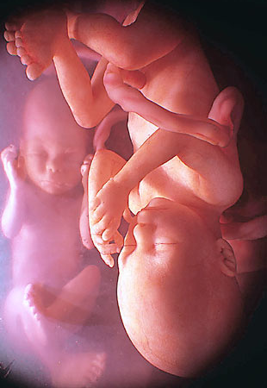
MODE OF DELIVERY
The NICE guideline on caesarean section makes two recommendations relating to multiple pregnancy:
In uncomplicated twin pregnancies at term where the presentation of the first twin is cephalic, the effect of planned CS in improving outcome for the second twin remains uncertain and therefore CS should not routinely be offered outside a research context.
In twin pregnancies where the first twin is not cephalic the effect of CS in improving outcome is uncertain, but current practice is to offer a planned CS.
Surveillance report 2017 – Multiple pregnancy (2011) NICE guideline CG129
Notes:
The NICE guideline on caesarean section makes two recommendations relating to multiple pregnancy. It advises that in uncomplicated twin pregnancies at term where the presentation of the first twin is cephalic, the effect of planned CS in improving outcome for the second twin remains uncertain and therefore CS should not routinely be offered outside a research context. It also advises that in twin pregnancies where the first twin is not cephalic the effect of CS in improving outcome is uncertain, but current practice is to offer a planned CS. These recommendations may need to be incorporated into a new section on intrapartum care in CG129.

Slide 23
MODE OF DELIVERY
Birth of the healthy first twin presenting by vertex is associated with a low perinatal mortality and morbidity.
The recommended mode of birth in case of breech presentation of the first twin is caesarean section. Studies have found significantly more depressed Apgar scores when the presentation of the first twin is breech, weighs more than 1500g, and has a vaginal birth.
In case of transverse lie of the presenting twin an elective caesarean is the recommended of mode of delivery.
Limited data is available concerning vaginal birth after caesarean in twin births, and currently there are no published randomized controlled trials.
Recent studies have shown a trial of VBAC with twins does not appear to increase maternal morbidity, and perinatal morbidity is uncommon in gestation more than 34 weeks, with similar risk of uterine rupture to a singleton and no more likelihood failing a trial of labour or experiencing major morbidity.
Women and newborn health service King Edward Memorial Hospital
Department of Health Western Australia, 2015
Notes:
PLANNED VAGINAL TWIN BIRTH:
Birth of the healthy first twin presenting by vertex is associated with a low perinatal mortality and morbidity. However, some retrospective studies suggest there may be increased perinatal mortality due to intrapartum anoxia in the second twin at term. There have been no randomised controlled trials comparing planned vaginal breech delivery to planned caesarean section.
PREVIOUS CAESAREAN BIRTH:
Limited data is available concerning vaginal birth after caesarean in twin births, and currently there are no published randomised controlled trials. Recent studies have shown a trial of labour with twins does not appear to increase maternal morbidity, and perinatal morbidity is uncommon in gestation more than 34 weeks. Other studies have found similar risk of uterine rupture to a singleton trial of labour, with no more likelihood failing a trial of labour or experiencing major morbidity.
The decision for trial of vaginal birth (VBAC) should be made in conjunction with the Consultant and the woman.
TRANSVERSE LIE OF THE PRESENTING TWIN:
An elective caesarean is the recommended of mode of delivery.
BREECH PRESENTATION OF THE FIRST TWIN:
The recommended mode of birth is caesarean section. A planned caesarean section for the singleton breech presentation at term results in lower perinatal morbidity and mortality when compared to a planned vaginal birth. Studies have found significantly more depressed Apgar scores when the presentation of the first twin is breech, weighs more than 1500g, and has a vaginal birth.

Slide 24
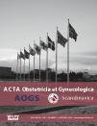
MODE OF DELIVERY
Department of Obstetrics, University Hospital, Lille, France
Retrospective analysis over a 13-year period.
To analyze mode of delivery and neonatal morbidity according to chorionicity in a hospital birth center with a policy of vaginal delivery for twins.
1009 twin pregnancies: 17% uncomplicated MC and 83% DC pregnancies.
The rate of CS was 45.7% with no difference found based on chorionicity.
The rate of UA cord blood values with a pH < 7.10 was similar in MC and DC.
There was no difference in neonatal complications between the two groups.
MC and DC twin pregnancies had similar delivery outcomes.
The neonatal outcome for twin 2 was not different between MC and DC pregnancies.
Vaginal birth could be offered to women with twin pregnancies regardless of chorionicity.
Charles Garabedian, Chloe Poulain, Alain Duhamel, Damien Subtil, Veronique Houfflin-Debarge, Philippe Deruelle
Intrapartum management of twin pregnancies: are uncomplicated monochorionic pregnancies
more at risk of complications than dichorionic pregnancies?
Acta Obstetricia et Gynecologica Scandinavica, March 2015, Volume 94, Issue 3, pages 301–307
Notes:
Objective
To analyze mode of delivery and neonatal morbidity according to chorionicity in a hospital birth center with a policy of vaginal delivery for twins.
Study design
Retrospective analysis over a 13-year period.
Setting
Department of Obstetrics, University Hospital, Lille, France.
Population
In all, 1009 twin pregnancies were included, divided into 171 uncomplicated monochorionic pregnancies (17%) and 838 dichorionic pregnancies (83%).
Methods
We compared the monochorionic and the dichorionic populations.
Main outcome measures
Rate of cesarean section and neonatal outcome (umbilical artery pH, Apgar score and neonatal complications).
Results
The rate of cesarean sections was 45.7% with no difference found based on chorionicity. The reasons for elective cesarean section were mainly noncephalic presentation, which was more frequent in dichorionic than in monochorionic (48.8% vs. 37.2%, p = 0.025) pregnancies. Birthweight was lower in monochorionic twins (2249 ± 469 g vs. 2329 ± 478 g, p = 0.045). The rate of umbilical artery cord blood values with a pH < 7.10 was similar in monochorionic and dichorionic pregnancies. There was no difference in neonatal complications between the two groups.
Conclusion
Monochorionic and dichorionic twin pregnancies had similar delivery outcomes. The neonatal outcome for twin 2 was not different between monochorionic and dichorionic pregnancies. Vaginal birth could be offered to women with twin pregnancies regardless of chorionicity.

Slide 25
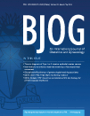
MODE OF DELIVERY
Department of Obstetrics and Gynaecology, Sheba Medical Centre, Ramat-Gan, Israel
A retrospective cohort study in the tertiary medical centre.
2194 women with twin pregnancies not complicated with very low birthweight: 59.8% had PLC and 40.2% underwent TOL.
Of the 883 women who underwent TOL, the rate of vaginal delivery was 86.9%, the rates of CS were 11.1% and combined vaginal–caesarean delivery 2.0%.
Presentation of second twin, gestational age and maternal age did affect the chances of success.
Nulliparity [odds ratio (OR) 2.38, 95% confidence interval (95% CI) 1.4–4.05], Foley induction of labour (OR 2.33, 95% CI 1.38–3.91) and BMI >30 kg/m² (OR 1.76, 95% CI 1.03–3) were independent risk factors for caesarean delivery.
The rate of vaginal delivery among women with twin pregnancies who undergo labour can be high, especially in women who laboured spontaneously and have delivered before.
in a hospital with a policy of vaginal delivery for twins…
H de Castro, J Haas, E Schiff, E Sivan, Y Yinon, E Barzilay
Trial of labour in twin pregnancies: a retrospective cohort study
BJOG, May 2016, Volume 123, Issue 6, Pages 940–945
Notes:
Objective
To assess the success rate of vaginal delivery among women with twin pregnancies;
the Twin Birth Study has shown that vaginal delivery and caesarean section are equally safe for twin delivery but >40% of the planned vaginal delivery group delivered by caesarean section.
Design
A retrospective cohort study.
Setting
A tertiary medical centre.
Population
A total of 2194 women with twin pregnancies not complicated with very low birthweight.
Methods
Planned mode of delivery was documented in the woman's electronic record upon entering the delivery room. Information regarding maternal age at delivery, parity, gestational age, presentation, previous history of caesarean delivery, birthweight and Apgar score was collected from the obstetric electronic charts.
Main outcome measured
Rate of vaginal twin delivery.
Results
Of the 2194 women included, 1311 twin pregnancies had planned caesarean delivery and 883 underwent a trial of labour. Of the 883 women who underwent a trial of labour, the rate of vaginal delivery was 86.9%, whereas the rates of caesarean delivery and combined vaginal–caesarean delivery were 11.1% and 2.0%, respectively. Presentation of second twin, gestational age and maternal age did affect the chances of success. Nulliparity [odds ratio (OR) 2.38, 95% confidence interval (95% CI) 1.4–4.05], Foley induction of labour (OR 2.33, 95% CI 1.38–3.91) and body mass index >30 kg/m² (OR 1.76, 95% CI 1.03–3) were independent risk factors for caesarean delivery.
Conclusions
The rate of vaginal delivery among women with twin pregnancies who undergo labour can be high, especially in women who laboured spontaneously and have delivered before.

Slide 26
MODE OF DELIVERY
Malpresentation of the second twin has the strongest association with emergency caesarean section for delivery of the second twin, increasing the intervention fourfold.
The rate of this event is as low as 2.2% in some centres but as high as 17% in others.
External cephalic version (ECV) is strongly advocated by some authors and the technique was endorsed by the ACOG.
Data from pooled observational studies suggest that vaginal delivery of a transverse, oblique or breech second twin is likely to be successful in only 45% of cases after ECV compared with 97% of cases with breech extraction with or without IPV.
Evidence of fetal compromise during delivery may be seen in as few as 1% of cases when breech extraction is employed, compared with 18% after ECV.
Webster SNE, Loughney AD.
Internal podalic version with breech extraction.
The Obstetrician & Gynaecologist 2011;13:7–14.
Notes:
Most women would prefer to avoid the vaginal delivery of one twin followed by delivery by caesarean section of the second twin. The rate of this event is as low as 2.2% in some centres but as high as 17% in others. In the largest cohort reported in the literature, the rate was 9.45%. Malpresentation of the second twin has the strongest association with emergency caesarean section for delivery of the second twin, increasing the intervention as much as fourfold. The data from these studies suggest that modern clinicians may be more confident delivering a malpresenting second twin abdominally rather than vaginally. It is also possible that the findings of the Term Breech Trial have had an impact on the management of twins, even though the trial protocol specifically excluded women with twin and preterm pregnancies from entering the study.
(The options for delivery of a non-cephalic second twin after the vaginal birth of the ﬁrst are summarised in Box1)
External cephalic version is strongly advocated by some authors and the technique was endorsed by the American College of Obstetricians and Gynecologists in 1988. Nevertheless, data from pooled observational studies suggest that vaginal delivery of a transverse, oblique or breech second twin is likely to be successful in only 45% of cases after external cephalic version compared with 97% of cases with breech extraction with or without internal podalic version.
These studies also suggest that evidence of fetal compromise during delivery may be seen in as few as 1% of cases when breech extraction is employed, compared with 18% after external cephalic version.
There is a clear need for a large-scale randomised controlled trial investigating the optimal mode of delivery for cephalic/non-cephalic twins. Nevertheless, current information suggests that the use of internal podalic version and breech extraction for the delivery of a second twin is a reasonable approach for a skilled obstetrician to take because of the high chance of success, the apparently low risk of fetal compromise and the avoidance of a potentially unnecessary caesarean section.

Slide 27
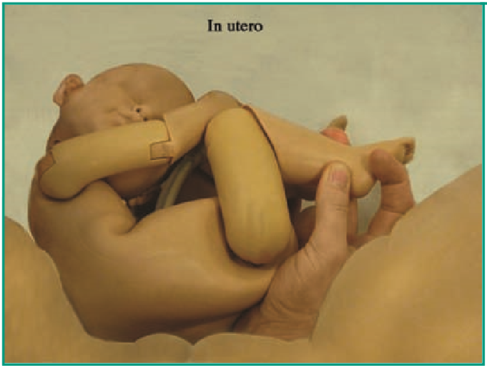
MODE OF DELIVERY
Current information suggests that the use of internal podalic version and breech extraction for the delivery of a second twin is a reasonable approach for a skilled obstetrician because of the high chance of success, the apparently low risk of fetal compromise and the avoidance of a potentially unnecessary caesarean section.
Webster SNE, Loughney AD.
Internal podalic version with breech extraction.
The Obstetrician & Gynaecologist 2011;13:7–14.
Notes:
Most women would prefer to avoid the vaginal delivery of one twin followed by delivery by caesarean section of the second twin. The rate of this event is as low as 2.2% in some centres but as high as 17% in others. In the largest cohort reported in the literature, the rate was 9.45%. Malpresentation of the second twin has the strongest association with emergency caesarean section for delivery of the second twin, increasing the intervention as much as fourfold. The data from these studies suggest that modern clinicians may be more confident delivering a malpresenting second twin abdominally rather than vaginally. It is also possible that the findings of the Term Breech Trial have had an impact on the management of twins, even though the trial protocol specifically excluded women with twin and preterm pregnancies from entering the study.
(The options for delivery of a non-cephalic second twin after the vaginal birth of the ﬁrst are summarised in Box1)
External cephalic version is strongly advocated by some authors and the technique was endorsed by the American College of Obstetricians and Gynecologists in 1988. Nevertheless, data from pooled observational studies suggest that vaginal delivery of a transverse, oblique or breech second twin is likely to be successful in only 45% of cases after external cephalic version compared with 97% of cases with breech extraction with or without internal podalic version.
These studies also suggest that evidence of fetal compromise during delivery may be seen in as few as 1% of cases when breech extraction is employed, compared with 18% after external cephalic version.
There is a clear need for a large-scale randomised controlled trial investigating the optimal mode of delivery for cephalic/non-cephalic twins. Nevertheless, current information suggests that the use of internal podalic version and breech extraction for the delivery of a second twin is a reasonable approach for a skilled obstetrician to take because of the high chance of success, the apparently low risk of fetal compromise and the avoidance of a potentially unnecessary caesarean section.

Slide 28
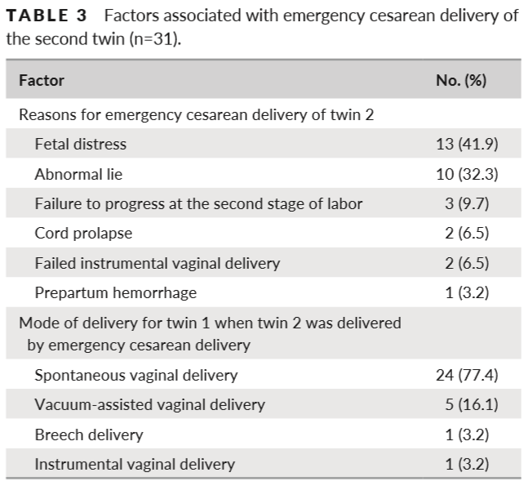
MODE OF DELIVERY
6.4% women who attempted a TOL, required an emergency cesarean to deliver the second twin.
Abnormal lie, suspected fetal compromise, and failed IVD were the most frequent indications for emergency cesarean delivery of the second twin.
Improvement in the CTG interpretation by continuous training of all staff in EFM, and hands-on in IPV and IVD could help to reduce the rate of emergency cesarean for the second twin.
5-minute Apgar scores of 9 or 10 were observed among most twins, irrespective of mode of delivery.
Vaginal delivery can be safely and successfully achieved for almost two-thirds of DCDA twins.
Ewelina Rzyska, Bini Ajay, Edwin Chandraharan
Safety of vaginal delivery among dichorionic diamniotic twins over 10 years in a UK teaching hospital
Int J Gynecol Obstet 2017; 136: 98–101
Notes:
A retrospective study on the safety of vaginal delivery among DCDA twins was conducted at a large teaching hospital (St George’s University Hospitals NHS Foundation Trust, London, UK).
The local protocol mandates that all twin deliveries should be directly supervised by a consultant or a senior registrar with at least 5 years of obstetric experience to improve maternal and neonatal outcomes.
Of the 474 women who attempted a vaginal delivery, only 31 (6.4%) required an emergency cesarean to deliver the second twin. This value is similar to a previously reported rate of 9.5%. Abnormal lie, suspected fetal compromise, and failed instrumental vaginal delivery were the most frequent indications for emergency cesarean delivery of the second twin after successful vaginal delivery of the first twin.
Improvement in the interpretation of cardiotocographic data by continuous training of all staff in fetal monitoring could help to reduce the rate of emergency cesarean delivery for the second twin, as might hands- on training in IPV and instrumental vaginal deliveries. The maternity unit of the present study center offers hands- on training for instrumental vaginal deliveries and currently has the lowest reported failed instrumental delivery rate in the UK. This policy might explain the low rate of failed instrumental vaginal delivery recorded for both first and second twins in the present study.
Of note, 5- minute Apgar scores of 9 or 10 were observed among most twins, irrespective of their mode of delivery.

Slide 29
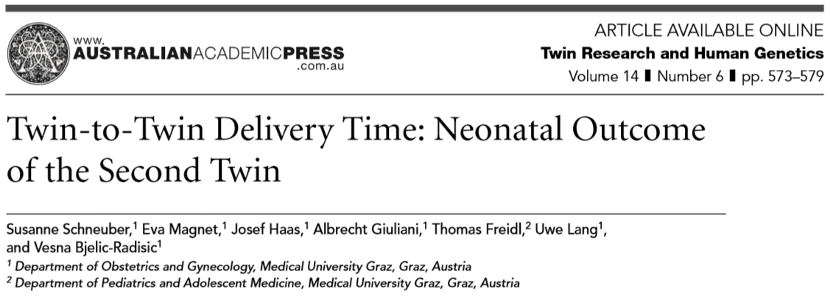
NEONATAL RESULTS
Increasing TTDT was not associated with a significant decline of the umbilical cord pHart.
The data do not suggest a clear cut-off level of TTDT to identify a higher probability of fetal acidosis.
TTDT was not considered to have any significant effect on the acid-base status or perinatal mortality of second twins.
It is impossible to assess the influence of the time factor on the status of the second twin because in cases with suspicious cardiotocogram there was an obvious necessity for delivery by intervention.
In cases of uncomplicated twin delivery with a normal cardiotocogram there is no necessity for the second twin to be born as soon as possible after the birth of the first twin.
Schneuber S., Magnet E., Haas J., Giuliani A., Freidl T., Lang U., Bjelic-Radisic V.
Twin-to-twin delivery time: Neonatal outcome of the second twin.
Twin Research and Human Genetics, December 2011, Volume 14, Number 6, pp. 573–579
Notes:
Objective:
To examine the effect of twin-to-twin delivery time (TTDT) on neonatal outcome.
Methods:
We evaluated twin deliveries >34 weeks of gestation.
Twin pregnancies with both twins delivered by cesarean section and pregnancies with antenatal complications were excluded.
We analyzed TTDT and neonatal outcomes of the second twin (umbilical arterial pH value (pHart), Apgar scores at 1, 5 and 10 minutes, need for intensive care).
The study population was divided into two homogenous groups based on the mode of delivery:
(A) vertex presentation and vaginal delivery of both twins,
(B) vertex presentation and vaginal or vaginal operative delivery of twin I, breech or transverse presentation and vaginal breech delivery or cesarean section (CS) of twin II.
Results:
A total of 207 twin pairs were included in our study. In Group A ( n = 151) there were no significant correlations between TTDT and pHart or Apgar scores at 1,5 and 10 minutes of twin II ( p = .156; 0.861; 0.151 and 0.384, respectively). In Group B ( n = 56), the mean pHart of twin II was inversely correlated to TTDT, but not significantly ( p = .417). TTDT was inversely related to 1-min and 5-min Apgar scores, but not significantly ( p = .330; p = .138, respectively). The 10-min Apgar score showed no correlation with TTDT ( p = .638).
Conclusion: Increasing TTDT was not associated with adverse fetal outcome. Expectant management of the second twin appears possible and elapsed time alone does not appear to be an indication for intervention.
In conclusion, our data suggest that:
Increasing TTDT by itself has no influence on neonatal morbidity.
Expectant management of the second twin is reasonable and no intervention is necessary on the basis of time only.
Continuous FHR monitoring of the second twin is important to ensure good perinatal outcome.
Based on our data the following recommendations are justified:
In twin pregnancies > 34 weeks of gestation with both fetuses in vertex presentation TTDT is of minor importance and twin II need not be delivered promptly after twin I, if constant fetal monitoring is guaranted and immediate operative delivery is possible.
Even in those cases, in which twin I is in vertex presentation and twin II is in breech presentation, expectative management is justified, as long as fetal monitoring is guaranted and the option of immediate operative delivery readily available.

Slide 30
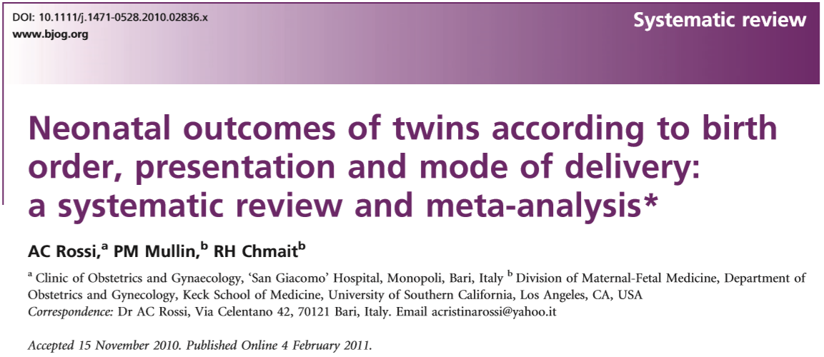
NEONATAL RESULTS
Systematic review suggests that an attempt at vaginal delivery should be considered in twin pregnancies.
In V/V twins, vaginal delivery is safer than caesarean section for the ﬁrst twin, with no differences observed for the second twin after VB or CS.
In V/NV pregnancies, women should be counselled that trial of labour is a safe option in the absence of risk factors that may increase the risk of a caesarean delivery of the second twin after VB of the ﬁrst twin.
Predicting combined delivery in the antenatal period is almost impossible.
Randomized control trials might not be feasible to perform because delivery of twins is highly inﬂuenced by the operator’s skill and experience
Rossi A, Mullin P, Chmait R.
Neonatal outcomes of twins according to birth order, presentation and mode of delivery: a systematic review and meta-analysis.
BJOG 2011;118:523–532.
Notes:
In the absence of more deﬁnitive data, our systematic review suggests that an attempt at vaginal delivery should be considered in twin pregnancies. Current literature shows that in twins with vertex/vertex presentation, vaginal delivery is safer than caesarean section for the ﬁrst twin, and no differences are observed for the second twin after vaginal or caesarean section. In pregnancies with vertex presentation of the ﬁrst twin and nonvertex presentation of the second twin, women should be counselled that trial of labour is a safe option in the absence of risk factors that may increase the risk of a caesarean delivery of the second twin after vaginal delivery of the ﬁrst twin, although predicting combined delivery in the antenatal period is almost impossible. Multicentre, randomised studies are needed to assess guidelines about the optimal mode of delivery for twin pregnancies. However, randomised control trials might not be feasible to perform because delivery of twins is highly inﬂuenced by the operator’s skill and experience.

Slide 31
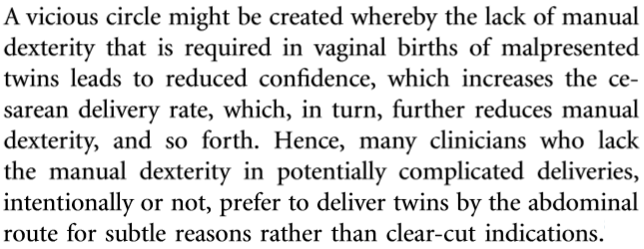
OBSTETRICAL TACTIC
American Journal of Obstetrics & Gynecology MARCH 2016, p. 308-310

Slide 32
OBSTETRICAL TACTIC
The potential effects of the choice of planned mode of delivery in speciﬁc clinical circumstances are complex, and extend beyond the easily measurable clinical outcomes, to less obvious consequences such as emotional effects on the mother, her sense of self-esteem and her relationship with her child or children.
Because of consistent trend to more long-term neurological sequale following medical interventions during childbirth than would be expected on the basis of the short-term perinatal outcomes, clinical decisions must be based on long-term rather than short-term outcomes.
Medical interventions in the birth process such as caesarean section should be avoided unless there is reasonable clinical certainty that they will be of long-term beneﬁt.
Hofmeyr GJ, Barrett JF, Crowther CA.
Planned caesarean section for women with a twin pregnancy.
Cochrane Database of Systematic Reviews 2015, Issue 12
Notes:
Summary of main results:
There were no differences in perinatal or maternal outcomes between the groups of women randomised to planned caesarean versus vaginal birth for any of the primary or secondary outcomes reported.
The potential effects of the choice of planned mode of delivery in speciﬁc clinical circumstances are complex, and extend beyond the easily measurable clinical outcomes, to less obvious consequences such as emotional effects on the mother, her sense of self-esteem and her relationship with her child or children.
Previous large randomised trials of interventions associated with more medical intervention in the birth process, which have included long-term follow-up of the children, have shown unexpected discordance between short-term perinatal morbidity and long-term neurodevelopmental outcomes. Two examples are planned caesarean section for term breech presentation, and continuous electronic fetal monitoring and scalp blood sampling during labour. In the Term Breech Trial, in countries with low perinatal mortality rates, there were three perinatal deaths and 26 babies with severe perinatal morbidity of 511 in the planned vaginal birth group, compared with no deaths and severe perinatal morbidity in two of 514 babies following planned caesarean section (Hannah 2000). One would have expected less neurodevelopmental delay at two years in the planned caesarean section group, but the trend (though not statistically signiﬁcant) was in the opposite direction: 12/457 compared with 7/463 in the planned vaginal birth group (Whyte 2004).
In the Dublin trial of continuous cardiotocography during labour, neonatal seizures occurred in 12 of 6530 babies following continuous electronic monitoring during labour, and 27 of 6554 following intermittent auscultation (Macdonald 1985). There were 14 perinatal deaths in each group. Despite there being far fewer cases of neonatal seizures in the continuous electronic monitoring group, the rate of subsequent cerebral palsy was similar between groups: 12/6527 versus 10/6552 respectively (Grant 1989). Similar comparisons in the Seattle trial of continuous electronic monitoring and scalp blood sampling for preterm labour were: seizures 7/122 versus 7/124 (Luthy 1987); cerebral palsy 16/82 versus 7/ 91, respectively (Shy 1990). Because of this consistent trend to more long-term neurological sequale following medical interventions during childbirth than would be expected on the basis of the short-term perinatal outcomes, clinical decisions must be based on long-term rather than short-term outcomes. As more data relevant to this review become available, it is important that the implications of short-term perinatal morbidity be interpreted with caution, and the results of long-term follow-up be awaited. As the study of Barrett 2013 was a multicentre trial with a wide geographic distribution, the results should be applicable to a variety of clinical settings. However, caution should be exercised in applying the evidence to settings without ready access to caesarean section, or where there may not be access in subsequent pregnancies.
Implications for practice:
Data mainly from one large, multicentre study found no clear evidence of beneﬁt from planned caesarean section for term twin pregnancies with leading cephalic presentation. Data on long-term infant outcomes are awaited. Women should be informed of possible risks during labour and vaginal birth pertinent to their speciﬁc clinical presentation, as well as the beneﬁcial perinatal effects of labour and vaginal birth, and the current and long-term effects of caesarean section for both mother and babies.
Medical interventions in the birth process such as caesarean section should be avoided unless there is reasonable clinical certainty that they will be of long-term beneﬁt.
There is insufﬁcient evidence to support the routine use of planned caesarean section for term twin pregnancy with leading cephalic presentation, except in the context of further randomised trials.
Trials are also needed to assess the usefulness of planned caesarean section for preterm twin pregnancy.

Slide 33
CONCLUSIONS
Preserving the art of obstetric maneuvering is important as well for twin deliveries. In cases of V/NV presentation, vaginal delivery is preferred in certain conditions.
Pope RJ, Weintraub AY, Sheiner E
Vaginal delivery of vertex-nonvertex twins: a fading skill?
Arch Gynecol Obstet., Aug 2010, 282(2):117-20.
When appropriate criteria are used to decide mode of delivery, a careful intrapartum protocol is followed, and an experienced obstetrician, midwife, and anesthesiologist are in attendance, attempted vaginal delivery is a reasonable option for first twins in breech position.
LOÏC SENTILHES, FRANÇOIS GOFFINET, ALAIN TALBOT, ALAIN DIGUET,
ERIC VERSPYCK, DOMINIQUE CABROL, LOÏC MARPEAU
Attempted vaginal versus planned cesarean delivery in 195 breech first twin pregnancies
Acta Obstetricia et Gynecologica Scandinavica, January 2007, Volume 86, Issue 1, Pages 55–60.
Scientific evidence and society opinion are likely insufficient to reverse the national trends favoring cesarean delivery for twins. Without novel provider-focused strategies, we may passively relinquish the requisite skills for not only our patients, but for future generations of obstetricians.
Sarah Rae Easter, Laura Taouk, Jay Schulkin, Julian N. Robinson
Twin Vaginal Delivery: Innovate or Abdicate
American Journal of Obstetrics & Gynecology , Feb 7, 2017.

Slide 34
THANK YOU!
It’s time to go back to the “barn”…
Notes:
A catch-22 situation:
an impossible situation where you are prevented from doing one thing until you have done another thing that you cannot do until you have done the first thing

