Slide 1
General approach to gynecological emergencies
Agnieszka Horała, MD
ENTOG Executive Member
Poznan University of Medical Sciences

Slide 2
Reasons for Gynecologic Emergency Consultation
88%
J Gynecol Obstet Biol Reprod (Paris). 2012 [Gynecological emergencies: etiology and degree of gravity]. Alouini S, Mesnard L, Coly S, Dolique M, Lemaire B.
Notes:
95%) came from their own initiative;
The mean age of the patients was of 31±11years a
181 (88%) abdominal/pelvic or lumbar pain and or metrorragia.
Most of the patients consulted for minor obstetrical or gynecological pathologies without relation with the function of Emergency department. Ectopic pregnancy remains a rare event. Better information of the users on the significance of the urgency is desirable.
For 94 patients (46%), the diagnosis was an asymptomatic intra-uterine pregnancy in 41 cases or associated with minor symptoms.
21 patients (8.9%) consulted for menstruation with or without dysmenorrhea,
17 (8,3%) had a miscarriage,
14 (7%) a genital infection,
11 (5%) an ovarian pathology
8 (4%) an ectopic pregnancy or its follow-up.
7 axillary lymphocele or a breast tumor
4 symptomatic myomas.
6 non-gynecological pathologies.
23 (11%) no organic cause was found.
Only 24 patients (12%) were hospitalized and
9 (4.5%) operated.
2

Slide 3
Emergency!
A
Initial assessment of the patient
Vital signs
B
Identify life-threatening conditions requiring emergent management
C
Detailed diagnosis:
in- or outpatient treatment?

Slide 4
Modified Early Warning Score (MEWS) for Clinical Deterioration
Score of ≥5 is associated with a higher likelihood of admission to an intensive care unit or death
Notes:
used for the early detection of clinical deterioration and potential need for higher level of care
threshold score of 5 or more has been shown to be associated with a higher likelihood of admission to an intensive care unit or death
Early warning system - Early warning criteria, as well as differential diagnoses for each, have been developed to speed identification and treatment, and thereby lessen the impact of, maternal morbidities (table 2 and table 3) [83]. These criteria are designed to trigger a response by an appropriately trained care team. The success of such a trigger-based system requires education and training for all clinical staff so they can identify the triggers, clearly identified clinical responders who react to such triggers, and a system for communication among the care teams. The purpose of an early warning system is to facilitate early diagnosis and treatment. These criteria do not identify every maternal complication nor are they designed to replace clinical judgment. In a prospective observational study of over 1000 deliveries, a maternal early warning charting system had positive and negative predictive values of 53.8 and 96.9 percent, respectively, for the identification of maternal morbidity [84,85]
4

Slide 5
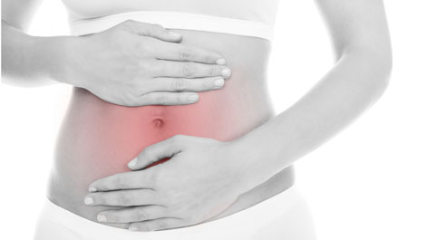
Abdominal Pain
Bleeding
Ectopic pregnancy
Ovarian torsion
Ruptured ovarian cyst
Degenerating fibroid
Pelvic Inflammatory Disease/Tubo-ovarian abscess/Endometritis
Pelvic endometriosis
Ovarian Hyperstmulation Syndrome
Vulvar abscess
Miscarriage/abortion
Severe vaginal bleeding
Abnormal menses/dysmenorrhea
Postoperative complications

Slide 6
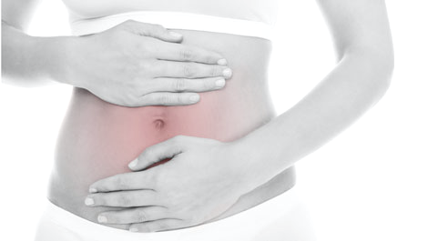
Differential diagnosis
Gastrointestinal
Appendicitis
Bowel obstruction
Diverticulitis
Inflammatory bowel disease
Irritable bowel syndrome
Strangulated or incarcerated hernia
The uterus, cervix, and adnexa share the same visceral innervation as the lower ileum, sigmoid colon, and rectum.
Miscellaneous
Urinary tract infection/calculi
Pelvic thrombophlebitis
Aneurysm
Notes:
The uterus, cervix, and adnexa share the same visceral innervation as the lower ileum, sigmoid colon, and rectum.

Slide 7
Gathering information
Medical history (location, charater, onset and duration, surgery, diseases)
Physical examination –
Vital signs should be obtained immediately
Abdomen: inspection, palpation, auscultation +/- percussion
pelvic examination (external genitalia, speculum +/-microbiological samples, bimanual examination)
rectovaginal examination if indicated
Laboratory tests (beta hCG, complete blood count, urinalysis, CRP)
Imaging (ultrasound)
Doctors who completed ambulatory training in general medicine accurately predicted diagnosis in 65% of cases from a simple patient questionnaire
Uehara et al. Int J Gen Med. 2014
Notes:
A pregnancy test should be obtained in all women of reproductive age presenting with acute pelvic pain.

Slide 8
Abdominal Pain + beta HCG (+)
Miscarriage
8-20% of pregnancies (1:12-1:5)
Ectopic pregnancy
0.4-1.7% of pregnancies (1:60-1:250)
Ovarian tumor producing hCG
0.2% of ovarian tumors (1:500)
Ov Tu during pregnancy: 1-2% -> 1:50000
80% occur in the first 12 weeks
Notes:
But the actual rate of miscarriage is even higher since many women have very early miscarriages without ever realizing that they are pregnant. One study that followed women's hormone levels every day to detect very early pregnancy found a total miscarriage rate of 31 percent

Slide 9
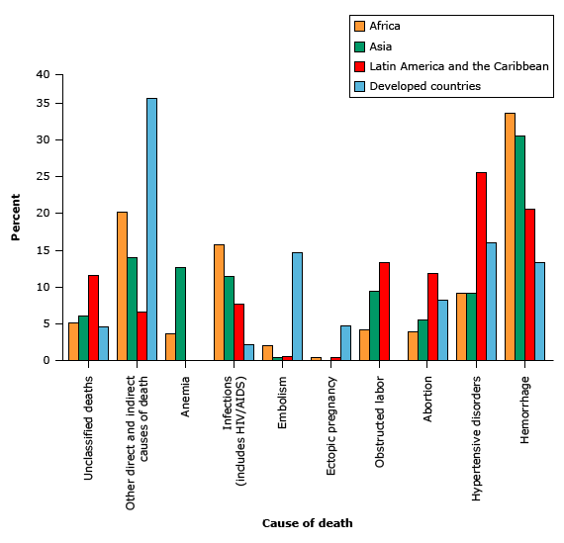
Abdominal Pain + beta HCG (+): Miscarriage/Abortion
Worldwide, abortion accounts for approximately 14% of pregnancy-related deaths, and septic abortion is a major cause of the deaths from abortion.
Threatened
Inevitable
Incomplete
Complete
Septic
„unsafe”
In the United States, mortality from septic abortion rapidly declined after legalization of abortion. Death now occurs in less than 0,6 per 100,000 abortions. Figures for most European countries are similar to US rates.
Zane S et al. Abortion-Related Mortality in the United States 1998–2010. Obstet Gynecol. 2015.
Khan KS, Wojdyla D, Say L, Gülmezoglu AM, Van Look PF. WHO analysis of causes of maternal death: a systematic review. Lancet 2006; 367:1066.
Notes:
Unsafe abortion generally refers to termination of unwanted pregnancy either by persons lacking the necessary skills or
it being performed in an environment lacking the minimal medical standards, or both
Treatment : early curettage to remove infected and devitalized tissue even in the face of continued fetal heart tones. Important secondary treatments are the administration of fluids and antibiotics.
Treatment is intensive antibiotic therapy plus uterine evacuation as soon as possible. A typical antibiotic regimen includes clindamycin 900 mg IV q 8 h plus gentamicin 5 mg/kg IV once/day, with or without ampicillin 2 g IV q 4 h. Alternatively, a combination of ampicillin, gentamicin, and metronidazole 500 mg IV q 8 h can be used.

Slide 10
Abortion: Mortality
USA: 1998–2010, 16.1 million abortion Overall mortality rate: 0.7 deaths per 100,000 abortions
weeks of gestation | Mortality per 100,000 | Main causes
<8 | 0.3 | anesthesia complications and infection
9-13 | 0.5
14-17 | 2.5 | infection and hemorrhage
>18 | 6.7
20 of the 108 cases, the abortion was performed as a result of a severe medical condition where continuation of the pregnancy threatened the woman’s life
Zane S et al. Abortion-Related Mortality in the United States 1998–2010. Obstet Gynecol. 2015
Notes:
Unsafe abortion generally refers to termination of unwanted pregnancy either by persons lacking the necessary skills or
it being performed in an environment lacking the minimal medical standards, or both
Treatment : early curettage to remove infected and devitalized tissue even in the face of continued fetal heart tones. Important secondary treatments are the administration of fluids and antibiotics.
Treatment is intensive antibiotic therapy plus uterine evacuation as soon as possible. A typical antibiotic regimen includes clindamycin 900 mg IV q 8 h plus gentamicin 5 mg/kg IV once/day, with or without ampicillin 2 g IV q 4 h. Alternatively, a combination of ampicillin, gentamicin, and metronidazole 500 mg IV q 8 h can be used.

Slide 11
Septic/unsafe Abortion
Symptoms: 24 to 48 h after abortion, similar to pelvic inflammatory disease (e.g. chills, fever, vaginal discharge, often peritonitis and vaginal discharge, which may be thick and may have a foul odor)
Perforation of the uterus
Septic shock - hypothermia, hypotension, oliguria, respiratory distress (MEWS!)
Lab: aerobic and anaerobic cultures of blood, CBC, liver function tests, electrolyte levels, glucose, BUN, creatinine
Treatment : early curettage + fluids + antibiotics (clindamycin + gentamycin + ampicillin/metronidazole) 14d
Case fatality – 3.3% (0-22%)
Eschenbach DA. Treating spontaneous and induced septic abortions. Obstet Gynecol. 2015
Contemporary Gynecologic Practice - Overview of Gynaecological Emergencies - D.S. Abam

Slide 12
Adnexal mass + beta HCG = germ cell tumor
Malignant germ cell tumors constitute 5% of all malignant OvTu
Embryonal carcinoma
4 % of malignant OGCTs
one of the most aggressive OvTu
average age at diagnosis: 15 years
most of these neoplasms produce hCG, some also AFP
Dysgerminoma
2% of ovarian tumors
80% in women <30y
20% are diagnosed during pregnancy (!)
3-5% produce hCG
Mixed germ cell tumors
5.3% of malignant OGCTs
Other markers:
lactate dehydrogenase (LDH)
alpha fetoprotein (AFP)
solid tumors
large lobulated
vascular
Jung S. Ultrasonography of ovarian masses using a pattern recognition approach. Ultrasonography 2015
Notes:
large solid tumors that are more common in younger women. dysgerminoma appear as large lobulated solid tumor with prominent fibrovascular core and minimal necrosis

Slide 13
Ovarian/Tube/Adnexal Torsion
5th most common surgical emergency:
ectopic pregnancy
corpus luteum rupture with hemorrhage
pelvic inflammatory disease
appendicitis
ovarian mass predisposes to ovarian torsion, esp. >5cm
may occur in normal ovaries, particularly in the pediatric population
right ovary is more likely to torse (right utero-ovarian ligament is longer + sigmoid colon)
Incidence: unknown
2.7%-7.4% of all gynaecological emergencies
174 pregnant women with a persistent adnexal mass ≥4 cm: 15%
OHSS - 8%
Bouguizane S et al. Adnexal torsion: a report of 135 cases. J Gynecol Obstet Biol Reprod (Paris) 2003
Damigos E. An update on the diagnosis and management of ovarian torsion. The Obstetrician&Gynecologist 2012.
Notes:
Ovarian torsion refers to the complete or partial rotation of the ovary on its ligamentous supports, often resulting in impedance of its blood supply
When ovarian torsion occurs, the ovary typically rotates around both the infundibulopelvic ligament and the utero-ovarian ligament. The fallopian tube often twists along with the ovary; when this occurs, it is referred to as adnexal torsion
As the size of the mass increases, the risk of torsion increases, until the mass becomes large enough to be fixed in place in the pelvis
There are some data regarding the rate of torsion among patients presenting for gynecologic care to an acute care setting. In a classic report of a 10-year review of patients at a women's hospital, ovarian torsion accounted for 2.7 percent of emergency surgeries [22]. Torsion was the fifth most common surgical emergency, preceded by (in descending order) ectopic pregnancy, corpus luteum rupture with hemorrhage, pelvic inflammatory disease, and appendicitis. In a 10-year review of surgically treated adnexal masses, torsion accounted for 15 percent of cases [23].
Normal ovaries — It is important to note that torsion may occur in the presence of normal ovaries, particularly in the pediatric population [36]. In children under the age of 15 years, normal ovaries have been demonstrated in over 50 percent of patients with ovarian torsion [37,38]. As an example, one large series of patients with adnexal torsion reported that 23 of 103 patients (22 percent) had no identifiable adnexal lesion [24]. In another study, 12 of 22 patients under the age of 15 years with adnexal torsion had normal ovaries visualized at laparoscopy [37]. Asynchronous bilateral torsion of normal ovaries has also been reported [39,40].
The incidence of torsion during pregnancy is uncertain; one five-year retrospective study reported 7 cases out of 4274 deliveries (0.2 percent) [42]. In a series of 174 pregnant women with a persistent adnexal mass ≥4 cm, the incidence of torsion was 15 percent [43]. Torsion was most likely between 10 and 17 weeks of gestation, but occurred through term and the postpartum period. Ovarian masses 6 to 8 cm in diameter were more likely to undergo torsion than larger masses, although torsion occurred in women with masses that were 10 to 20 cm.
During pregnancy: 7/4274 deliveries (0.2%)

Slide 14
Ovarian torsion
SYMPTOMS
Pelvic pain (90%) of sudden onset (59%) sharp, stabbing, colicky, or crampy, and may radiate to the flank, back, or groin.
USG
ovary rounded and enlarged compared with the contralateral ovary
Adnexal mass (86-95%)
Nausea and vomiting (47-70%)
Fever (2-20%)
Abnormal genital tract bleeding (4%)
Decreased or absent Doppler flow within the ovary
Multiple small peripheral follicles (“string of pearls”)
reported sensitivity of ultrasound for the diagnosis of ovarian torsion: 46-75%
SYMPTOMS
USG
Notes:
1. Examination: Peritoneal signs are present in a small number of patients, and should raise concern for adnexal necrosis.
2. USG - Multiple small peripheral follicles (“string of pearls”) – This is thought to be due to displacement by edema. This feature is also seen in polycystic ovarian syndrome, although in polycystic ovaries, the stroma is echogenic centrally, the ovary does not appear edematous, and the patient does not have acute pain
3. Decreased or absent Doppler flow within the ovary. Since the ovary has a dual blood supply, flow can be present even in the presence of torsion. Arterial flow in systole without flow in diastole is evidence for outflow obstruction. Venous flow in the setting of torsion is associated with ovarian viability.
4. The reported sensitivity of ultrasound for the diagnosis of ovarian torsion ranges from 46 to 75 percent [61,70]. abnormal ovarian location (sensitivity: 90 percent and specificity: 68 percent); free fluid around ovary or in posterior cul-de-sac (89 and 54 percent); ovarian cyst/mass (83 and 70 percent); and abnormal ovarian blood flow (80 and 54 percent) [70].
5. In a woman with acute pelvic pain and an adnexal mass, ectopic pregnancy, a ruptured ovarian cyst, and tuboovarian abscess should be excluded. A negative serum human chorionic gonadotropin excludes ectopic pregnancy. Appendicitis

Slide 15
Ovarian torsion
32-year-old with right lower quandrant pain and right ovarian torsion. (A) Transvaginal color Doppler ultrasound shows an enlarged edematous appearing right ovary without demonstrable flow. (B) Transvaginal color Doppler ultrasound of the left ovary shows a normal sized ovary with normal flow.
Carolyn S et al. Ultrasonography of adnexal causes of acute pelvic pain in pre-menopausal non-pregnant women. Ultrasonography 2015

Slide 16
Ovarian torsion – Management: to save or not to save?
ovaries with bluish appearance have been thought to be nonviable
multiple studies have found that ovaries that were blue/black retained function – follicular development after detorsion was >80%
Damigos E. An update on the diagnosis and management of ovarian torsion. The Obstetrician&Gynecologist 2012.
Notes:
Traditionally, ovaries with this appearance have been thought to be nonviable, but multiple studies have found that many women (even those with an ovary that is blue or black) retain ovarian function following detorsion [81,83-90]. In studies with ultrasound follow-up, the rate of follicular development after detorsion was 80 percent or higher [75,86,89,90]. As an example, in a study of 40 women with ovarian torsion who had a “bluish-black” appearance of the ovary at surgery and underwent detorsion, normal follicular development was demonstrated on ultrasound in 35 of 37 patients who were followed after surgery [86]. A possible explanation of the viability of ovarian tissue, based upon rat data, is that total arterial occlusion may not be present in the torsed ovary despite venous and lymphatic congestion [91].
Other approaches have been proposed to assess whether ovarian perfusion is present, but these are investigational. One technique is ovarian bivalving, in which the ovary is untwisted and the ovarian cortex incised. In our practice, we make the incision with a laparoscopic instrument with an electrosurgical “L-hook” needle tip attachment. This method allows visualization of whether blood flow is present at the incision. In addition, there is a potential therapeutic effect by relieving the increased pressure exerted by the lymphatic and venous congestion (picture 2A-C) [92,93]. This approach was reported in one series of five patients who underwent bivalving, four of whom had normal postoperative follicular development documented by ultrasound [92].
Fetuses and neonates — Ovarian masses in a fetus are occasionally detected on prenatal ultrasound and are followed with serial sonography. In-utero ovarian torsion may occur, in which case, the ovary may undergo necrosis and develop into a calcified persistent mass or resorb. Prenatal puncture of ovarian cysts thought to be at risk for torsion has been described, but is investigational [101]. Consultation with a maternal-fetal medicine specialist is advised.

Slide 17
Ovarian torsion – Prevention OF Recurrence
assessed risk of recurrence: 2%-5%; more common in children (2%-11.4%)
Suppression of ovarian cysts – high dose oral contraceptives
Shortening of the utero-ovarian ligament
Oophoropexy
Notes:
Oophoropexy - The procedure can be performed laparoscopically and we typically shorten the utero-ovarian ligament or, if the ovary is greatly enlarged without a discrete mass, then it can be sutured to the uterosacral ligament (
– Unilateral or bilateral oophoropexy following ovarian detorsion (no high quality data regarding the efficacy)
tive in reducing the recurrence rate.47 There are case reports in the literature of fixing the de-torted ovary, or contralateral ovary, to the back of the uterus, or shortening of the utero-ovarian ligament. These reports are mainly in children and adolescents, however, long-term outcomes in these cases are unclear.43

Slide 18
Abdominal Pain: Hemorrhagic Cyst
An image from a 28-year-old female with right pelvic pain (A) demonstrates the lace-like pattern of fibrin strands that forms with clot hemolysis (B) more peripheral and solid-appearing retracting clot
Carolyn S et al. Ultrasonography of adnexal causes of acute pelvic pain in pre-menopausal non-pregnant women. Ultrasonography 2015

Slide 19
Abdominal Pain: Ovarian Hyperstimulation Syndrome
fertility treatments
incidence of severe OHSS 0.2-1% of all stimulation cycles (WHO)
Europe: hospitalisation due to OHSS 0.3% in 2010 USA: the commonest complication of IVF treatment
Ovulatory hCG injection — essential
PCOS – risk factor (RR 6.8)
shift of serum from the intravascular space to the third space, enhanced vascular permeability
RCOG, Green-top Guideline No. 5 - The Management of Ovarian Hyperstimulation Syndrome, 2016
Notes:
Ovarian hyperstimulation syndrome (OHSS) occurs when the ovaries are hyperstimulated and enlarged due to fertility treatments (or rarely, mutations in the follicle-stimulating hormone [FSH] receptor), resulting in the shift of serum from the intravascular space to the third space, mainly to the abdominal cavity. In its severe form, OHSS is a life-threatening condition because it can cause venous or arterial thromboembolic events, including stroke and loss of perfusion of an extremity. OHSS is the most serious complication of controlled ovarian hyperstimulation (COH) for assisted reproduction technologies (ART). It is a broad spectrum of signs and symptoms that include abdominal distention and discomfort, enlarged ovaries, ascites, and other complications of enhanced vascular permeability
Increased vascular permeability leads to loss of fluid into the third space, manifesting as ascites or, less commonly, pleural and pericardial effusions. Women with severe OHSS demonstrate hypovolaemia, with a typical loss of 20% of their calculated blood volume in the acute phase of OHSS. 5

Slide 20
Ovarian Hyperstimulation Syndrome
3.1% to 8%
Mild (30%) | Moderate | Severe | Critical
Abdominal bloating Mild abdominal pain Ovarian size usually < 8 cm3 | Moderate abdominal pain Nausea ± vomiting Ultrasound evidence of ascites Ovarian size usually 8–12 cm3 | Clinical ascites (± hydrothorax) Oliguria (< 300 ml/day or < 30 ml/hour) Haematocrit >0.45 Hyponatraemia (Na<135 mmol/l) Hypo-osmolality (osmolality <282 mOsm/kg) Hyperkalaemia (K+> 5 mmol/l) Hypoproteinaemia (serum albumin < 35 g/l) Ovarian size >12 cm3 | Tense ascites/ large hydrothorax Haematocrit >0.55 White cell count >25000/ml Oliguria/anuria Thromboembolism Acute respiratory distress syndrome
The 14th European IVF-Monitoring report
Notes:
cystic enlargement of the ovaries with ascites or pleural and pericardial effusion
Rarely, OHSS may be associated with life-threatening complications, including renal failure, acute respiratory distress syndrome (ARDS), haemorrhage from ovarian rupture, and thromboembolism.

Slide 21
Ovarian Hyperstimulation Syndrome
DIAGNOSIS — clinical history of stimulation followed by administration of human chorionic gonadotropin (hCG) + transvaginal ultrasound
TREATMENT
Paracetamol/opiates for pain relief NSAIDs should be avoided (compromise of renal function)
Paracentesis
Consider thromboprophylaxis in severe OHSS
Estimated mortality rate: 1/45 000- 1/500 000, mostly due to thromboembolic complications
Jung S. Ultrasonography of ovarian masses using a pattern recognition approach. Ultrasonography 2015
Notes:
The symptoms of OHSS are not specific
combination of elevated haematocrit and reduced serum osmolality and sodium is indicative of OHSS
Important differential diagnoses include pelvic infection, pelvic abscess, appendicitis, ovarian torsion or cyst rupture, bowel perforation and ectopic pregnancy. OHSS should not, therefore, be the ‘default diagnosis’ for women presenting with abdominal pain during fertility treatment
Women with severe OHSS are at increased risk of thromboembolism .Although there are no trials on this subject, thromboprophylaxis should be provided for these women in view of the serious nature of this complication
management of established ovarian hyperstimulation syndrome (OHSS) should be conservative and directed at symptoms; many women can be managed as outpatients. However, women with severe or critical OHSS require hospitalization
Hospital admission should be considered for women who: ● are unable to achieve satisfactory pain control ● are unable to maintain adequate fluid intake due to nausea ● show signs of worsening OHSS despite outpatient intervention ● are unable to attend for regular outpatient follow-up ● have critical OHSS
Indications for paracentesis include the following: ● severe abdominal distension and abdominal pain secondary to ascites ● shortness of breath and respiratory compromise secondary to ascites and increased intra-abdominal pressure ● oliguria despite adequate volume replacement, secondary to increased abdominal pressure causing reduced renal perfusion. Paracentesis should be carried out under ultrasound guidance and can be performed abdominally or vaginally. Paracentesis should be carried out under ultrasound guidance to avoid trauma to the enlarged, vascular ovaries. Removal of more than 4 liters of fluid is not recommended.

Slide 22
Pelvic Inflammatory Disease (PID)
spectrum of inflammatory disorders of the upper female genital tract (endometritis, salpingitis, oophoritis or tuboovarian abscess and pelvic peritonitis)
affects 4% to 12% of young women, one of the most common causes of morbidity in this age group
sexually transmitted organisms, particularly Neisseria gonorrhoeae and Chlamydia trachomatis (30-50% of cases)
bacterial vaginosis did not icrease the risk of PID (n = 1,179 from 5 U.S. centers)
Ness RB et al. Bacterial vaginosis and risk of pelvic inflammatory disease. Obstet Gynecol. 2004
Notes:
Although it does not usually constitute an emergency in the sense that immediate treatment is life-saving, urgent treatment is required to minimize the effect of the disease on subsequent fertility and reduces the risk of sequelae, including tubal factor infertility, ectopic pregnancy, and chronic pelvic pain. This applies to both mild and severe disease.

Slide 23
Pelvic Inflammatory Disease (PID) – Diagnosis
Clinical criteria represent the best diagnostic method for discriminating PID
Cervical motion tenderness occurs in 1/2 of women with ectopic pregnancy and 1/4 with acute appendicitis
Gaitán H et al. Accuracy of five different diagnostic techniques in mild-to-moderate pelvic inflammatory disease. Infect Dis Obstet Gynecol. 2002
Quan M. Diagnosis of acute pelvic pain. J Fam Pract 1992; 35:422.
Notes:
In 15-30% of suspected cases, there is no laparoscopic evidence of disease
Although cervical motion tenderness is a sensitive sign of pelvic inflammatory disease, it is not as specific for pelvic inflammatory disease as is generally thought. Cervical motion tenderness occurs in about one half of women with ectopic pregnancy and about one fourth of those with acute appendicitis [7]. Quan M. Diagnosis of acute pelvic pain. J Fam Pract 1992; 35:422.
Diagnosis provided by an evaluated method was compared with a standard diagnosis (by surgical findings, histopathology, and microbiology)
Clinical criteria represent the best diagnostic method for discriminating PID. Laparoscopy showed the best specificity and is thus useful in those cases having an atypical clinical course for discarding abdominal pain when caused by another factor. The other diagnostic methods might have limited use.

Slide 24
Pelvic Inflammatory Disease (PID) – Diagnosis
Gaitán H et al. Accuracy of five different diagnostic techniques in mild-to-moderate pelvic inflammatory disease. Infect Dis Obstet Gynecol. 2002

Slide 25
Pelvic Inflammatory Disease - Treatment
broad-spectrum antibiotics which cover Chlamydia trachomatis, Neisseria gonorrhoeae and anaerobic bacteria
Nitroimidazole
Azithromycin
Doxycycline
Clindamycin+aminoglycoside
Quinolone
Cephalosporin
Chochrane Review of 37 RCTs (6348 women): no conclusive evidence that one regimen of antibiotics was safer or more effective than any other
Savaris RF et al. Antibiotic therapy for pelvic inflammatory disease. Cochrane Database Syst Rev. 2017

Slide 26
Complications of Gynecologic Surgery
Thermal bowel injury
Ileus
Bladder or ureter injury
Incarcerated herniae
Uterine perforation after hysteroscopy
Notes:
Thermal bowel injury 0.5-3.2/1000 cases
symptoms may not develop for days or weeks: bilateral lower quadrant pain, tenderness, fever, leukocytosis, and peritonitis.
Ileus or free gas under the diaphragm may be noted on a plain abdominal radiograph.
Peritonitis may occur as a consequence of undetected bowel perforations.
Other complications include abscess, enterocutaneous fistula, and septic shock.
Thermal injury to the bladder or ureter may manifest up to 14 days postoperatively with abdominal or flank pain, fever, and peritonitis. Findings from an intervenous pyelogram demonstrate extravasation of urine or urinoma. Patients with mechanical obstruction may present in 1 week with a similar clinical picture.
Incisional herniae rarely become incarcerated. Patients present with abdominal pain and signs of bowel obstruction or perforation.
Hysteroscopy can result in uterine perforation especially in elderly women, which may involve the bowel. Such a possibility should be kept in mind when evaluating a patient.

Slide 27
vaginal Bleeding
Pregnancy?
Trauma?
Cancer?
Notes:
Patients with massive vaginal bleeding require resuscitation which includes securing of
intravenous access with a wide bore cannula, obtaining blood samples for a complete blood
count and infusing of crystalloids. Possible causes of the vaginal bleeding should be ruled out.
There is the need to correct anaemia with haematinics and even blood transfusion.
Control of bleeding may be achieved by use of haemostatic drugs like tranexamic acid (an
antifibrinolytic agent) and ethamsylate, or by hormonals like medroxyprogesterone, prior to
definitive treatment of the cause. Mirena, a levonorgestrel-impregnated intrauterine system,
and endometrial ablation techniques like the NovaSure system may also be employed [42] for
control of bleeding.
The definitive treatment is dependent on the cause and emergency dilatation and curettage
(D&C), myomectomy, and even a hysterectomy (Fig. 4) are possibilities. For those emanating
from gynaecological cancers referral to oncology units with expertise in their management is
required.

Slide 28
Take-Home Message
88% of gynecological emergency consultation are due to pain and/or bleeding
General condition of the patients has to be assessed. Early Warning Scores are helpful.
Ectopic pregnancy must be ruled out in reproductive-age women
Ovarian mass, especially larger than 5cm, predisposes to ovarian torsion.
Detorsion of an ovary preserves its function in >80% of the cases.
Ovarian Hyperstimulation Syndrome is an exaggerated response of the ovaries for ovulation stimulation. It may lead to potentially life-threatening complications. History of infertility treatment+elevated hematocrit is indicative of OHSS.
Clinical criteria represent the best diagnostic method for discriminating PID. Treatment with broad-spectrum antibiotics is recommended to avoid long-term consequences.

Slide 29
Thank you!
… and follow the emergency plan!

Slide 30
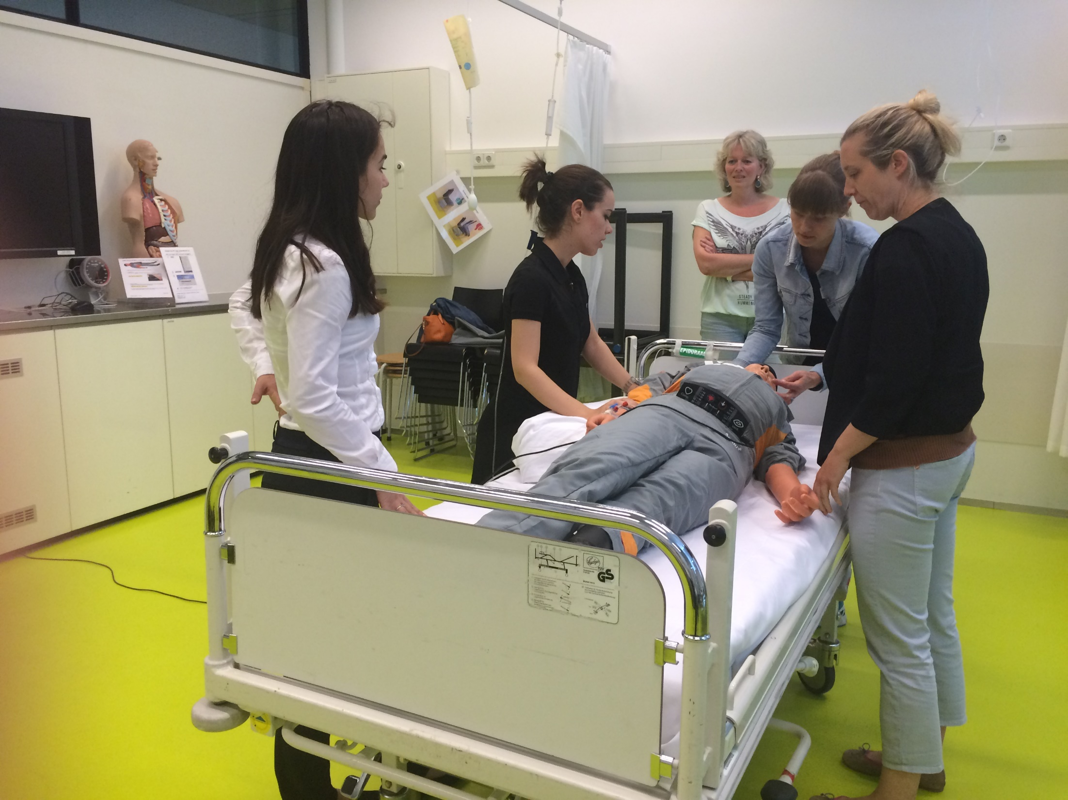
Preparing for Ob&Gyn Emergencies
Early Warning Scores
Rapid Response Teams
Protocols
Ongoing training – emergency drills and simulations
ACOG Committee Opinion no. 590, 2014
Notes:
Early Warning Systems – many emergencies are preceded by a period of instability during which timely intervention may help avoid a disaster; these include events – reffered to as „triggers” which are not emergencies themselves but indicate a deterioration in the patient’s conditio that is alarming (e.g. new-onset tachycardia). Recognition of these events should be incorporated into protocols, such as MEWS and MEOWS (developed in the UK). By designing criteria that define an emergency, it becomes clear when to call for help.
Rapid Response Teams – When the bedside personel recognizes a such a „trigger” they should immediately notify the Rapid Response Team which may comprise a diverse range of stakeholders. Activation of the RRT directly, e.g. by a nurse omitting the attending physician, was proved to be associated with improved survival of hospitalized patients and decreased admissions to Intensive Care Units.
Protocols – The roles of each member of a team have to be defined. Also, communication protocols should be designed to allow the staff to exchange information in a clear and concise manner. Lack of teamwork and suboptimal communication have been cited as the leading cause of death
Ongoing training and drills – In order to ensure good implementation of the protocols, simulation training is crucial. It ensured that in case of emergency the team members are able to cooperate&communicate efficiently and helps to identify and correct common clinical errors.
30

Slide 31
Abdominal Pain
sensation from serosal surfaces
SOMATIC
sensation from parietal peritoneum, muscles, fascia, subcutaneous tissue, skeletal system
constant, well localized, located directly over the inflamed area -> increased by palpation/movement
NEUROGENIC
injury to sensory nerves
Examples: herpes zoster, arthritis, herniated nucleus pulposus, diabetes, multiple sclerosis, syphilis
Deep, dull, vague, poorly-defined +/- malaise, sweating, nausea, diarhhea, fever
Distension of organ, spasm, infection, ischaemia
Examples: ureter calculi, ovarian heamorrhagic cyst, ovulation, ischaemia of leiomyoma, appendicitis
VISCERAL
Examples: intraperitoneal bleeding, necrosis of an intraabdominal structure, inflammation due to infection
Visceral
Somatic
Neurogenic
Notes:
VISCERAL – sensation from serosal surfaces (e.g. bladder, fallopian tubes, uterus, colon)
Distension of organ, spasm, infection, ischaemia
Exmaples: ureter calculi, ovarian heamorrhagic cyst, ovulation, ischaemia of leiomyoma, appendicitis
Deep, dull, vague, poorly-defined +/- malaise, sweating, nausea, diarhhea, fever
The uterus, cervix, and adnexa share the same visceral innervation as the lower ileum, sigmoid colon, and rectum.
SOMATIC – sources: muscles, fascia, parietal peritoneum, subcutaneous tissue, skeletal system
hernia, hematoma, muscle strain, muscle injury, myositis, inflammation, trauma, inflammation of the parietal peritoneum
pain is located directly over the inflamed area
increased by palpation/movement ->the patient with peritonitis lies quietly in bed, preferring to avoid any movement or motion
Constant, well localized;
abdominal tenderness, involuntary guarding, rebound tenderness
Examples: intraperitoneal bleeding, necrosis of an intraabdominal structure, inflammation due to infection
NEUROGENIC – injury to sensory nerves (herpes zoster, arthritis, tumors, herniated nucleus pulposus, diabetes, multiple sclerosis, syphilis)
Signals travel via the sympathetic nerves to spinal cord segments T10 through L1. Because of this shared pathway, distinguishing between pain of gynecologic and gastrointestinal origin is often difficult. ^{[1]}
Jones HW, Jones GS. Pelvic pain and dysmenorrhea. Berek JS, Adashi EY, Hillard PA, eds. Novak's Textbook of Gynecology. 12th ed. Baltimore, Md: Williams & Wilkins; 1996: 399-428.
Visceral pain - The localization of visceral pain can be difficult because the viscera are innervated by a low concentration of
nociceptive nerve endings. Furthermore, significant overlap of pathways within the same spinal segments of
pelvic and abdominal viscera and within visceral and somatic structures causes viscerosomatic convergence
resulting in referred pain (ie, pain felt at a distant location from the diseased organ)
SOMATIC - The intensity of pain and inflammation varies depending on the inciting material, as well as the duration of peritoneal exposure. As an example,
intraperitoneal blood and urine may go undetected if exposure to the peritoneum has not been sudden and
massive. With bacterial infection, such as in pelvic inflammatory disease, pain is usually of gradual onset with
initially low intensity, until there is sufficient bacterial multiplication to cause the production and release of
inflammatory, irritating substances.

Slide 32
Abdominal Pain + Adnexal Mass
Ovarian torsion
Ruptured ovarian cyst
Hemorrhagic ovarian cyst
Degenerating fibroid
Hemorrhagic, necrotic ovarian tumor

Slide 33
Abdominal Pain: Adnexal Mass - Hemorrhagic Cyst
A 21-year-old female with acute-onset pelvic pain. Gray-scale sonograms show a right ovarian cyst (A) with associated complex free fluid in the pelvis (B). Floating debris in the fluid is consistent with blood products. Follow-up laparoscopy over concern for ectopic pregnancy revealed a ruptured hemorrhagic ovarian cyst.
Carolyn S et al. Ultrasonography of adnexal causes of acute pelvic pain in pre-menopausal non-pregnant women. Ultrasonography 2015
Notes:
Rupture of an ovarian cyst is often accompanied by sonographic evidence of hematoperitoneum or free fluid in the pelvis; free fluid may also be seen with torsion [61]. In addition, the classic history of cyst rupture is the sudden onset of pelvic pain at midcycle, often following sexual intercourse. Symptom patterns and ultrasound findings vary for both conditions, and may appear similar. When the patient has pain with associated fluid, the distinction between a ruptured cyst and torsion may be difficult. I

Slide 34
I Simms et al. Diagnosis of pelvic inflammatory disease: time for a rethink. Sex Transm Infect. 2003

Slide 35
PID: Tubo-ovarian abscess
Transvaginal ultrasound scanning may be helpful, and its sensitivity is up to 85%.
as complex multilocular cyst with thick walls and thick septa, filled with homogeneously diffuse low echoic materials
Jung S. Ultrasonography of ovarian masses using a pattern recognition approach. Ultrasonography 2015
Notes:
As the disease progresses, the walls and septa can be changed to be thicker with more increased vascularity. Therefore, one should keep in mind that the above type of cyst may be confused with ovarian malignancies (Fig. 12). Transvaginal ultrasonography shows a thick walled multilocular cystic mass with internal echogenic debris. Regular thickening of the outer wall and the septum of the cystic mass should be noted (arrows).

Slide 36
Abdominal Pain + beta HCG (+): Miscarriage/Abortion
Threatened
Inevitable
Incomplete
Complete
Septic
„unsafe”
In the United States, mortality from septic abortion rapidly declined after legalization of abortion. Death now occurs in less than 0,6 per 100,000 abortions. Figures for most European countries are similar to US rates.
Zane S et al. Abortion-Related Mortality in the United States 1998–2010. Obstet Gynecol. 2015
Notes:
Unsafe abortion generally refers to termination of unwanted pregnancy either by persons lacking the necessary skills or
it being performed in an environment lacking the minimal medical standards, or both
Treatment : early curettage to remove infected and devitalized tissue even in the face of continued fetal heart tones. Important secondary treatments are the administration of fluids and antibiotics.
Treatment is intensive antibiotic therapy plus uterine evacuation as soon as possible. A typical antibiotic regimen includes clindamycin 900 mg IV q 8 h plus gentamicin 5 mg/kg IV once/day, with or without ampicillin 2 g IV q 4 h. Alternatively, a combination of ampicillin, gentamicin, and metronidazole 500 mg IV q 8 h can be used.

Slide 37
Abortion: maternal mortality
Worldwide, abortion accounts for approximately 14% of pregnancy-related deaths, and septic abortion is a major cause of the deaths from abortion.
Khan KS, Wojdyla D, Say L, Gülmezoglu AM, Van Look PF. WHO analysis of causes of maternal death: a systematic review. Lancet 2006; 367:1066.
Notes:
Estimates by the WHO give a global annual total of 42 million induced abortions with 20 million being unsafe
It is estimated that 21 to 22 million unsafe abortions occur worldwide, and 98 percent of these abortions occur in the developing world

