Slide 1

Cervical cancer screening
CWE Redman
President of EFC, EBCOG 2017

Slide 2

Screening for cervical cancer in Europe 2018
12
20
Nationwide HPV screening
19
Regional HPV screening
21
29
1
10
Organised HPV screening
in progress
9
8
7
16
Political decision for organised
HPV Screening
2
6
17
13
5
Organised recall Pap Screening
4
3
11
Pap screening programs
Wild Pap screening
K.U. Petry 2017

Slide 4
What we know
HPV vaccination commenced
HPV primary screening coming
More sensitive: more HSIL detected

Slide 5


HPV Primary Screening Protocol Algorithm
All women aged 25-64 on routine call/recall and early recall
HR-HPV Test
HR-HPV -ve
HR-HPV +ve
Routine recall 3y(25-49) 5y(≥50)
Cytology triage
Cytology normal#
Cytology abnormal – borderline or worse
Re-screen in 12m
Colposcopy referral
HR-HPV -ve
HR-HPV +ve
Routine recall 3y(25-49) 5y(≥50)
Cytology normal#
Cytology abnormal – borderline or worse
Re-screen in 12m
Colposcopy referral
HR-HPV -ve
HR-HPV +ve#
Routine recall 3y(25-49) 5y(≥50)
Colposcopy referral

Slide 6


Slide 7
Needle in the Haystack
No CIN
No CIN
II
LG CIN
II
LG CIN
HG CIN+
HG CIN+
Notes:
7

Slide 8
Performance

Slide 9
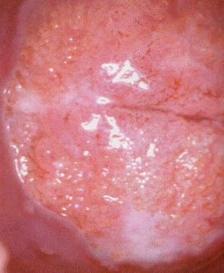
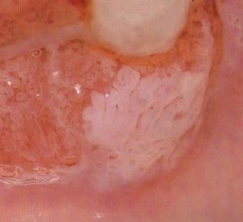
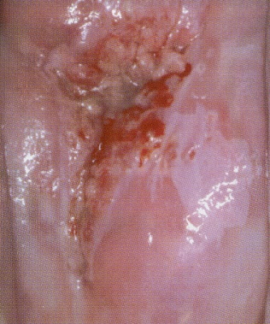
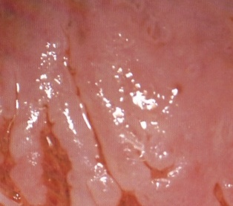
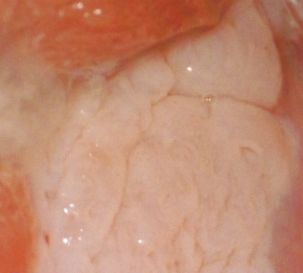
Acetowhitening
Metaplasia
CIN3
Density

Slide 10
Comment about spectrum
“The most benign condyloma and most worrisome intraepithelial neoplasia are linked by a spectrum of continuous morphological change”

Slide 11
How good is colposcopy?
Screening Colposcopy - poor sensitivity and specificity Schneider A, IJC 2000
HPV-Vaccine trials: poor sensitivity for CIN3+ Stoler M, IJC 2011
RCT studies: colposcopy as sensitive as immediate LEEP TOMBOLA, BMJ 2010
Sensitivity of colposcopy CIN3 29-93% in a US trial Pretorius R, JLGTD 2011
Lacks sensitivity in women with positive HPV tests but normal cytology Petry KU, GO 2012

Slide 12
How to improve colposcopy
Training / certification
Number of biopsies
Adjunctive technologies

Slide 13
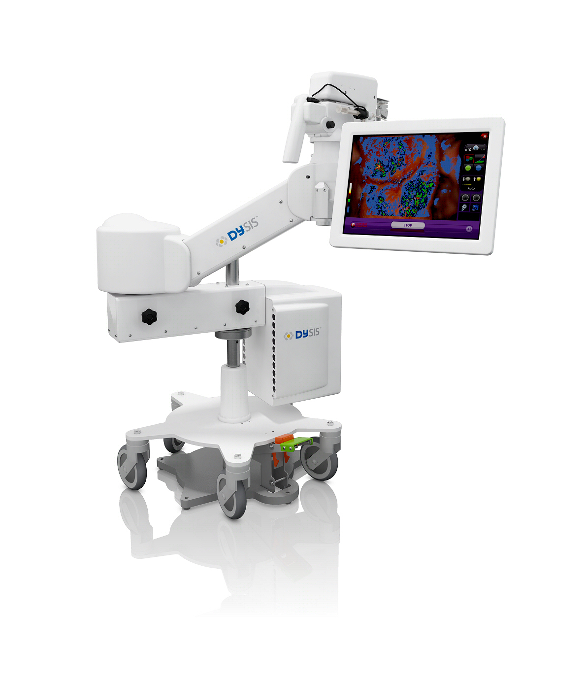
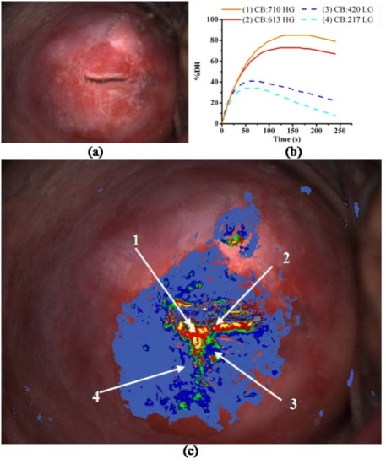
DySIS
Greater sensitivity than conventional colposcopy

Slide 14
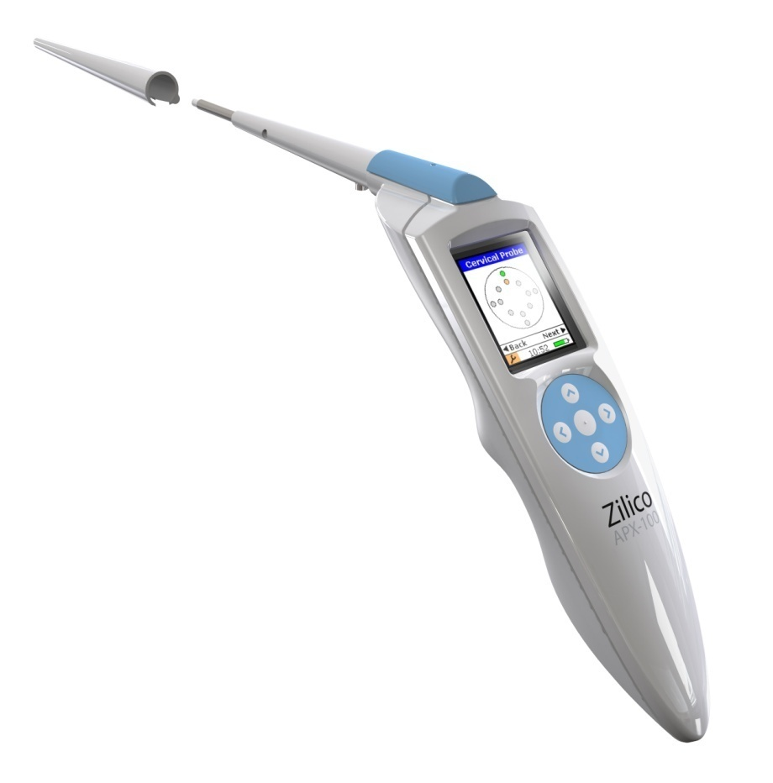
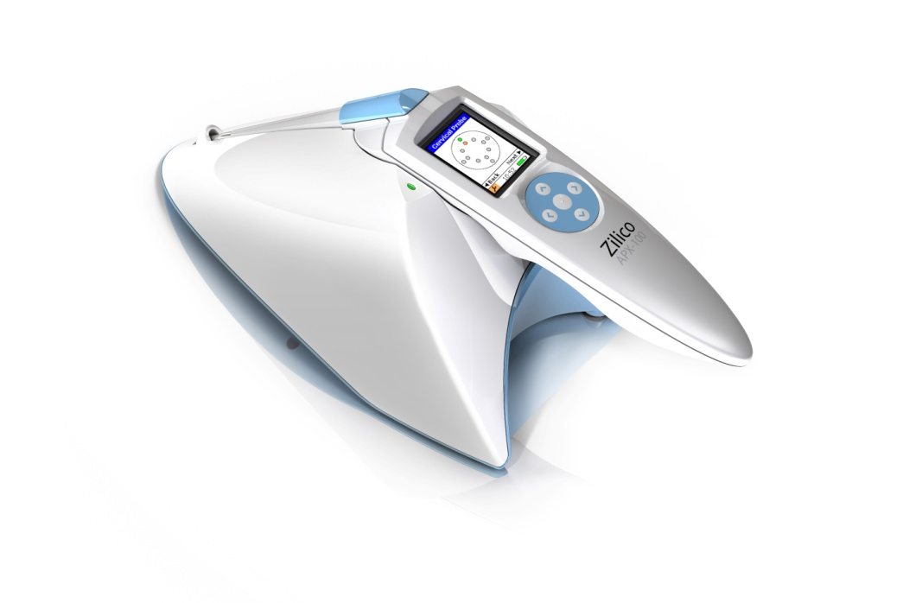
Zedscan

Slide 15
Electrical Impedance Spectroscopy
Conventional colposcopic sensitivity = 88% (80-94)
Significantly improves colposcopic performance
(ROC curve AOC =0.887 cf. 0.82 in Mitchell’s paper)
Performance profile can be adjusted
Tidy et al Br J Obstet Gynaecol 2013:120;400-11

Slide 16
Managing Capacity

Slide 17
HPV Primary Screening Pilot
Colposcopy Management Recommendations Algorithm
DRAFT Version 2.0 Aug 2014
Colposcopy Examination
Inadequate
Normal and adequate
Index HR-HPV +ve - cytology ≤low grade
Index HR-HPV +ve - cytology ≥high grade
No biopsy or biopsy <CIN1
Abnormal Biopsy CIN1+
Manage according to ‘abnormal colposcopy examination’
Repeat colposcopy in 12m
LLETZ
Index HR-HPV+ve/ cytology ≤low grade
Index HR-HPV+ve/ cytology ≥high grade
Consider LLETZ – patient choice
Discharge to 3y recall
Discussion at MDT within 2m

Slide 18


Slide 19
Quality Assurance

Slide 20
West Midlands procedure at first attendance low grade referrals
No treatment
Excision
Diagnostic biopsy (punch)
Other
Clinic A
Clinic B
Clinic C
Notes:
A: Majority no treatment (Sandwell)
B: Mixture of no treatment and punch biopsy (Rugby)
C: Majority Biopsy (Alexandra)

Slide 21
Summary
Management of capacity
Proactive Quality Assurance
Systematic pre-emptive education
Adjunctive colposcopic technology

Slide 22

Thank you!
Notes:
As per slide!!!

