Slide 1
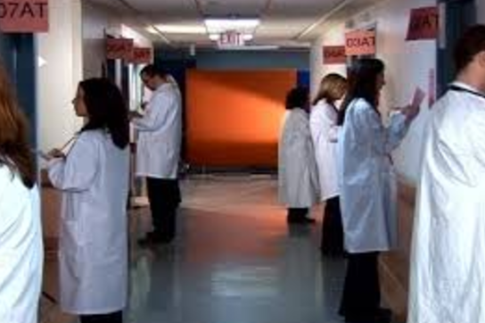
EBCOG European Fellowship Exam in Obstetrics and Gynecology
Part 2
Evaluation of clinical skills (OSCEs)
Diogo Ayres-de-Campos (Portugal)

Slide 2
Objective
To evaluate clinical skills that cannot be assessed in written tests
(technical, communication, and teamwork)
history taking
communicating a clinical diagnosis
formulating a shared management plan
applying technical skills
applying teamwork skills
evaluating a scientific article
managing clinical risk

Slide 3
While some stations will be more directed towards the evaluation of a particular skill, a combination of several skills will be assessed in most stations

Slide 4
Requirements for candidacy
To have passed Part 1
Applications in the website until 3 months before the exam

Slide 5
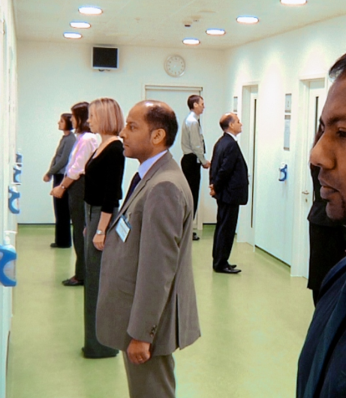
Structure of the exam
10 stations (including one prep station)
12 min each
1 min for reading instructions
11 minutes for the exam
All conducted in English

Slide 6
Station 1
History taking and summarising to colleague
Patient actor
Aim is to take a history, and then to provide a summary to the examiner with a list of possible diagnoses.
Examples: molar pregnancy, pre-eclampsia, endometrial cancer, endometriosis.

Slide 7
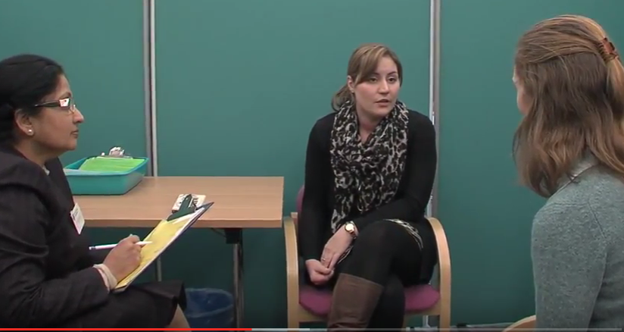
Station 2
Transmitting bad news
Patient actor
Aim is to communicate the result of a test that causes anxiety and suffering to a patient, and then formulate a shared management plan.
Examples: non-viable 1st trim pregnancy, increased nuchal translucency, HIV positive results, invasive cervical cancer.

Slide 8
Station 3
OB
Basic technical skill
Simulator
Aim is to briefly explain the procedure to the patient, obtain consent, and then perform the skill.
Examples:
3 - instrumental vaginal delivery, external cephalic version.
4 - inserting an IUD, diagnostic hysteroscopy, laparoscopic sterilisation, transvaginal and transabdominal ultrasound.
Station 4
GYN

Slide 9
Station 5
OB
Explaining a clinical situation and establishing a shared management plan
Patient actor
A short summary is provided, exam results are supplied if requested. Aim is to explain the main diagnoses, address doubts, concerns, transmit management options, and establish a shared management plan
Station 6
GYN

Slide 10
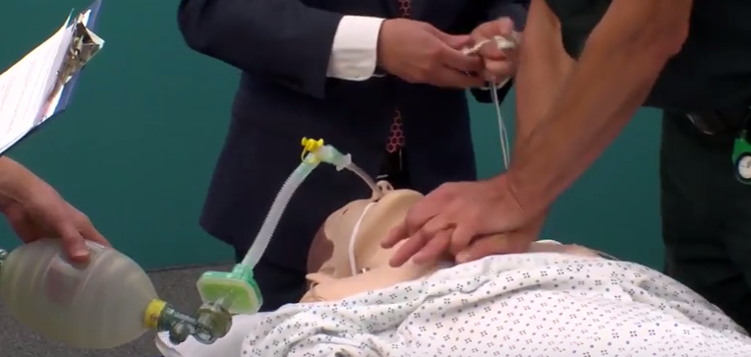
Station 7
Complex technical and teamwork skills
Patient actor + simulator + team
Aim is to identify a clinical problem, communicate with the patient, and then divide tasks with the team in order to resolve the situation.
Examples: shoulder dystocia, retention of aftercoming head, eclampsia, postpartum hemorrhage, ruptured ectopic.

Slide 11
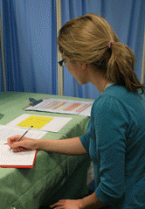
Station 8
Preparatory station
Dedicated to reading the abstract/summary of a scientific article and the summary of a clinical governance report.
(these will be evaluated in the following stations)

Slide 12
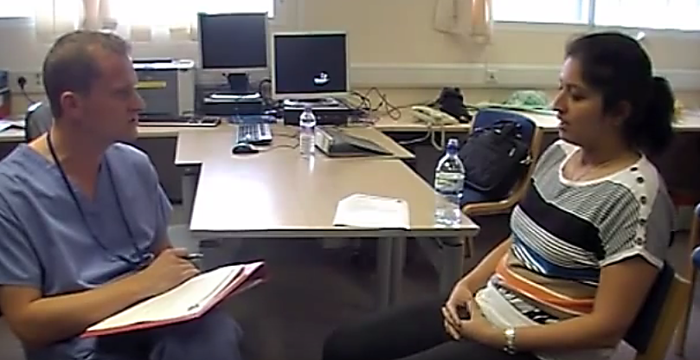
Station 9
Discussion of a scientific article
Examiner only
Aim is to identify the research question, recognise the study design, to discuss strengths and weaknesses, list the main results, and discuss how they may influence current clinical practice

Slide 13
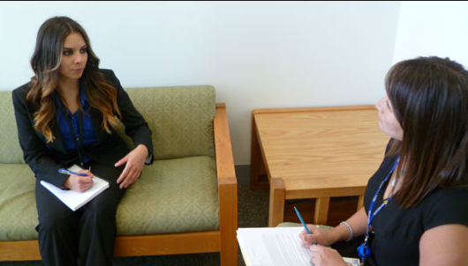
Station 10
Discussion of clinical governance and risk
Examiner only
Aim is to identify the motive for conducting an audit, the methodology used, the main findings, and suggest measures to change the quality of care, as a result of the information acquired

Slide 14
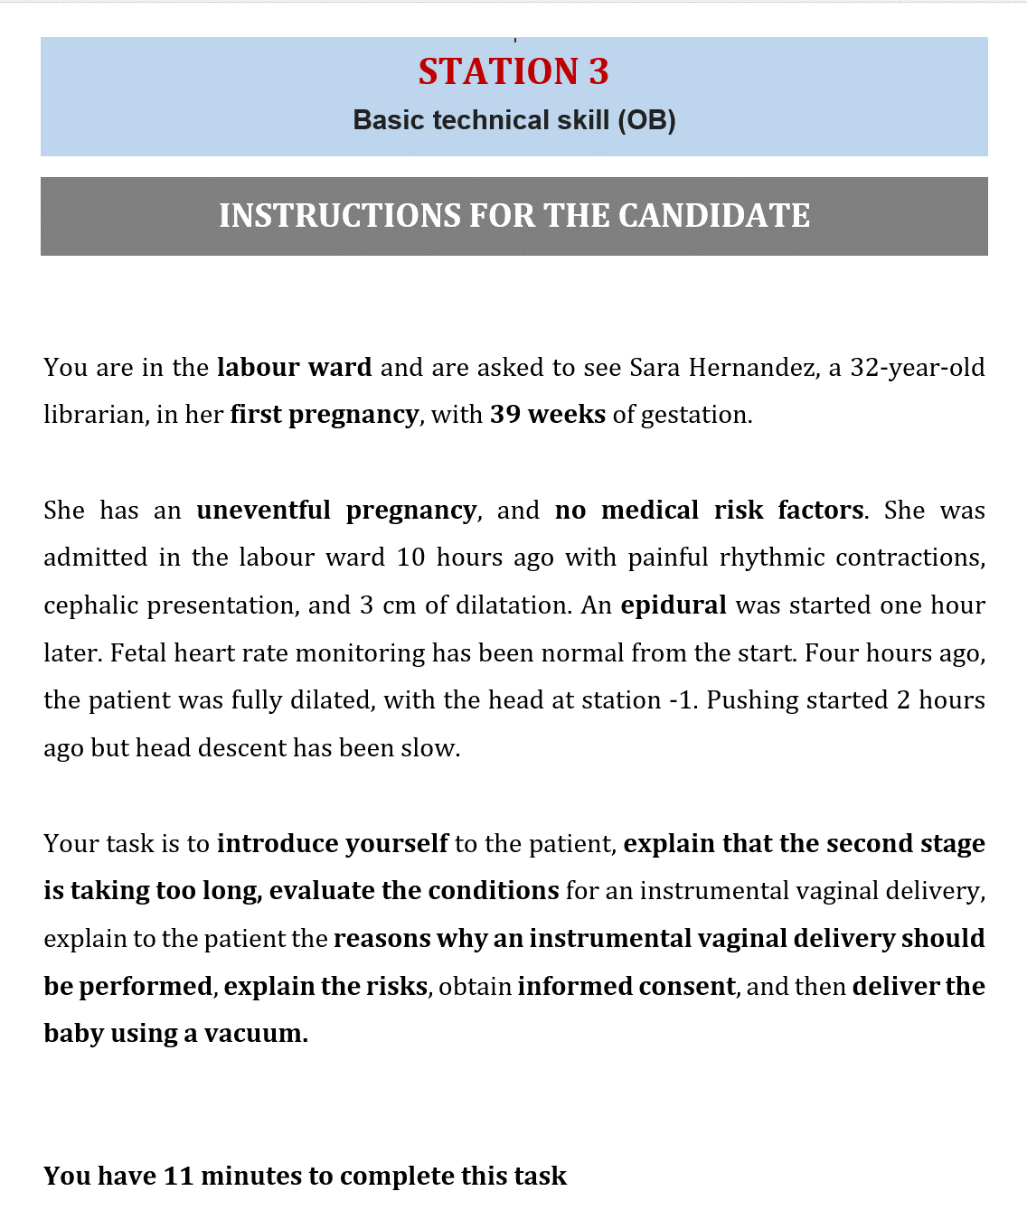

Slide 15
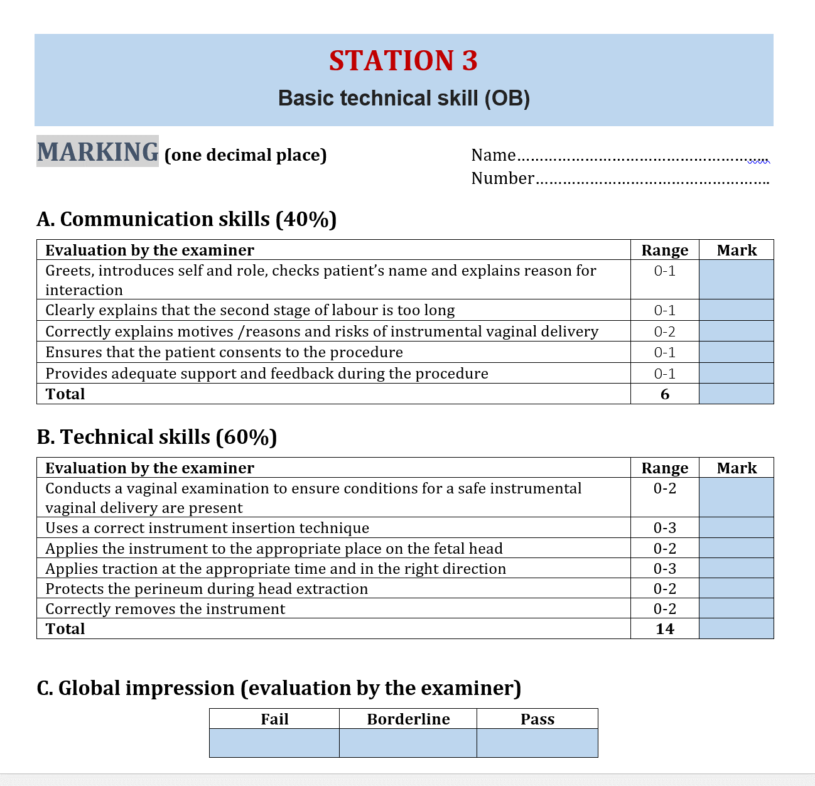

Slide 16
Organisation of the exam
Maximum 40 candidates per day
4 rounds: 08:00-10:00, 10:30-12:30
14:00-16:00, 16:30-18:30

Slide 17
Exam marking and passing
0-20 points per station - 180 points
Pass mark - median score of “borderline” candidates
Results available within one week

Slide 18
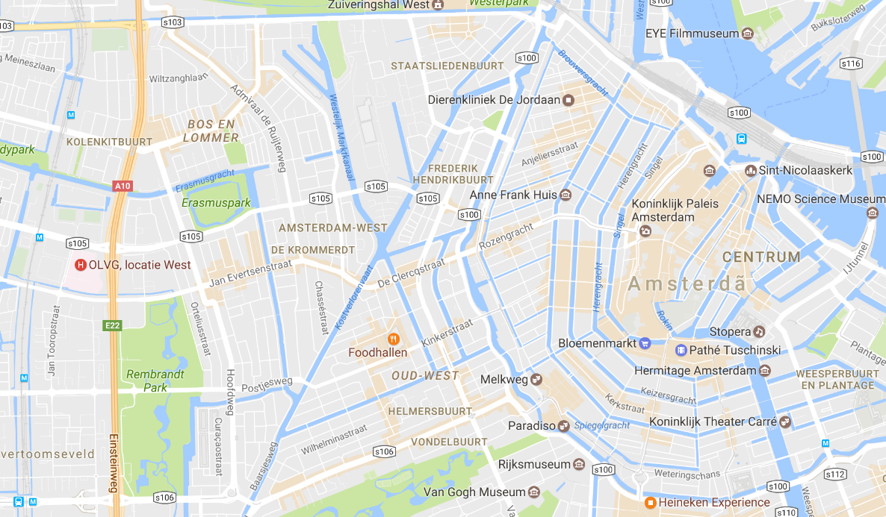
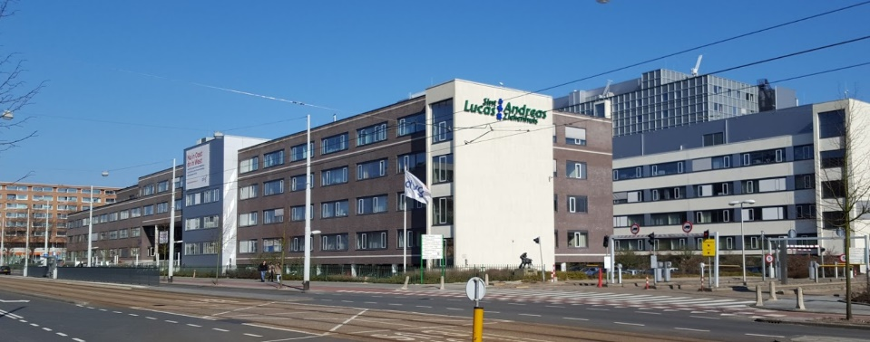
Exam 2017
Amsterdam, 18-19th November 2017
OLVG West Jan Tooropstraat 164 1061 AE Amsterdam

Slide 19
Training course
Brussels, Saturday 9th September 2017
Registrations on the EBCOG website

