Slide 1
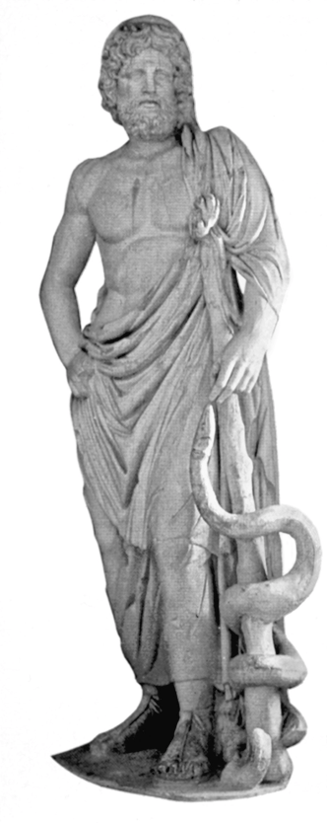
DEALING WITH CHALLENGES IN OBSTETRICS AND GYNAECOLOGICAL PRACTICE Caesarean section surgical techniques and long term consequences for the woman of Caesarean section
C. Savona-Ventura

Slide 2
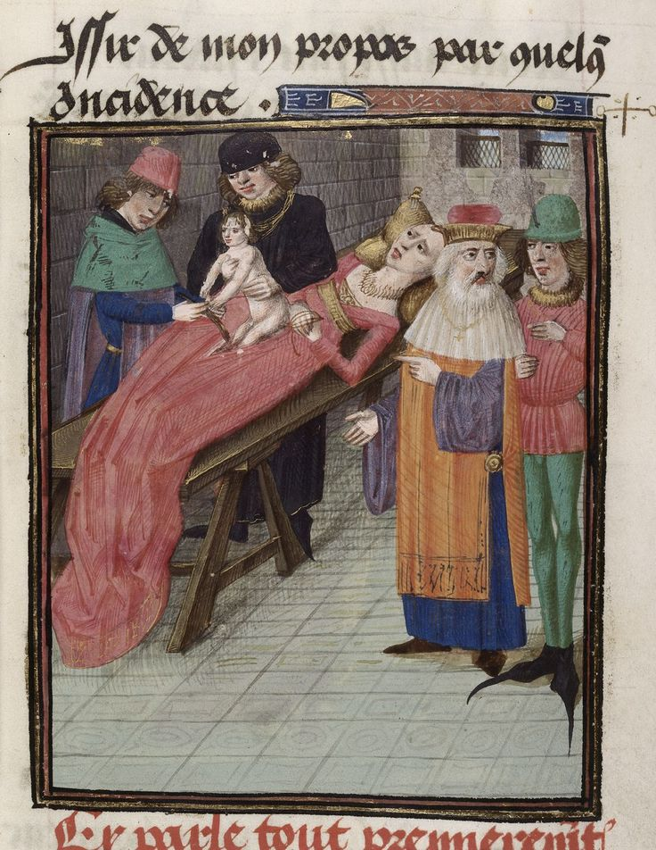
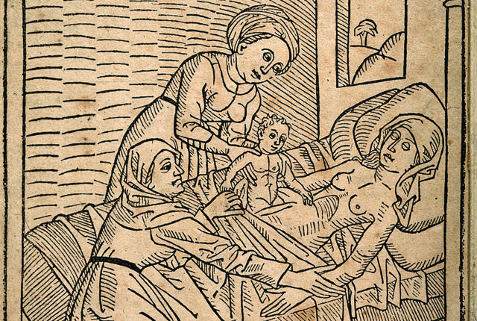
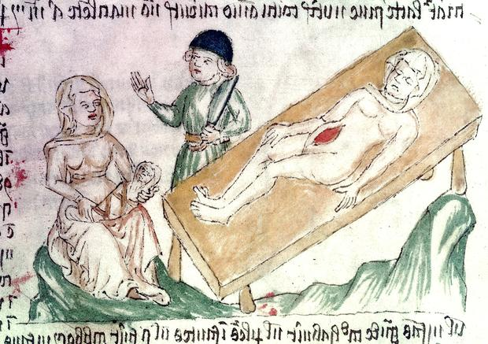
Earliest written record comes from Switzerland in 1500.
Wife of sow gelder Jacob Nufer in labour for several days
Unable to deliver even with help of thirteen midwives
Permission sought by husband from local authorities to attempt a Caesarean delivery.
Both mother and child survived the operation with child living to age of 77 years.
Mother eventually gave birth normally to five children, including twins.
Woodcut, 1483

Slide 3
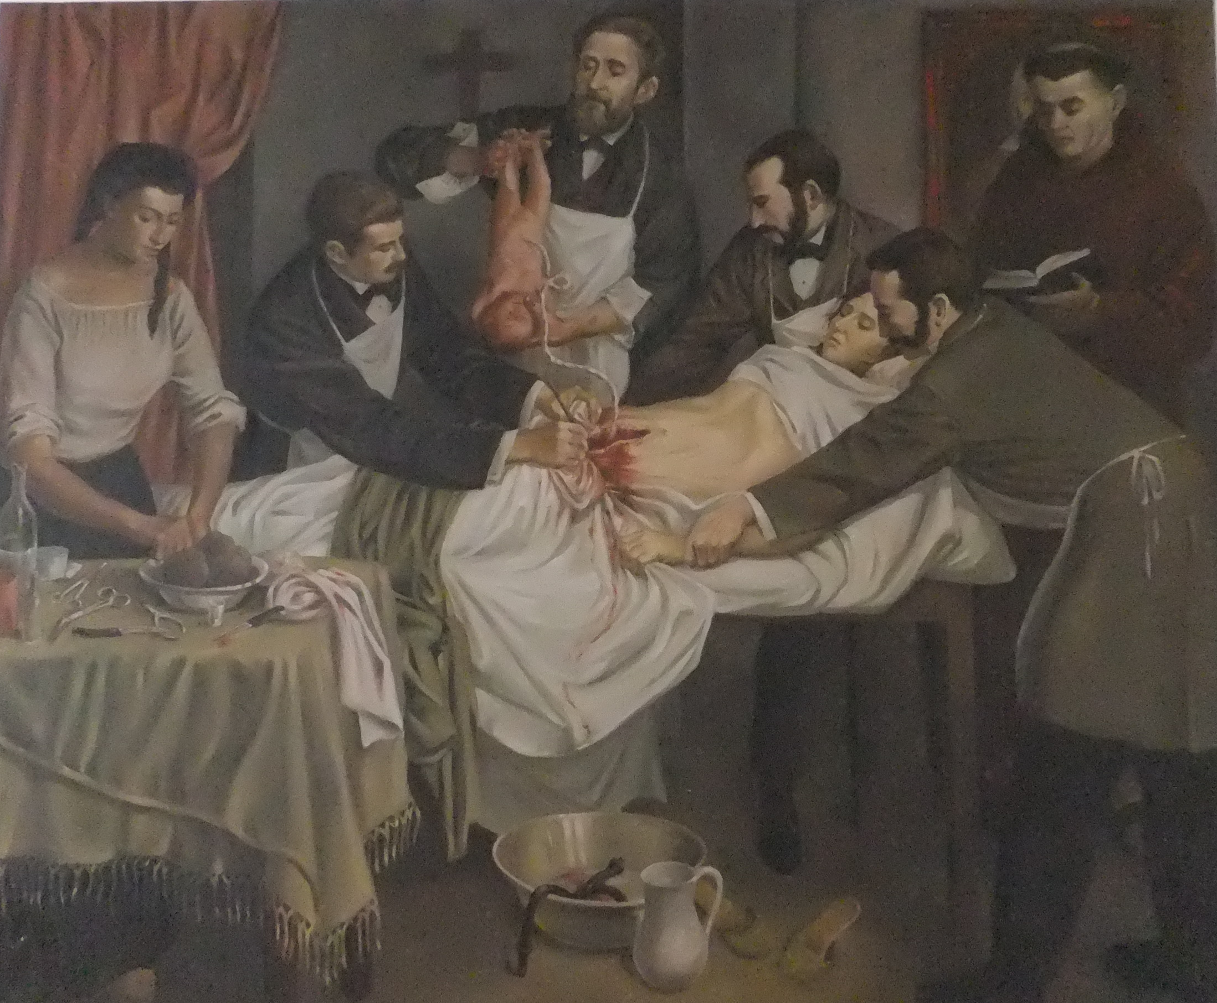
However any abdominal surgery was associated with a high mortality.
Procedure was therefore generally restricted to instances of maternal death to attempt deliver the child.
During the 19th century, principles of anaesthesia, antisepsis, and asepsis during surgery were firmly established.
Advances in surgical techniques developed to reduce risks.
Increasing use of abdominal delivery for wider range of indications.
Caesarian section in Colombia in 1844 by Dr. Jose Ignacio Quevedo

Slide 4
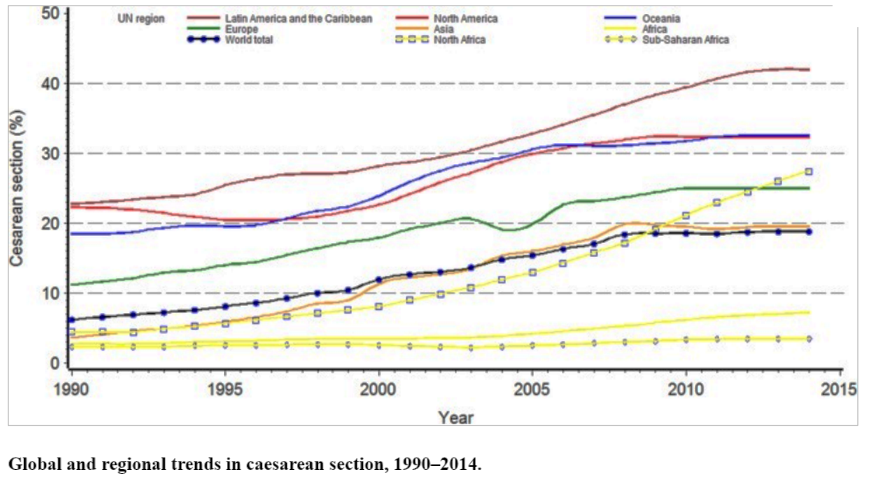
Betrán et al PLoS One. 2016; 11(2): e0148343.

Slide 5
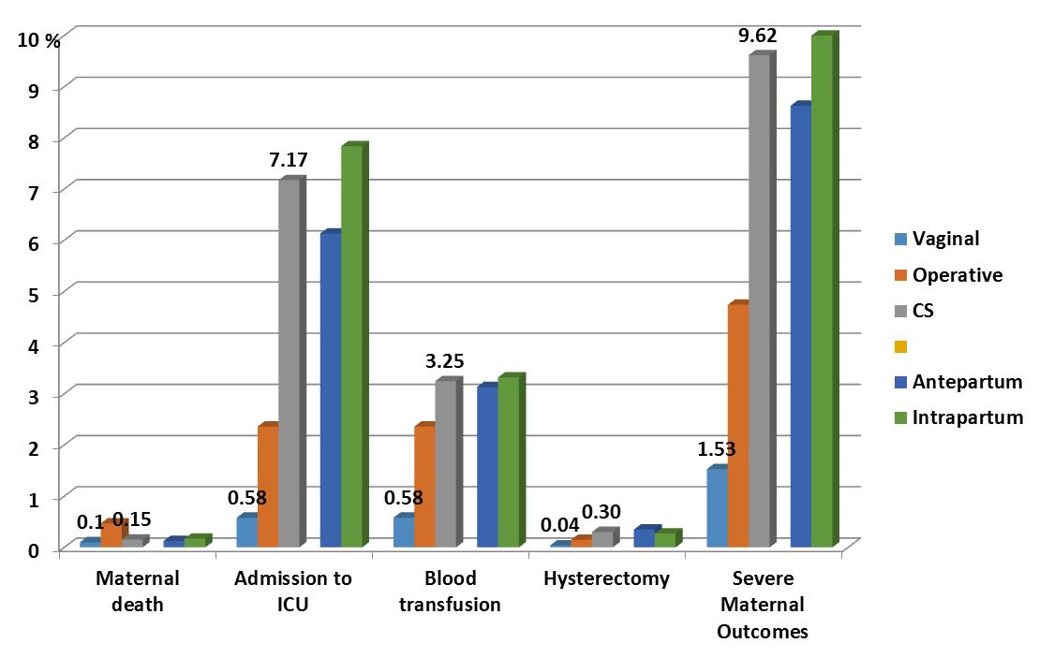
Short-term morbidity - 2004-2008 WHO Global Survey on Maternal and Perinatal Health
Are complication rates dependant on surgical technique?
Accidental trauma
Amniotic fluid embolism
Complications of anaesthesia
General & Spinal
Haemorrhage
Infection
Wound
Urinary tract
Respiratory
Thromboembolic events
Paralytic ileus
Wound dehiscence
Increased hospital stay
Repeated hospital admission
Negative psychological consequences.
Impaired self-esteem.
Feelings of being helpless during the birth.
Clinical depression.
CS vs Vag
X1.5
X12.4
X5.6
X7.5
X6.3
After Souza JP et al. 2010, BMC Medicine, 8:71

Slide 6
OBJECTIVES: To compare short-term effects of:
1) different types of uterine incision,
2) methods of performing the uterine incision,
3) suture materials and technique of uterine closure
METHODS: All published, unpublished, and ongoing randomised controlled trials comparing various types and closure of uterine incision during caesarean section.
27 randomised trials involving 17,808 women undergoing caesarean section were included in the review.
Auto-suture devices vs hysterotomy
No difference in febrile morbidity
Blunt vs sharp
No difference in febrile morbidity
Lower risk of mean blood loss and need for transfusion with blunt dissection
Transverse vs cephalad-caudad blunt extension of the uterine incision
Lower risk of mean blood loss following transverse extension.
No other differences identified.
Chromic catgut vs polygactin-910 closure
Lower risk of blood transfusion and re-laparotomy at after catgut closure
Single layer vs double layer closure of the uterus.
No difference in febrile morbidity.
Reduced blood loss after single layer closure but no difference in risk of blood transfusion.
AUTHORS' CONCLUSIONS:
There is increasing evidence that for many techniques, short-term maternal outcomes are equivalent. Until long-term health effects are known, surgeons should continue to use the techniques they prefer and currently use.

Slide 7
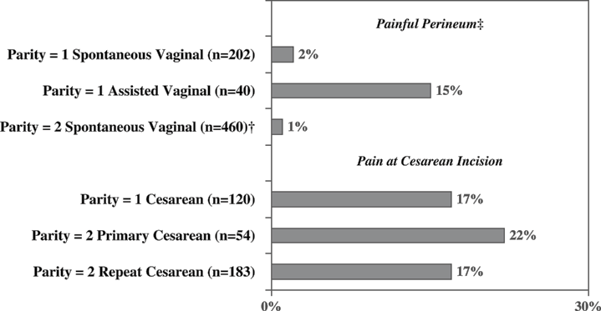
Long-term morbidity – Surgical incision problems
Incisional hernias
Pain at incision site
18% of women reported pain at the incision site six months after the delivery. Only 2% of women reported pain at incision site after vaginal delivery.
Declercq E et al. , Birth. 2008; 35(1):16-24
Intra-abdominal adhesions
Bowel problems → chronic bowel discomfort, potential bowel obstruction from volvulus
Urinary problems → chronic urgency and dysuria
Potential complicated future abdominopelvic surgery

Slide 8
Long-term morbidity – Surgical incision problems
‘Niche’ within scar [discontinuation in myometrium at site of scar]
Identified in more than 50% of CS [range 19.4% to 88%]
More likely after single layer closure with peritoneal closure
30% had intermenstrual spotting 6-12 months postpartum
Gynaecological problems due to deficient uterine scar healing
Abnormal bleeding; dysmenorrhoea; dyspareunia
Chronic pelvic pain
Subfertility
Potentially higher risk of complications during gynaecologic procedures
[uterine evacuation, hysterectomy, endometrial ablation, insertion of an intrauterine device]
Vervoort AJ et al. Hum Reprod. 2015 Dec;30(12):2695-2702
Tower AM, Frishman GN. J Minim Invasive Gynecol. 2013 Sep-Oct; 20(5):562-572.

Slide 9
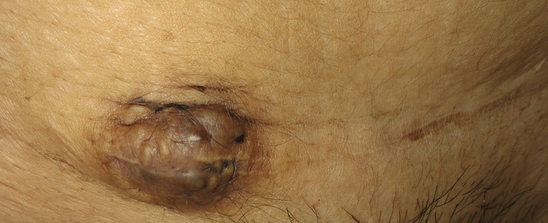
Long-term morbidity – Surgical incision problems
Scar Endometriosis causing growth of incisional tumour with cyclical pain and/or bleeding
Ozturk A et al. J Reprod Med. 2016; 61(5-6):249-53.
Uterovesicocutaneous fistula caused by endometriosis
Juneja SK et al. Int J Appl Basic Med Res. 2016; 6(4):300-302.
Endometriosis-associated clear cell carcinoma
Ferrandina G et al. World J Surg Oncol. 2016; 14(1):300.

Slide 10
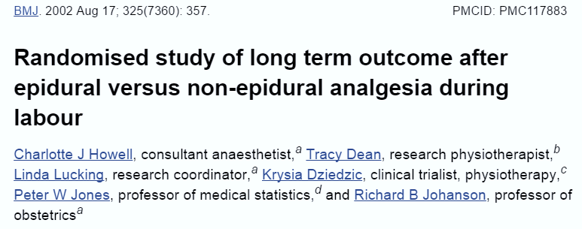
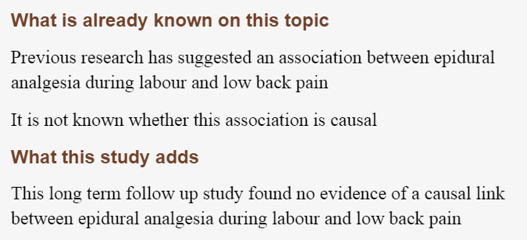
Long-term morbidity – Anaesthesia problems
Complications of spinal \ epidural anaesthesia
Chronic back pain
Total of 857 subjects. No comparative group
Wound scar pain 9.2%
Back pain 36.9%
Migraine 10.2%
51 subjects had persistent pain
Constant 9.8%
Daily 9.8%
Intermittently 23.5%
Independent risk factors for of chronic pain:
higher pain scores recall postoperatively
pain present elsewhere
non-private insurance status

Slide 11
Long-term morbidity - Future fertility
Decreased Fertility
Meta-analysis data suggests that women with previous CS had:
9% lower pregnancy rate
11% lower birth rate than women with previous vaginal birth.
Bhattacharya, S. et al, BJOG 2006; 113(3), 268-275.
Potentially voluntary infertility
Possibly involuntary caused by:
Incomplete uterine healing
Post-operative infection causing tubal infertility → unlikely: no apparent increase in tubal pregnancy rates
Saraswat L. Reprod BioMed Online 2008; 17:259-264

Slide 12
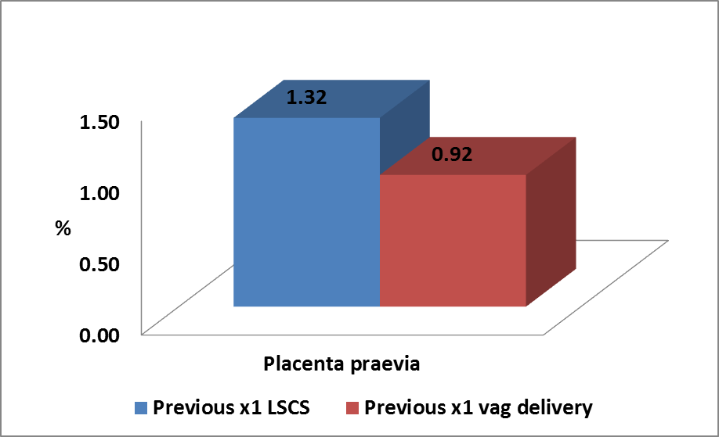
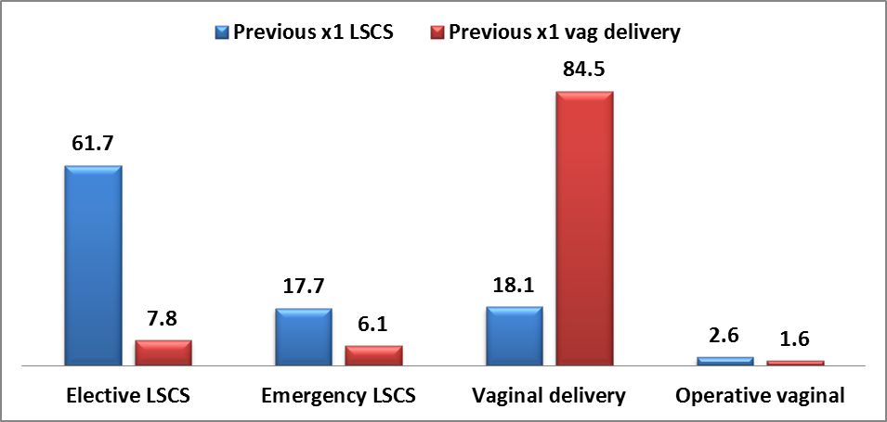
Long-term morbidity – Future obstetric
Abnormal placentation
Caesarean scar ectopic pregnancy
Condition is life-threatening to the mother and always fatal for the embryo.
Placenta praevia / Placenta accreta / Placenta percreta
Increase the risk for severe haemorrhage
Potentially life-threatening complications for mother and baby.
Relative Risk 1.44
Maltese Is. 2006-2015
Relative Risk 1.44
NOIS database [accessed 2017, unpublished]
Maltese Is. 2006-2015
Repeat Caesarean section
Relative Risk of x7.9 for having a repeat elective CS
Relative Risk of x2.9 for having an emergency CS
NOIS database [accessed 2017, unpublished]
RR | 7.94 | 2.89 | 0.21 | 1.61

Slide 13
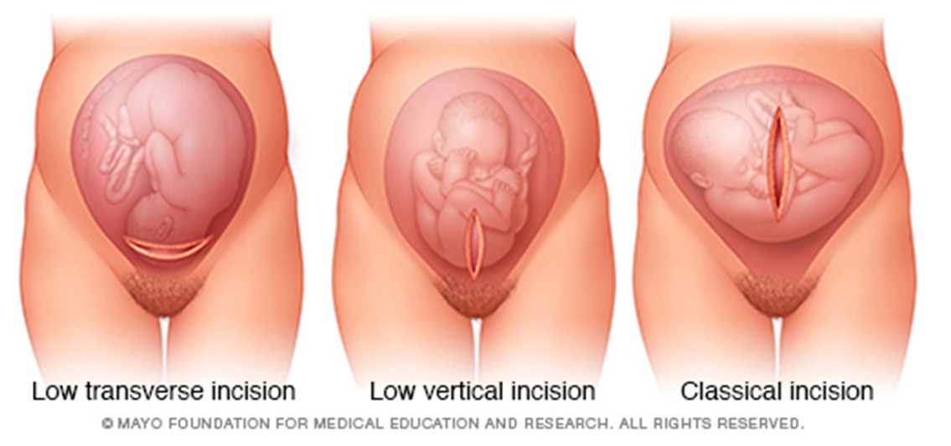
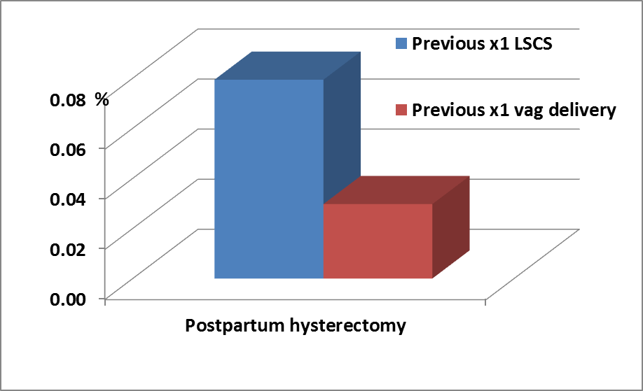
Long-term morbidity – Future obstetric
Uterine scar rupture.
Planning repeat caesarean reduces the excess risk, but possibility of antenatal scar rupture.
Dependant on type of incision.
Emergency hysterectomy
Risk was higher with increasing numbers of previous caesarean deliveries
OR 2.14 with one previous delivery [95% CI 1.37-3.33],
OR 18.6 with two or more [95% CI 7.67-45.4]
Knight, M. et al. Obstet Gynecol 2008, 111(1), 97-105
Original uterine incision & risk of subsequent rupture | Rate 95% confidence limits
Unknown | 0.2 – 0.7% : 0.5%
Low transverse | 0.6 – 0.8% : 0.7%
Low vertical | 0.2 – 7.0% : 2.0%
Classical | 0.2 – 6.5% : 2.0%
Odds Ratio 2.67
Relative Risk 2.67
Maltese Is. 2006-2015
NOIS database [accessed 2017, unpublished]
After Landon MB et al. N Engl J Med. 2004;351(25):2581-2589

Slide 14
Uterine scar complication risks – empirical mechanisms
Endometrial tissue deposition during surgery
Devascularization of uterine muscle during surgery
Uterine scar weakness & incomplete healing
Position & number of uterine incisions
Uterine scar endometriosis
Persistent raw surface & haematomas
Placenta praevia
Caesarean scar ectopic
Placenta accreta/percreta
Chronic pain over scar
Uterine scar rupture
External adhesions
Chronic pelvic pain
Urinary symptoms
Bowel disturbances

Slide 15
Uterine scar complication risks – empirical contributors
Endometrial tissue deposition during surgery
Manual delivery of placenta
Swabbing of uterine cavity
Exterior vs intra-abdominal repair
Inclusion of endometrium in first suture layer
Endometrium pouting upwards rather than inwards
Devascularization of uterine muscle during surgery
Blunt vs sharp entry
Locking blanket-type stitch vs running continuous stitch
Short-lasting suture material vs longer-lasting material
Single vs Double layered suturing
Low transverse vs low vertical or classical incisions
Low vs high transverse incision → Surgery undertaken after development of lower segment or intrapartum
Limit number of caesarean sections
Position & number of uterine incisions
Persistent raw surfaces & haematomas
Peritoneal closure vs non-closure
Multiple haemostatic sutures vs minimal

Slide 16
Reducing uterine scar complication risks
Surgical techniques commonly used often based on:
Personal or Unit habits and traditions rather that evidence-based observations
Handed down from one generation to the next
Need for Evidence-based best surgical practice to be developed
Disadvantages
Empirical
Advantages
Proven

Slide 17
Outcomes of 13,153 women undergoing CS using different techniques followed-up for a duration of 3.8 yrs
Outcomes included pelvic pain; deep dyspareunia; hysterectomy and outcomes of subsequent pregnancies.
Blunt versus sharp abdominal entry | No difference in risk of abdominal hernias
Exteriorisation of the uterus for repair versus intra-abdominal repair | No difference in risk of infertility or of ectopic pregnancy
Single versus double layer closure of the uterus | No difference in maternal death or a composite of pregnancy complications
Closure versus non-closure of the peritoneum | No evidence in any outcomes relating to symptoms associated with pelvic adhesions such as infertility
Chromic catgut versus polyglactin-910 for uterine repair. | No evidence in the main comparisons for adverse pregnancy outcomes in a subsequent pregnancy, such as uterine rupture
CONCLUSION:
Although study was not powered to detect modest differences in rare but serious events, there was no evidence to favour one technique over another. Suggests that the rigorous use of the surgical techniques is more important than the technique as such.

Slide 18
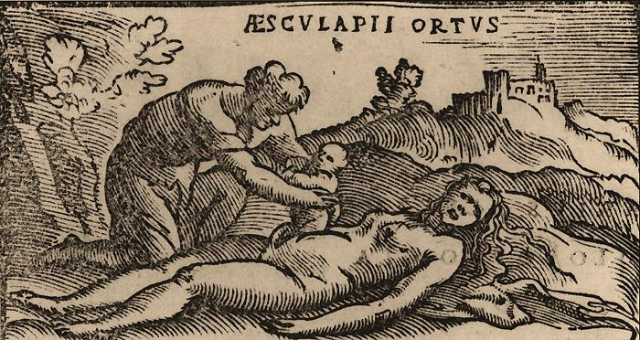
Teşekkür ederim
The birth of Asclepius from the abdomen of his mother Coronis by his father Apollo

