Slide 1
Best Practice in Abortion Care
Professor Emeritus Allan Templeton, University of Aberdeen

Slide 3
EBCOG Statement
The provision of safe abortion is crucial to the public health of all communities.
EBCOG considers that the availability of abortion in all countries in Europe is fundamental to women’s health and well-being.
WHO advises that the choice of abortion should be readily available to women in all national healthcare systems.
Medical abortion is one of the safest procedures in medical practice, with minimal morbidity and mortality, and as such there appears to be no good reason to restrict the licensing of mifepristone and misoprostol.
EBCOG recommends that training in abortion care is mandatory and is included in the curriculum for anyone training in the specialty of gynaecology and obstetrics.

Slide 4
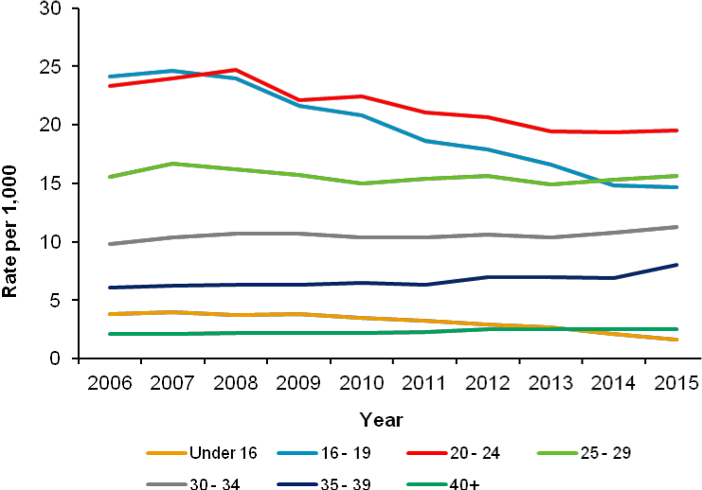
Abortions by age group 2006-15

Slide 5
Abortion case-fatality Rates (per 100,000)
All Abortion | 0.7
Medical | 0.8
Miscarriage | 0.7
(Childbirth | 12.1)
Soper 2007

Slide 6
Subsequent Health and Reproductive Risks
Morbidity and mortality are lower with induced abortion (medical or surgical) than with pregnancy carried to term.
Induced abortion is not associated with an increased subsequent risk of ectopic pregnancy, placenta previa, infertility, or miscarriage
A subsequent risk of preterm birth, which increases with the number of abortions, has been reported.
There are no data to suggest that medical abortion differs from
surgical abortion with respect to these risks.

Slide 7
The most common emotional response after abortion is a profound sense of relief, although some women have lingering feelings of sadness and regret -----
no increased risk of mental disorders after an induced abortion ----
main predictor of mental health problems after abortion is mental health difficulties preceding the pregnancy ----
---- few studies have compared medical and surgical abortion with respect to subsequent mental health problems, although one
trial showed no difference in psychological health at 2 years.

Slide 8
Complications of 43619 abortions up to 64 days, in Finland 2000-6
 | Medical % | Surgical %
Haemorrhage | 15.6 | 1.8
Incomplete | 6.7 | 1.6
Surgical re-evac | 5.9 | 1.8
Injury | 0.03 | 0.6
Infection | 1.7 | 1.7
All adverse events | 20 | 5.6
Niinimaki et al 2009

Slide 9
Outcome of medical abortion in 10291 women
 | <7 | 8-9 | 10 | 11 | 12 | 13 | 14-15 | 16-17 | 18-19 | >19
Evac | 1.8 | 1.7 | 3.8 | 4.8 | 6.4 | 6.0 | 4.7 | 6.0 | 4.1 | 2.2
Incomp | 1.3 | 1.1 | 2.6 | 2.7 | 3.2 | 2.5 | 3.5 | 3.9 | 3.0 | 1.5
FH | 0 | 0.2 | 0.7 | 1.8 | 2.8 | 2.7 | 0 | 0.3 | 0.0 | 0.0
Emerg | 0.5 | 0.4 | 0.5 | 0.3 | 0.4 | 0.8 | 1.2 | 1.8 | 1.1 | 0.7

Slide 10
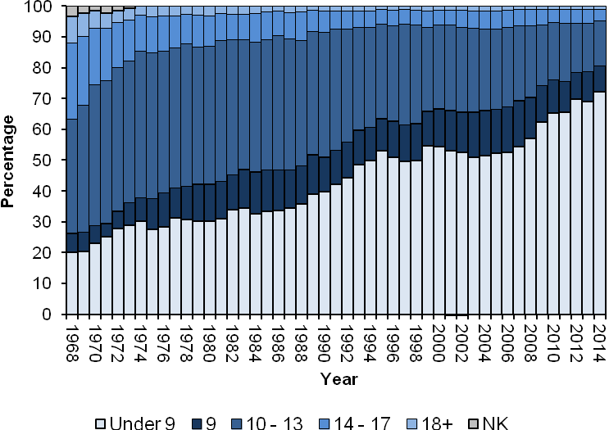
Abortions in Scotland by Gestation 1968-2014

Slide 11
Abortions at Home, Aberdeen 2003-2015

Slide 12
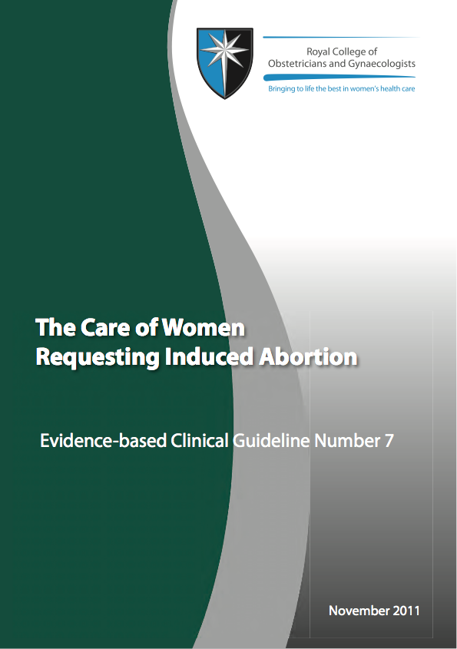

Slide 13
The Care of Women Requesting Induced Abortion
1. Introduction and methodology
2. Summary of recommendations
3. Legal aspects of abortion
4. Commissioning and organising services
5. Complications and sequelae of abortion: what women need to know
6. Pre-abortion management
7. Abortion procedures
8. Care after the abortion
9. Standards for audit and service accreditation
10. Further research
Declarations of interests Systematic reviews Evidence tables References Index

Slide 14
Referral and Procedure
Referral to procedure 10-12 days
Counselling should not be compulsory
Routine ultrasound unnecessary
Choice of method at all gestations
Medical Abortion at Home Offered
Surgical without GA
Infection screening and prophylaxis
Cervical preparation in surgical cases

Slide 15
Sawaya et al 1996 Antibiotics at the Time of Induced Abortion :
The Case for Universal Prophylaxis based on a Meta-analysis
Low risk High risk
Prevalence
Prevalence of postabortal infection 8% 20%
Risk reduction 36% 50%
NNTT 35 10

Slide 16
Penney et al 1998 A Randomised Comparison of Strategies for Reducing Infective Complications in Induced Abortion
Problems reported up to 8 weeks after abortion in 1672 women
Prophylaxis Screen and Treat
% %
Suspected PID 4.6 6.8
Antibiotics 8.3 11.2

Slide 17
FDA Mifepristone and Misoprostol Use 2001-2014
Twelve Women died of Sepsis
Eight in US, one each in Canada, Portugal, Australia, England
Misoprostol was vaginal in ten and buccal in one
Clostridium in eleven, sordellii (9), perfringens (1), septicum (1)
Streptococcus in one

Slide 18
Rates of serious infection dropped significantly after the joint change to buccal from vaginal misoprostol and to either testing for STI or routine antibiotics.
The rate declined 73%, from 0.93 to 0.25 per 1000 abortions (P<0.001)
The subsequent change to routine provision of antibiotics led to a further significant reduction in the rate of serious infection.
Further 76% decline, from 0.25 to 0.06 per 1000 abortions (P=0.03)
Fjerstad et al, 2009

Slide 19
FDA does not have sufficient information to recommend the use of prophylactic antibiotics for women having a medical abortion
Reports of fatal sepsis in women undergoing medical abortion are very rare (approximately 1 in 100,000)
Prophylactic use of antibiotics can stimulate the growth of “superbugs,” bacteria resistant to everyday antibiotics
Finally, it is not known which antibiotic and regimen (what dose and for how long) will be effective in cases such as the ones that have occurred

Slide 20
Antibiotic Policy for both Medical and Surgical Abortion
All women are screened for chlamydia and gc
If positive given azithromycin (can use doxycycline)
If 18 years and under - given prophylactic azithromycin
All women get metronidazole 800mgs at time of abortion

Slide 22
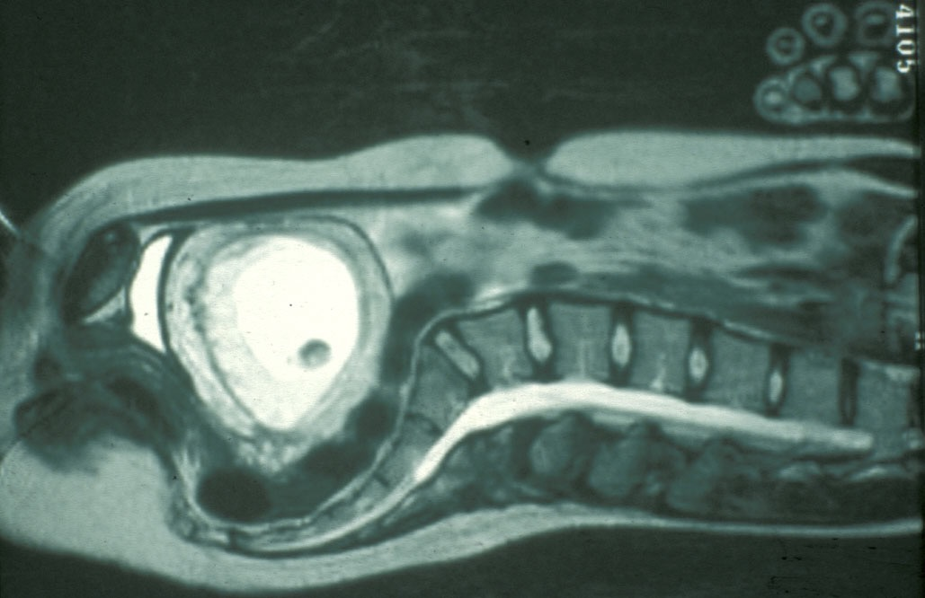
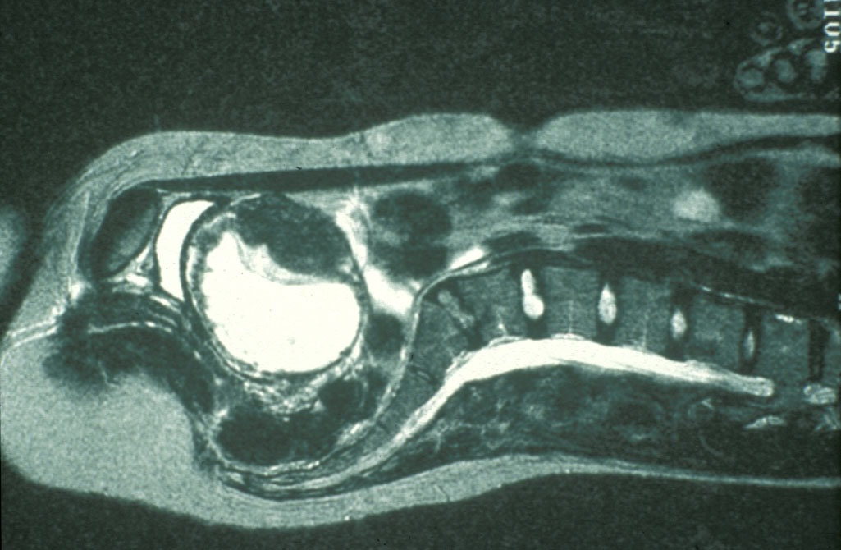

Slide 23
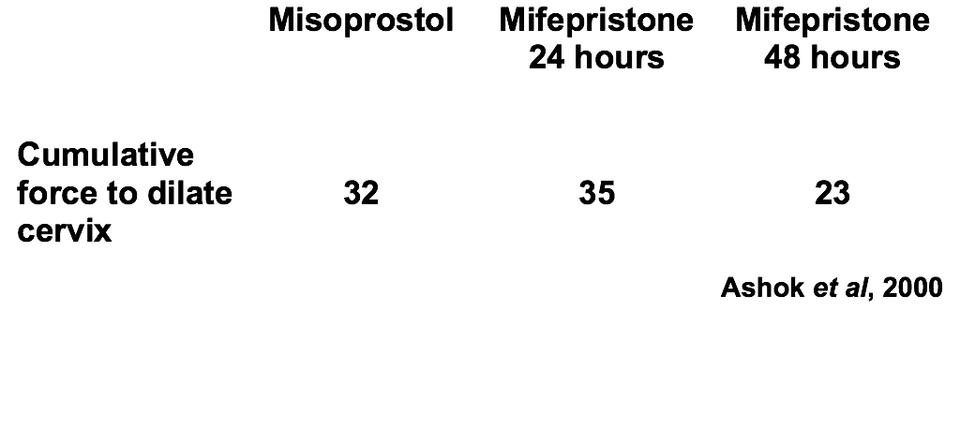
Comparison of mifepristone and misoprostol

Slide 24
Meirik et al 2012 Complications of first-trimester abortion by vacuum aspiration after cervical preparation with and without misoprostol : a multicentre randomised trial
Misoprostol Placebo RR(CI)
n=2427 n=2431
Complications (%) 2 4 0.7(0.5-0.96)
Incomplete (n) 19 55 0.3(0.2-0.6)

Slide 25
Abortion and Preterm Birth
Systematic review and metaanalysis
Included 36 studies and 1,047,683 women
Uterine evacuation 5.7% v 5.0% OR 1.44
Surgical Abortion 5.4% v 4.4% OR 1.52
Women with Medical TOP had similar risk to those with no abortion
Saccone et al 2015

Slide 26
Preterm Birth following Medical and Surgical Abortion (Compared to Primigravida)
Surgical Medical
Adj RR 1.45 1.11
99% CI (1.37-1.55) (0.99-1.24)
Bhattacharya et al 2012

Slide 27
In Conclusion
Follow current Guideline
Medical abortion at home
Pharmaceutical dilatation of the cervix prior to surgery in all cases.
Antibiotic prophylaxis or screen and treat at the time of abortion,
(best approach is still uncertain)

