Slide 1
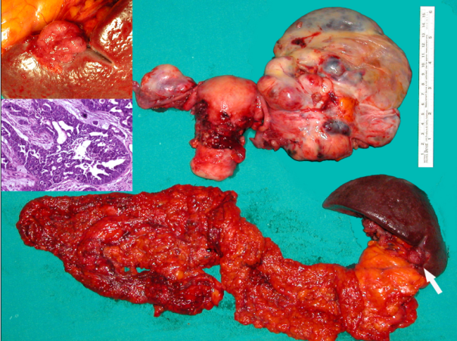
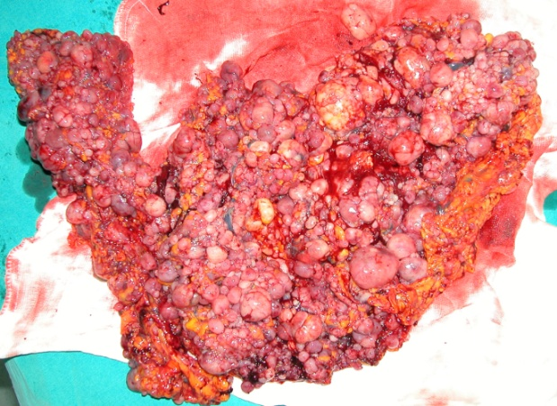
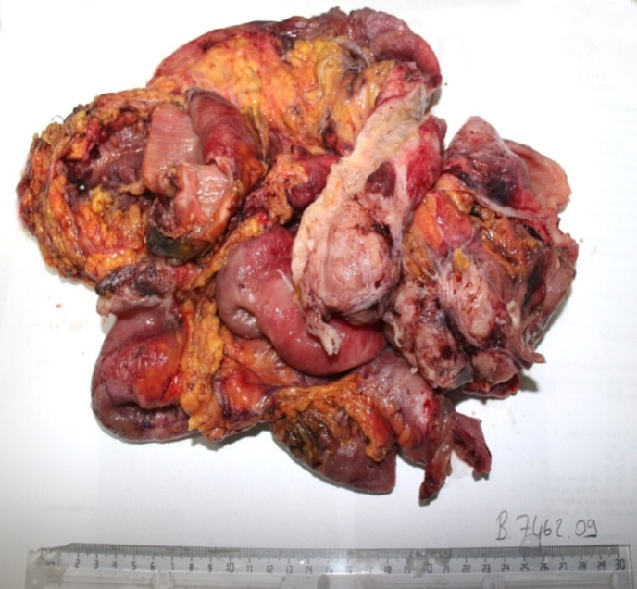
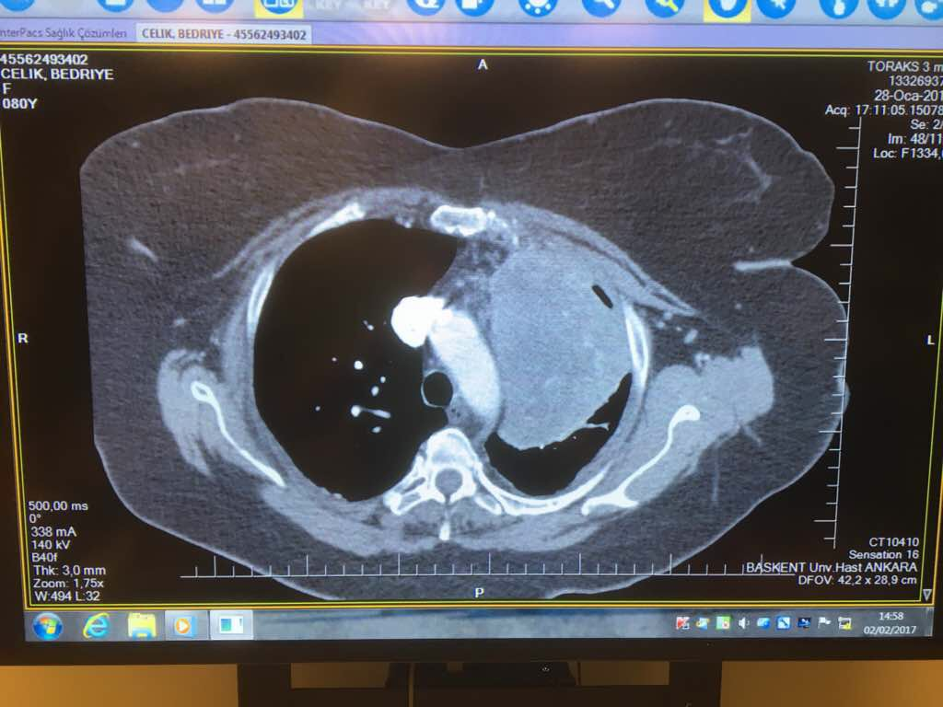
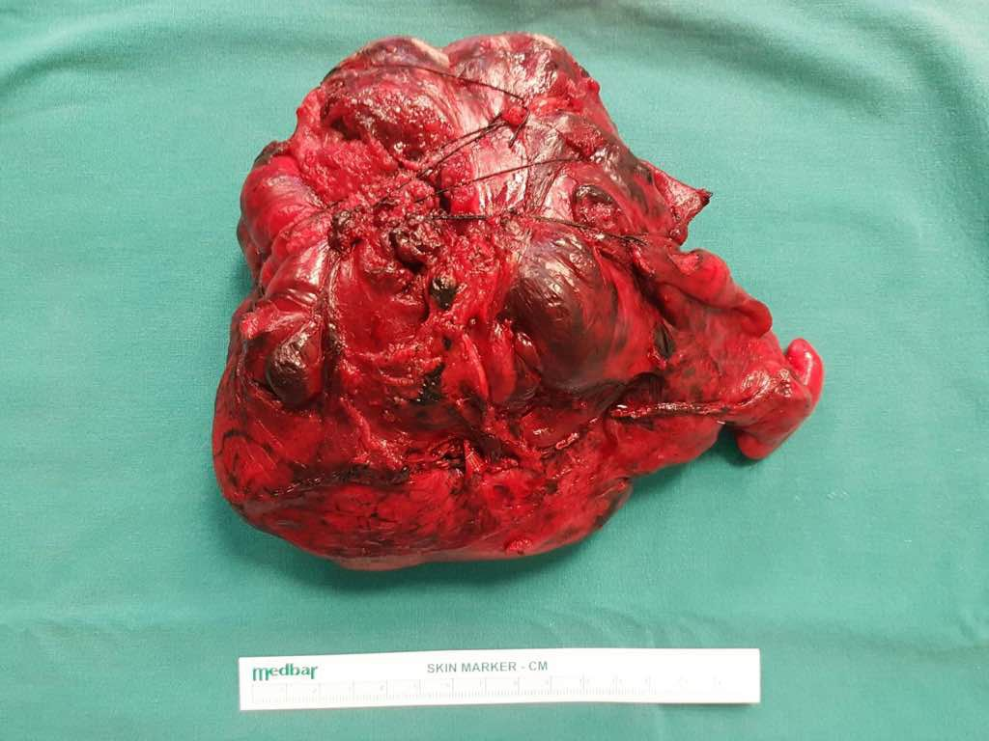
Primary Debulking vs NACT+IDS in EOC (PFS/OAS/Morbidity)
Ayhan Ali, MD
Baskent University School of Medicine
Department of Obstetrics and Gynecology
Division of Gynecologic Oncology

Slide 2
Ovarian Cancer
No effective screening
More than 60% stage III-IV
Agressive cytoreduction followed by platin - taxane chemotherapy

Slide 3
70-80% clinical remission
Most patients will relapse and cure rate is 20-25%
The aim is the prevention or delay of progression, and recurrence after PDS

Slide 4
Therapy depends on:
Patients’ factor
(Age, performance, fertility desire)
Tumor factors
(Histology, grade, molecular)
Genetic alterations
Surgeon factor
Clinical factors
(Accurate diagnosis, extend of tumor,
experienced team, high-volume hospital)

Slide 5
Pre-operative work-up
History-Examination
(systemic, abdominal, pelvic)
Lab studies
(cyto, chemical marker… etc )
Imaging
( USG, CT, if needed MRI,PET, diff MRI if needed)
L/S (open) or Small Incision L/T
( Primary or metastatic possibility of surgery – Fagotti’s, Bristow’s,
Leuven-Essen criterias)
M. Petrillo et al. Gyn Oncol 139 (2015) 5-9
Vergote et al. J Clin Ocol Vol 34 No 32 (Nov
10), 2016 Leisewortz et al.Int J Gynecol Cancer 2017

Slide 6
Limitation of PDS (Metastatic sites and dissemination)
658 patients
578 upfront surgery
191 had residual disease
p: 0.001
Location of Residuel Tm | ALL N:191 | TR 1-10 mm N:144 (75,4%) | TR>10 mm N:47 24,6% | p
Small intestine | 150(79,8%) | 124(87,9%) | 26(55,3%) | <0.001
Portahepatis Lig.hepatoduodenale | 19(10,1%) | 7(5%) | 12(25,5%) | <0.001
Parenchymal Liver met. | 8(4,3%) | 1(0,7%) | 7(14,9%) | <0.001
Supradiaphragmatic | 25(14,9) | 21(14,9%) | 7(14,9%) | 1.000
Pancreas | 15(8%) | 4(2,8%) | 11(23,4%) | <0.001
Stomach | 6(3,2%) | 2(1,4%) | 4(8,5%) | 0.035
T.coeliacus | 5(2,7%) | 2(1,4%) | 3(6,4%) | 0.101
Residue | OAS (months)
R0 | 56
0-10 mm | 32
>10 mm | 17
Heitz et al Gynecol Oncol 2016 May;141(2):264-70

Slide 7
Currently Standard Upfront Therapy
In advanced epithelial OC primary debulking surgery aiming to remove all visible tumor tissue followed by adjuvant CT with Platinum/Taxane±Bevacizumab

Slide 8
Rationale of Primary Debulking Surgery
Eliminates
Necrotic and hypoxic tumor burden
Decreases:
Chemo-sensitive and -resistant cells at the initial diagnosis
The quantity of cells that can spontaneously mutate to drug-resistant pheno-types
Aids in overcoming negative tumor biology
Vascular perfusion of small tumors is higher than large tumors

Slide 9
Primary Debulking Surgery
PDS IDS SDS
Middle & Lower Abdominal
Upper Abdominal
Hysterectomy
Oopherectomy
Bowel resection
Appendectomy
LND (Pelvic,aortic)
Diaphragm
Splenectomy
Distal Pancreatectomy
Liver resection
Porta Hepatis resection
Others
VATS

Slide 10
What is the Survival Impact of Cytoreduction
Overall survival, stage IIIC ovarian cancer, 1989–2003.
Residual disease Pts Median OS
(mo)
Micro 67 106
<0,5cm 70 66
0,5-1cm 99 48
1-2cm 53 33
>2cm 176 34
D.S. Chi et al. / Gynecologic Oncology 103 (2006) 559–564

Slide 11
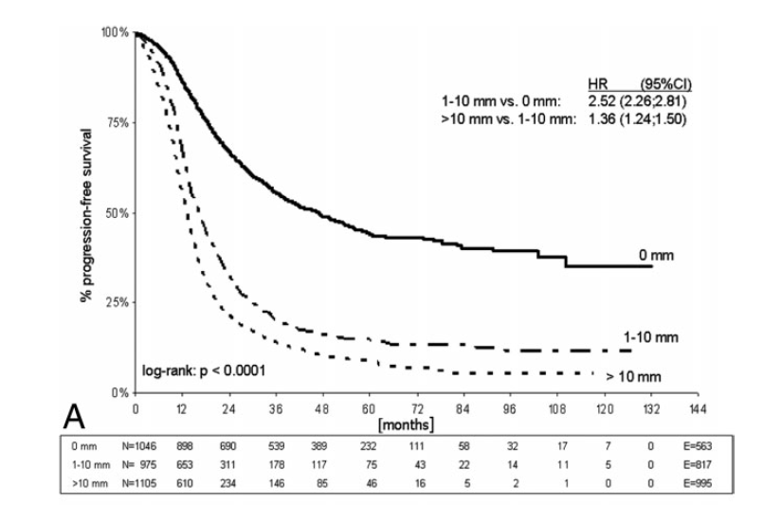
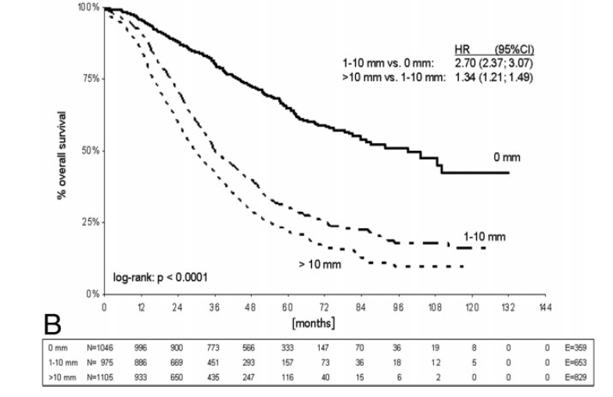
 | HR (95% CI)
1-10 mm vs 0 mm | 2.62 (2.26;2.81)
>10 mm vs 1-10 mm | 1.36 (1.24;1.60)
0 mm | n:1046 | 898 | 690 | 539 | 389 | 232 | 111 | 58 | 32 | 17 | 7 | 0 | E:563
1-10 mm | n:975 | 653 | 311 | 178 | 117 | 75 | 43 | 22 | 14 | 11 | 5 | 0 | E:817
>10 mm | n:1105 | 610 | 234 | 146 | 85 | 46 | 16 | 5 | 2 | 1 | 0 | 0 | E:995
 | HR (95% CI)
1-10 mm vs 0 mm | 2.70 (2.37;3.07)
>10 mm vs 1-10 mm | 1.36 (1.21;1.49)
du Bois et al. Cancer 2009
0 mm | n:1046 | 996 | 900 | 773 | 566 | 333 | 147 | 70 | 36 | 19 | 8 | 0 | E:359
1-10 mm | n:975 | 886 | 669 | 451 | 293 | 157 | 73 | 36 | 18 | 12 | 5 | 0 | E:653
>10 mm | n:1105 | 933 | 650 | 435 | 247 | 116 | 40 | 15 | 6 | 2 | 0 | 0 | E:829

Slide 12
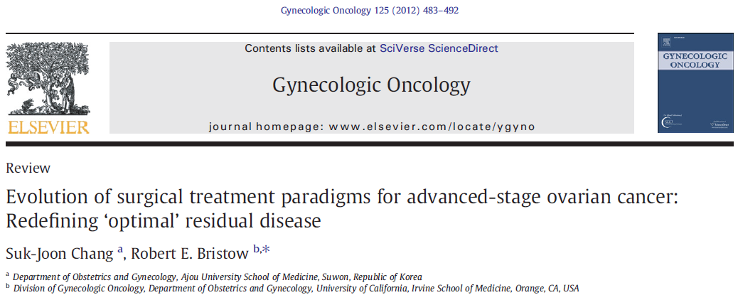
A review about cytoreduction
Tumor Size | N | MOS
No Gross Residue | 3593 | 77.8
Residu tm <1cm | 4780 | 39
Residu tm >1cm | 3518 | 31.1
S.-J. Chang, R.E. Bristow / Gynecologic Oncology 125 (2012) 483–492

Slide 13
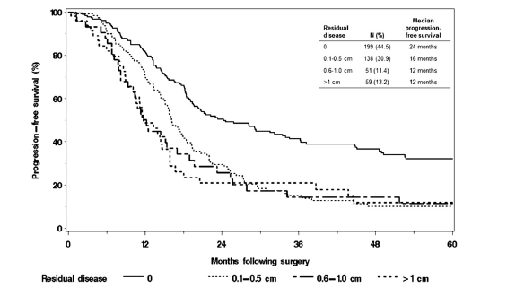
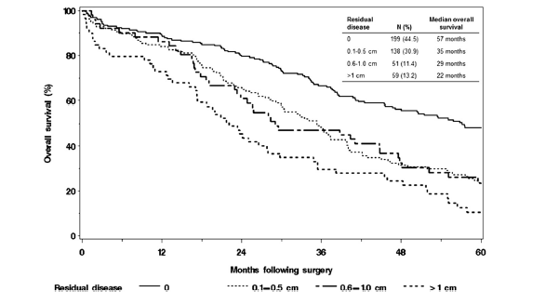
Optimal Debulking vs Survival
447 patients | n: | PFS | OAS
RD 0 cm | 199 | 24 | 57
RD 0.1-0.5 cm | 138 | 16 | 35
RD 0.5-1 cm | 51 | 12 | 29
RD > 1 cm | 59 | 12 | 22
Wallace et al. Gynecol Oncol 2017

Slide 14
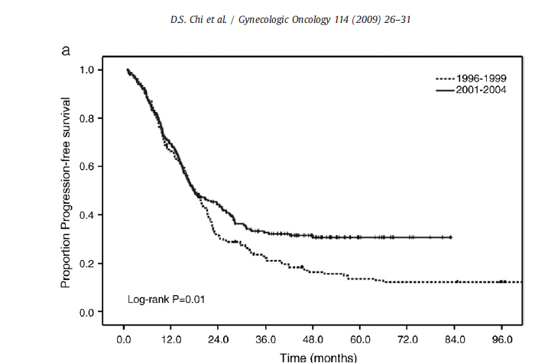
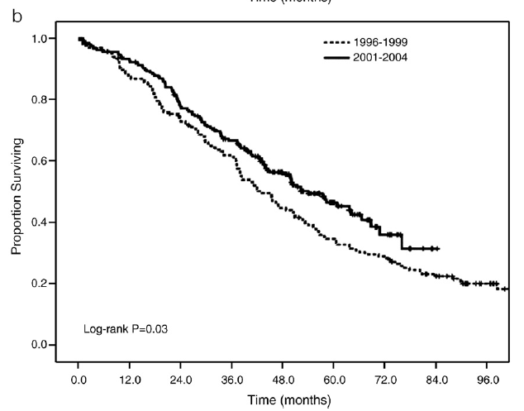
PCR vs ES
What about Extended Surgery
 | 5-year OS(%) | Median OS(mts) | 5-year PFS(%)
Primary Cytoreduction | 35 | 43 | 14
Extended Surgery | 47 | 54 | 31
Also significantly more optimal cytoreduction
and less gross tumor in ES
D.S. Chi et al. / Gynecologic Oncology 114 (2009) 26–31

Slide 15
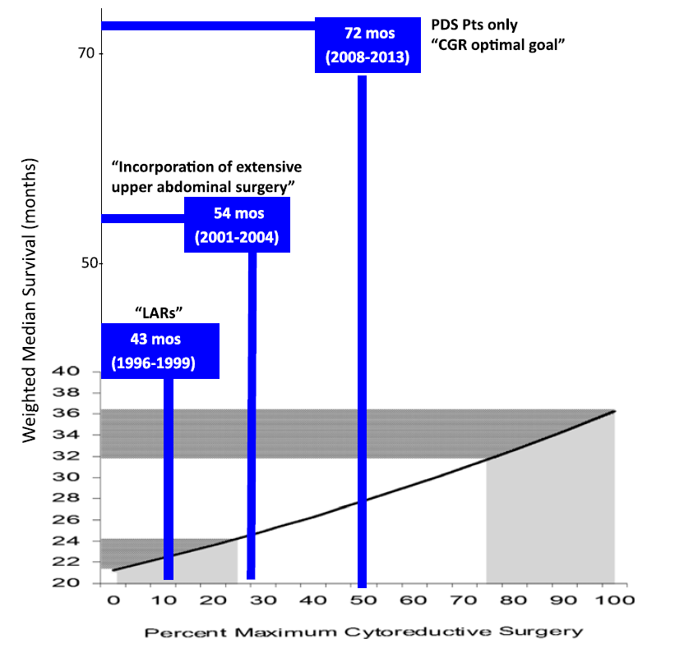
MSKCC Primary Cytoreduction OS and CGR Rates
Leary et al. ESGO Educational Book 2016

Slide 16
Optimal Debulking Surgery in Stage IV Ovarian Ca
Study | Optimal debulking n (%) | Criteria (cm) | Optimal Median OS* (m) | Suboptimal Median OS* (m)
Curtin et al 1997 | 41 (45) | ≤2 | 40 | 19
Liu et al 1997 | 14 (30) | ≤2 | 37 | 17
Munkarah et al 1997 | 31 (31) | ≤2 | 25 | 15
Bristow et al 1999 | 25 (30) | ≤1 | 38 | 10
Akahira et al 2001 | 70 (31) | ≤2 | 32 | 16
Aletti et al 2008 | 50 (46) | ≤1 | 37 | 16
Winters et al 2008 | 78 (22) | 0.1-1 | 29 | 20
* All SS
Curr Treat Options in Oncol 2016; 17:1

Slide 17
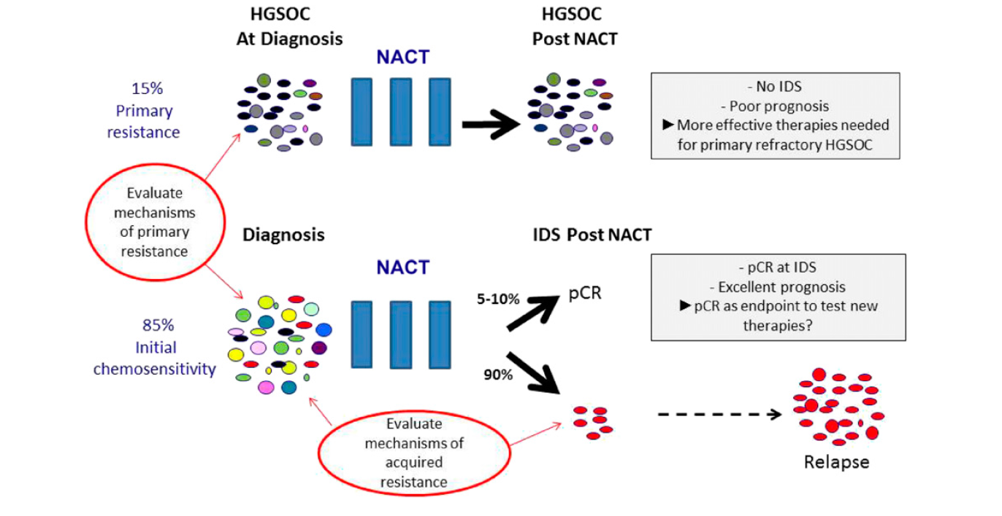
NACT Setting: A Translational Research Oppurtinity
Leary et al. ESGO Educational Book 2016

Slide 18
Randomized Trial of PDS vs NACT+IDS
Variables | EORTC/ NCIC PDS | EORTC/ NCIC NACT | CHORUS PDS | CHORUS NACT
Number of Patient | 361 | 357 | 255 | 219
Residual ≤1 cm (%) | 42 | 81 | 41 | 73
No Gross Residual (5) | 18 | 45 | 17 | 39
PFS (m) | 12 | 12 | 11 | 12
OS (m) | 29 | 30 | 23 | 24
Leary et al. ESGO Educational Book 2016

Slide 19
Tumor Biology Effects The Response to First-Line Platinum-Based Chemotherapy
Response rates in High Grade Serous OC approaches to 75%
Tumor Subtype | No. Of patients With Evaluable Disease | Activity | Study
Low Grade Serous OC | 24 | < 5% | Schmeler et al
Clear Cell OC | 23-68, 4 studies | 22%-41% | Kita et al, Sugyama et al, Ho et al, Takano et al
Muscinous OC | 9-50, 5 studies | 13%-60% | Hess et al, Alexandre et al, Pectasides et al, Gore et al, Shimada et al
Leary et al. ESGO Educational Book 2016

Slide 20
What About Long Term Survival?
PDS vs IDS
Median survival (m)* | PDS | IDS | Total
OS | 43 | 33 | 41
PFS | 17 | 14 | 16
*All SS
n:14182 (PDS; 11871 + IDS; 2311) median follow-up 43 m
Subgroups after Complete Resection
Median survival (m)* | PDS | IDS
OS | 69 | 46
PFS | 29 | 18
*All SS
Ann Surg Oncol. 2016 May;23(5):1666-73

Slide 21
PDS vs IDS
Any Residual
*R0 Resection
n:14182 (PDS; 11871 + IDS; 2311) median follow-up 43 m
Ann Surg Oncol. 2016 May;23(5):1666-73

Slide 22
PDS vs IDS in Stage IV
n:1796 | Median OS (m) | Complete Cytoreduction % | OAS (m)
PDS (n:1488) | 27 | 15 | 63
IDS (n:308) | 29 | 35 | 32
Ann Surg Oncol. 2016 May;23(5):1666-73

Slide 23
Multiple Cycles of NACT Associated with Poor Survival in Bulky Stage IIIC and IV Ovarian Cancer
n:408 | Median OS (m) | 5y OAS (%)
PDS (Only one or never) | 43 | 36
NACT+IDS (More than one) | 27,3 | 31
p: 0,032
IJGC 2015; 25: 1398-1404

Slide 24
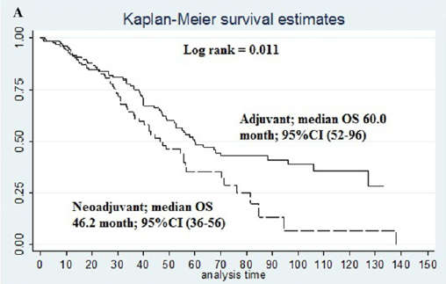
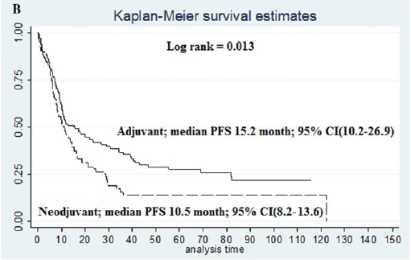
Stage III&IV
Kaplan-Meier OS (A) and PFS (B) curves in function of type of protocol comparing
patients undergoing neo-adjuvant versus adjuvant chemotherapy
Kessous et al. Gynecologic Oncology 144 (2017) 474–479

Slide 25
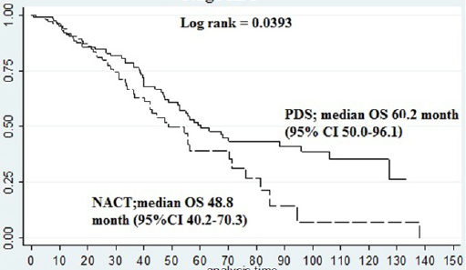
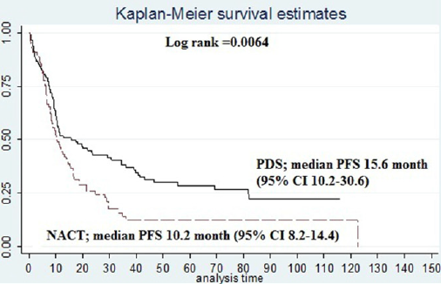
Stage IIIC
Kessous et al. Gynecologic Oncology 144 (2017) 474–479

Slide 26
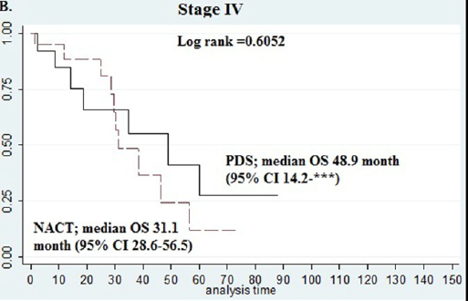
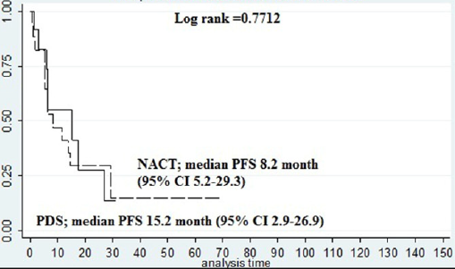
Stage IV
Kessous et al. Gynecologic Oncology 144 (2017) 474–479

Slide 27
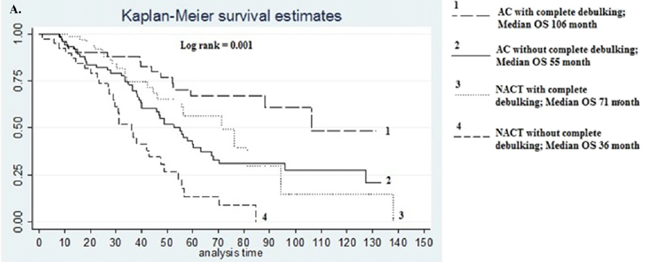
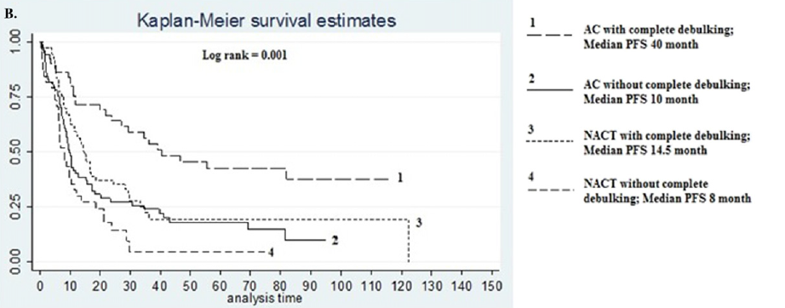
Complete vs Incomplete Debulking
Kessous et al. Gynecologic Oncology 144 (2017) 474–479

Slide 28
What about Quality of Life?
Total of 404 stage IIIC or IV ovarian cancer pts:
n=201 in PDS arm; n=203 in NACT+IDS arm
QoL Compliance of the Institution | Optimal Debulking Status | OS (m) median | PFS (m) median
Good | 39.9% | 32.3 | 12.3
Poor | 19.9% | 23.2 | 9.9
Survival and QOL after NACT followed by surgery was similar to survival and QOL after PDS followed by chemotherapy
Institutions with good QOL compliance had better survival outcomes
Greimel et al., Gynecologic Oncology 131 (2013) 437–444

Slide 29
What about the Cost?
Retrospective cohort, btw 2000-2009, newly diagnosed stage III/IV EOC n=8188
Cumulative lifetime costs was
NACT $ 134,576
PDS $ 117,159
Significantly lower surgical complication costs -$4987 but higher CT-related costs $6874 for the NACT group
NACT is cost-effective in “normal levels” in the high-risk subgroup:
-Stage IV tumor
-Older age
-Poor performance status
However not for the overall sample or for non-high risk pts
Poonawalla et al. Value in Health 18 (2015) 387-395

Slide 30
Gynecologic Oncology 144 (2017) 474–479
263 patients were included in the study analysis
127 patients received NACT with IDS
Platinum sensitivity
72.2%
Debulking results
136 patients had primary debulking and adjuvant CT
Platinum sensitivity
77.4%
Debulking results
Complete 65.9%
PFS: 14.5 mo
OS: 71 mo
Complete 40.2%
PFS: 40 mo
OS:106 mo
Sub optimal
34.1%
PFS: 8 mo
OS: 36 mo
Sub optimal
59.8%
PFS: 10 mo
OS: 55 mo
Higher rates of
CR
But OAS?

Slide 31
PDS vs IDS in Stage
III or IV
Year Study | Primary Endpoint | Study Arm | n | Stg IV (%) | No Residual (%) | PFS (Months) | OAS (months)
2016 Scorpion | Surgical Comp. | NACT PCS | 55 55 | 7 15 | 58 46 | Not reported | Not reported
2015 CHORUS | OS | NACT PCS | 274 276 | 25 25 | 39 17 | 12.0 10.7 | 24.1 22.6
2014 JCOG 0602 | OS | NACT PCS | 152 149 | 30 32 | 63 30 | Not reported | Not reported
2010 EORTC 5591 | OS | NACT PCS | 334 336 | 24 23 | 51 19 | 12 12 | 30 29
Wright et al. Gynecol Oncol 143 (2016) 3-15

Slide 32
Conclusion
OC remains as the most lethal GYN neoplasm
No effective screening programme
More than 60% is advanced stage
Currently PDS with no residual tm + Adjuvant CT is the standard of care
NACT + IDS is not standard yet just in selected cases
Platinum resistance after NACT is controversial
NACT + IDS does not extend OAS? (unclear)

Slide 33
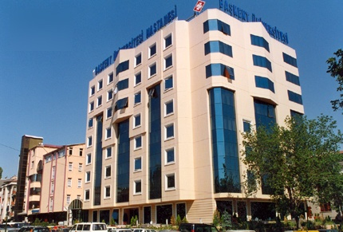
Thank you for your attention

