Slide 1

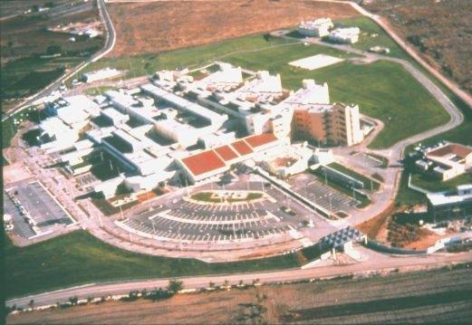

OBESITY AND INFERTILITY
Professor IOANNIS E. MESSINIS
MD, PhD (Aberdeen, UK), FRCOG
Department of Obs/Gynae
University of Thessaly
Larissa, Greece

Slide 2
DISCLOSURE
Nothing to disclose

Slide 3
CLASSIFICATION OF OBESITY
Categories
BMI (kg/m2)
Underweight <18.5
Normal 18.5-24.9
Overweight 25-29.9
Class I obesity 30-34.9
Class II severe obesity 35-39.9
Class III obesity
(extreme or morbid obesity) ≥40
World Health Organization

Slide 4
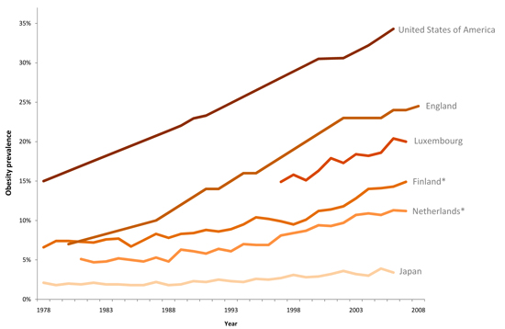
TRENDS IN ADULT PREVALENCE OF OBESITY (BMI≥30 kg/m2)
35
USA
30
25
England
20
Luxembourg
Obesity prevalence
15
Finland
10
Netherlands
5
Japan
0
1978
1983
1988
1993
1998
2003
2008
Year
% of adult
population
On line Eco-Santé databases (OECD)

Slide 5
Outline
Impact of obesity on fertility potential
Role of obesity in ART
Weight reduction and fertility

Slide 6
NORMAL CYCLE
Dafopoulos ...
Messinis, 2009
Fertil. Steril.
92, 1378-80
100
300
80
LH
IU/L
E2
pg/ml
200
60
40
100
20
0
0
25
12
FSH
IU/L
P4
ng/ml
20
10
8
15
6
10
4
5
2
0
0
-14
-10
-6
-2
2
6
10
14
-14
-10
-6
-2
2
6
10
14
Cycle days
Cycle days
Figure 1.

Slide 7
Frequency of irregular menstrual cycles
Obesity %
Grade 1 & 2
(n=48) 19
Grade 3 & 4
(n=35) 54*
* P=0.01
Castillo-Martinez et al., 2003
Nutrition, 19, 317-20

Slide 8
Obese with and without menstrual disorders
Menstrual
disorders
Controls
P
n 39 44 NS
Age (y) 31.6±4.9 32.2±4.4 NS
BMI (kg/m2)* 29.8±3.6 28.7±4.0 NS
Trunk fat mass (kg) 14.9±4.1 12.9±3.8 <0.05
Leg fat mass (kg) 10.0±1.8 10.6±3.3 NS
Trunk-leg fat ratio 1.48±0.29 1.25±0.38 <0.01
mean±SD
* >25kg/m2
Douchi et al., 2002
Acta Obstet. Gynecol. Scand. 81, 147-50

Slide 9
Menstrual problems (by 33 y)
BMI at 7 y
BMI at 23 y
Underweight 0.87 1.34*
Normal 1.00 1.00
Overweight 1.05 1.34*
Obese 1.78* 2.43**
*P<0.05
** P<0.0001
n=5799 females
1958 British birth cohort study
Lake et al., 1997
Int. J. Obes., 21, 432-8

Slide 10
Women with anovulation
Anovulation
Overweight
<20% 2.6%
20-49% 4.0%
50-74% 5.8%
>74% 8.4%
n=26638 women
20-40y
Hartz et al., 1979
Int. J. Obes. 3, 57-73

Slide 11
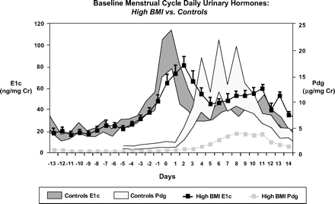
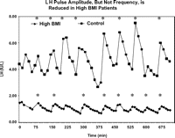
MENSTRUAL CYCLE
(urinary hormones)
High BMI (48.6±1.4) vs controls (<25 kg/m2)
120
25
100
E1c
ng/mg
Cr
20
Pdg
μg/mg
Cr
80
15
60
40
10
20
5
0
0
-12
-10
-8
-6
-4
-2
0
2
4
6
8
10
12
14
Controls E1c
Days
n=11
LH pulses
Controls Pdg
n=18
mean±SEM
High BMI E1c
Jain et al., 2007
JCEM 92, 2468-73
High BMI Pdg

Slide 12
Mechanism
Increased conversion of androgen to estrogen in adipose tissue
Decreased gonadotrophins
Disturbed LH pulsatility
Decreased SHBG levels by insulin
Insulin stimulates increased production of androgen from the ovaries
Changes in the production of adipokines

Slide 13
Adipokines in obesity
 | Blood levels in obese | Primary effects | Effects on insulin sensitivity
Adiponectin | Decreased | ↑ Fat oxidation ↑ Insulin sensitivity | Increased
Resistin | Increased | Increases insulin resistance | Decreased
Leptin | Increased | Signal of energy stores | Increased

Slide 14
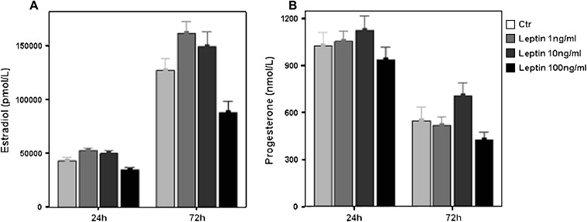
Effect of leptin on steroidogenesis
1200
Control
E2 pmol/l
P4 nmol/l
150000
Leptin 1ng/ml
Leptin 10ng/ml
900
Leptin 100ng/ml
100000
900
50000
900
0
0
24h
72h
24h
72h
Human luteinized granulosa cells
mean±SEM
Karamouti et al., 2008
Fertil. Steril. 90, 1444-50

Slide 15
Risk ratios for conceiving within 12 months
BMI at 7 y
BMI at 23 y
Underweight 0.91 0.91
Normal 1.00 1.00
Overweight 1.00 1.03
Obese 0.80 0.70*
*P<0.005
Did not conceive within 12 mo:
33.0% of obese
18.6% of normal weight
Lake et al., 1997
Int. J. Obes., 21, 432-8

Slide 16
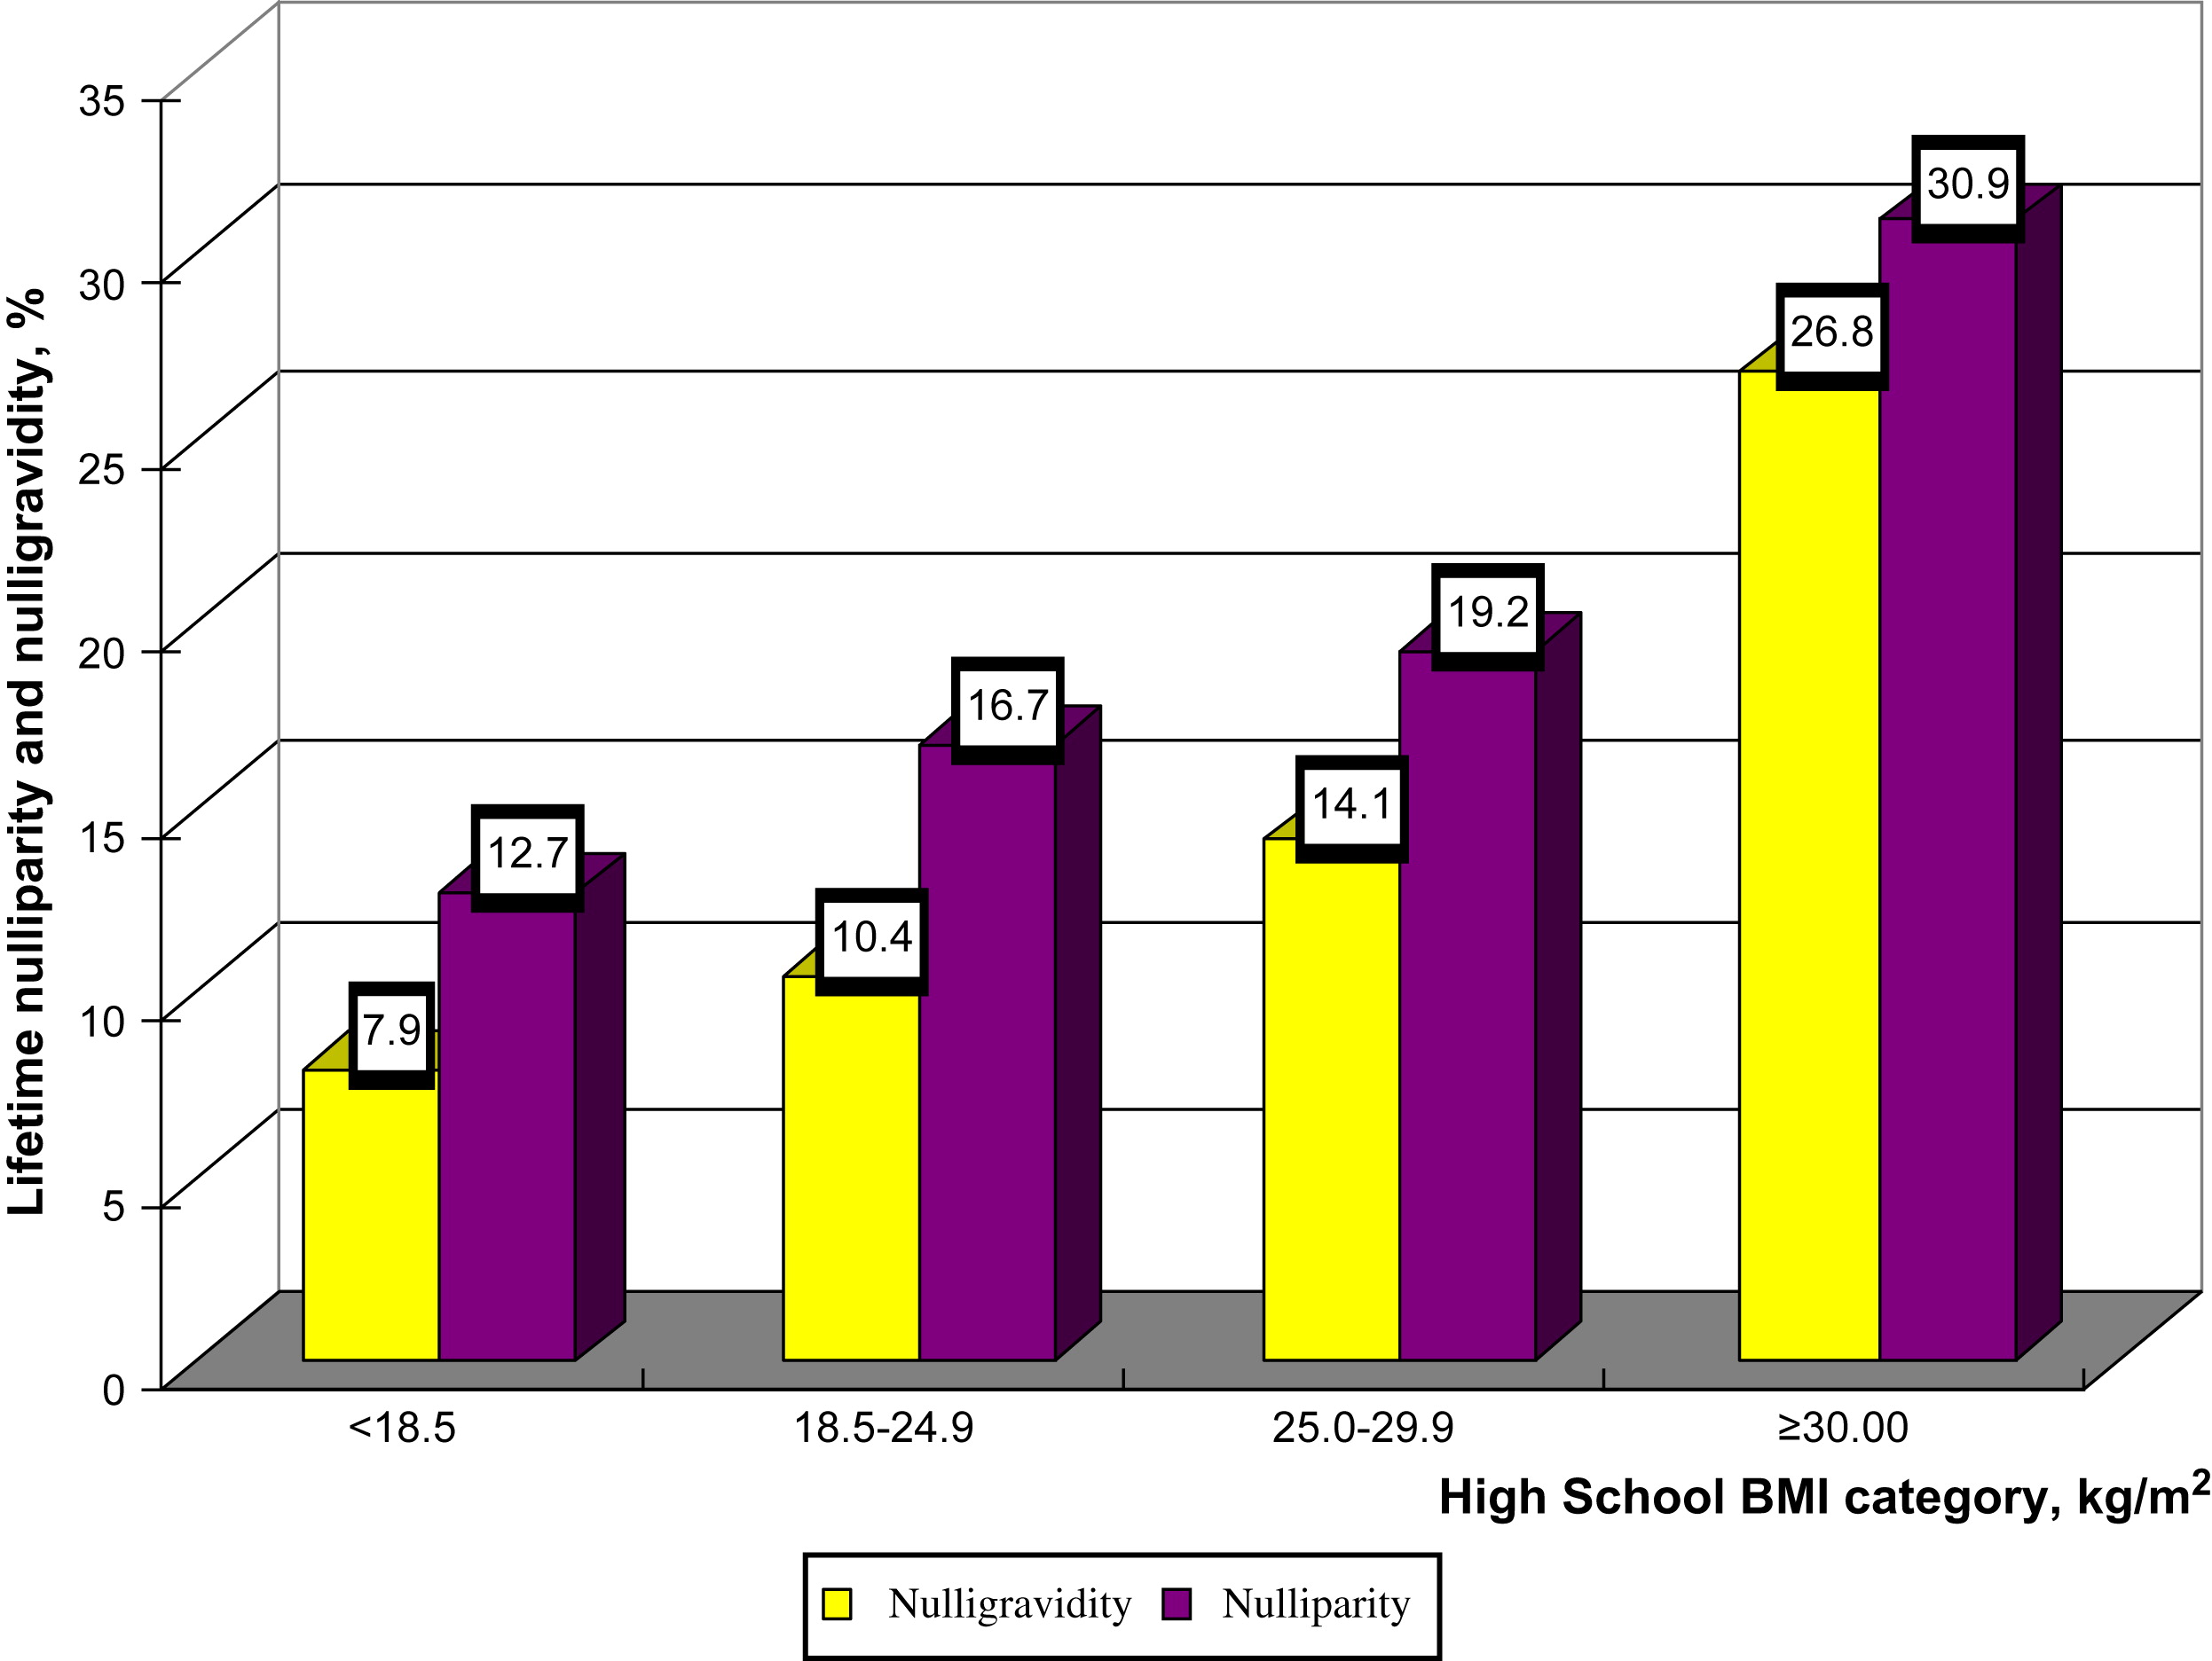
Adolescent obesity and lifetime nulliparity
Figure 1
35
30
25
20
nulligravidity
Lifetime nulliparity
and nulligravidity %
15
nulliparity
10
5
0
<18.5
18.5-24.9
25.0-29.9
≥ 30.0
High school BMI category (kg/m2)
Polotsky et al., 2010
Fertil. Steril. 93, 2004-11
n=3154 women
SWAN study
Fertility and Sterility 2010 93, 2004-2011DOI: (10.1016/j.fertnstert.2008.12.059)
Notes:
Prevalence of lifetime nulliparity and nulligravidity by high school BMI categories (yellow bars = nulligravidity; purple bars = nulliparity).

Slide 17
Risk of ovulatory disorder infertility
BMI at 18 y
(kg/m2)
RR
for infertility
20-21.9 1.0
24-25.9 1.3
26-27.9 1.7
28-29.9 2.4
30-31.9 2.7
>32 2.7
Case-control study
2527 women with ovulatory disorder infertility
46718 controls (married parous women)
Rich-Edwards et al., 1994
Am. J. Obstet. Gynecol. 171, 171-7

Slide 18
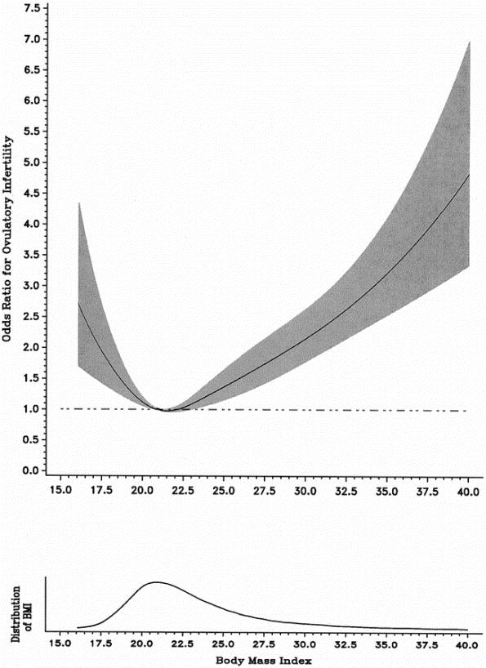
Ovulatory disorder infertility by BMI
7.5
7.0
6.5
6.0
5.5
5.0
4.5
Odds ratio for ovulatory
infertility
4.0
3.5
3.0
2.5
2.0
Nurses’ Health study II
1.5
1.0
0.5
0
15
17.5
20
22.5
25
27.5
30
32.5
35
37.5
40
Rich-Edwards et al., 2002
Epidemiology 13, 184-90
Distribution
of BMI
21
15
17.5
20
22.5
25
27.5
30
32.5
35
37.5
40
Body mass index (kg/m2)
2

Slide 19
Outline
Impact of obesity on fertility potential
The role of obesity in ART
Weight reduction and fertility

Slide 20
Response to clomiphene in WHO II
Reduced with increasing BMI:
  OR 0.92 (0.88-0.96)
Reduced with increasing waist-to-hip ratio:
  OR 0.60 (0.40-0.89)
Imani et al., 2002
Fertil. Steril. 77, 91-7
Messinis et al., 2015
Best Pract. Res. Clin. Obstet. Gynaecol. 29, 479-88
Ovulation induction

Slide 21
Clomiphene resistance
(No ovulation)
- Increase in:
  FAI
  BMI
  Mean ovarian volume
  Insulin, LH
  Age
  AMH
- Amenorrhea
Imani et al., 1998 (JCEM), 1999 (JCEM),
2002a (Fertil. Steril.), 2002b (Fertil. Steril.),
Van Santbrink et al., 2002 (Fertil. Steril.)
Mahran et al., 2013 (JCEM)

Slide 22
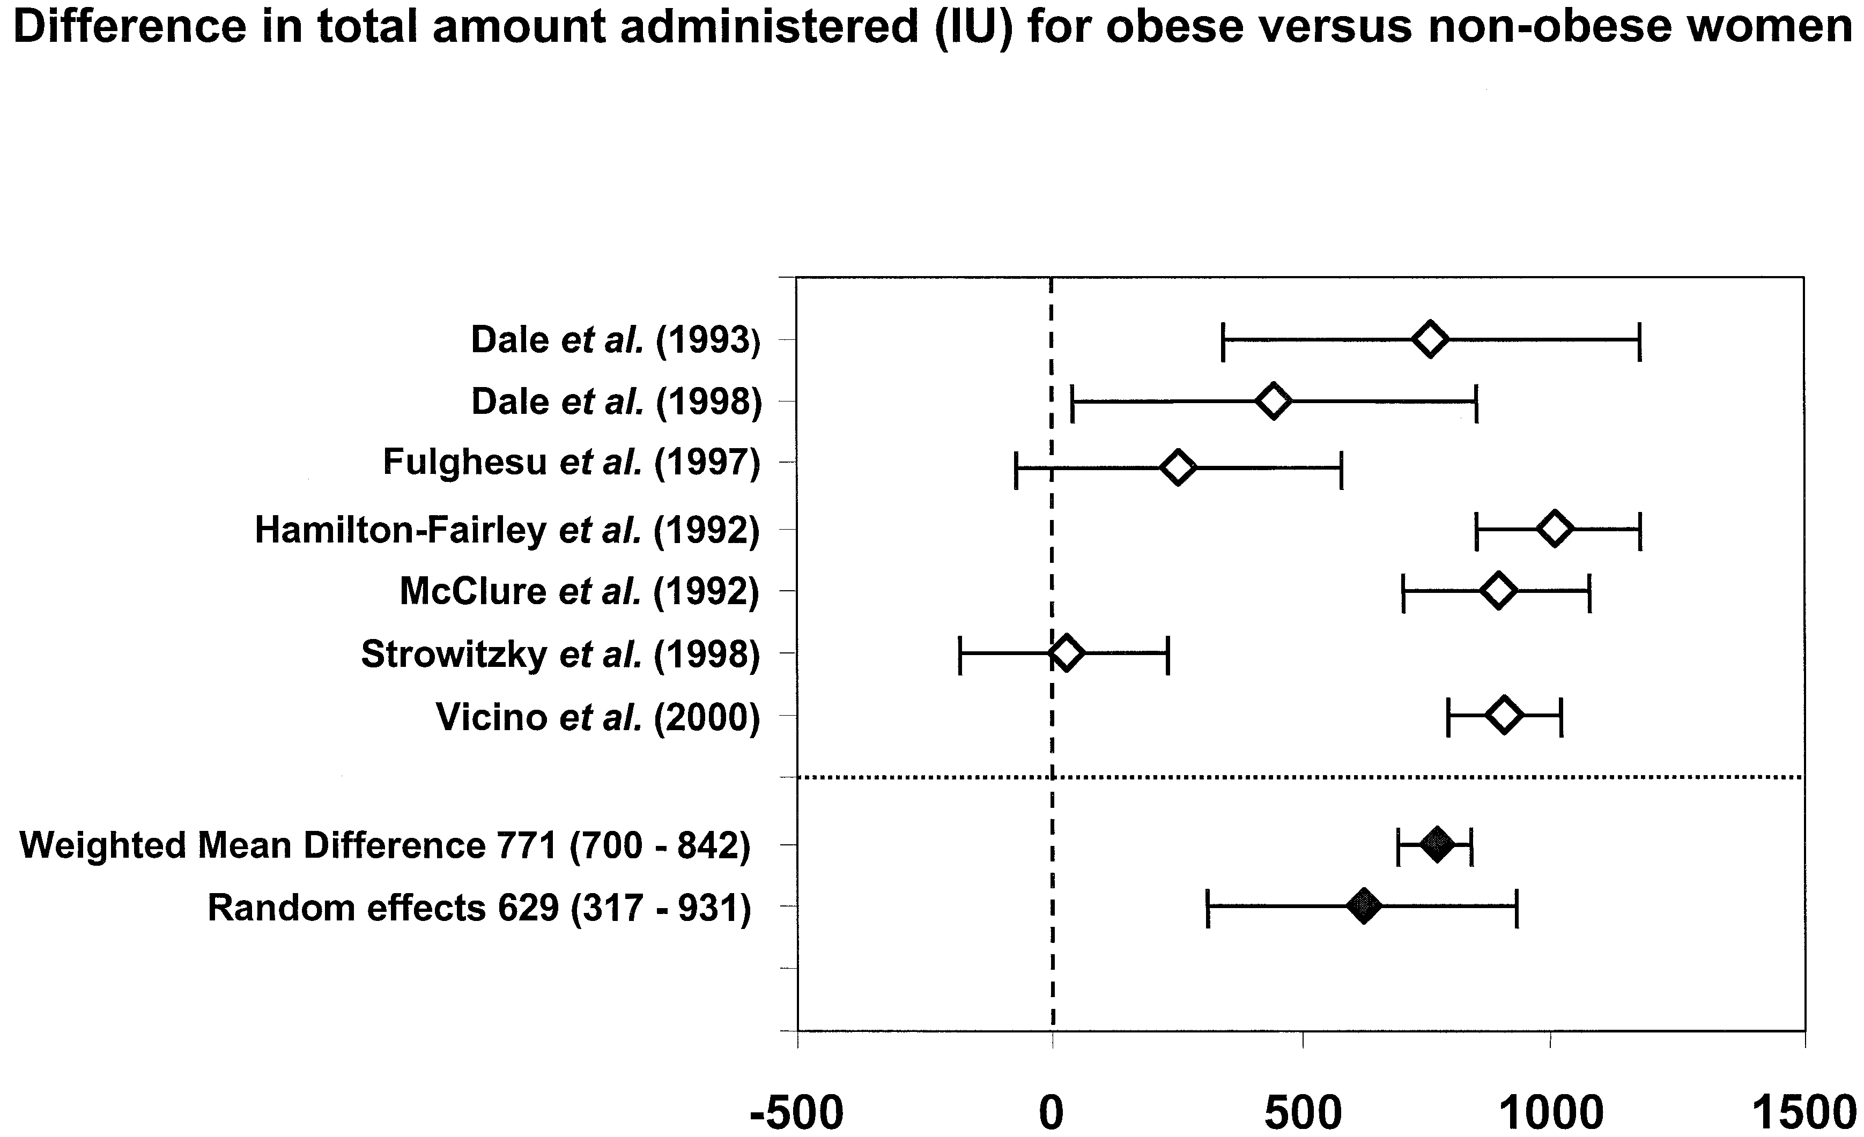
Association between obesity and total amount of administered FSH (IU)
-500
0
500
1000
1500
Ovulation induction
(WHO group II)
Mulders et al., 2003
Hum. Reprod. Update 9, 429-49

Slide 23
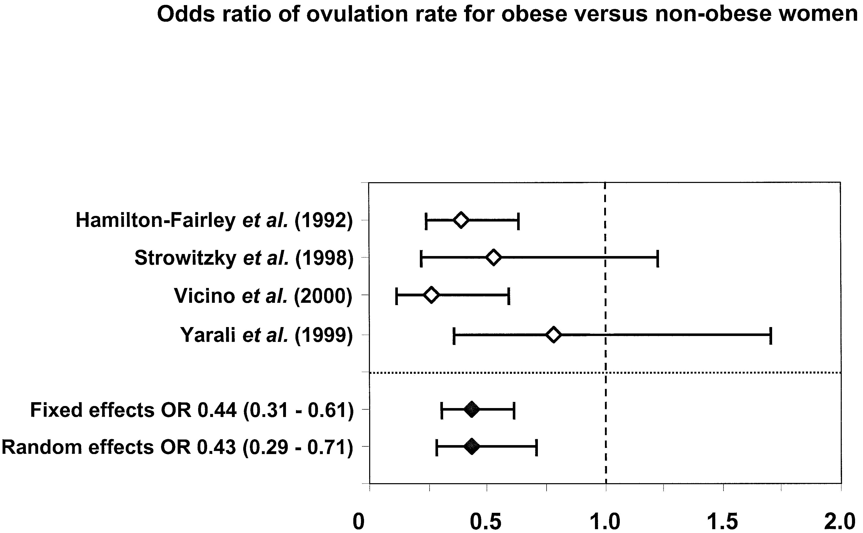
Odds ratio of ovulation rate for obese versus non-obese women
0
0.5
1.0
1.5
2.0
Mulders et al., 2003
Hum. Reprod. Update 9, 429-49
Ovulation induction
(WHO group II)

Slide 24
IVF/ICSI: Impaired responsiveness to gonadotrophins
Increased duration of stimulation
Increased amount of gonadotrophins
Increased cancellation rate
A lower number of medium/large follicles
Decreased number of oocytes retrieved

Slide 25
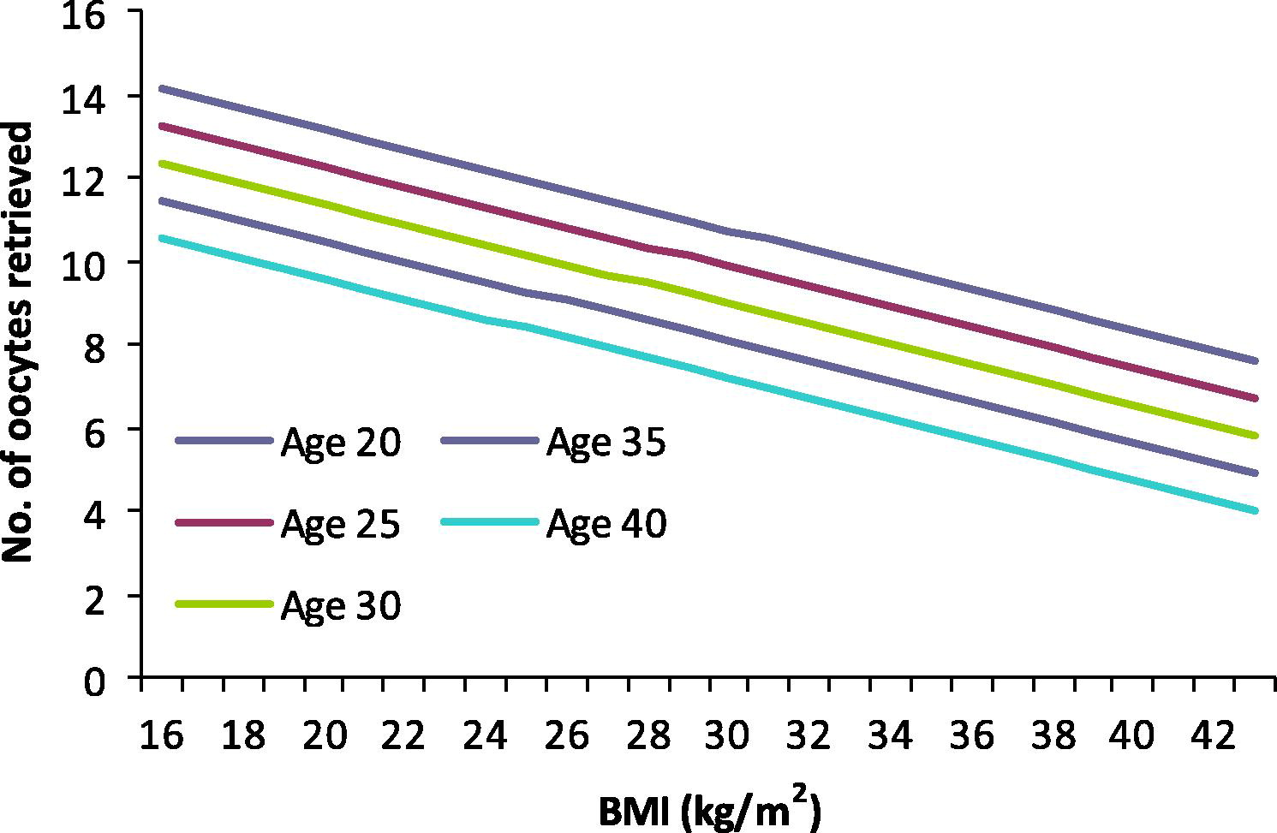
Female body weight and number of oocytes
Figure 2
16
14
12
10
No. of retrieved oocytes
8
6
4
2
0
16
18
20
22
24
26
28
30
32
34
36
38
40
42
BMI (kg/m2)
Pinborg et al., 2011
RBM Online 23, 490-9
Longitudinal multicenter cohort
(487 couples; 1417 cycles)
Reproductive BioMedicine Online 2011 23, 490-499DOI: (10.1016/j.rbmo.2011.06.010)
Notes:
The expected number of oocytes retrieved related to women’s body mass index (BMI) and female age. Multiple linear regression analysis only including the first IVF or intracytoplasmic sperm injection cycle showed a significant negative association between the number of collected oocytes and BMI (P<0.001, B=−0.243, SE=0.059) and women’s age (P=0.014, B=−0.179, SE=0.073).

Slide 26
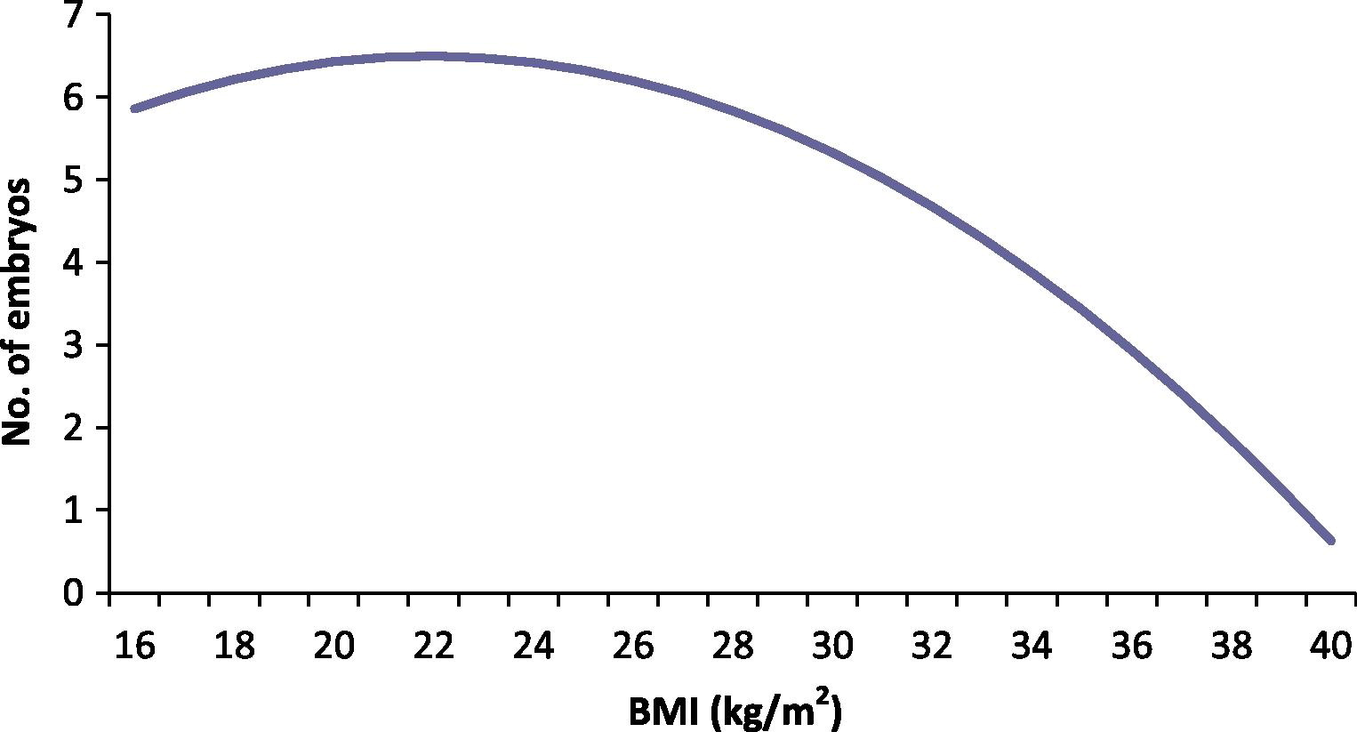
Female body weight and number of embryos
Figure 3
7
6
5
4
No. of embryos
3
2
1
0
16
18
20
22
24
26
28
30
32
34
36
38
40
BMI (kg/m2)
Pinborg et al., 2011
RBM Online 23, 490-9
Longitudinal multicenter cohort
(487 couples; 1417 cycles)
Reproductive BioMedicine Online 2011 23, 490-499DOI: (10.1016/j.rbmo.2011.06.010)
Notes:
The expected number of embryos related to women’s body mass index (BMI). The association between BMI and the number of embryos showed a quadratic relationship with an inverse U-formed curve with fewer embryos among the low-weight and the obese women (P=0.03, B=−0.018, SE=0.008).

Slide 27
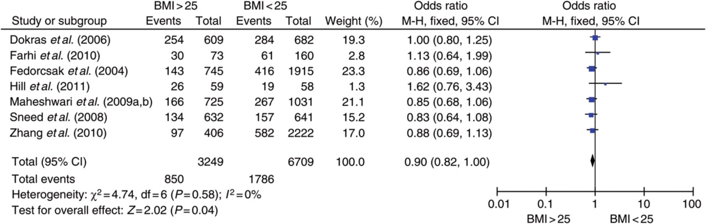
Live birth rate for overweight and normal weight
BMI >25
BMI <25
No difference in:
OHSS
Multiple pregnancies
Koning et al., 2012
Hum. Reprod. 27, 457-67
Notes:
27

Slide 28
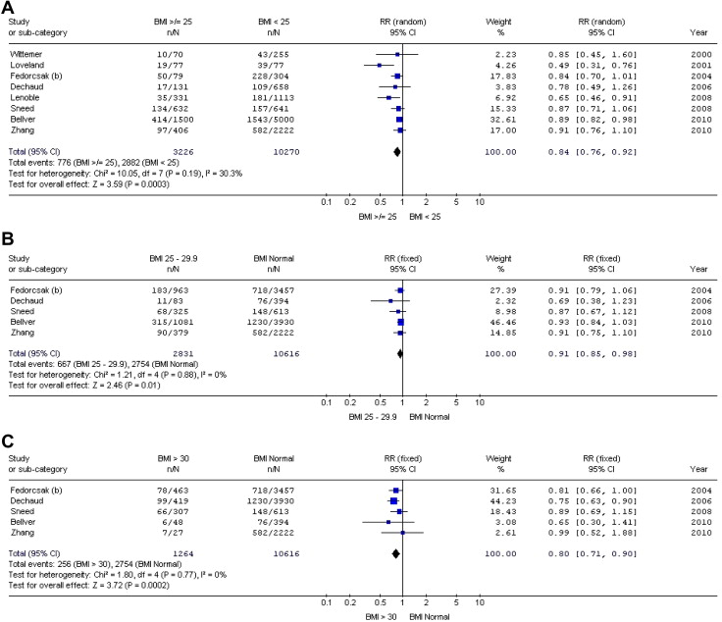
Live birth rate for different BMI: Meta-analysis
0.84, 95% CI: 0.76–0.92
BMI ≥ 25
BMI<25
0.91, 95% CI: 0.85–0.98
BMI=25-29.9
BMI<25
0.80, 95% CI: 0.71–0.90
Rittenberg et al., 2011
RBM Online 23, 421-39
n=47967 cycles
BMI>30
BMI<25

Slide 29
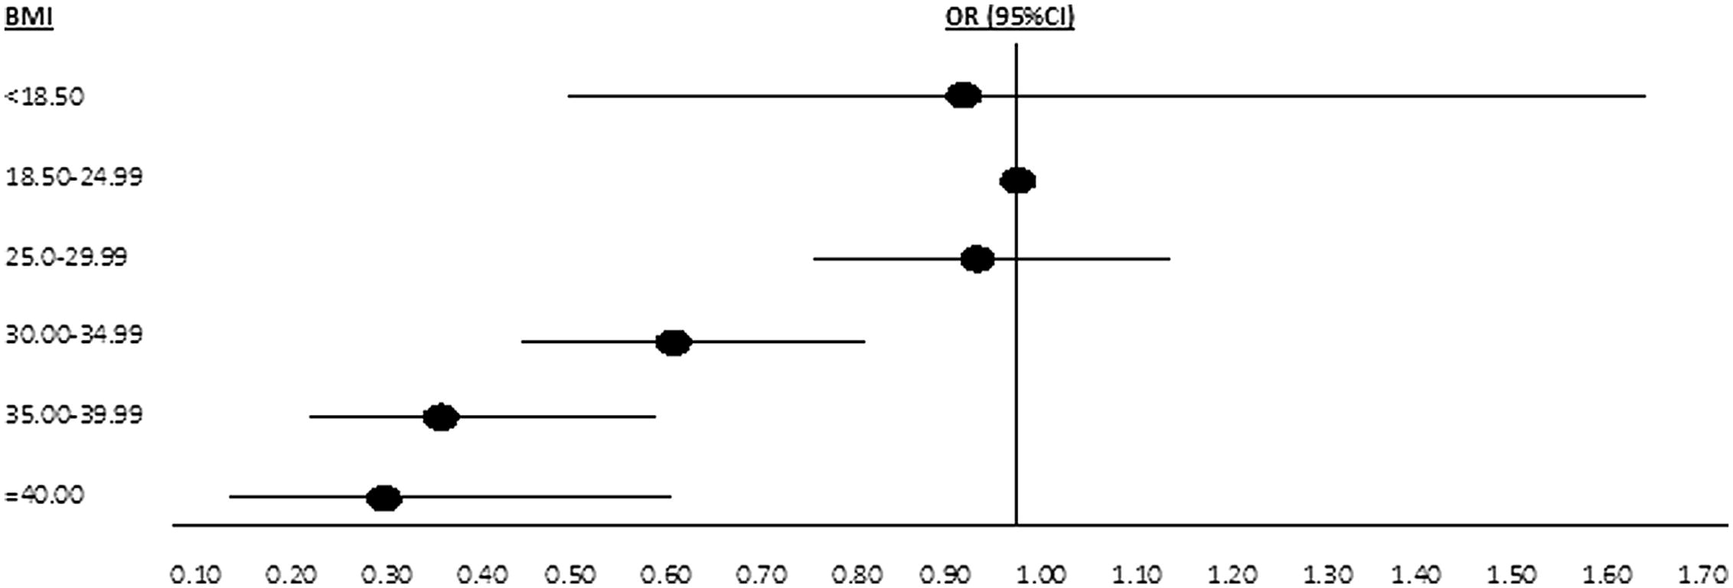
Adjusted live birth rate according to BMI
Figure 1
BMI kg/m2
OR (95%CI)
<18.50
18.50-24.99
25.00-29.99
30.00-34.99
35.00-39.99
=40.00
0.10
0.30
0.50
0.70
1.00
1.30
1.50
1.70
Moragianni et al., 2012
Fertil. Steril. 98, 102-8
First fresh IVF cycle
n=4609 patients
Fertility and Sterility 2012 98, 102-108DOI: (10.1016/j.fertnstert.2012.04.004)
Notes:
Forest plot of adjusted live birth rate according to body mass index (BMI, kg/m²) category (circle represents odds ratio [OR], horizontal line represents 95% confidence interval [CI]).

Slide 30
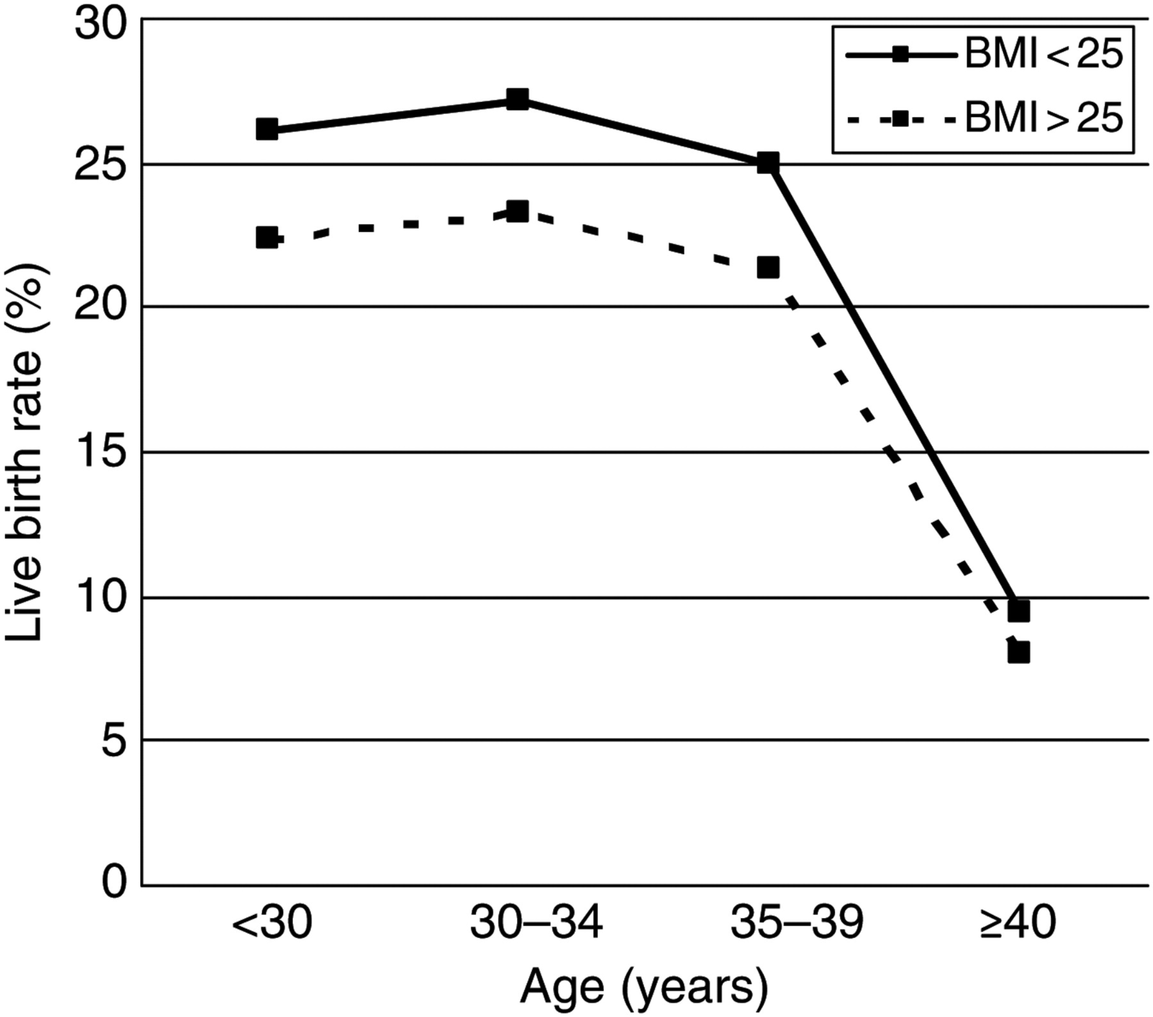
Live birth rate after IVF for overweight and normal weight women according to age
30
25
20
Live birth rate (%)
15
10
5
0
Koning et al., 2012
Hum. Reprod. 27, 457-67
<30
30-34
35-39
≥ 40
Age (years)
Notes:
30

Slide 31
Predictors of a first live birth
All treatment cycles All fresh cycles
(n = 1334) P-value* (n = 1164) P-value*
Female BMI 0.96 (0.93–1.00) 0.034 0.96 (0.93–0.99) 0.024
Female age 0.95 (0.90–1.00) 0.037 0.93 (0.89–0.98) 0.011
Male age 0.96 (0.93–1.00) 0.040 0.97 (0.94–1.01) NS
* For each increase in women’s BMI of 1 kg/m2 and for each 1-year increase in women’s age and men’s age
Pinborg et al., 2011
RBM Online 23, 490-9

Slide 32
Obesity and IVF (Probability of live birth)
Ovulatory women - 23652 cycles
Anovulatory women - 1539 cycles
Underweight: 0.92 (0.70-1.22)
Normal weight: 1
Overweight: 0.88 (0.79-0.99)
Obese: 0.75 (0.63-0.90)
Both (F & M) ≥25 0.73 (0.48-1.11)
No effect in ICSI
No effect of male BMI
Underweight: 1.37 (0.75-2.48)
Normal weight: 1
Overweight: 0.86 (0.60-1.23)
Obese: 0.89 (0.60-1.31)
Petersen et al., 2013; Fertil. Steril. 99, 1654-62

Slide 33
Male obesity: Evidence varies as to whether it:
Alters sperm function
Increases sperm DNA damage
Decreases sperm mitochondrial activity
Induces seminal oxidative stress
Impairs blastocyst development
Reduces pregnancy outcome in ART
Increases miscarriage in ART
Practice Committee of ASRM, 2015
Fertil. Steril. 104, 1116-26

Slide 34
Male BMI: Probability of live birth
 |  | Live birth rate (%)
IVF | Normal weight | 37.06
IVF | Overweight | 39.35
IVF | Obesity | 36.86
ICSI | Normal weight | 41.34
ICSI | Overweight | 39.96
ICSI | Obesity | 40.41
IVF + ICSI | Normal weight | 38.81
IVF + ICSI | Overweight | 39.60
IVF + ICSI | Obesity | 38.64
Zhu et al., 2015; Fertil. Steril. 104, 1406-10

Slide 35
Impact of BMI and Age on pregnancy rate
P<0.05
P<0.05
34.4%
26.7%
22.2%
20.0%
Women
20.0%
31.3%
29.6%
Men
25.9%
27.0%
16.7 %
<701
801-900
>1000
701-800
901-1000
Score of AgeXBMI
Anifandis et al., 2013
Andrology 1, 85-9

Slide 36
Endometrial gene expression in the window of implantation
Obese vs controls:
  151 genes were dysregulated (transcription, biosynthesis)
Obese with PCOS:
  Dysregulated genes related to development, morphogenesis and the immune system
  (Biopsies on day LH surge/HCG + 7 days)
Bellver et al., 2011
Fertil. Steril. 95, 2335-41

Slide 37
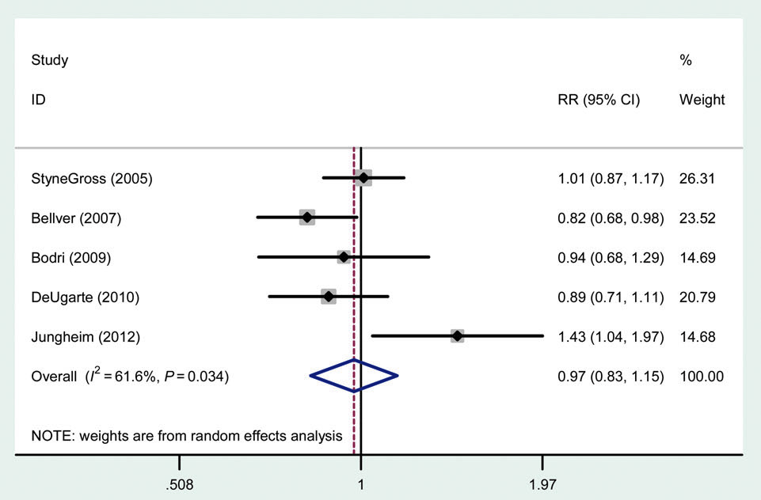
Oocyte donors: obese vs normal weight recipients
%
Clin. Preg. rate
Jungheim et al., 2013; Hum. Reprod. 28, 2720-7

Slide 38
Obesity in surrogates: Impact on outcome
BMI<35
BMI≥35
P value
First cycle only (n=349)
CPR 61 35 0.030
LBR 49 24 0.041
Mean % implantation 38 18 0.021
All cycles (n=551)
CPR 61 36 0.019
LBR 49 28 0.051
Mean % implantation 34 16 0.003
Oocyte-donors
No impact on miscarriages
DeUgarte et al., 2010; Fertil. Steril. 93, 1008-10

Slide 39
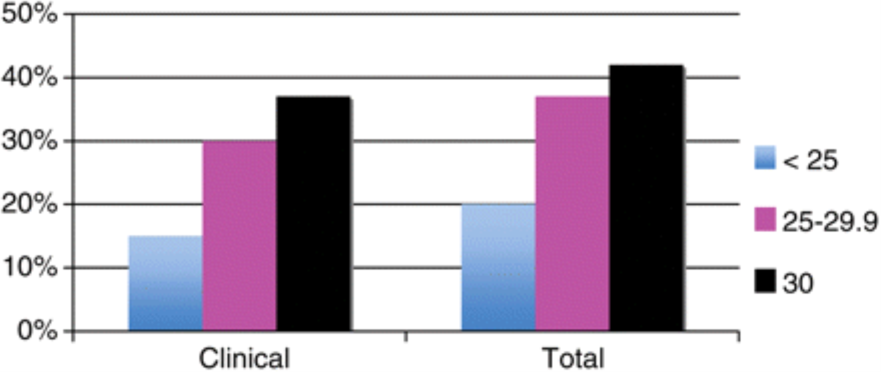
Miscarriage rate and BMI
50%
40%
30%
<25
20%
25-29.9
10%
30
0%
Clinical
Total
Single blastocyst transfer
(Fresh and cryo-thawed)
Rittenberg et al., 2011
Hum. Reprod. 26, 2642-50
Notes:
39

Slide 40
Outline
Impact of obesity on fertility potential
The role of obesity in ART
Weight reduction and fertility

Slide 41
Weight reduction
Lifestyle modification
Medical treatment
Bariatric surgery

Slide 42
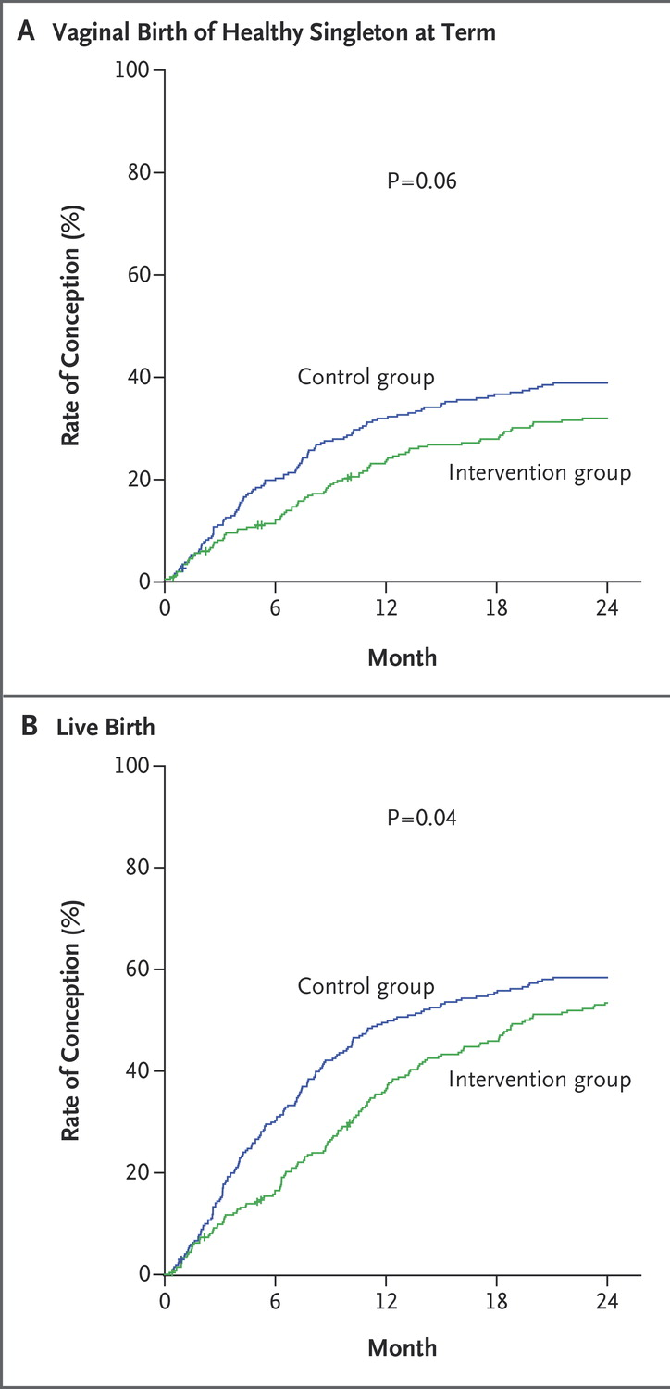
Lifestyle programme
in obese infertile
women
100
Vaginal birth of
healthy at term
(within 24 mo.)
80
60
40
P=0.06
Control group
Intervention group
RR 0.77 (0.60-0.99)
20
0
0
6
12
18
24
Rate of conception (%)
Month
RCT
BMI≥29 kg/m2
100
Live birth
(within 24 mo.)
80
Intervention (n=289):
6 mo. lifestyle+
18 mo. infertility treatment
Control (n=285):
24 mo. infertility treatment
P=0.04
Control group
60
Intervention group
40
20
Mutsaerts et al., 2016
N. Engl. J. Med. 374, 1942-53
0
0
6
12
18
24
Month

Slide 43
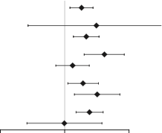
Lifestyle intervention in obese infertile
Overall effect 1.83 (1.21-2.76)
Age (years)
≥36 4.83 (0.53–44.0)
<36 1.78 (1.16–2.73)
Ovulatory status
Anovulatory 3.08 (1.61–5.91)
Ovulatory 1.21 (0.71–2.09)
BMI (kg/m2)
≥35 1.64 (0.99–2.71)
<35 2.31 (1.11–4.80)
WH ratio
≥0.80 2.04 (1.30–3.18)
<0.80 0.88 (0.26–2.99)
Favours
control
Favours
intervention
● No increase in healthy LBR
● Increase in natural conceptions
(A subgroup analysis of a RCT)
Van Oers et al., 2016
Hum. Reprod. 31, 2704-13

Slide 44
Conclusions
Obesity has a negative impact on the fertility potential
Obese women may have menstrual irregularities and lower possibility to conceive (even from adolescence)
There is reduced response to ovulation inducing agents
Oocyte quality is affected
Endometrial function may be impaired
The role of men’s obesity needs further investigation
Lifestyle modification is recommended but it increases natural conceptions only in anovulatory infertile women

