Slide 1
EFOG – HOW TO PREPARE FOR IT? Rules and regulations
Professor Ioannis E. Messinis
MD, PhD (UK), FRCOG (UK)
Director of Examinations
Member of Executive Committee

Slide 2
DISCLOSURE
Nothing to disclose

Slide 3
OBS/GYNAE TRAINING
PROGRAMME IN EUROPEAN COUNTRIES
Completion of a five year training in Obs/Gynae
Trainees sit national final exit exam
CCST in Obs/Gynae
EBCOG
Exams
(EFOG)

Slide 4
QUALITY EXAMS
Training
EBCOG
Standards

Slide 5
EBCOG Examination
Organised according to the rules developed by CESMA

Slide 6
UEMS-CESMA
CESMA: Council for European Medical Specialist Assessments
An advisory body of UEMS
Glasgow group (declaration in 2007)

Slide 7
PURPOSE OF THE EBCOG EXAMINATION
To assess the level of competency of the candidates (knowledge, judgement, skills and attitude) at an agreed EU standard.
This will facilitate mobility of Obstetricians and Gynaecologists throughout the countries of the European Union.
Passing the exams does not imply a license to practice.

Slide 8
EBCOG EXAMINATION
It will not replace the national examination process
It will be complementary to the national examination process
It will be an additional to the accreditation procedure to validate the quality of training

Slide 9
EBCOG Exams: General rules
The procedure is valid in format, content and outcome
The assessment is
clear, reliable and fair with no discrimination
subject to quality management and review
conducted in English
The Examination Committee considers appeals of failed candidates
Clear instructions are provided to the candidates

Slide 10
The EBCOG Examination
STRUCTURE (Methods of assessmnent)
Guidance before and during the Examination
Notification and dissemination of results
Preparation of candidates for the Examination
Eligibility criteria
V
V
v

Slide 11
The EBCOG Examination
STRUCTURE (Methods of assessmnent)
Guidance before and during the Examination
Notification and dissemination of results
Preparation of candidates for the Examination
Eligibility criteria
V
V
v

Slide 12
Structure of Examination
Part 1
Written (KBA)
Part 2
OSCE
EBCOG Fellowship
(EFOG-EBCOG)

Slide 13
The EBCOG Examination
STRUCTURE (Methods of assessmnent)
Guidance before and during the Examination
Notification and dissemination of results
Preparation of candidates for the Examination
Eligibility criteria
V
V
v

Slide 14
Eligibility criteria (I)
Candidates must have a primary medical degree
Candidates must be listed on the Register of Medical Practitioners of their own country
Candidates will be able to sit the exam at the end of their mandatory national obs/gynae specialist training programme

Slide 15
Eligibility criteria (II)
Candidates must have spent a minimum of four years in post-graduate training posts (as national regulations)
Candidates will be asked to provide evidence of their good standing
Candidates must provide evidence of their clinical experience and post-graduate training since graduation

Slide 16
Eligibility criteria (III)
Candidates must certify that they are not currently suspended or removed from medical practice
They must also confirm that they are not involved in any disciplinary procedure related to their clinical practice anywhere in the world
The Examination is open to European and non-European candidates

Slide 17
Applicants should provide proof
Medical doctors
License to practice
Completed basic training in Obs/Gynae
Good standing
Identity card

Slide 18
The EBCOG Examination
STRUCTURE (Methods of assessmnent)
Guidance before and during the Examination
Notification and dissemination of results
Preparation of candidates for the Examination
Eligibility criteria
V
V
v

Slide 19
Preparation of candidates
for the Examination
EBCOG Syllabus of the Examination
Pre-Examination Preparatory Courses
Part 1
Part 2

Slide 20
The EBCOG Examination
STRUCTURE (Methods of assessmnent)
Guidance before and during the Examination
Notification and dissemination of results
Preparation of candidates for the Examination
Eligibility criteria
V
V
v

Slide 21
Before the Examination
Applications (checking candidates for eligibility - closing date)
Examination timetable
“Test exam” for Part 1 (KBA)
Computer is compatible
Familiarise themselves
Venue

Slide 22
Day of Examination (before the examination starts)
Registration desk
Identification (name, photograph)
userID
Invigilators (Part 1)
Examiners (Part 2)

Slide 23
During the Examination: on-site
Identification
On-line papers (Part 1)
Stations (Part 2)
Time-schedule
End of exams

Slide 24
Pass mark
Part 1
Modified Angoff method
Part 2
Median score of “borderline” candidates

Slide 25
The EBCOG Examination
STRUCTURE (Methods of assessmnent)
Guidance before and during the Examination
Notification and dissemination of results
Preparation of candidates for the Examination
Eligibility criteria
V
V
v

Slide 26
Notification and dissemination
of results
Candidates’ exams are marked and analysed by computer and verified by the Examination authorities
Candidates are notified of their results by e-mail of examination secretariat
Candidates who successfully pass the Part 1 Examination are notified of the dates, details and venue of Part 2 of the Examination

Slide 27
Number of attempts
Candidates who fail to pass Part 1 exam cannot sit for Part 2.
Candidates who pass Part 1 should take Part 2 within a period of 3 years.
Once this period has expired or the candidates have failed to pass Part 2 within 3 years of passing Part 1, it would be required to re-sit Part 1.

Slide 28
QUALITY ASSURANCE
Quality management
Monitoring system (good practice)

Slide 29
Quality management
Validity
Reliability
Fairness
Legal defensibility
Statistical analysis
Primary statistical validity
Secondary analysis
SWOT analysis

Slide 30
Monitoring system (good practice)
The writing of the questions
The marking system
Security of the procedure
Transparency of the procedure
Dissemination of the results

Slide 31
DIPLOMA
When both parts of the examination have been passed the diploma of the EFOG-EBCOG is awarded.

Slide 32
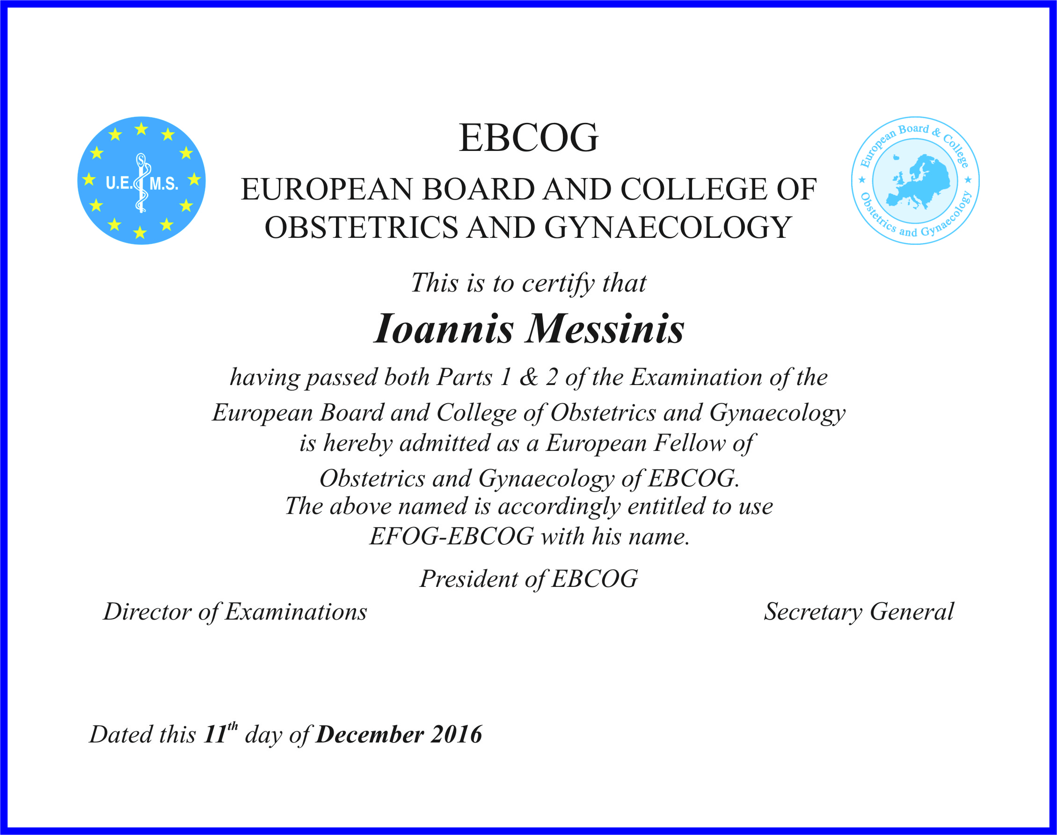

Slide 33
Information about the exams (rules and regulations)
EBCOG website: ebcog.org
General information
Relevant documents

Slide 34
SUMMARY
The Examination started last year (2016) and is a key priority for EBCOG
EBCOG uses the UEMS/CESMA standards and rules (as other medical specialities)
EBCOG has produced documents that provide information to the candidates
The aim is the Examination to become an efficient process in the best interest of candidates

