Slide 1
AGENESIS OF THE DUCTUS VENOSUS ASSOCIATED WITH EXTRAHEPATIC UMBILICAL VEIN DRAINAGE: CASE REPORT
Selcuk Özden, Ilker Ali Çerçi, Ilknur Demir Karakılıç,
Mehmet Sühha Bostancı
Sakarya University, Medical Faculty,
Department Of Obstetrics And Gynecology, Sakarya, Turkey

Slide 2
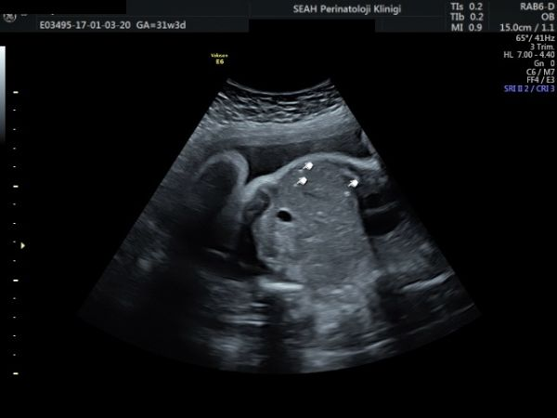
CASE
A 33-year-old G3P2 woman at an estimated 24 weeks of gestation.
Multiple hepatic calcifications in the parenchyma of the fetal liver were found sonographically.

Slide 3
DILATED VENA CAVA
Significantly dilated IVC
Absence of DV.

Slide 4
UMBILICAL VEIN
Umbilical vein directly connecting to the right iliac vein.

Slide 5
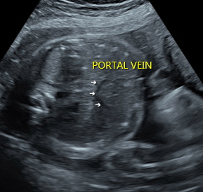
PORTAL SYSTEM
The portal system was intact.

Slide 6
FOLLOW UP & OUTCOME
Patient was followed by our clinic at 2 weeks intervals of .
Birth started spontaneously at 34 weeks of gestation. 2240 grams, a male baby was delivered by spontaneous vaginal delivery.
Baby was discharged with her mother on the postpartum first day.

Slide 7
AGENESIS OF DUCTUS VENOSUS (ADV)
A rare vascular anomally (1 /2,500 at 11-13 gw ).
The intrahepatic and extrahepatic shunts are the main anatomic variants of ADV.
The cases with intrahepatic shunt , the umbilical vein drains properly into the left branch of the intrahepatic portal vein.

Slide 8
AGENESIS OF DUCTUS VENOSUS
The extrahepatic shunt is categorized by several subtypes which bypass connecting to the liver and connecting to an atrial or venous structure.
Umbilical vein at the extrahepatic umbilical venous drainage directly iliac vein, inferior vena cava, renal vein and right atrium.

Slide 9
SUMMARY
Antenatal diagnosis is very important and additional defects play a role on prognosis.
Portal system should be evaluated in case of umbilical venous extrahepatic drainage in cases where ADV is detected.
When the portal system is intact and there are no associated anomalies, a good outcome can be expected.

Slide 10
THANKS FOR YOUR ATTENTION

