Slide 1
ISUOG Basic Training
Management of Abnormal Growth
Jacky Nizard

Slide 2
Learning objectives
At the end of the lecture you will be able to:
describe the role of ultrasound imaging in the management of abnormal fetal growth
describe the role of Doppler studies in the management of abnormal fetal growth

Slide 3
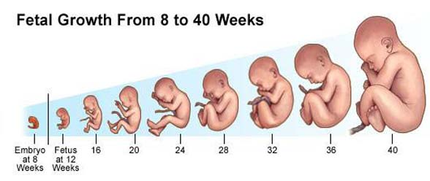
Fetal growth
Notes:
The purpose of prenatal growth monitoring (IUGR) is to identify IUGR fetuses , to monitor these fetuses closely, and to make an appropriate decision for fetal extraction if their condition worsens to avoid maternal and/or fetal complications.

Slide 4
Growth patterns
macrosomia
fetal growth restriction (FGR)
Notes:
Intrauterine growth restriction (IUGR) is one of the most common and complex problems in modern obstetrics. Diagnosis an management are complicated by the use of ambiguous terminology and lack of uniform diagnostic criteria….
Size alone is not an indication of a complication. As a result of this confusion, underintervention and overintervention can occur
Macrosomia

Slide 5
Macrosomia
Definition | Cut-off | Prevelence
Neonate at term | > 4.5 kg | 1.3 – 1.5%
Gestational age dependent | > 97th centile
Birth weight at term | > 4 kg | 7%
Gestational age dependent | > 90th centile
Campbell S. UOG 2014; 43: 3–10
Notes:
Important is to realize

Slide 6
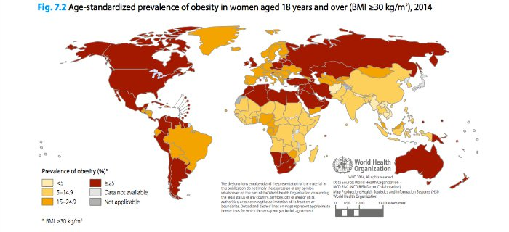
Macrosomia risk factors
maternal diabetes
gestational diabetes
maternal obesity
family history
genetic syndromes:
Beckwith-Wiedemann,
Simpson-Golabi-Behmel,
Sotos…
Okun et al. J Matern Fetal Med 1997;6:285–290
Notes:
Riskfactor 5-10% of macrosomia associated with maternal or gestational diabetes, recognized during pregnancy Macrosomic fetuses of non-diabetic women can be identified as being at risk by factors such as maternal obesity and family history but are generally unsuspected until the possibility of a big baby is raised by antenatal clinical or ultrasound examination.
BMI > 30 uit Campbell
BWS 1:13000 mutatie deletion Ch 11 but also other chroom, omphalocele, tumors
SGB x-linkedmutatie GPC3gen HD ventriculomeg polydactylie, corvitium
Sotos ccagen mutatie chrom 5spychomotor developm varieert sterk.

Slide 7
Macrosomia
Risk for mother
emergency CS
instrumental delivery
shoulder dystocia
trauma to birth canal
bladder, perineum and sphincter injury
Risk for infant
mortality
brachial plexus injury
facial nerve injury
fracture humerus / clavicle
birth asphyxia
Basso et al Am J Epidemiol 2006;164:303–311
Notes:
If screening for the large-for-gestational age infant is to be attempted, it might be a good option to undertake a two-stage operation, i.e. a screening scan at around 32–34weeks’ gestation to identify a high-risk group, followed by a detailed scan at 39 weeks in those identified
as being large. The object of the earlier or triage scan
would be to achieve as high a sensitivity as possible so that
most large fetuses are in the screen-positive group.

Slide 10
Why do we care about SGA?
we don’t care about SGA …
most SGA babies display perinatal outcomes similar to those of normally grown fetuses…
we care about FGR fetuses which have:
poorer perinatal outcomes
abnormal Dopplers, suggesting fetal adaptation to undernutrition/hypoxia
signs of placental disease
higher risk of preeclampsia
and long term poorer outcomes
Notes:
SGA vs IUGR: we don’t care about SGA. It is only a proxy for IUGR….

Slide 11
Fetal growth impacts late in our lives
Notes:
What happens in the womb during pregnancy is essential as it probably shapes the rest of our life

Slide 12
Screening for abnormal growth
clinical assessment
maternal risk factors
measurement of fundal height
ultrasound
biometry (HC and AC)
estimation of fetal weight (BPD, HC, AC, FL)
measurement of amniotic fluid (AFI or MVP)
Notes:
Symfyseal fundal height Low sensitivity, high false positive rates, significant intra- and inter-observer variation make this test alone unsuitable for diagnosis. 50% FGR missed

Slide 13
Screening for abnormal growth
FGR: Failure to achieve the anticipated growth potential
FGR
Notes:
The first aim in the clinical management of FGR should be to
distinguish ‘true’ FGR from constitutional small for gestational
age (SGA) fetuses

Slide 14
Screening for abnormal growth
Restriction in growth is associated with morbidity and mortality
FGR
MORBIDITY/
MORTALITY

Slide 15
Screening for abnormal growth
Different from SGA and constitutionally small
FGR
MORBI / MORTALITY
SGA

Slide 16
Screening for abnormal growht
Screening tools
FGR
MORBI / MORTALITY
SGA

Slide 17
Correct recognition of SGA and FGR
correct dating
correct use of measurements
correct tools to assess biometry
appropriate management of clinical situation

Slide 18
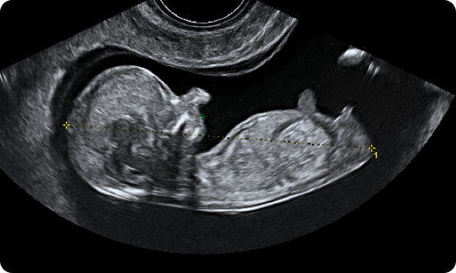
Correct dating
pregnant women should be offered an early US scan between 10 weeks 0 days and 13 weeks 6 days to determine gestational age
CRL measurement appears to be the most precise, allowing an accurate determination of the day of conception, to within 5 days either way in 95% of cases
© Dr Jean-Philippe Bault
ISUOG Practice Guidelines: performance of first-trimester fetal ultrasound scan
Ultrasound Obstet Gynecol 2013:41:102-113

Slide 19
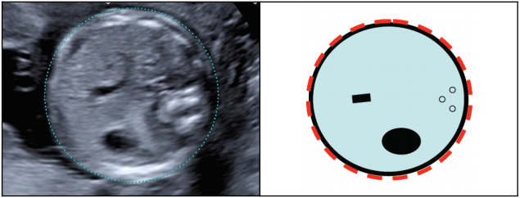
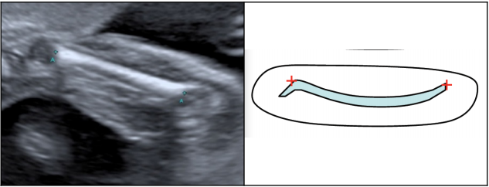
Correct use of measurements
© Intergrowth 21
ISUOG Practice guidelines for performance of the routine mid-trimester fetal ultrasound scan
Ultrasound Obstet Gynecol 2011:37:116-126

Slide 20
Correct tools to assess biometry
biometric assessment - central role in the identification of fetuses at risk of FGR and related adverse outcomes
multiple tools to assess the likelihood of FGR prenatally, using biometric measurements:
biometry charts
estimated fetal weight (EFW) and related charts

Slide 21
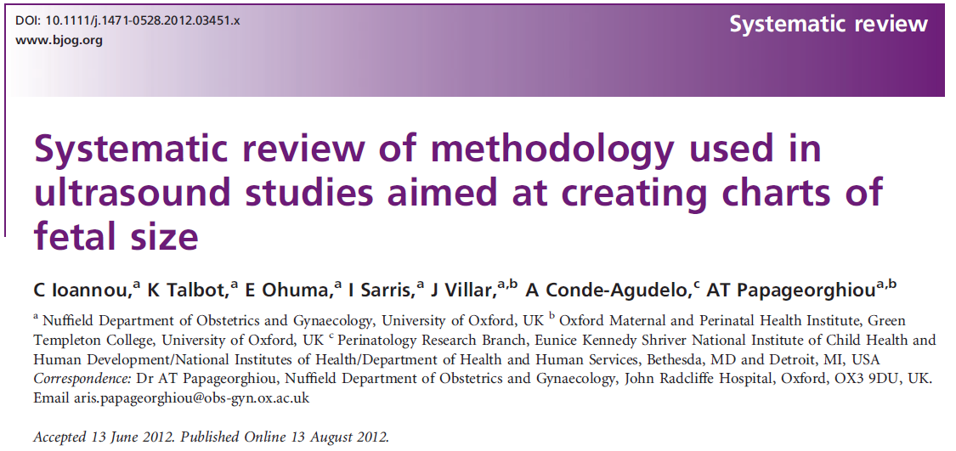
Appropriate choice of charts

Slide 22
Clinical implications
15th centile
3rd centile
Fetal HC
Gestational age

Slide 23
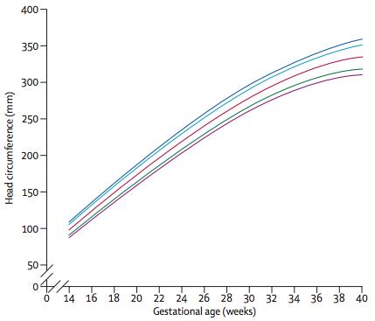
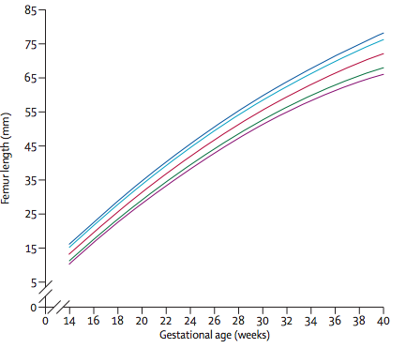
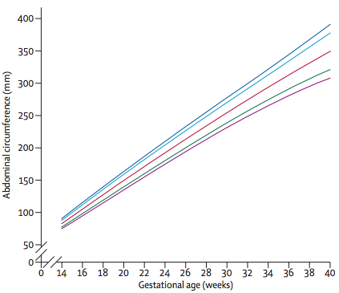
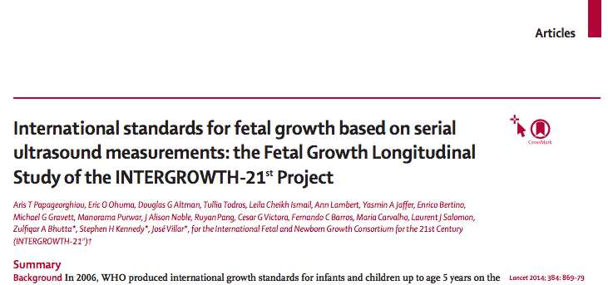
Intergrowth charts
provide prescriptive standards
represent ‘healthy’ growth of a normal population
suggest the targets to achieve
Notes:
A reference chart is a graphic presentation of how children normally grow without making any claims about the health of its population, whereas a standard represents ‘healthy’ growth of a population and suggests a target to achieve

Slide 24
Estimated fetal weight (EFW)
ultrasound superior to clinical estimate before 37 weeks
clinical estimate has accuracy similar to that of ultrasound at term
80% of EFW are within 10% of actual birthweight, remainder are within 20% actual BW (Chauhan AJOG 1998)
Hadlock (AJOG 1985) - EFW calculated from HC, AC, and FL
(log EFW = 1.326 + 0.0107 HC + 0.0438 AC + 0.158 FL – 0.00326 AC x FL)
Intergrowth estimated fetal weight standards (Stirnemann et al, Ultrasound Obstet Gynecol 2017;49:478-486)

Slide 25
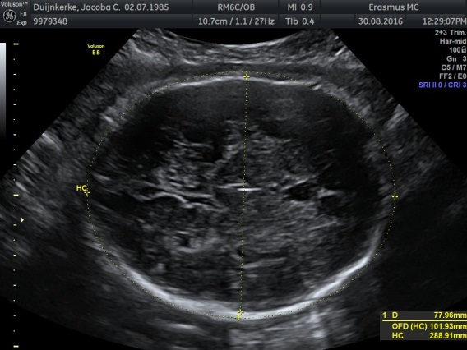
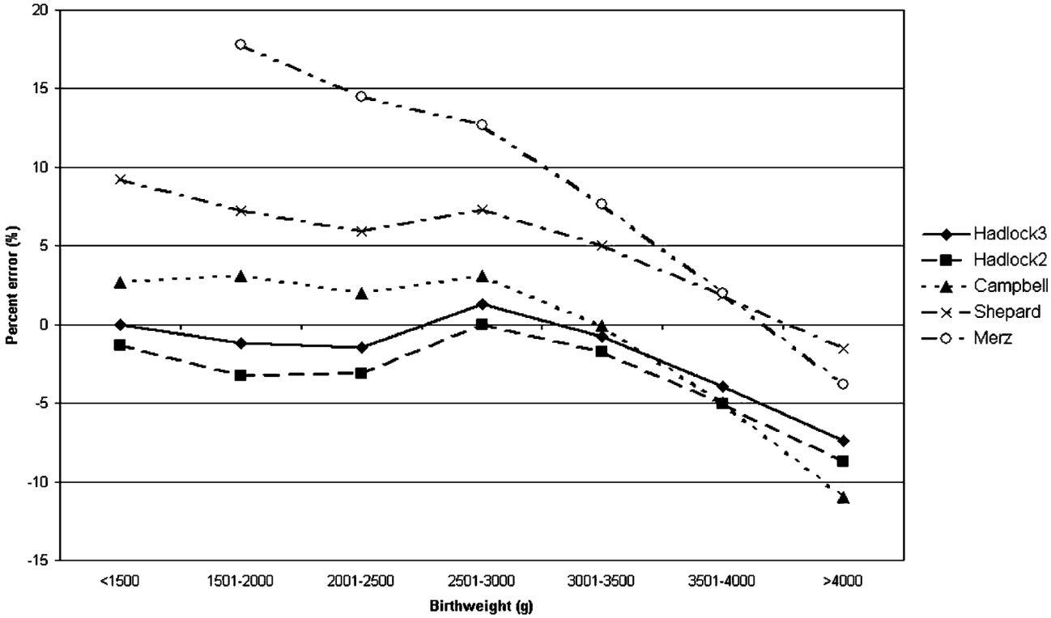
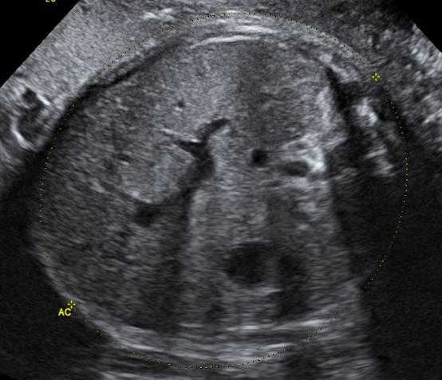
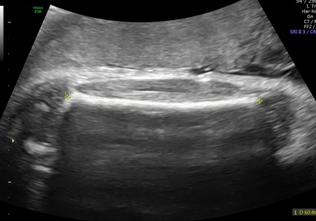
Estimated fetal weight
most reliable formula – Hadlock 3
Kurmanavicius et al J Perinat Med 2004;32:155-61
Notes:
Onderschatting naar mate gewicht groter is

Slide 26
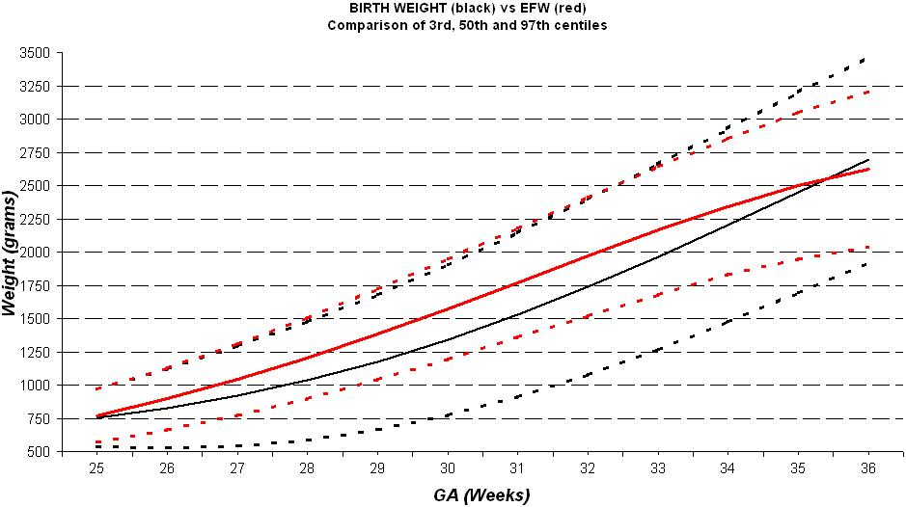
Birth weight versus EFW
EFW (Hadlock) normal range
(n = 18,958)
Birthweight normal range
(n = 58,934)
BW charts reflect a significant proportion of premature FGR neonates, reporting EFW from BW charts therefore misleading at 28-32 wks, 50th centile for BW = 10th centile for EFW!
Salomon, Bernard and Ville. Ultrasound Obstet Gynecol 2007:29;550-555
Notes:
26

Slide 27
FGR risk factors
fetal
chromosomal anomaly
genetic syndrome
congenital anomaly
maternal
idiopathic
chronic disease
abnormal implantation
(PE, HELLP, antiphospholipid, FGR
SGA / FGR
placenta
mosaicism
uterine anomaly
velamentous cord insertion
external factors
smoking
infection
psycho/social

Slide 28
Placental insufficiency
mother
fetus/newborn
FGR
brain remodelling
pre-eclampsia,
HELLP syndrome,
eclampsia,
increased risk of C-section
increased prenatal mortality,
increased risk of C-section
short term
born SGA, increased perinatal morbidity and mortality
impaired neurodevelopment, poorer school performance,
accelerated gain in fat
medium term
long term sequelae of per partum complications
long term
obesity, diabetes, hypertension
cardiac diseases, stroke

Slide 29
Appropriate diagnosis of FGR in SGA fetuses
diagnosis of FGR currently performed by means of combination of biometric measurements and other parameters:
umbilical artery (UA) Doppler historically used to distinguish FGR from SGA - identifies severe placental disease but fails to pick up mild placental disease, i.e. majority of FGR
UA should always be used in combination with cerebroplacental ratio (CPR)
uterine artery Doppler PI (UtA PI) and very low estimated fetal weight (<p3) independently predict poorer outcome in small fetuses
maternal symptoms
crossing centiles
abnormal biometry (EFW and/or AC <10th centile)
→ UA, CPR, UtA PI, amniotic fluid etc

Slide 30
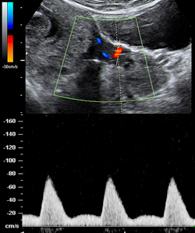
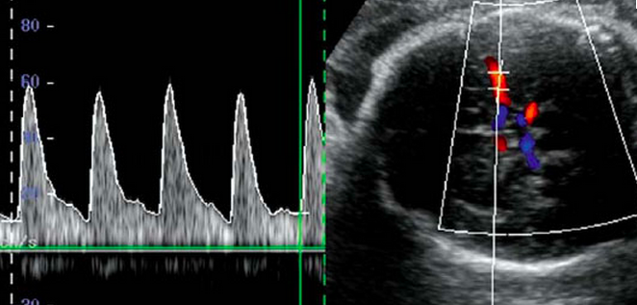
Distinguishing between FGR and SGA
umbilical artery
uterine artery
MCA
ductus venosus
Notes:
+ the mother

Slide 31
Appropriate recognition of late FGR / prevention of stillbirth
appropriate dating
appropriate use of biometry
appropriate tools to diagnose late FGR
appropriate management of situations
Notes:
The problem is more to recognize the situation rather than to manage it…

Slide 32
How to manage SGA
Delivery
Expectant management
neonatal death RDS
hypoglycemia
sepsis
NICU complications..
stillbirth
neurodevelopmental delay
decisions
appropriate GA estimation
appropriate definition of SGA /FGR
appropriate monitoring of fetal condition

Slide 33
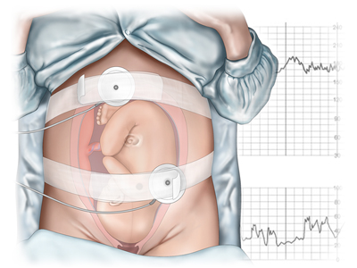
Biophysical profile
Biophysical profile variable | Normal score (2) | Abnormal score (1)
fetal breathing movement | one episode fetal breathing 30 s | absent or < 30 s
gross fetal movement | three discrete body/limb movements | two or less
fetal tone | one episode active extension with return to flexion of fetal limbs / trunk | slow extension with partial flexion or limb movement without flexion or none
fetal heart rate reactivity | < 26wks: two accelerations of ≥ 10 beats, two of ≥10 s 26–36wks: two accelerations of ≥10 beats, ≥15 s ≥ 36wks: two accelerations of ≥20 beats, ≥20 s | less than two episodes of accelerations and durations as specified
amniotic fluid volume | pocket 2 x 2 cm | pocket < 2 x 2 cm
Baschat A. UOG 2001; 18: 571–577
Manning FA. Obstet Gynecol Clin North Am 1999; 26: 557–77
Notes:
Biophysical profile scoring and Doppler surveillance are the primary methods for fetal assessment in intrauterine growth restriction (IUGR). As placental insufficiency worsens, the fetus adapts by progressive compensation. Initial mechanisms, such as increasing red cell mass and oxygen extraction, give way to deliberate shunting of blood away from non-essential vascular beds. As this second hemodynamic mechanism is maximized, the final resort (reduction in oxygen expenditure) is invoked. At this point, adaptation is exhausted and demise is threatened. Biophysical profile scoring and fetal multivessel Doppler surveillance provide insight into different facets of these fetal responses. The biophysical profile score (BPS) incorporates dynamic fetal variables into a composite scoring
system1

Slide 34
Early FGR and late FGR
early FGR
easy to diagnose, difficult to treat
late FGR
difficult to diagnose, easy to treat
Notes:
Baschat 2011 Once the clinical diagnosis of FGR has been made, the progression differs in preterm and term pregnancies. In early-onset FGR before 34 weeks, late cardiovascular manifestations of placental dysfunction become more likely when the UA end-diastolic velocity is reversed (UAREDV). The typical pattern of deterioration progresses from escalating abnormalities in UA and venous Doppler parameters to abnormal biophysical parameters.
In contrast, in late-onset FGR presenting after 34 weeks, cardiovascular abnormalities do not extend beyond the cerebral circulation. As placental vascular dysfunction is less severe, a decreased CPR, with either normal or only minimally elevated UA Doppler indices, may be observed

Slide 35
Early and late onset FGR – main differences
Figuros F and Gratacos E. Fetal Diagn Ther. 2014; 36:86-98

Slide 36
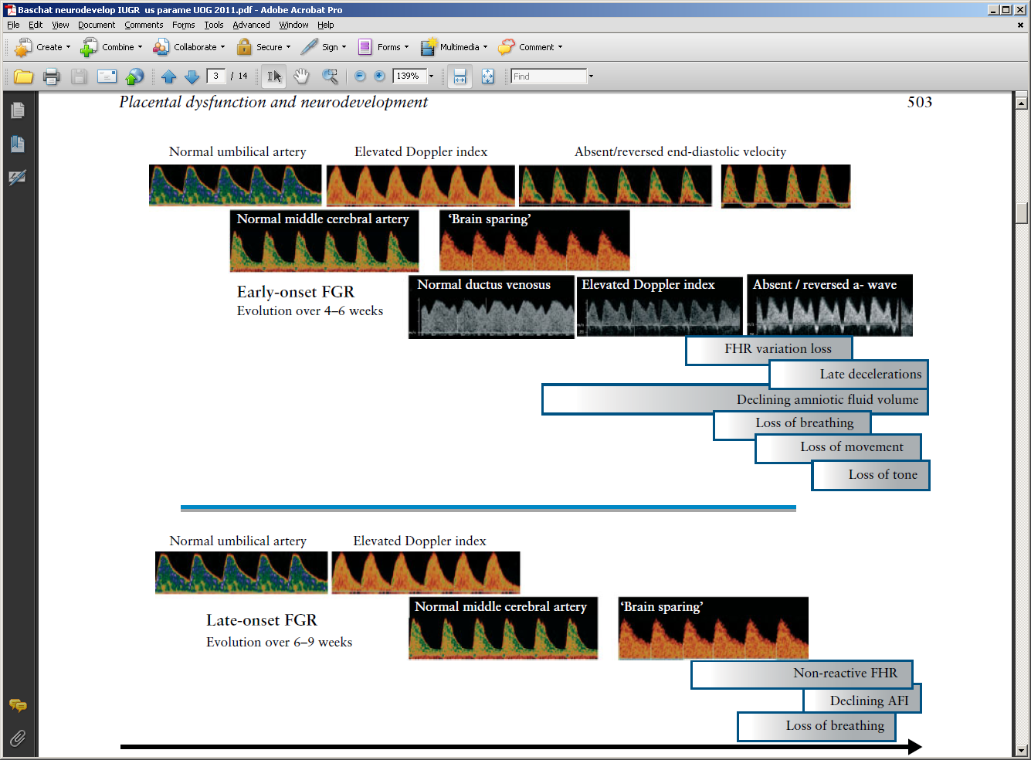
Placental insufficiency, early and late response
fetal
demise
Baschat A. UOG 2011;37:501–514
Notes:
In this setting, the metabolic status and the diminishing supply of glucose forces the brain and heart to metabolize lactate and ketones as their primary energy sources36,37.
With increasing severity of placental dysfunction, transfer of these important nutrients also becomes impaired and their deficiency has been linked independently to a
range of neurodevelopmental disorders38,39. The rate of deterioration of UA Doppler parameters determines the overall speed of deterioration in early-onset FGR, often
necessitating preterm delivery4,7. Accordingly, fetuses are forced to make critical adjustments in the cerebral metabolism of essential nutrients prior to delivery.
In contrast, in late-onset FGR presenting after 34 weeks, cardiovascular abnormalities do not extend beyond the cerebral circulation. As placental vascular dysfunction is less severe, a decreased CPR, with either normal or only minimally elevated UA Doppler indices, may be observed2,4,5,40–42. This is followed by intracerebral redistribution of blood flow towards the basal ganglia, at the expense of the frontal lobe43,44, and a
decreased MCA Doppler index that may occur as an isolated finding without a preceding increase in the UA Doppler index. Although term FGR does not present with the same degree of clinical deterioration as does early-onset disease, abnormal brain microstructure and metabolism have been documented independent In summary, it appears that the associations between UA Doppler and neurodevelopment manifest differently
across gestational ages and patterns of fetal growth delay. In early-onset FGR, the risk of abnormal neurodevelopment increases as end-diastolic velocity decreases. Due to
the high rate of prematurity-related morbidity, independent impacts on motor development are more difficult to demonstrate at very early gestational ages. Between 28
and 34 weeks’ gestation, the neurological and cognitive impact of increased UA blood flow resistance emerges more clearly as a factor independent of lagging head growth, severity of growth delay or condition at birth. In FGR presenting near term, abnormal UA Doppler is a less prominent feature and developmental abnormalities emerge in other domains that appear to be related to specific brain areas and higher brain functions.

Slide 37
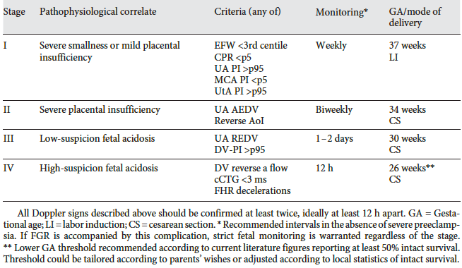
Stage based classification and management of FGR
Figuros F and Gratacos E. Fetal Diagn Ther. 2014; 36:86-98

Slide 38
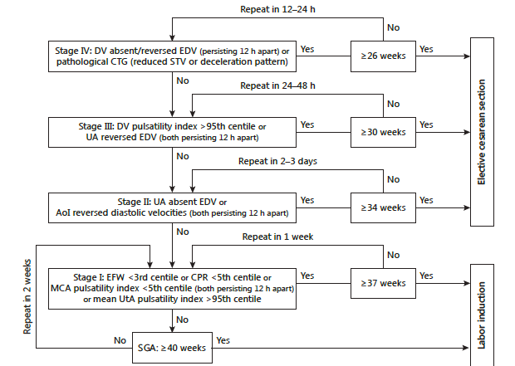
Stage based decision algorithm for FGR management
Figuros F and Gratacos E. Fetal Diagn Ther. 2014; 36:86-98

Slide 39
Take home messages
growth anomalies - public health problem responsible for mortality + short and long term morbidity
appropriate understanding of the differences and overlap between SGA and FGR required
Doppler (UA, MCA and CPR) useful for improving diagnostic efficiency and management:
helps distinguish between constitutionally small and FGR fetuses
increases sensitivity in cases with borderline biometric anomalies
DELIVER IF
26w
30w
34w
37-38w
abnormal CTG
absent or reverse DV
daily monitoring
abnormal CTG
reversed UA EDF
bi-weekly monitoring
abnormal CTG
absent UA EDF
weekly monitoring
FGR

Slide 40
Key points
use BPD, HC, AC and FL to assess fetal growth and EFW
beware of the causes of impaired and increased fetal growth
leave at least 10 days between scans
assess amniotic fluid, fetal wellbeing and Doppler to document the placental origin of FGR, and monitor the pregnancy
deliver >36/37 weeks in late FGR
use Doppler and CTG to optimise GA at delivery in early FGR

