Slide 1
Gynaecological Emergencies:
Ectopic pregnancy
Laura Spinnewijn
MD, Trainee in Obstetrics & Gynaecology – Radboud University Medical Center Nijmegen
ENTOG Executive Member – European Network of Trainees in Obstetrics and Gynaecology
Antaly EBCOG/TSOG Congress - 21st of May 2017

Slide 2
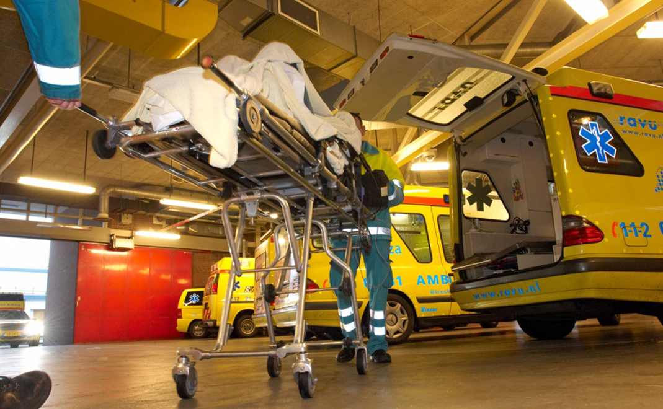

Slide 3
Introduction – Ectopic Pregnancy
Any pregnancy outside uterine cavity
11-20 in 1000 pregnancies; IVF more
Main complication: abdominal bleeding
Mortality: 16.9 in 100,000 ectopic pregnancies*
Goals:
Early recognition
Correct treatment
*Saving mothers lives (2011)

Slide 4
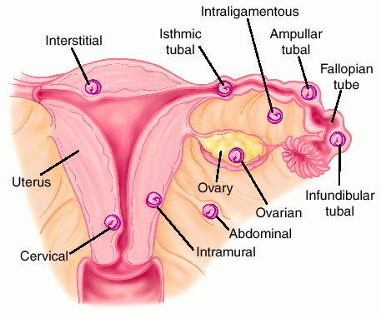
Cornual /
/ Caesarean scar
96-98% in Fallopian Tube
Dorland's Medical Dictionary for Health Consumers. (2007). Retrieved May 14 2017

Slide 5
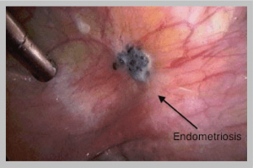
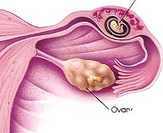
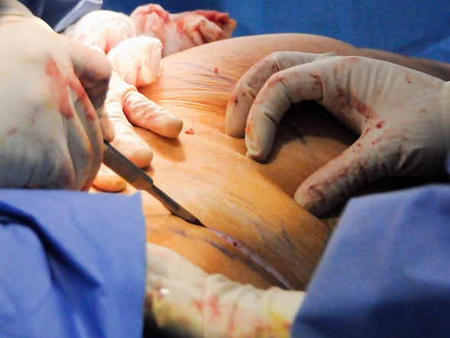
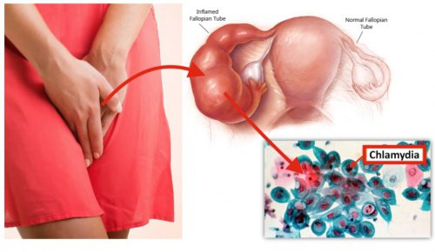
Risk Factors

Slide 6
Signs and Symptoms
Pain
Vaginal Bleeding
Amenorrhoea (positive pregnancy test)

Slide 7
Signs and Symptoms
Pain → common in early pregnancy?
Vaginal Bleeding → misscarriage?
Amenorrhoea (positive pregnancy test)
Nausea – vomiting
Abdominal distension and ternderness
Peritonism
Haemorrhagic Shock

Slide 8
Diagnostics - Ultrasound
Always perform a pregnancy test!
Sensitivity 84.4% - Specificity 98.9%

Slide 9
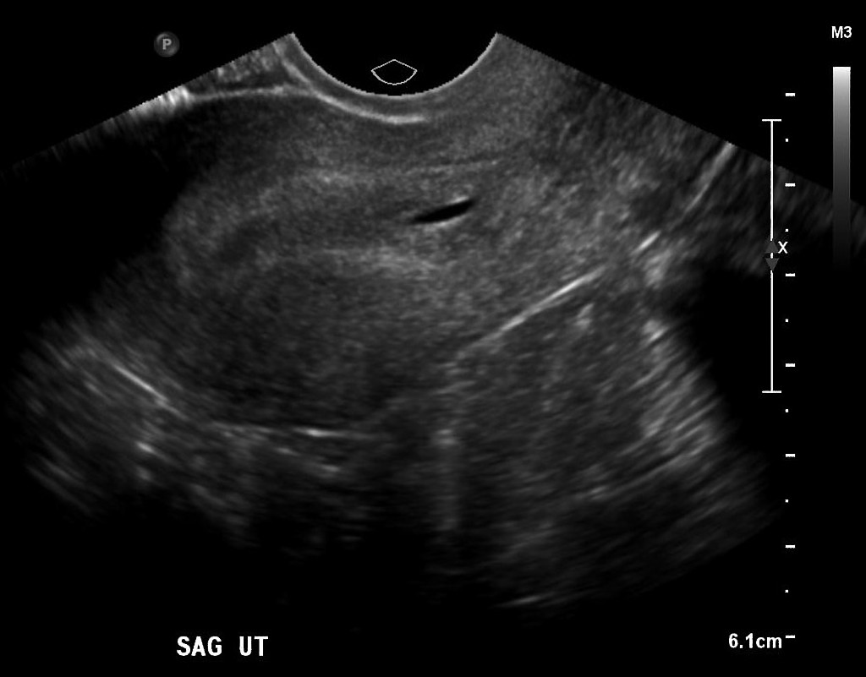
Ultrasound criteria
Empty uterine cavity
Thick echogenic endometrium
Pseudogestational sac
10-20% of ectopic pregnancies
Case courtesy of Dr Matt A. Morgan, Radiopaedia.org, rID: 34217

Slide 10
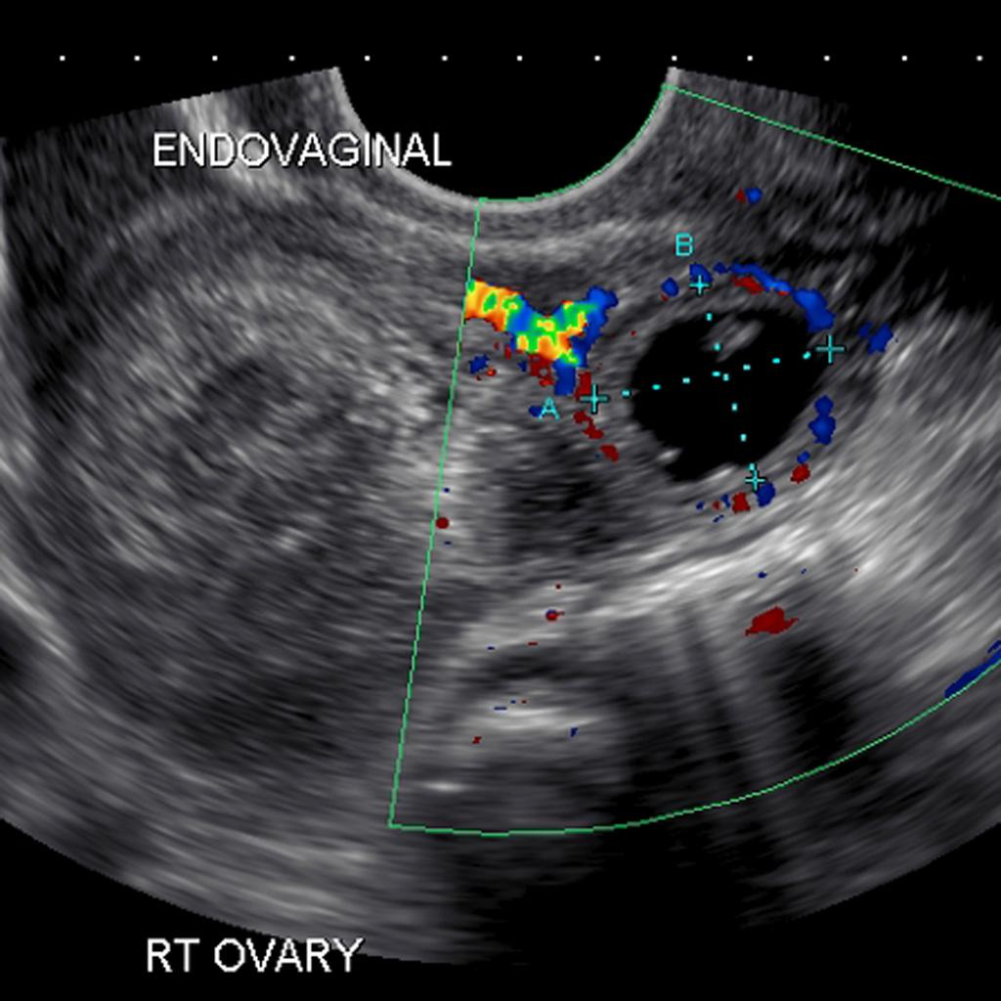
Ultrasound Criteria - 2
Ectopic mass
20% empty extra-uterine sac
20% yolk sac/embryionic parts
Tubal ring
Doppler: ring of fire
Case courtesy of A.Prof Frank Gaillard, Radiopaedia.org, rID: 8161

Slide 11
Ultrasound Criteria - 3
Free pelvic fluid
haematoperitoneum

Slide 12
Pregnancy of unknown location - PUL
Not a diagnosis!
Follow-up with ultrasound and bloodtests

Slide 13
Blood tests
Serum beta-human chorionic gonadotrophin (β-hCG)
<1000 IU/lectopic pregnancy unlikely
>2000 IU/l intra-uterine pregnancy likely visible (CAVE miscarriage!)
48h follow-up: viable pregnancy rise >50-66%*
Serum progesterone:
<20nmol/l viable pregnancy unlikely
>60nmol/l viable pregnancy likely
No routine use
* Kirk et al. (2013) Diagnosing ectopic pregnancy and current concepts in the management of pregnancy of unknown location

Slide 14
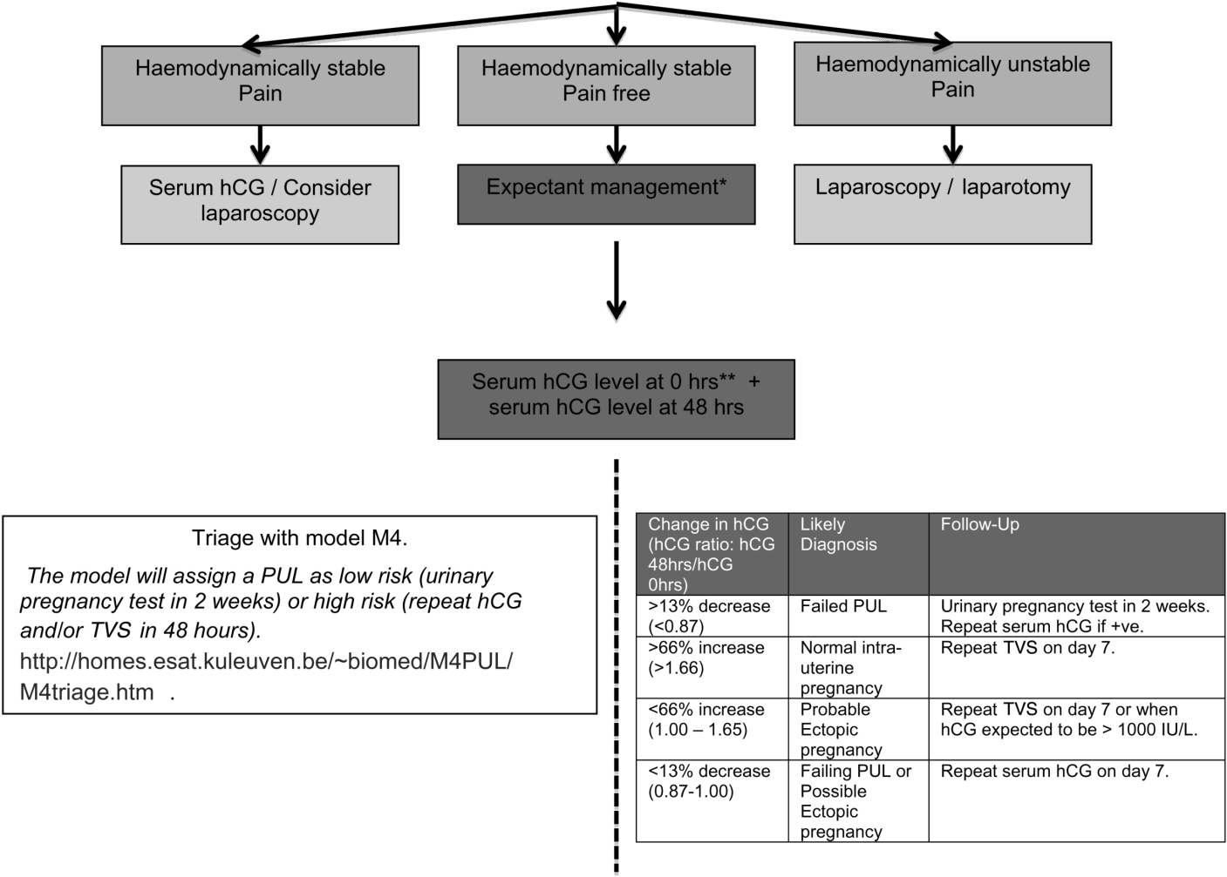
Follow-up PUL
Mathematical models
β-hCG / β-hCG ratio
Ultrasound
hCG cut-off points
Curettage
* Kirk et al. (2013) Diagnosing ectopic pregnancy and current concepts in the management of pregnancy of unknown location

Slide 15
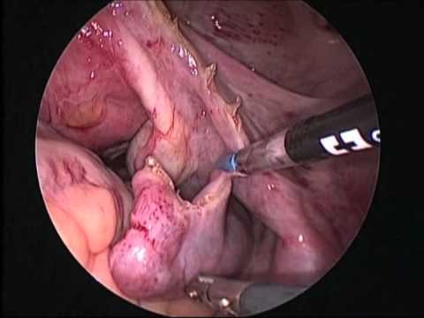
Treatment – Surgical management
Laparoscopy
Tubectomy vs. Tubotomy
Tubotomy: 3,9-11% persistent trophoblast disease
Follow-up β-hCG.

Slide 16
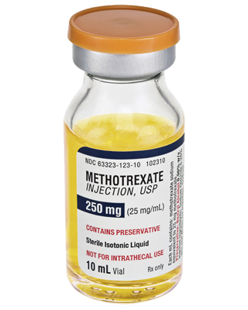
Treatment - Methotrexate
First choice: Single shot intramuscular dose 50mg/m3
Serum β-hCG levels on day 4 and 7
Weekly β-hCG levels until low
Expected decrease >15% per week
If <15%: Consider ultrasound, 2nd dose
Success rates 65-98%
2nd dose in 3-27%

Slide 17
Treatment - Methotrexate
Predictors of success:
Intial β-hCG <5000
No yolk sac or fetal parts
hCG increase < 20% in 48 hours
Decreasing β-hCG day 4 after dose
Side effects: bone marrow suppression, pulmonary fibrosis, nonspecific pneumonitis, liver cirrhosis, renal failure and gastric ulceration.

Slide 18
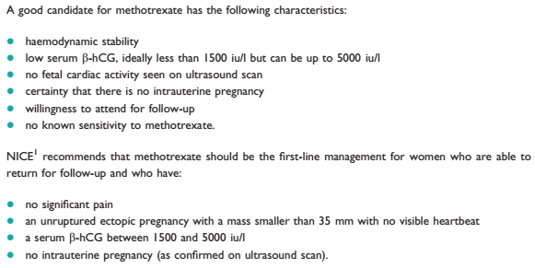
Treatment - Methotrexate
Green-top Guideline No. 21 – Diagnosis and Management of Ectopic Pregnancy

Slide 19
Treatment – Expectant management
No or few clinical signs
Decreasing β-hCG levels
β-hCG <1500 IU/l at diagnosis
Well-instructable
Able to visit gynecology department
Follow-up!

Slide 20
Adopted and adapted from NVOG guideline Ectopic Pregnancy (2017)

Slide 21
Take Home Messages
Always consider ectopic pregnancy
Perform adequate pregnancy tests (β-hCG)
Perform ultrasound
Follow-up of non-ectopic pregnancy only ends with proof of intra-uterine pregnancy or miscarriage
Use the right ectopic pregnancy follow-up protocols
Choose appropriate treatment methods for individual patients (surgery – methotrexate – expectant management)

Slide 22
Thank you!

