Slide 1
A case of metastatic giant bilateral ovarian masses presenting as theca lutein cysts in pregnancy
Ghanim Khatib, Berin Bayat, Mehmet Ali Vardar, Ahmet Barış Güzel, Ali Duran, Cem Kaan Parsak, Mete Sucu, Selim Büyükkurt, Mehmet Özsürmeli, İpek Eskiyörük, Süleyman Cansun Demir, İbrahim Ferhat Ürünsak
Ganim Khatib, MD
Çukurova University
Gynecological Oncology

Slide 2
Introduction
Approximately 275 cases of colon cancer associated with pregnancy have been reported in the literature.
The first case of large intestine carcinoma during pregnancy was reported by Evers in 1928.

Slide 3
Introduction
The incidence of colorectal cancer during pregnancy is %0.002.
The metastatic spread of colon ca to the ovaries has been reported to be high in pregnant women compared to the general population (%25 vs %5).

Slide 4
Introduction
Nausea, vomiting, abdominal pain and rectal bleeding are the symptoms of colorectal cancer.
Since these symptoms are common in the pregnants, physicians and patients usually attribute them to the pregnancy leading to delayed diagnosis, advanced stage and poor prognosis.

Slide 5
Introduction
Here we reported a case of metastatic bilateral giant multilocular cystic ovarian masses arised from the colon in a young pregnant woman, which were presented as theca lutein cysts in the ultrasonographical examination.
To the best of our knowledge; atributed to its features, our case will carry the title of being ‘’first’’ in the medical literature.

Slide 6
Case presentation
A 26 years old, G4P3, woman admitted to our clinic at 22nd week of gestation with a history of abdominal pain and distension.

Slide 7
Case presentation
Ultrasonography showed that the abdomen was filled with a bilateral multilocular collosal cystic masses of the ovaries, beside the pregnancy. In addition to the pregnancy factor, masses’ ultrasonographical characteristics were appropriate with theca lutein cysts.

Slide 8
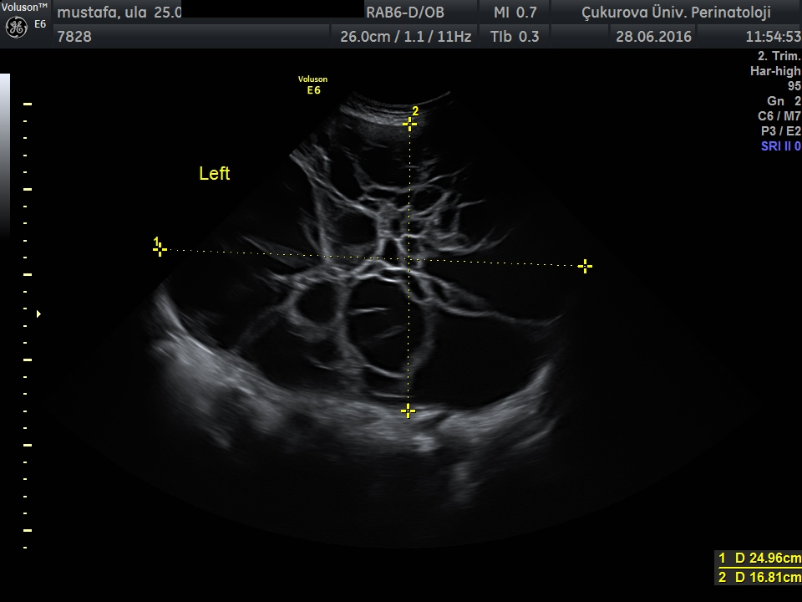

Slide 9
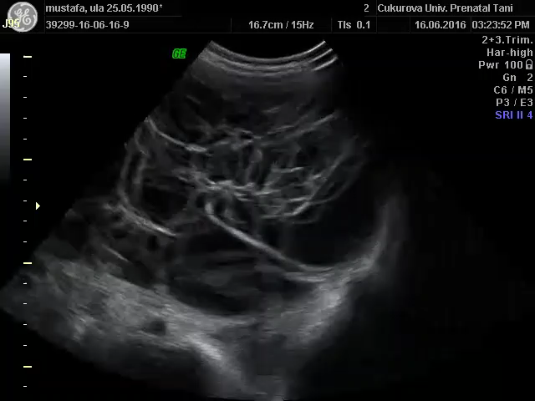

Slide 10
Case presentation
Pregnancy was terminated
Tumor markers; CA125:349; CA72.4>300; CEA>1044.
Colonoscopy: an ulcerated mass in the hepatic flexura region of the colon was seen, biyopsies were taken and the result was adenocarcinoma.
Endoscopy was normal.
MR: 20x30cm abdominal mass

Slide 11
Case presentation
After further discussion at the multidisciplinary team meeting, laparotomy was decided
on laparotomy; bilateral giant ovarian masses with a solid cecal mass was observed.

Slide 12
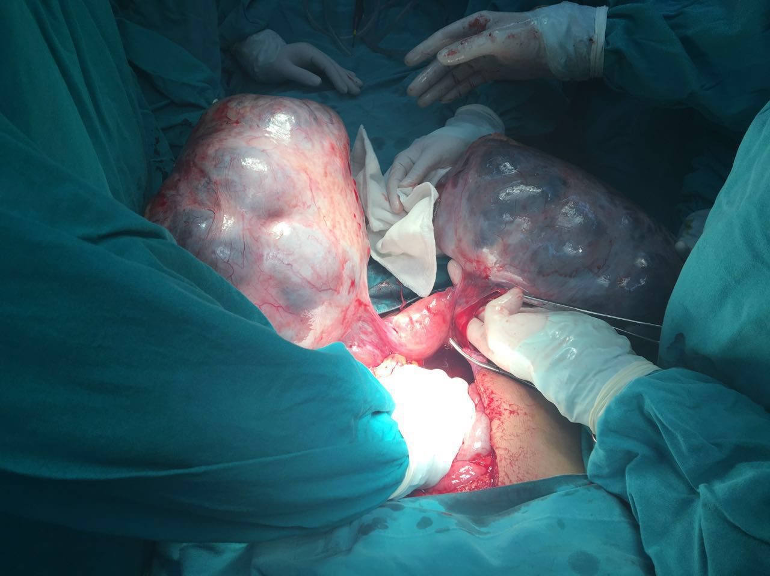
Case presentation

Slide 13
Case presentation
Bilateral salpingooophorectomy, total omentectomy, right hemicolectomy and ileocolic anastomosis were performed.
Final pathological report: primary colon adenocarcinoma and bilateral ovarian metastases.

Slide 14
Conclusion
Common presenting signs and symptoms of colon cancer include abdominal pain, anemia, nause, vomiting and rectal bleeding are also frequently found in pregnancy.
Clinicians must be aware of these potential warning signs and symptoms.

Slide 15
Conclusion
It should be kept in mind that, in pregnancy metastatic ovarian masses may present with typical ultrasonographical imaging of theca lutein cysts (bilateral multilocular cystic ovarian masses), therefore; in such cases efforts should be focus on the ways of preoperative histopathological diagnosis.

