Slide 1
ART ‘de Ovulasyon Trigger Yöntemleri
Prof.Dr.Kadir Savan
Şişli Kolan İnternational Hospital

Slide 2
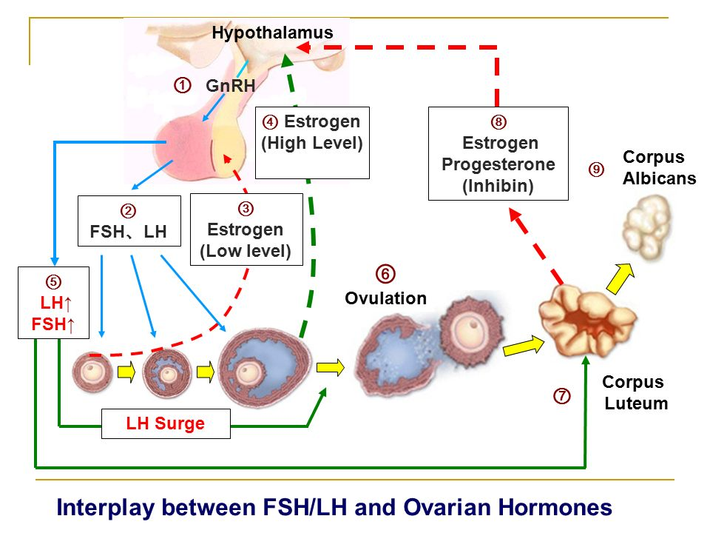

Slide 4
Ovulasyon Trigger amacıyla yıllardır ‘gold standart’ olarak hCG uygulanmıştır

Slide 5
hCG Trigger
Oosit Maturasyonu
Ovulasyon İndüksiyonu
Yeterli Luteal Faz Desteği

Slide 6
hCG Trigger Zamanlaması
Folükül çapı
E2 düzeyi
Progestron düzeyi
Pik E2/Folükül sayısı (>14mm)
OPU dan önce uygun zamanda luteinizasyonun başlaması,oosit kalitesi ve endometrium reseptivitesi için önemlidir

Slide 7
hCG Dozu
Standart hCG dozu: 10.000 IU
Düşük standart hCG dozu: 5000 IU
Düşük hCG dozu: 2500-3300 IU
RBM Online 2007;14(6):682
Fertil Steril 2007;88(5):1382
OHSS riski:
10.000IU hCG % 8.3
5000 IU hCG % 2
Middle EastFertil Soc j 2006;11:99

Slide 8
E2-hCG Dozu
hCG sliding scale
E2< 1500 pg/ml: 10.000 IU hCG
E2= 1500-2500 pg/ml : 5000 IU hCG
E2= 2500-3000 pg/ml : 4000-5000 IU hCG
E2> 3000 pg/ml: 2500-3300 IU hCG
Fertil Steril 2004;82(4):841
Eur j Obst Gynec Reprod Biol 2011:159(1):143

Slide 9
Ovulasyonu sağlayan efektif – en düşük hCG dozu tam olarak belirlenmemiştir
OHSS riski nedeniyle hCG bolus dozu 10.000 IU den 6500 veya 5000 IU ye düşürülmelidir.
hCG dozunun azaltılması OHSS riskini ortadan kaldırmaz, azaltır
RBM online 2009;19(1):52
RBM online 2014;28(5):552

Slide 10
r-hCG vs u-hCG
Her ikisinde de yeterli endojen LH surge sağlanmaktadır
Ovulasyon,matur oosit ve gebelik oranları yönünden fark yoktur
Cochrane Database Syst Rev 2016 Apr 23;4: CD003719

Slide 11
OHSS Riski
OHHS riski % 3,1- 8 arasında olup, yüksek risk grubundaki hastalarda bu oran % 20’ ye çıkabilir
Hum Reprod Update 2002;8(6):559
Ultrasound Obstet Gynecol 2015;45(4):377

Slide 12
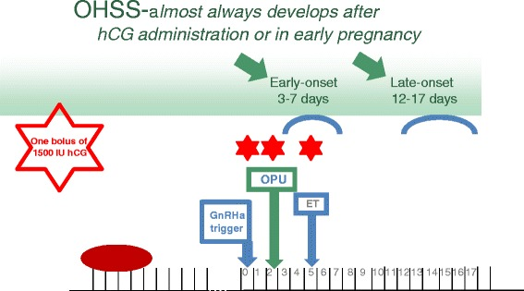
OHHS

Slide 13
OHSS Önlenmesi
OHSS’ yi tam’a yakın önler
hCG Trigger: OHSS % 5-8
GnRHa : OHSS% 0-2
Human Reprod update 2011:17;510
Cochrane Database syst.Rev 2014 Oct 31 (10):CD 008046

Slide 14
Triggering final oocyte maturation with reduced doses of hCG in IVF/ICSI: a prospective, randomized and controlled study
H. Lin et al. / European Journal of Obstetrics & Gynecology and Reproductive Biology 159 (2011) 143–147
A B S T R A C T
Objective: To compare the effectiveness of urinary human chorionic gonadotropin (u-hCG) at reduced doses of 4000 IU and 6000 IU in inducing final oocyte maturation during in vitro fertilization (IVF) and intracytoplasmic sperm injection (ICSI) cycles. Study design: 164 patients with an indication for IVF or ICSI recruited in this randomized, single-blinded and controlled study in IVF clinic at the Sun Yat-sen Memorial Hospital. Patients were prospectively randomized to receive 4000 IU (Group A, n = 83) and 6000 IU (Group B, n = 81) of hCG for triggering final oocyte maturation. Number or percentage of mature oocytes retrieved per patient, fertilization rates, pregnancy rates were the main outcome measures. Results: No evidence of statistically significant difference in the number or proportion of mature oocytes retrieved was observed in both groups. The lower fertilization rate and significantly lower clinical pregnancy rate were observed in Group A. The ovarian hyperstimulation syndrome (OHSS) rates in both groups were also similar. In the subgroup of BMI < 20 kg/m2 , fertilization rate were significantly higher in the administration group of hCG at the dose of 6000 IU when compared with the dose of 4000 IU (82.40% vs. 70.92%, P = 0.017); in contrast, no significant difference in clinical pregnancy rates was observed in both groups. In the subgroup of BMI 20–25 kg/m2 , clinical pregnancy rates were significantly higher in patients treated with hCG at dose of 6000 IU than patients treated with hCG at dose of 4000 IU (65.3% vs. 35.0%, P = 0.004); however, no significant difference in fertilization rates was observed. Conclusion: Both doses of u-hCG revealed an equal effect on the induction of final oocyte maturation in the patients with moderate or high ovarian response; however, the reduced dose of hCG could result in an obvious impact on clinical pregnancy rates and did not exhibit an obvious effect on OHSS rates

Slide 15
An OHSS-Free Clinic by segmentation of IVF treatment
Hum Reprod. 2011 Oct;26(10):2593-7. Devroey P, Polyzos NP, Blockeel C.
Abstract
Published data indicate a significant increase in ovarian hyperstimulation syndrome globally. The occurrence of approximately three maternal deaths per 100,000 stimulated women has been reported, and extrapolation of these figures to a global situation would give an impressive number. The syndrome can be erased by applying ovarian stimulation using the combination of GnRH antagonist with GnRH agonist to trigger ovulation. In this case, the strategy is to freeze all of the oocytes or embryos for later use.

Slide 16
GnRHa trigger for final oocyte maturation: is HCG trigger history?
Reprod Biomed Online.2014 Sep;29(3):274-80.
Humaidan P, Alsbjerg B
Abstract
Since the introduction of the gonadotrophin-releasing hormone analogues (GnRHa) protocol, it has become possible to trigger final oocyte maturation with a bolus of GnRHa. This leads to a significant reduction or complete elimination of ovarian hyperstimulation syndrome compared with human chorionic gonadotrophin (HCG) trigger. Early trials showed a severe luteal phase insufficiency after GnRHa trigger despite the application of standard luteal phase support protocols. Subsequent research has led to modifications of the luteal phase support, resulting in reproductive outcome comparable to that seen after HCG trigger in normal- and high-responders. GnRHa trigger facilitates a tailored approach to subsequent luteal phase support, taking into account the ovarian response to stimulation. In the future, GnRHa is likely to be used for trigger in all women co-treated with GnRH antagonists.

Slide 17
Human chorionic gonadotropin vs. gonadotropin-releasing hormone agonist trigger in assisted reproductive technology—‘‘The king is dead, long live the king!’
Fertil steril 2014:102(2):339
Similar to the old king, human chorionic gonadotropin (hCG) has been used for decades to trigger final oocyte maturation in assisted reproductive technology (ART), closely mimicking the actions of the midcycle surge of luteinizing hormone (LH). With this long-standing trigger concept, excellent results have been obtained; however, these come at the expense of an increased risk of ovarian hyperstimulation syndrome (OHSS),
In the early 1990s, this fact prompted clinical researchers to explore the use of a bolus of gonadotropinreleasing hormone agonist (GnRH-a) to trigger final oocyte maturation instead of hCG in OHSS risk patients, and results were promising. Thus, mature oocytes were retrieved, and OHSS seemed to be prevented.

Slide 18
GnRHa Trigger
Endojen LH ve FSH Surge’ ne neden olur
Ancak LH Surge’nun yarılanma ömrü ve etki süresi daha kısadır
hCG’ye göre daha fizyolojik bir Oosit Maturasyonu sağlar

Slide 19
GnRHa Trigger
Endojen LH ile birlikte FSH surge’ne yol açar.
Oosit’in meiosis bölünmesini tamamlar
GC’lerde LH reseptör oluşumunu sağlar
Cumulus hücre ekspansiyonu
Ovulatuar proteolitik enzimleri salgılatır
Mol Hum Reprod 1999:5:726
Hum Reprod 2011;17:510
J Hum Reprod SCI 2016:9(2):101
Daha çok matür oosit elde edilir

Slide 20
GnRHa - M2 OOSİT
RCT de:
hCG ve GnRHa uygulanan hastalarda, GnRHa grupta M2 Oosit ve embriyo sayısı daha fazladır
Hum Reprod 2005:20;1213
Reprod Biomed online 2010:20;783

Slide 21
GnRHa Trigger
Oosit Maturasyonu sağlamada çok başarılı
Erken Luteal Faz desteği zayıf
Standart Luteal Faz desteği modifiye edilmelidir

Slide 22
GnRHa Trigger Endikasyonları
OHSS riski olan hastalar
Donor KOH Siklüs
Tekrarlayan IVF başarısızlıkları
Empty Foll. Sendromu
Immatür Oosit (foll.) sendromu
Int J Endocrinol Metab 2013:11(2);107

Slide 23
GnRHa Trigger Yöntemleri
Dual Trigger
Double Trigger
GnRHa + OPU günü 1500 IU hCG
GnRHa + OPU günü 1500 IU hCG + OPU5 days 1500 IU hCG

Slide 24
Dual Trigger
Normal Responder:
GnRHa+5000 IU hCG
High Responder:
GnRHa+1500 IU hCG

Slide 25
Double Trigger
OPU’dan 40 saat önce GnRHa ve 34 saat önce hCG uygulanır
J Ovarian Res 2015:8;60

Slide 26
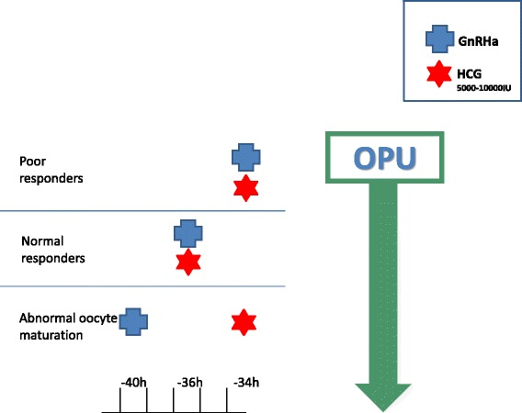
Double Trigger

Slide 27
GnRHa Avantajları
Güvenli
Etkili
Hasta dostu-kullanım kolaylığı
Daha çok matür oosit toplanması
Daha az siklüs iptali

Slide 28
GnRHa Doz
Triptorelin: - 0,3 ve 0,4 mg
Leuprolide Asetat: 1-2 mg
Buserelin: 0,5 mg
Hum Reprod 2005:20;1213
Fertil Steril 2016:105(2);356
0,2

Slide 29
GnRHa:Yeterli Cevap
GnRHa’ dan 8-13 saat sonra, LH ve P4 ölçülür
LH>15 IU
P4>3 ng/ml
Fertil Steril 2016 Jun 21 (Epub ahead of print)
Yetersiz cevap olgularında:hCG ile re-trigger uygulanır

Slide 30
GnRHa Negatif Etkileri
Derin LH süpresyonuna bağlı olarak Korpus Luteum Yetmezliği: Luteal Faz Defekti
- Gebelik oranları düşük
- Erken gebelik kayıpları yüksek
- Canlı doğum oranları düşük
Cochrane Database SYST Rev 2014 Oct 31:(10):CD008046

Slide 31
GnRHa:Suboptimal Cevap
% 2- 5,2 olguda suboptimal cevap görülür
Düşük BMI
Siklüs başında FSH ve LH düşük
Ovulasyon Trigger günü, FSH ve LH düşük
Uzun süreli stimülasyon ve yüksek doz gonodotropin uygulanması
Tedavi öncesi uzun süre OKS kullanılması
Fertil Steril 2016 Jun 21 (Epub ahead of print)
Fertil Steril 2015;104(3):637

Slide 32
GnRHa
Oosit disfonksiyonunda hCG ile birlikte uygulanır:
Ooplazmik matürite
Nükleer ve sitoplazmik matürite
Fertil Steril 2014;102:405
Fertil Steril 2015;103:874

Slide 33
GnRHa to trigger final oocyte maturation: a time to reconsider. Humaidan P¹, Papanikolaou EG, Tarlatzis BC
Abstract
Recently GnRH antagonist protocols for the prevention of a premature LH surge were introduced, allowing final oocyte maturation to be triggered with a single bolus of a GnRH agonist (GnRHa). GnRHa is as effective as hCG for the induction of ovulation, and apart from the LH surge a FSH surge is also induced. Until recently, prospective randomized studies reported a poor clinical outcome when GnRHa was used to trigger finaloocyte maturation in IVF/ICSI antagonist protocols, presumably due to a luteal phase deficiency, despite standard luteal phase supplementation with progesterone and estradiol. As GnRHa triggering of final oocyte maturation could possess advantages over hCG triggering in terms of a reduced if not eliminated risk of ovarian hyperstimulation syndrome (OHSS) and the retrieval of more mature oocytes, the challenge has been to rescue the luteal phase. In the literature now several studies report a luteal phase rescue with a reproductive outcome comparable to that of hCG induced final oocyte maturation. Although more research is needed, GnRHa triggering is now a valid alternative with potential benefits.
Hum Reprod 2009 Oct;24(10):2389-94.

Slide 34
Efficacy of Kisspeptin-54 to Trigger Oocyte Maturation in Women at High Risk of Ovarian Hyperstimulation Syndrome (OHSS) During In Vitro Fertilization (IVF) Therapy.
Abstract
CONTEXT:
In vitro fertilization (IVF) treatment is an effective therapy for infertility, but can result in the potentially life-threatening complication, ovarian hyperstimulation syndrome (OHSS).
OBJECTIVE:
This study aimed to investigate whether kisspeptin-54 can be used to effectively and safely trigger oocyte maturation in women undergoing IVF treatment at high risk of developing OHSS.
SETTING AND DESIGN:
This was a phase 2, multi-dose, open-label, randomized clinical trial of 60 women at high risk of developing OHSS carried out during 2013-2014 at Hammersmith Hospital IVF unit, London, United Kingdom.
INTERVENTION:
Following a standard recombinant FSH/GnRH antagonist protocol, patients were randomly assigned to receive a single injection of kisspeptin-54 to trigger oocyte maturation using an adaptive design for dose allocation (3.2 nmol/kg, n = 5; 6.4 nmol/kg, n = 20; 9.6 nmol/kg, n = 15; 12.8 nmol/kg, n = 20). Oocytes were retrieved 36 h after kisspeptin-54 administration, assessed for maturation, and fertilized by intracytoplasmic sperm injection with subsequent transfer of one or two embryos. Women were routinely screened for the development of OHSS.
MAIN OUTCOME MEASURE:
Oocyte maturation was measured by oocyte yield (percentage of mature oocytes retrieved from follicles ≥ 14 mm on ultrasound). Secondary outcomes include rates of OHSS and pregnancy.
RESULTS:
Oocyte maturation occurred in 95% of women. Highest oocyte yield (121%) was observed following 12.8 nmol/kg kisspeptin-54, which was +69% (confidence interval, -16-153%) greater than following 3.2 nmol/kg. At all doses of kisspeptin-54, biochemical pregnancy, clinical pregnancy, and live birth rates per transfer (n = 51) were 63, 53, and 45%, respectively. Highest pregnancy rates were observed following 9.6 nmol/kg kisspeptin-54 (85, 77, and 62%, respectively). No woman developed moderate, severe, or critical OHSS.
CONCLUSION:
Kisspeptin-54 is a promising approach to effectively and safely trigger oocyte maturation in women undergoing IVF treatment at high risk of developing OHSS
J Clin Endocrinol Metab 2015 Sep;100(9):3322-31

Slide 35
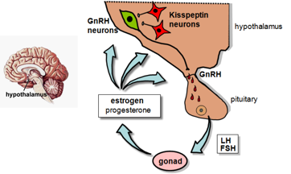

Slide 36
Kispeptin Dozu
Efektif doz: 9.6 nmol/kg
İmplantasyon oranı: % 57.7
Biyokimyasal gebelik oranı: % 85
Klinik gebelik oranı: % 77
Canlı doğum oranı: % 62
J Clin Endocrinol Metabol 2015;100(9):3322

Slide 37
Sonuç-1-
GnRHa uygulayanlarda OHSS riski azalır
Matur Oosit sayısı artar
Embriyo sayısı artar

Slide 38
Sonuç-2-
GnRHa; Oosit maturasyonun da, hCG’ ye iyi bir alternatiftir.
GnRHa güvenli, hasta dostu, etkin ve daha fizyoljik bir trigger yöntemidir.
Kisspeptin gelecekte çok önemli bir ovulasyon triggeri olacağı düşünülmektedir
Luteal Fazın desteklenmesi gerekmektedir

Slide 39
TEŞEKKÜRLER.....

