Slide 1
KANITA DAYALI TIP PERSPEKTİFİNDEN SEZARYEN NASIL YAPILMALI ?
Prof. Dr. CEM TURAN

Slide 2
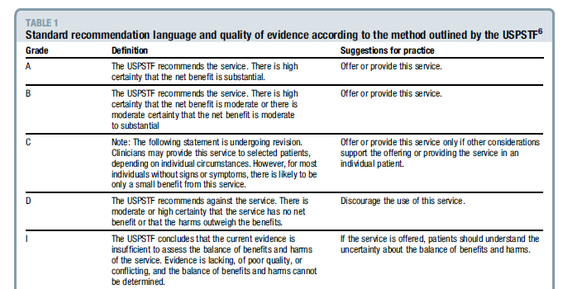
Birleşik Devletler Önleyici Hizmetler Görev Gücü (United States Preventive Services Task Force)
FAYDA
KESİN
ÖNER
FAYDA
ORTA
ÖNER
FAYDA
SEÇİLMİŞ VAKADA
ÖNER
MİNİMAL
FAYDA YOK
HATTA ZARARLI
ÖNERME
FAYDA ?
ZARAR ?

Slide 3
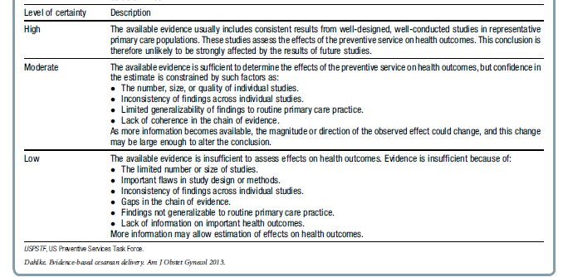
Birleşik Devletler Koruyucu Hizmetler Görev Gücü (United States Preventive Services Task Force)

Slide 4
Pre-operatif Değerlendirme Rıza Beyan formu
Planlı C/S: Öykü, Fizik muayene, kan idrar testleri
Acil C/S: Kişiselleştirme gerekir.
Naji, O, Abdallah, Y, et al,Cesarean Birth: Surgical Techniques. Glob. libr. women's med., (ISSN: 1756-2228) 2010; DOI 10.3843/GLOWM.10133

Slide 5
Abdominal Hazırlık
RCT yok. Gözlemsel ve retrospektif çalışmalar var.
Eğer gerekiyorsa; genital bölge kıllarının temizlenmesi operasyon odasında yapılmalıdır.
Daha önceden yapılan temizlik bakteriyel kontaminasyonu arttırır.
Naji, O, Abdallah, Y, et al,Cesarean Birth: Surgical Techniques. Glob. libr. women's med., (ISSN: 1756-2228) 2010; DOI 10.3843/GLOWM.0133

Slide 6
Operasyon Masası Hazırlığı - Pozisyon
RCT yok. Gözlemsel ve retrospektif çalışmalar var.
İnferior vena kava basısını azaltmak için sol lateral eğimli pozisyon tercih edilmeli.
Öneri: I Düzey: Düşük
* Clemetson CA, Hassan R, Mallikarjuneswara VR, Wallace G. Tilt-bend cesarean section. Obstet Gynecol 1973;42:290-8.
*Crawford JS, Burton M, Davies P. Time and lateral tilt at caesarean section. Br J Anaesth 1972;44:477-84.
*Downing JW, Coleman AJ, Mahomedy MC, Jeal DE, Mahomedy Y. Lateral table tilt for caesarean section. Anaesthesia 1974;29:696-703.
*Cluver C, Novikova N, Hofmeyr GJ, Hall DR. Maternal position during caesarean section for preventing maternal and neonatal complications. Cochrane Database Syst Rev 2010;6:CD007623.
*Carbonne B, Benachi A, Leveque ML, Cabrol D, Papiernik E. Maternal position during labor: effects on fetal oxygen saturation measured by pulse oximetry. Obstet Gynecol 1996; 88:797-800.
Naji, O, Abdallah, Y, et al,Cesarean Birth: Surgical Techniques. Glob. libr. women's med., (ISSN: 1756-2228) 2010; DOI 10.3843/GLOWM.10133

Slide 7
Batının Antiseptik Temizliği
CHG (Klorheksidin Glukonat) veya Povidon İodine
Her ikisi de etkin.
* Edwards PS, Lipp A, Holmes A. Preoperative skin antiseptics for preventing surgical wound infections after clean surgery. Cochrane Database Syst Rev 2005.
*Magann EF, Dodson MK, Ray MA, Harris RL, Martin JN, Morrison JC. Preoperative skin preparation and intraoperativepelvic irrigation: impact on post cesarean endometritis and wound infection. Obstet Gynecol 1993;81: 922-5.

Slide 8
Adezif Örtü
Öneri: D Düzey: Orta
*Cordtz T, Schouenborg L, Lauren K, Daugaard HO, Buur K, Munk Christensen B. The effect of incision plastic drapes and redisinfection of operation site on wound infection following caesarean section. J Hosp Infect 1989; 13:267-72.
*Ward HRG, Jennings OGN, Potgieter P, Lombard CJ. Do plastic adhesive drapes prevent post caesarean wound infection? J Hosp Infect 2001;47:230-4.

Slide 9
Profilaktik Antibiyotik
Tek doz ampisilin veya 1. jenerasyon sefalosporin (3 RCT)
Öneri: A Düzey: Yüksek
*Ziogos E, Tsiodras S, Matalliotakis I, Giamarellou H, Kanellakopoulou K. Ampicillin/ sulbactam versus cefuroxime as antimicrobial prophylaxis for cesarean delivery: a randomized study. BMC Infect Dis 2010;10:341.
*Alekwe LO, Kuti O, Orji EO, Ogunniyi SO. Comparison of ceftriaxone versus triple drug regimen in the prevention of cesarean section infectious morbidities. J Matern Fetal Neonatal Med 2008;21:638-42.
*Rudge MV, Atallah AN, Peracoli JC, Tristao Ada R, Mendonca Neto M. Randomized controlled trial on prevention of postcesarean infection using penicillin and cephalothin in Brazil. Acta Obstet Gynecol Scand 2006;85:945-8.

Slide 10
Profilaktik Antibiyotik Verilme Zamanı
Antibiyotik verilme zamanı (Preoperatif veya kordon klemplenmesinden sonra)
4 RCT ve 1 metaanaliz
*Thigpen BD, Hood WA, Chauhan S, et al. Timing of prophylactic antibiotic administration in the uninfected laboring gravida: a randomized clinical trial. Am J Obstet Gynecol 2005;192: 1864-8; discussion 1868-71.
*Sullivan SA, Smith T, Chang E, Hulsey T, Vandorsten JP, Soper D. Administration of cefazolin prior to skin incision is superior to cefazolin at cord clamping in preventing postcesarean infectious morbidity: a randomized, controlled trial. Am J Obstet Gynecol 2007;196: 455.e1-5.
*Witt A, Doner M, Petricevic L, et al. Antibiotic prophylaxis before surgery vs after cord clamping in elective cesarean delivery: a double-blind, prospective, randomized, placebo-controlled trial. Arch Surg 2011;146:1404-9.
*Macones GA, Cleary KL, Parry S, et al. The timing of antibiotics at cesarean: a randomized controlled trial. Am J Perinatol 2012;29:273-
*Costantine MM, Rahman M, Ghulmiyah L, et al. Timing of perioperative antibiotics for cesarean delivery: a metaanalysis. Am J Obstet Gynecol 2008;199:301.e1-6.
2 çalışmada fark yok, diğer iki çalışmada preoperatif verilme (neonatal problem yaratmadan) daha üstün bulundu.
Metaanaliz: Preoperatif (15-30 dakika önce)
daha üstün
Öneri: A Düzey: Yüksek

Slide 11
Tromboprofilaksi
Rutin tromboprofilaksi ve antiembolik çorap ile yapılmış RCT yok.
Heparin ve LMWH ile yapılmış bir çalışmalar var.
*Hill NC, Hill JG, Sargent JM, Taylor CG, Bush PV. Effect of low dose heparin on blood loss at caesarean section. Br Med J (Clin Res Ed) 1988;296:1505-6.
*Burrows RF, Gan ET, Gallus AS, Wallace EM, Burrows EA. A randomised doubleblind placebo controlled trial of low molecular weight heparin as prophylaxis in preventing venous thrombolic events after caesarean section: a pilot study. BJOG 2001;108:835-9.
* Gates S, Brocklehurst P, Ayers S, Bowler U. Thromboprophylaxis and pregnancy: two randomized controlled pilot trials that used lowmolecular-weight heparin. Am J Obstet Gynecol 2004;191:1296-303
Risk faktörlerine göre karar verilmeli.
Öneri: I Düzey: Düşük

Slide 12
Preoperatif Vajinal Povidone-Iodin ile Hazırlık
2 RCT ve 1 derleme
Bir çalışmada enfeksiyon azalıyor. Diğerinde istatistiksel anlamlı azalma yok.
Cochrane derleme: Enfeksiyon azalıyor.
Öneri: B Düzey: Orta
*Starr RV, Zurawski J, Ismail M. Preoperative vaginal preparation with povidone-iodine and the risk of postcesarean endometritis. Obstet Gynecol 2005;105(5 Pt 1):1024-9.
*Haas DM, Pazouki F, Smith RR, et al. Vaginal cleansing before cesarean delivery to reduce postoperative infectious morbidity: a randomized, controlled trial. Am J Obstet Gynecol 2010;202:310.e1-6.
*Haas DM, Morgan Al Darei S, Contreras K. Vaginal preparation with antiseptic solution before cesarean section for preventing postoperative infections. Cochrane Database Syst Rev 2010;3:CD007892.

Slide 13
Mesane Sondası Uygulanması
2 RCT ve 1 metaanaliz
Sonda ya takılmamalı ya da erken çıkarılmalı
Öneri: C Düzey: Orta
*Nasr AM, El Bigawy AF, Abdelamid AE, Al-Khulaidi S, Al-Inany HG, Sayed EH. Evaluation of the use vs nonuse of urinary catheterization during cesarean delivery: a prospective, multicenter, randomized controlled trial. J Perinatol 2009;29:416-21.
*Ghoreishi J. Indwelling urinary catheters in cesarean delivery. Int J Gynaecol Obstet 2003;83:267-70.
Li L, Wen J, Wang L, Li YP, Li Y. Is routine indwelling catheterisation of the bladder for caesarean section necessary? A systematic review. BJOG 2011;118:400-9.

Slide 14
Morbidite Azalması için Oksijen Desteği
2 RCT, Fark yok.
Öneri: D Düzey: Yüksek
*Scifres CM, Leighton BL, Fogertey PJ, Macones GA, Stamilio DM. Supplemental oxygen for the prevention of postcesarean infectious morbidity: a randomized controlled trial. Am J Obstet Gynecol 2011;205:267.e1-9.
*Gardella C, Goltra LB, Laschansky E, et al. High-concentration supplemental perioperative oxygen to reduce the incidence of postcesarean surgical site infection: a randomized controlled trial. Obstet Gynecol 2008;112:545-52

Slide 15
İnsizyondan sonra 2. Bisturi
Öneri: D Düzey: Orta
Hasselgren PO, Hagberg E, Malmer H, Saljo A, Seeman T. One instead of two knives for surgical incision: does it increase the risk of postoperative wound infection? Arch Surg 1984;119:917-20.

Slide 16
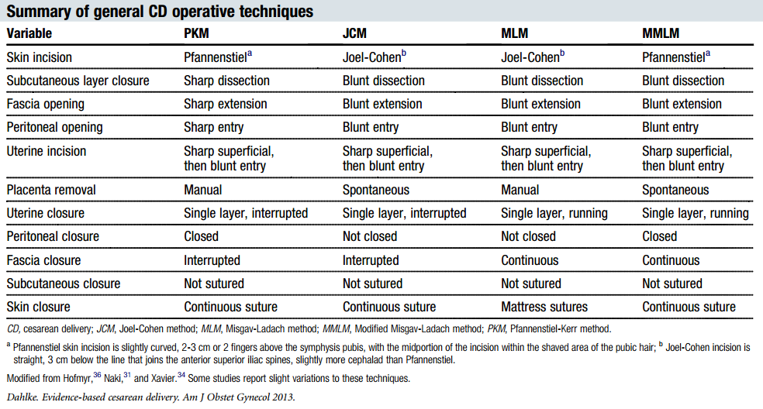
İnsizyon Tipi
Özel durumlarda: *Klasik (Orta Hat Vertikal)
*PELOSİ Tekniği

Slide 17
İnsizyon Tipi
4 RCT, 1 Cochrane Derleme, 1 Metananaliz
JC teknikte daha az kan kaybı, ateş, ağrı.
Öneri: C Düzey: Orta
*Naki MM, Api O, Celik H, Kars B, Yasar E, Unal O. Comparative study of Misgav-Ladach and Pfannenstiel-Kerr cesarean techniques: a randomized controlled trial. J Matern Fetal Neonatal Med 2011;24:239-44.
*Gedikbasi A, Akyol A, Ulker V, et al. Cesarean techniques in cases with one previous cesarean delivery: comparison of modified Misgav-Ladach and Pfannenstiel-Kerr. Arch Gynecol Obstet 2011;283:711-6.
*Belci D, Kos M, Zoricic D, et al. Comparative study of the “Misgav Ladach” and traditional Pfannenstiel surgical techniques for cesarean section. Minerva Ginecol 2007;59:231-40.
*Xavier P, Ayres-De-Campos D, Reynolds A, Guimaraes M, Costa-Santos C, Patricio B. The modified Misgav-Ladach versus the Pfannenstiel-Kerr technique for cesarean section: a randomized trial. Acta Obstet Gynecol Scand 2005;84:878-82.
Mathai M, Hofmeyr GJ. Abdominal surgical incisions for caesarean section. Cochrane Database Syst Rev 2007;1:CD004453.
*Hofmeyr JG, Novikova N, Mathai M, Shah A. Techniques for cesarean section. Am J Obstet Gynecol 2009;201:431-44.

Slide 18
İnsizyon Uzunluğu
12 cm – 15 cm
Öneri: I Düzey: Düşük
Finan MA, Mastrogiannis DS, Spellacy WN. The "Allis" test for easy cesarean delivery. Am J Obstet Gynecol 1991;164:772-5.

Slide 19
Bisturi yerine kesici koter kullanımı
RCT yok.
Bisturi tercih edilmeli.
Berghella V, UpToDate; Cesarean delivery: Technique, http://www.uptodate.com/contents/cesarean-delivery-technique#H23

Slide 20
Uterus insizyonu
Aşağı transvers (Monro Kerr veya Kerr)
T şeklinde uzatma
J şeklinde uzatma
Aşağı vertikal (Kronig, De Lee, Cornell)
Klasik

Slide 21
1-Subkutan ve Fascia İnsizyonu, Parietal Periton Açılması (Keskin vs. Keskin + elle), 2- Fascia Diseksiyonu
1 RCT, Manuel diseksiyonda; hemoglobinde daha az düşme ve daha az ağrı
Öneri: I Düzey: Düşük
* Kadir RA, Khan A, Wilcock F, Chapman L. Is inferior dissection of the rectus sheath necessary during Pfannenstiel incision for lower segment caesarean section? A randomised controlled trial. Eur J Obstet Gynecol Reprod Biol 2006;128:262-6.

Slide 22
Mesane Flepi ve Visseral Peritonizasyon
Mesane flepi: 2 RCT
Visseral peritonizasyon: 1 RCT
Flep oluşturma ve visseral peritonizasyon avantaj sağlamıyor, hatta sık idrara gitme şikayeti yapabiliyor, ancak mesane yaralanması adhezyon ile ilgili veriler yetersiz.
Öneri: D Düzey: Orta
*Tuuli MG, Odibo AO, Macones GA. Utility of the bladder flap at cesarean delivery: a randomized controlled trial. Obstet Gynecol 2012;120:709.
*Malvasi A, Tinelli A, Guido M, et al. Effect of avoiding bladder flap formation in caesarean section on repeat caesarean delivery. Eur J Obstet Gynecol Reprod Biol 2011;159:300-4.
*Shahin AY, Hameed DA. Does visceral peritoneal closure affect post-cesarean urinary symptoms? A randomized clinical trial. Int Urogynecol J 2010;21:33-41.

Slide 23
Uterin İnsizyonun Uzatılması
Parmakla (Sefalo-kaudal)
Öneri: A Düzey: Yüksek
Sekhavat L, Dehghani Firouzabadi R, Mojiri P. Effect of expansion technique of uterine incision on maternal blood loss in cesarean
section. Arch Gynecol Obstet 2010;282:5-479.
Cromi A, Ghezzi F, Di Naro E, Siesto G, Loverro G, Bolis P. Blunt expansion of the low transverse uterine incision at cesarean delivery: a randomized comparison of 2 techniques. Am J Obstet Gynecol 2008;199:292.e1-6.
Dodd JM, Anderson ER, Gates S. Surgical techniques for uterine incision and uterine closure at the time of caesarean section. Cochrane Database Syst Rev 2008;3:CD004732.
Magann EF, Chauhan SP, Bufkin L, Field K, Roberts WE, Martin JN. Intra-operative haemorrhage by blunt versus sharp expansion of the uterine incision at caesarean delivery: a randomised clinical trial. BJOG 2002;109: 448-52.
Rodriguez AI, Porter KB, O’Brien WF. Blunt versus sharp expansion of the uterine
incision in low-segment transverse cesarean section. Am J Obstet Gynecol 1994;171:
1022-5.

Slide 24
Uterin İnsizyonun Uzatılması Künt ?, Keskin?
2 RCT, 1 Derleme: Künt üstün (Kanama daha az)
Öneri: A Düzey: Yüksek
*Sekhavat L, Dehghani Firouzabadi R, Mojiri P. Effect of expansion technique of uterine incision on maternal blood loss in cesarean section. Arch Gynecol Obstet 2010;282:5-479.
*Cromi A, Ghezzi F, Di Naro E, Siesto G, Loverro G, Bolis P. Blunt expansion of the low transverse uterine incision at cesarean delivery: a randomized comparison of 2 techniques. Am J Obstet Gynecol 2008;199:292.e1-6.
*Dodd JM, Anderson ER, Gates S. Surgical techniques for uterine incision and uterine closure at the time of caesarean section. Cochrane Database Syst Rev 2008;3:CD004732.

Slide 25
Batın Retraktörü Kullanımı
1 Çalışma (enfeksiyon?), çalışma güçlü değil.
Öneri: I Düzey: düşük
*Theodoridis TD, Chatzigeorgiou KN, Zepiridis L, et al. A prospective randomized study for evaluation of wound retractors in the prevention of incision site infections after cesarean section. Clin Exp Obstet Gynecol 2011;38:57-9.

Slide 26
Bebeğin Doğurtulması - Sefalik Prezentasyon
Fetal baş oksiput transvers poziyona ve fleksiyona getirilir. Fundal bası daha sonra yapılır.
Forseps tek kaşığı ya da vakum kullanılabilir.
Öneri: I Düzey: düşük
* Bofill JA, Lencki SG, Barhan S, Ezenagu LC. Instrumental delivery of the fetal head at the time of elective repeat cesarean: a randomized pilot study. Am J Perinatol 2000;17: 265-9.
* Majoko F, Gardener G. Trial of instrumental delivery in theatre versus immediate caesarean section for anticipated difficult assisted births. Cochrane Database Syst Rev 2012;10: CD005545.

Slide 27
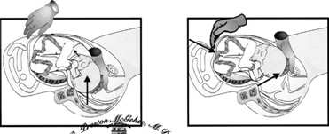
Bebeğin Doğurtulması - Sefalik Prezentasyon
* Story L, Paterson-Brown S: Cesarean deliveries: indications, techniques and complications. Chapter 10: Best Practice in Labour and Delivery, ed. R. Warren and S. Arulkumaran. Published by Cambridge University Press 2009.
* Naji, O, Abdallah, Y, et al,Cesarean Birth: Surgical Techniques. Glob. libr. women's med., (ISSN: 1756-2228) 2010; DOI 10.3843/GLOWM.10133

Slide 28
Bebeğin Doğurtulması - Makat Prezentasyon
Mümkün olduğunca membranlar açılmamaya çalışılır.
Eğer saf makat ise, başa yapılan manevraya benzer şekilde doğum sağlanır.
Eğer tam makat ise ayaklar doğurtulmaya çalışılır.
Bu sırada fetal sırt anteriora getirilir.
Maurcieu Smellie Veit manevrası ile doğum sağlanır.
* Story L, Paterson-Brown S: Cesarean deliveries: indications, techniques and complications. Chapter 10: Best Practice in Labour and Delivery, ed. R. Warren and S. Arulkumaran. Published by Cambridge University Press 2009.
* Naji, O, Abdallah, Y, et al,Cesarean Birth: Surgical Techniques. Glob. libr. women's med., (ISSN: 1756-2228) 2010; DOI 10.3843/GLOWM.10133

Slide 29
Plasenta Manuel? Spontan?
Çalışmalarda masaj ile spontan ayrılma sağlandığında endomyometrit ve kan kaybı daha az.
Öneri: A Düzey: Yüksek
Eldiven Değişimi
Öneri: D Düzey: Orta
Atkinson M, Owen J, Wren A et al: The effect of manual removal of the placenta on post-cesarean endometritis. Obstet Gynecol 87:99, 1996
McCurdy CM Jr, Magann EF, McCurdy CJ et al: The effect of placental management at cesarean delivery on operative blood loss. Am J Obstet Gynecol 167:1363, 1992
Khan GQ, John IS, Wani S et al: Controlled cord traction versus minimal intervention techniques in delivery of the placenta: A randomized controlled trial. Am J Obstet Gynecol 177:770, 1997
* Naji, O, Abdallah, Y, et al,Cesarean Birth: Surgical Techniques. Glob. libr. women's med., (ISSN: 1756-2228) 2010; DOI 10.3843/GLOWM.10133

Slide 30
Postpartum Kanamanın Önlenmesi Bolus Oksitosin vs. İnfüzyon Oksitosin
2 RCT
10-40 IU / 1 lt kristalloid – 4-6 saat etkindir.
Bolus: Etkisi belirsiz.
Öneri: B Düzey: Yüksek
*Sheehan SR, Montgomery AA, Carey M, et al. Oxytocin bolus versus oxytocin bolus and infusion for control of blood loss at elective caesarean section: double blind, placebo controlled, randomised trial. BMJ 2011;343: d4661.
*Butwick AJ, Coleman L, Cohen SE, Riley ET, Carvalho B. Minimum effective bolus dose of oxytocin during elective caesarean delivery. Br J Anaesth 2010;104:338-43.

Slide 31
Postpartum Kanamanın Önlenmesi Misoprostol tek veya kombine
5 RCT
Misoprostol kombine kullanıldığında ek uterotonik ihtiyacı azalıyor.
Ancak; titreme, ateş ve ağızda metalik tad gibi yan etkiler fazla.
Misoprostol oksitosine üstün değil.
Öneri: D Düzey: Orta
*Chaudhuri P, Banerjee GB, Mandal A. Rectally administered misoprostol versus intravenous oxytocin infusion during cesarean delivery to reduce intraoperative and postoperative blood loss. Int J Gynaecol Obstet 2010;109:25-9.
*Owonikoko KM, Arowojolu AO, Okunlola MA. Effect of sublingual misoprostol versus intravenous oxytocin on reducing blood loss at cesarean section in Nigeria: a randomized
controlled trial. J Obstet Gynaecol Res 2011;37:715-21.
*Eftekhari N, Doroodian M, Lashkarizadeh R. The effect of sublingual misoprostol versus intravenous oxytocin in reducing bleeding after
caesarean section. J Obstet Gynaecol 2009;29: 633-6.
*Vimala N, Mittal S, Kumar S. Sublingual misoprostol versus oxytocin infusion to reduce blood loss at cesarean section. Int J Gynaecol Obstet 2006;92:106-10.
*Hamm J, Russell Z, Botha T, Carlan SJ, Richichi K. Buccal misoprostol to prevent hemorrhage at cesarean delivery: a randomized study. Am J Obstet Gynecol 2005;192: 1404-6.

Slide 32
Postpartum Kanamanın Önlenmesi Tranexamik asit
3 RCT
İnsizyon öncesi 10 mg/kg IV; intraoperatif ve postoperatif kanamayı azaltıyor.
Öneri: B Düzey: Orta
*Butwick AJ, Coleman L, Cohen SE, Riley ET, Carvalho B. Minimum effective bolus dose of oxytocin during elective caesarean delivery. Br J Anaesth 2010;104:338-43.
*Movafegh A, Eslamian L, Dorabadi A. Effect of intravenous tranexamic acid administration on blood loss during and after cesarean delivery. Int J Gynaecol Obstet 2011;115:
224-6.
*Sekhavat L, Tabatabaii A, Dalili M, Farajkhoda T, Tafti AD. Efficacy of tranexamic acid in reducing blood loss after cesarean section. J Matern Fetal Neonatal Med 2009;22:
72-5.

Slide 33
Postpartum Kanamanın Önlenmesi Oksitosin Agonisti (Karbetosin) vs Oksitosin
2 RCT
Karbetosin grubunda ek doz ihtiyacı daha az.
Major kanama açısından fark yok.
Öneri: C Düzey: Orta
*Borruto F, Treisser A, Comparetto C. Utilization of carbetocin for prevention of postpartum hemorrhage after cesarean section: a randomized clinical trial. Arch Gynecol Obstet 2009;280:707-12.
*Attilakos G, Psaroudakis D, Ash J, et al. Carbetocin versus oxytocin for the prevention of postpartum haemorrhage following caesarean section: the results of a double-blind randomised trial. BJOG 2010;117:929-36.

Slide 34
Plasental Drenaj
1 RCT (n:86)
Amaç: Fetomaternal transfüzyonu azaltmak
Vaka sayısı azlığı nedeniyle sonuca ulaşılamadı.
Öneri: I Düzey: Düşük
*Leavitt BG, Huff DL, Bell LA, Thurnau GR. Placental drainage of fetal blood at cesarean delivery and feto maternal ransfusion: a randomized controlled trial. Obstet Gynecol 2007;110:608-11.

Slide 35
Uterusun Batın Dışına Alınması
7 RCT, 1 metaanaliz
Febril komplikasyonlar ve cerrahi süre açısından fark yok.
Cerrahın isteğine göre iki teknikte uygundur.
Öneri: C Düzey: Yüksek
* Orji EO, Olaleye AO, Loto OM, Ogunniyi SO. A randomised controlled trial of uterine exteriorisation and non-exteriorisation at caesarean section. Aust N Z J Obstet Gynaecol 2008;48: 570-4.
*Siddiqui M, Goldszmidt E, Fallah S, Kingdom J, Windrim R, Carvalho JC. Complicationsof exteriorized compared with in situ
uterine repair at cesarean delivery under spinal anesthesia: a randomized controlled trial. Obstet Gynecol 2007;110:570-5.
*Nafisi S. Influence of uterine exteriorization versus in situ repair on post-Cesarean maternal pain: a randomized trial. Int J Obstet Anesth 2007;16:135-8.
*Coutinho IC, Ramos de Amorim MM, Katz L, Bandeira de Ferraz AA. Uterine exteriorization compared with in situ repair at cesarean delivery: a randomized controlled trial. Obstet Gynecol 2008;111:639-47.
*Ozbay K. Exteriorized versus in situ repair of the uterine incision at cesarean delivery: a randomized controlled trial. Clin Exp Obstet Gynecol 2011;38:155-8.
*Doganay M, Tonguc EA, Var T. Effects of method of uterine repair on surgical outcome of cesarean delivery. Int J Gynaecol Obstet
2010;111:175-8.
*Ezechi OC, Kalu BK, Njokanma FO, Nwokoro CA, Okeke GC. Uterine incision closure at caesarean section: a randomised comparative study of intraperitoneal closure and closure after temporary exteriorisation. West Afr J Med 2005;24:41-3.
*Walsh CA, Walsh SR. Extraabdominal vs intraabdominal uterine repair at cesarean delivery: a metaanalysis. Am J Obstet Gynecol
2009;200:625.e1-8

Slide 36
Servikal Dilatasyon
3 RCT, 1 Cochrane derleme
Morbidite ve hematometra açısından fark yok.
Öneri: D Düzey: Yüksek
*Ahmed B, Abu Nahia F, Abushama M. Routine cervical dilatation during elective cesarean section and its influence on maternal morbidity: a randomized controlled study. J Perinat Med 2005;33:510-3.
*Tosun M, Sakinci M, Celik H, et al. A randomized controlled study investigating the necessity of routine cervical dilatation during elective cesarean section. Arch Gynecol Obstet 2011;284:85-9.
*Gungorduk K, Yildirim G, Ark C. Is routine cervical dilatation necessary during elective caesarean section? A randomised controlled trial. AustNZ J Obstet Gynaecol 2009;49:263-7.
*Liabsuetrakul T, Peeyananjarassri K. Mechanical dilatation of the cervix at non-labour caesarean section for reducing postoperative morbidity. Cochrane Database Syst Rev 2011; 11:CD008019.

Slide 37
Uterusun Kapatılması (Tek vs Çift Tabaka)
2 RCT, 1 metaanaliz, 1 Cochrane derleme
Enfeksiyon, süre, ağrı, kan transfüzyonu ihtiyacı, tekrar hastaneye yatış, emzirme açılarından bir fark yok.
Ancak, daha sonraki gebelikte komplikasyon ve rüptür?
*Caesarean section surgical techniques: a randomised factorial trial (CAESAR)*. BJOG 2010;117:1366-76.
*Roberge S, Chaillet N, Boutin A, et al. Single- versus double-layer closure of the hysterotomy incision during cesarean delivery and risk of uterine rupture. Int J Gynaecol Obstet 2011;115:5-10.
*Dodd JM, Anderson ER, Gates S. Surgical techniques for uterine incision and uterine closure
at the time of caesarean section. Cochrane Database Syst Rev 2008;3:CD004732.
* Viney R, Isaacs C, Chelmow D. Intraabdominal Irrigation at cesarean delivery: a randomized controlled trial. Obstet Gynecol 2012;120:708.

Slide 38
Uterusun Kapatılması (Tek vs Çift Tabaka)
Fertilite isteyenlerde çift tabaka kapatma
Öneri: C Düzey: Orta. Yani vakaya göre davranılmalı. Kişiselleştir!
Fertilite istemeyenlerde tek tabaka kapatma
Öneri: A Düzey: Yüksek

Slide 39
Kilitli veya Kilitsiz sütür
RCT yok.
Kilitli sütürlerde, iyileşme döneminde myometrium daha ince, skar defekti, ayrılma daha fazla.
Berghella V, UpToDate; Cesarean delivery: Technique, http://www.uptodate.com/contents/cesarean-delivery-technique#H23
*Yasmin S, Sadaf J, Fatima N. Impact of methods for uterine incision closure on repeat caesarean section scar of lower uterine segment. J Coll Physicians Surg Pak 2011; 21:522.
*Ceci O, Cantatore C, Scioscia M, et al. Ultrasonographic and hysteroscopic outcomes of uterine scar healing after cesarean section: comparison of two types of single-layer suture. J Obstet Gynaecol Res 2012; 38:1302.
*Roberge S, Chaillet N, Boutin A, et al. Single- versus double-layer closure of the hysterotomy incision during cesarean delivery and risk of uterine rupture. Int J Gynaecol Obstet 2011; 115:5.

Slide 40
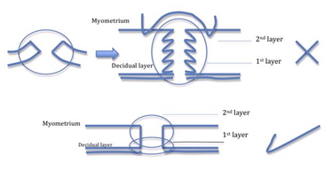
Çift tabaka kapatma tekniği
YANLIŞ
DOĞRU
* Story L, Paterson-Brown S: Cesarean deliveries: indications, techniques and complications. Chapter 10: Best Practice in Labour and Delivery, ed. R. Warren and S. Arulkumaran. Published by Cambridge University Press 2009.
* Naji, O, Abdallah, Y, et al,Cesarean Birth: Surgical Techniques. Glob. libr. women's med., (ISSN: 1756-2228) 2010; DOI 10.3843/GLOWM.10133

Slide 41
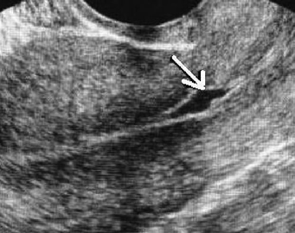
Sezaryen Skar Defekti
Skar gebeliği
Plasenta yapışma anomalileri
Ayrılma, Rüptür
Anormal uterin kanama, Dismenore

Slide 42
Sezaryen Skar Defekti
Postpartum ilk 6 haftada sıklık oranı: % 20-60
Tek tabaka kapatma (özellikle kilitli) tekniğinde myometrium kalınlığı daha az ve skar defekti daha fazla.
Am J Obstet Gynecol. 2014 Nov;211(5):453-60. doi: 10.1016/j.ajog.2014.06.014. Epub 2014 Jun 6.
Impact of single- vs double-layer closure on adverse outcomes and uterine scar defect: a systematic review and metaanalysis. Roberge S¹, Demers S², Berghella V³, Chaillet N⁴, Moore L¹, Bujold E⁵

Slide 43
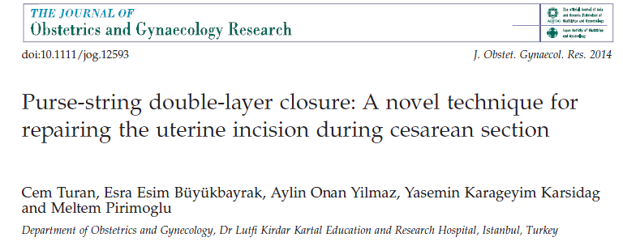
Uterusun çift tabaka kese ağzı sütür ile kapatılması

Slide 44
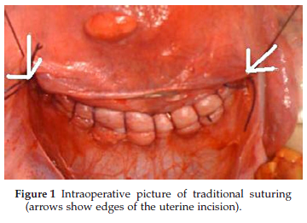
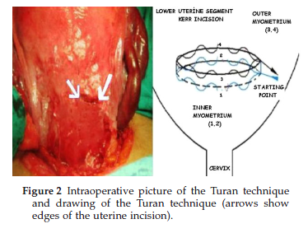
* Çift tabaka klasik sütür sonrası insizyon uzunluğu: 8.5 ± 1.8
Çift tabaka kese ağzı sütür sonrası insizyon uzunluğu: 4.3 ± 1.9 (p<0.001)

Slide 45
p<0.001
 | TÜM C / S | ESKİ C / S | PRİMER C / S
Klasik Çift Kat Skar Defekt Oranı (%) | 60 | 74.3 | 43.3
Purse string Çift kat Skar Defekt Oranı (%) | 23.5 | 33 | 9.5

Slide 46
Elektif Apendektomi
1 RCT
Operasyon süresinde artış, febril morbiditede artış yok.
Öneri: D Düzey: Orta
*Pearce C, Torres C, Stallings S, et al. Elective appendectomy at the time of cesarean delivery: a randomized controlled trial. Am J
Obstet Gynecol 2008;199:491.e1-5.

Slide 47
İntraabdominal İrigasyon
1 RCT
Bulantı artıyor,
Kan kaybı, operasyon süresi, komplikasyonlar, hastanede kalış süresi, gastrointestinal fonksiyonlar, enfeksiyon açısından fark yok.
Öneri: D Düzey: Orta
74. Viney R, Isaacs C, Chelmow D. Intraabdominal Irrigation at cesarean delivery: a randomized controlled trial. Obstet Gynecol
2012;120:708.

Slide 48
Adezyon Bariyeri
RCT yok.
Rutin adezyon bariyeri kullanımı önerilmiyor.
Berghella V, UpToDate; Cesarean delivery: Technique, http://www.uptodate.com/contents/cesarean-delivery-technique#H23
*Edwards RK, Ingersoll M, Gerkin RD, et al. Carboxymethylcellulose adhesion barrier placement at primary cesarean delivery and outcomes at repeat cesarean delivery. Obstet Gynecol 2014; 123:923.
*Gaspar-Oishi M, Aeby T. Cesarean delivery times and adhesion severity associated with prior placement of a sodium hyaluronate-carboxycellulose barrier. Obstet Gynecol 2014; 124:679.
*Walfisch A, Beloosesky R, Shrim A, Hallak M. Adhesion prevention after cesarean delivery: evidence, and lack of it. Am J Obstet Gynecol 2014; 211:446.

Slide 49
Periton Kapatılması ?
7 RCT, 2 metaanaliz, 1 Cochrane derleme
* Caesarean section surgical techniques: a randomised factorial trial (CAESAR)*. BJOG 2010;117:1366-76.
* Anteby EY, Kruchkovich J, Kapustian V, Gdalevich M, Shenhav S, Gemer O. Short-term effects of closure versus non-closure of the visceral and parietal peritoneum at cesarean section: a prospective randomized study. J Obstet Gynaecol Res 2009;35:1026-30.
* Kapustian V, Anteby EY, Gdalevich M, Shenhav S, Lavie O, Gemer O. Effect of closure versus nonclosure of peritoneum at cesarean section on adhesions: a prospective randomized study. Am J Obstet Gynecol 2012;206:56. e1-4.
* Shahin AY, Osman AM. Parietal peritoneal closure and persistent postcesarean pain. Int J Gynaecol Obstet 2009;104:135-9.
* Komoto Y, Shimoya K, Shimizu T, et al. Prospective study of non-closure or closure of the peritoneum at cesarean delivery in 124
women: impact of prior peritoneal closure at primary cesarean on the interval time between first cesarean section and the next pregnancy and significant adhesion at second cesarean. J Obstet Gynaecol Res 2006;32:396-402.
* Malomo OO, Kuti O, Orji EO, Ogunniyi SO, Sule SS. A randomised controlled study of non-closure of peritoneum at caesarean section in a Nigerian population. J Obstet Gynaecol 2006;26:429-32.
* Zareian Z, Zareian P. Non-closure versus closure of peritoneum during cesarean section: a randomized study. Eur J Obstet Gynecol Reprod Biol 2006;128:267-9.
* Shi Z, Ma L, Yang Y, et al. Adhesion formation after previous caesarean section-a meta-analysis and systematic review. BJOG
2011;118:410-22.
*Cheong YC, Premkumar G, Metwally M, Peacock JL, Li TC. To close or not to close? A systematic review and a meta-analysis of peritoneal non-closure and adhesion formation after caesarean section. Eur J Obstet Gynecol Reprod Biol 2009;147:3-8.

Slide 50
Periton Kapatılmaması
Avantaj: Daha az ağrı, daha kısa operasyon süresi, daha az post op ateş
Dezavantaj: Adezyon (Özellikle Parietal periton için)
Öneri: C Düzey: Orta
Peritonun kapatılıp, kapatılmaması konusu bireyselleştirilmelidir.

Slide 51
Künt (Yuvarlak) veya Keskin İğne
1 RCT, 1 Cochrane derleme
Yuvarlak uçlu iğne kullanımı, eldiven perforasyon riskini azaltıyor. Keskin iğneye göre de dezavantajı da yok.
Öneri: A Düzey: Orta

Slide 52
Subkutan Doku Kapatılması
1 RCT, 1 Metaanaliz
Subkutan doku 2 cm ve üzerinde ise kapatılmalı.
Öneri: A Düzey: Yüksek
* Caesarean section surgical techniques: a randomised factorial trial (CAESAR)*. BJOG 2010;117:1366-76.
* Hellums EK, Lin MG, Ramsey PS. Prophylactic subcutaneous drainage for prevention of wound complications after cesarean delivery—a metaanalysis. Am J Obstet Gynecol 2007;197: 229-35.

Slide 53
Fascia Kapatılması
Kontinu kilitli veya Kontinu Kilitsiz
Öneri: I Düzey: Düşük
Parantainen A, Verbeek JH, Lavoie MC, Pahwa M. Blunt versus sharp suture needles for preventing percutaneous exposure incidents in surgical staff. Cochrane Database Syst Rev 2011;11:CD009170.
Sullivan S, Williamson B, Wilson LK, Korte JE, Soper D. Blunt needles for the reduction of needlestick injuries during cesarean delivery: a randomized controlled trial. Obstet Gynecol 2009;114(2 Pt 1):211-6.
Parantainen A, Verbeek JH, Lavoie MC, Pahwa M. Blunt versus sharp suture needles for preventing percutaneous exposure incidents in surgical staff. Cochrane Database Syst Rev 2011;11:CD009170.

Slide 54
Subkutan Dren ve İrigasyon
1 Metaanaliz, 1 RCT
Subkutan dren uygulaması ek yarar sağlamıyor.
Öneri: D Düzey: Yüksek
İrigasyon
Öneri: I Düzey: Düşük
* Hellums EK, Lin MG, Ramsey PS. Prophylactic subcutaneous drainage for prevention of wound complications after cesarean delivery—a metaanalysis. Am J Obstet Gynecol 2007;197: 229-35.
*Ramsey PS, White AM, Guinn DA, et al. Subcutaneous tissue reapproximation, alone or
in combination with drain, in obese women undergoing cesarean delivery. Obstet Gynecol
2005;105(5 Pt 1):967-73.

Slide 55
Cilt Kapatılması
5 RCT, 2 metaanaliz, 1 Cochrane derleme
Stapler ve intrakutan kapatma ile ilgili sonuçlar çelişkili
Öneri: C Düzey: Orta
Vakaya göre karar verilmeli, (Kişiselleştir !)
* Rousseau JA, Girard K, Turcot-Lemay L, Thomas N. A randomized study comparing skin closure in cesarean sections: staples vs
subcuticular sutures. Am J Obstet Gynecol 2009;200:265.e1-4.
* Basha SL, Rochon ML, Quinones JN, Coassolo KM, Rust OA, Smulian JC. Randomized controlled trial of wound complication rates
of subcuticular suture vs staples for skin closure at cesarean delivery. Am J Obstet Gynecol 2010;203:285.e1-8.
* Cromi A, Ghezzi F, Gottardi A, Cherubino M, Uccella S, Valdatta L. Cosmetic outcomes of various skin closure methods following cesarean delivery: a randomized trial. Am J Obstet Gynecol 2010;203:36.e1-8.
* Tan PC, Mubarak S, Omar SZ. Absorbable versus nonabsorbable sutures for subcuticular skin closure of a transverse
suprapubic incision. Int J Gynaecol Obstet 2008;103:179-81.
* de Graaf IM, Rengerink KO, Wiersma IC, Donker ME, Mol BW, Pajkrt E. Techniques for wound closure at caesarean section: a randomized clinical trial. Eur J Obstet Gynecol Reprod Biol 2012;165:47-52.
* Clay FS, Walsh CA, Walsh SR. Staples vs subcuticular sutures for skin closure at cesarean delivery: a metaanalysis of randomized controlled trials. Am J Obstet Gynecol 2011;204:378-83.
* Tuuli MG, Rampersad RM, Carbone JF, Stamilio D, Macones GA, Odibo AO. Staples compared with subcuticular suture for skin
closure after cesarean delivery: a systematic review and meta-analysis. Obstet Gynecol 2011;117:682-90.
* Mackeen AD, Berghella V, Larsen ML. Techniques and materials for skin closure in caesarean section. Cochrane Database Syst
Rev 2012;11:CD003577.

