Slide 1
GENETİK SONOGRAM SORUNSALI
Dr.Lütfü Önderoğlu
Ankara

Slide 2
21 Mart Dünya Down sendromu Günü
Down Sendromu Derneği 21 Mart’ta sempozyum düzenledi.
Medya : Ulaştırma Bakanı Down Sendromuna YAKALANAN çocuklarla kurabiye pişirdi.
Galiba herkesin kafası karışık !

Slide 3
1990 sonrası sürekli artan ticari hacim

Slide 4
Milyonluk sendrom 'Çok sağlıklı' denilen bebek, down sendromlu doğdu. Aile doktora ve hastaneye 1.2 milyon TL'lik dava açtı

Slide 5
O ana kadar hastalıkla ilgili hiçbir şey bilmeyen anne-baba yıkıldı.
Psikolojisi bozulan çift, doktor ve hastane aleyhine 1.2 milyon TL'lik manevi tazminat davası açtı.

Slide 6
Ultrasound in Pregnancy
6- 7 wks Fetal viability scan
11-14 wks Fetal anomaly scan
22-23 wks Pregnancy assessment scan
32 wks Fetal Growth and Well-being
38 wks Fetal Condition before birth
Notes:
16
16
24

Slide 7
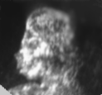
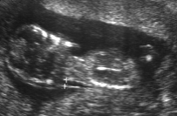
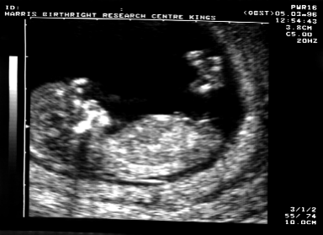
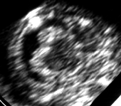
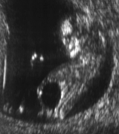
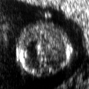
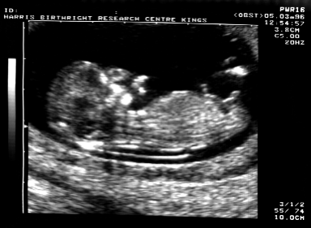
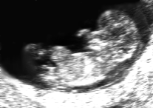
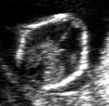
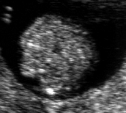
The 11-13⁺⁶ weeks scan
Diagnosis of fetal abnormalities

Slide 8
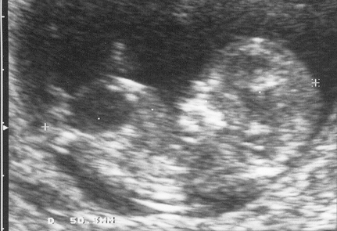
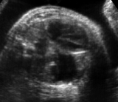
The 11-13⁺⁶ weeks scan
Screening for structural defects
Author
N
Anomalies
Prenatal diagnosis
Total
11-13⁺⁶ weeks
Hernandi and Torocsik, 1997
3,991
40
30 (75.0%)
11 (27.5%)
Economides et al, 1998
1,632
13
10 (76.9%)
7 (53.8%)
Carvalho et al, 2002
2,853
66
52 (78.8%)
25 (37.8%)
Total
8,476
119
92 (77.3%)
43 (36.1%)
Head
Acrania, encephalocele, holoprosencephaly, ventriculomegaly, microcephaly
Spine
Spina bifida, kyphoscoliosis
Thorax
Lungs: CDH, Cystic adenomatoid malformation, sequestration; Heart defects
Abdomen
Exomphalos, gastroschisis, GIT obstruction, Renal defects
Extremities
Skeletal dysplasias, amputations, arthrogryposis

Slide 9
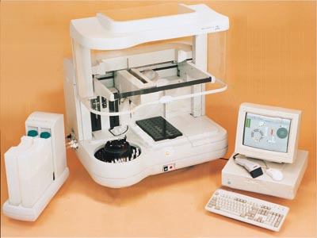
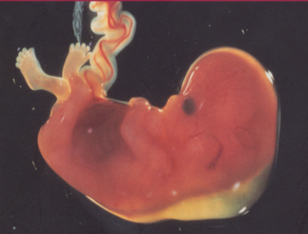
DOWN SYNDROME
NT + NB+DV+TR+FA+mM
β HCG & PAPP-A
Detection
rate 97%
Counselling
CVS
Invasive
testing 5%

Slide 10
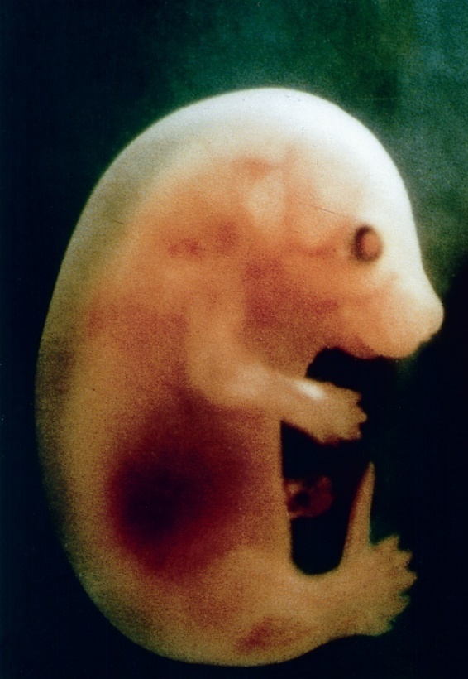
The 11-13⁺⁶ wk scan

Slide 11
Calculation of Risk for Chromosome Abnormalities
Adjusted risk =
Background (a priori) risk
X
Factor(s) derived from screening test(s)
Adjusted risk = a priori risk x LR1 x LR2 x LR3…..

Slide 12
Counselling
CVS
Down's
1 in ?
Miscarriage
1 in 200

Slide 13
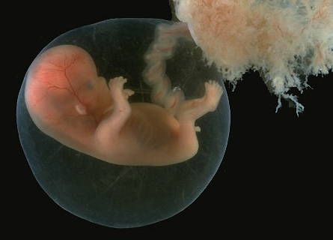
Maternal serum biochemistry

Slide 14
MA & NT & β-hCG & PAPP-A
Intermediate-risk (1/100–1000)
16.1% of the population
15.4% of Trisomy 21
High-risk (> 1 in 100)
1.9% of the population
81.5% of Trisomy 21
Low-risk (<1 in 1000)
82% of the population
3.1% of Trisomy 21
Assessment of:
NASAL BONE
DUCTUS VENOSUS
TRICUSPID VALVE
FACIAL ANGLE
MINOR MARKERS
2006
2008
Risk
>1 in 100
Risk
<1 in 100
FPR
2.1%
2.7%
2.7%
3.0%
2.5%
DR
92.0%
94.2%
91.7%
91%
95%
Chorionic villous sampling
Ultrasound scan
at 22 wks

Slide 15
Ultrasound Findings Minor Markers
No pathological significance
But found more commonly in chromosomally abnormal than normal fetuses
Traditionally considered as second-trimester markers but they can now be seen in the first trimester
LR +ve LR –ve
Choroid plexus cyst (>1.5mm) 1.49 0.97
Echogenic intracardiac focus 6.41 0.92
Hyperechogenic bowel 4.78 0.91
Hydronephrosis (antero-posterior diameter >1.5mm) 3.25 0.88
These findings are only included in the risk calculation for T21 and not for T13/18
although it should be noted that CPCs have a stronger association with T18 rather than T21.
Therefore the finding of CPCs should prompt a thorough examination to exclude any other markers of T18
Notes:
7
7

Slide 16
Fetal abnormalities with a low prevalence of chromosomal abnormalities
Gastroschisis
Jejunal atresia
Large bowel obstruction
Unilateral multicystic kidney
Ovarian , duplication, mesenteric cysts
Hemivertebra
Fetal tumours
Cystic adenomatoid malformation of lung
Sequestrated segment of lung
Porencephaly
Schizencephaly

Slide 17
Fetal abnormalities with a high prevalence of chromosomal abnormalities
Ventriculomegaly
Holoprosencephaly
Agenesis of corpus callosum
Dandy walker complex
Facial cleft
Micrognathia
Diaphragmatic hernia
Cardiac abnormalities
Omphalocele
Duodenal atresia
Urinary tract abnormalities
Skeletal abnormalities

Slide 18
Ultrasound-Genetic sonogram
Detection of certain findings
must increase the risk for
chromosomal anomalies
The absence of such findings
must lower the risk

Slide 19
Genetic sonogram-minor markers
Use of multiple ultrasound markers
sensitivity ↑, false positive rate ↑
If the presence of a single marker is considered a positive screen;
ANXİETY ↑↑↑

Slide 20
Absence of defects
Combined data from two centres
350 t21
No markers (25 %)
9384 N
No markers (86 %)
LR 0.30 for t21
Likelihood Ratio: Incidence of marker in t21 /incidence in chromosomally normal fetuses
Nyberg DA. J Ultrasound Med 2001
Bromley B. J Ultrasound Med 2002

Slide 21
Indication for second trimester genetic amniocentesis
Detection of 60-65% of fetuses with trisomy 21
Second trimester maternal serum + Maternal age
Amniocentesis rate 8% (False positive)
70 amniocentesis needed to detect one fetus with trisomy 21
Loss of one normal fetus to every three fetuses with trisomy 21

Slide 24
Systematic 2nd trimester scan LR- Reduction
Perinatal expert no markers 0.13 7.7
Routine no markers 0.52 1.9
*If any markers, look for others

Slide 25
Eğer I.trimester testi ülkede kullanamıyorsa, yeri olabilir, bunda da a priori risk : yaş ve önceki gebelik ve aile öyküsü temel alındıktan sonra sonografi sonucu konsültasyon olarak verilmelidir.
Sadece sonografi baz alındıysa düşük bir «detection rate» olacağı bilinmelidir (%3 FPR ile %59 DR)

Slide 26
II.trimester testi ile kombine kullanılması DR’ı arttıracaktır (%77-80) fakat en önemli nokta burada devreye girmektedir.
Soft marker-Genetik sonogram’da KALİTE KONTROLU – EĞİTİM programları- AUDIT bulunmamaktadır.
(Belki Perinatoloji uzmanlık eğitimi –tartışmalı ) !!!!

Slide 27
Kalite kontrolu zorlukları
EF ve EB kalitatif
NF ölçümü –standardize edilmesi güç
FL ve HL ölçümleri MoM ifade edilmeli
Hidronefroz ve ventrikülomegali kantitatif
Nazal kemik (NBL) (absent kantitatif) -ölçüm ise BPD ile oransal ifade gerekir
İleriye yönelik umut vaat eden gelişmeler var, (prenazal kalınlık PNT, frontomaksiller fasiyal açı, prefrontal space ratio, gibi)
Fakat sorun : STANDARDİZASYON

Slide 28
Yeni dönem
Non – invasive prenatal tanı : Maternal kanda fetal cell free (cf)DNA ile gelecek
Ancak , maliyet ile ulaşılabilirlik sorunları aşılıncaya dek en doğru, en etkin, en ölçülebilir, en çok kalitesi denetlenebilir, öğrenebilinir , öğretilebilinir testi kullanmalıyız.

Slide 29
Teşekkür Ederim.

