Slide 1
The Changing Culture of Embryo Culture:
Advances in Embryo Culture Platforms
Jason E. Swain, PhD, HCLD
University of Michigan
Notes:
Thank you for the introduction. Thank you for attending. Today I”ll be talking about advances in the culture system. Though we try to keep variables constant within the lab for quality control purposes, as a field we’re constantly looking for new methods to optimize our systems to improve outcomes. I am going to highlight some of these areas. I would like to preface this talk by saying the majority of data is preliminary. The purpose is to try to look to the future. So, though some of the approaches may not be ready for routine clinical application, and some may never be, I’m asking you to keep an open mind and step outside the comfort zone so-to-speak for the next 40 minutes or so as we explore some novel approaches.

Slide 2
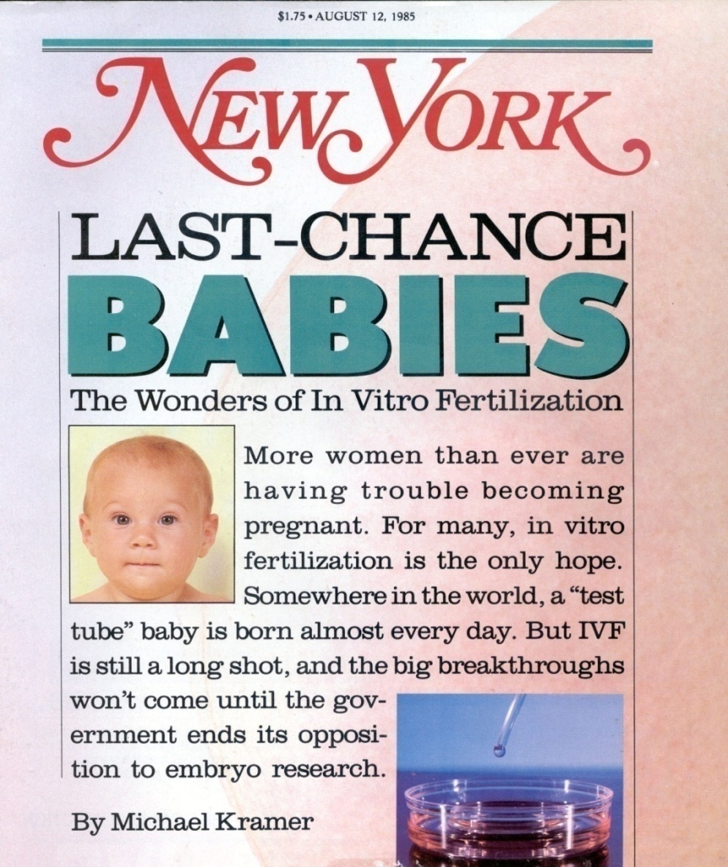
In Vitro Culture Platforms
“small microdrops were used for culture, and enlarged when the embryos were eight celled. The embryos were left undisturbed for long periods after this time”
Steptoe et al. 1971, Nature
“culture with medium in a multidish under 5% CO₂ in air at 37°C in an open system“
Feichtinger et al. 1983 Acta Eur Fertil
As we gain tools to better understand embryo physiology, we should modify the in vitro environment to better suit their needs – this includes the culture platform (physical culture environment)
Notes:
Despite changes in chemical environment, evidenced by the well known changes in culture media formulations, little has changed in the culture platform. You can see here with experts from relevent papers. Microdrops on a flat petri dish from one of the first reports of growing human blastocysts by bob edwards. Falcon tubes from the first report of an austrialian IVF baby. Frist german baby and one of the first reports of usinga multiwell or nunc dish. Here we can see an article fro m NY in the mid 1980s, using an organ culture dish. The same devices most, if not all, labs still use today. Pretty safe statement is that ..this has applied culture media, but should also include the platform.

Slide 3
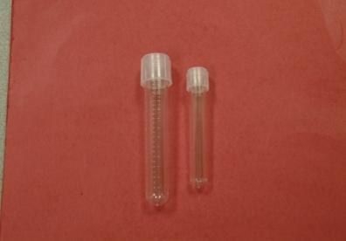
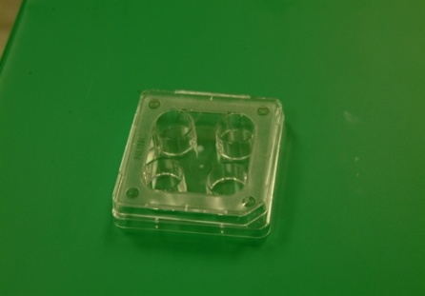
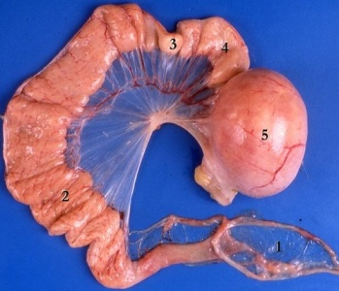
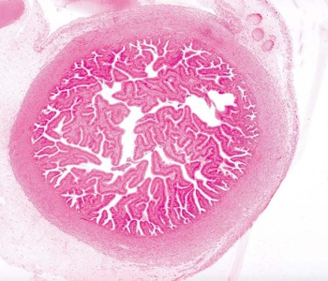
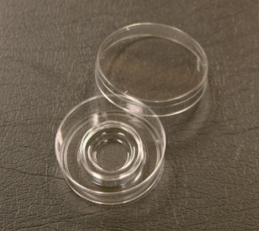
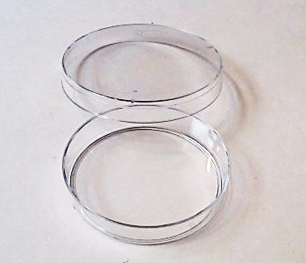
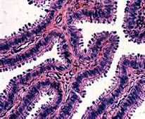
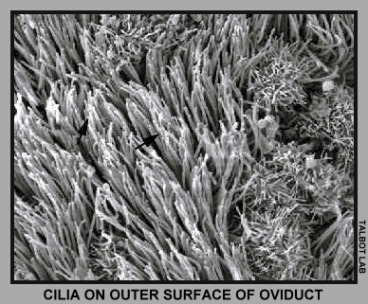
Culture Platform Comparison
In Vitro
In Vivo
~1-2ml
~500µl
vs.
~1ml
~10-50µl
Large volume
Static
Inert surfaces
Moist/constricted
Dynamic
Surface coatings
Notes:
To begin, I think we’d all agree that the physical culture environment in vitro is dramatically different from that experienced by embryos in vivo. In the lab, we placed embryos into a variety of plastic containers, large volume and static. This is in stark contract to the coated surfaces of the female reproductive tract, that is moist, contrictive, where the embryos are moved towards the uterus during their development. This point of departure may be something we can modify in our labs to improve embryos development.

Slide 4
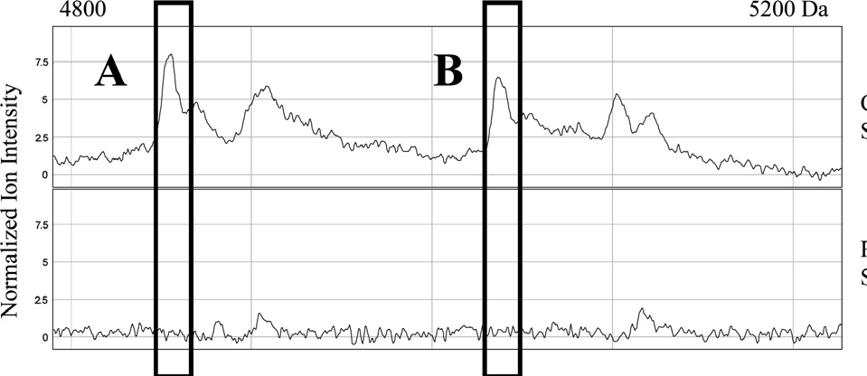
Embryo Secreted Factors (Human)
“Good” Embryo
(Implanted)
MS
Spent Culture Media
“Bad” Embryo
(non implanted)
Positive Markers
CRH (Katz-Jaffe et al. 2010)
ApoA1 (Mains et al. 2011)
Ubiquitin (Katz-Jaffe et al. 2006)
PRC2 (Cortezzi et al. 2011)
Negative Markers
Lipocalin-1 (McReynolds et al. 2011)
TSGA10 (Cortezzi et al. 2011)
Notes:
So lets briefly review what we know. We know embryos secrete various factors. Studies have analyzed spent culture media with a variety of techniques. For example such as MS, and they have even compared “good” versus “poor” embryos in attempts to identifyy positive makers or negative predictive markers of quality.

Slide 5
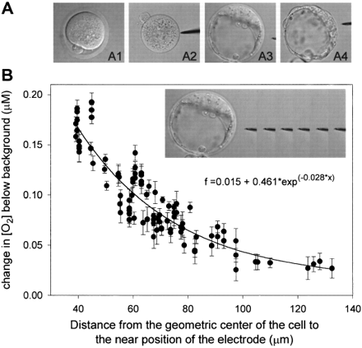
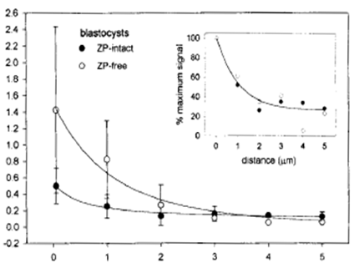
Embryo Media Depletion
Oxygen
Ca⁺²/Mg⁺²
Depletion
Concentration
Calcium Concentration
Probe Distance from Mouse Embryo
Probe Distance from Mouse Embryo
Gradients are formed
Embryos modify their surrounding environment
Trimarchi et al. 2000a,b
Notes:
We know embryos deplete components of their media. Using probes set at discrete distances form mouse embryos, it has been shown that oxygen and ca/mg gradients are forms around embryos.

Slide 6
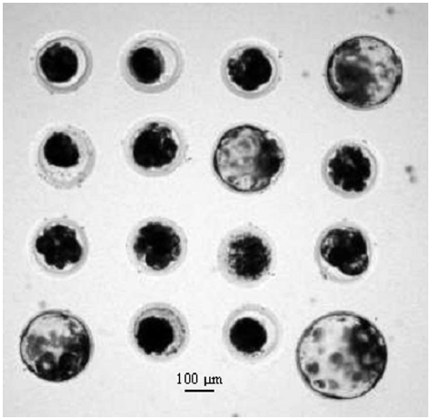
Embryo Spacing (Bovine)
Cel-Tak™ (4x4 grid)
Distance Between Embryos (µm)
Gopichandran & Leese 2006
Notes:
As a result, we know that embryo spacing is therefor important. In the cow, embryos were spaced at discrete distnaces. Has been show that this impacts development. Around 165um was ideal. Replicated in the pig.

Slide 7
Embryo Spacing (Human)
Individual
(OWI)
Contact
Group (OWG)
Development
Pregnancy
Live Birth
Pooled
zygotes
No Contact
Group (CW)
Ebner et al. 2010
Endpoint | No Contact Group (CW) | Individual (OWI) | Contact Group (OWG)
Early Compaction | 38.2%ª | 38.9%ª | 49.5%^{b}
Total Blastocyst | 40.8%ª | 45.2%ª | 55.8%^{b}
High Quality Blast | 68.8%^{ab} | 64.7%ª | 79.2%^{b}
Clinical Pregnancy | 41.7% | 38.5% | 62.2%
Live Birth | 41.7% | 38.5% | 62.2%
* Significant difference within an endpoint, p<0.05
Spacing may be important for human embryos
Notes:
Also appears true in the human. Thomas ebner used a specialized culture dish that permitted embryos proximity or kept apart but permitted meedia exchange. Cutlured individuallly. Showed better development in those cultured in groups that had close proximity or contact.

Slide 8
Group Culture Effect
Species | Reference | Optimal Embryo # | Volume (µl) | Embryo Density
Mouse | Wiley et al. 1986 | 20 | 10-12 | 0.5-0.6
 | Paria & Day 1990 | 5-10 | 25-50 | 2.5-10
 | Canseco et al. 1992 | 5 | 10 | 2
 | Lane & Gardner 1992 | 2-16 | 5-320 | 0.3-40
 | Kato & Tsunoda 1994 | 20 | 10 | 0.5
 | Salahuddin et al. 1995 | 10 | 20 | 2
Cow | Donnay et al. 1997 | 20 | 20 | 1
 | Larson & Kubisch 1999 | 40 | 25 | 0.6
 | Nagao et al. 2008 | 25-100 | 50 | 0.5-2
 | Ferry et al. 1994 | 40 | 40 | 1
Cat | Spindler et al. 2006 | 10 | 20 | 2
Hamster | Schini & Bavister 1988 | 2 | <1 | <0.5
Notes:
Again makes sense bc most of use accept the fact that there is a benefit to group embryos culture..as shown here in a variety of species (sheep not listed..so these aren’t all litter baring animals)

Slide 9
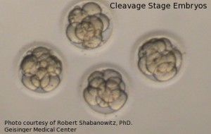
Group Culture Effect (Human)
Group embryo culture appears beneficial for human embryos
  Moessner & Dodson, 1995
  Almagor et al., 1996
  Rebollar-Lazaro & Matson, 2010
  Ebner et al., 2010
Likely requires extended culture
Optimal embryo density remains unknown
Notes:
Group effect may also be apparent in human. Variety of studies. Shown it likely requires extended culture day day 5/6. Should be pointed out, we don’t know an optimal density of #/volume. Very difficult to determine.

Slide 10
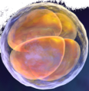
Thinking Big by Thinking Small
Customized culture devices can create a confined culture area/volume that regulate embryo density and spacing and produce/regulate a microenvironment that may benefit embryo development
Notes:
So, using this information, we can created novel culture platforms produce a microenvironemnt in the hopes of improving embryo development. Confine the area, reduce spacing.

Slide 11
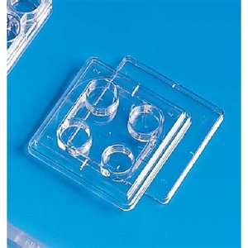
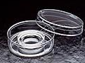
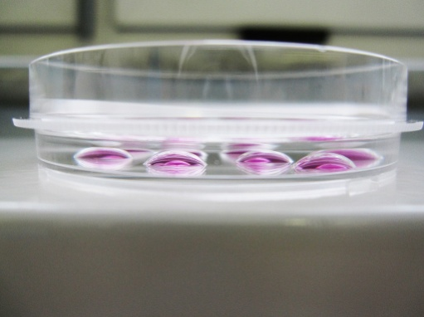
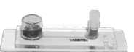
Static Microculture
    1) Macro-micro culture (~400-1000µl)
    -may not optimize microenvironment
    2) a) Microdrops (~10-50µl)
    - uniformity, dispersion, displacement
    b) Ultramicrodrops/submicroliter(<10µl)
      -evaporation, difficult recovery
    3) Microchannels
      - recovery, no individual ID
  Refined platforms specific for IVF are now available
Notes:
4 main approaches taken so far in terms of static micro cutlure. I should Mention not truly static, but for purpose of this talk—those without active or purposeful media movement. First is macro

Slide 12
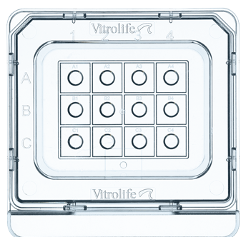
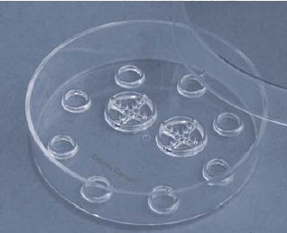
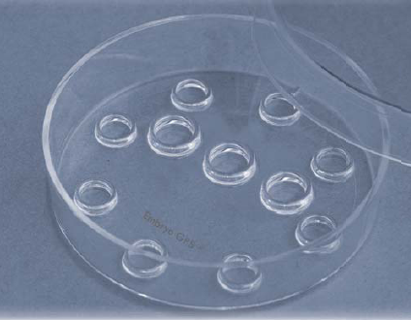
Embryo-Specific Dishes
Rounded bottoms/edges for easy location
  Rapid identification, control embryo spacing
Prevent microdrop dispersion or displacement
Microdroplet Dish
Embryo Corral®
Embryo GPS®
Notes:
One of these commercial devices is the embryo GPS – really just an improvement on microdrop

Slide 13
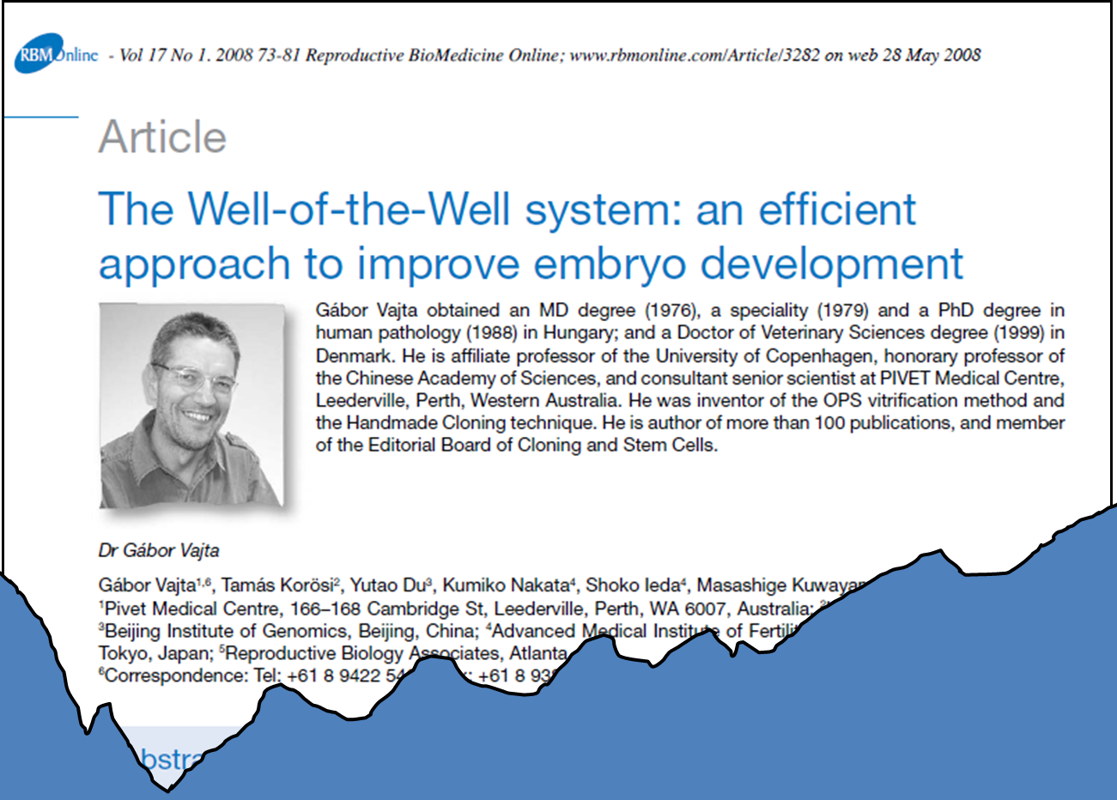
Notes:
One approach that seems very promising is the WOW. Most well known from work by Dr. Vajta.

Slide 14
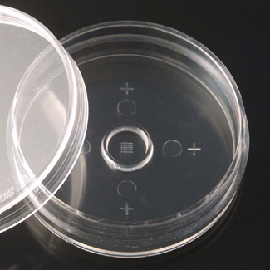
Well-of-the-Well (WOW)
Constrictive – microenvironments
Surface area/points of contact
Permits individual ID with group effect
Can regulate embryo spacing
Notes:
Constrictive, permits embryo contact, which might be helpful, permits individual ID, regulate spacing.

Slide 15
Well-of-the-Well (WOW)
Well Size
(w × h)
Conditions
(Test vs. Con)
Endpoint
(From 1-cell)
Outcome
(Test vs. Con)
Species
Reference
1 embryo/WOW (16 total) /500µl
16 embryos/500µl µdrop
(CR1aa media)
Blast @192h
Blast Cell#
Apoptosis
31 vs. 22% (p<0.05)
99.6 vs. 99.3 (NS)
2.8 vs. 2.6% (NS)
Hoelker et al., 2009
700 × 700µm
1 embryo/WOW (25 total) /125µl
25 embryos/125µl µdrop
(CR1aa media)
Blast @168h
Blast Cell#
Apoptosis
Pregnancy (30d)
37 vs. 36% (NS)
111.5 vs. 102.7 (NS)
9.0 vs 13.5% (p<0.05)
51.7 vs. 25% (p<0.05)
Sugimura et al., 2010
287 × 168µm
Bovine
1 embryo/WOW (20 total) /100µl
20 embryos/100µl µdrop
(IVD101 media)
Blast @192h
Blast Cell#
17% vs. 18% (NS)
81.4 vs. 84.5 (NS)
Akagi et al., 2010
346 × 200µm
1 embryo/WOW (20total) /100µl
20 embryos/100µl µdrop
(SOF media)
Blast @168h
37 vs. 30% (NS)
Matoba et al., 2010
1000 × 700µm
Porcine
1000 × 300µm
4-5 embryo/WOW (3 total) /500µl
12-15 embryos/30µl µdrop
(PZM3 media)
Blast @192h
Blast Cell#
25 vs. 13% (p<0.05)
36 vs. 37 (NS)
Taka et al., 2005
1 embryo/WOW (5 total) /400µl
1 embryo/35µl µdrop
(CZB media)
Exp Blast @144h
80 vs. 40% (p<0.05)
Vajta, 2008
Murine
250 × 200µm
Notes:
Many studies using the WOW in a variety of species. Have looked at various endpoints. Seems to be beneficial in many cases.

Slide 16
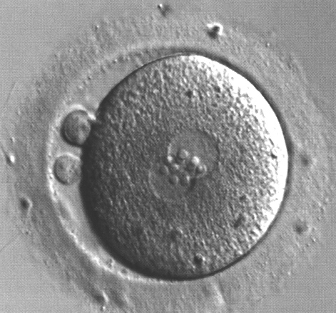
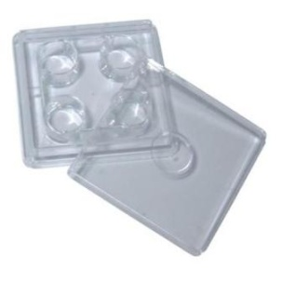
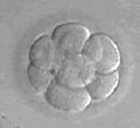
WOW (Human)
Sibling ICSI Zygotes
n=81
n=84
a
a
b
% Development
b
Control
Nunc/ WOW
(250 x 200um)
SAGE + 15%SPS
5% CO₂, 5%0₂, 90%N₂
Individual Culture 80ul
Day 3
Day 3
>6 cell
Day 3
A/B Quality
Day 5
Blastocyst
Day 5/6
Transferred/
Frozen
Day 5/6
Vajta et al. 2006
Notes:
One publication with it’s use in human. I believe some of the work was done with the help of Dr. Nagy. Sibling zygotes were split, and cultured individually. So, any benefit would really be due ot localized microenvironemnt. WOW showed better blastocyst formation in the and more WOW embryos were transferred and frozen.

Slide 17
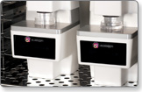
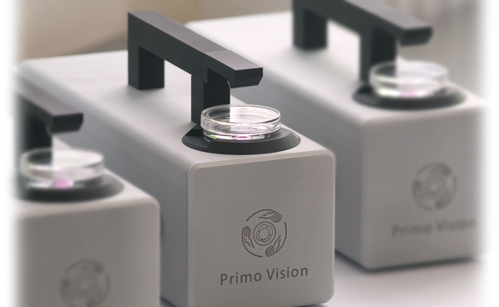
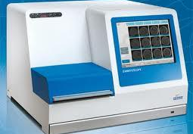
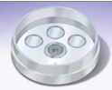
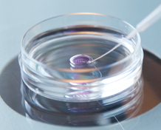
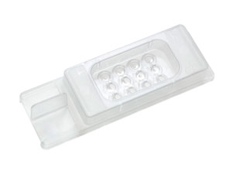
Cameras & Culture Dishes
Eeva™
Primo Vision™
EmbryoScope™
Eeva dish
WOW
EmbryoSlide™
Notes:
Soon the type of culture platform we use may be dictated by technology in the lab. We’ve heard about the potential for real time monitoring…these platforms may also be giving us a better culture platform. For example the emerging cameras have required dishes to hold embryos in place for viewing. 2 examples seen here

Slide 18
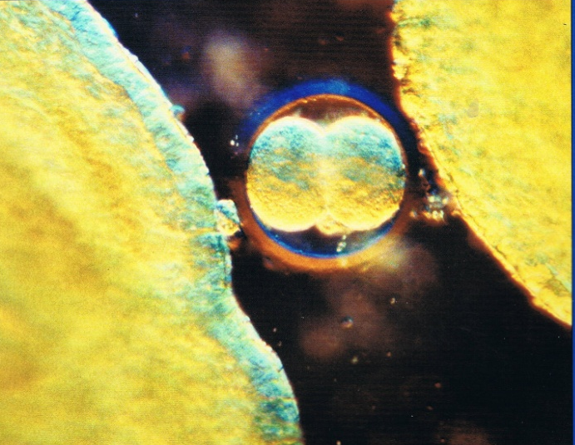
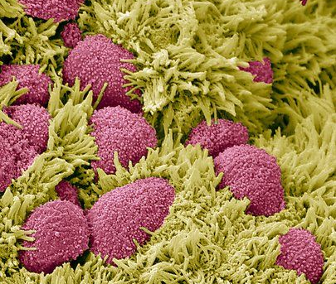
Dynamic Embryo Culture
In vivo – cilia and peristaltic muscle contractions
  Beating frequency of 5-20Hz (Paltiel et al. 1995, Westrom et al. 1977)
  Average speed ~0.1µm/s (Greenwald 1961)
  Sheer force ~0-3dyn/mm²
Gentle movement may be “normal” for embryos
Notes:
Though the WOW may be an advancement, it’s still a static system. In vivo, cilia and peristalsis move embryos along the female reproductive tract. So, gently movement may be “normal” for embryos and may convey some benefit.

Slide 19
“Rock-a-Bye-Baby”
Possible Benefits of Dynamic Culture
1) Disruption of gradients
  Substrate renewal?
  Removal of harmful byproducts?
2) Mechanical stimulation
  Sensory mechanotransduction (Synthichaki & Tavernarakis 2003)
    Cell ability to respond to physical stimuli
    Influences ion channels, etc
  Embryos can “sense” sheer stress (Xie et al. 2006, 2007)
  Possible activation of trophic signaling pathways
Not that simple
  What about benefit of static micro-culture?
Notes:
This benefit of dynamic culture could be due to disruptions of those gradients we mentioned. Specifically, removal of substrates, removal of harmful bypruducts. However, just saw that there appears to be a benefit of static microculture. This is likely due to retainment of beneficial factors., but that implies the good outweighs the bad..may not always be the case.
However, alternate idea is that benefit of dynamic culture could be mechanical stimulation. Sensory mechtrans occurs in avarity of cell types..permits cells to respond to physicl stimuli. Most notably ion channels. We know embryos can sense sheear stress. Mech stim can likely results in stimulation of signalling pathways, some of which might be embryotrophic or beneficial.

Slide 20
Active Embryo Hypothesis
Excessive movement and resulting sheer forces can be detrimental to embryo development, activating signaling pathways that lead to apoptosis. Less vigorous or periodic movement or other physical stimuli, such as surface interactions, vibrations or gentle media flow, can be embryo-trophic.
Notes:
This leads us to the idea that exessive movement can be detrimental.

Slide 21
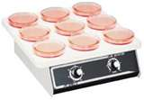
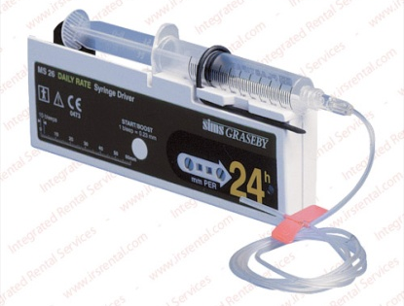
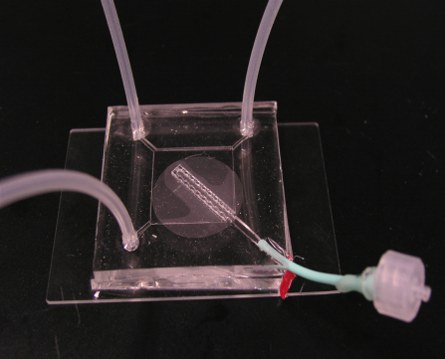
Early Attempts at Dynamic Culture
  Orbital shakers (Zeilmaker et al. 1971, Hoppe & Pitts 1973, Cohen 1981)
  Macroscale perfusion systems (Pruitt et al. 1991, Lim et al. 1996, Thompson et al. 1997)
  Microchannel perfusion (Hickman et al. 2002)
    Gravity
    External pumps
  Perfusion co-culture (Mizuno et al.2007)
    External pumps
Technical limitations to early systems
Notes:
Not entirely a new idea. Various early attempts. All had their limitition that prevented widespread application and certainly no clinical use.

Slide 22
Tilting Embryo Culture System (TECS)
C.
10° tilt, 10 min, hold = 0.00015 dyn/cm², 20ul
Frozen/Thawed cleavage stage human embryos
Treatment | % Blastocyst | % >3BB | Cell #
TECS | 52.9% | 17.2% | 43*
Static | 43.5% | 11.8% | 34*
* Statistically significant difference between treatments p<0.05
Matsuura et al. 2010
Notes:
With advances, we now have some clinically used approaches. The first is one of the simplest. TECS. Very brief study using frozen cleavage embryos.

Slide 23
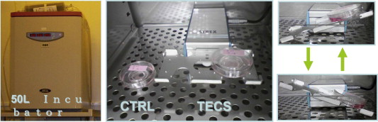
Tilting Embryo Culture System (TECS)
Human IVF Cases
a
b
a
%t Development/Positive
b
a
b
Hara et a.. 2013
Notes:
With advances, we now have some clinically used approaches. The first is one of the simplest. TECS. Very brief study using frozen cleavage embryos.

Slide 24
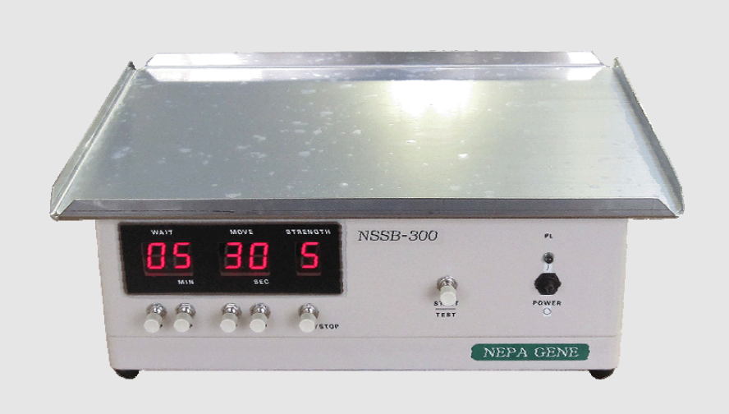
Vibrating Embryo Culture
< 44hz, 5 s/hr, 2 embryos/50ul
Fresh human zygotes
Treatment | Day 1 PN | Day 3 A/B Quality | Day 5/6 Blast | Day 3 ET PR | Day 5/6 PR
Vibration | 73±3.4% | 90.1±1.7%ª | 14.1±2.8%ª | 78.4±3.2%ª | 72.2±1.5%ª
Static | 76±2.1% | 77.9±4.4%^{b} | 4.5±1.7%^{b} | 50.1±4.9%^{b} | 33.2±2.4%^{b}
* Statistically significant difference between treatments, p<0.05
Isachenko et al. 2010, 2011
Notes:
Also a vibrating cutlure system. Short pulses on a vibrtaing platform placed into a large incubator. Showed better day 3 and day 5 develpoment and PR

Slide 25
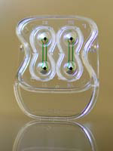
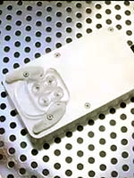
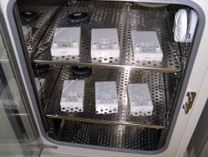
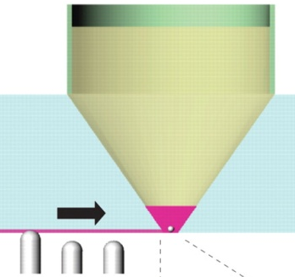
Pulsatile Microfunnel
0.1hz 17.9nl/min
-Gentle media disruption
-Minimal embryo movement
-Minimal embryo shear stress
-Confined culture area
-Customized media exchange (rate/pattern)
-Specialized “dish” required
Notes:
Finally, system most of you have likely seen discussed in the pultatile microfunnel from Gary smith’s lab. Provides dynamic culture, but also confied area, customized exchange if desired. Does require a specliazed dish.

Slide 26
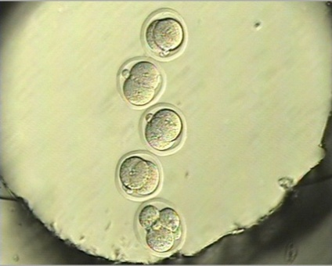
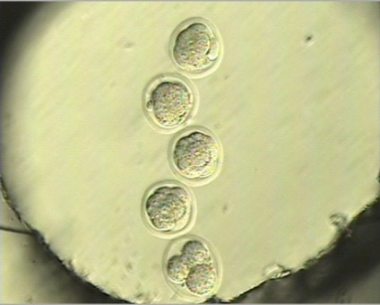
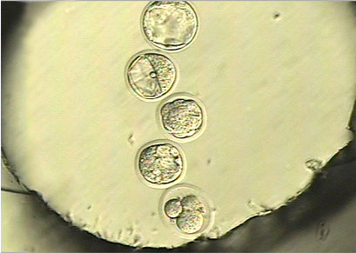
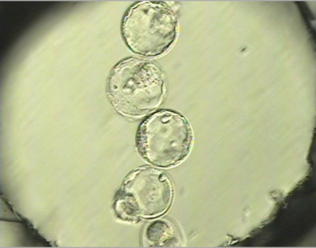
Pulsatile Microfunnel (Mouse)
24h
24h
22%PR
48h
48h
72h
72h
96h
Heo et al. 2010
Notes:
In mouse, in contract to other approaches, embryos don’t really move. This was one of the first studies to show not only a benefit of embryo development, but also PR with dynamic cutlure.

Slide 27
Culture Surfaces
Polystyrene may compromise growth of adherent cells (Summer et al. 2012)
  Alters microenvironment – pH, ROS
Matrigel coating may be beneficial or detrimental for embryo development (Carnegie et al. 1995, Dawson et al. 1997, Lazzaroni et al. 1999)
Surface stiffness may impact embryo development (PDMS polymer) (Kholani et al. 2012)
  Is this really a factor for embryos? – consider the zona pelludica barrier
Need to consider media and molecule absorption
Notes:
Very briefly…despite these design changes, surfaces are the same. …mostly polystyrene. This Might this be an area of future improvement. Have been only a few of studies addressing this. Using an extracellular matrix known as matrigel—mostly glycoproteins like laminine, culture mouse embyros, but saw conflicing results. May be due to mouse strain. Gary smiths gorups looked at a coating of HA. Supplmentation improves embryo development. Coated dish survace. Or made microwells. …no benefit and worse. Looks to be altering microenvirment…and may deserve more attention.

Slide 28
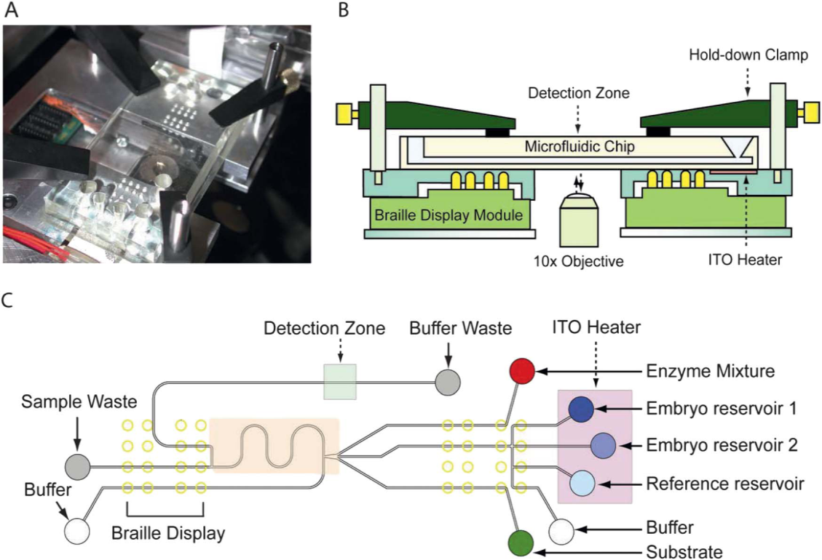
An Ideal Culture Platform?
Individually housed micro-culture/dynamic platforms
  no need for daily opening and dish removal
  permit group culture with individual ID
Real-time imaging
Inline Assays/Measures
Customized media exchange
Specialized material/surface
USER FRIENDLY
AFFORDABLE
Heo et al. 2012
Is this feasible?

Slide 29
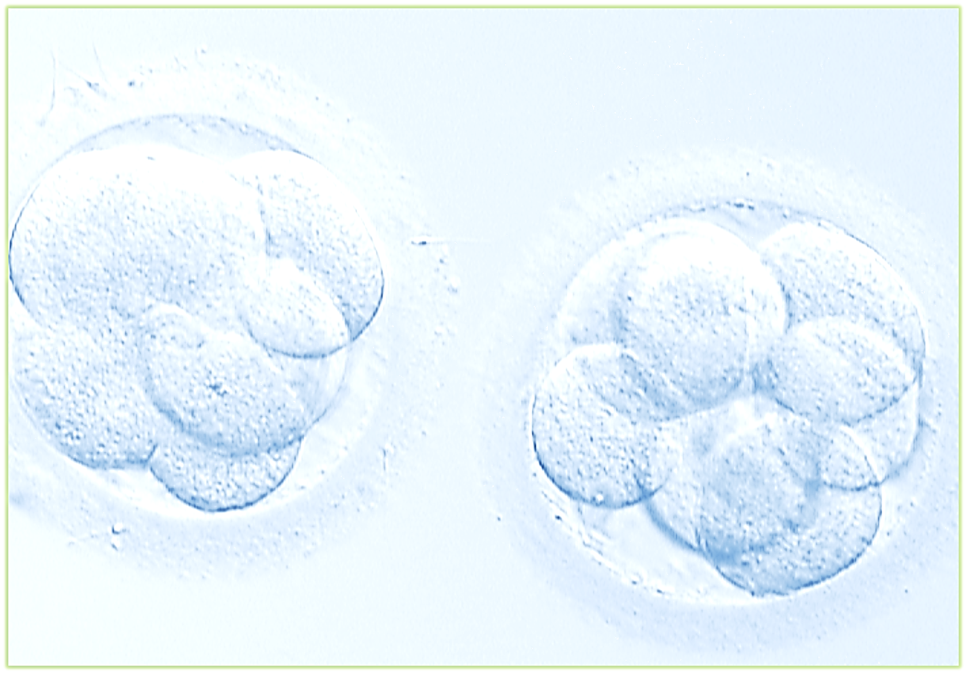
Conclusions
Microstatic platforms improve embryo development
Dynamic embryo culture is beneficial
May be a role for periodic physical stimuli
Still need to optimize dynamic conditions
  Speed, duration, motion paths, embryo density
Need a refined system for widespread use

Slide 30

Acknowledgements
Center for Reproductive Medicine
IVF Lab Staff
Colleagues
Melissa Hiner, TS
Laura Keller, GS
Lisa Gerisch
Rusty Pool, PhD, HCLD
Gary D. Smith, PhD, HCLD
Mike Reed, PhD, HCLD
Charles Bormann, PhD, HCLD

