Slide 1

Transfer Tekniklerinin IVF Başarısındaki Yeri
Prof. Dr. N. Cem FIÇICIOĞLU
Yeditepe Üniversitesi Tıp Fakültesi
Kadın Hastalıkları ve Doğum A. D. Başkanı
IVF Merkezi Direktörü

Slide 2
IVF başarısını etkileyen değişkenler
Kadın yaşı
Over rezervi
Embryo kalitesi
Endometriyal reseptivite
Embryo transfer tekniği
Strandel A, Hum Reprod 2000
Hoozemans DA, RBM online 2004
Schoolcraft WB, Fert Steril 2001
Notes:
Despite great advances in ovarian stimulation protocols and embryo culture, few improvements have been noted in ET techniques since it received relatively little attention until recently.5–7 Embryo transfer, the final step of ART, has recently been observed to be a crucial step in assuring ART success. Despite the lack of consensus on the optimal ET technique, most studies have recently highlighted the importance of ET procedure with various recommendations.8,9

Slide 3
İmplante olabilecek sağlıklı bir embryo yokluğunda transfer şüphesiz başarısız olacaktır,
Ancak travmatik bir embryo transferinde de embryologun kaliteli bir embryo geliştirme çabası boşa çıkmış olacaktır.

Slide 4
Transfer Tekniği
Embryo transferi IVF’ deki en son ve en önemli basamaktır.
Neithardt AB, Fertil Steril 2005;83:710–4.
Lambers MJ, Fertil Steril 2007;88:68–73.
IVF/ICSI deki başarısızlıkların %30’ u kötü embryo transfer tekniğinden kaynaklanır.
MansourRT, AboulgharMA. Hum Reprod 2002;17:1149–53.

Slide 5
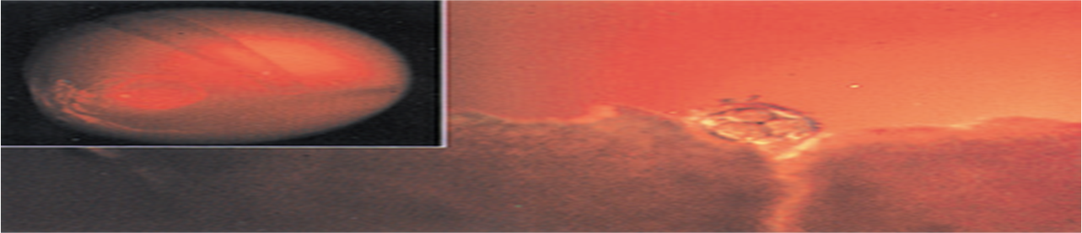
İmplantasyon
Başarısı
Uterin reseptivite
Embryo kalitesi
Embryo transferi
Ultrason rehberliği
Servikal hazırlık
Transfer kateter tipi
Kateter yükleme tekniği
Kateterde kan, mukus varlığı
Kateterde kalmış embryo varlığı
Mock transferi
Myometriyal kontraksiyon
Transfer kolaylığı
Embryonun veriliş noktası
Goudas V. Fertil Steril 1998;
Schoolcraft WB, Fertil Steril 2001
Mansour RT. Hum Reprod 2002,
Mirkin S, J Assist Reprod Genet 2003

Slide 6
Başarısızlığın muhtemel nedenleri
Kateter ile endometriyumun bozulması
Uterin kontraksiyonların uyarılması
Embryoların suboptimal bir lokasyona bırakılması
İşlem esnasında embryoların zedelenmesi
Mains L .and Van Voorhis BJ. Fertil Steril 2010;94:785-90.

Slide 7
Transfer kolaylığı
Mükemmel transferde gebelik oranı %33.3, kötü transferde gebelik oranı %16
Englert Y, J In Vitro Fertil Embryo Transfer 1986;3:243–6.
Kolay transferde gebelik oranı %20.4, zor transferde gebelik oranı %4
Mansour R, Fertil Steril 1990;54:678–81.
Notes:
Englert mukemmel olarak yazılan et lerınde gebelık oranı 33% iken zor yazılanlarda 10. Mansourda bezer sekılde fark gostermış.

Slide 8
Transfer kolaylığı
Zorlu transfer, subjektif kavram;
Zaman alıcı
Rahatsızlığa yol açan
Sert kateter gerektiren
Kateter ucunda kan izlenen
Tenakulum/buji gerektiren transferlerdir.
Notes:
The transfer could be considered difficult if time spent on ET was long, and if a firmer catheter, additional maneuvers and/or instrumentation, sounding or cervical dilatation were needed and if the resistance to the catheter advancement was encountered, and the presence of blood on the transfer catheter was noted. Difficult ET is more common in cases with severe anteflexion, retroflexion or anteversion and retroversion of the uterus and cervical stenosis. The presence of blood on the transfer catheter results from traumatic cervical passage of the catheter, subclinical infection, or endometrial bleeding due to traumatic contact with the catheter

Slide 9
Sorunlu Serviks
Servikal stenozu olanlarda transferden sadece 2 gün önce dilatasyon yapılması durumunda hiç gebelik bildirilmemiştir
Visser DS, J Assist Reprod Genetics 1993;10:37–43.
OPU günü dilatasyon yapılanlarda gebelik oranı %2.5 dir
Groutz A, Fertil Steril 1997:67:909–11.
Servikal stenozu olanlara
  ET den 1 ay önce H/S yapılabilir
  ET den 1 ay önce laminaria konulabilir
Yanushpolsky EH, Fertil Steril 2000;73:402–5.
Glatstein IZ, Fertil Steril 1997;67:1172–4.
Notes:
Servikal stenozu olanlarda ET den sadece 5 gün önce dilatasyon yapılanlarda gebelik düşük
In the case of severe cervical stenosis, cervical dilatation can be performed by mechanical dilation, use of osmotic dilators such as laminaria, placement of a Malecot catheter, and hysteroscopic shaving. These procedures may be performed several weeks before ET to assure adequate recovery time of endometrium from potential injury, inflammation, or bacterial contamination inflicted by the procedure. With such approaches an improvement in PRs has been reported in patients with cervical stenosis

Slide 10
The difficulties encuntered with embryo transfer and role of catheter choice in pregnacy success rates in IVF cycles.
 | Clinical pregnancy rate
Easy group I | 41.4 %
Moderate group II | 36.2 %
Difficullt group III | %
Fıçıcıoğlu C., Middle East Fertility Journal 2005,

Slide 11
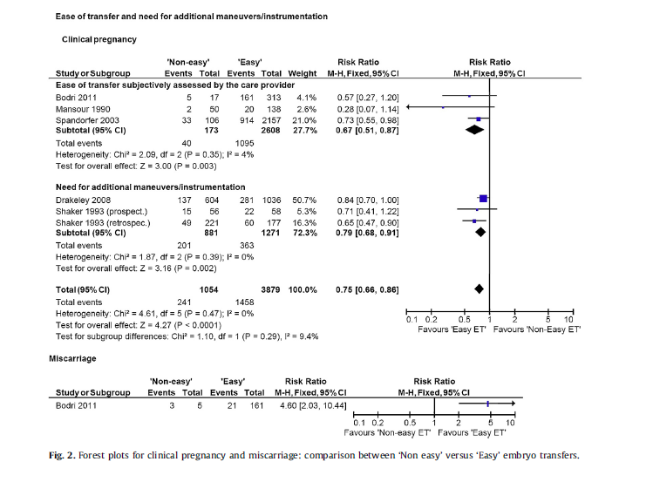
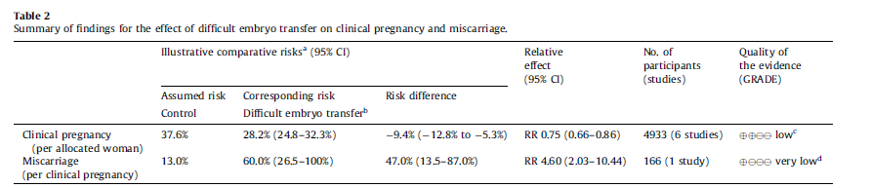
Phillips JAS, Eurp j obst gynec and repr B, 2013
A difficult embryo transfer (defined subjectively or by the need for additional instrumentation) was associated with a reduced chance of achieving pregnancy
Notes:
We concluded that low quality evidence suggests that a difficult embryo transfer but not a bloody catheter reduces the chance of achieving a clinical pregnancy. More good quality studies are needed to evaluate the effect of difficult embryo transfer and the presence of blood on the catheter on the main outcomes of assisted reproduction.
There is some evidence that embryo transfers subjectively considered to be difficult or those that require additional manoeuvres and/or instrumentation have a negative effect on clinical pregnancy. The current evidence also suggests that the presence of blood at embryo transfer does not affect the chance of
achieving a clinical pregnancy. There are no data on the corresponding effect on live birth and only one study on miscarriage, which is insufficient to draw any meaningful conclusions.
The results of the review are limited by the different definitions used to define a difficult embryo transfer. Future research should benefit from a universally accepted classification for difficult embryo transfer and presence of blood in catheter. Future studies should report live births and miscarriages and try to address comparability of confounders (e.g. age) between groups.

Slide 12
Trial Transfer
(deneme-mock transferi)
Deneme transferi işlemden 1-2 ay önce yapılmalıdır
  Serviksin durumu, uterus kavitesinin mesafesi ölçülür
  Transferin zor-kolay olacağı önceden kestirilir
ET günü yerine tedaviden 1 ay önce yapılan “dummy” transfer (mock-trial-deneme) de gebelik oranı daha yüksektir. Allahbadia GN. Fertility and Sterility 2005;84 Suppl 1:362.
Uterin kavite uzunluğu dinamik olup oosit toplama günü önceki günlere göre daha uzundur ve ET den 3-5 gün önce yapılması zararlı olmaz . Katariya K Fertil Steril 2007
Notes:
The value of mock transfer on reducing difficult ET has been controversial. Mock, dummy, or trial transfer, first reported in the early 1990s, can provide references for actual transfer regarding the selection of the appropriate transfer catheter, the direction and curve of the catheter, the length and direction of the endometrial cavity and cervical canal, and potential problems associated with the procedure. For example, encountering a severely flexed uterus requiring a tenaculum clamp or realization of a stenotic cervix needing cervical dilatation during the actual procedure may be problematic and knowing about such issues before ET may be advantageous for proper planning ^{19,20}. Trial transfer could be carried out before starting ovarian stimulation, at the time of oocyte retrieval, or just before the actual transfer. The timing of a trial transfer does not influence embryo implantation or pregnancy rates

Slide 13
USG Rehberliğinde ET
USG rehberliğinde ET nin birçok avantajı vardır.
  Yumuşak kateterlerin yerleştirilmesinde kolaylık sağlar
  Fundusa temastan kaçınmamızı sağlar
  Serviksi uzun olanlarda kateterin servikal kanaldan geçip kaviteye ulaştığını gösterir
  Kateteri endometriyal konturlar arasında geçirmemizi ve daha az endometriyal bozulma veya kanama yapmamızı sağlar
  Ayrıca
    Overler görülür, OHSS şüphesini ekarte ederiz
    Kavitedeki sıvı görülür
    Mesane doluluğu gerekir ki bu da transferi kolaylaştırır
Notes:
The use of routine US guidance in ET rather than relying on blind clinical touch technique could be another approach to improve ET outcome, since blind clinical touch technique may potentially disrupt the endometrium. Ultrasound guidance in ET assists in gentle insertion of the catheter while avoiding its direct contact with the fundus, which may prevent uterine contractions during ET. The ultrasonographic visualization of newer ET catheters is made easier by the manufacturers, leading to even better live assessment of embryo replacement depth within the endometrial cavity. Therefore, US guided ET may significantly increase PRs ²⁷⁻³⁰. A Cochrane review also concluded that US guidance does appear to improve the probability of live birth/ongoing and clinical pregnancy rates as compared with the clinical touch methods albeit most of the studies were deemed to be of limited quality ³¹. Ultrasound guided ET also requires a full bladder and a second operator which may cause some patient discomfort. The full bladder can allow the operator to put an appropriate curve on the catheter to accommodate the cervico-uterine angle while somewhat straightening the cervico-uterine angle to facilitate the proper advancement of the catheter in cases of severely anteverted and anteflexed uteri ^{32,33}.

Slide 14
USG Guided (UGET) vs Clinical Touch ET (CTET)
Devam eden gebelik oranı
Devam eden gebelik oranı, USG eşliğinde ET yapılan gruplarda (441/1254) Clinical touch ET gruplarına (350/1218) oranla anlamlı olarak daha fazladır (OR 1.38, 95%CI 1.16 to 1.64, P<0.0003).
Brown J, Cochrane Database of Systematic Reviews 2010,
Notes:
The ongoing pregnancies per woman randomised associated with UGET (441/1254) was significantly higher than for clinical touch (350/1218) OR 1.38, 95%CI 1.16 to 1.64, P<0.0003
US guidance does appear to improve the probability of live birth/ongoing and clinical pregnancy rates as compared with the clinical touch methods albeit most of the studies were deemed to be of limited quality

Slide 15
USG Guided (UGET) vs Clinical Touch ET (CTET)
Olumsuz olaylar
Çoğul gebelik, dış gebelik, spontan düşük gibi olumsuz olayların insidansı açısından gruplar arasında anlamlı fark saptanmamıştır.
Brown J, Cochrane Database of Systematic Reviews 2010.
Notes:
No statistically significant differences
in the incidence of adverse events were identified between the comparison groups.

Slide 16
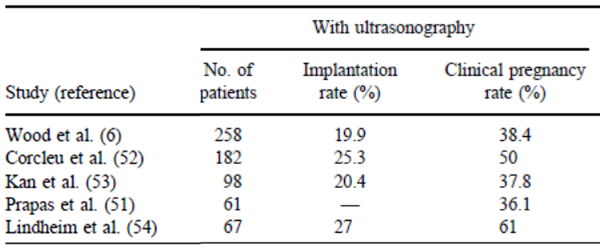
USG ile ET
Schoolcraft Fertil steril 2001

Slide 17
Uteroservikal açının düzeltilmesi
(mesane tam dolu)
Gebelik oranı
Düşük oranı
Transfer esnasında mesanenin tam dolu olması ile boş olması arasında gebelik oranları açısından anlamlı fark saptanmamıştır.
Derks RS, Farquhar C, Mol BWJ, Buckingham K, Heineman MJ.
Cochrane Database of Systematic Reviews 2009.
Notes:
Full bladder uteroservıkal acıyı sadece %12 duseltır 40.6% 60 derece uzerı kalır 60 dereceden fazla acı gebelık oranınıdusururu There was no evidence of a statistically significant change in the pregnancy outcomes when performing ETwith a full bladder compared with an empty bladder.
Ultrasound guided ET also requires a full bladder and a second operator which may cause some patient discomfort. The full bladder can allow the operator to put an appropriate curve on the catheter to accommodate the cervico-uterine angle while somewhat straightening the cervico-uterine angle to facilitate the proper advancement of the catheter in cases of severely anteverted and anteflexed uteri

Slide 18
Kateter tipi
Yumuşak kateterler daha az endometriyal travma ve uterus uyarısına yol açarlar.
Schoolcraft WB. Fertil Steril 2001
.
Notes:
Despite their limitations, the majority of these studies compared the outcomes of soft versus firm catheters and concluded that using the soft catheter during ET significantly increases PRs albeit the potential effects of the catheter type is still considered controversial ^{34,35}. It is suggested that the ideal ET catheter is soft enough to avoid trauma to the cervix and endometrium since it is known that firm catheters which may be required in difficult transfers, can be associated with more bleeding and induction of uterine contractions
As a result, the choice of ET catheter may be decided by its cost and mostly by operator’s preference

Slide 19
US eşliğinde ET için Wallace kateteri ile Cook Echo-Tip kateterin karşılaştırıldığı prospektif randomize çalışma
Cook Echo-Tip kateter ekojen ucu sayesinde US eşliğinde ET’ni kolaylaştırır, ancak gebelik oranları Wallace kateteri ile benzerdir.
Karande V. Fertil Steril 2002;77:826 –30.
Notes:
A prospective randomized comparison of the Wallace catheter and the Cook Echo- Tip catheter for ultrasound-guided embryo transfer
The Cook Echo-Tip catheter with its echogenic tip simplifies ultrasound-guided ET, but
pregnancy success rates are similar to those obtained when a Wallace catheter is used.

Slide 20

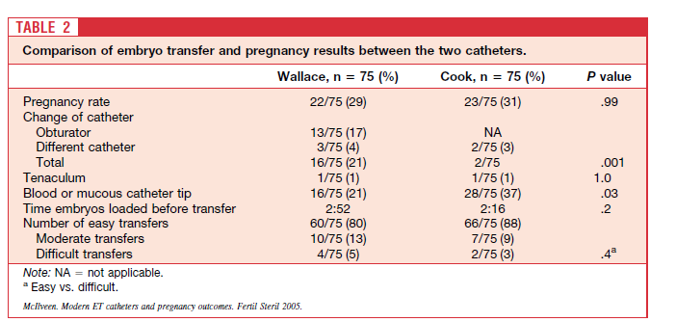
There was no significant difference in the clinical PR between the Wallace and the Cook catheters (22/75 [29.3%] and 23/75 [30.6%], relative risk [RR]: 0.96 [95% confidence nterval 0.58 –1.58]). There is no significant difference in the PRs achieved by modern, soft, double-lumen ET catheters.
Notes:
In our study the Cook catheter appeared to be easier to use as reflected by the lower incidence of catheter change compared to the Wallace catheter (P.001). However, it must be emphasized that PRs were equivalent.
The Cook catheter has a bulbous tip that comes into close contact with the internal os as it is passed through. Therefore a bloody tip may not necessarily indicate endometrial trauma or trauma sufficient to set off uterine contractions. Rather, it may be as a result of slight trauma to the internal os
The results of this study have further confirmed that modern ET catheters are embryo friendly and impact little on the pregnancy outcome in assisted reproduction treatment. Therefore, the choice of ET catheter may be decided by economics and operator preference. Some catheters may be easier to use for training purposes and this also should be taken into account so that the patients may not suffer as a result of training.

Slide 21
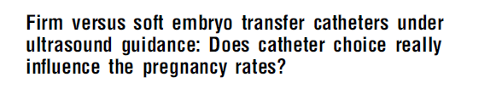
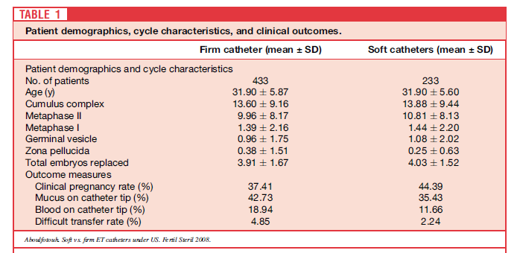
In conclusion, and in contrast to the previously available evidence, under ultrasound guidance individual catheter choice does not seem to statistically significantly affect the clinical pregnancy rate in a modern clinical IVF practice. This may be as a result of ecreasing the incidence of difficult transfers and endometrial injury
Ismail Aboulfotouh, Fertil Steril 2008

Slide 22
Hastanın hazırlanması
“Servikal mukus”
Servikal mukus endometriyal kavite ve embriyonun kontaminasyonuna neden olabilir.
Servikal mukus kültürü %71 pozitif, bunlarında %49 unda katere ucu kültürü pozitif bulunmuştur. Kateter ucu kültürü pozitif olanlarda gebelik oranı %29.6, negatif olanlarda %57 saptanmıştır.
Egbase PE, Hum Reprod 1996;11:1687–9.
Notes:
Ceftraxone metronıdazloe retrieval zamanında verilirseo zaman kateter tipindeki kontamınasyon azalır denıyır servikal mukus katetri plug yapabılır Eskanderin 2007calışmasında mukusun alınması gebelık oranını artırırı derken visshersın 2007çalışması fark yok dıyor
The detection of mucus on the catheter may be associated with cervical contamination of the catheter itself while passing it through the cervical canal. The administration of antibiotics at the time of retrieval is suggested as an intervention to improve PR by reducing levels of microbial colonization during ET ⁴⁵. However, the use of antibiotics for ET is still a subject of debate and is currently not recommended because of the lack of proven benefit. Furthermore, it is thought that the potential disruption of normal cervical flora induced by antibiotics may actually result in an inflammatory response ⁴⁶. A Cochrane review concluded that the administration of antibiotics before ET did not affect clinical PRs although it reduced the microbial contamination of the upper genital tract ⁴⁷.

Slide 23
Kateter Ucunda Kan-Mukus Varlığı
Kateter ucunda kan-mukus varsa embryo retansiyonu daha sıklıkla görülür.
Visser DS, J Assist Reprod Genetics 1993;10:37–43.
ET kateteri, makroskopik veya mikroskopik kan veya mukus varlığı ile kontamine olsun olmasın implatasyon ve klinik gebelik oranları etkilenmez. Moraganni V., Fertil Steril 2010 93,2
Notes:
Transfer kateteri dısında kan gebelık oranlarını 6-7 kez azaltır Goudas 1998
Although the evidence is conflicting, the presence of macroscopic or microscopic mucus on the ET catheter may be considered as a variable affecting the ET outcome. Mucus on the transfer catheter may negatively affect ART success by causing retention of embryos with mechanical blockage of the catheter opening, also known as the “sling shot effect” ^{40,14}. The presence of mucus on the ET catheter has been shown to decrease implantation and pregnancy rates ^{12,15,42}. The cleaning of cervical mucus was shown to increase clinical PRs although some conflicting reports exist ⁴³. Therefore, significant cervical mucus should be routinely removed prior to ET in a gentle fashion in an effort to decrease the incidence of retained embryos and cervical contamination. The mucus in the cervical canal can be removed by a sterile cotton swab, with gentle irrigation with saline or culture media and it can also be aspirated using a sterile syringe ⁴⁴. Vaginal antiseptics are not recommended at ET due to their potential toxicity to the embryos.

Slide 24

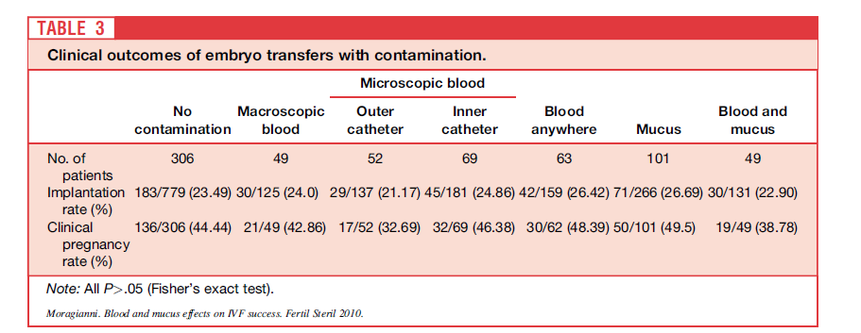
In general, IR and CPR appear to be unaffected by ET catheter contamination, whether it is macroscopic or microscopic presence of blood or mucus. Contamination of the ET catheter has no statistically significant effect on IVFET success rates
Notes:
The IR and CPR of IVF-ETs were comparable regardless of the presence (26.59% and 48.78%, respectively) or absence (23.49% and 44.44%, respectively) of any type of contamination. Even when analyzing specific contamination categories (i.e., macroscopic blood, microscopic blood on the outer catheter, microscopic blood on the inner catheter, blood anywhere without mucus, mucus only, or blood and mucus combined), there was no statistical significance in IR (range: 21.17% to 26.69%) or CPR (range: 32.69% to 49.5%).

Slide 25
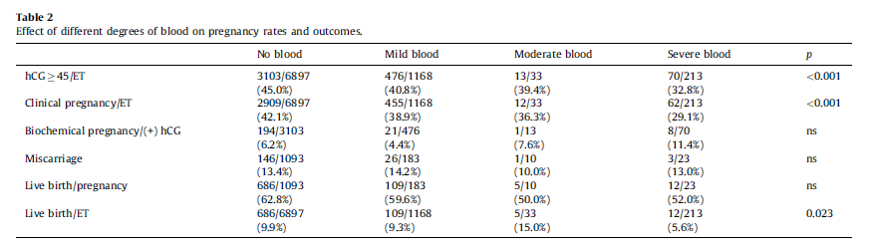
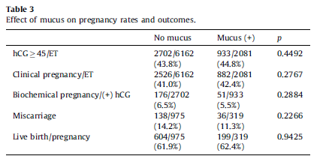
This study showed decreased IR, CPR and live birth rates in ETs associated with blood on the catheter. Mucus on the catheter appeared to be a simple contamination in this study and pregnancy rates remained unaffected.
Tiras B, E J Obs & Gyn Rep Bio 2012
Notes:
Retrospective analysis of 8311 ultrasound-guided embryo transfers performed in a single center. In 6897 cases (82.9%), there were no blood on the catheter after ET, 1168 transfers were associated with mild blood (14.1%), 33 transfers with moderate blood (0.4%) and 213 transfers with severe blood
(2.6%). A total of 6162 transfer catheters were free of mucus (74.8%), whereas mucus was detected on 2081 catheters (25.2%). Results: The implantation rate (IR) was highest in the group with no blood on the transfer catheter, and lowest in the group with severe blood on the catheter. The clinical pregnancy rate (CPR) was lowest in the group with severe blood on the catheter. The presence of mucus on the catheter was found to have no effect on IR, CPR, biochemical pregnancy rates, miscarriage rates and live birth rates.

Slide 26
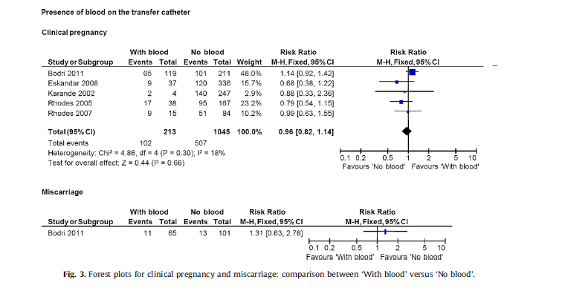
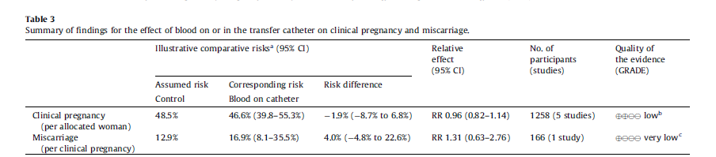
Phillips JAS, Eurp j obst gynec and repr B, 2013
We did not find any evidence about the effect of a difficult embryo transfer or presence of blood on the chance of live birth

Slide 27
ET kateterinde kan varlığı implantasyon ve klinik gebelik oranlarında azalma ile ilişkilidir
Kateterin dış yüzünde (içinde değil) bulunan kan embryo implantasyon oranı ve klinik gebelik oranlarında azalma ile ilişkilidir.
Goudas VT. Fertil Steril 1998;70:878–82.
Notes:
Blood on the embryo transfer catheter is associated with decreased rates of embryo implantation and clinical pregnancy with the use of in vitro fertilization–embryo transfer
Blood found outside, but not inside, the transfer catheter after ET is associated with lower rates of embryo implantation and clinical pregnancy with the use of IVF-ET
27

Slide 28
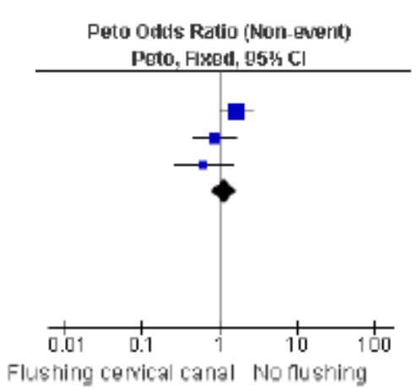
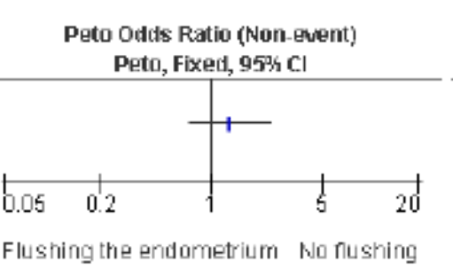
Servikal-Endometriyal Ön Hazırlık gebelik oranları
ET öncesi servikal mukus temizlenmesinin gebelik oranına anlamlı katkısı saptanmamıştır.
Endoservikal lavaj yapmak ile yapmamak arasında anlamlı fark bulunmamıştır.
Derks RS, Farquhar C, Mol BWJ, Buckingham K, Heineman MJ.
Cochrane Database of Systematic Reviews 2009,
Notes:
There was no evidence of a statistically significant difference when removal of cervical mucus was performed prior to ET.
Flushing the endocervical canal compared to no flushing showed no statistically significant difference.
28

Slide 29

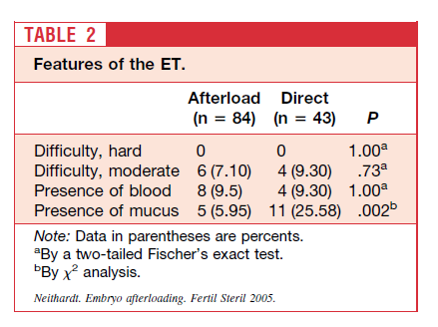
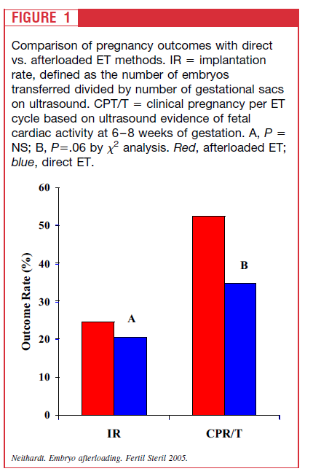
There was a trend toward an increase in pregnancy rate when an embryo afterloading technique was used. A prospective randomized trial is needed to examine this issue.
Direkt transfer: yüklü kateter ile direkt ET
Afterload transfer: boş kateter servikal kanaldan geçer, iç kateter çekilir, sonra yüklü kateter ile ET yapılır
Notes:
Retrospective cohort analysis. One hundred twenty-seven patients met inclusion criteria, and the overall pregnancy rate was 46.5%. There was no difference between the two groups with respect to age, basal FSH, or number of embryos transferred. The ET method used was at the discretion of the provider. There was no difference between the two groups in the presence of blood on the transfer catheter. However, there were significantly more transfer catheters with mucus contamination in the direct transfer group (25.58% vs. 5.95%). The clinical pregnancy rate in the group with ET using the afterloading technique was higher than in the direct ET group (52.4% vs. 34.9%).
In conclusion, embryo afterloading is a refinement of standard ET and may improve clinical pregnancy rates. This method may be especially useful in centers that are training physicians to perform ET. A randomized clinical trial would be required to confirm an increase in clinical pregnancy rates using this method.

Slide 30
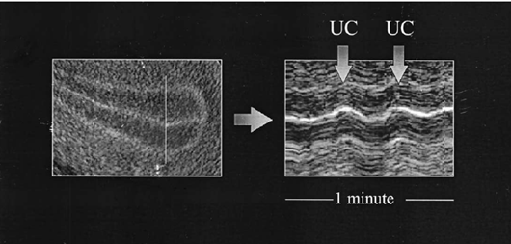
Uterin kontraktilite
Uterin kontraksiyon sıklığı 4.3 /dk dır.
Bu sıklıkta artış olursa gebelik oranları düşer.
ET günü serum P4 seviyeleri ile kontraksiyon arasında bir korelasyon vardır.
P4 seviyesi artıkça kontraksiyon sıklığı azalır.
Fanchin R, Hum Reprod 1998;13:1968–74.
Luteal fazda uterin kontraksiyonlar genelde serviko-fundal yöndedir. (Bu IVF/ICSI deki dış gebelikleri açıklar).
Lesny P, Hum Reprod Update 1998;4:440–5.
Zor embryo transferlerinde kontrakilite fundo-servikal olur ve sıklığı artar.
Lesny P, Hum Reprod Update 1998;4:440–5.
Notes:
Uterjunctıonal zone kontraksıyon luteal fazda progressıv olarak azalır buda balastosıst transferlerındekı yuksek basarıyı ızah edebılır.

Slide 31
Embryo retansiyonu
Rutin sorunsuz transferlerde bile embryoların %8.7 si servikal kanalda veya spekulumda saptanmıştır. Poindexter AN 3d, Fertil Steril 1986;46:262–7.
Yıllar geçtikçe bu oranın azaldığını görmekteyiz
10 % ….1993
1.41 % …2003 Hye-Chun L. Fertil steril 2004,82;2:334-7
Notes:
Inspection of the catheter after transfer under light microscopy is necessary for detection of retained embryos. The cervix and speculum should be routinely checked as well. If retained embryos are detected and immediately retransferred, no detrimental effects on PRs would be expected

Slide 32
Embryo retansiyonu & re-transferi
Embryo retansiyonunda hemen hızlıca tekrar transfer yapılması gebelik oranlarını etkilemez.
Lee HC. Fertil Steril 2004;82:334 –7..
Goudas VT, Fertil Steril 1998;70:878–82.
Nabi A, Hum Reprod 1997;12:1188–90.
Embryo retansiyonunda tekrar transfer yapılsa dahi gebelik oranları düşer.
Visser DS, J Assist Reprod Genetics 1993;10:37–43.
..

Slide 33

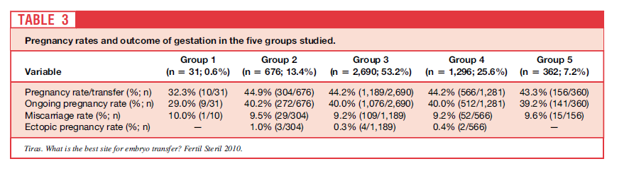
Pregnancy rates and ongoing PRs are higher if the embryos are replaced at a distance >10mm from the fundal endometrial surface. In addition because significantly more embryos were replaced in cycles where the transfers occurred at a distance of >20 mm, a distance >10 mm to <20 mm seems to be the best site for embryo transfer to achieve higher PRs.
Grup 1: Fundal kaviteden 10 mm ya kadar ki mesafeye
Grup 2: Fundal kaviteden 10 -15mm arası mesafeye
Grup 3: Fundal kaviteden 15-20 mm arası mesafeye
Grup 4: Fundal kaviteden 20-25 mm arası mesafeye
Grup 5: Fundal kaviteden 25 mm den daha uzak bir mesafeye
Tıraş B. Fertil Steril 2010
Notes:
Mean total number of embryos transferred in groups 4 and 5 were significantly higher than in groups 2 and 3. Analysis of PRs and outcome of gestations in the five groups studied yielded similar PRs in all groups except for group 1.

Slide 34
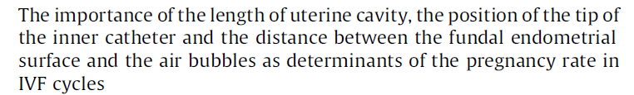
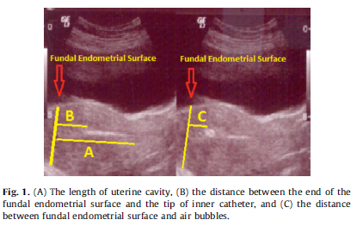
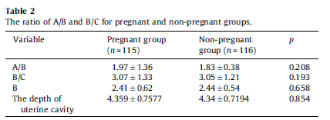
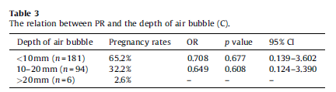
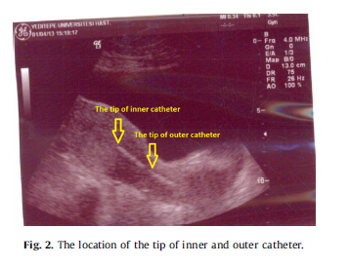
Pınar Ozcan Cenksoy, Cem Fıcıcıoglu, Mert Yesiladali , Oya Alagoz Akcin, Cigdem Kaspar
E J Obst&Gyn Repr Bio 2014
Notes:
Study design: Prospective data analysis of 281 consecutive US-guided fresh ETs performed by a single physician at Yeditepe University Hospital IVF Center, Istanbul, Turkey, after controlled ovarian hyperstimulation between April 2012 and March 2013. The length of the uterine cavity (A), the distance between the fundal endometrial surface and the tip of inner catheter (B), the distance between the fundal endometrial surface and the air bubbles (C), and the pregnancy rates (PRs) were recorded. Results: The mean age of the patients was 33.25 5.5 years. Of all transfers, 115 (40.9%) resulted in a clinical pregnancy. With regard to distance (C), the clinical intrauterine pregnancy rates were 65.2%, 32.2% and 2.6% in the <10 mm, 10–20 mm, and 20 mm distance groups, respectively. The PR was dramatically reduced in cases with >10 mm between the fundal endometrial surface and the air bubbles, although this did not reach statistical significance. Between those patients who conceived and those who did not, there was no significant difference in terms of the distance between the fundal endometrial surface and the tip of inner catheter, the ratio of A/B or the ratio of B/C. Conclusions: The final position of the air bubble used as an identifier of the position of the embryo at ET can be determinative for PR, although it cannot be predicted. Clinical pregnancy rates appeared higher in cases with air bubbles closer to the fundus and the optimal position of the air bubble seems to be a distance of <10 mm from the fundal endometrial surface. It could be advisable to monitor the final position of air bubble at ET for identifying PR. In addition, the depth of uterine cavity may be considered to indirectly be important factor as it affects ET depth. The optimal distance between the fundal endometrial surface and the tip of inner catheter is 1.5–2 cm. Further well-designed randomized controlled trials are required to optimize ET technique in the future.

Slide 35
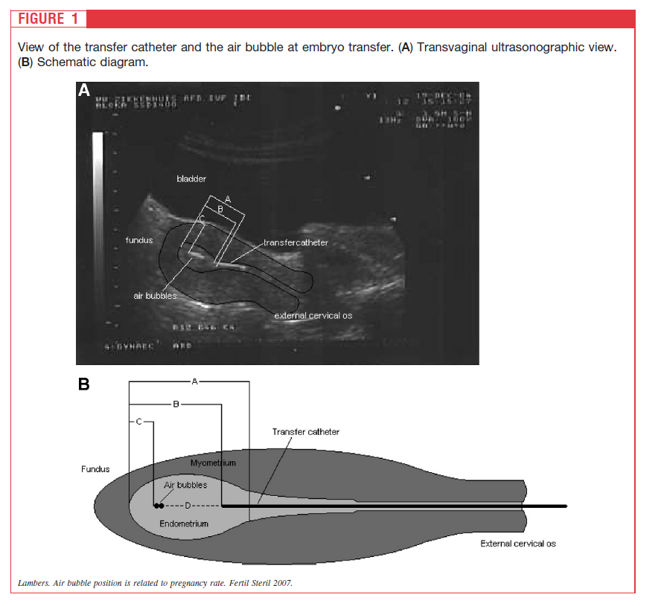
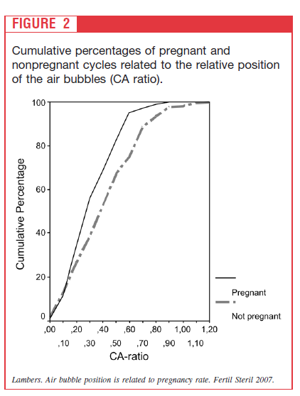
The position of the air bubbles after embryo transfer is related to pregnancy rate; the highest pregnancy rates are found when the air bubbles end up closer to the fundus
Notes:
Prospective data-analysis Analysis of 367 consecutive ultrasonographic-guided embryo transfers following IVF or intracytoplasmic sperm injection treatment. Both absolute and relative position of the air bubbles were significantly closer to the fundus in patients who became pregnant compared with patients who did not become pregnant. When the relative position of the air bubbles was in the fundal half of the endometrial plate pregnancy rates were significantly higher compared with the lower half of the endometrial plate, 43.0% and 24.4%, respectively, P.002. Multiple regression analysis revealed the relative position as an independently associated determinant for pregnancy.
The position of the air bubble at embryo transfer was found to be relevant for pregnancy rates, but unfortunately, it is at present not possible to predict and/or control the position of the air bubbles; after positioning of the transfer catheter the final position of the air bubbles is dependent on the syringe, the resistance of the plunger, the pressure used to press the plunger, and patient-related determinants as a possible intrauterine resistance. Therefore, we feel there is need for a more standardized method of embryo transfer that allows the surplus value of exact positioning at embryo transfer to be analyzed.

Slide 36
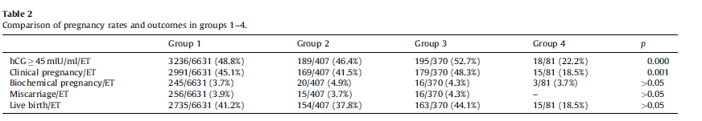
An initial finding of our study was significantly decreased positive pregnancy test rates and clinical pregnancy rates with air bubbles moving towards the cervical canal after transfer. Although air bubbles moving towards the uterine fundus with ejection were associated with higher pregnancy rates, higher miscarriage rates and similar live birth rates were observed compared to air bubbles remaining stable after transfer
Tiras B, E J Obs & Gyn Rep Bio 2012
Notes:
Retrospective analysis of 7489 ultrasound-guided embryo transfers. Group 1 included 6631 embryo transfers in which no movement of the air bubbles was observed after transfer. Group 2 consisted of 407 embryo transfers in which the air bubbles moved towards the uterine fundus spontaneously, a
little time after transfer. Group 3 included 370 embryo transfers in which the air bubbles moved towards the uterine fundus with ejection, immediately after transfer. Group 4 consisted of 81 embryo transfers in which the air bubbles moved towards the cervical canal. The four patient groups were different from one another with respect to positive pregnancy tests. Post hoc test revealed that this difference was between group 4 and other groups

Slide 37
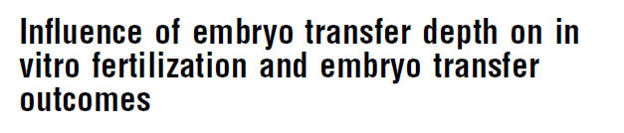
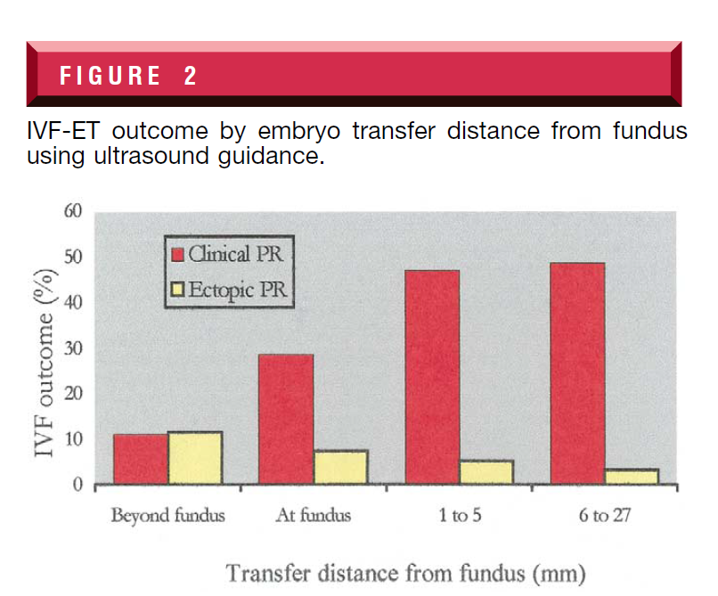
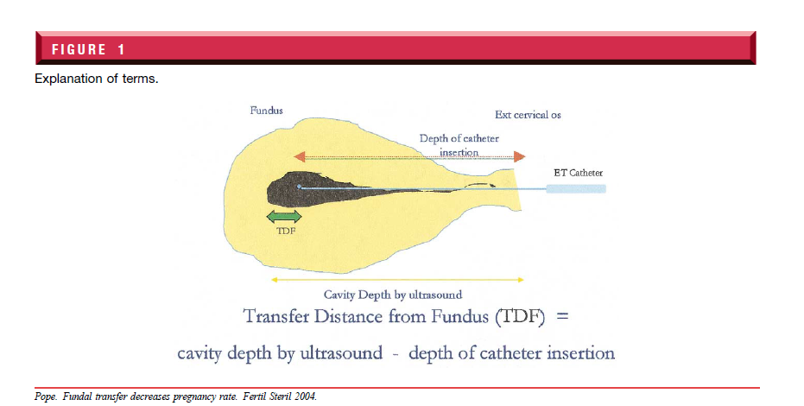
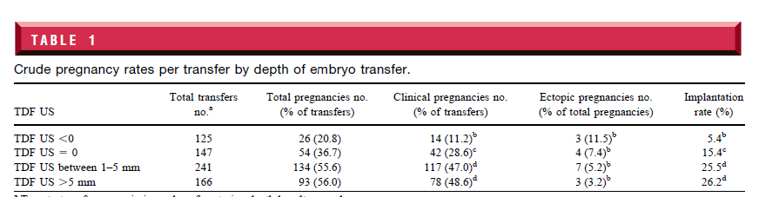
Pope JC. Fertil Steril 2004;81:51– 8.
Notes:
Result(s): Clinical, implantation, and ectopic PR were 37%, 20%, and 2.1%. Cavity depth by US differed
from cavity depth by mock by at least 10 mm in 30% of cases. The TDF by US was highly predictive of
PR; TDF by mock was not predictive of PR. Increasing the TDF by US resulted in significantly increased PR
as well as lower ectopic rates. Using regression analysis, the odds ratio for TDF by US was 1.11 (95% CI:
1.07–1.14). This suggests that for every additional millimeter embryos are deposited away from the fundus,
the odds of clinical pregnancy increased by 11%.
Conclusion(s): After controlling for potential confounders, the clinical PR is significantly influenced by the
transfer distance from the fundus. Cavity depth by US is clinically useful to determine the depth beyond which
catheter insertion should not occur

Slide 38

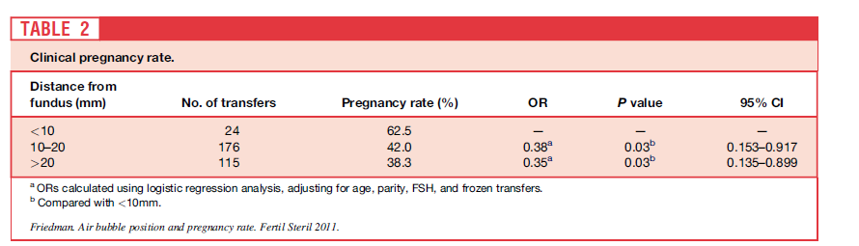
This study is the first to suggest that BT closer to the fundus is associated with higher PR. Although no ectopic pregnancies occurred in the <10-mm group, this outcome should be monitored closely in larger studies
Friedman BE. Fertil Steril 2011
Notes:
Retrospecti
Result(s): After controlling for age, parity, FSH and frozen transfers, and accounting for repeated cycles per patient, the PRs for both the >20-mm (38.3%) and the 10–20-mm (42.0%) from the fundus group were significantly reduced compared with the group in which the bubble was <10 mm from the fundus (62.5%).
Conclusion(s): This study is the first to suggest that BT closer to the fundus is associated with higher PR. Although no ectopic pregnancies occurred in the <10-mm group, this outcome should be monitored closely in larger studiesve cohort study.

Slide 39

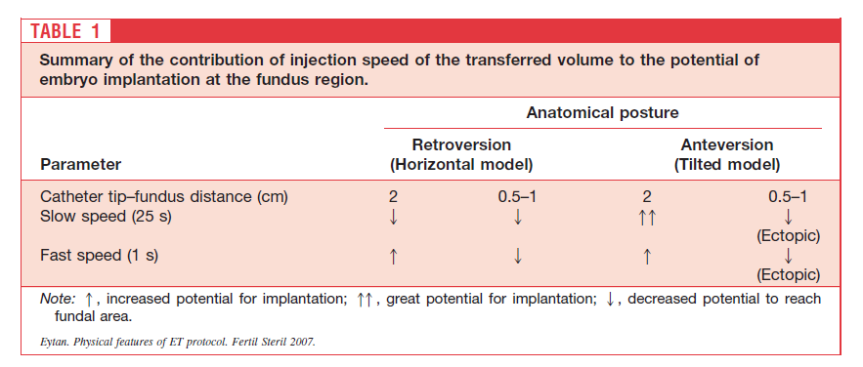
Notes:
Scholgraft embryo shoulbe placed at transfer poınt less than 0.8 cm bunun translatı sudur more than 1 cm ın 5cm endo cavıty o.8 cm more than 4 cm cavıty transfer point: 1-da/db db uterin cavıte uzunulugu da fundusdan mesafe tp transfer point
Dispersion of the transferred matter depended on the position of sagittal cross-section of the uterine cavity with respect to the horizon. The air bubbles were pulled up by buoyant forces toward the highest point of the cavity (e.g., the fundus) and thereby dragged behind them the transferred media with the embryos. Placement of the catheter tip near the fundus appeared to transfer the embryos into the tube when transfer was performed
at fast speeds, possibly leading to ectopic pregnancies.
Conclusion(s): Fundal level of the uterine cavity, location of the catheter tip, and transfer speed determine the
potential for embryo implantation. Adjustment of ET protocol to individual patient anatomy is recommended

Slide 40
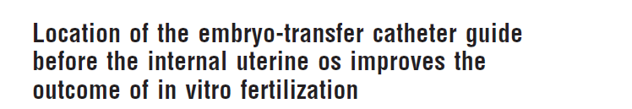
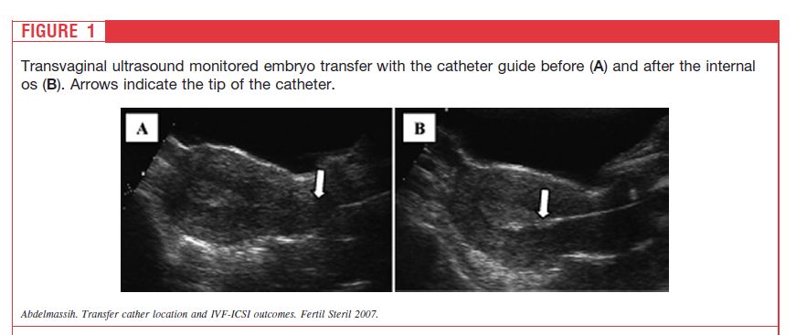
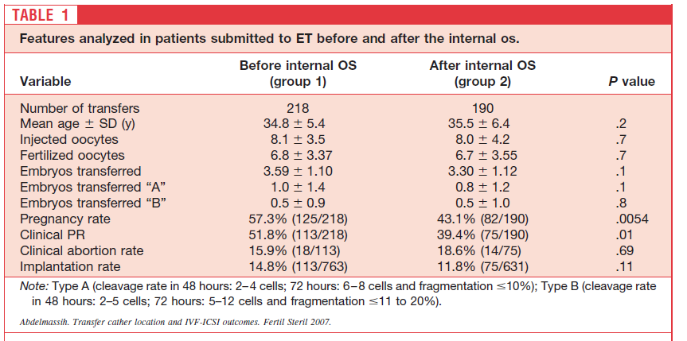
Abdelmassih VG. Fertil Steril 2007
Notes:
We analyzed ultrasound-guided ETs in IVF-intracytoplasmic sperm injection (ICSI) cycles, performed with the tip of the ET catheter guide just before the internal os (group 1) and beyond the internal os (group 2). Implantation and pregnancy rates were significantly better in group 1 than in group 2,
at 14.8% versus 11.8% and 57.3% versus 43.1, respectively. We conclude that passing the ET catheter guide beyond the internal os reduces implantation and pregnancy rates

Slide 41
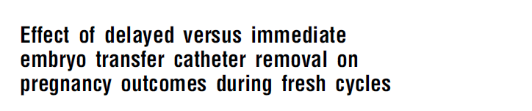
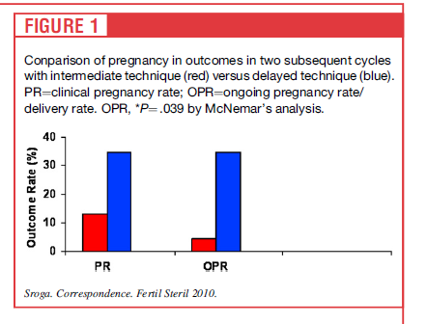
Notes:
A total of 218 patients underwent fresh ET during over a 2- year time period. Ninety-eight underwent ET using a delayed catheter removal technique (group 1), and 122 with immediate catheter removal (group 2). there were no differences in terms of clinical pregnancy rates (48% in each group), ongoing pregnancy rates (43.9% vs. 47.8%, P¼.35), and spontaneous abortion (SAB) rate (5.1% vs. 3.3%, P¼.37), respectively. Our results do suggest that timing of catheter removal may alter pregnancy rates in patients with a previously failed ET. Patients that have failed an initial embryo transfer may be more sensitive to contractions, and leaving the catheter in place 60 seconds may help stabilize the uterus during ET. Our sample size is too small to make definitive statements regarding delaying catheter removal in this subset of patients, and further investigation into the timing of catheter removal is warranted to ultimately answer this question

Slide 42

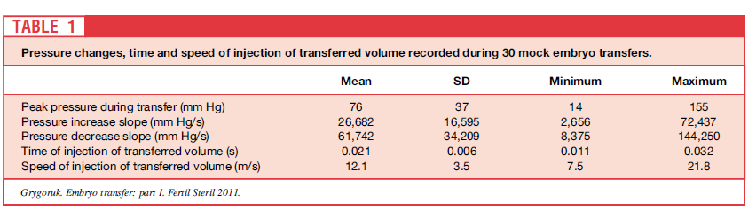
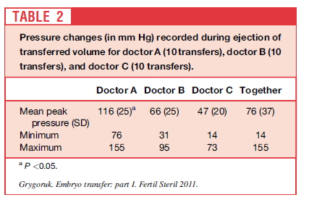
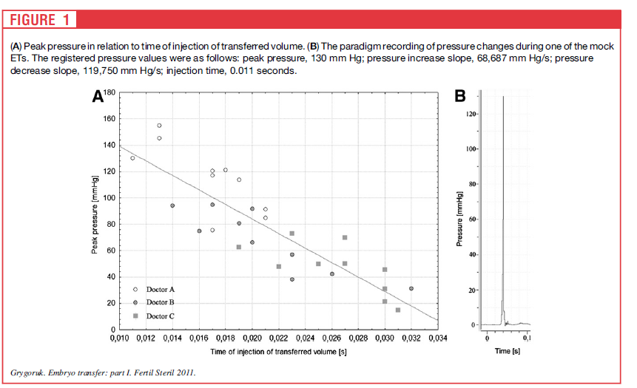
ET can cause rapid pressure fluctuations in the transferred liquid. Therefore, it is advisable to transfer the embryo gently with minimum ejection speed, to avoid exposing the embryo to the steep pressure gradient
Notes:
Result(s): Injection of a transferring load during mock ET could increase pressure locally up to 155mmHg in<0.1 seconds. The recorded pressure increase slope reached values as high as 72,000 mmHg/s, and the pressure decrease slope reached 144,000 mmHg/s. The pressure buildup in the transferred liquid was proportional to the ejection speed of the transferred load.
Conclusion(s): ET can cause rapid pressure fluctuations in the transferred liquid. Therefore, it is advisable to transfer the embryo gently with minimum ejection speed, to avoid exposing the embryo to the steep pressure gradient.

Slide 43
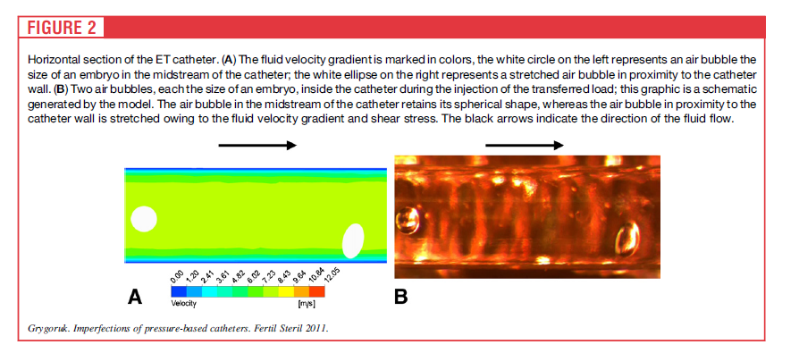
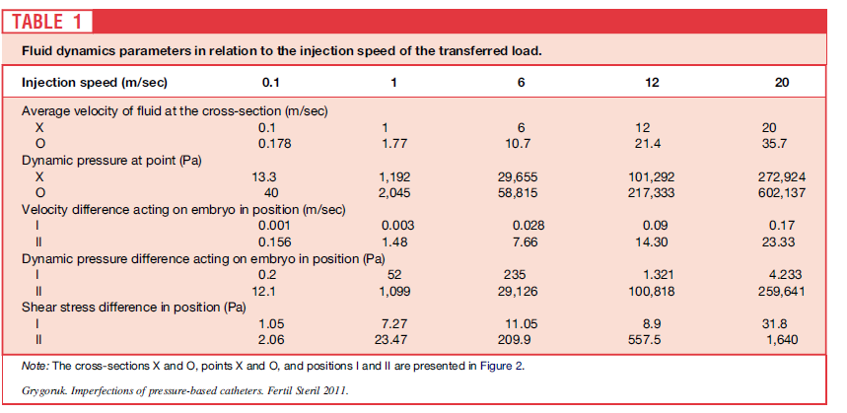
Notes:
Result(s): An increase of injection speed for the transferred load increased the shear stress, dynamic pressure, and velocity differences acting on the embryo. The narrowing of the catheter lumen diameter by 20% amplified the transferred fluid velocity by 78%. An embryo positioned in proximity to the catheter’s wall was exposed to considerably higher shear stress, dynamic pressure, and velocity difference than an embryo in the center of the catheter’s
lumen.
Conclusion(s): The transfer of an embryo should be conducted gently and with minimal injection speed. Any narrowing
of the catheter lumen should be eliminated. Preferably the embryo should be kept far from the catheter’s
wall during injection of the transferred load

Slide 44
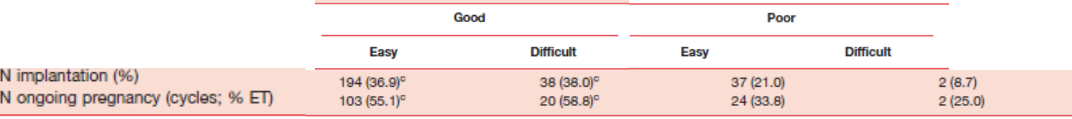
ET süresi
120 saniyeyi aşan süre lerde daha kötü sonuçlar elde edilmiş onedenle mümkün olan en kısa sürede işlem tamamlanmalı.
Matorras R, Hum Reprod 2004;19:2027–30.
Embryo kaltesi iyi ise işlem süresi sonucu etkilemez
İyi kaliteli yumurtadan üretilen embryolar kötü kalitelilerden üretilenlere göre çevresel koşullara daha az duyarlıdır.
Ciray HN. Fertil Steril 2007;87:1218 –21.
Notes:
The time interval between loading the embryo and depositing it into the uterine cavity should be minimized to avoid exposure of the embryo to the ambient conditions since a longer time interval is associated with lower implantation and pregnancy rates

Slide 45
Hekim Faktörü
4 ve 6 deneyimi az doktorun başarı oranlarını gösteriyor
Doktorların ilk 50 transfer de başarı oranları
ET tekniklerinın IVF başarısındaki rolünü kuvvetlendiren , değişik hekimler tarafından yapılan embryo transferlerinde elde edilen gebelikler yönünden anlamlı farklılıklar gözlenmiş
Hearns-Stokes RM. Fertil Steril 2000;74:80–6
Notes:
En deneyımlı provıderlar en yuksek kalıtelı <3 den az embryo ıle gebelige ulaşırken bu sayı deneyım az olanlar ıcın 7.6..deneyımın outcome ıle ılıskısı tam gosterılmemıs vısser hekımler arası fark bulamamısken karande 11 klınısyen arasında fark bulmuş

Slide 46
“Fellowship” eğitimi
44 % eğitim sırasında ET yapmadan bitiriyor.
ET öncesi fellow 30 > deneme transferi ve IUI yapmış olması gerekiyor.
Fellow 10 gün içinde yaptığı 3 transferde “iyi kalite embryo” 30% < gebelik oranından düşük oranda kalırsa , tekrar 30 deneme transferi ve IUI pratiğine alınıyor.
Wittenberger M, Fertil steril 2007.

Slide 47
ET Sonrası Yatak İstirahati
Uzun süreli yatak istirahat gerekmez
Sharif K, Hum Reprod 1995
ET sonrası 24 saat yatak istirahati ile başarı artmamıştır.
Botta G, Hum Reprod 1997
ET ile verilen havanın Uterus içindeki yeri transfer sonrası hemen hareket edenlerde; 94 %; değişmemiş, 4%; 1 cm oynamış, 2%; 4 cm > oynamış. (USG ile kontrol)
Woolcott R, Hum Reprod 1998.
Peritransfer periodunda cinsel ilişki gebelik oranlarını etkilemez. Tremellen KP. Human reprod 2000

Slide 48
ET sonrası hemen hareket & 1 saat yatak istirahati
ET sonrası hemen ayağa kalkmanın gebelik açısından hiçbir olumsuz etkisi yoktur.
Bar-Hava I. Fertil Steril 2005.
Notes:
Immediate ambulation following the ET procedure has no adverse influence on the ability to conceive.

Slide 49
SONUÇ
Kanıta dayalı
  Zor transferden kaçınmak
  Ultrason rehberliğinde uygulama transferi kolaylaştırır, başarıyı arttırır
  Yumuşak kateter kullanılmalı
Mains L, Fertil Steril 2010
Uzman tavsiyeleri
  Deneme tranferi zor transfer için daha iyi bir hazırlık sağlar
  Servikal mukus temizlenmesi bakteryel kontaminasyonu azaltır, mukusun kateteri tıkamasını önler
  Embryo uterusun “midportion” bırakılmalı
  Kateteri geri çekerken negatif basınç oluşturma
  Kısa sürede bitir

Slide 50

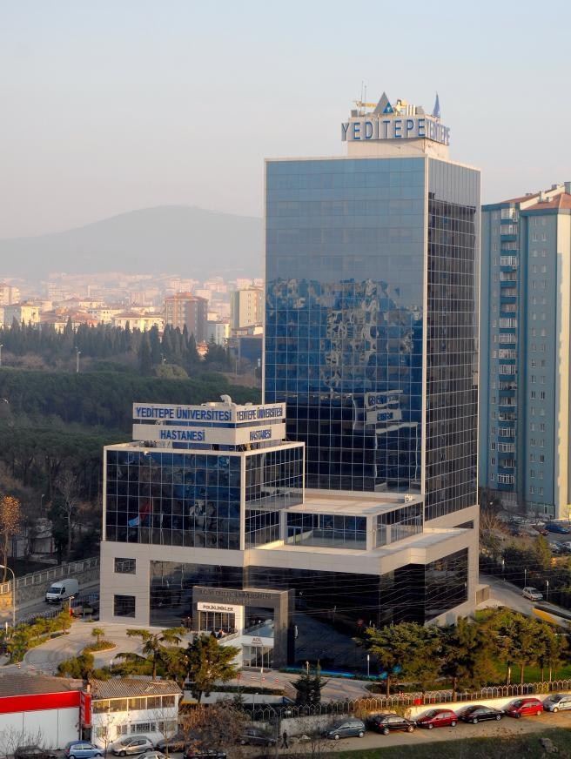
Teşekkürler

Slide 51
Başarılı ET için Anahtar Faktörler
Siklus öncesi deneme transferi
Mesane tam doluyken TAUS eşliğinde transfer
Fazla mukusun uzaklaştırılması için kültür medyumu ile servikal lavaj
Sadece internal os’a kadar deneme transferi
Wallace kateteri, 30 L volum, embryolar sıvının son 10 L’de, continuous fluid column to syringe
Nazikçe giriş: serviksin spekulum ile manuplasyonu, gereğinde internal osu geçmek için ring forseps
Kateter ucunun endometriyumu zedelemesi ve fundusa dokunmaktan kaçınmak için US kullanımı
US ile konfirme ederek embryoları fundustan 1.5 cm mesafeye enjekte etmek, sonrasında kateteri yavaşça çekmek
Kateterin embryolog tarafından kan, mukus, embryo retansiyonu açısından değerlendirilmesi
Schoolcraft WB, Fertil Steril 2001;76:863–70
Notes:
Precycle trial transfer
Transabdominal ultrasonographic guidance with full bladder
Cervical lavage with culture media to remove excess mucus
Practice transfer just through internal os
Wallace catheter, 30 L volume, embryos in last 10 L of fluid, continuous fluid column to syringe
Gentle insertion: manipulate cervix with speculum, ring forceps as necessary to negotiate internal os
Use ultrasonography to avoid catheter tip disrupting endometrium; avoid touching fundus
Inject embryos slowly 1.5 cm from fundus as confirmed by ultrasonography withdraw catheter slowly
Inspection of catheter by embryologist for blood, mucus, or retained embryos

Slide 52
Başarılı ET için Önemli Faktörler
Öncelik | Ort skor (1-10)
Hidrosalpeksin çıkarılması | 6.8
Kan veya mukus olmaması | 6.6
Kateter tipi | 6.1
Fundusa dokunmamak | 5.8
Tenakulum kullanmamak | 5.7
Mukusun tümüyle uzaklaştırılması | 5.2
İşlem öncesi USG | 4.3
Kateterin içeride 1 dk bırakılması | 4.2
30 dk yatak istirahati | 3.8
Deneme transferi | 3.1
USG görüntüleme | 2.6
Uterin kontraksiyonların önlenmesi için antiprostaglandin kullanımı | 1.9
Kovacs GT. Hum Reprod 1999;14:590–92.

Slide 53
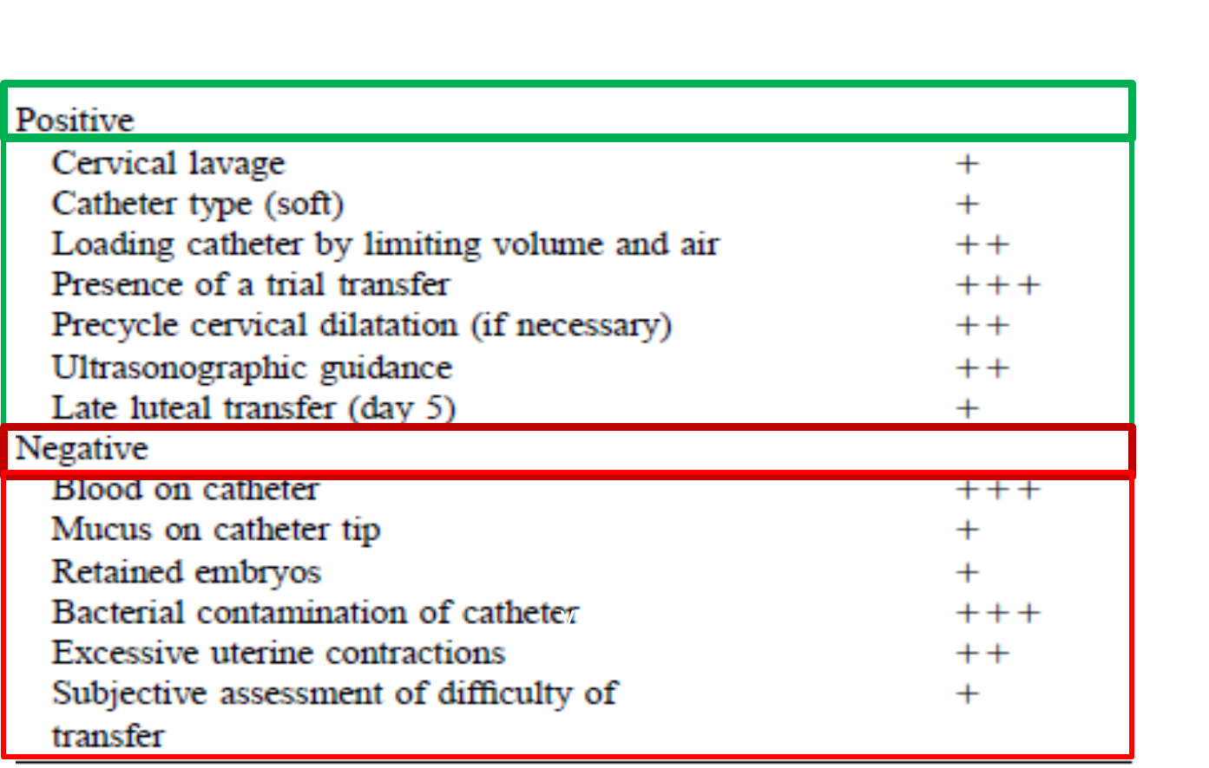
Başarılı ET için Değişkenler
Schoolcraft WB, Fertil Steril 2001;76:863–70

Slide 54
ET sonrası hemen hareket & 1 saat yatak istirahati
Immediate ambulation following the ET procedure has no adverse influence on the ability to conceive.
Bar-Hava I. Fertil Steril 2005;83:594 –7.

Slide 55
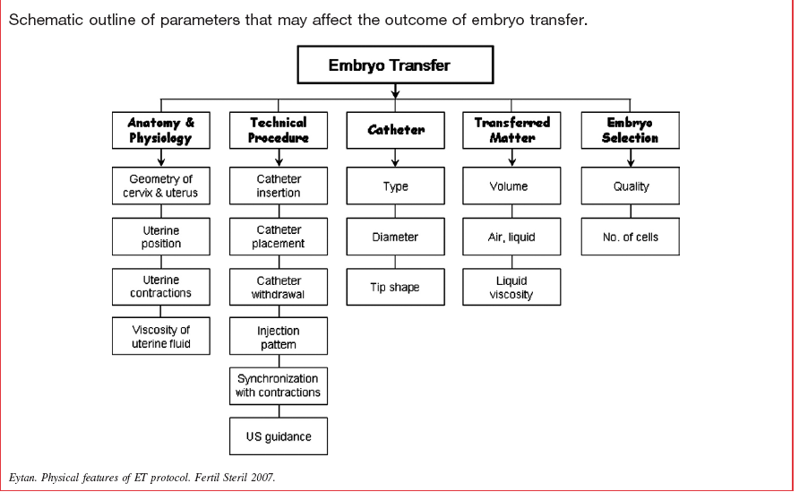

Slide 56
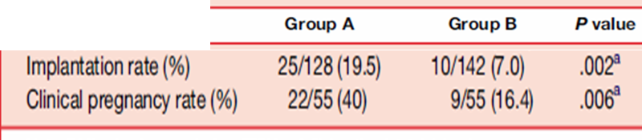
Transfer sonrası katetere hava vermek
Grup A: Katetere transferin hemen sonrasında 0.2 ml hava verilenler
Grup B: Verilmeyenler
Katetere transferin hemen sonrasında 0.2mL hava verilen grupta implantasyon ve klinik gebelik oranları anlamlı olarak yüksek bulunmuştur.
Madani T. Fertil Steril 2010;94:2424–6.

Slide 57
Transfer kolaylığı
Transfer “kolay”lığı ile gebelik arasında güçlü bir korelasyon olduğunu bildiren pek çok çalışma vardır.
İşlem genel anlamda basit olmasına rağmen zorlu transferler olur, bu durumda implantasyon ve gebelik oranlarının anlamlı olarak düşük olduğu gösterilmiştir.
Englert Y, J In Vitro Fertil Embryo Transfer 1986;3:243–6.
Mansour R, Fertil Steril 1990;54:678–81.
Wood EG, Hum Reprod. 2000;15:107-12
Tomas C, Hum Reprod 2002; 17: 2632

Slide 58
Başarılı ET için Anahtar Faktörler
Precycle trial transfer
Transabdominal ultrasonographic guidance with full bladder
Cervical lavage with culture media to remove excess mucus
Practice transfer just through internal os
Wallace catheter, 30 L volume, embryos in last 10 L of fluid, continuous fluid column to syringe
Gentle insertion: manipulate cervix with speculum, ring forceps as necessary to negotiate internal os
Use ultrasonography to avoid catheter tip disrupting endometrium; avoid touching fundus
Inject embryos slowly 1.5 cm from fundus as confirmed by ultrasonography withdraw catheter slowly
Inspection of catheter by embryologist for blood, mucus, or retained embryos
Schoolcraft WB, Fertil Steril 2001;76:863–70

Slide 59
ART & İmplantasyon
Uterin reseptivite
Embryo kalitesi
Embryo transferi
  Ultrason rehberliği
  Servikal hazırlık
  Transfer kateter tipi
  Kateter yükleme tekniği
  Kateterde kan, mukus varlığı
  Kateterde kalmış embryo varlığı
  Mock transferi
  Myometriyal kontraksiyon
  Transfer kolaylığı
  Embryonun veriliş noktası
  Kateterin geri çekilmesiyle oluşan negatif basınç
Goudas V. Fertil Steril 1998;70:878–82.
Schoolcraft WB, Fertil Steril 2001;76:863–70
Mansour RT. Hum Reprod 2002;17:1149–53
Mirkin S, J Assist Reprod Genet 2003;20:318–22

Slide 60
Kolay –Zor Transfer
Tenakulum yok
Fundusa temas yok
Kateterde kan-mukus yok
Buji-dilatator yok
Mükemmel transferde gebelik oranı %33.3, kötü transferde gebelik oranı %16
Englert Y, J In Vitro Fertil Embryo Transfer 1986;3:243–6.
Kolay transferde gebelik oranı %20.4, zor transferde gebelik oranı %4
Mansour R, Fertil Steril 1990;54:678–81.

Slide 61
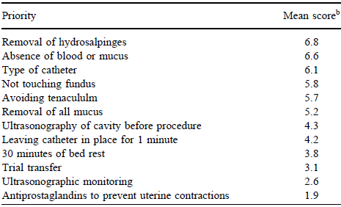
Başarılı ET için Önemli Faktörler
Skor:1-10 arası skala üzerinden
Kovacs GT. Hum Reprod 1999;14:590–92.

Slide 62
Muhtemel başarısızlık
  Kateterle endometriumu zedelemek
  Uterin kontraksiyona sebep olmak
  Embryoyu suboptimal lokalizasyona bırakmak
  Transfer sırasında embryoya zarar varmek
Notes:
Kontraktılıte uyanırsa embryo expulsıyon olur mukus kateterı tıkar embryo takılır ve gerı gelebılır embryoyu ıyı yere yerlestıremıyebılırsın o yuzden et zaman ayır veya tarasesını cızmeden 6 cm e veya ınternalosu gec 2cm bırak naaktgeboren 1998

Slide 63
Transfer kolaylığı
Zorlu transfer, fundal temas ya da servikal manuplasyon, “serviksin tenakulum ile tutulması”, fundo-servikal kontraksiyonları arttırır, implantasyonu engelleyebilir.
Lesny P, Hum Reprod 1998;13:1540-6.
Fanchin R Hum Reprod 1998;13:1968-74
Dorn C Eur J Obstet Gynecol Reprod Biol 1999; 70: 878-82
Notes:
Traumatic or difficult ET has been linked to a lower clinical pregnancy rate (PR) due to disruption of the endometrium and induction of uterine contractions associated with the release of prostaglandins and oxytocin. Since uterine contractions may also result from cervical trauma, the use of a tenaculum clamp, cervical stenosis requiring dilatation or use of a firm catheter may lead to embryo expulsion. A trial transfer, gentle manipulation, use of a soft catheter, and US guided ET have been associated with improved PR possibly by minimizing endometrial and cervical trauma during ET ¹⁰. Furthermore, progesterone frequently used for luteal phase support may also help to decrease uterine contractions at the time of ET

Slide 64
Servikal dilatasyon gebelik oranı
Only one study on cervical dilatation was included and it showed a significant increase of the odds for live births and pregnancies but no significant difference in miscarriage rates.
Derks RS, Farquhar C, Mol BWJ, Buckingham K, Heineman MJ.
Cochrane Database of Systematic Reviews 2010, Issue 4. Art. No.: CD007682.

Slide 65
USG Guided (UGET) vs Clinical Touch ET (CTET)
Devam eden gebelik oranı
The ongoing pregnancies per woman randomised associated with UGET (441/1254) was significantly higher than for clinical touch (350/1218) OR 1.38, 95%CI 1.16 to 1.64, P<0.0003).
Brown J, Buckingham K, Abou-Setta AM, Buckett W.
Cochrane Database of Systematic Reviews 2010, Issue 1. Art. No.: CD006107.
Notes:
17 RCT

Slide 66
USG Guided (UGET) vs Clinical Touch ET (CTET)
Adverse Events
No statistically significant differences
in the incidence of adverse events were identified between the comparison groups.
Brown J, Buckingham K, Abou-Setta AM, Buckett W.
Cochrane Database of Systematic Reviews 2010, Issue 1. Art. No.: CD006107.

Slide 67
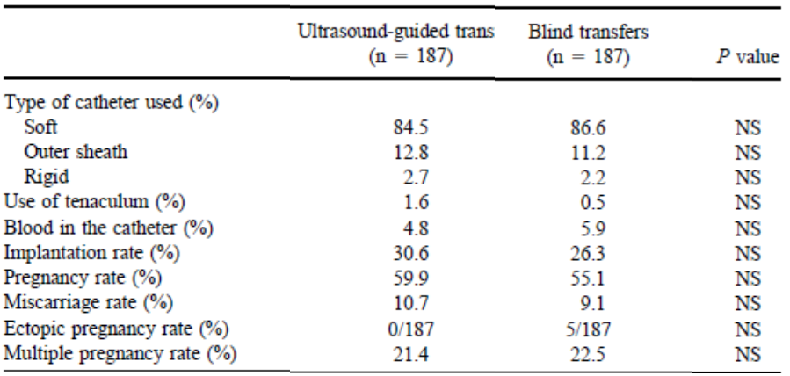
Transabdominal ultrasound-guided embryo transfer does not increase pregnancy rates in oocyte recipients
Blind ET is usually quite successful when experienced providers are involved.
The use of transabdominal ultrasound during the ET procedure provided a greater degree of confidence to both patients and physicians.
However, there is no increase in the pregnancy rate among patients receiving donor oocytes.
Garcı´a-Velasco JA. Fertil Steril 2002;78:534 –9.

Slide 68
Servikal-Endometriyal Ön Hazırlık gebelik oranları
There was no evidence of a statistically significant difference when removal of cervical mucus was performed prior to ET.
Flushing the endocervical canal compared to no flushing showed no statistically significant difference.
Derks RS, Farquhar C, Mol BWJ, Buckingham K, Heineman MJ.
Cochrane Database of Systematic Reviews 2010, Issue 4. Art. No.: CD007682.
Notes:
Metilen mavisi kullanarak yapılan mock transferlerde : mock oncesı servıkal mukus temızlenmış olanlarda metlen mavısı 23% oranında temızlenmemış olanlarda 57 % oranında serviksde gözukmuş

Slide 69
Embryo afterloading: a refinement in embryo transfer technique that may increase clinical pregnancy
Direkt transfer: yüklü kateter ile direkt ET
Afterload transfer: boş kateter servikal kanaldan geçer, iç kateter çekilir, sonra yüklü kateter ile ET yapılır
Embryo afterloading teknikde gebelik oranları daha yüksek
Bu metod bilhassa eğitim merkezlerinde ET uygulama pratiğinde tercih edilmeli
Neithart AB, Fertil Steril 2005;83:710–4.
Notes:
Bu metod fatma aletebi tarafından yapılan calışmadda desteklenmış ana faydası hekim hazırım dedeiğinde mebro ıkubatorden cıkıp geliyo atravmatık sekılde trasfer hızlıca yapılıyorteorık olarak embryo mukusa takılmasını onleyerek retansyon ve yanlış yereleşmesını engellıyorsun ancak fatma bunu labotectle yapmış sadece dıs kılıfı ınner osdan gecırmış bence bu bır handıcap. Afterload avantajı trıal yerıne ıkı kateterle zedelem yapıncaya kadar bır yapıyosun

Slide 70
The position of transferred air bubbles after embryo transfer is related to pregnancy rate
The position of the air bubbles after embryo transfer is related to pregnancy rate;
The highest pregnancy rates are found when the air bubbles end up closer to the fundus.
Lambers MJ. Fertil Steril 2007;88:68 –73.
Notes:
Aır bublesyerı ıle ılgılı 3 calışma var krampl fertil steril 1995 ve frankfurterın çalışmaları ama farklı sonuç??? 2011 freidman calışması va esas: embryo pozısyonu ve gebelik oranı arsındakı ılışkı: implantasyon faktörleri leptin MUC -1 endometrium butununde değişik ornalardadırbuimplantasyon faktörlerinin fundal endometrıumda implantasyon ıcın dha fazla optimal olduğu söylenebılır.

Slide 71
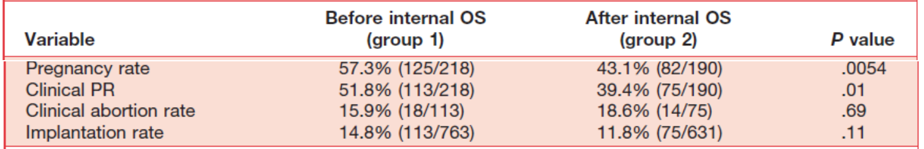
Location of the embryo-transfer catheter guide
before the internal uterine os improves the
outcome of in vitro fertilization
…passing the ET catheter guide beyond the internal os reduces
implantation and pregnancy rates.
Abdelmassih VG. Fertil Steril 2007;88:499 –503.

Slide 72
A prospective randomized comparison of the Wallace catheter and the Cook Echo- Tip catheter for ultrasound-guided embryo transfer
The Cook Echo-Tip catheter with its echogenic tip simplifies ultrasound-guided ET, but
pregnancy success rates are similar to those obtained when a Wallace catheter is used.
Karande V. Fertil Steril 2002;77:826 –30.

Slide 73
Blood on the embryo transfer catheter is associated with decreased rates of embryo implantation and clinical pregnancy with the use of in vitro fertilization–embryo transfer
Kateter ucunda kan-mukus varlığı zor transferi işaret eder ve düşük gebelik oranına neden olur.
Goudas VT. Fertil Steril 1998;70:878–82.

Slide 74
Kateteri yükleme
Kullanılan enjektör toksik olmamalıdır.
Fazla hava (60 L) embryonun ekspulsiyonuna yol açabilir
Poindexter AN Fertil Steril 1986;46:262–7.
Havanın azaltılması gebelik oranlarını artırır.
30 mikro-L hava ve airtight enjektör kullanılması ve embryonun kateter ucuna yakın yüklenmesi gebelik oranlarını arttırır.
Gardner DK. Handbook of in vitro fertilization.
Transfer medyumundaki protein oranı (%75-%8-%2.5 karşılaştırılmış) sonucu etkilemez
Khan I, Fertil Steril 1991;56:98–101.
Transfer medyumunun vizkozitesinin arttırılması transfer başarısını arttırmaz.
Menezo Y, Fertil Steril 1989;52:680–2.
Transfer medyumundaki proteini hyaluronan larla değiştirmek deneysel modellerde başarıyı arttırmıştır.
Gardner DK. Hum Reprod 1999;14: 2575–80.
Notes:
Kateterin plungerı serbest kalırsa recoil etkısıyle embryo reaspire olabılır leong kateterı 1 cm cek ve brisk injectıon avoıd retrograde flow by capillary actıon

Slide 75


Air in the transfer catheter does not affect the success of embryo transfer
The air loaded into the transfer catheter to bracket the embryo-containing medium has no negative effect on implantation and pregnancy rates
Moreno Fertil Steril 2004;81:1366-70

Slide 76


Transfer sonrası katetere hava vermek
Grup A: Katetere transferin hemen sonrasında 0.2 ml hava verilenler
Grup B: Verilmeyenler
Madani T. Fertil Steril 2010;94:2424–6.

Slide 77
Uteroservikal açıyı düzeltmek
(mesane full dolu)
There was no evidence of a statistically significant change in the pregnancy outcomes when performing ETwith a full bladder compared with an empty bladder.
Derks RS, Farquhar C, Mol BWJ, Buckingham K, Heineman MJ.
Cochrane Database of Systematic Reviews 2010, Issue 4. Art. No.: CD007682.

Slide 78
İmplantasyon başarısı
İmplantasyon başarısızlığından;
Kötü embryo kalitesi
Suboptimal uterin reseptivite
Transfer tekniği
sorumlu olabilir.
Notes:
İmplantasyon başarısızlığı kötü embryo kalitesi veya suboptimal uterin reseptiviteye bağlı olabileceği gibi transfer tekniğinin kendisi de IVF başarısındaki belirleyicilerden biridir.
78

Slide 79
Servikal dilatasyon gebelik oranı
Servikal dilatasyonun yapıldığı tek çalışma Cochrane Database açısından uygun (RCT çalışma) Bu çalışmada Cx dilatasyon grubunda gebelik ve canlı doğum oranlarında anlamlı artış saptanmış
Düşük oranları açısından gruplar arasında fark yok.
Derks RS, Farquhar C, Mol BWJ, Buckingham K, Heineman MJ.
Cochrane Database of Systematic Reviews 2009, Issue 4. Art. No.: CD007682.
Notes:
Only one study on cervical dilatation was included and it showed a significant increase of the odds for live births and pregnancies but no significant difference in miscarriage rates.

Slide 80
Sorunlu Serviks
Stenoz &Angulasyon
Bu soruna ET zamanında rastlanırsa,
  Malleable stile ve soft kateter kullanılır
Hesla J, Fertil Steril 1998;70 Suppl 1:S222.
  “Towako metodu” kullanılabilir. (Transmyometriyal ET)
  Kato O, Fertil Steril 1993;59:51–3.

Slide 81


Embryo transferinin MIP noktasına olması implantasyon ve gebelik oranlarını arttırmakta

Slide 82
Transfer kateterindeki hava ET başarısını etkilemez
Embryo içeren medyuma bariyer olması amacı ile transfer kateterine yüklenen havanın implantasyon ve gebelik oranlarına negatif etkisi olmaz.
Moreno Fertil Steril 2004;81:1366-70
Notes:
Air in the transfer catheter does not affect the success of embryo transfer
The air loaded into the transfer catheter to bracket the embryo-containing medium has no negative effect on implantation and pregnancy rates

Slide 83
TAUSG eşliğinde ET donör oosit alıcılarında gebelik oranını artırmaz
Deneyimli kişiler tarafından uygulandığında körlemesine ET de genellikle başarılıdır.
ET esnasında TAUSG kullanılması hem hasta hem de doktor açısından güven derecesini artırmıştır.
Ancak donör oosit alıcılarında gebelik oranını artırmamıştır.
Garcı´a-Velasco JA. Fertil Steril 2002
Notes:
The use of transabdominal ultrasound during the ET procedure provided a greater degree of confidence to both patients and physicians.
However, there is no increase in the pregnancy rate among patients receiving donor oocytes.

Slide 84
Servikal lavaj
Servikal lavaj yapılanlarda gebelik oranı yüksektir
McNamee P, Fertil Steril 1998;70 Suppl 1:S228.
Servikal lavaj gebelik oranlarını değiştirmez.
Glass KB, Fertil Steril 2000;74 Suppl 1:S31.
Notes:
Metilen mavisi kullanarak yapılan mock transferlerde : mock oncesı servıkal mukus temızlenmış olanlarda metlen mavısı 23% oranında temızlenmemış olanlarda 57 % oranında serviksde gözukmuş

Slide 85


Variation in pregnancy rates between embryo transfer catheters depends on variation between operators. Results from randomized clinical trials comparing embryo transfer catheters should not be generalized, because inconsistent conclusions may be unavoidable
on the account of different proportions of cycles with transfers by each type of operator
Zhan Yao Hum Repr 2009
Notes:
A total of 1446 embryo transfers were performed in 1155 women undergoing IVF or ICSI treatment. A total of 723 cycles were randomized to the Cook catheter and 723 cycles to the Frydman catheter. Following intention-to-treat analysis, the adjusted odds ratio of clinical pregnancy between for the Cook versus the Frydman catheter was 1.11 [95% confidence interval (95% CI) 0.89–1.38]. Odds ratios of clinical pregnancy between the Cook and Frydman catheters for the three operators were respectively 1.19 (95% CI 0.84–1.69), 2.35 (95% CI 1.40–3.95) and 0.69 (95% CI 0.48–0.99).
In conclusion, we have found that variation in pregnancy rates between embryo transfer catheters depends on the variation between operators. Although the present randomized prospective study did not detect a significant difference in overall success rate between the Cook and Frydman catheter, when correcting for the effect of operator by employing interaction terms between catheter and operator, a subgroup analysis revealed that our study involved
three different types of operators: the first worked equally well with Cook and Frydman, the second worked better with Cook and the third with Frydman. This effect was regardless of the absence of significant differences in total success rate among the three operators collapsing over the two types of catheter. Thus, the results from randomized clinical trials comparing embryo transfer catheters should not be generalized, because inconsistent conclusions may be
unavoidable on the account of different proportions of cycles transferred by each type of operator.

Slide 86
IVF uygulamalarının başlangıcından bu yana canlı doğum oranlarının artışında, etkili olan;
  embryoloji laboratuar tekniklerindeki gelişmeler,
  stimulasyon protokollerindeki yenilikler gibi,
  bir çok faktör arasında
  embryo transfer tekniklerindeki gelişmeler de rol oynamıştır.

Slide 87
Bu komplikasyonları en aza indirgemek , bunların gebelik oranına gerçek etkisini araştırmak için de değişik teknikler denenmiştir.
Bu faktörleri değerlendiren çalışmalar arasında fikir birliği olmamasına rağmen, embryo transferinde belli metodların başarı oranını artırdığını gösteren kanıtlar vardır.

Slide 88
Kateteri yükleme
Transfer volumunün 60 mikro L> embryonun vaginaya ekspulsiyonuna sebep olabilir
10 mikro L < volüm ise implantasyon oranlarını negatif etkiler. Ebner T, Fertil Steril 2001,76,630-2
Transfer medyumunun vizkozitesinin arttırılması transfer başarısını arttırmaz.
Menezo Y, Fertil Steril 1989;52:680–2
Notes:
An embryo is generally loaded into the ET catheter by use of the “three-drop technique” (invisible embryo(s) and visible air bubbles determining the final position of the embryo(s)) in which the air bubbles are created on both sides of the medium drop containing the embryo(s) ^{48,49}. In this technique, first an air bubble is loaded into the catheter and then 20 µL of medium is drawn up into the catheter, followed by the embryos in the smallest possible volume of medium. A second air bubble is then loaded into the catheter. Finally, enough medium is drawn up to bring the total volume to 30 µL. The excess fluid proximal to the embryo in the catheter increases the risk of embryo expulsion while lower fluid volumes may also negatively affect embryo implantation rates ^{50,51}.

Slide 89
Başarılı ET
Başarılı bir embryo transferinin amacı, embryoları uterus içinde,
implantasyonun en iyi olacağı yere, atravmatik bir şekilde ulaştırmaktır.

