Slide 1
THE INDUCED ABORTION PRACTICES IN THE WORLD AND ITS CONSEQUENCES
Dr Anibal Faundes
12th National Turkish Gynaecology and Obstetrics Congress"
Antalya, 15-19 May 2014

Slide 2
Induced abortions can be legal and safe

Slide 3
Induced abortions can be legal and safe or Ilegal and Unsafe

Slide 4
Countries where abortion is not permitted in any circumstance
AFRICA
- South Sudan
EUROPE
- Holy See; Malta
LATIN AMERICA & CARIBBEAN
Dominican Republic. El Salvador; Nicaragua,- Chile
Source: World Abortion Policies 2013

Slide 5
Countries where abortion is allowed only to save women's lives
AFRICA
Eastern Africa | Middle Africa | Northern Africa | Southern Africa | Western Africa
Djubouti Madagascar Malawi Mauritius Somalia | Angola Central African Rep. Congo Dem.Rep. of Congo Gabon Sao Tome & Principe | Egypt Libya | Lesotho | Côte d’lvoire Guinea -Bissau Mauritania Senegal
Source: World Abortion Policies 2013

Slide 6
Countries where abortion is allowed only to save women's lives
ASIA
South-Central Asia | South-Eastern Asia | Western Asia
Afghanistan Bangladesh Iran, Islamic Republic Sri Lanka | Brunei Darussalam Myanmar Philippines Timor-Leste | Iraq Lebanon Oman Syrian Arab Republic
Source: World Abortion Policies 2013

Slide 7
Countries where abortion is allowed only to save women's lives
EUROPE
Northern Europe | Southern Europe
Ireland | Andorra, San Marino
LATIN AMERICA & CARIBBEAN
Caribbean | Central America | South America
Dominica Haiti | Guatemala Honduras | Paraguay Suriname Venezuela
Source: World Abortion Policies 2013

Slide 8
RATES OF UNSAFE ABORTION PER 1000 WOMEN AGED 15 - 44 YEARS
Source: Elisabeth Ahman, Iqbal H. Shah. IJGO ; v115:2;121-126

Slide 9
Unsafe abortion-related maternal deaths per 100,000 unsafe abortions in 1990 and 2008, major regions.
Nota: Japón, Australia y Nueva Zelanda han sido excluidos de las estimaciones regionales, pero se incluyen en el total de las regiones más desarrolladas
Source: Shah I, Ahman E. Unsafe abortion mortality: new estimates and trends. IJGO (accepted for publication)

Slide 10
UNSAFE ABORTION MORTALITY RATIO (number of unsafe-abortion ralated maternal deaths per 100.000 live births)
Source: Elisabeth Ahman, Iqbal H. Shah. IJGO ; v115:2;121-126

Slide 11
To keep induced abortion legally restricted do not have scientific justification
Notes:
11

Slide 12
Why criminalization of induce abortion is not reasonable
Unsafe Abortions cause suffering and deaths
Notes:
12

Slide 13
Maternal Deaths
Unsafe Abortion is one of the main causes of maternal mortality in the countries where abortion is ilegal
Notes:
13

Slide 14
Why criminalization of induce abortion is not reasonable
Unsafe Abortions cause suffering and deaths
Criminalization of abortion only increases mortality,
Notes:
14

Slide 15
Los efectos de la criminalización del aborto en Rumania en noviembre de 1965, sobre la mortalidad relacionada con el aborto y la mortalidad materna global
Muertes por 100.000 nacimientos vivos
Mortalidad materna
Mortalidad relacionada con aborto
Años
Fuente: Stephenson et al., 1992; WHO, 1997

Slide 16
Why criminalization of induce abortion is not reasonable
Unsafe Abortions cause suffering and deaths
Criminalization of abortion only increases mortality, without decreasing the incidence of induced abortions
Notes:
16

Slide 17
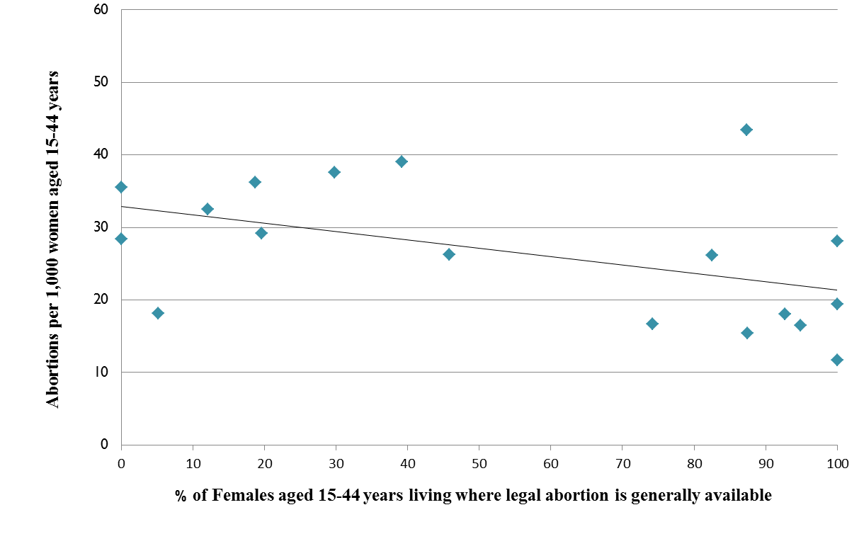
Abortion rate by sub-region (per 1000 women 15-44) according to prevalence of liberal abortion laws.
Restrictive
Liberal
Fuente: Sedgh et al., 2012
Notes:
17

Slide 18
Why criminalization of induce abortion is not reasonable
Unsafe Abortions cause suffering and deaths
Criminalization of abortion only increases mortality, without decreasing the incidence of induced abortions
Decriminalization dramatically reduces mortality
Notes:
18

Slide 19
Abortion related deaths before and after legalization in South Africa
Abortion related deaths in public hospitals per year
1994 (before) 425
1998-2001 36
Diff. before/after: -91%
Fuente: Jewkes & Rees, 2005

Slide 20
Why criminalization of induce abortion is not reasonable
Unsafe Abortions cause suffering and deaths
Criminalization of abortion only increases mortality, without decreasing the incidence of induced abortions
Decriminalization dramatically reduces mortality
Decriminalization does not increase abortion rate
Notes:
20

Slide 21
Evolution of abortion rate after legalization in France
Fuente: The Alan Guttmatcher Institute. Sharing responsibility: Women, Society and Abortion Worldwide.
New York: The Alan Guttmacher Institute, 1999 .

Slide 22
Evolution of abortion rate after legalization in France and Italy
Fuente: The Alan Guttmatcher Institute. Sharing responsibility: Women, Society and Abortion Worldwide.
New York: The Alan Guttmacher Institute, 1999 .

Slide 23
Proportion pregnancies ended in induced abortion after legalization in Turkey

Slide 24
Why criminalization of induce abortion is not reasonable
Unsafe Abortions cause suffering and deaths
Criminalization of abortion only increases mortality, without decreasing the incidence of induced abortions
Decriminalization dramatically reduces mortality
Decriminalization does not increase abortion rate
The people is not in favor of penalizing women who abort
Notes:
24

Slide 25
PEOPLE`S OPINION ABOUT PUNISHING WOMEN WHO ABORT
The results depend on how you formulate the question

Slide 26
Porcentage of public servants in favor of more liberal abortion law, asked in abstract (n=1.660)
(n=1.640)
(n=1.205)

Slide 27
Percentage of public servants in favor of NOT punishing any woman who aborts (n=1.660)
(n=1.640)
(n=1.205)
(n=1.547)

Slide 28
Percentage of public servants in favor of NOT punishing a woman they know who aborts (n=1.660)
(n=1.640)
(n=1.205)
(n=1.547)
(n=952)

Slide 29
Why FIGO and WHO favors greater access to safe abortion services
Unsafe Abortions cause suffering and deaths
Criminalization of abortion only increases mortality, without decreasing the incidence of induced abortions
Decriminalization dramatically reduces mortality
Decriminalization does not increase abortion rate
The people is not in favor of penalizing women who abort
Physicians are afraid of the stigma, but accept the abortion for themselves or those close to them
Notes:
29

Slide 30
Porcentage of gynecologits-obstetricians who agree that abortion should not be a crime in certain circunstances. Brasil
* Circunstância apresentada somente em 2005

Slide 31
BEHAVIOR OF GYNECO-OBSTETRICIANS CONFRONTED WITH A REQUEST OF LEGAL ABORTION AFTER RAPE, AT A PUBLIC HOSPITAL. BRAZIL, 2005 (n = 2.788)

Slide 32
SURVEY AMONG BRAZILIAN GYNECOLOGISTS-OBSTETRICIANS
Did you help a client or family member to have an abortion:
Recommended a colleague known to do safe abortions
Taught to use misoprostol
Did the abortion

Slide 33
IN CASE OF UNWANTED PREGNANCY, PERCENTAGE OF GYNECO-OBSTETRICIANS WHO HELPED A CLIENT OR FAMILY MEMBER TO HAVE AN ABORTION

Slide 34
SURVEY AMONG BRAZILIAN GYNECOLOGISTS-OBSTETRICIANS
At anytime you or your partner ha and absolutely unwanted pregnancy?
Did you or your partner had an abortion?

Slide 35
IN CASE OF UNWANTED PREGNANCY, PERCENTAGE OF GYNECO-OBSTETRICIANS WHO HELPED A CLIENT OR FAMILY MEMBER , HERSELF OR HIS PARTNER TO HAVE AN ABORTION

Slide 36
To keep induced abortion legally restricted do not have scientific justification
Notes:
36

Slide 37
To keep induced abortion legally restricted do not have scientific justification
What is required for a better understanding of provision of safe abortion?
Notes:
37

Slide 38
WHAT IS REQUIRED FOR A BETTER UNDERSTANDING OF PROVISION OF SAFE ABORTION
1. To make clear that it is not promoting abortion and there will not be less abortion if women are punished

Slide 39
WHAT IS REQUIERED FOR A BETTER UNDERSTANDING OF PROVISION OF SAFE ABORTION
To make clear that it is not promoting abortion and there will not be less abortion if women are punished
2. Promote, at the same time, the interventions with proven capacity to reduce abortions

Slide 40
THANK YOU VERY MUCH

